Slide 1
CERN
Education Programmes
Dr. Sascha Marc Schmeling
1st CERN-Slovenian Committee Meeting
May 12th, 2021

Slide 2








Education @ CERN – Today
CERN Education Programme for Teachers and Students
1 staff
1 admin
1 tech
Teacher Programmes
S’Cool LAB
Competitions
Internships
Publications
1 staff
½ doct
1 fellow
1 doct
1 technician
2 fellows
1 fellow
1 staff
1 fellow
Collaboration
1 user
Science Gateway
Physics Education Research
3½ doct

Slide 3
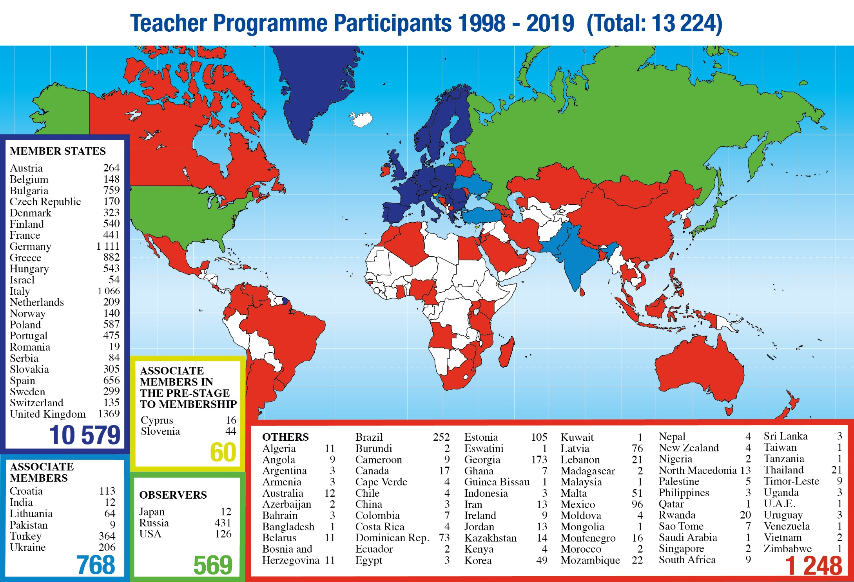
Teacher Programmes
National (Language) Teacher Programmes | 4-6 days
focus on visits and lectures
International Teacher Programme “HST” in English | 2 weeks
International Teacher Weeks in English | 2 weeks
focus on visits, lectures, and collaboration

Slide 4
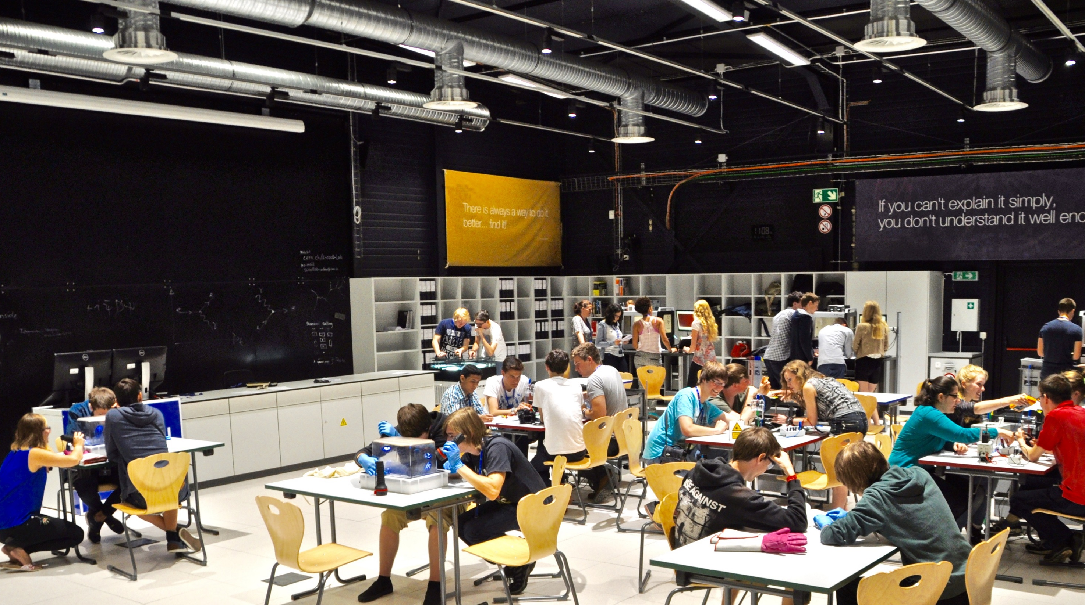

Welcome

Slide 5
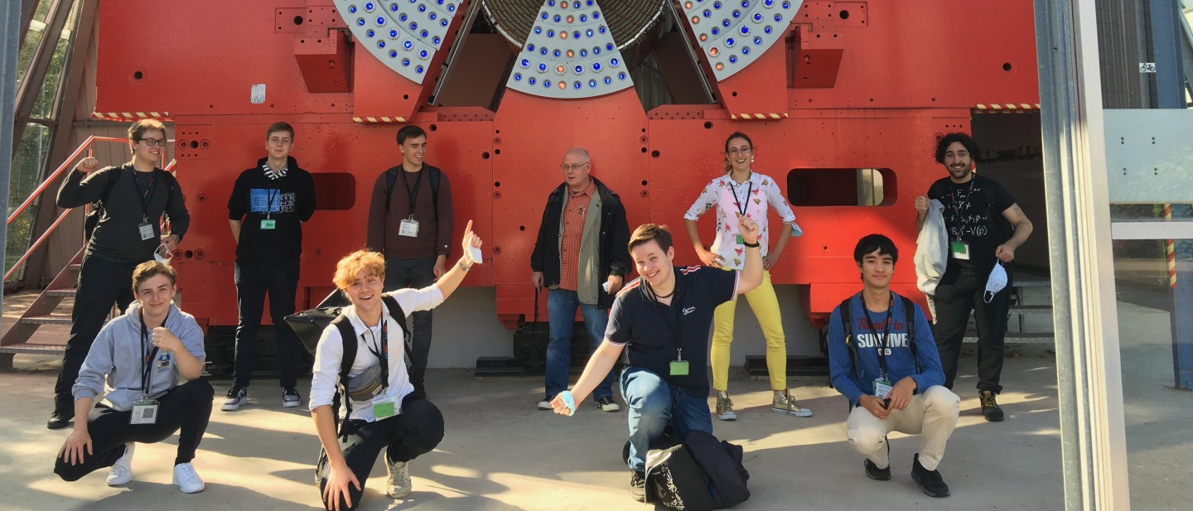
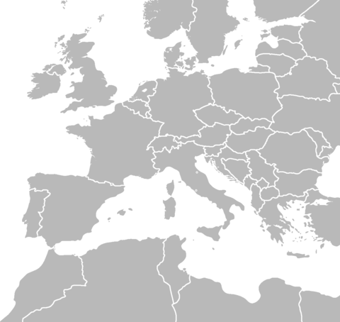


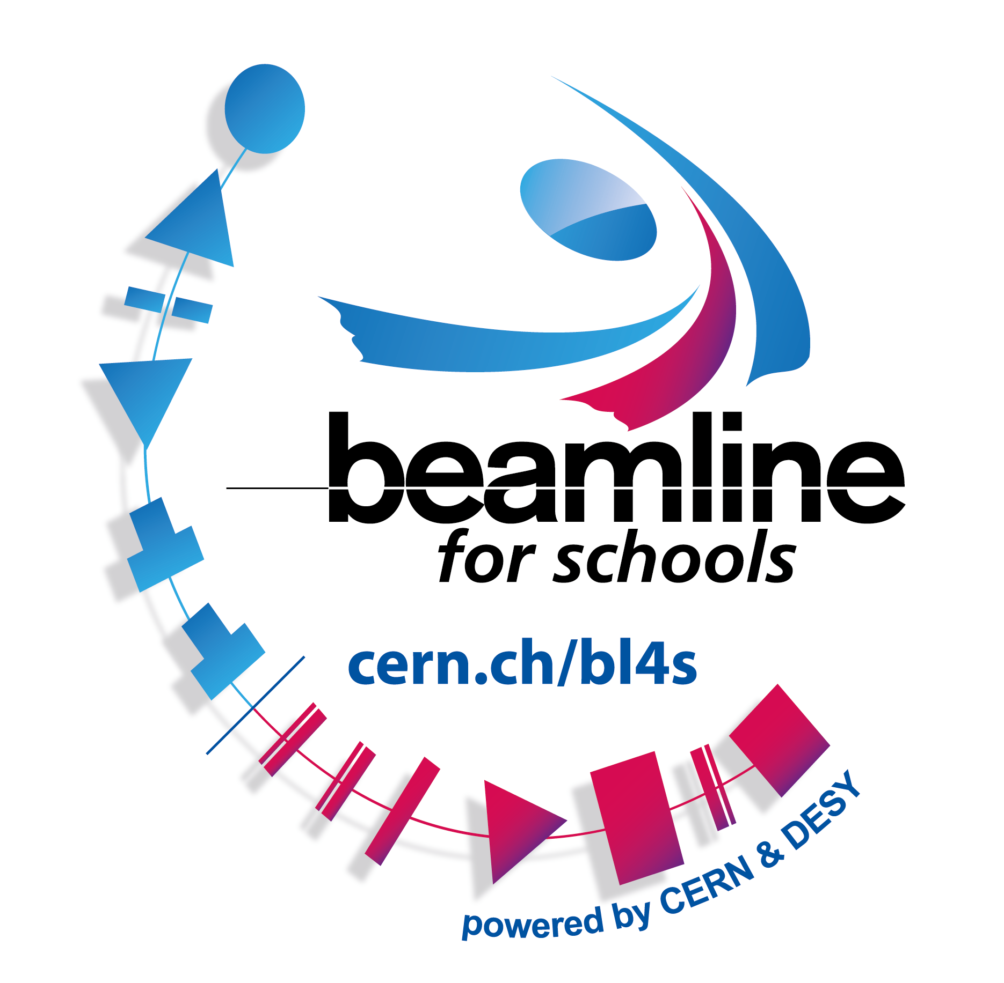
Beamline for Schools
Participation 2021
  298 proposals
Slovenia
  2014
    2 proposals
    25 participants
2022
  beamline at CERN back in the competition
Team @ DESY
DESY
Edition
CERN
Number of Proposals/Countries

Slide 6





















High-School Students Internship Programme
2017
2018
2019
2021

Slide 7
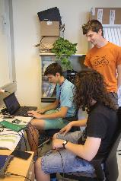
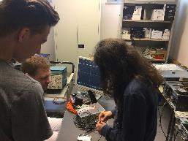
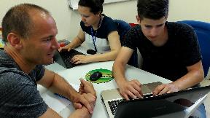
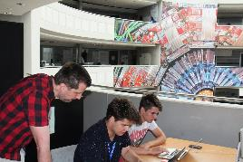
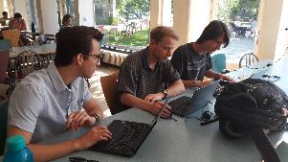
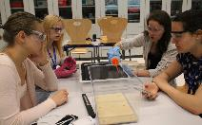
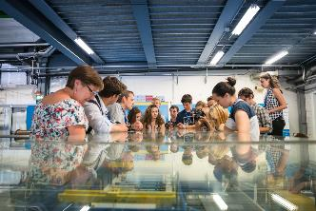
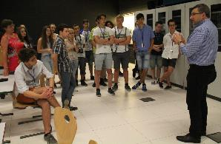
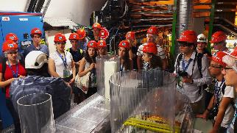
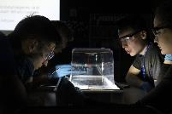
Programme Description
Target Audience
  high-school students aged 16+
Idea
  Give high-school students the possibility to experience work at an international research laboratory through
    work shadowing,
    own projects, and
    own insights.
  Provide a frame programme to showcase the laboratory and International Geneva.
  Welcome up to 24 high-school students each from one country come for a two week internship.
  Lodge them in the CERN Hotel.
  Groups are accompanied by two adults from their home country.
  Start with five programmes per year.
Selection
  CERN oversees a fair selection in the country.
Evaluation
  Questionnaires for the participants, evaluation of the results during the final presentations.
  Collection of media feedback in the country.

Slide 8
Physics Education Research

Slide 9
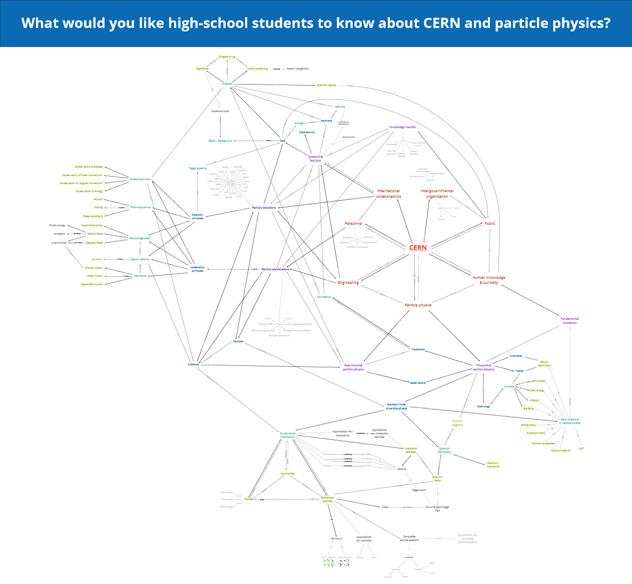
Evaluation of CERN’s Teacher Programmes
Overall aim
  Evaluation of CERN’s teacher programmes and overview of concepts in the field “CERN and particle physics” that are relevant for high-school education to ...
  improve CERN’s teacher programmes
  create a valuable teaching resource
Important steps
  Defining the goals for CERN’s teacher programmes
  Expert concept map about CERN and particle physics
  Overview of particle physics topics in various national high-school curricula
  Main study: Evaluation of CERN’s teacher programmes

Slide 10
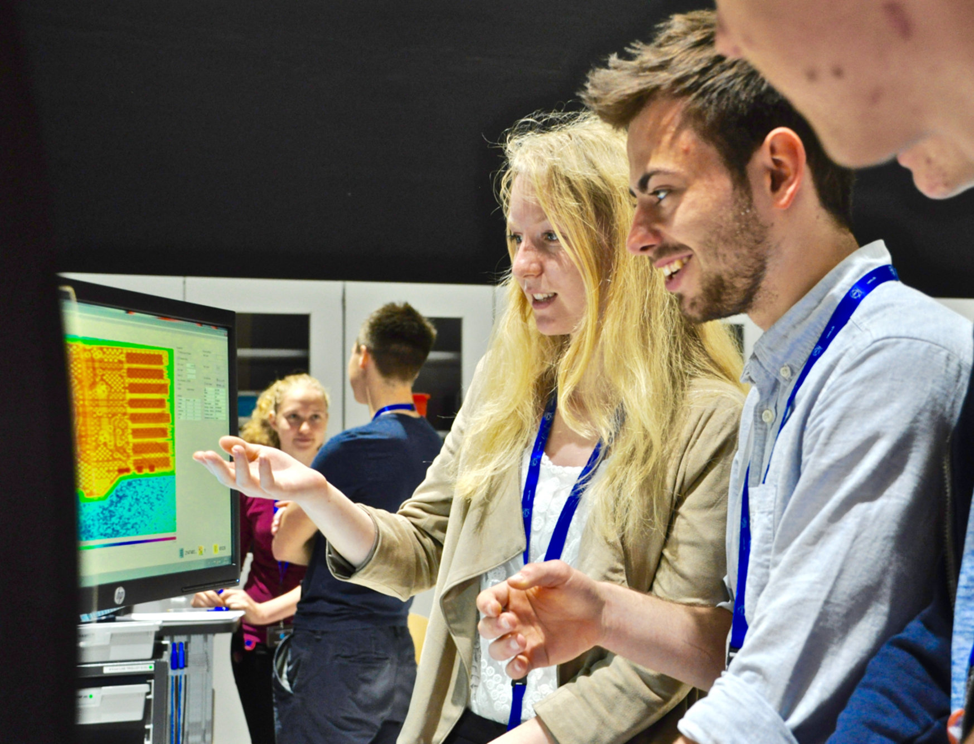
Interesting Content and Contexts in Physics Education
Overall aim
  Study high-school students’ interest in particle physics contents and contexts and categorise them into different interest types according to their physics-related self-concept to …
  give recommendations for interesting learning materials
  introduce self-concept as a gender-neutral clustering variable in PER
Important steps
  Development and piloting of questionnaire about interest in particle physics contents and context
  Main study about students’ interest in particle physics
  Study about interesting contexts of particle physics
  Recommendations for interesting learning

Slide 11
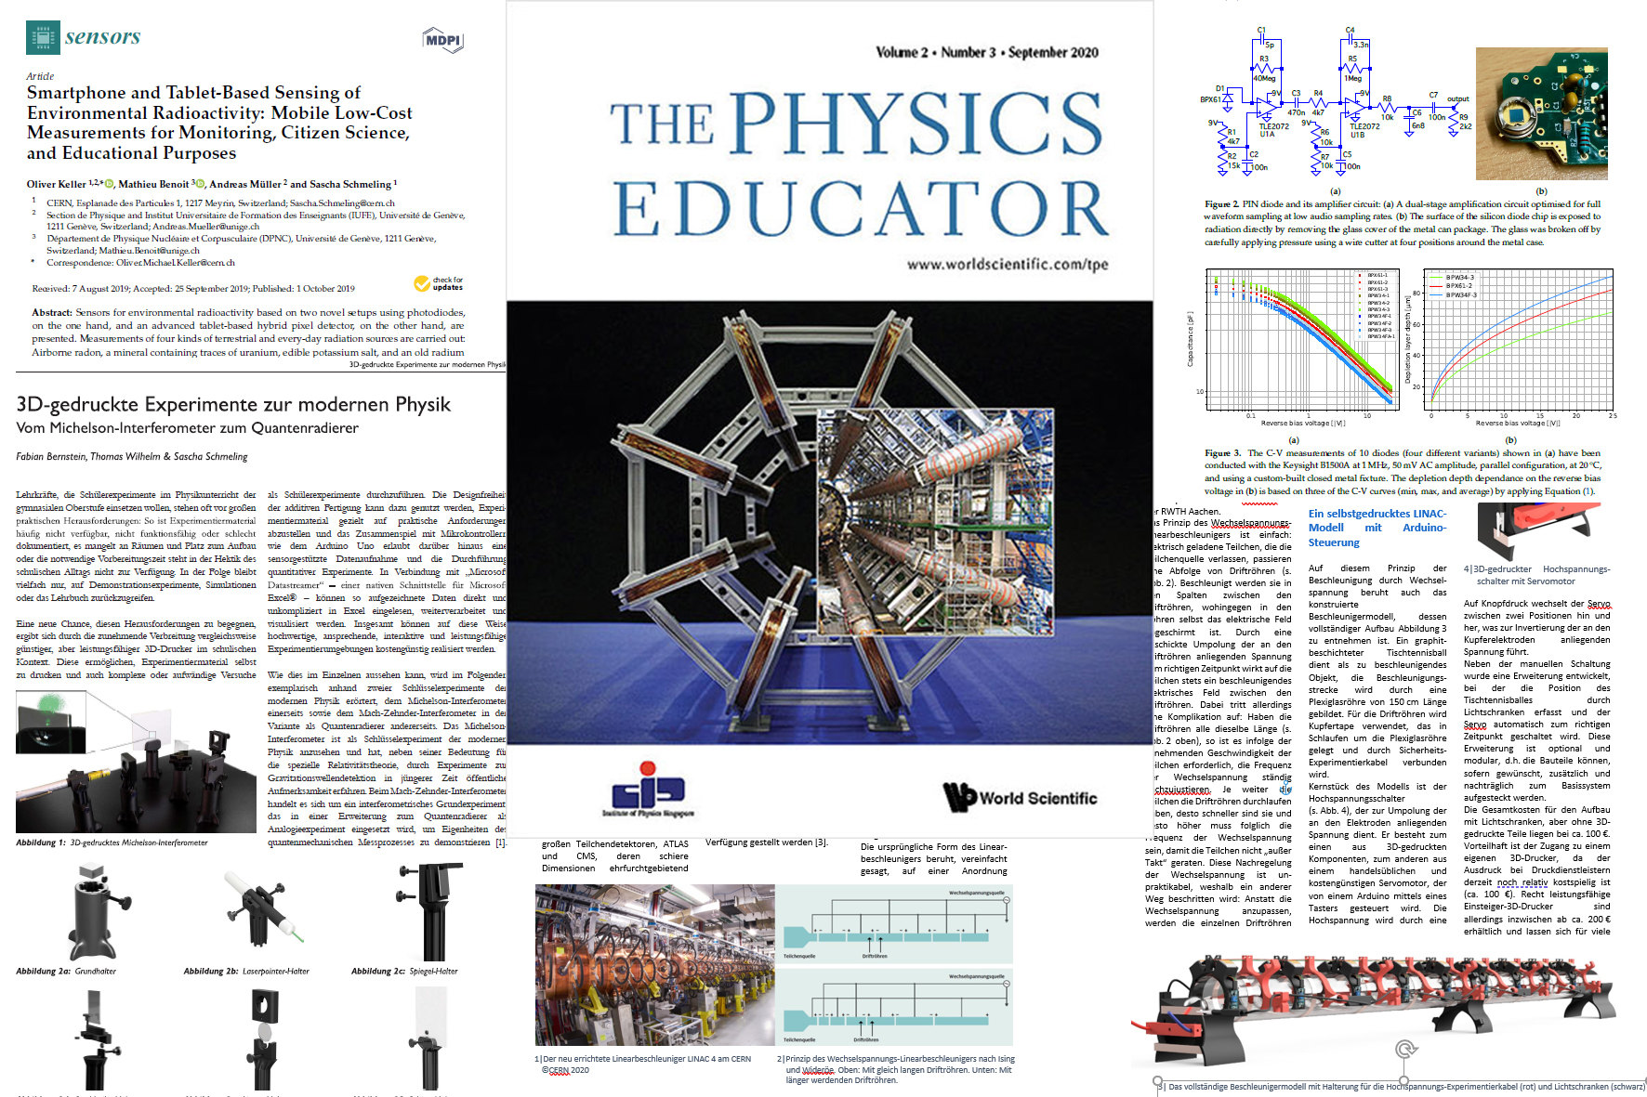
Hands-On Experiments
publications on experiments for the classroom and home
  smartphone physics
  3D-printed experiments
    interferometers
    linear accelerator
  silicon detectors

Slide 12
Teacher and Student Forum

Slide 13
Teacher and Student Forum
Mission Statement
  This is one of several CERN Member State Thematic Forums. Their goal is to bring together CERN and Member State representatives who are experts in the relevant field to exchange information, share ideas and discuss the development of coherent strategies. Associate Member States may also participate.
  The Teacher and Student Forum will focus on pre-university activities, both for teachers and for students.
first meeting in December 2016
regular meetings in the March and September CERN Council Weeks
most CERN Member States have nominated a participant, also several Associate Member States
Slovenia:
Dr. Aleš Mohorič

Slide 14
Participation from Slovenia
Teacher Programmes
  HST 2004 1 teacher
  Slovenian TP 2019 23 teachers (high-school)
  Slovenian Online TP 2021 51 teachers (high&primary-school)
S’Cool LAB
  no participation in S’Cool LAB Days/Workshops
  Online Science Shows 2021 360 participants
Beamline for Schools
  2014 two teams participated

Slide 15
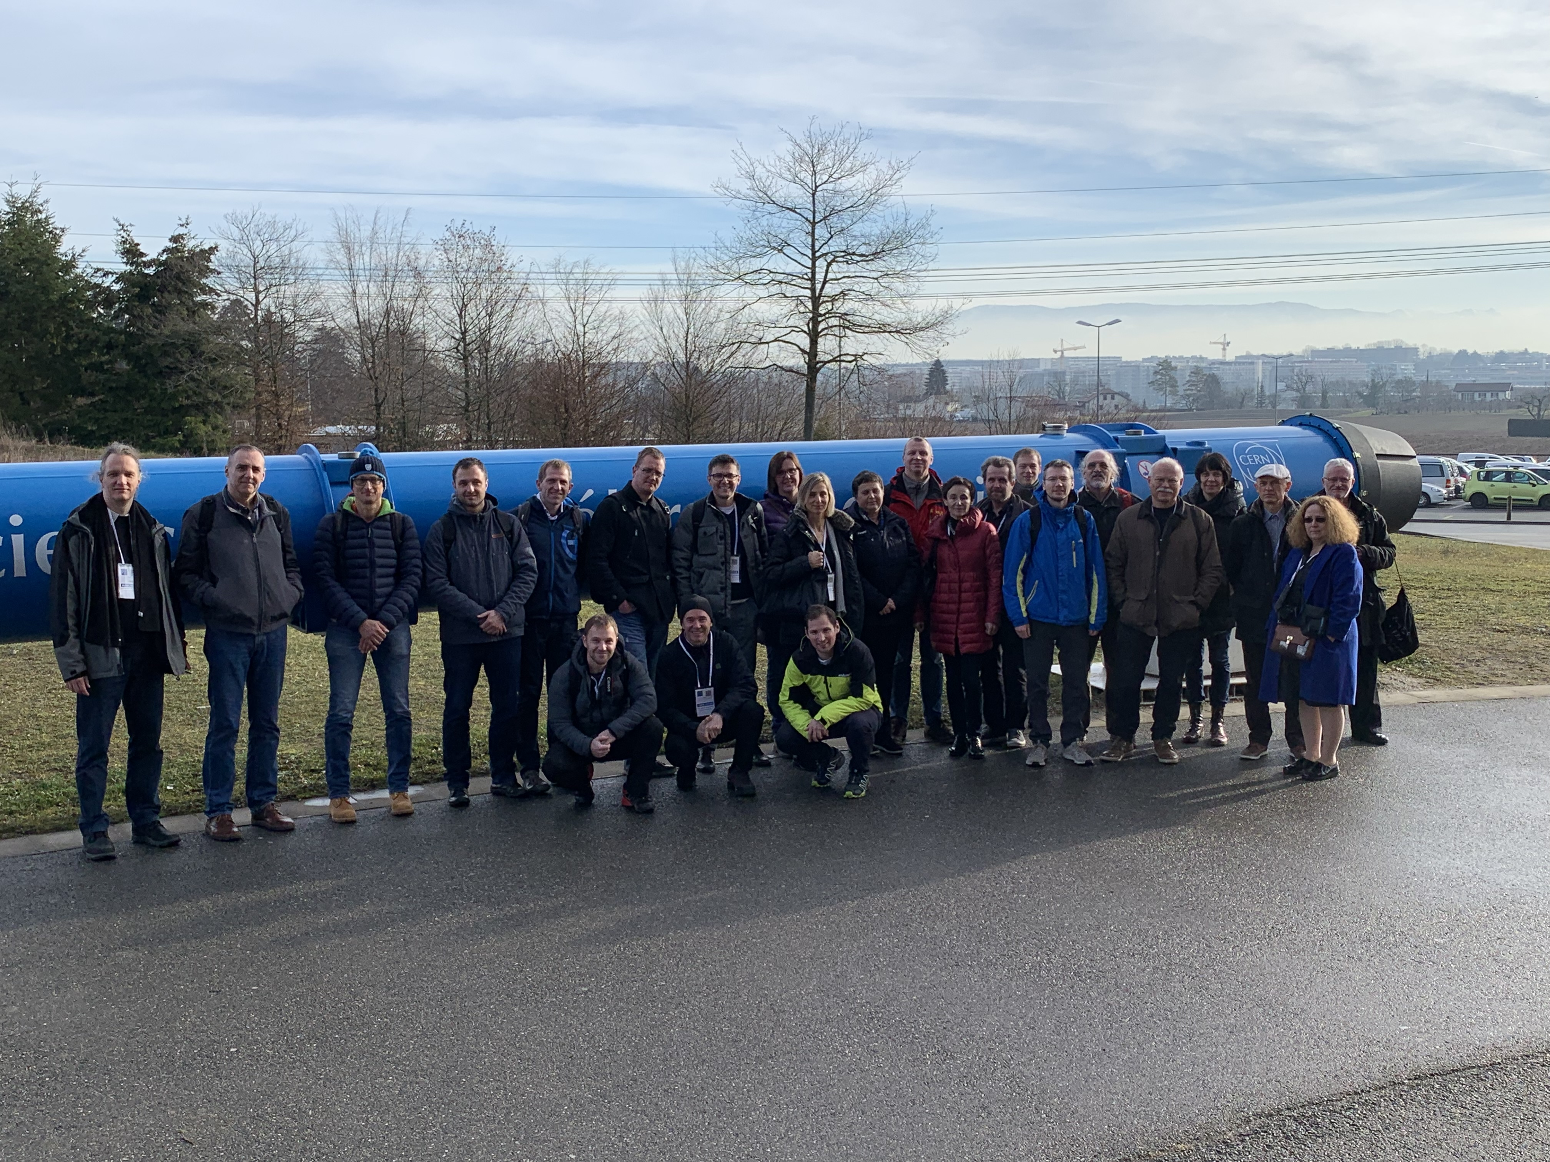
How to connect to Slovenian classrooms?
Anja’s thoughts after several discussions
Further support for teachers
through initial and continuous education
Online forums for teacher-scientist exchanges (e.g. for sharing ideas)
Online resources for teachers and students (e.g. online science shows)
CERN excursions
Science camps for students (e.g. HSSIP)

Slide 16
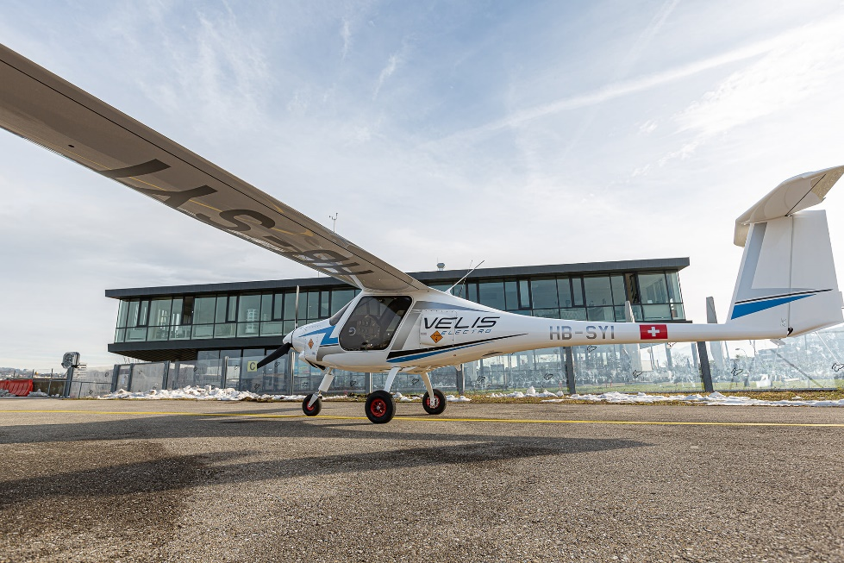
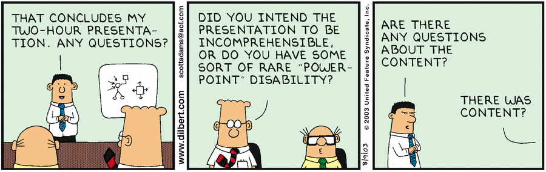
Your Time, Your Questions!

