Slide 1
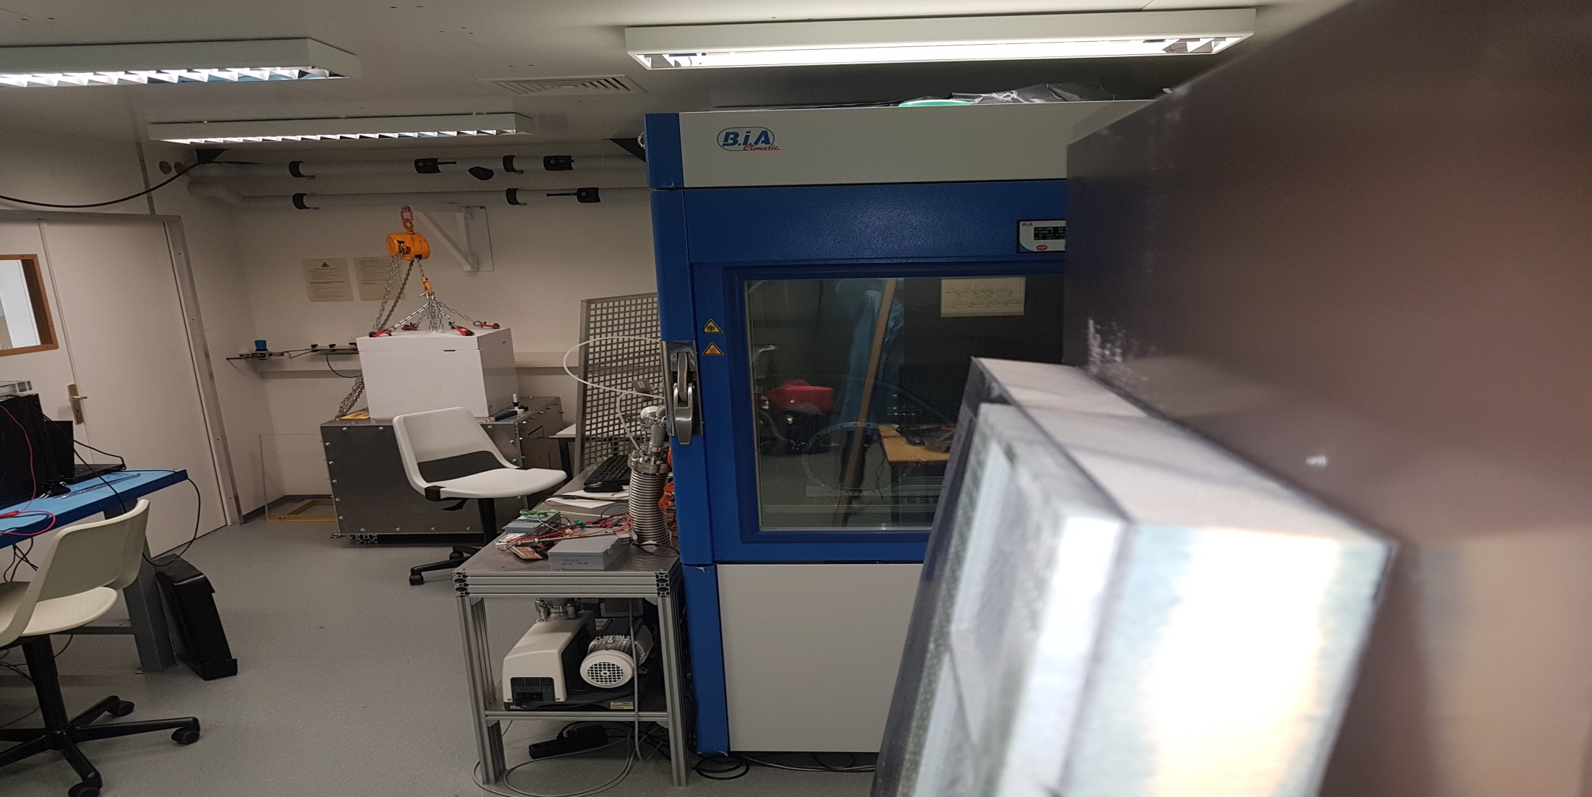
Status report on Thermal tests
(sFGD “Bottom Sandwich”)
FACULTY OF SCIENCE
Department of Nuclear and Particle Physics
Notes:
I can’t sharing from my home office because my bandwidth is limited
So can you download the presentation on your side please
And I will tell you when I switch slide .

Slide 2
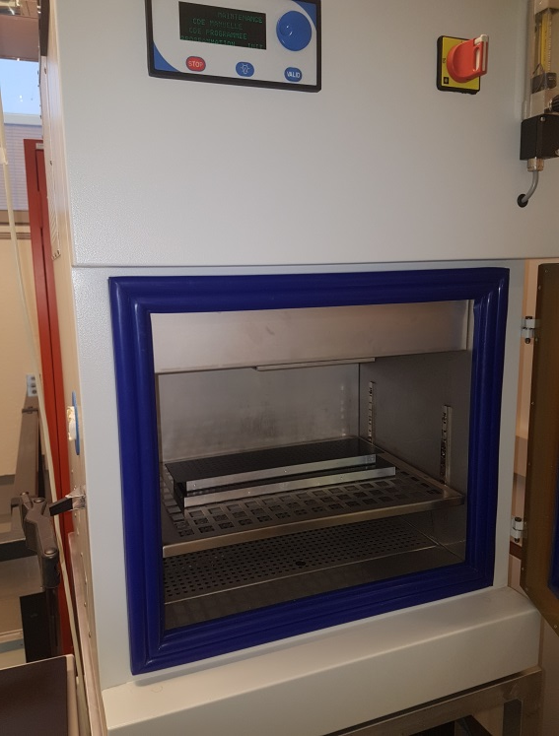
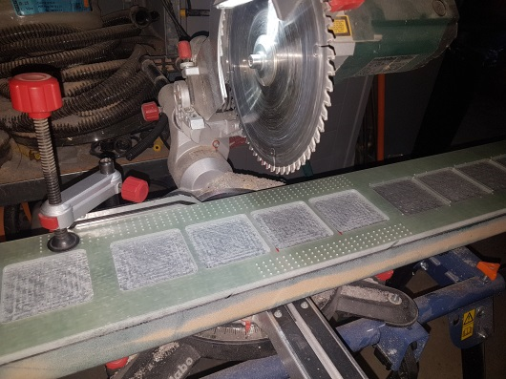
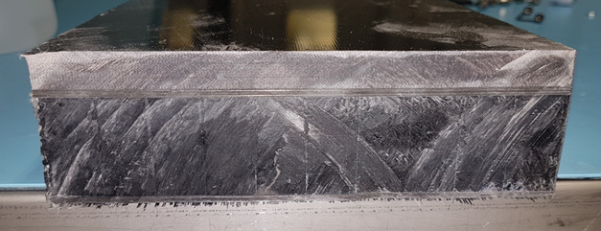
Sandwich prototypes under testing
Various types of sandwich have been tested so far…
  First panels with aluminium frame, CFRP and foam (30cmx15cmx1.5cm thick)
  Long prototypes in PMMA core, G10 and CFRP facing plates (4,5cm thick, 15cmx 240cm)
  Long prototypes in foam core, G10 and CFRP facing plates (4,5cm thick, 15cmx 240cm)
  Long prototypes in foam core, CFRP facing plates (4cm thick, 15cmx 240cm)
Using the Thermal chamber @ UniGe
  1,6m deep, 1m wide and 1m high
  Maximum chamber temperature range: [-50°C, +180°C]
  Maximum speed for temperature change is about 4°C/min
Need to re cut the longest prototypes to 1.8m
  Fitting the chamber in diagonal
  Using a circular saw (no precise cut, rough..)

Slide 3
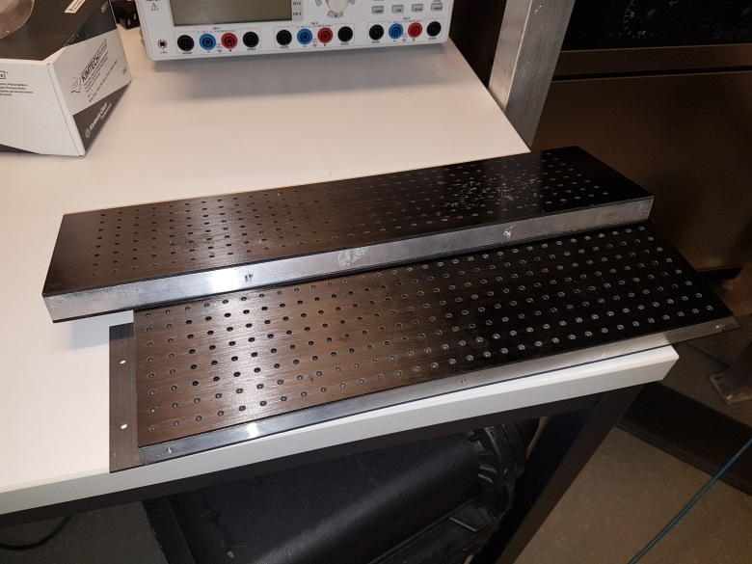
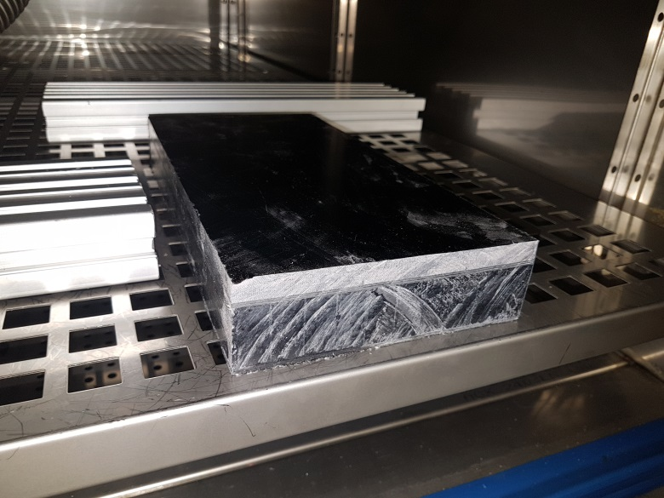
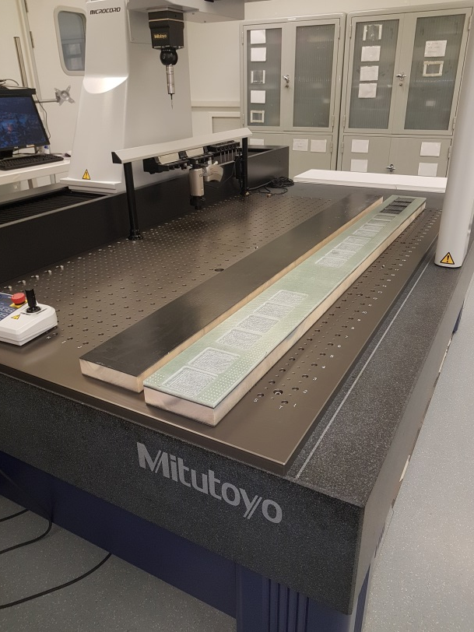
Sandwich prototypes under testing
Various types of sandwich have been tested
Test#1: aluminum frame, foam
Test#2: G10, PMMA core
Test#3,4,5: G10, No G10, but foam

Slide 4
Sandwich prototypes under testing
Test campaign (updates since last time…)
  Test#1: 2 aluminium framed panels at the same time
    Up to 52°C in chamber, stored outside by mistake at -8, -10°C… extreme storage case
    No smooth steps up to 52°C… and down to -10°C with smooth temperature change…
  Test#2: PMMA core, G10 on 1 side
    1.8m long proto: up to 52°C, down to -10°C (extreme storage case)
    On short segment: same as before…. to repeat the observations on 1.8m long!
    No smooth steps up to +52°C, down to -10°C!
  Tests#3: 2 samples at the same time, with and w/o G10, Foam core!
    Short segment: up to 30°C, down to 15°C…normal working conditions
    1.8m long proto: up to 30°C, down to 15°C…normal working conditions
    Smooth steps (+ or -5°C/2 hours)..
  Tests#4: on short segments
    Repeat Test#3,4 but higher storage case (52°C, -10°C)
    Smooth steps … +-5°C per 2 hours!
  Tests#5: same as Test#4, but LONG segments!
PMMA core
Foam core; working conditions
Foam core; Harsh storage conditions

Slide 5
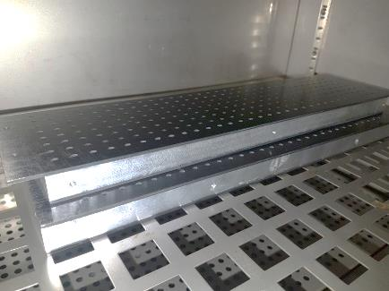
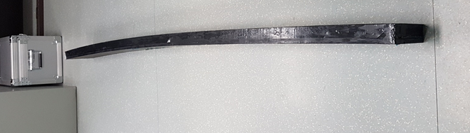
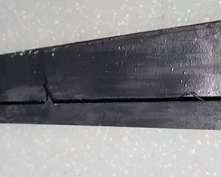
Sandwich prototypes under testing
Test campaigns_ Observations, measurements…
  Test#1: 2 aluminium framed panels at the same time
    No sign of anything wrong (no visible delamination)
    Successful tests… even if quite short length!
  Test#2: PMMA core, G10 on 1 side
    Delamination of the PMMA/CFRP glue join at G10 side
    G10 Asymmetry causing a bending of the sample
    On short segment: G10 / PMMA “shrinkage” observed at 52°C (no visible delamination)
  Tests#3,4,5: Foam core, with and w/o G10
    No measurable change in all directions
    No sign of any delamination
    On long samples: deformation observed at room temp. is unchanged!
    On the lasts tests (harsh storage conditions)… [-10°C;+52°C]
    … NO delamination, initial deformation remains the same!
PMMA
G10 side
delamination
PMMA

Slide 6
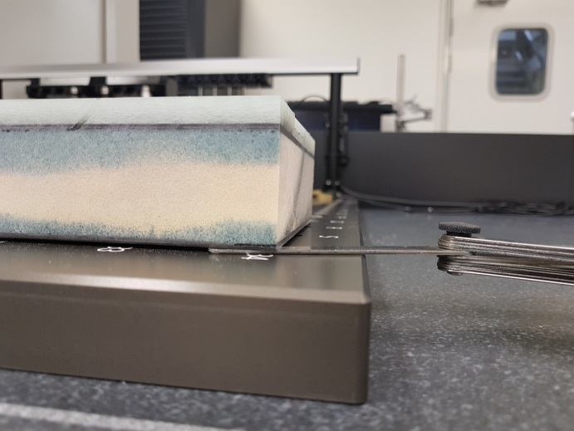
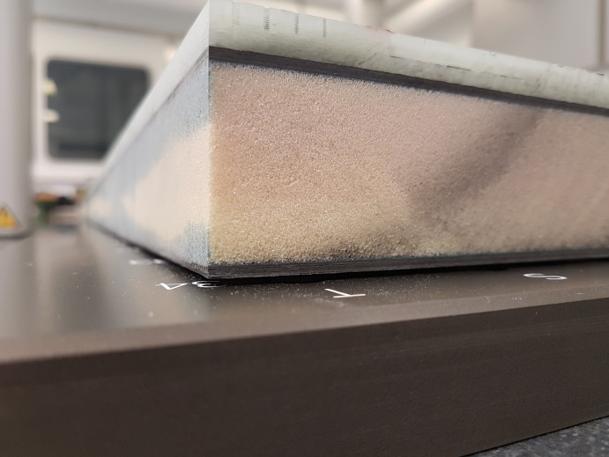
Sandwich prototypes under testing
Test campaigns_ Comment on G10 coupling (Foam type)
    Flatness issue is observed @ room temperature (assembly process)
    While very small deformation is seen without G10 …
    Measurement on small segment (30cm long):
      0.15mm w/o G10
      0.9mm with G10…
    The question is:
    Is it due to the machining of G10 that occurred after the gluing onto the panel??
    If so, how does it affect/interact with the thermally induced stress?
    A solution is also to have a more symmetrical panel (G10 on both sides)… good for both machining and thermal behaviour!
    Tests are foreseen on symmetrical Panel (G10 double sided)
Long sample > 1.5mm flatness
Long sample > 1.5mm

