Slide 1


A spatially resolved study of hard X-ray emission in Kepler's SNR:
Indications of different regimes of particle acceleration
Vincenzo Sapienza
INAF - Osservatorio Astronomico di Palermo
Department of Physics and Chemistry “Emilio Segré” - University of Palermo
Collaborators:
M. Miceli, F. Bocchino, S. Orlando, G. Peres, A. Bamba, S. Katsuda, T. Nagayoshi, Y. Terada

Slide 2
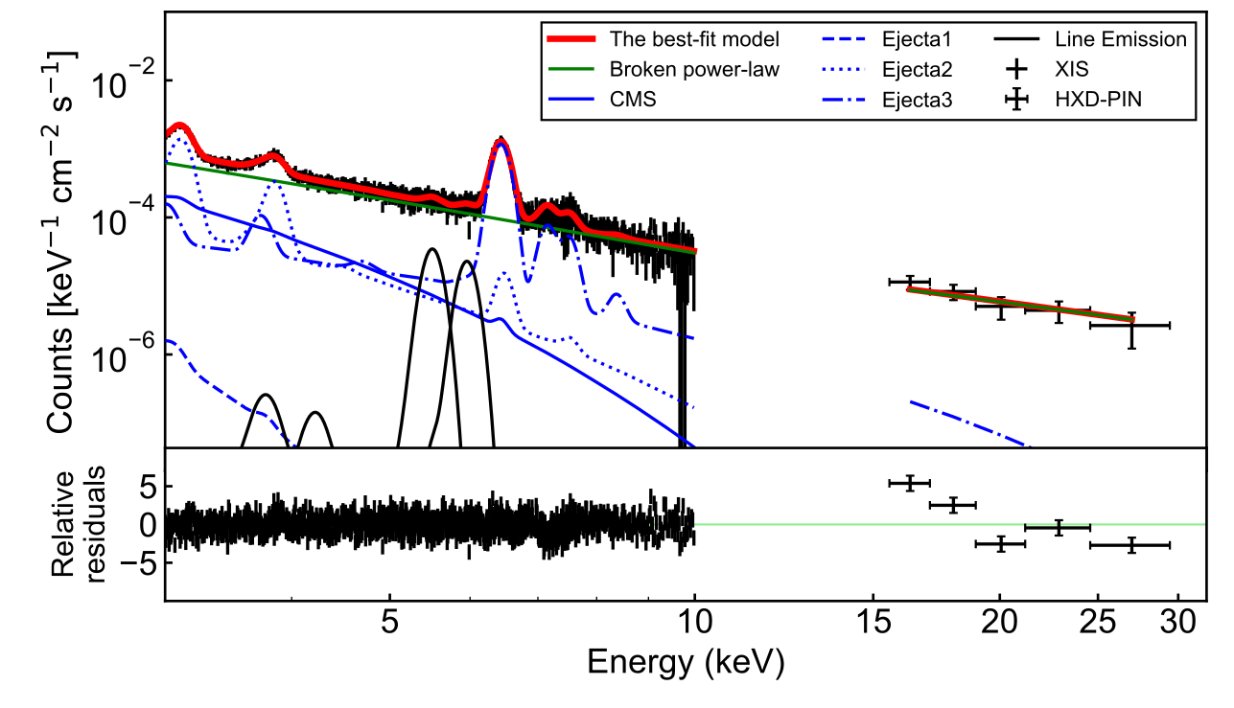
SNR as source of cosmic rays
Synchrotron emission is a powerful tool to study:
The distribution the accelerated particles
The mechanism that limits the acceleration process
Young SNRs have high shock velocities
Good acceleration efficiency
We chose the young Kepler’s SNR
First detection of hard X-ray with Suzaku
Nagayoshi et al. (2021):
Suzaku X-ray spectrum of Kepler’s SNR

Slide 3
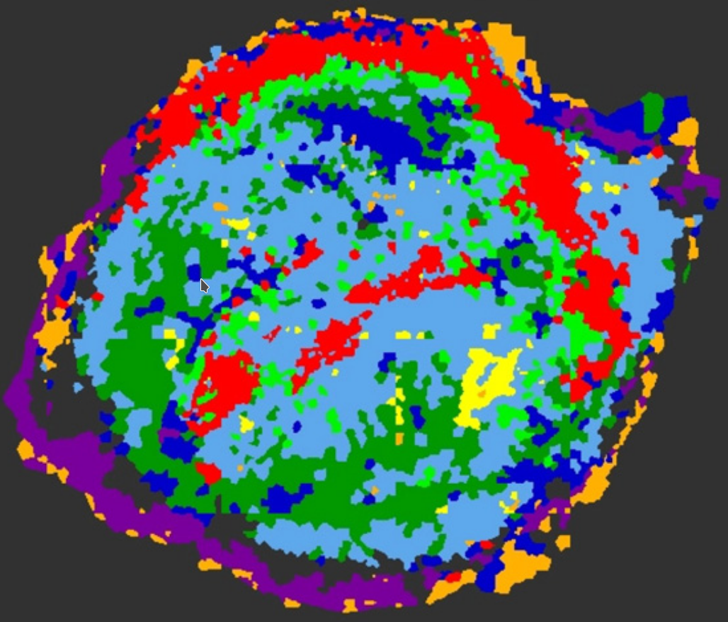
Hard non-thermal X-rays of Kepler’s SNR
Distance (pc) | Age (yrs) | Physical origin
5000 | 417 | type Ia SN
Shock interacting with circumstellar medium (red cluster)
Shock expanding in homogeneous medium
Spatially resolved spectral analysis
Non-thermal radiation from Kepler’s SNR
NuSTAR and XMM-Newton data in 4.1-25 keV
Burkey et al. (2013):
division of Kepler into spectral clusters.

Slide 4
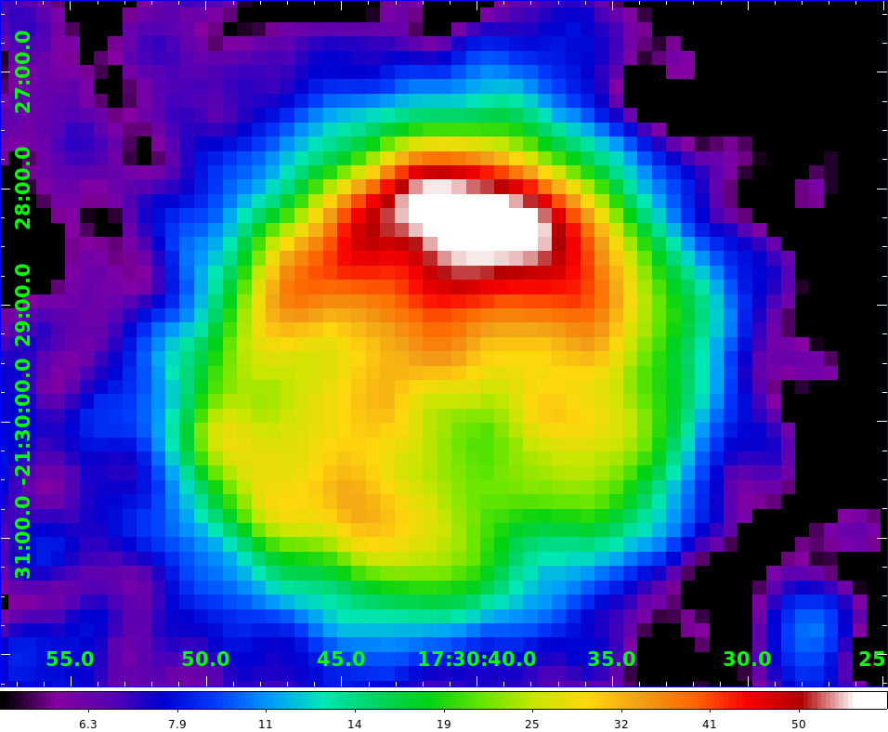
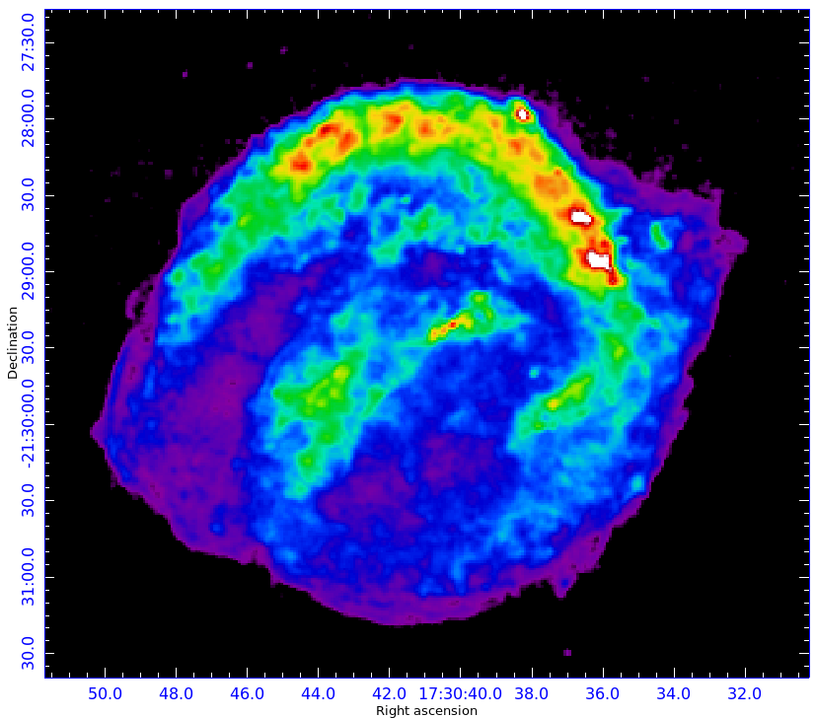
First Hard X-rays Image of Kepler’s SNR
8-20 keV
0.3-10 keV
Sapienza et al. in prep:
NuSTAR counts image of Kepler’s SNR in the 8-20 keV band
Sapienza et al. in prep:
Chandra flux image of Kepler’s SNR in the 0.3-10 keV band

Slide 5
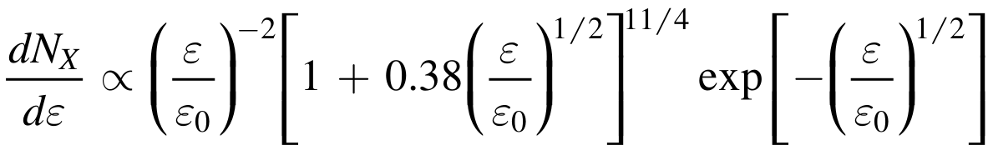
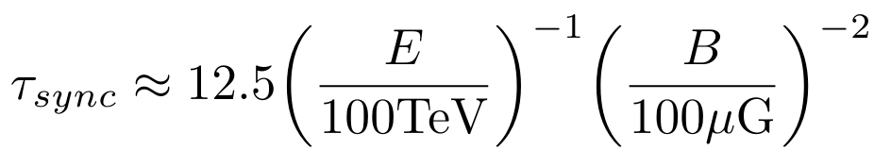
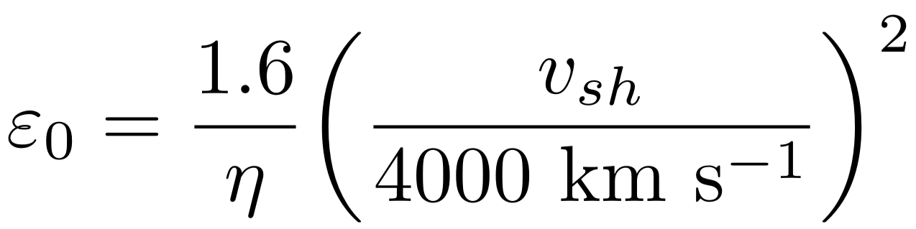
Loss limited model
Loss-limited spectrum model is (Zirakashvili & Aharonian 2007):
τ_{sync}= 62 yrs (B=100 μG E=20 TeV)
τ_{sync} < τ_{age}
Relation between ε₀ and shock velocity
η measure the acceleration efficiency
cutoff photon energy
yrs

Slide 6
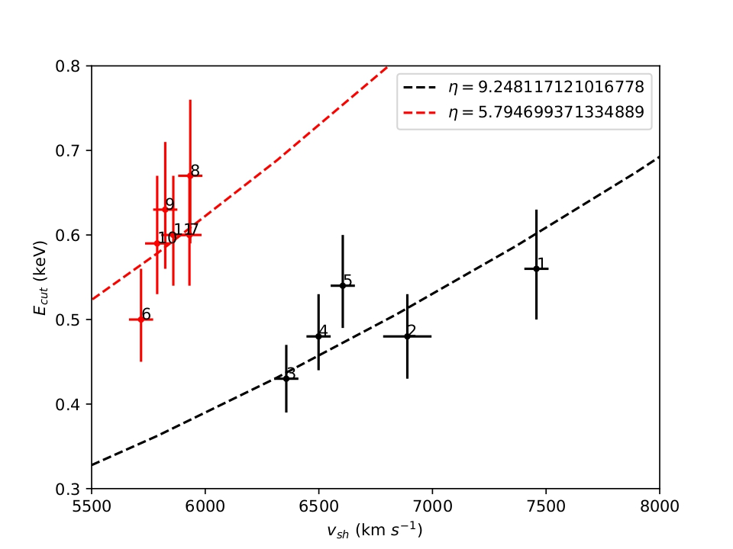
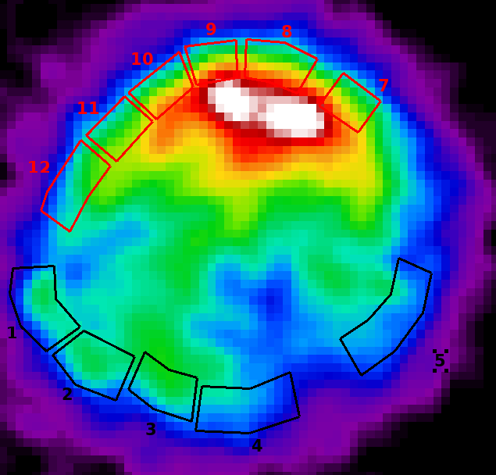
Cutoff photon energies vs. Shock velocity
Northern regions with higher cutoff energy on average
Different acceleration regimes (red vs. black)
Higher turbulence → better acceleration efficiency →
Higher cutoff energy →
Lower η
ε_{o} (keV)
Sapienza et al. in prep:
ε₀ vs. v_{sh} plot
Sapienza et al. in prep:
NuSTAR in the 8-20 keV band

Slide 7
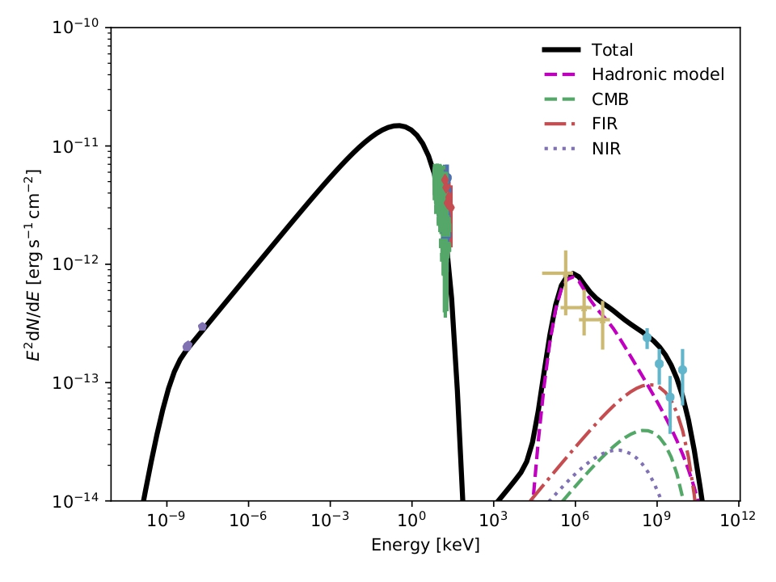
Spectral Energy Distribution
Recent detection of γ-rays from Kepler’s SNR
X-ray data from this project
One-zone Lepto-hadronic model:
Synchrotron for X-rays and Radio
Inverse Compton and Pion decay for γ-rays
ɑ | E_{cut} (TeV) | B (μG) | n (cm⁻³) | W_{p} (erg)
2.44 | 20 | 60 | 20 | 0.5x10⁴⁹
Sapienza et al. in prep: Radio: DeLaney et al. (2002). X-ray: Sapienza et al. in prep, Nagayoshi et al. (2021). γ-ray: Xiang & Jiang (2021,) Prokhorov et al. (2021).

Slide 8
Sapienza et al. in prep.:
First data analysis on NuSTAR data from Kepler’s SNR
Spatially resolved spectral analysis with a loss limited model
Electrons in northern regions are accelerated more efficiently
Shock interaction with circumstellar material amplifies magnetic field
Interaction with highly inhomogeneous medium enhances acceleration efficiency
SED: Indication of hadronic acceleration in Kepler’s SNR

Slide 9
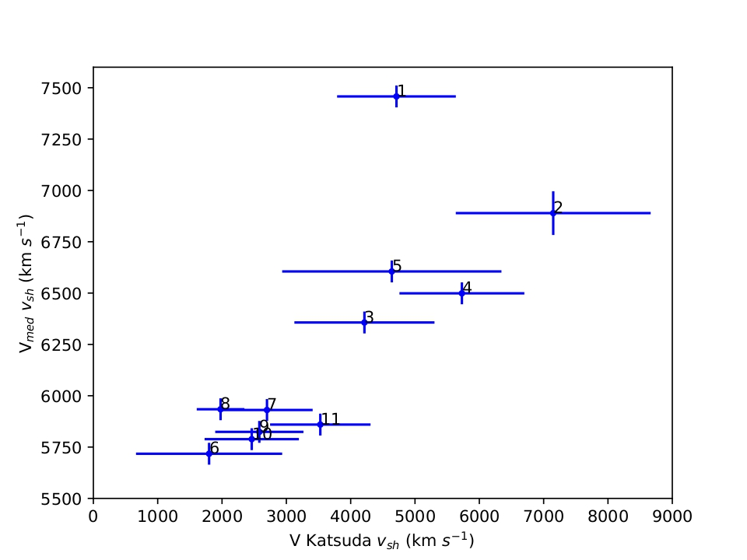
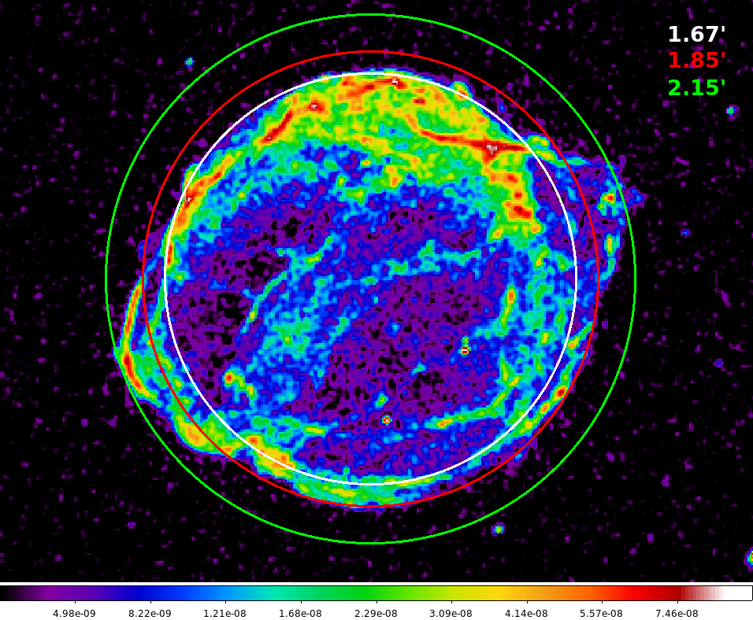
Why average shock velocity?
Average shock velocity = shock radius / age of the remnant

Slide 10
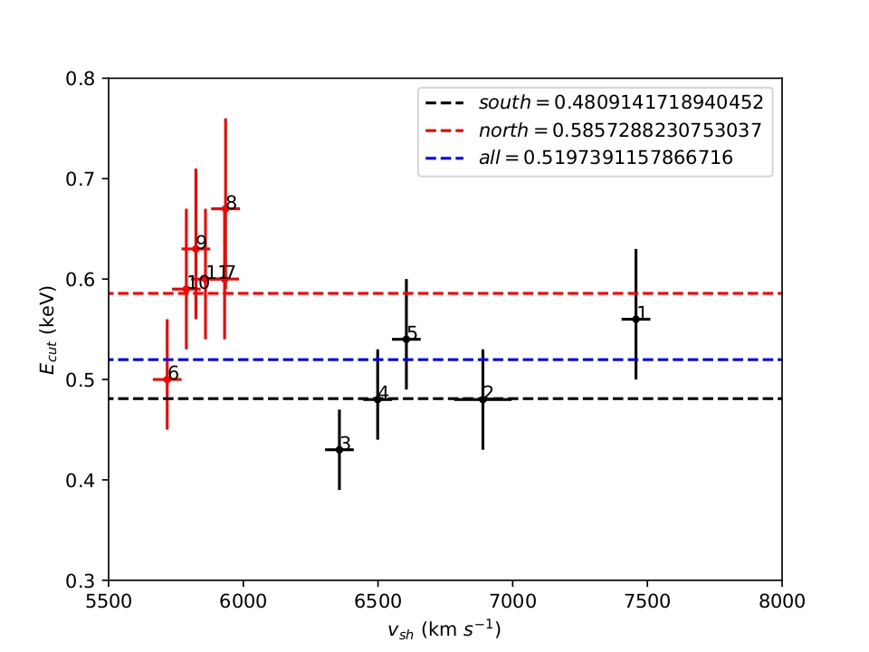
Quadratic vs. constant
ε_{o} (keV)
ε_{o} (keV)
null hypothesis probability ̴ 95%
null hypothesis probability ̴ 15%

