Slide 1

Status of LHC Operations
R. Assmann
for the LHC commissioning team and LHC teams & groups
LPCC 10.9.2010

Slide 2
Outline
Stable beams in August
Lessons learnt
Next Steps: Bunch Trains and Fast Ramp
Conclusion

Slide 3
LHC Strategy Over Summer
At end of July we reached the MJ regime in stored energy:
  1.4 MJ
  Beam sizes at 3.5 TeV down to 0.18 mm at some critical places.
This beam has a high destructive potential:
  More dangerous than record Tevatron beam.
  Close to damage limit of primary collimators (closest wall to beam).
August run with stable LHC configuration:
  No change in optics and orbit (beam position).
  No change in collimation and protection settings.
  Efforts to achieve maximum beam stability and maximum performance (both peak and integrated) in this period.
  Observe stability of collimation and machine protection.
  Good test on machine availability for stable running.
  Intensity doubled during last week of August.

Slide 4
Parameters for Luminosity Production
Fixed tunnel length: low revolution frequency at LHC makes it harder to produce lumi (compared to Tevatron)
β* = IP beta function (β_{x}=β_{y})
ε_{n} = norm. transv. emittance
N_{p} = protons per bunch
f_{rev} = revolution frequency
F = geometrical correction
m₀ = rest mass, e.g. of proton
c = velocity of light
Beam-beam: Fine with nominal bunch charge! Can put more…
constant
LHC luminosity is increased via stored energy → 2.8 MJ!
Go up by increasing number of bunches!
Extrapolating from 2.8 MJ: No show-stopper 30 MJ (2010 goal).
Go up not too fast & not too slow...
Achieved nominal emittance! Could be reduced!
At the moment set to 3.5 m in all IR’s: better margins for operation, collimation and protection.
Limit is ~1.2 m at 3.5 TeV. However, then very tight tolerances!

Slide 5
Highlight August Results
Bunch intensity: 1.15e11 nominal
Norm. emittance: 3.7 μm nominal
IP beta value: 3.5 m limited for larger margins
Stored energy: 2.8 MJ record in SC collider
Peak luminosity: 1.07 x 10³¹ cm⁻² s⁻¹ factor 10 to go in 2010
Average lumi.: 7.08 x 10³⁰ cm⁻² s⁻¹
Luminosity lifetime: ~25 h
Availability: ~85 % (max. weekly)
Time in physics: 40.2 % (max. weekly)
Integrated lumi.: 1.7 pb⁻¹ (max. weekly)
3.7 pb⁻¹ (total 2010)
Excellent performance at end of August. Then technical stop and next commissioning stage for higher luminosity!

Slide 6
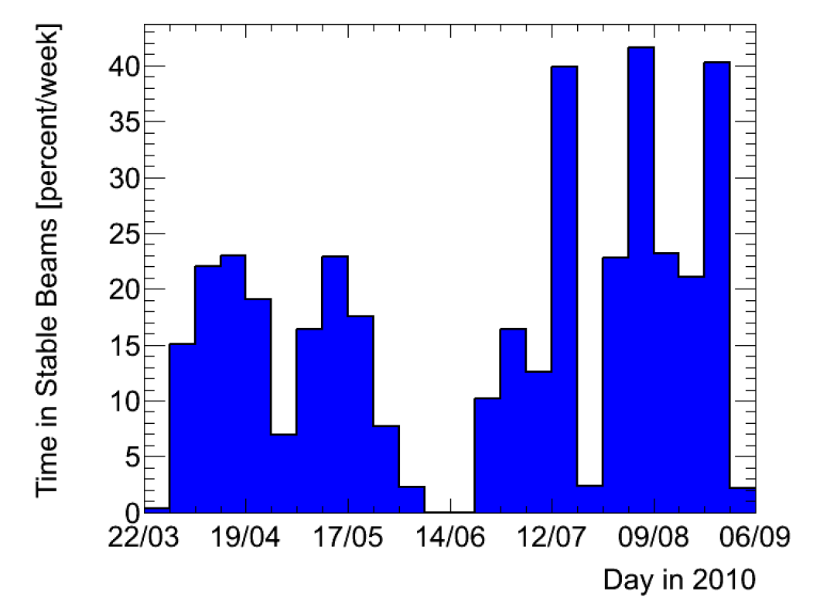
Remarkable Machine Availability
Impressive performance
of:
  cryogenics,
  QPS
  converters
  RF
  instrumentation,
  collimators,
  vacuum,
  beam dump and kickers,
  services,
  Injectors, …
Hard work of many colleagues to constantly improve weaknesses and to keep it working is appreciated.
Courtesy ATLAS
Time in Stable
Beams

Slide 7
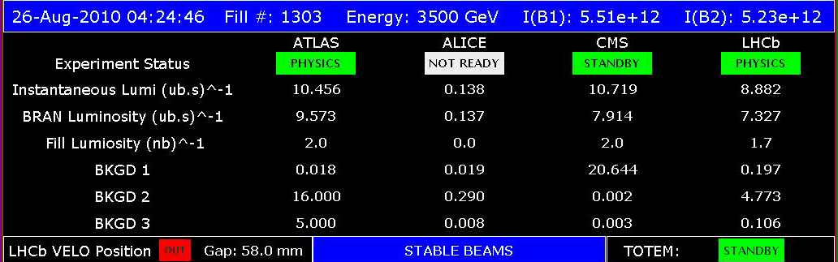
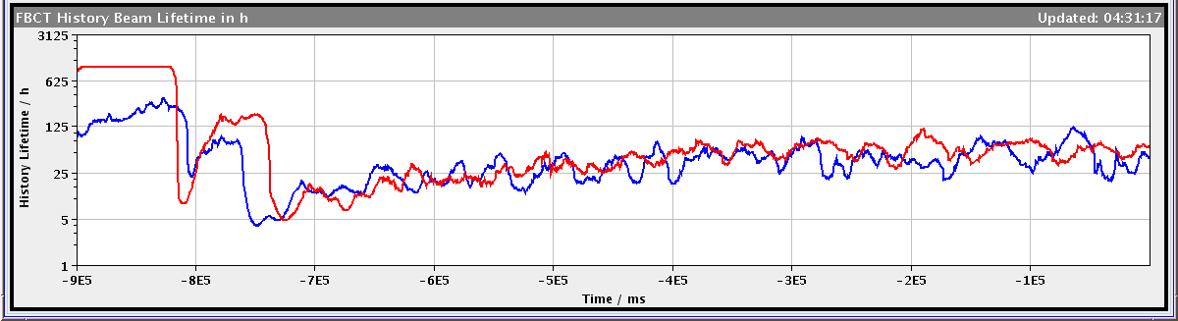
LHC Instantaneous Luminosity: August Record
→ Note also excellent beam lifetime at start of physics!

Slide 8
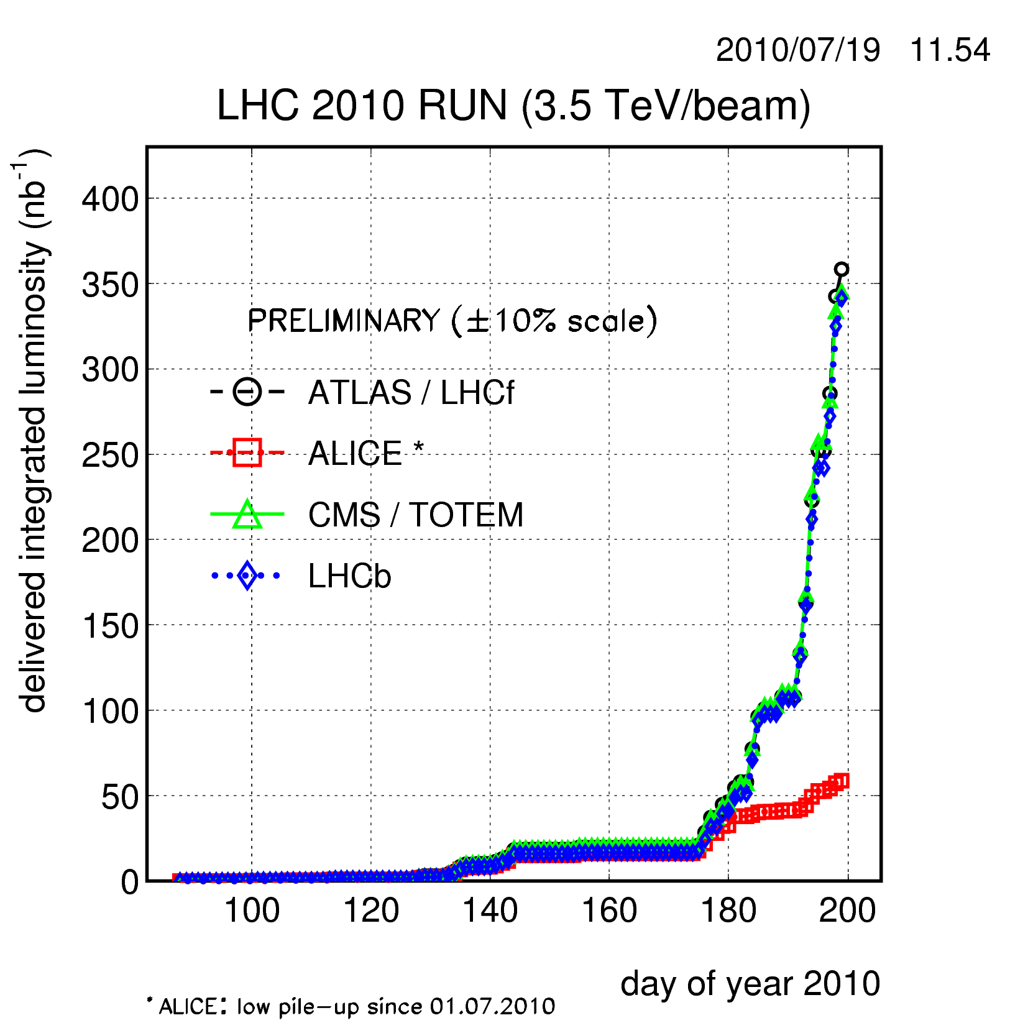
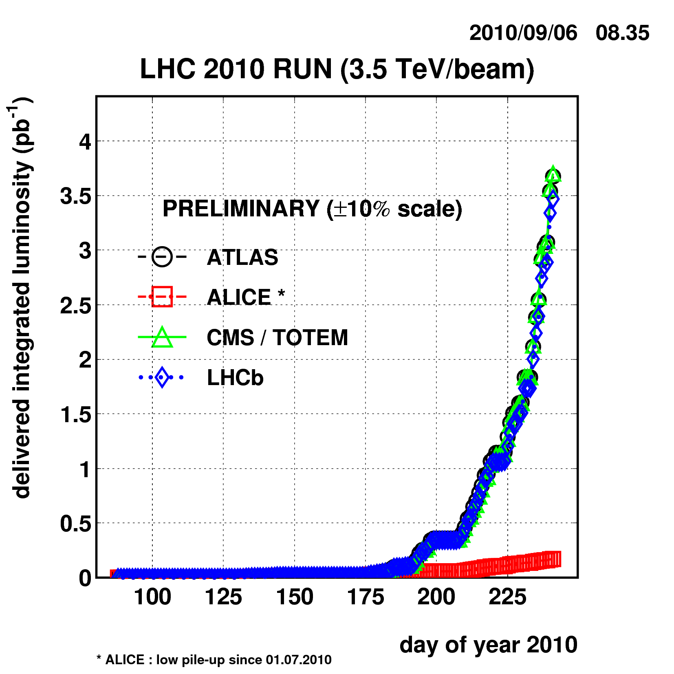
Delivered Luminosity
50b x 50b
2.8 MJ
25b x 25b
1.4 MJ
Low Intensity Commissioning
Set up nominal bunch intensity

Slide 9
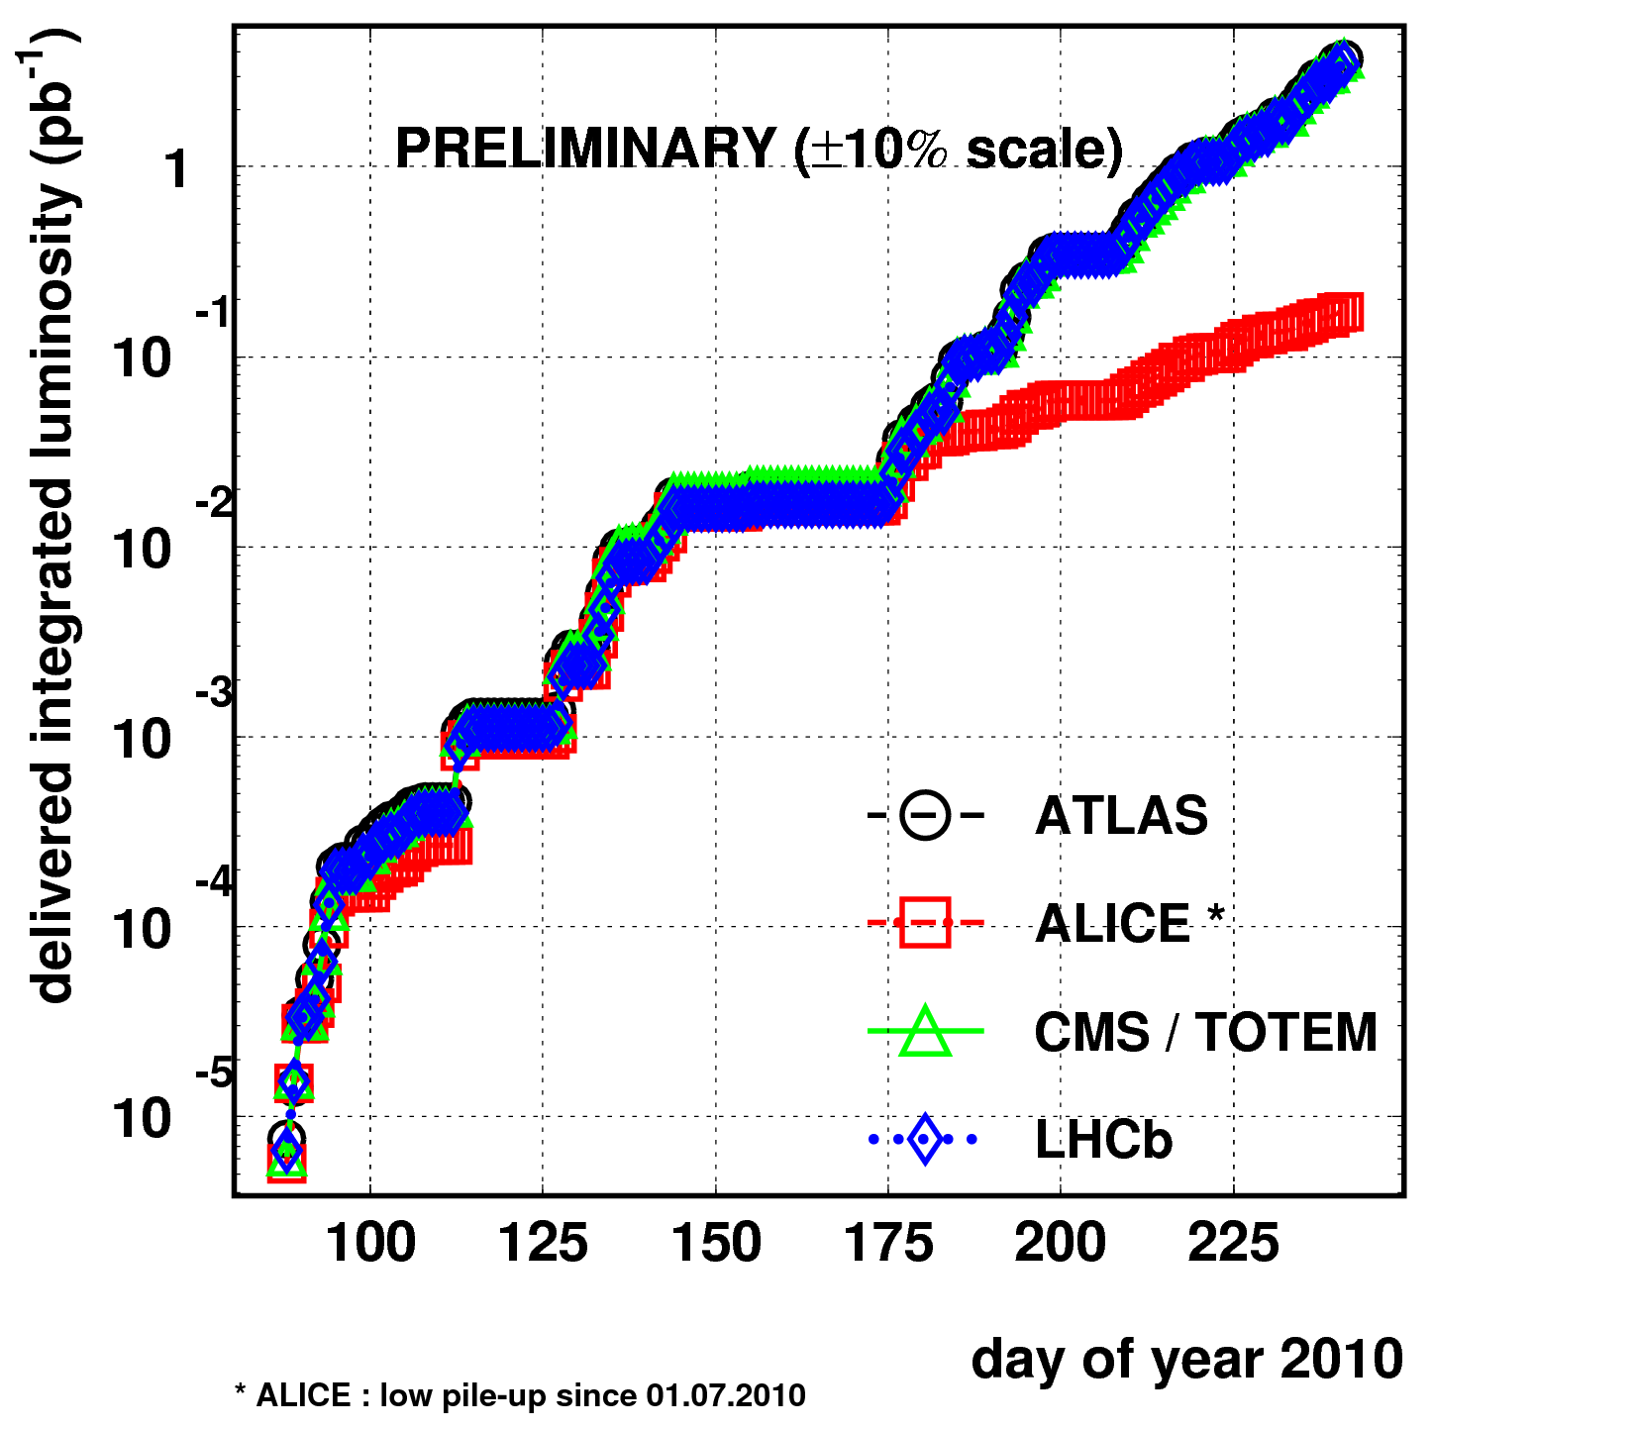
Exponential Increase
Note:
We will deviate from shown exponential slope!
Why:
Commissioning work for bunch trains (ongoing).
We all know that exponential growth can be dangerous and often ends badly → play it safe with MJ beams!
~ factor 10 per 30 days!

Slide 10
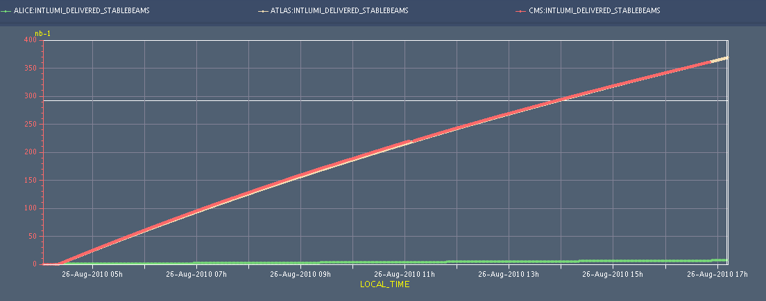
Integrated Luminosity in 1 Fill
370 nb⁻¹ over 13 hours.

Slide 11
Some Lessons Learnt in August
Coherent beam-beam instabilities (July) could be stabilized with the transverse feedback in collision.
No more sudden losses of up 26 %/s (July) but lifetimes inside specification.
Emittance growth with feedback in physics is small (~ 1.5% per hour).
Half of physics fills in last week of August ended on request → long and stable physics fills.
Long-range beam-beam matters (as expected). ➔
Collimation performance and protection stable. ➔
Something creates local scattering and losses. ➔
We might have seen the first SEE or EMC ➔
Luminosity high enough to see L-induced losses ➔

Slide 12
Intensity Loss Fill 1298 (first 2 h)
1 LR in 2 (33m)
1 LR in 2 (33m)
1 LR in 8 (33m)
1 LR in 8 (33m)
1 LR in 2 (22m)
1 LR in 2 (22m)
G. Papotti et al
48b x 48b
no Long Range interactions
with Long Range
  IPs: 1 5 2 8 - 1 5 8 - 1 5 2 - 1 5 - 2 8 - 8

Slide 13
Intensity Loss Fill 1295 (first 2 h)
1 LR in 2 (33m)
1 LR in 2 (33m)
1 LR in 8 (33m)
1 LR in 8 (33m)
1 LR in 2 (22m)
1 LR in 2 (22m)
G. Papotti et al
48b x 48b
no Long Range interactions
with Long Range
  IPs: 1 5 2 8 - 1 5 8 - 1 5 2 - 1 5 - 2 8 - 8

Slide 14
Intensity Loss Fill 1301 (first 2h)
G. Papotti et al
50b x 50b
no Long Range interactions
with Long Range
  IPs: 1 5 2 8 - 1 5 8 - 1 5 2 - 1 5 - 2 8 - 8

Slide 15
Some Lessons Learnt in August
Coherent beam-beam instabilities (July) could be stabilized with the transverse feedback in collision.
No more sudden losses of up 26 %/s (July) but lifetimes inside specification.
Emittance growth with feedback in physics is small (~ 1.5% per hour).
Half of physics fills in last week of August ended on request → long and stable physics fills.
Long-range beam-beam matters (as expected). ➔
Collimation performance and protection stable. ➔
Something creates local scattering and losses. ➔
We might have seen the first SEE or EMC ➔
Luminosity high enough to see L-induced losses ➔

Slide 16
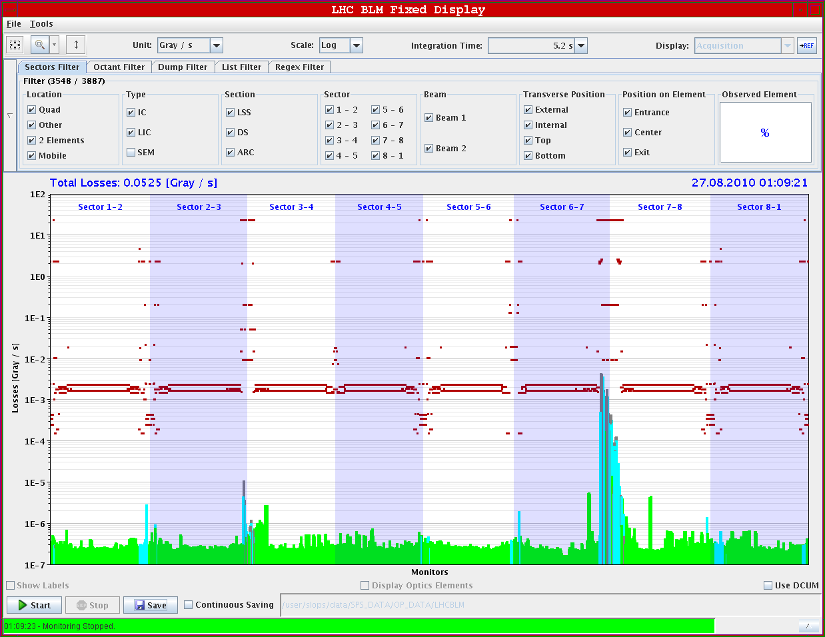
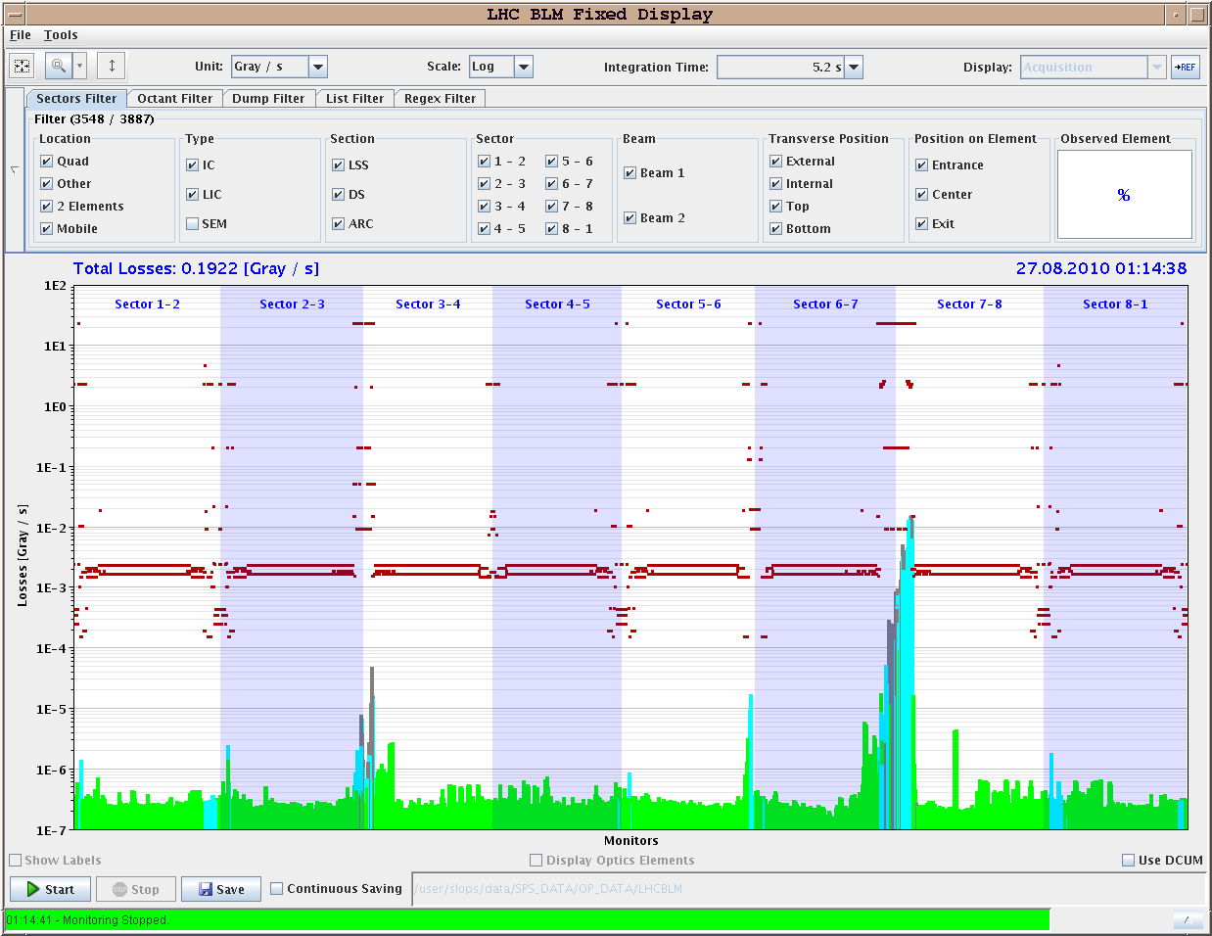
Collimation Loss Maps (Regular Monitoring)
Beam 1 vertical
Beam 2 vertical
OK
OK
OK
Not OK
R. Assmann et al
IR7 cleaning still quite good since June 12 setup.
IR3 anomaly seen for beam 2 → will be fixed with bunch train setup.

Slide 17
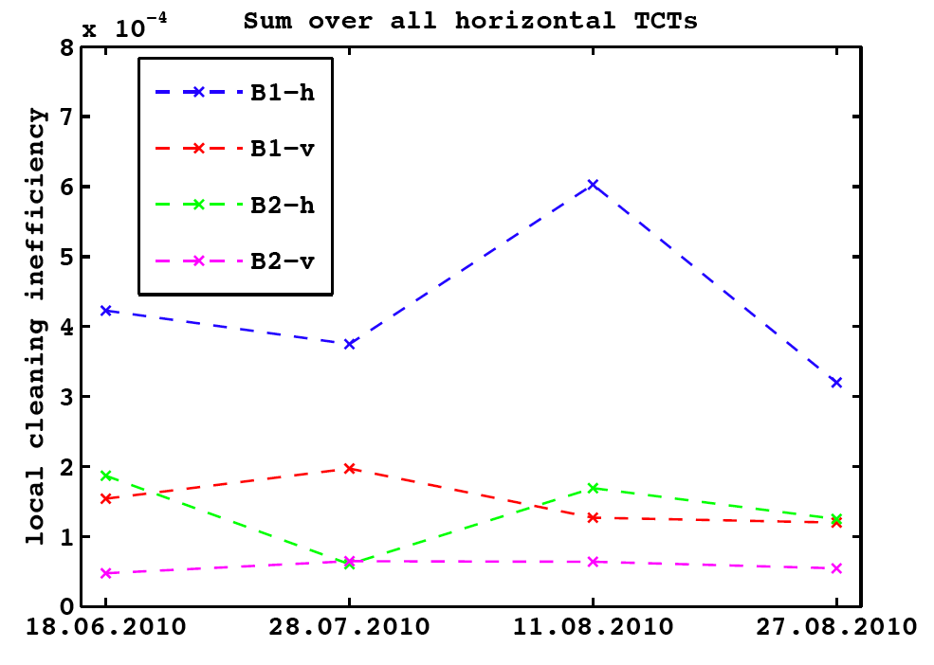
Betatron Cleaning: Leakage (Sum) to Horizontal TCT’s
3.5 TeV
D. Wollmann,
S. Redaelli,
R. Bruce,
R. Assmann
et al

Slide 18
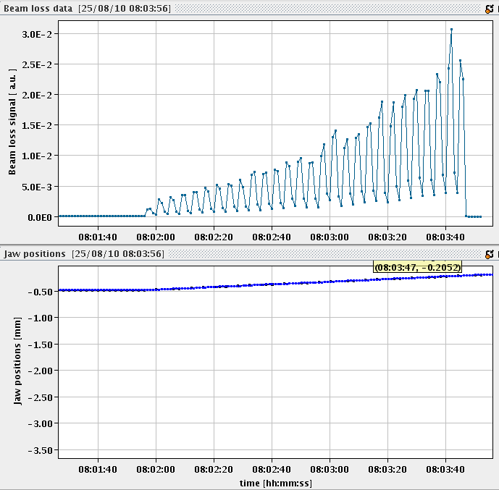
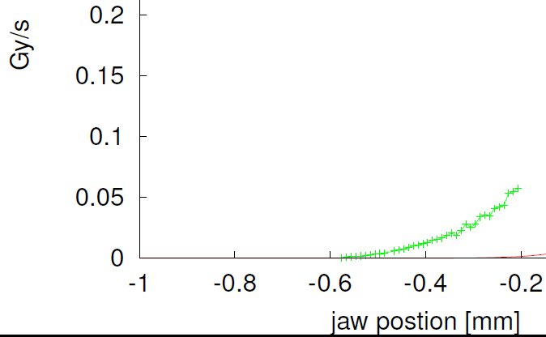
Several Percent of Beam in Far Tails
~ 5.7 σ
~ 4.7 σ
Beam Loss
Jaw position
TCP.D6R7.B2
~ 3.7 σ
3.5%
of beam within 1.5 σ
R. Assmann
F. Burkart
et al
σy = 0.27 mm

Slide 19
Some Lessons Learnt in August
Coherent beam-beam instabilities (July) could be stabilized with the transverse feedback in collision.
No more sudden losses of up 26 %/s (July) but lifetimes inside specification.
Emittance growth with feedback in physics is small (~ 1.5% per hour).
Half of physics fills in last week of August ended on request → long and stable physics fills.
Long-range beam-beam matters (as expected). ➔
Collimation performance and protection stable. ➔
Something creates local scattering and losses. ➔
We might have seen the first SEE or EMC ➔
Luminosity high enough to see L-induced losses ➔

Slide 20
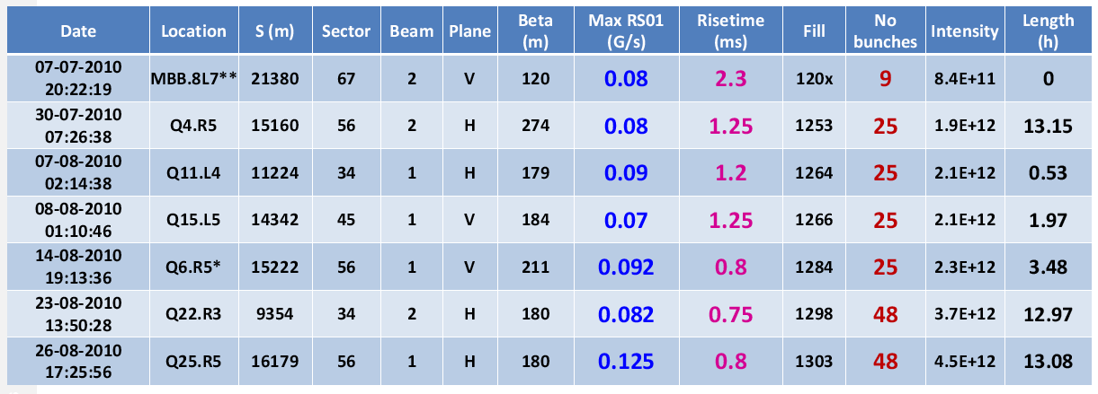
Sudden Local Losses
7 events of sudden local losses (some in the middle of the arc) have been recorded. No quench but preventive beam dump.
Cross-talk to collimation section is seen but losses happen in middle of large aperture sections!
Potential explanation: Dust particles falling into beam create local scattering source with showers propagating downstream.
J. Wenninger
et al

Slide 21
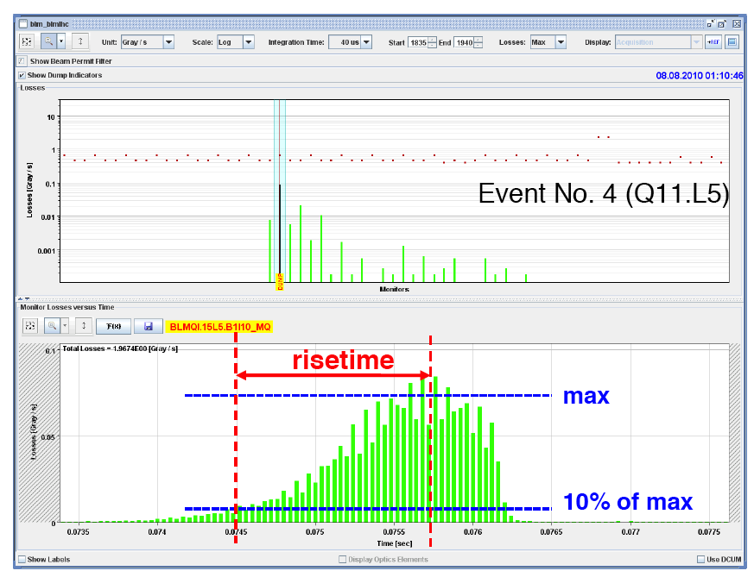
Beam Dumps with fast Local Loss
J. Wenninger
et al

Slide 22
Some Lessons Learnt in August
Coherent beam-beam instabilities (July) could be stabilized with the transverse feedback in collision.
No more sudden losses of up 26 %/s (July) but lifetimes inside specification.
Emittance growth with feedback in physics is small (~ 1.5% per hour).
Half of physics fills in last week of August ended on request → long and stable physics fills.
Long-range beam-beam matters (as expected). ➔
Collimation performance and protection stable. ➔
Something creates local scattering and losses. ➔
We might have seen the first SEE or EMC ➔
Luminosity high enough to see L-induced losses ➔

Slide 23
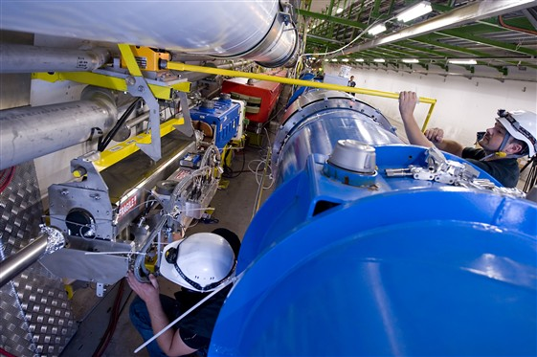
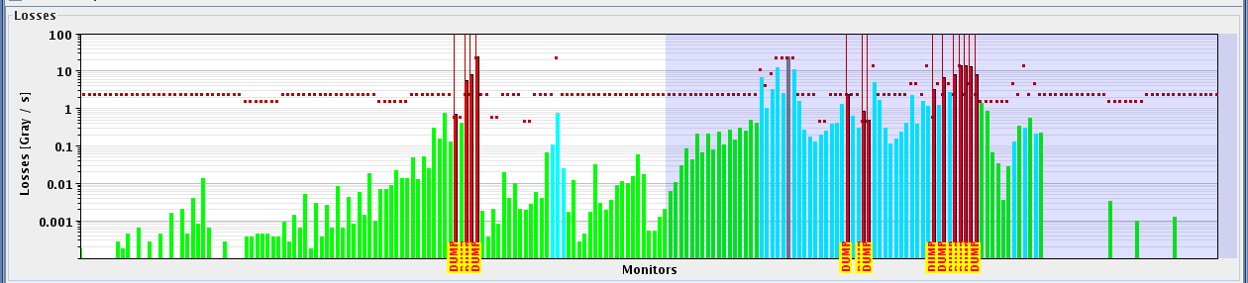
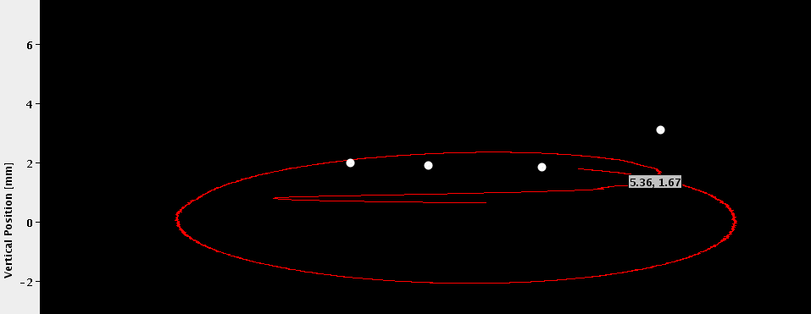
LHC Injection Losses (Beam 2)
Transfer line collimator
4 nominal bunches injected
Ring magnets with beam loss monitors
At same time:
Loss of QPS-OK on RB.A81, on magnet A8R8

Slide 24
Some Lessons Learnt in August
Coherent beam-beam instabilities (July) could be stabilized with the transverse feedback in collision.
No more sudden losses of up 26 %/s (July) but lifetimes inside specification.
Emittance growth with feedback in physics is small (~ 1.5% per hour).
Half of physics fills in last week of August ended on request → long and stable physics fills.
Long-range beam-beam matters (as expected). ➔
Collimation performance and protection stable. ➔
Something creates local scattering and losses. ➔
We might have seen the first SEE or EMC ➔
Luminosity high enough to see L-induced losses ➔

Slide 25
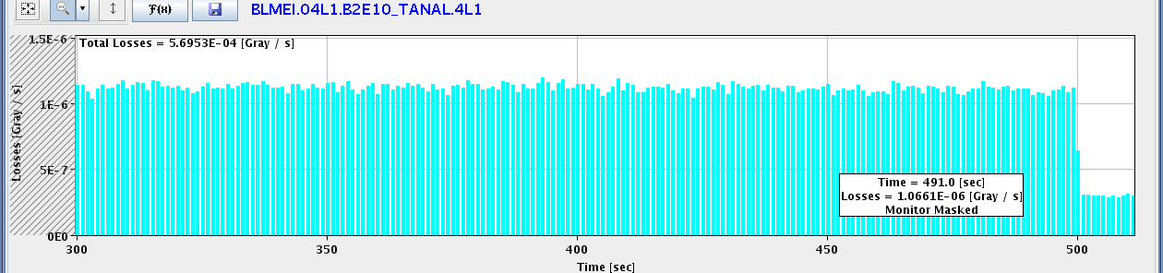

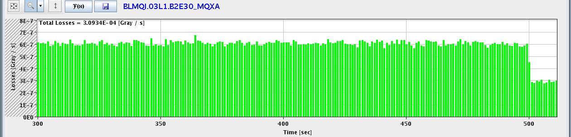
Luminosity-Induced Losses IR1: Selection
Beam dump
IR1 TAN L
IR1 TAN R
IR1 Q3L (SC)

Slide 26
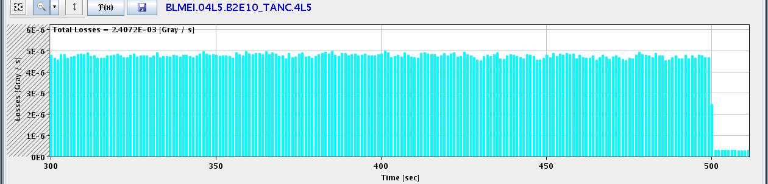

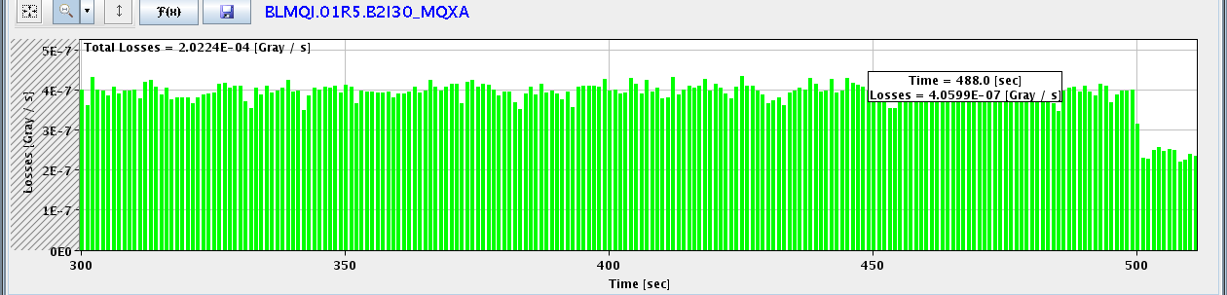
Luminosity-Induced Losses IR5: Selection
Beam dump
IR5 TAN L
IR5 TAN R
IR5 Q1R (SC)

Slide 27
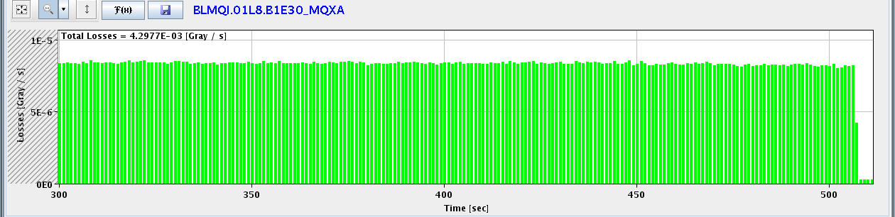
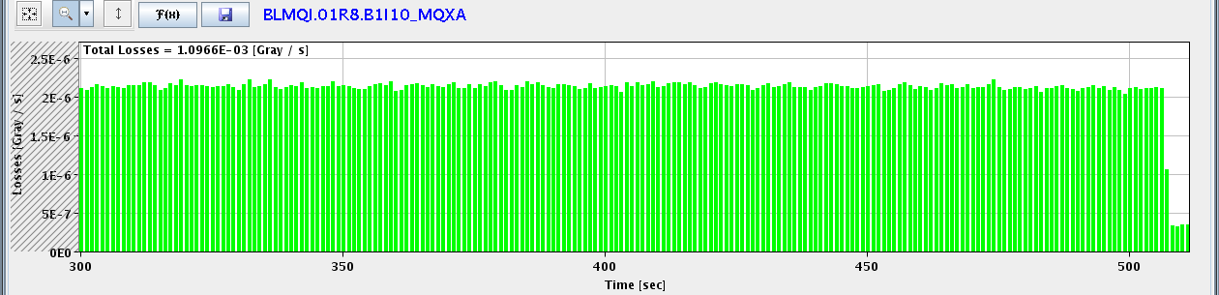
Luminosity-Induced Losses IR8: Selection
Beam dump
IR8 Q1L (SC)
IR8 Q1R (SC)

Slide 28
Next Step: Bunch Trains and 10 A/s
Goal is to set up bunch trains for nominal crossing angles at injection and 100/110 μrad at 3.5 TeV.
At the same time switch to faster ramp with 10 A/s. Requires new functions for magnets, collimators, …
Crossing angles require set up of injection, injection protection and IR collimation.
New golden orbits for 450 GeV, ramp and 3.5 TeV.
Qualify with loss maps.
Inject at least 3 batches of 4b per injection: readiness for factor 3 increase of intensity.
Set up RF, transverse damper, instrumentation, … for new beam conditions.

Slide 29
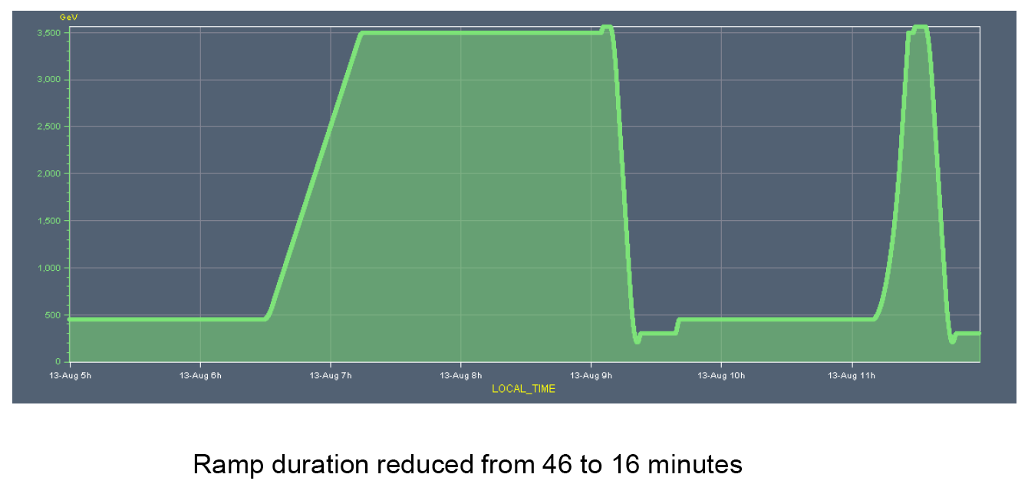
Faster Ramp: 2 A/s → 10 A/s
M. Lamont et al

Slide 30
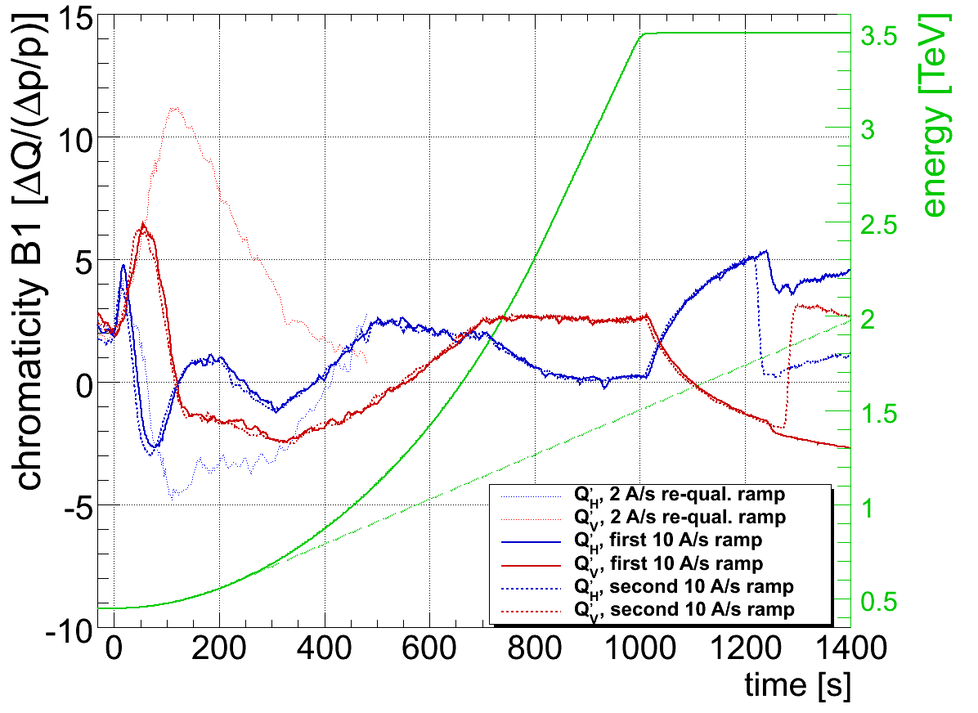
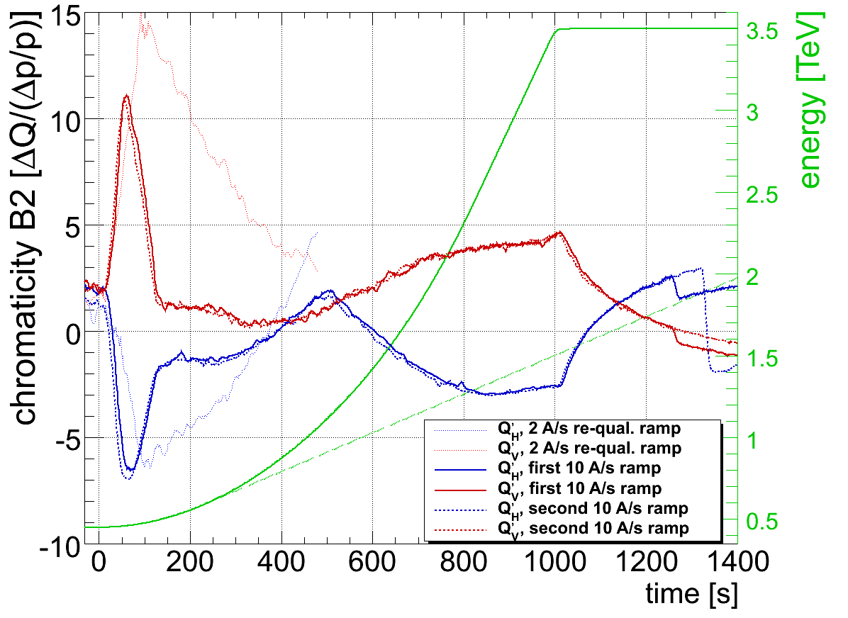
10 A/s ramp (w/o collimators)
Chromaticity during the ramp
R. Steinhagen et al

Slide 31
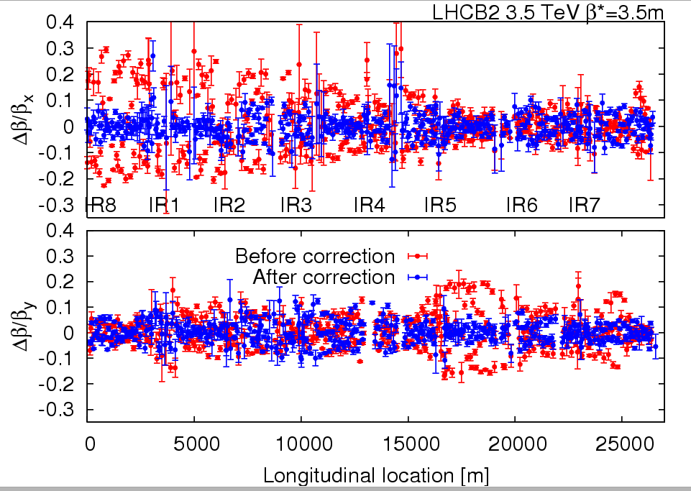
Squeeze
Correction of beta*: below 20% (better than nominal).
R. Tomas et al

Slide 32
Crossing angles
External crossing angles (tested now, nominal at injection):
  IR1: -170 μrad at inj./ramp and -100 μrad in squeeze/collision
  IR2: ±170 μrad at inj./ramp and ±110 μrad squeeze+collision
  IR5: +170 μrad at inj./ramp and +100 μrad in squeeze/collision
  IR8: -170 μrad at inj./ramp and -100 μrad in squeeze/collision
  IP2 with parallel separation (3 to 4 sigmas).
Note that balancing is ongoing at injection between aperture, orbit tolerances and crossing bumps!
Optimal value for 2010 at injection will be decided in next days!

Slide 33
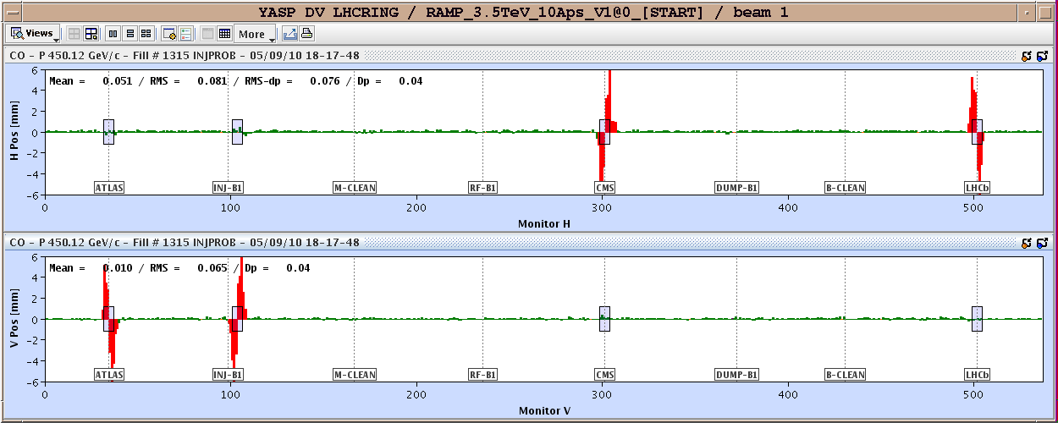
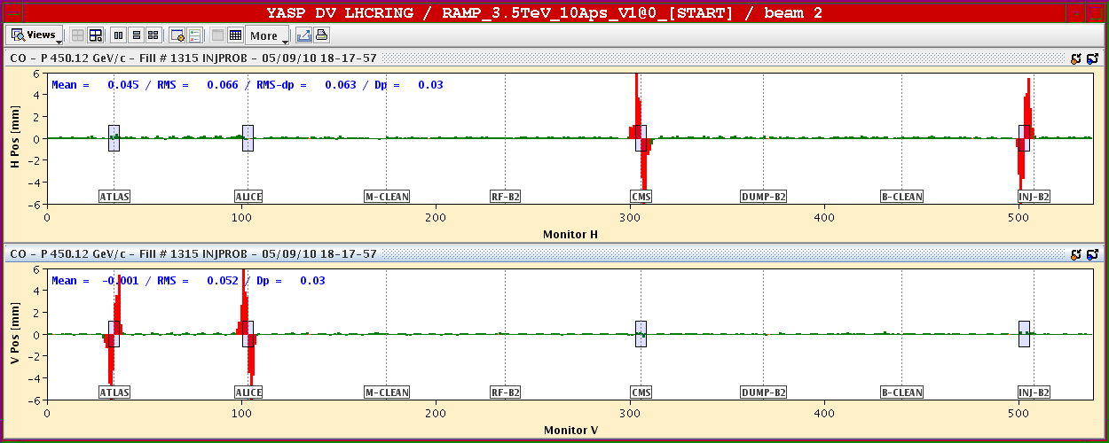
Crossing angles (nominal)
Non closure corrected Golden orbit defined at 450 GeV/c. Ramp with crossing angles ON done. Measurement and non closure correction calculation during the squeeze.
G. Arduini,
J. Wenninger
et al

Slide 34
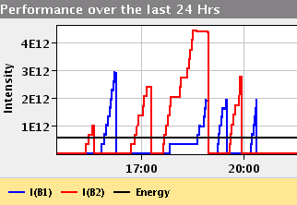
Batch Injection (Yesterday)
Injection of 4b per batch
(0.9e11 per bunch)
B. Goddard et al

Slide 35
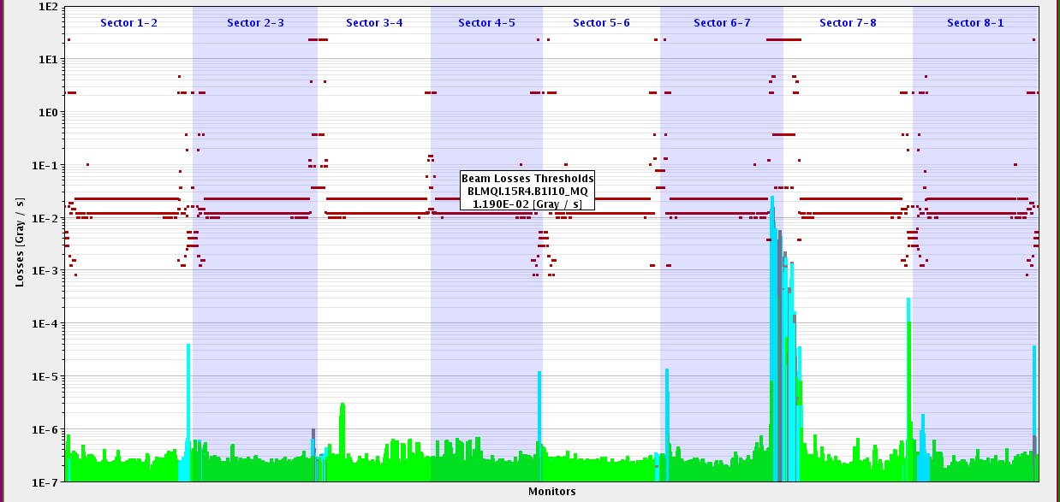
Loss Map B1 V: Losses in IR’s with Crossing
Injection protection out
LHC-b
ALICE
ATLAS
CMS
Detailed analysis to be performed! Preliminary:
Tighter injection aperture: 1-2 % leakage into IR8! 10 times above 3.5 TeV leakage.
No losses seen in SC IR aperture.
Protection of n1=8 seems to be sufficient (calculated is n1 slightly less than 7 for IR8).
D. Wollmann,
S. Redaelli,
R. Bruce,
R. Assmann et al

Slide 36
Conclusion
August running period ended very well with record performance, doubling the total delivered luminosity in the last week.
Machine availability excellent → hard work of numerous colleagues.
Many important lessons. Many good news! Looks fine so far for increasing intensity.
After technical stop started commissioning of crossing angles and faster ramp. Optimal crossing angles decided in next days!
Will allow next steps up in intensity (goal 30 MJ by end of year) with even better efficiency (faster ramp).
Plan for stable beams middle/end of next week.
On route towards 10³² cm⁻² s⁻¹! Factor 10 to go…

Slide 37
Thank you for your attention!

