Slide 1
Beam Instrumentation
&
Beam Commissioning

Slide 2
Outline
Beam status today
Per instrument highlights and issues
Summary

Slide 3
Summary of operational beams
Courtesy of M. Fraser SY-ABT-BTP
Fixed target beams | Status | Comment
SFTPRO (core only) | Operational | Delivered to SPS at ~6…7 ∙ 10¹¹ p/p
SFTPRO (5 turn extraction) | Intensity increase | 2-5 ∙ 10¹² p/p delivered to SPS at 4.5 ∙ 10¹² p/p
AD | Operational | 1.4 ∙ 10¹³ p
TOF | Setup | First basics
EAST | Setup | First basics
LHC-type beams | Status | Comment
LHCPROBE, LHCINDIV | Operational
LHC25 (72b) | Operational | Polished up to 1.3 ∙ 10¹¹ p/b ε_{h} (arrival flat-top) ≈ 1.8 mm mrad ε_{v} (end flat-bottom) ≈ 1.6 mm mrad
LHC25 (12b or 24b) | Temporary | 3 BP cycle delivered to SPS
LHC25 BCMS (48b) | Operational | Polished up to 1.3 ∙ 10¹¹ p/b

Slide 4
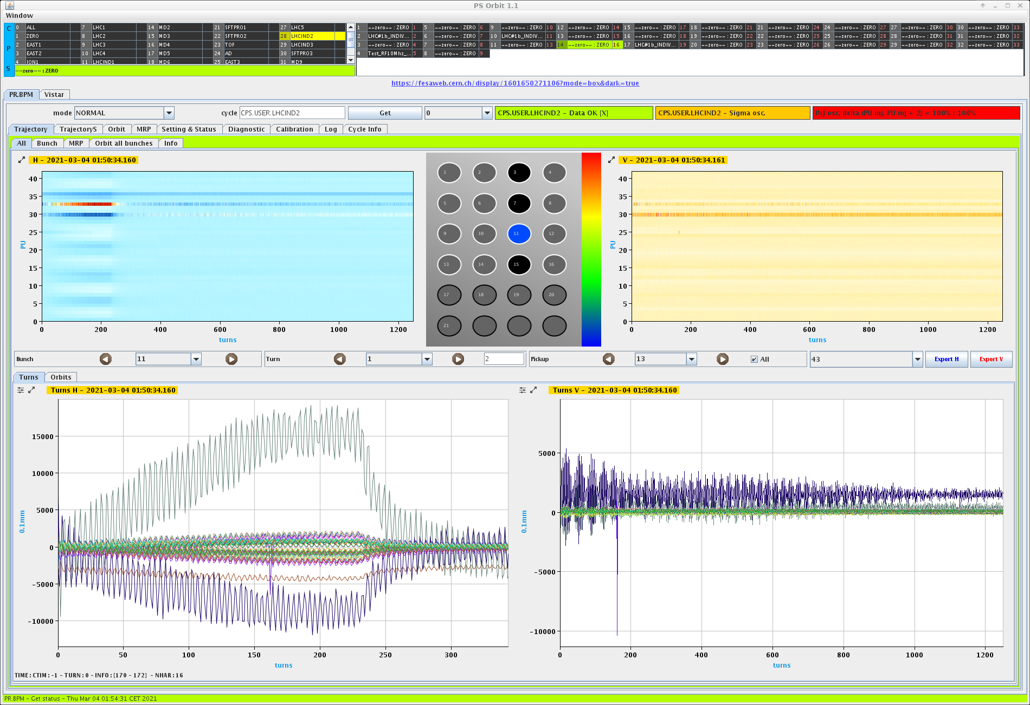
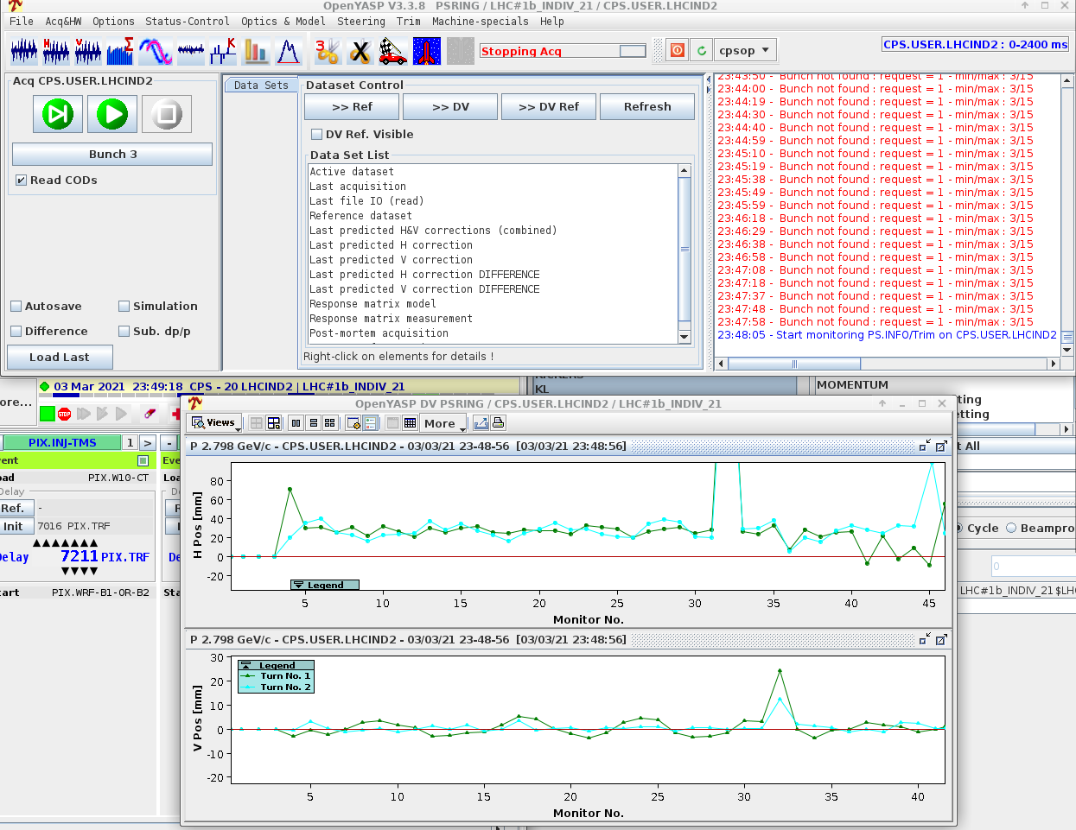
BPM Orbit & special PUs
3rd March first beam -> OPERATIONAL
Used successfully from day 1 for operation and beam set-up. Beam-based alignment at the beginning of the run
Special PUs: PU93 used for LI radial loop needed intervention

Slide 5
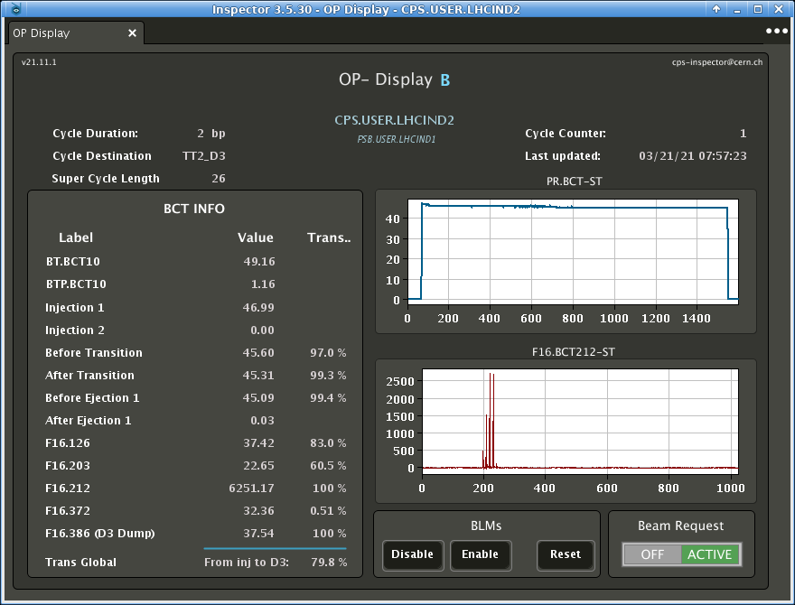
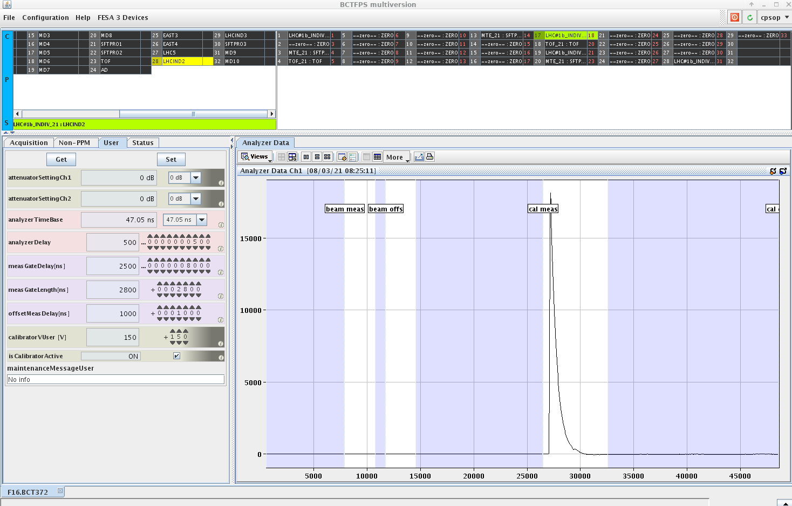
BCTs & FBCTs
3rd March first beam -> OPERATIONAL
BCTF Adjustments from the expert needed for some beams
Amplifiers removed in the TT2 tunnel to improve the signal
Amplifier installed in the surface for LI in F16.BCT126

Slide 6
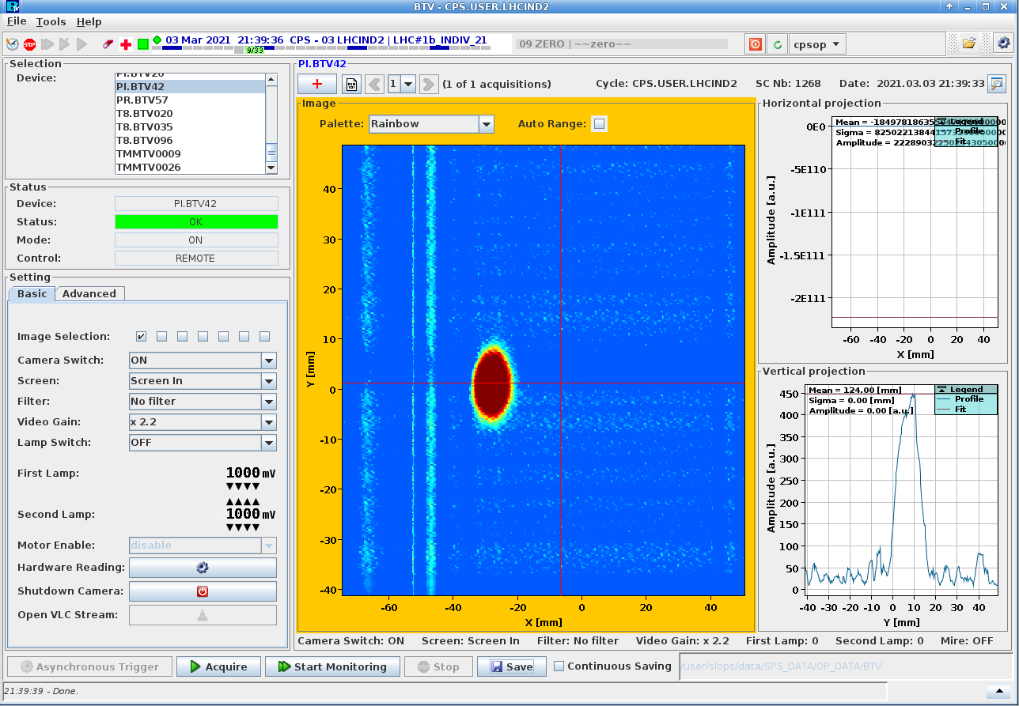
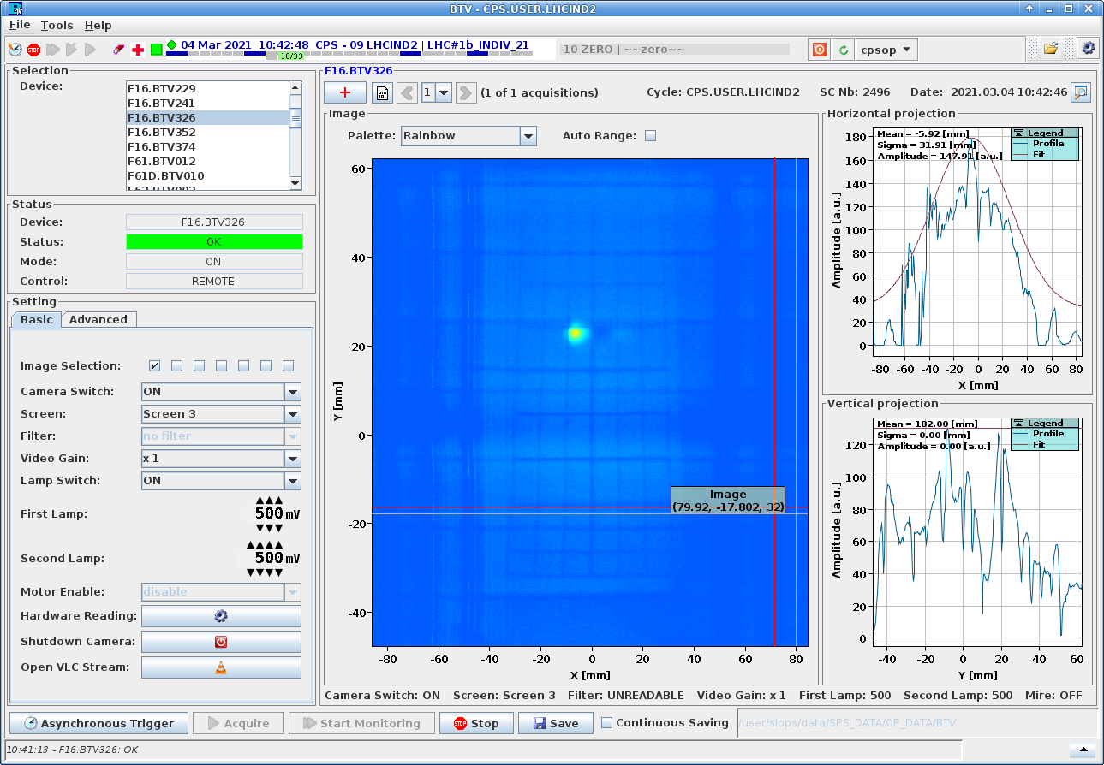
BTV
3rd March night first beam & 4th March extraction TT2 -> OPERATIONAL
Camera in 42 bumped in a SMH42 intervention
F16.BTV201 camera replacement
BTV16 mechanical arm issue
Flipping in the vertical position needed in TT2 devices (sw settings)

Slide 7
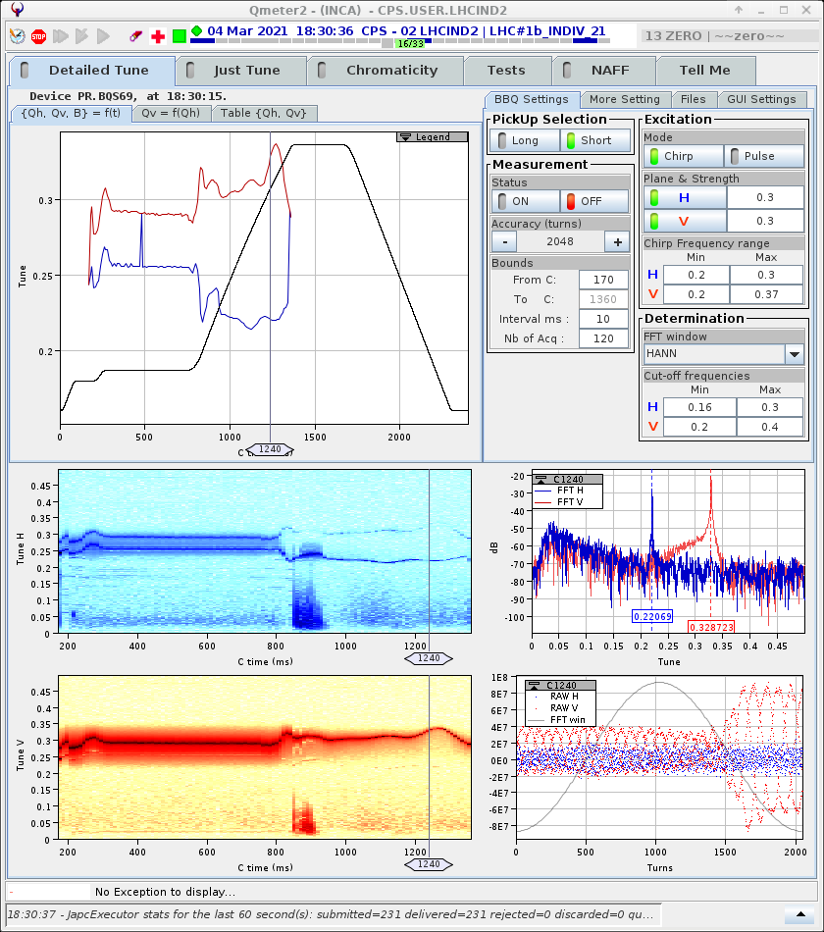
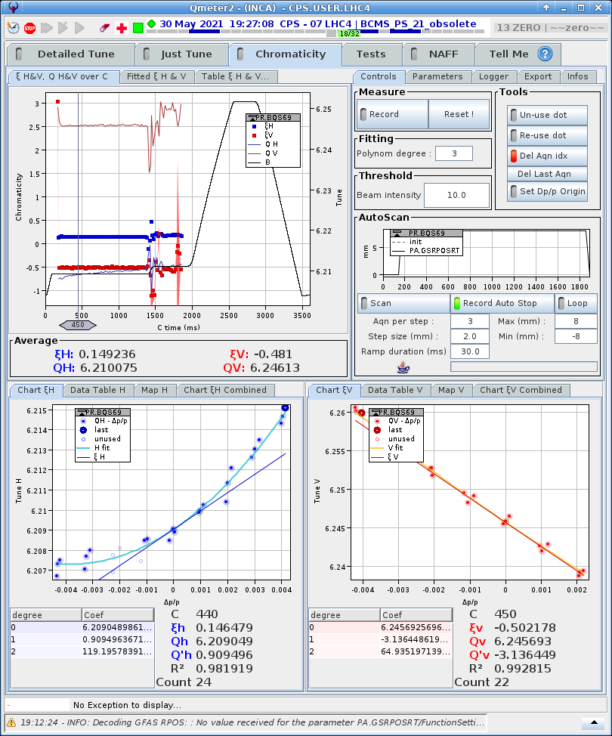
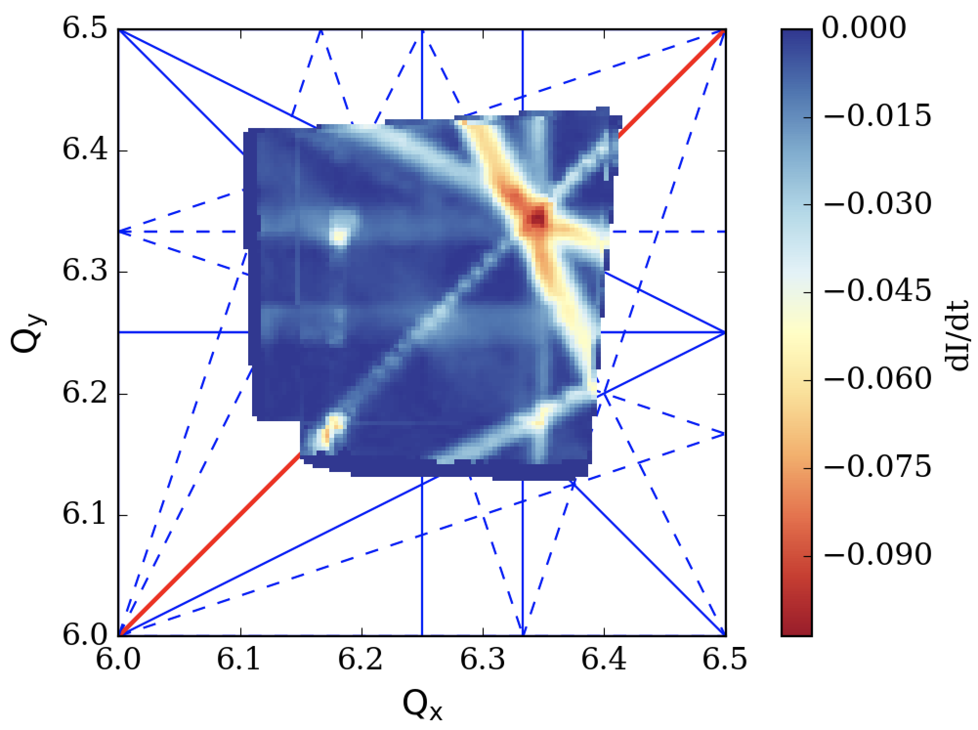
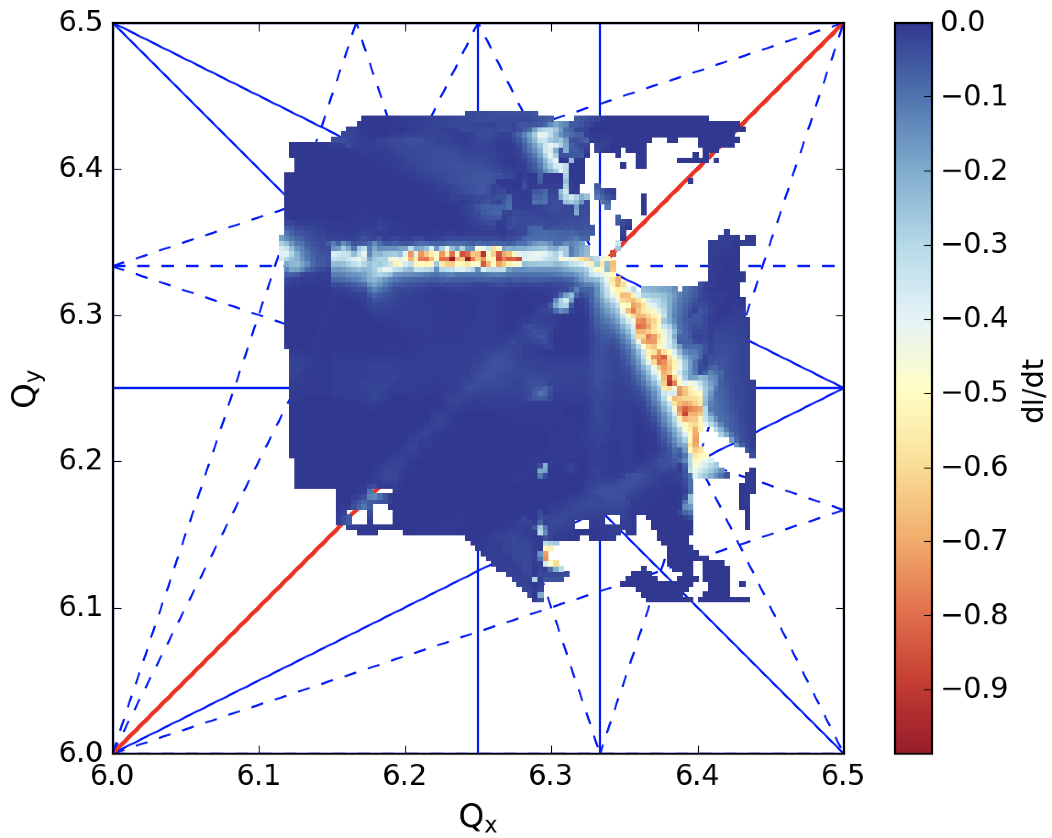
BBQ
Not worked first time 3rd March, FEC and RF signal issues, but the next day -> OPERATIONAL
Bare machine
Vertical magnet BGI84 ON
Tuning of LHC25ns low chromaticity optics
Loss maps with and without magnets of BGI82 and BGI84 / with and without compensation
  Vertical BGI84 magnet confirmed to excite skew sextupole resonances 3Qy=19 and 2Qx+Qy=19
  Horizontal BGI82 magnet confirmed to excite sextupole resonance.

Slide 8
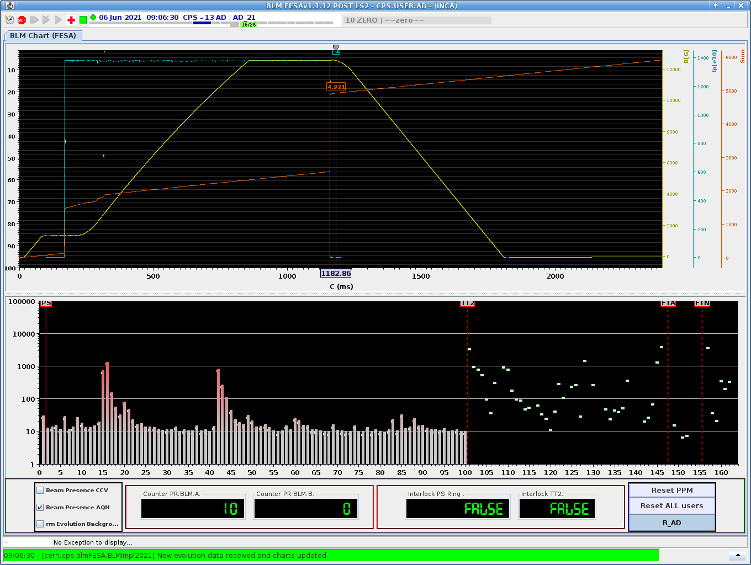
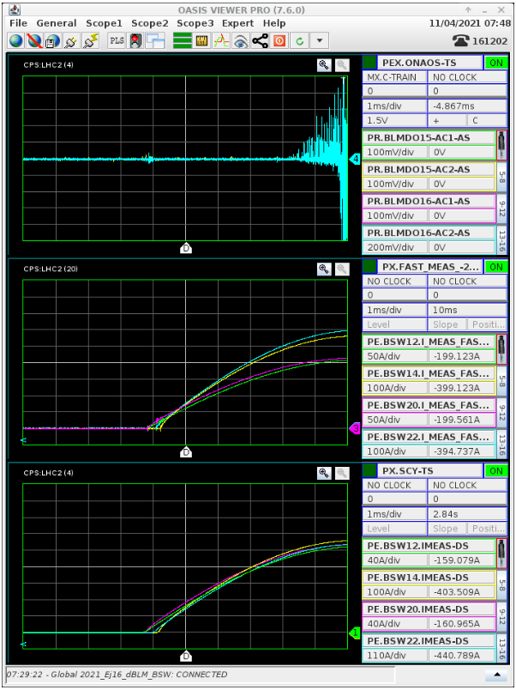
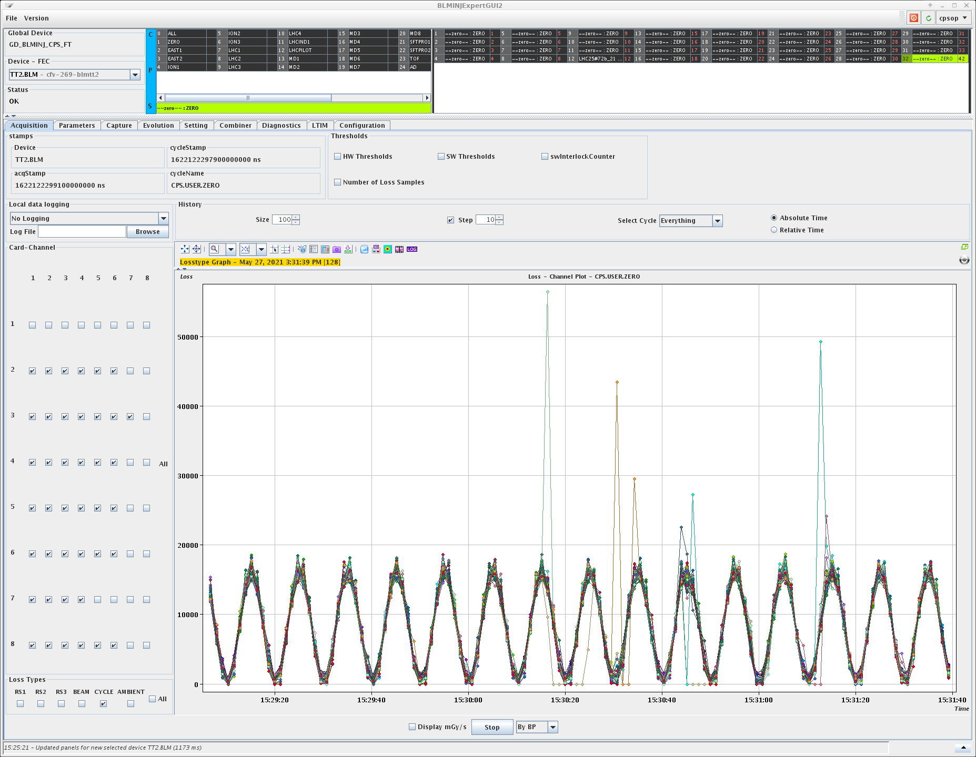
BLM & Fast BLM
TT2 noise -> Found a correlation with LTB.QNO40 and LTB.QNO60
Measuring from day 1
Initial mistrust due to lack of comparison with old levels overcome
S88 loss measurement lead to sector opening -> sponge
S42 losses lead to the finding skew sextupolar components excitation by the BGI magnet
Excellent results in spite of several last minute requests: ‘tail clipper’ specification insufficient, SIS too slow to be used
Hw interlock issue -> AFT 55min fault

Slide 9
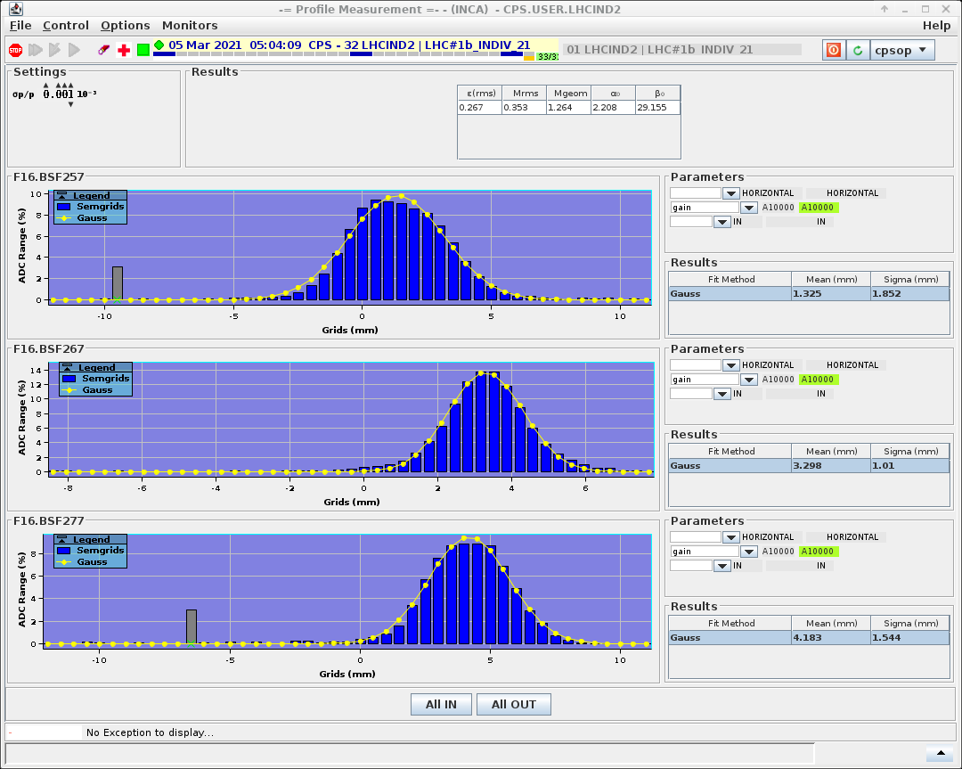
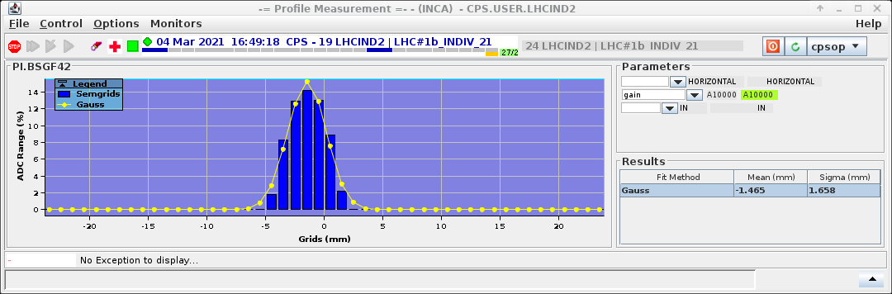
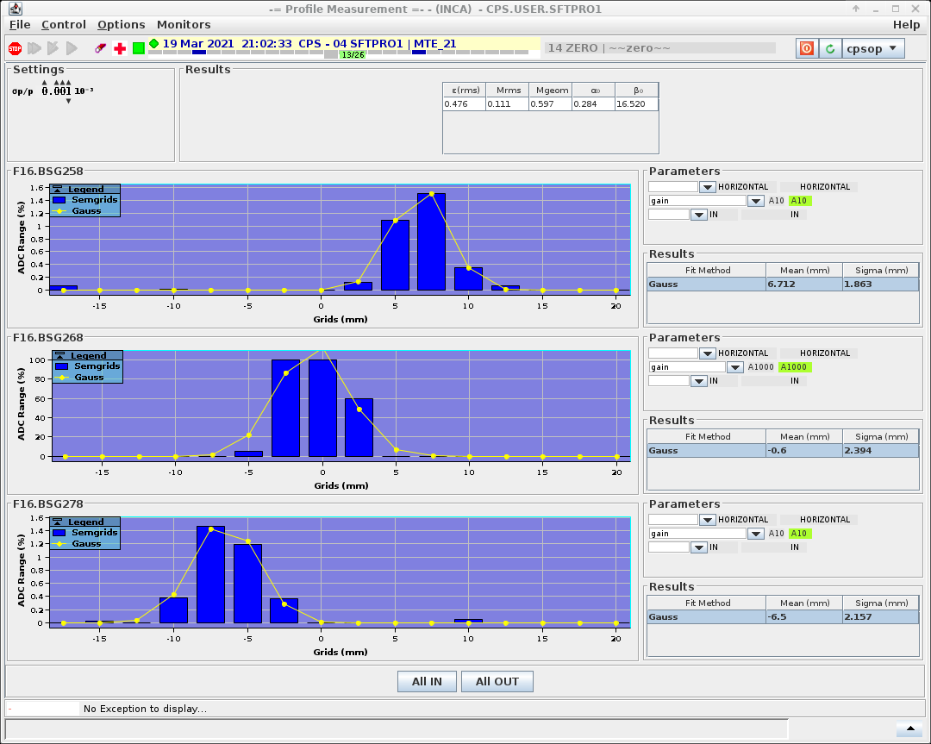
SEMgrids
PI.BSF42 did not provide a plot on the 3rd night but the next day after timing adjustments. TT2 grids also worked from day one after timing set-up -> OPERATIONAL
Tbt not commissioned yet. Needs very particular conditions, usage of all kickers and only one destination in the SSC. -> no beam to any other user/usage.
F16.BSF267 position unknown -> access Electrovalve and connector exchanged

Slide 10
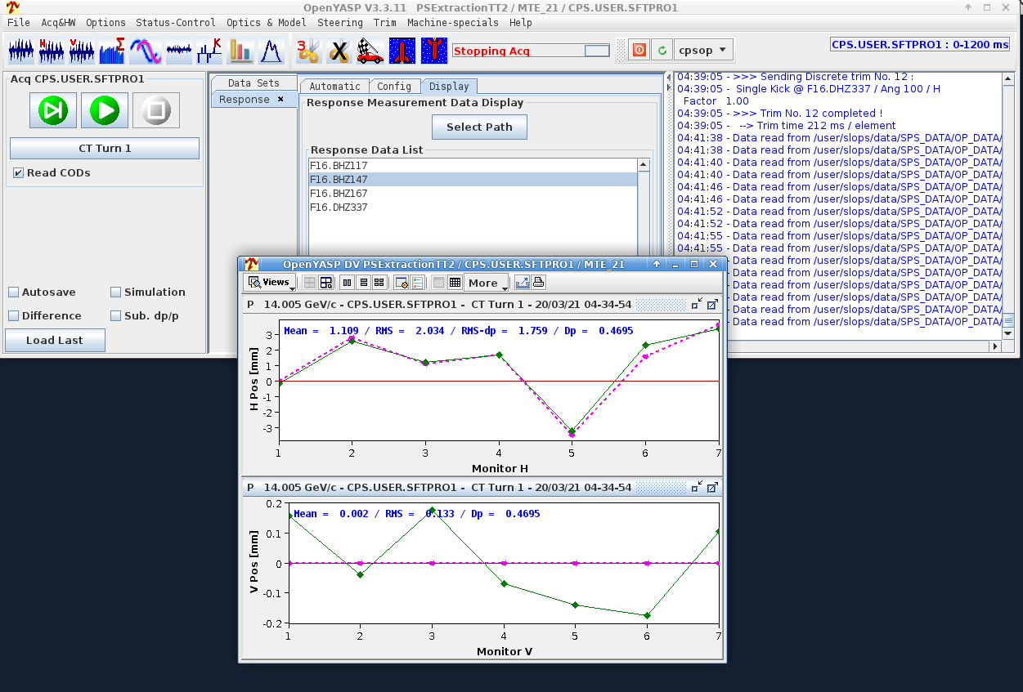
BPM TT2 Trajectory
Worked since day 1 -> OPERATIONAL
Following a survey campaign in TT2 we are requested to add the mechanical/optical/electrical offsets
Survey shows significant offsets for some PUs

Slide 11
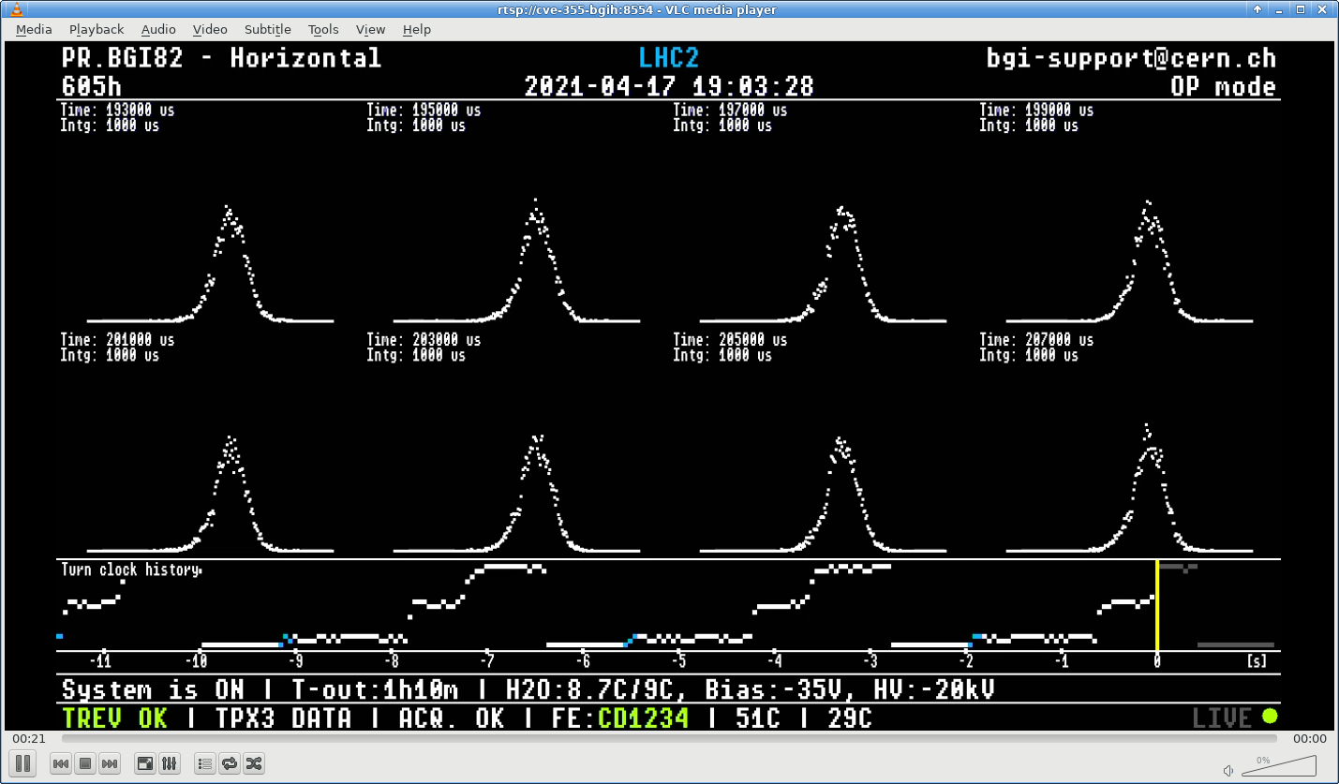
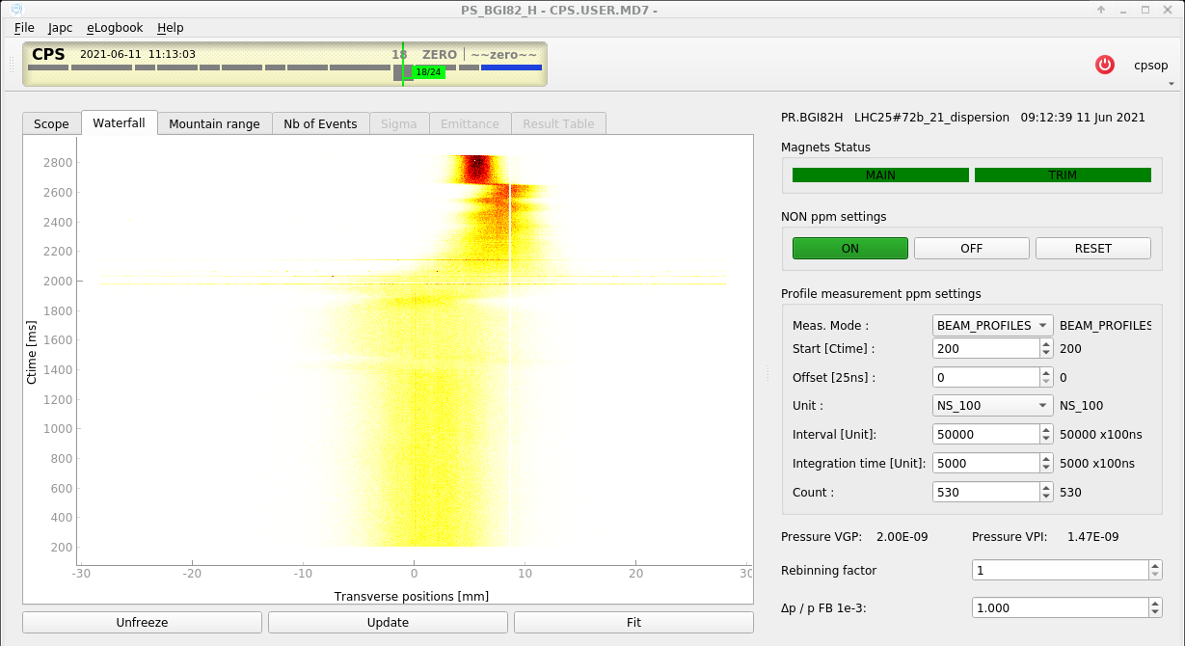
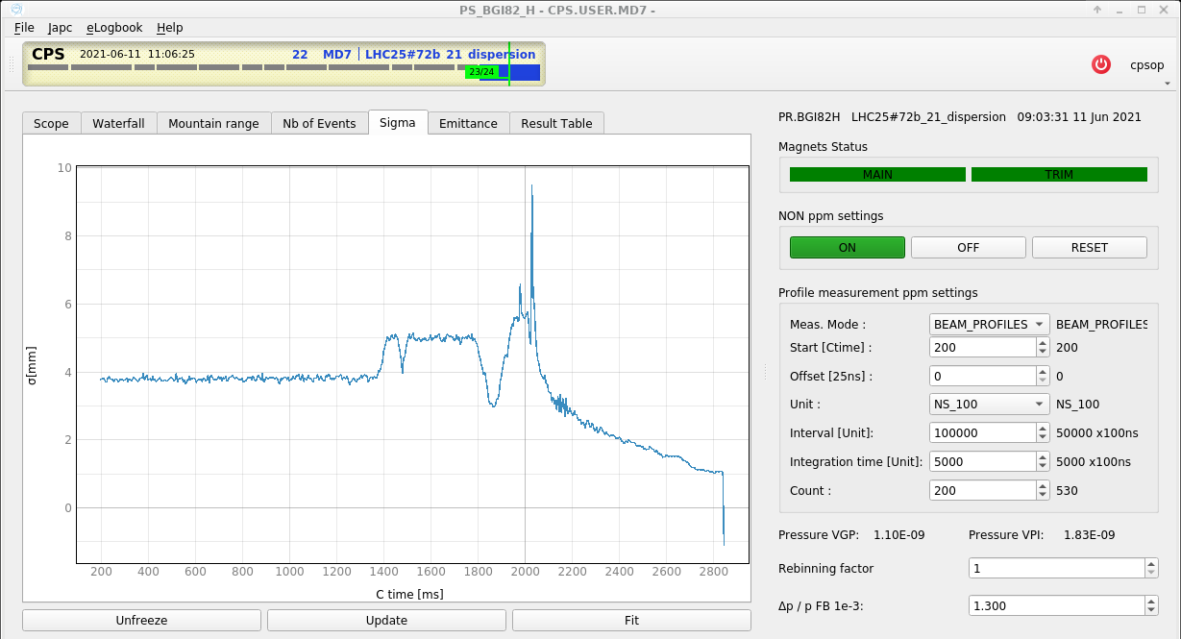
BGI
Enthusiastic feedback -> unprecedented shot-by-shot beam size information
Measurement integrated over 0.5 ms every 5 ms in H plane
Used for the optimisation of second injection bump
Unexpected BGI84 magnet issue -> Magnet model shows that the shielding plates are creating most of the skew sextupolar component as observed in the PS ring resonance
Tbt measurement available offline (at present min 10 turns integration needed)
3BP measurement issue solved

Slide 12
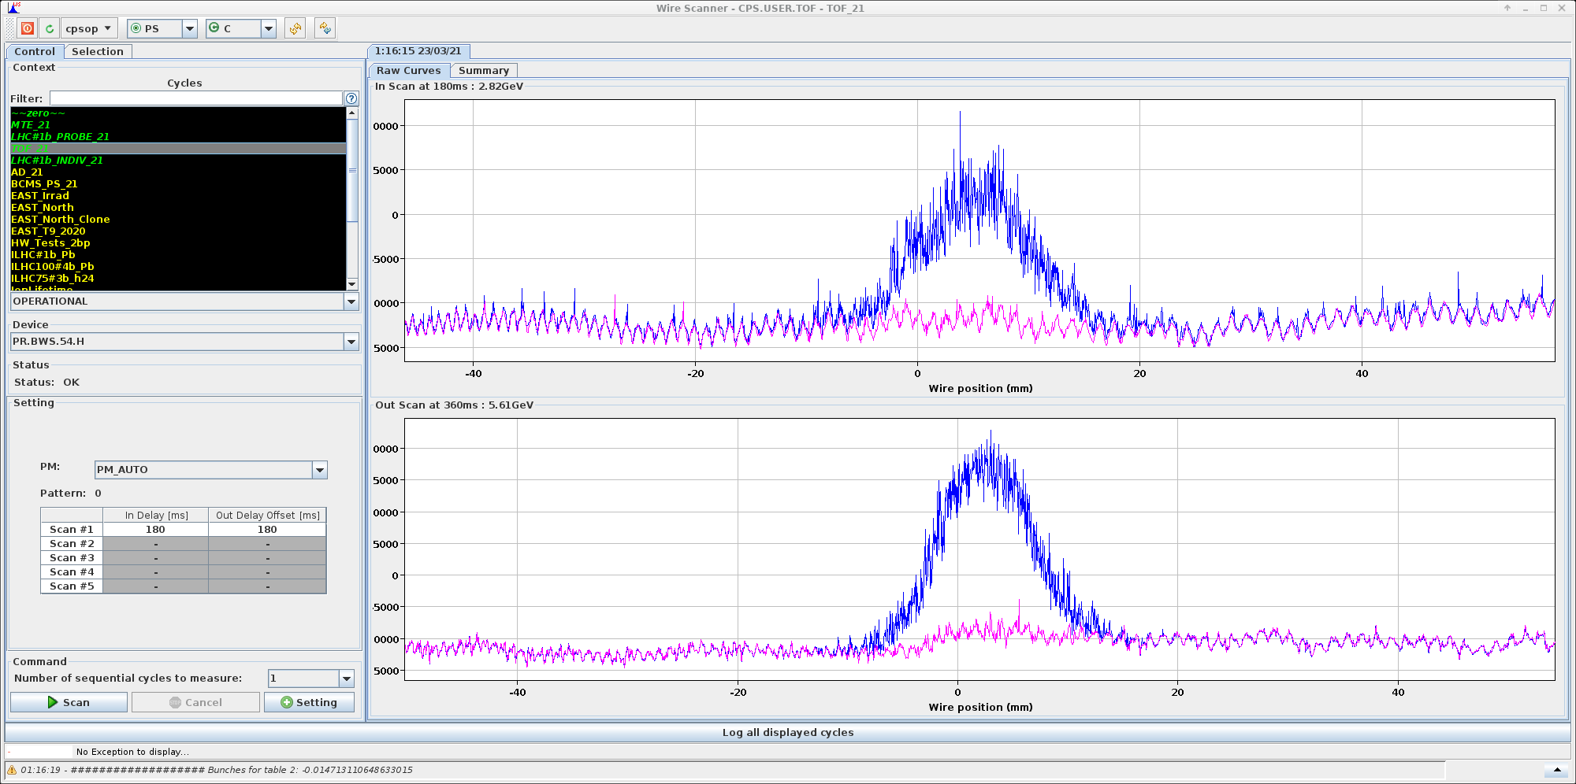
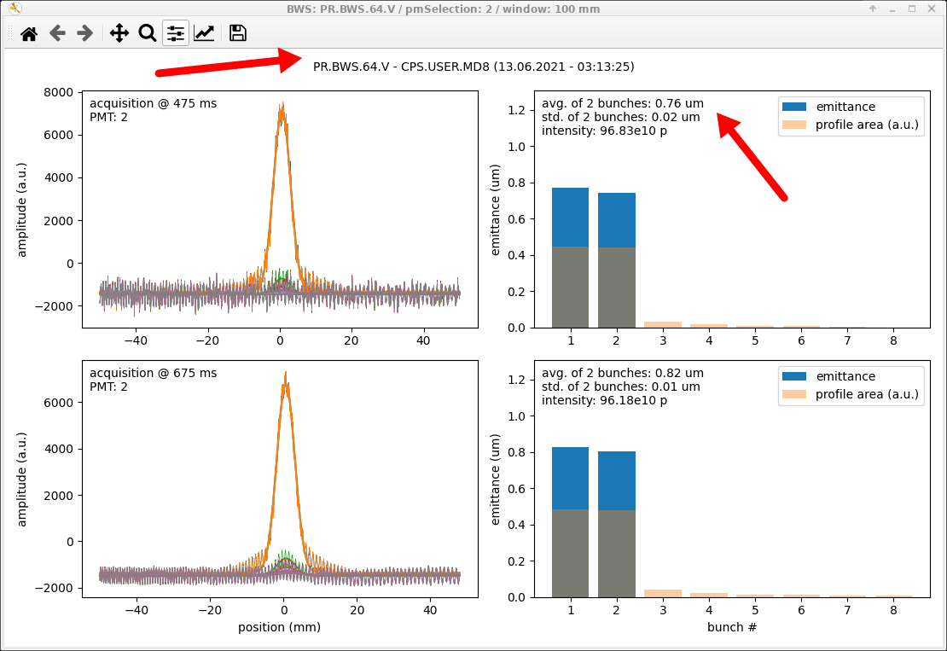
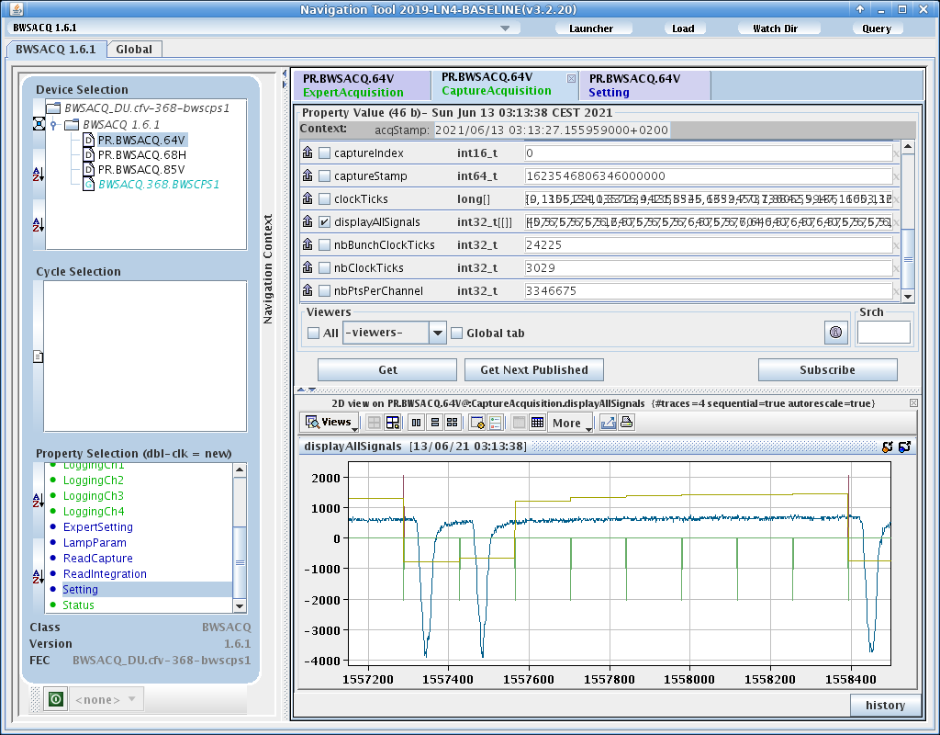
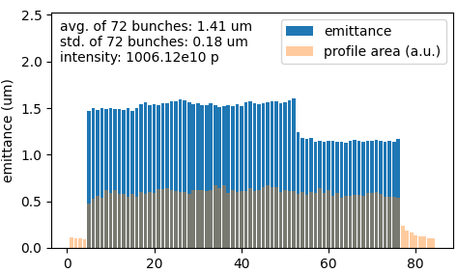
BWS
23rd March -> First acquisitions with the basic requirements for emittance measurement
Many additions and issues solved since then.
Start to be heavily used (Tuning LHC25 beams with low chromaticity optics, aperture investigations )
Currently working on:
16KHz noise generated from motor driver
Bunch offset set up
PMT and attenuation set up
‘Lost triggers’ issue
Courtesy of H. Bartosik & A. Huschauer

Slide 13
Summary
Smooth restart
Almost all instruments operational from day 1!
Very few operational issues received through Jira
Commissioning of new instruments well advanced except for the turn by turn injection SEMgrids, waiting the chance to see beam
  BWS: harmonic set up
  BGI turn measurements
OP Plans for this week
Beam instrumentation commissioning to continue focusing on BGI and WS
  Continue tests and noise investigations
  Exploitation: systematic WS measurements, check emittance blow-up of injection bump non-closuree
  beams
Thank you for your attention

