Slide 1


LHC beam-based feedbacks and tune estimation
Code renovations and machine learning applications
Student: Leander Grech^{1,2}
Supervisor: Dr. Ing. Gianluca Valentino¹
Co-supervisor: Dr. Diogo Alves²
17th June, 2021
¹
²

Slide 2
Introduction
~4 mins

Slide 3
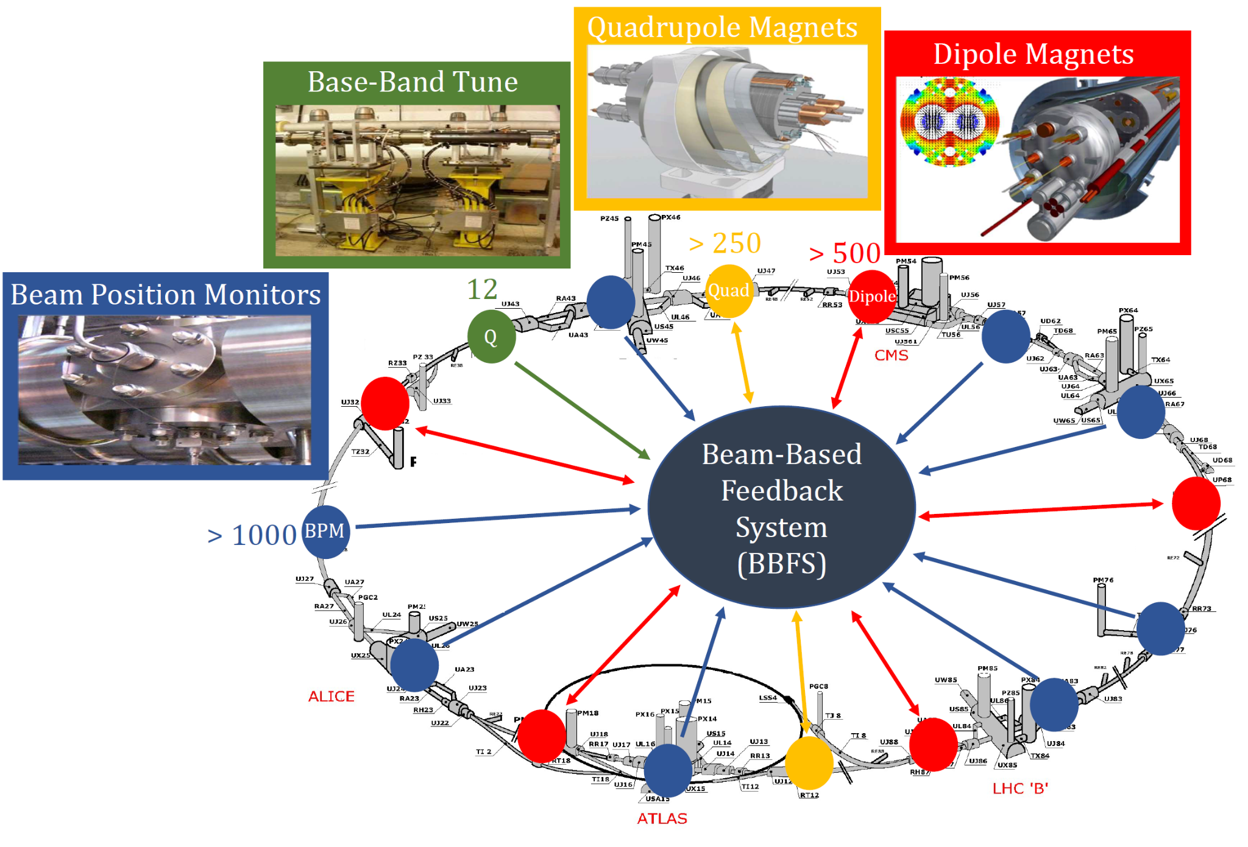
Beam-Based Feedback System (BBFS) I
BBFS was in operation until LHC Run 2 and contained the controllers for the:
  Orbit
  Tune (Q)
Beam Position Monitors (BPMs) provide the measured orbit of the beams
Base-Band Tune (BBQ) provides the estimated tunes

Slide 4
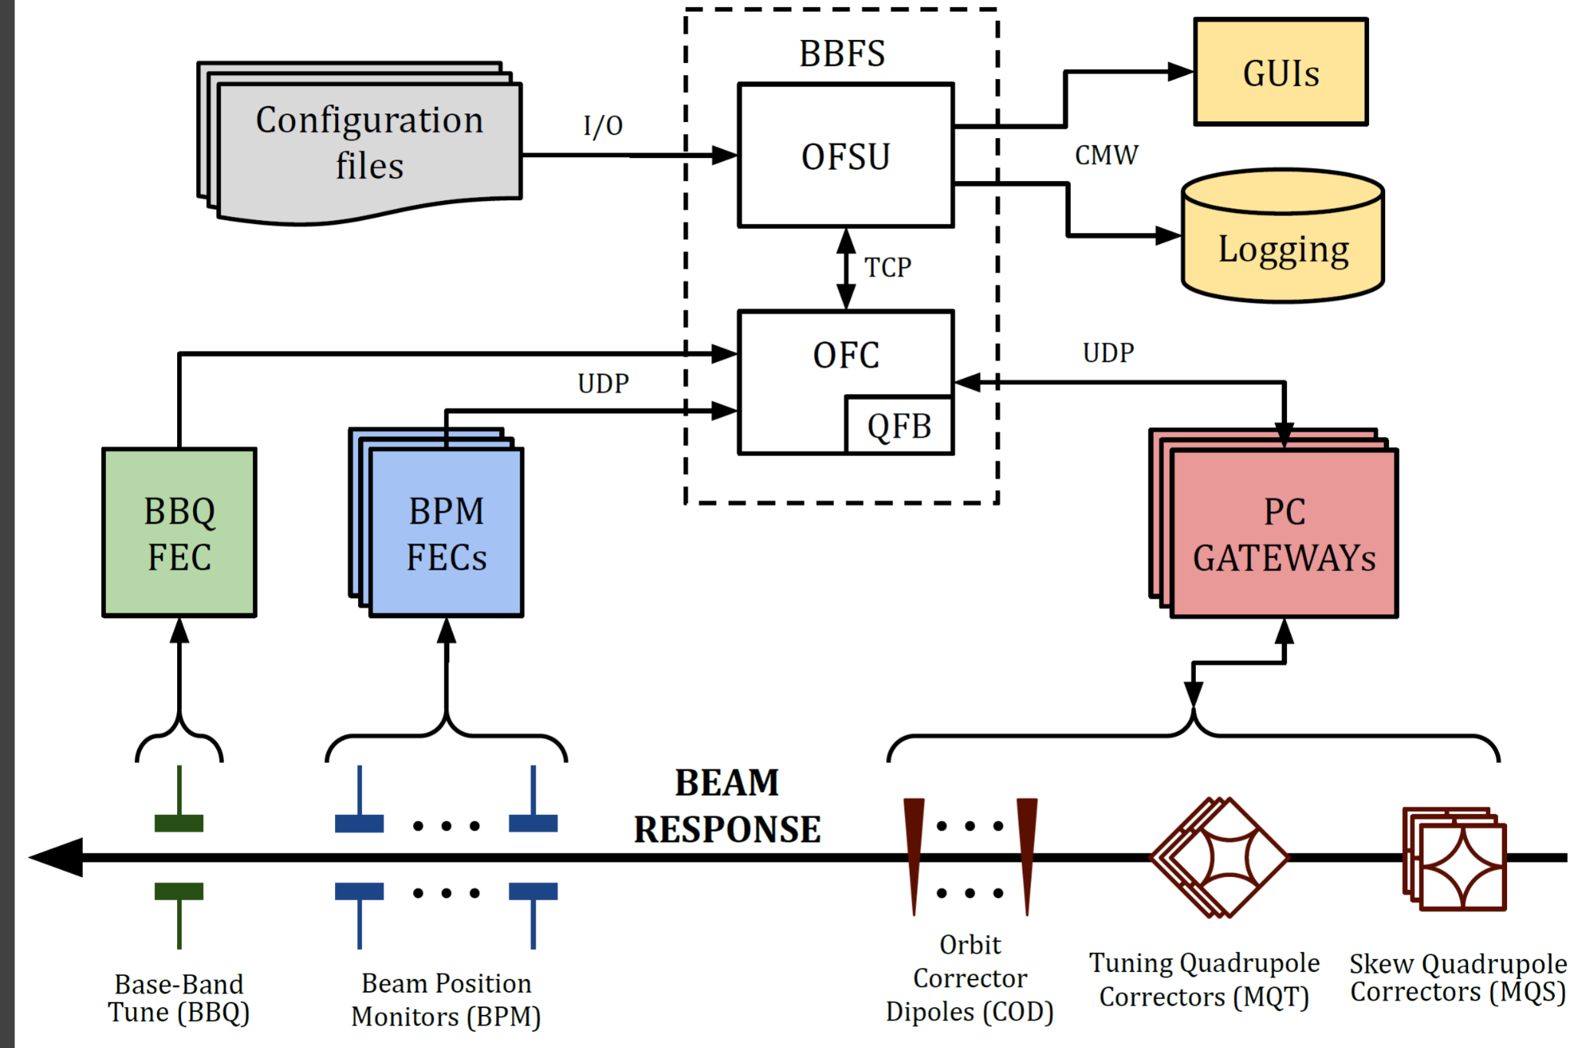
Beam-Based Feedback System (BBFS) II
BBFS was made up of two parts:
  Orbit Feedback Controller (OFC)
  Orbit Feedback Service Unit (OFSU)
BBFS was connected to all BPM Front-End Computers (FECs) and Power Converter (PC) gateways.
Data to and from the BBFS were sent via User Datagram Protocol (UDP) packets
  >150 packets at 25 Hz
  BBQ packet at 12.5 Hz
Orbit Trigger BST signal at 25 Hz

Slide 5
Orbit Feedback
~ 5 mins

Slide 6
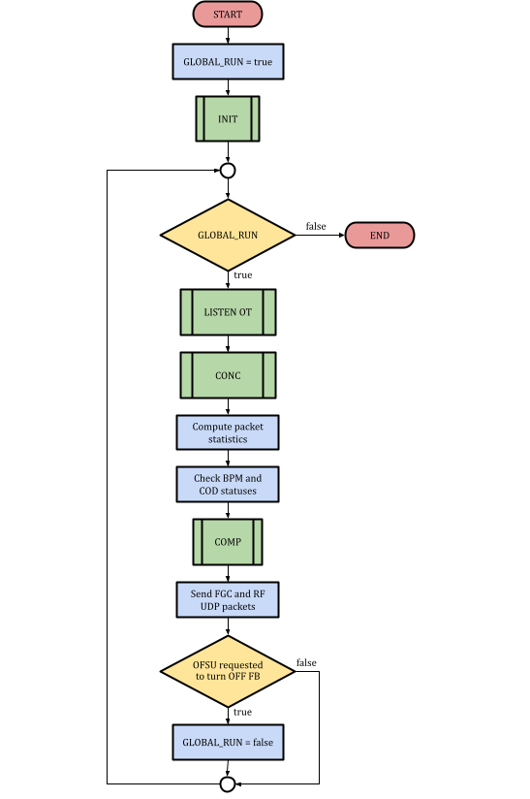
Orbit Feedback Controller (OFC)
The OFC was written in C++ and implemented with ROOT (v5.34) libraries
OFC also contained the Tune Feedback (QFB)
  However was still referred to as OFC
Main loop program:
SEND CORRECTIONS
UDP packets containing magnet current corrections are sent to PC gateways at 25 Hz
UNLOCK LOOP
Orbit Trigger (OT) LHC timing signal at 25 Hz
OFC main loop
COMPUTE CORRECTIONS
Magnet current corrections via linear beam optic models
CONCENTRATE DATA
Incoming UDP packets from BPMs, BBQ and CODs

Slide 7
Orbit Feedback Service Unit (OFSU)
LHC operators did not communicate directly to OFC
BBFS’ design principle was to keep the OFC simple, and delegate other tasks to the OFSU
OFSU was the largest FESA class in the LHC during Run 2
Communicating with GUIs
LHC operators controlled the OFC through many GUIs, e.g. YASP. These GUIs communicated with the OFSU FESA class.
Optics handling
Fetching optics from LSA and recalculation of beam optics model
Post-mortem
Creates post-mortem event with BPM and COD data
Provides API
Low-level interface built with FESA properties was created. Properties were split into two categories, set and get.
OFSU
tasks
Logging
Logging BPM, BBQ and COD data statistics of the OFC. Logging of OFC parameters to CERN database.

Slide 8
Renovation of BBFS → BFCLHC
Nov 2018
RUN 2
Mar 2021
Long Shutdown 2 (LS2)
Nov 2024
RUN 3
Hardware
24 Cores
32 Gb RAM
15 MB cache
Upgraded
Installation of new machines
64 Cores
200 Gb RAM
22 MB cache
Standardised
Merge & simplify >90k lines of code
Multithreaded optics¹ calculations & data concentration
BBFS
OFC
(C++)
OFSU
(FESA)
Software
BFCLHC
(FESA)
QFB
Homogenised
BI-OP tight collaboration
Weekly progress meetings
Monthly global review meetings
Different settings management of refOrbit, optics, gains, etc.
Deprecated functionalities
Playable Functions
Simplified API benefitting from years of LHC operational experience
Operations

Slide 9
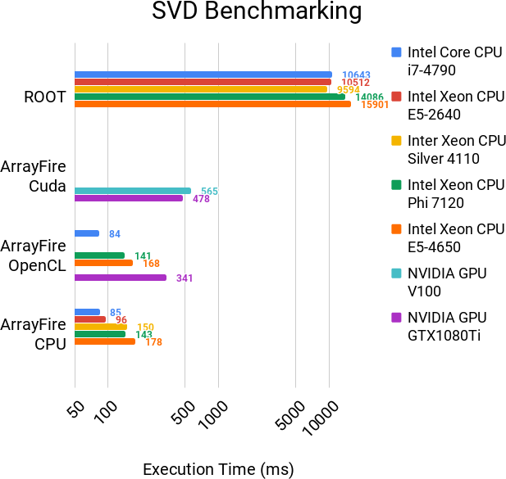
Renovation of BBFS → Hardware Acceleration
Invert linear beam optics model (a.k.a Response Matrix - RM) using Singular Value Decomposition (SVD)
  RM x (COD deflections) = BPM positions
SVD obtained Pseudo-Inverse (PI)
  PI x (BPM positions) = COD deflections
SVD took ~ 10 seconds to invert 1 RM
Can we use Hardware Acceleration (HA)? ¹
Time to transfer data to GPU overshadows code acceleration
Using GPUs is not ideal
Optimises use of CPU cache memory and uses multi-threading
Parallelised CPU execution is better
¹L. Grech, D. Alves, S. Jackson, G. Valentino, and J. Wenninger, “Feasibility of Hardware Acceleration in the LHC Orbit Feedback Controller,” in 17th International Conference on Accelerator and Large Experimental Physics Control Systems (ICALEPCS’19), New York, NY, USA, 05-11 October 2019, 2020, pp. 584–588.

Slide 10
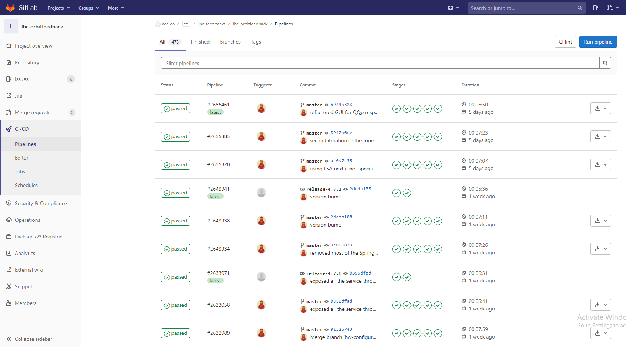

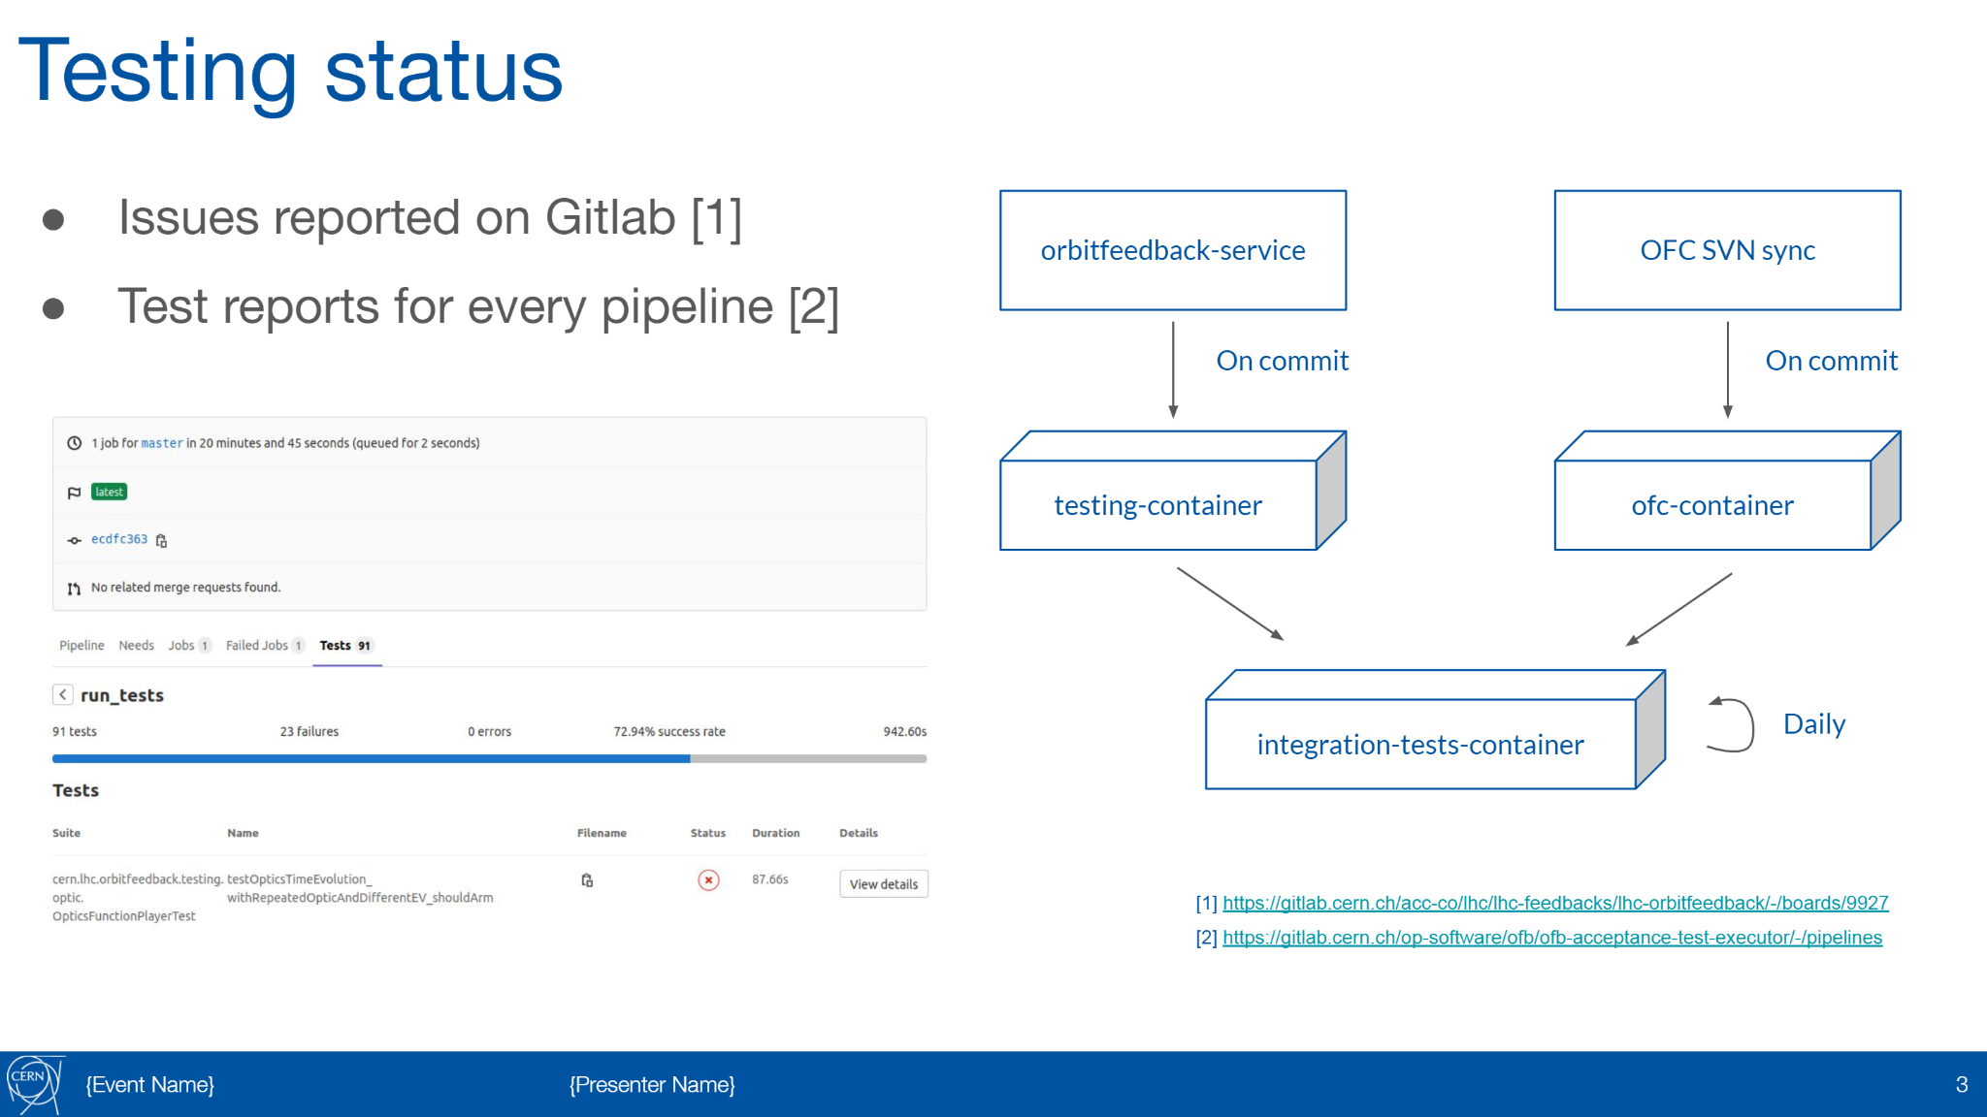



BFCLHC - testing framework ~ 30 seconds
BE-OP-LHC developed a new testing framework for the BFCLHC
  Previous unit test framework developed for Run 2; used as stepping stone
Docker integration
  FESA, CMW and ROOT libraries are added to the container
https://gitlab.cern.ch/acc-co/lhc/lhc-feedbacks/lhc-orbitfeedback/-/pipelines
A. Calia and M. Hostettler, “Sprint 2021.1,” 26-Feb-2021 [Online]. Available: https://gitlab.cern.ch/op-software/ofb/documentation/-/blob/master/Sprint_2021.1_-_OFB_testing_part_2.pdf

Slide 11
Tune estimation and feedback
~ 11 mins

Slide 12
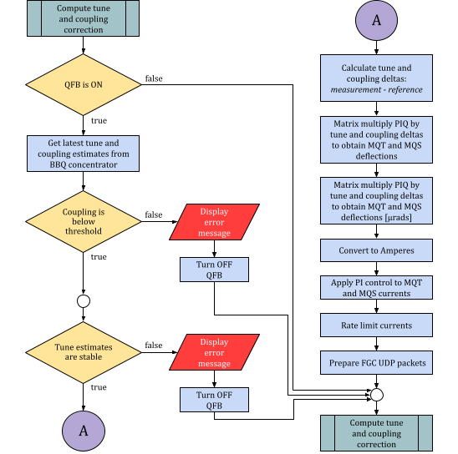
Tune Feedback (QFB)
Uses tune estimates from BBQ system and a linear beam optics model
Current [A] corrections are sent to Tuning Quadrupole Correctors (MQT)
Tune estimate stability measure
  If too unstable, switch off QFB
Until Run 2 QFB was only used intermittently due to its instability

Slide 13
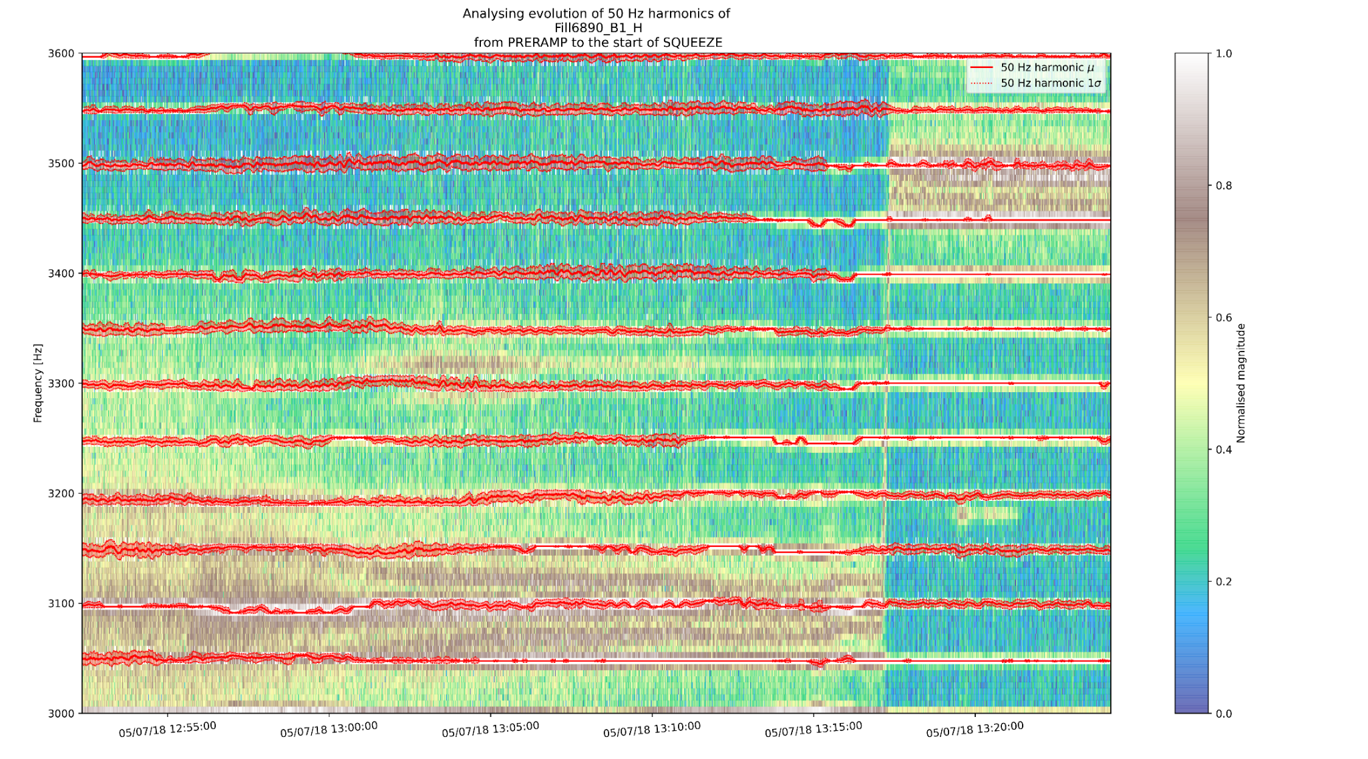
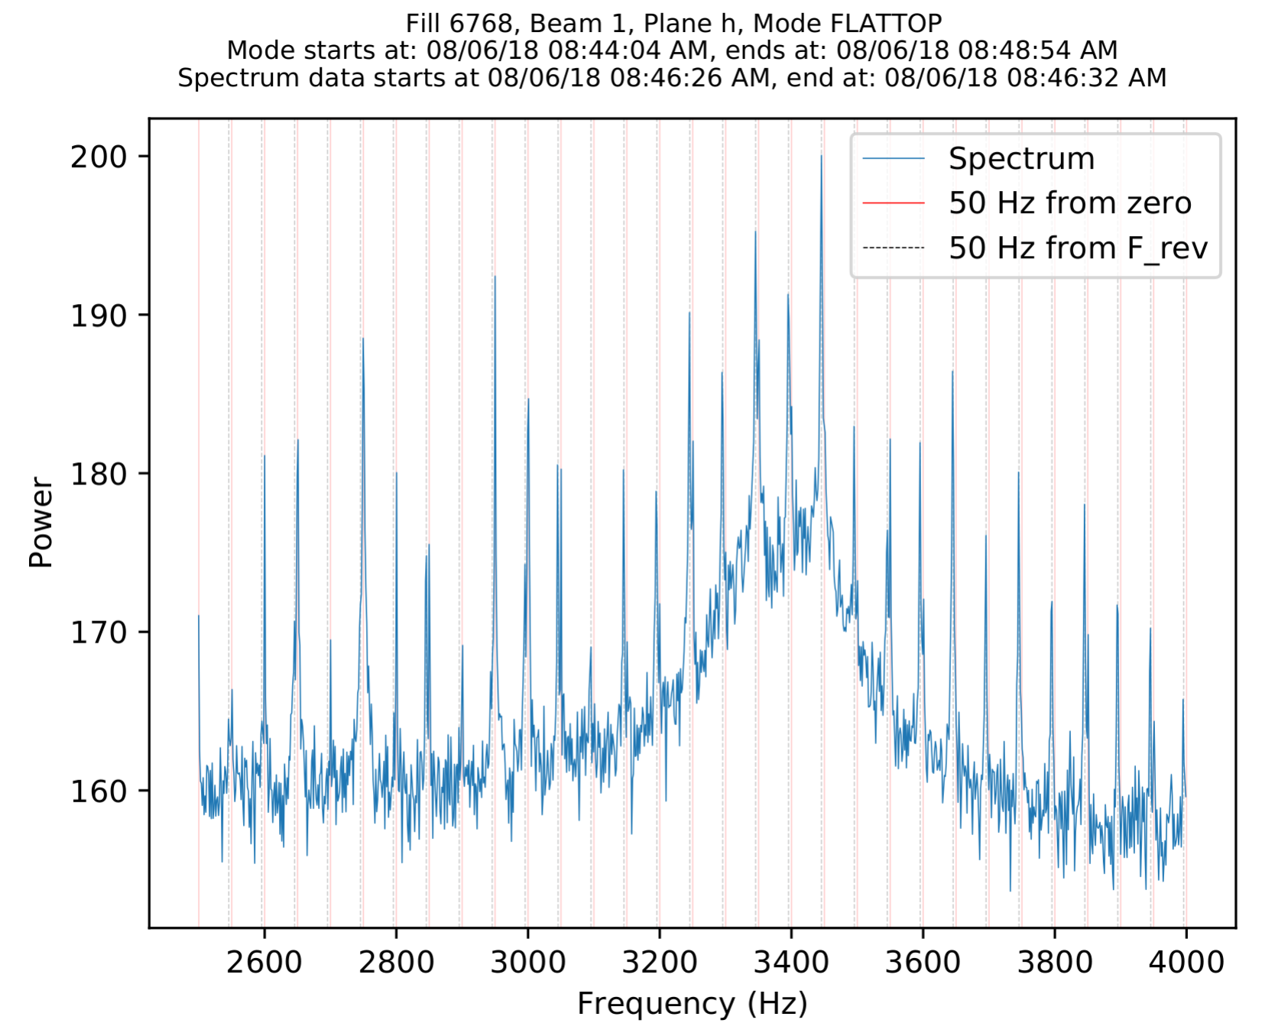
BBQ tune estimation and 50 Hz harmonics
BBQ system samples beam oscillations at revolution frequency (~11kHz)
  FFT of BBQ signal to get a spectrum
  1024 frequency bins
BQ algorithm¹ is used to estimate tune from BBQ spectrum
Since start of LHC, 50 Hz harmonics were observed²
Harmonics manifest as peaks in spectrum
Tracking the evolution of 50 Hz harmonics
¹See backup slide for more details about BQ algorithm
²S. Kostoglou, G. Arduini, L. Intelisano, Y. Papaphilippou, and G. Sterbini, “Origin of the 50 Hz harmonics in the transverse beam spectrum of the Large Hadron Collider,” 29-Feb-2020 [Online]. Available: http://arxiv.org/abs/2003.00140

Slide 14
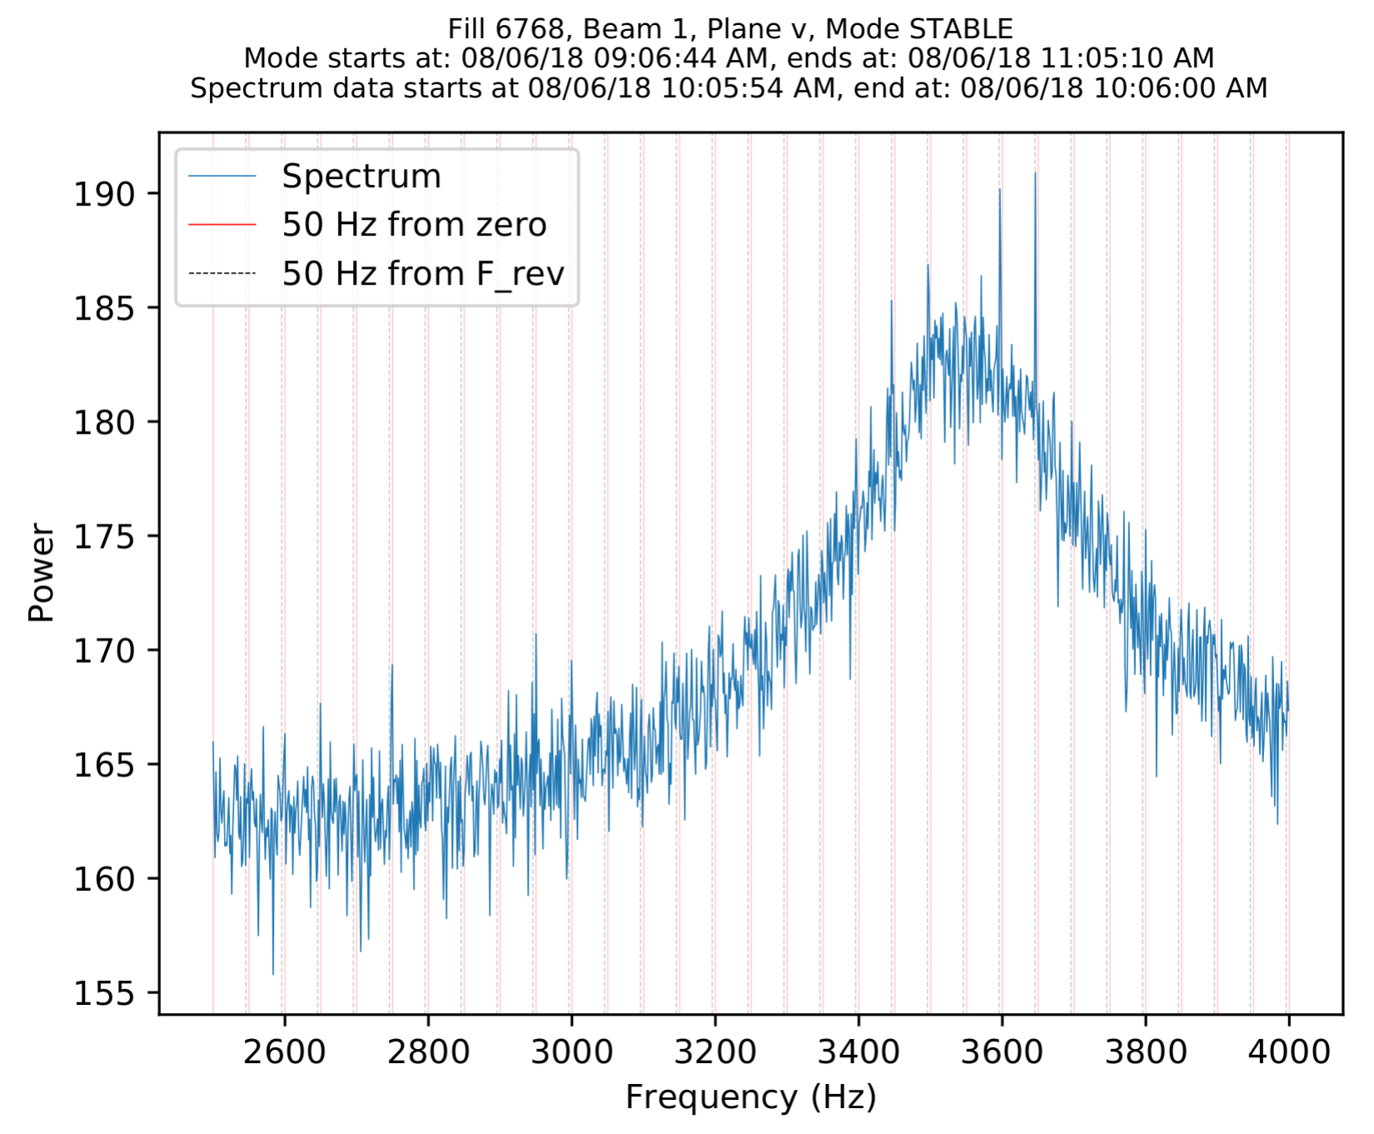
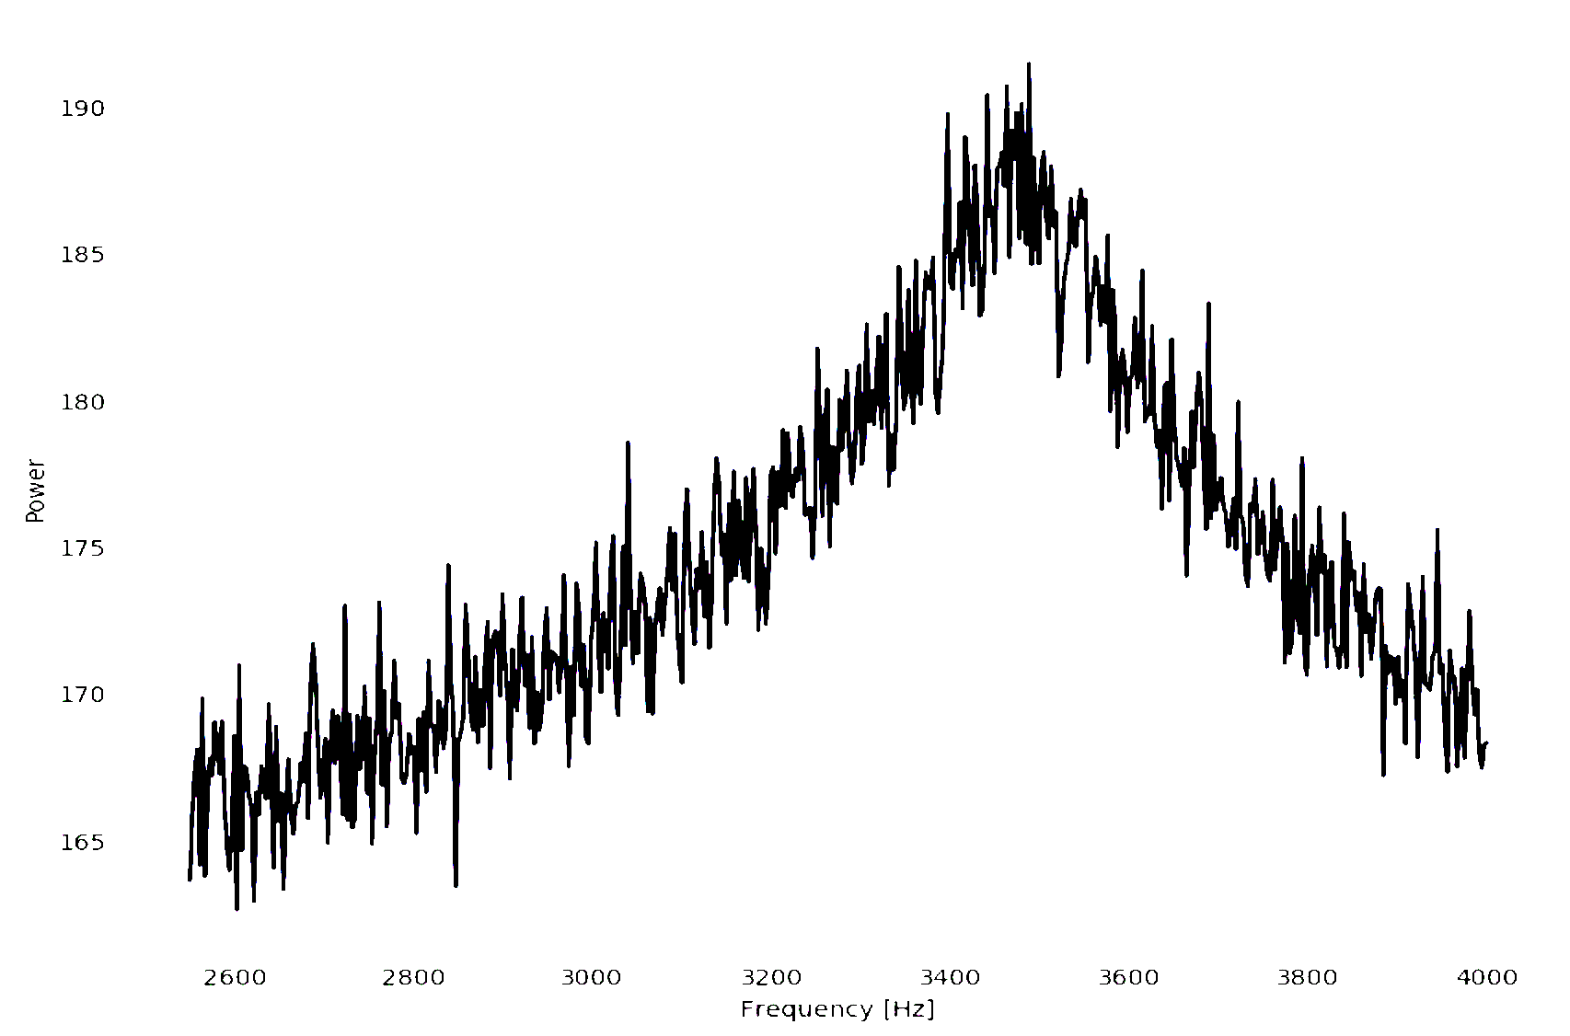
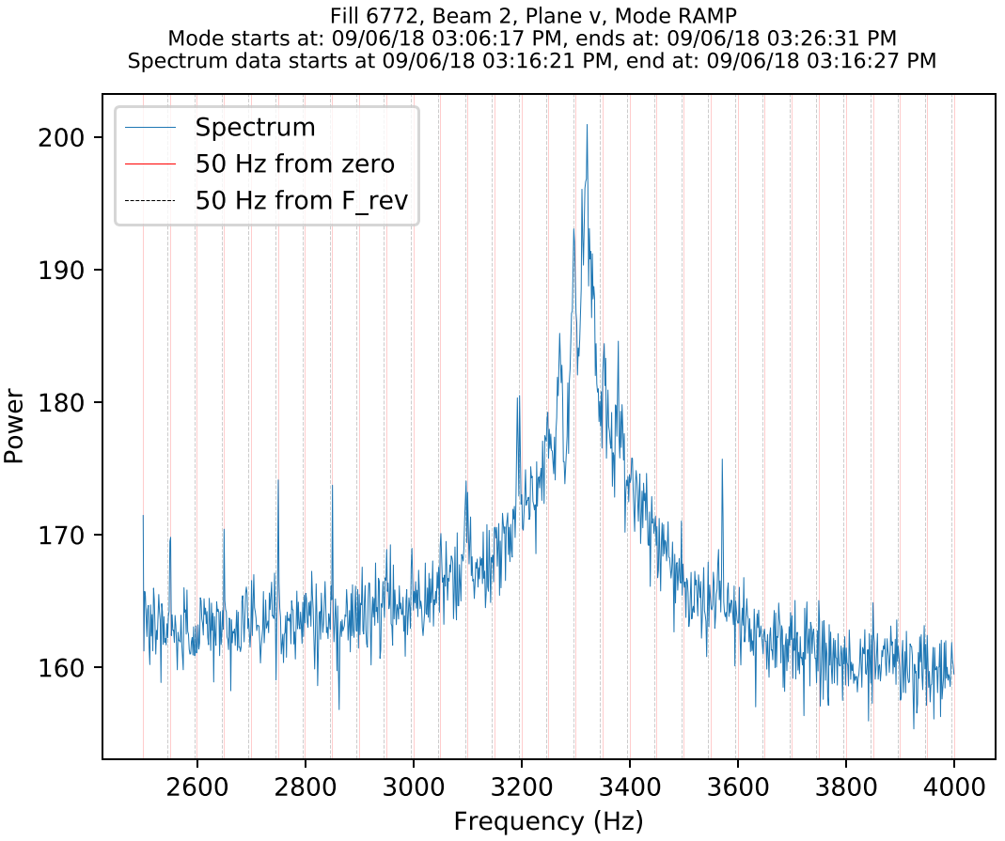
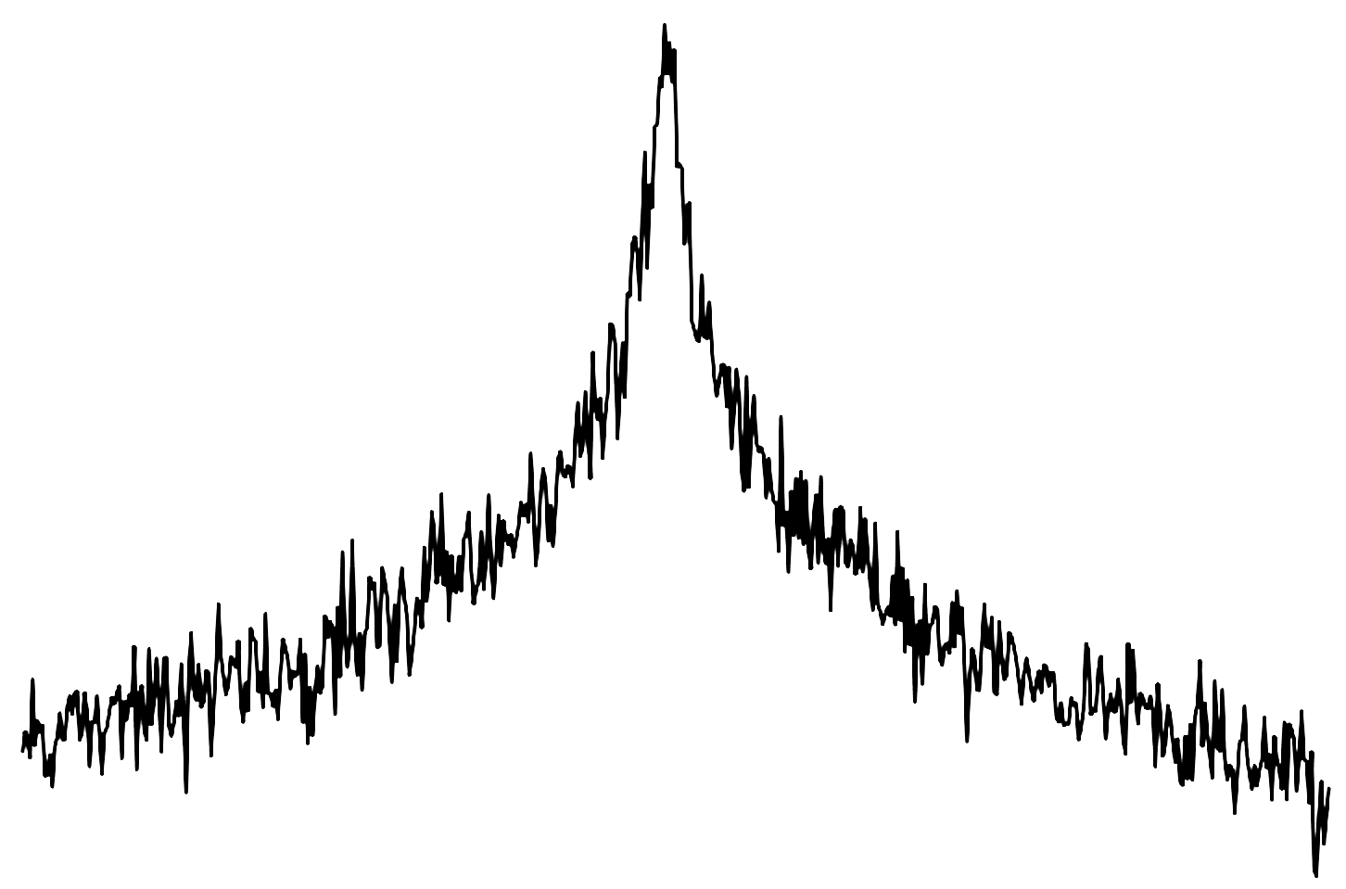
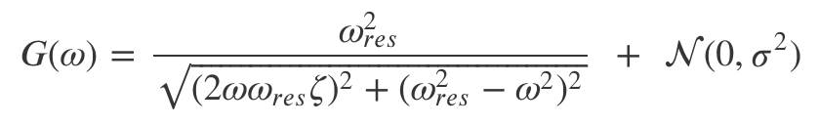

Ground-truth tune value problem
We do not have ground truth tune values for the logged BBQ spectra
2nd order system simulation
Some examples of real spectra:

Slide 15
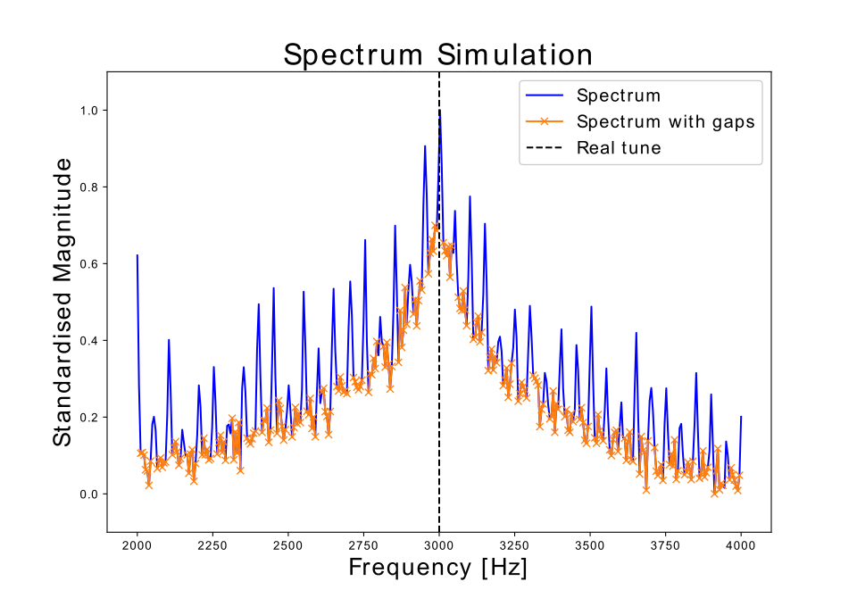
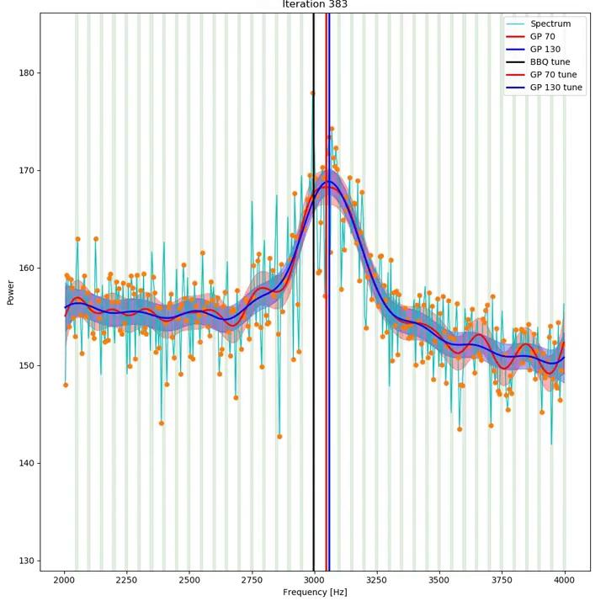
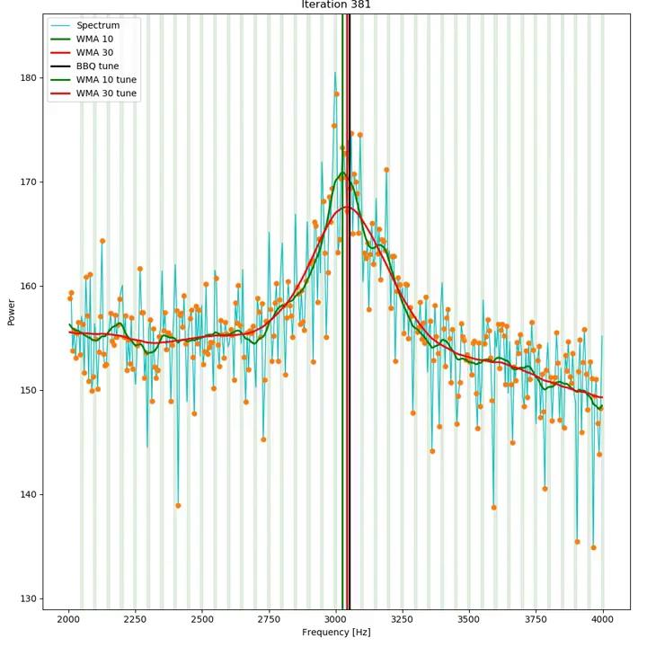
Alternative approach I
Old algorithm (BQ) used BBQ spectrum polluted with 50 Hz harmonics
Harmonics can be removed from BBQ spectra
New algorithms use spectra with gaps
Gaussian Process
Weighted Moving Average

Slide 16
Alternative approach II
Still some problems with alternative approach
  WMA - sensitivity to hyperparameters
  GP - Computationally expensive
  Finicky settings for 50 Hz gaps

Slide 17
Machine Learning approach I
Naive approach: Can we use BBQ spectrum as input to a neural network and BQ estimate as label?
  Model can be either a DNN or a 1D CNN
  However, prediction will not be better than BQ estimates!
Simple approach: We can use simulated spectra
  Ground truth tune available
  Spectra might not be perfectly representative
How do we measure performance on real data?
  Accuracy cannot be measured, but can be compared qualitatively
  Stability measure of QFB is used to compare models

Slide 18
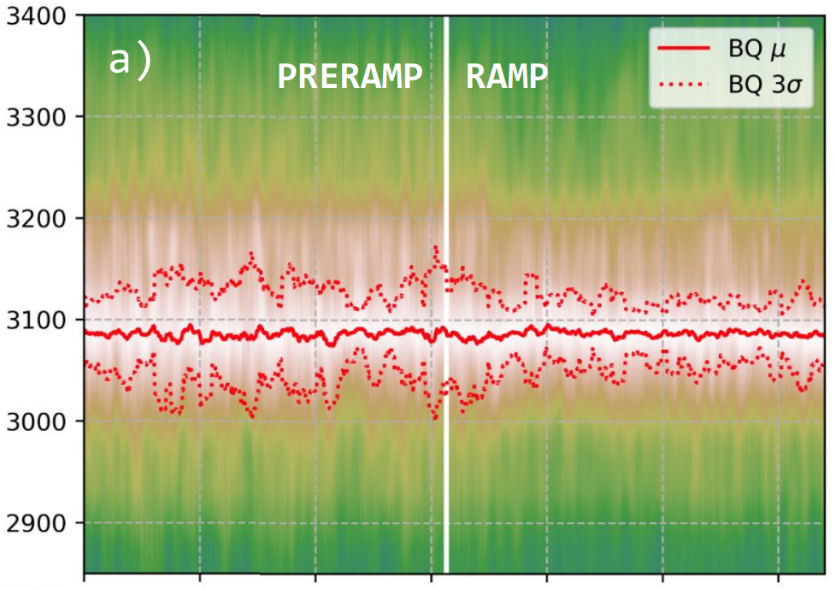
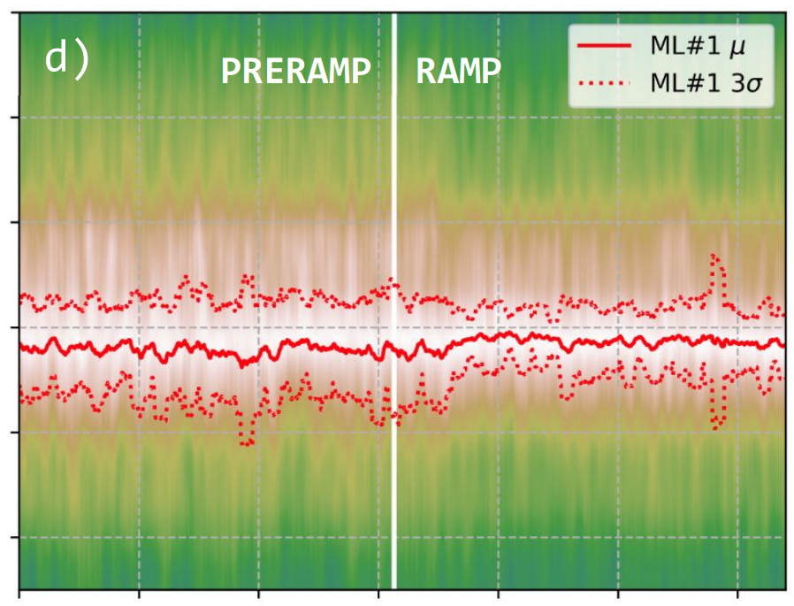
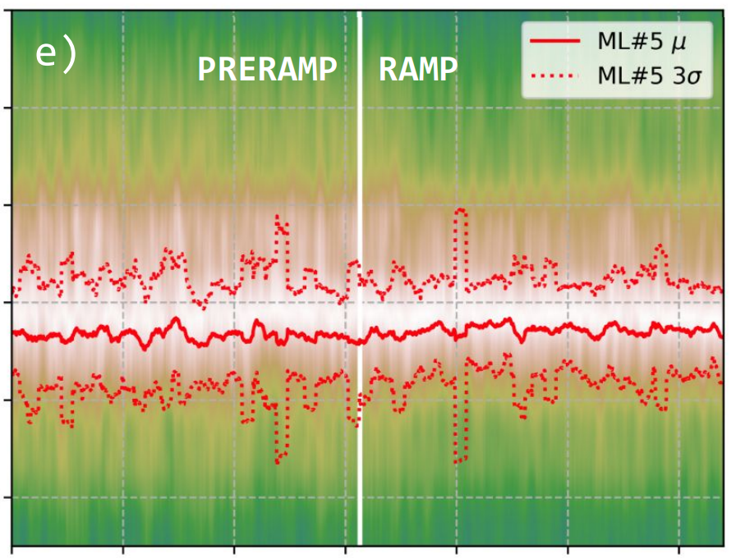
Simple approach
Evaluation on simulated spectra show promising results ...
… but when trying ML#1 and ML#5 on real spectra ...
Same spectra - smoothed in time and frequency
Frequency
Time
Time
Time
… the results are similar to BQ

Slide 19
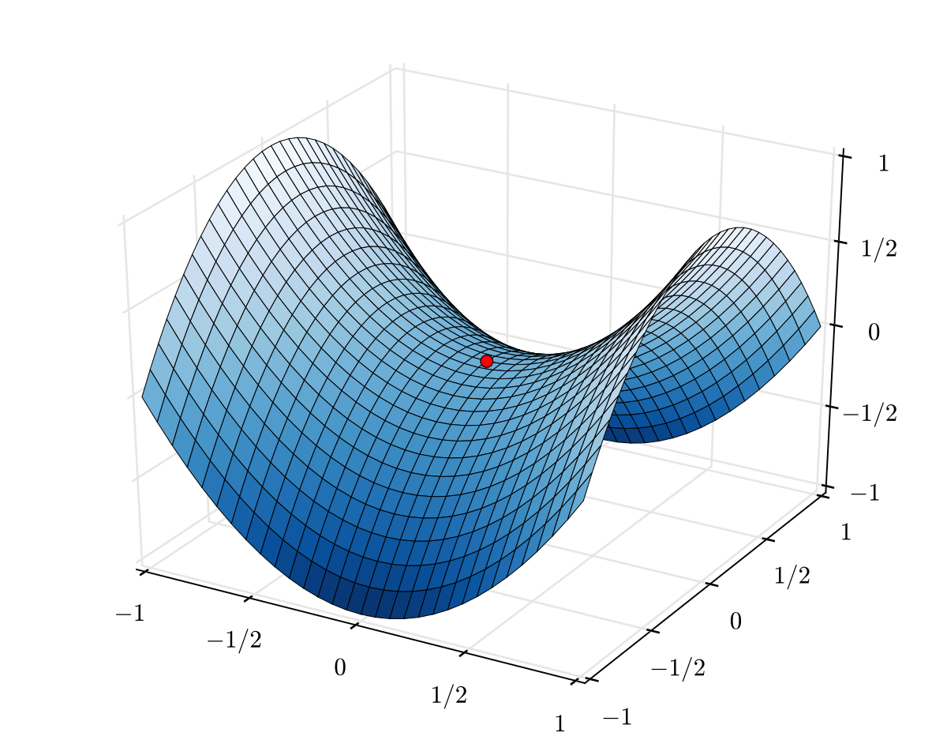
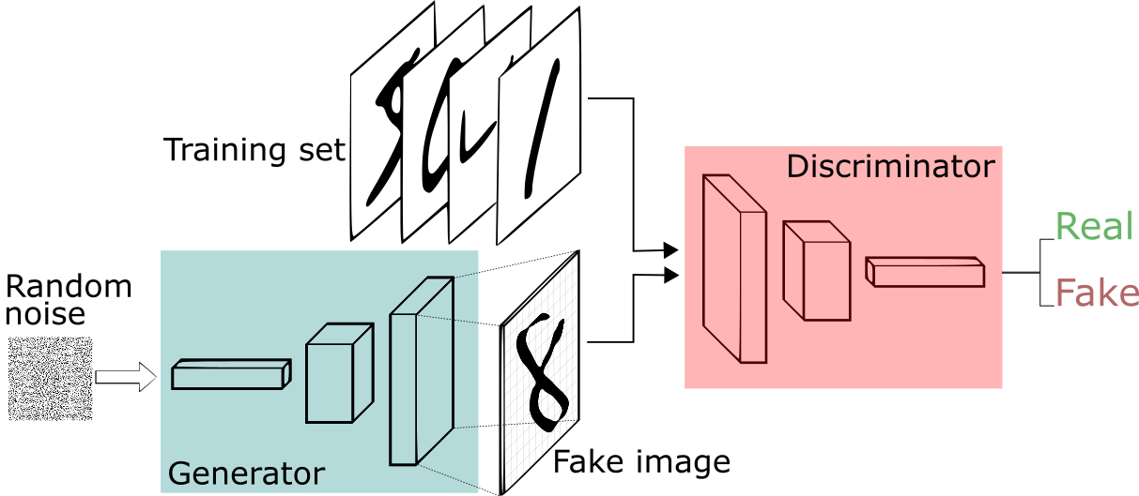
Improving the dataset I
It was known that simulated spectra do not look perfectly real
This affected training
  Models overfit to simulations
We can make the training dataset better by using a type of Generative Adversarial Network (GAN)
Train Generator (G) to create fake images
Train Discriminator (D) to classify real\fake images
Minimax problem
G maximises loss of D
D minimises class. loss

Slide 20
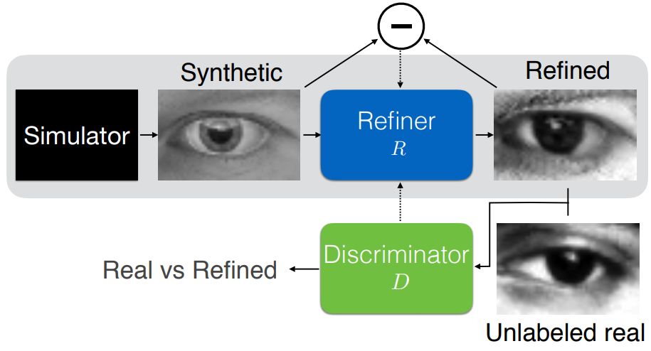
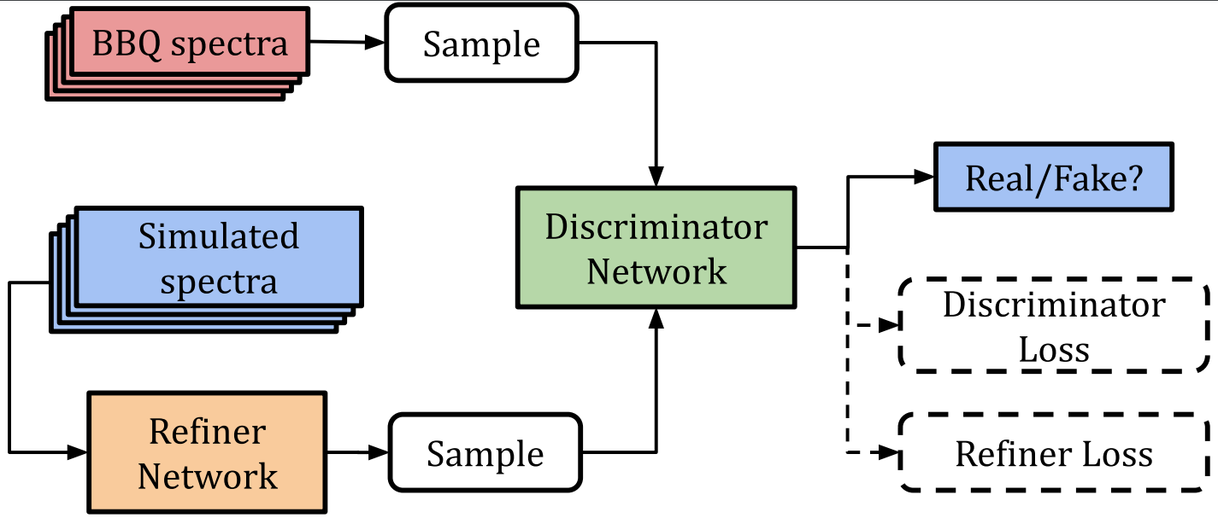
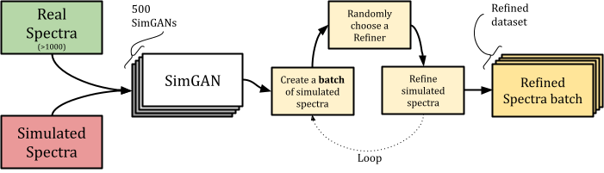
Improving the dataset II
Variant of GAN called SimGAN¹
Applying it to simulated and real BBQ spectra
Slight problem
  1 Refiner is not enough! It can produce similar looking artefacts
Solution
  Train 500 SimGANs with slightly different parameters
¹A. Shrivastava, T. Pfister, O. Tuzel, J. Susskind, W. Wang, and R. Webb, “Learning from simulated and unsupervised images through adversarial training,” in Proceedings of the IEEE conference on computer vision and pattern recognition, Hawaiʻi Convention Center, Honolulu, Hawaii, United States, 2017, pp. 2107–2116.

Slide 21
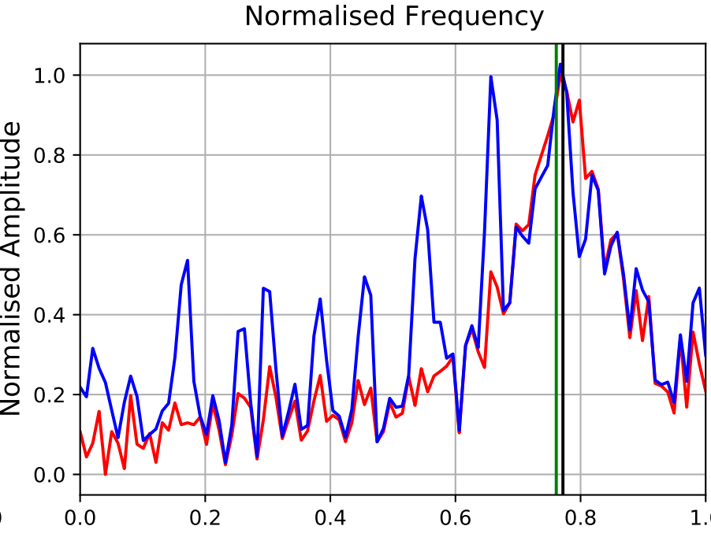
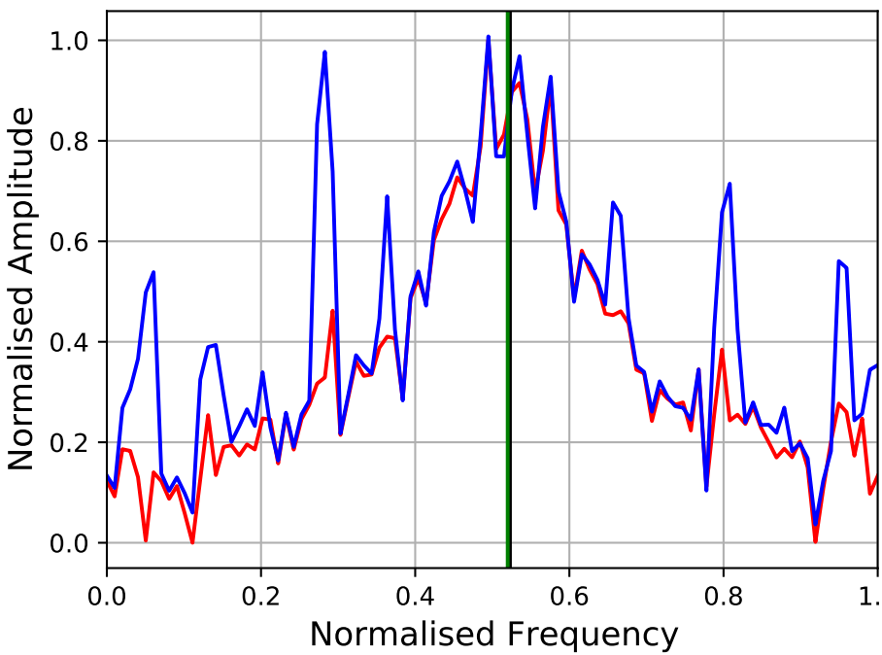
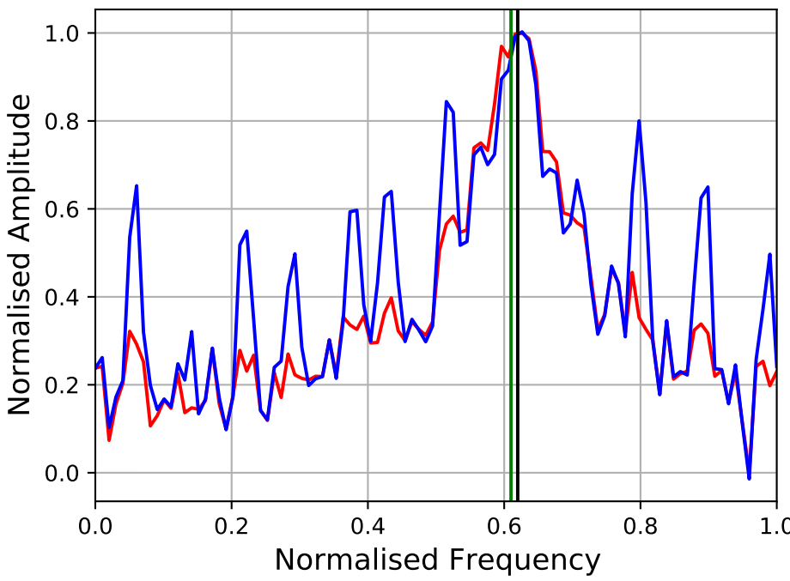
Improving the dataset III
Some examples of refined spectra
  Synthetic = Simulated
Artefacts added by SimGAN Refiner

Slide 22
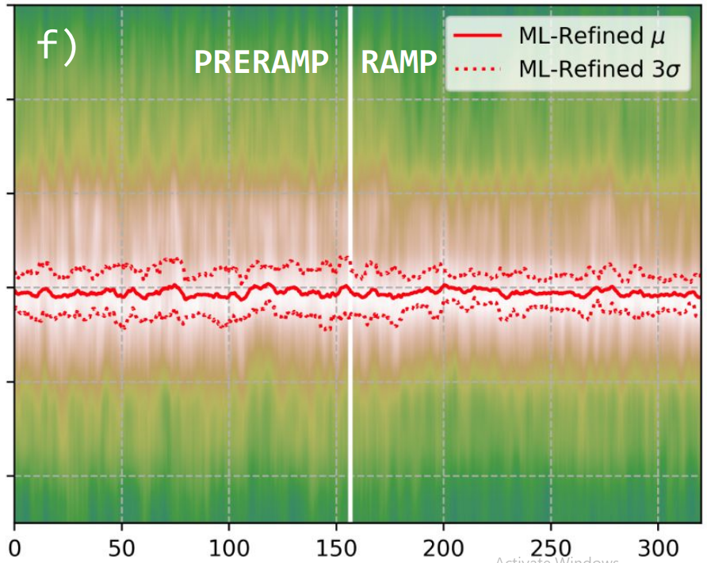
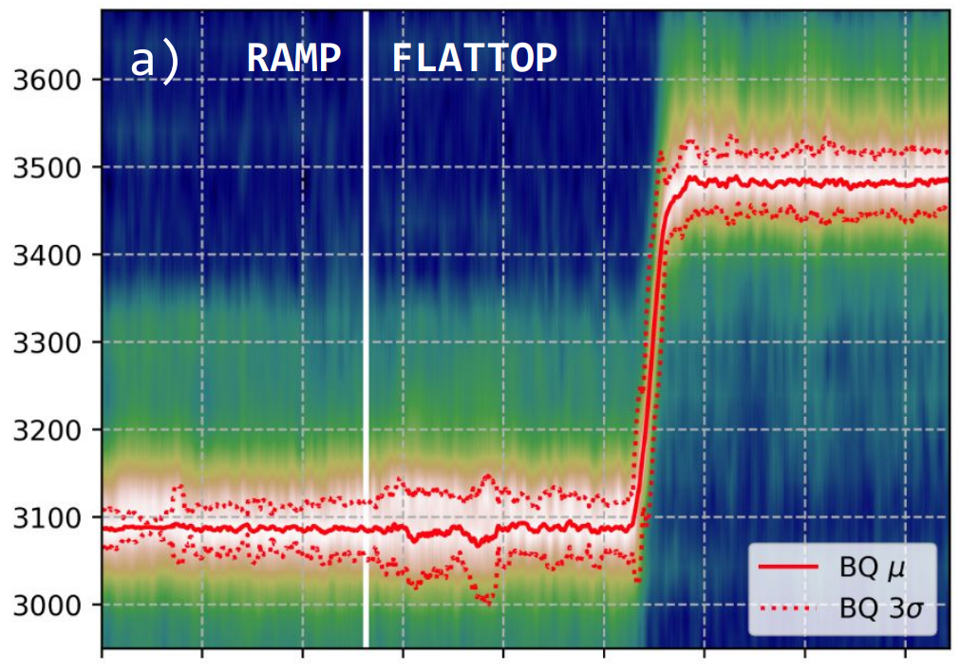
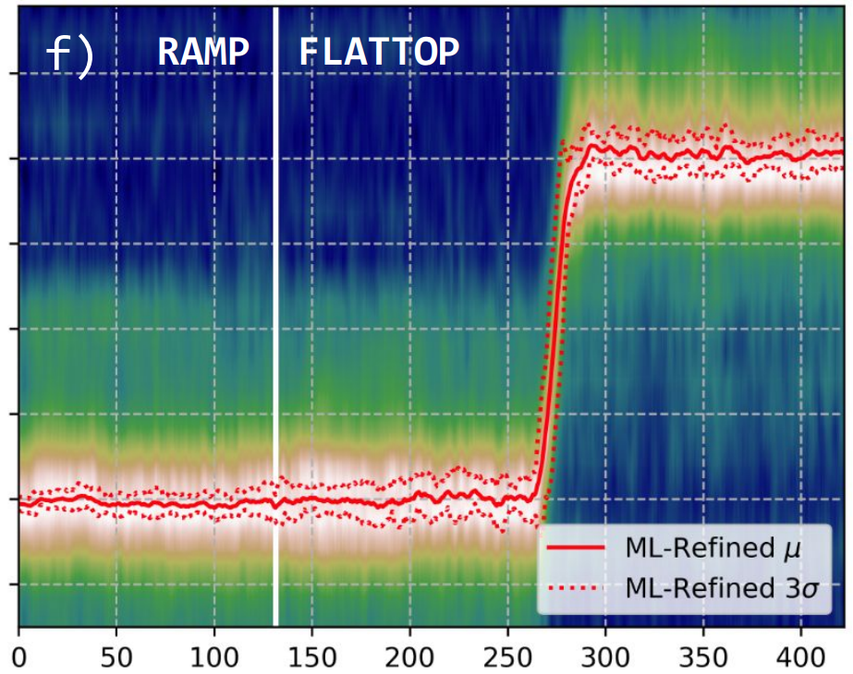
Refined Approach I
Train the best model architecture attempted in Simple Approach (ML#1) with refined dataset - ML-Refined
Frequency
Frequency
Time
Time

Slide 23
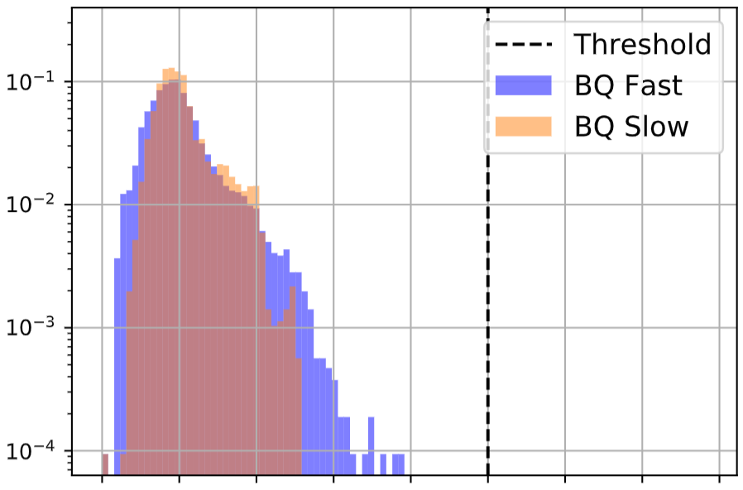
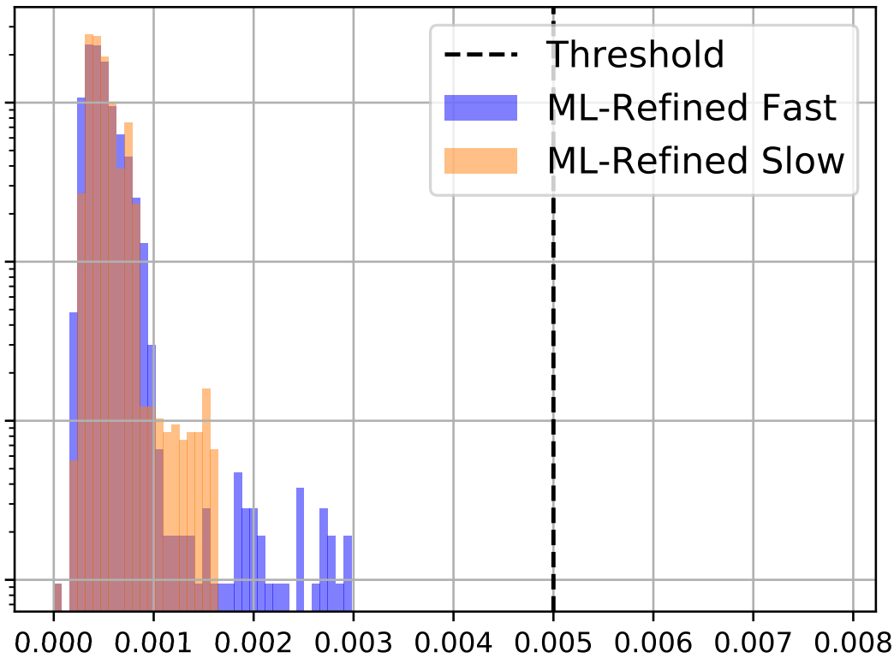

Refined Approach II
What about the QFB stability metric?
Probability
Stability
Stability
ML-Refined gave the most stable estimates from all tune estimation systems attempted

Slide 24
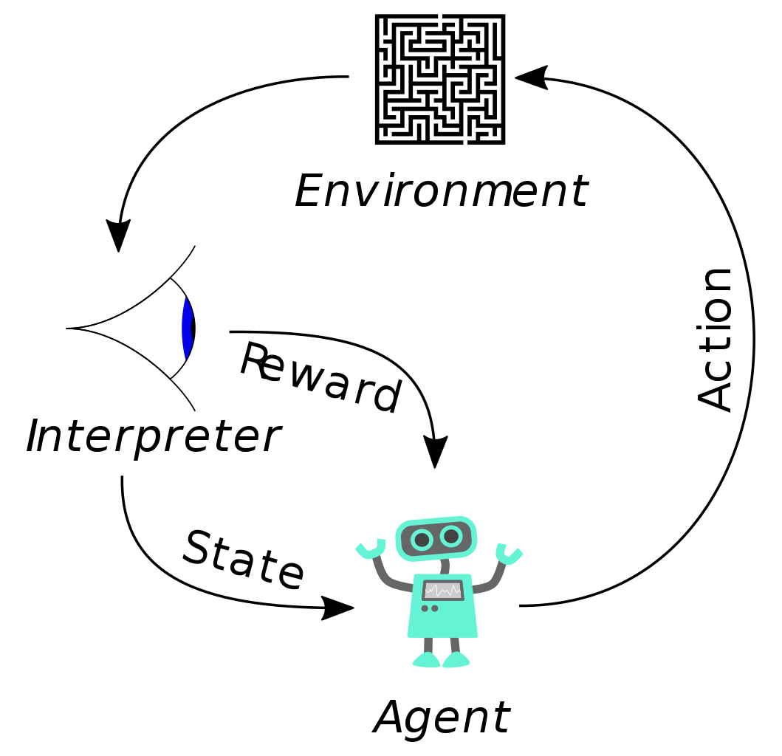

Reinforcement Learning in QFB I
Agent learns a behavioural policy
  Goal: Maximise reward from Environment
Environment in OpenAI Gym
  Linear beam optics model used as simulator
  Reward function:
Type of RL algorithms attempted:
  Proximal Policy Optimisation (PPO) on-policy & model-free
  Normalised Advantage Functions with Double Q-Learning (NAF2) off-policy & model-free
  AE-DYNA-SAC/AE-DYNA-PPO off-policy/on-policy & model-based
  Soft Actor-Critic (SAC) off-policy & model-free
  Twin-Delayed DDPG (TD3) off-policy & model-free

Slide 25
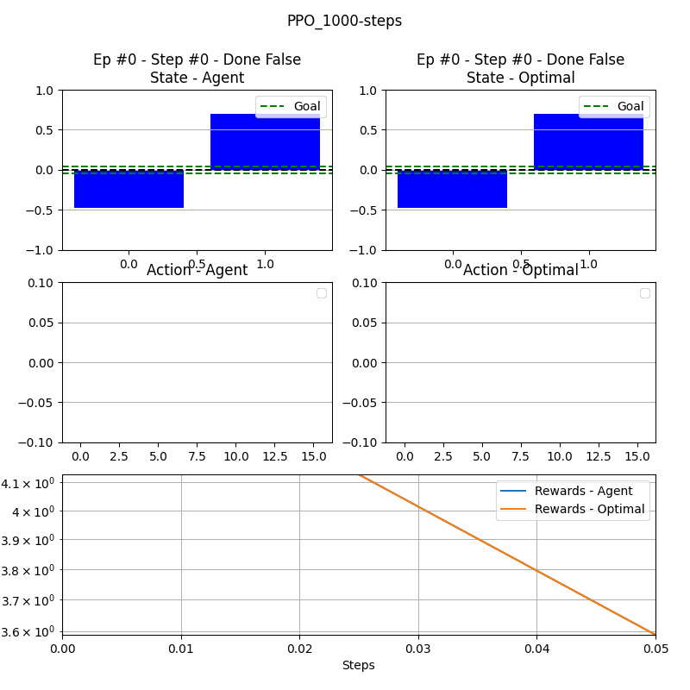


Reinforcement Learning QFB II
GIFs showing PPO vs PI controller
Training progress
After 1000 steps
After 10000 steps
After 100000 steps

Slide 26
Conclusion
List of publications
  L. Grech, D. Alves, S. Jackson, G. Valentino, and J. Wenninger, “Feasibility of Hardware Acceleration in the LHC Orbit Feedback Controller,” in 17th International Conference on Accelerator and Large Experimental Physics Control Systems (ICALEPCS’19), New York, NY, USA, 05-11 October 2019, 2020, pp. 584–588.
  L. Grech et al., “An Alternative Processing Algorithm for the Tune Measurement System in the LHC,” in Proceedings of the 9th International Beam Instrumentation Conference (IBIC 2020), Virtual, 2020.
  L. Grech, G. Valentino, and D. Alves, “A Machine Learning Approach for the Tune Estimation in the LHC,” Information, vol. 12, no. 5, p. 197, Apr. 2021.
Ongoing work
  Analysis of RL QFB results
  Feasibility of RL on Orbit feedback
Future work
  Testing new tune estimation techniques on LHC

Slide 28
Backup slides

Slide 29
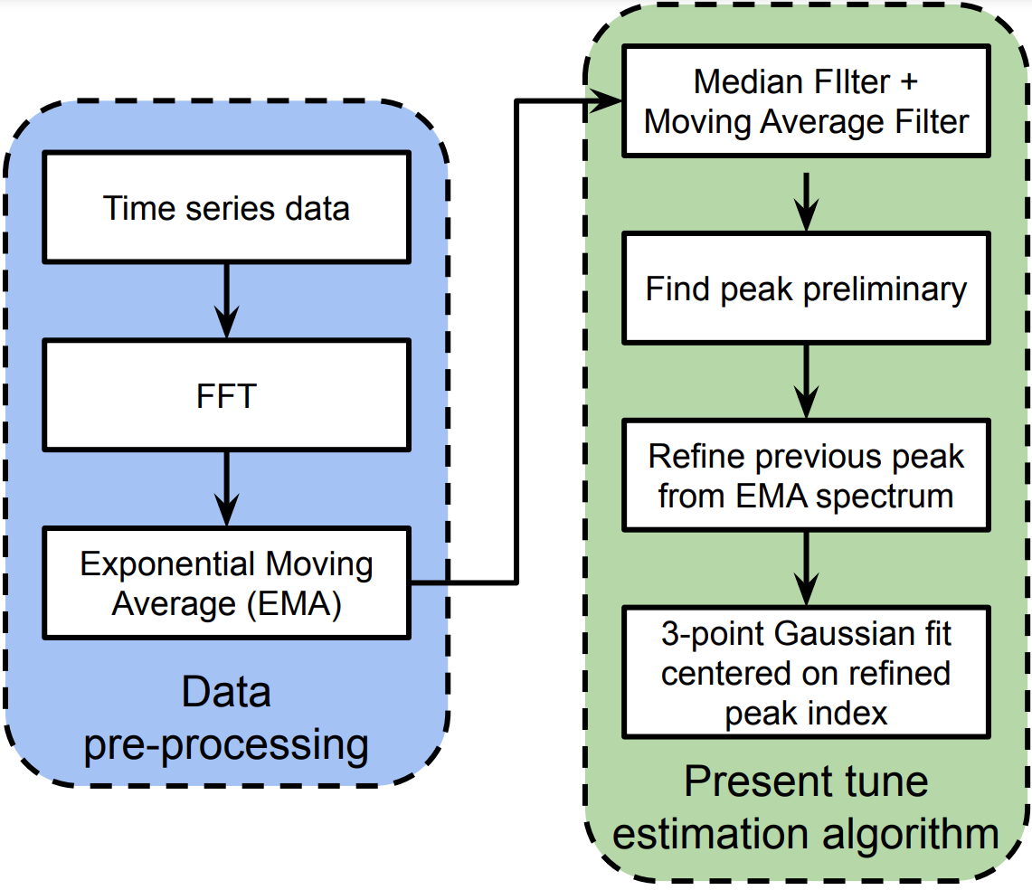
BBQ tune estimation algorithm - BQ
BBQ systems obtains time series data sampled at revolution frequency → ACQ data
Fast Fourier Transform (FFT) 2048 samples of ACQ data → FFT spectrum
  1024 frequency bins
EMA per frequency bin in FFT spectrum over time → EMA spectrum
Median and moving average filters over EMA spectrum → Filtered spectrum
Estimate peak position → Q-coarse
Check Q-coarse on EMA spectrum → Q-refined
Perform 3-point Gaussian fit centered around Q-refined → Q

Slide 30
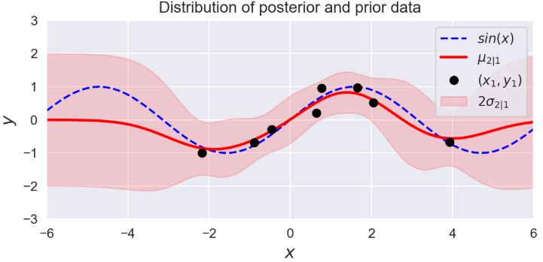
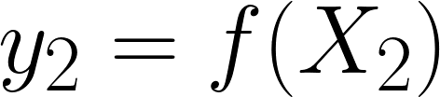
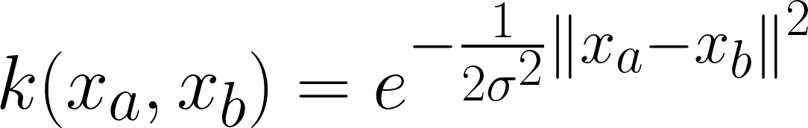
Gaussian Process (GP)
Distribution of functions:
Predict:
Given:
  Previously observed data (X1,Y1)
  A prior function k(Xa,Xb) (aka kernel)
  E.g. RBF (exponentiated quadratic) kernel:
Under these conditions we can parameterize the posterior conditional distribution:

Slide 31
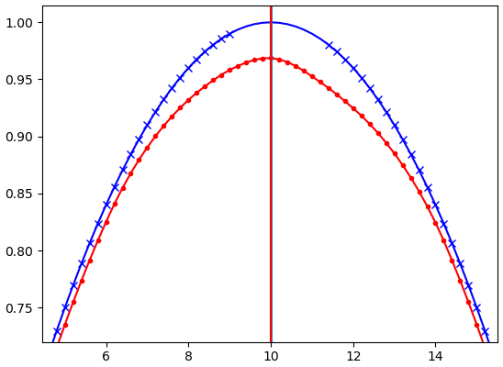
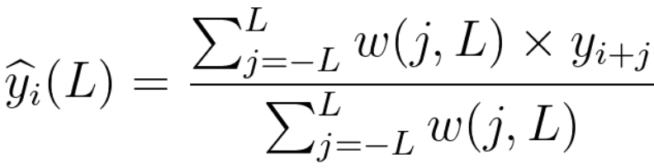
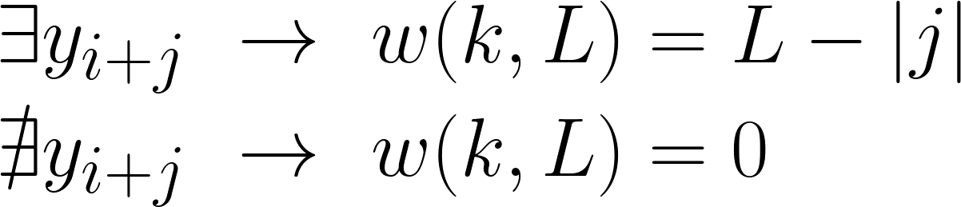
Weighted Moving Average (WMA)
Sinusoid with gaps
Fitted sinusoid
Uses a sliding window of size L:
Handles gaps in data:

Slide 32
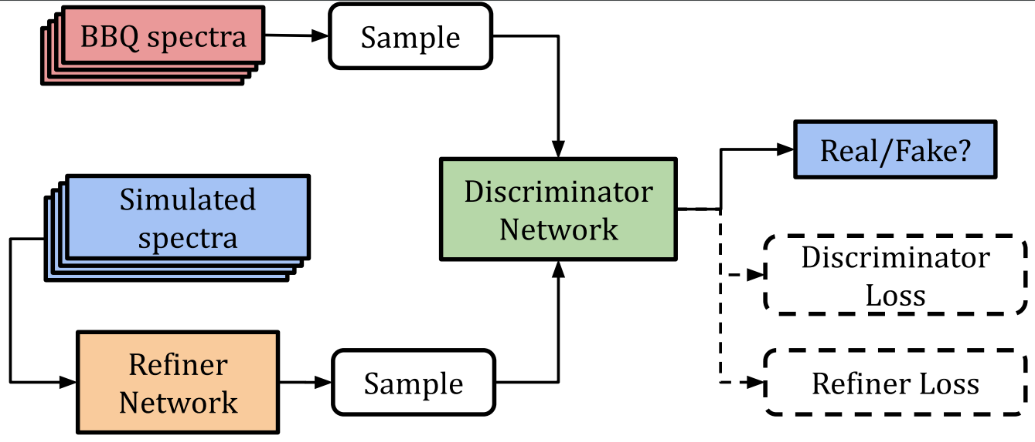
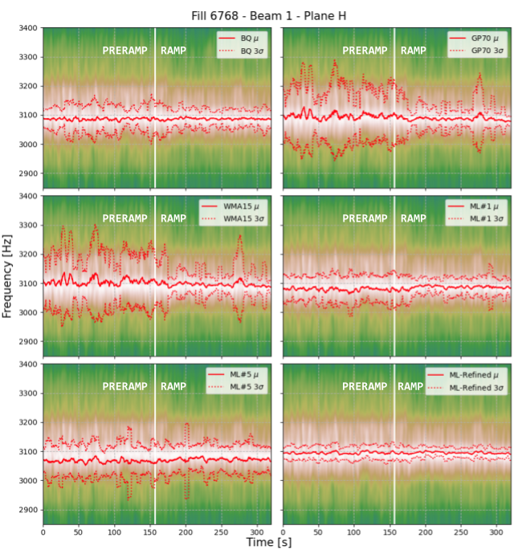
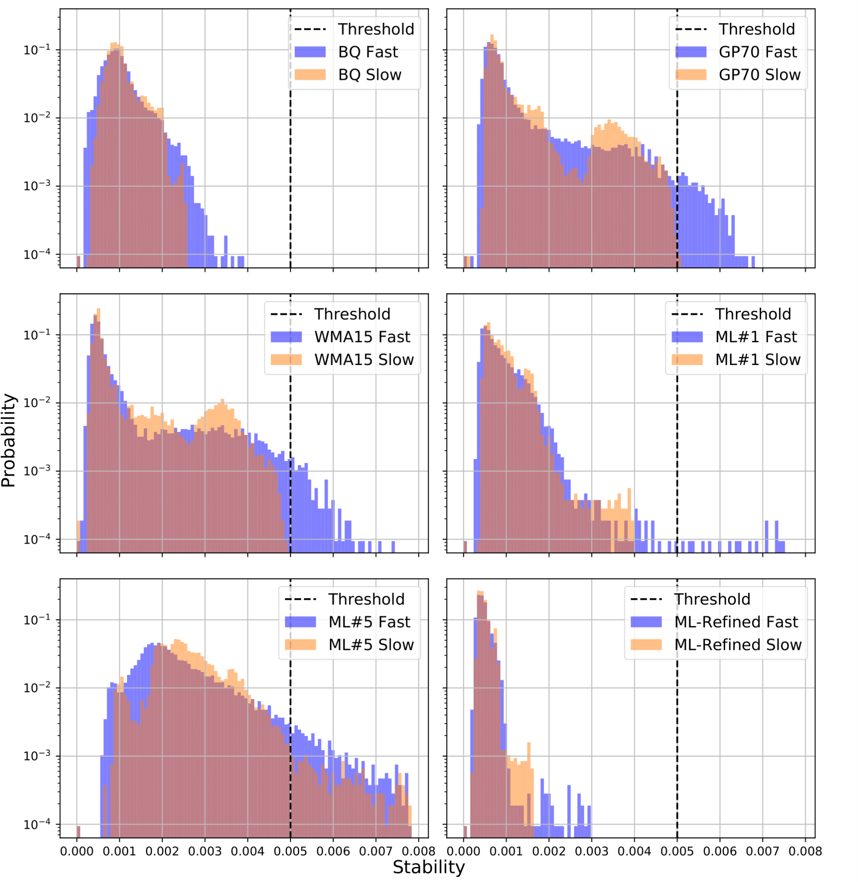
BBQ tune estimation algorithm - ML approach II
SimGAN refines simulated spectra¹
DNN model trained with refined spectra - ML-Refined
SimGAN refines simulation
DNN model trained with refined spectra
  Qualitatively provides most precise tune estimates
  Most stable estimate
¹L. Grech, G. Valentino, and D. Alves, “A Machine Learning Approach for the Tune Estimation in the LHC,” Information, vol. 12, p. 197, 2021.

