Slide 2

CERF
CERN-EU high-energy Reference Field facility
August 2021
M. Silari for the CERF team
HSE-RP

Slide 3
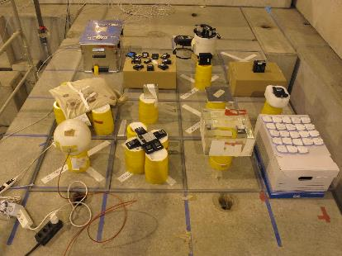
Physics goal
‘Field calibration’ facility for radiation protection instrumentation used at high-energy accelerators
‘Simulated workplace field’ to determine the response of detectors and dosimeters used around high-energy accelerators and for air-crew dosimetry
Several users from universities, research centres, private companies and CERN

Slide 4
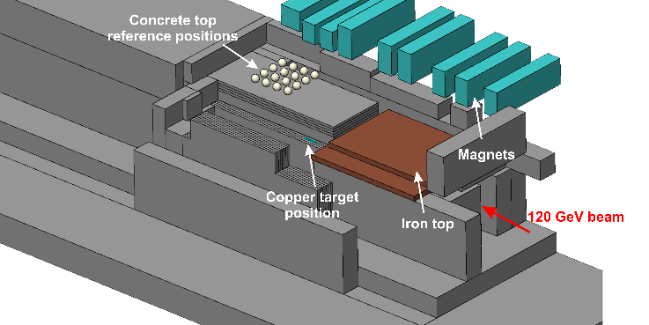
Installation and beam parameters
H6, PPE126
120 GeV/c positive hadron beam (~2/3 pions + 1/3 protons)
Typically 10⁶ - 10⁸ particles per spill

Slide 5
Important for H6 downstream users
Tight time schedule : Short irradiations – many external users from worldwide
(Last run in June 2018: 1 week - 10 teams - around 30 devices tested)
All H6 downstream experimental areas are interlocked during the CERF period
PLEASE DO NOT ACCESS areas downstream of CERF WHEN the BEAM is OFF
(we frequently stop the beam for a short time to allow users to access the irradiation positions, to change their detectors or start/stop measurements)
If you need short access, call us and we will agree on the time:
Marco SILARI 160640 or Fabio POZZI 166258 or Robert FROESCHL 160058

