Slide 1
May 2021
Users Meeting – Installation
Michael Lazzaroni BE-EA-DC

Slide 2
Installation Organization in North Area
Users Installation Coordinator
Michael Lazzaroni
Technical Installation Responsible #1
Sylvain Girod
Technical Installation Responsible #2
Nicolas Perez
Technical Installation Responsible #3
Michael Lazzaroni

Slide 3
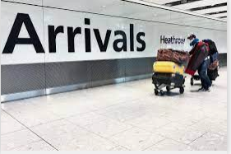
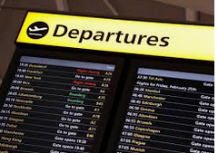

Installation Process
Technical meeting 3-4 weeks prior the experiment installation:
- Technical discussion of your set-up;
- Presentation of our infrastructure;
- Answer your questions;
and give you the maximum support to help you and us to have an efficient installation in our facilities☺
(details in the next slide)
Installation the “D” day :
- Ensure that your equipment are ready to be moved in the EA by the Transport team in the morning (exact hour will be communicated).
- All late requests will be treated at the end of the day (to not disturb the whole installation planning).
De installation at the end of your beam time period:
- Removal of all equipment in the EA and CR the Wednesday ASAP.
- Checkout of the EA and CR with us to be sure that all your equipment have been removed.
Preparation before your arrival
Your arrival in EHN1- Installation
End of your beam time period

Slide 4
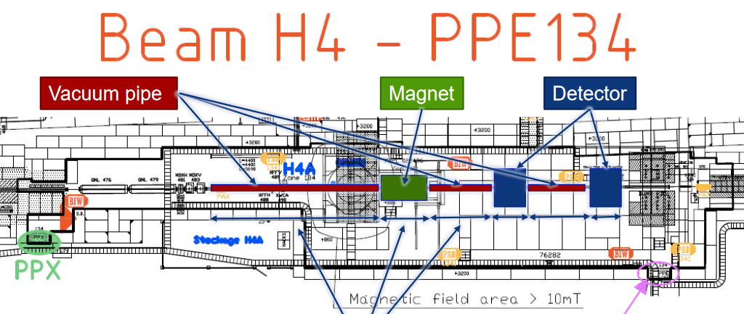
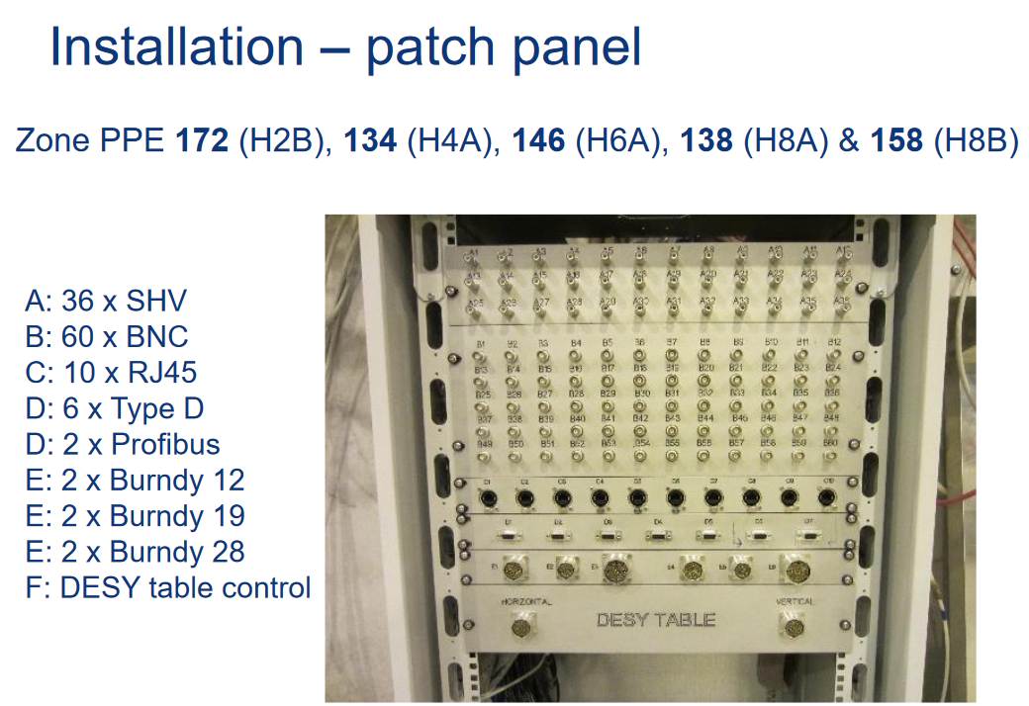
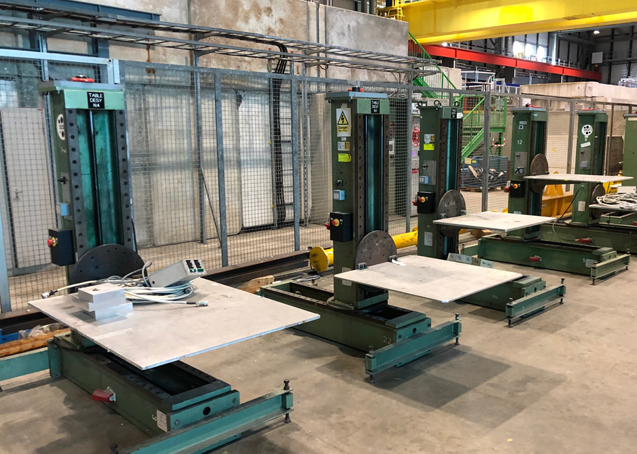
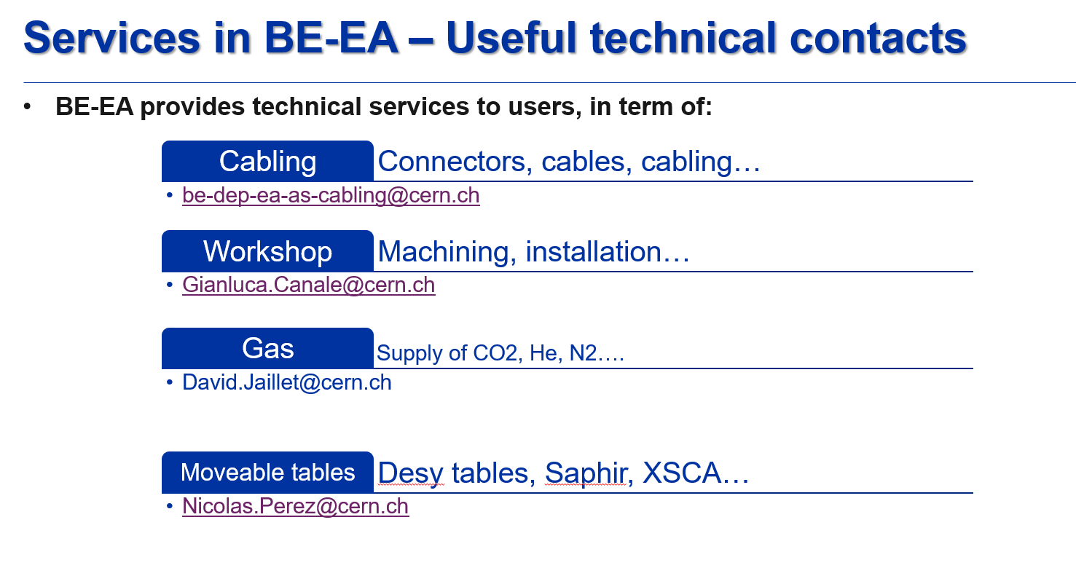
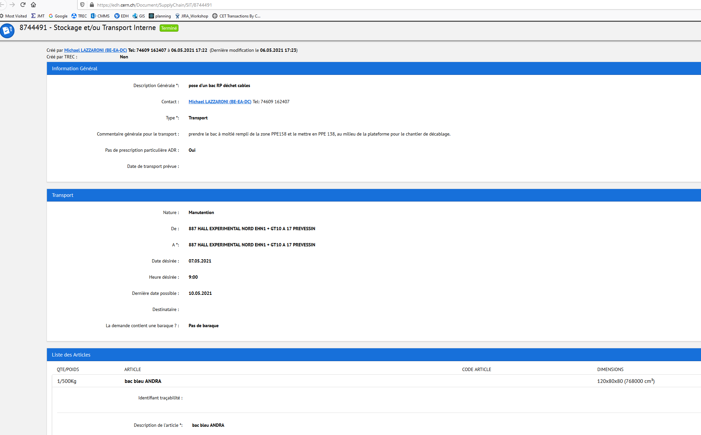
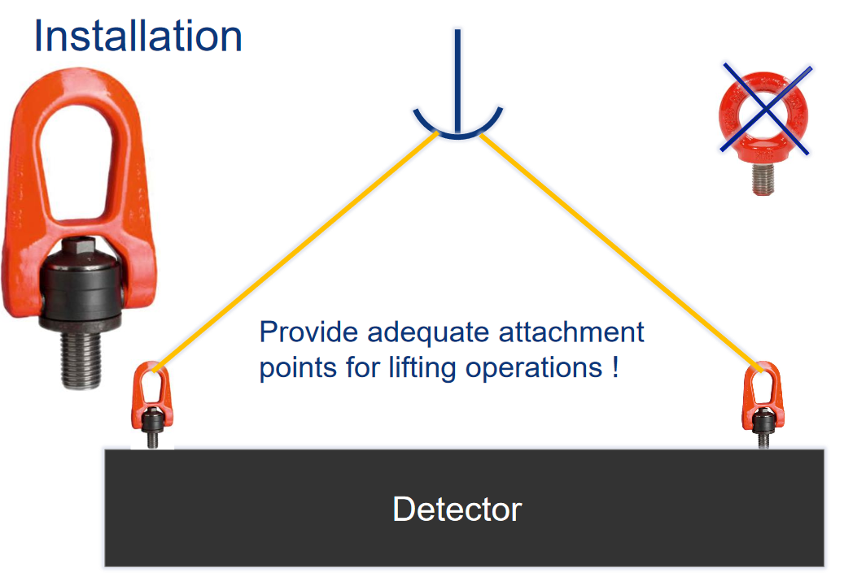
Technical meeting (3-4 weeks prior your installation)
Technical points to discuss concerning your installation:
  Preparation of the zone according your requirements, in term of:
    Beam line configuration (your detectors, vacuum pipes …)
    Cabling, patch panel needs
    Mechanical support for your set-up (DESY tables, concrete blocks…)
    General Services: electrical power needs…
    Technical services provided by BE-EA
    Gas (Reminder : make your gas request ASAP to David Jaillet)
  Preparation of your arrival:
    Quantity of material (storage place)
    How to prepare “transport request” via EDH to unload your material
    CERN requirements to handle your material safely

Slide 5
Thanks for your attention!

Slide 6
Services in BE-EA – Useful technical contacts
BE-EA provides technical services to users, in term of:
Cabling
Connectors, cables, cabling…
be-dep-ea-as-cabling@cern.ch
Gianluca.Canale@cern.ch
Moveable tables
Workshop
Machining, installation…
Desy tables, Saphir, XSCA…
Nicolas.Perez@cern.ch
Gas
David.Jaillet@cern.ch
Supply of CO2, He, N2….

