Slide 1
SPS User Meeting - Medipix
Benedikt Bergmann

Slide 2
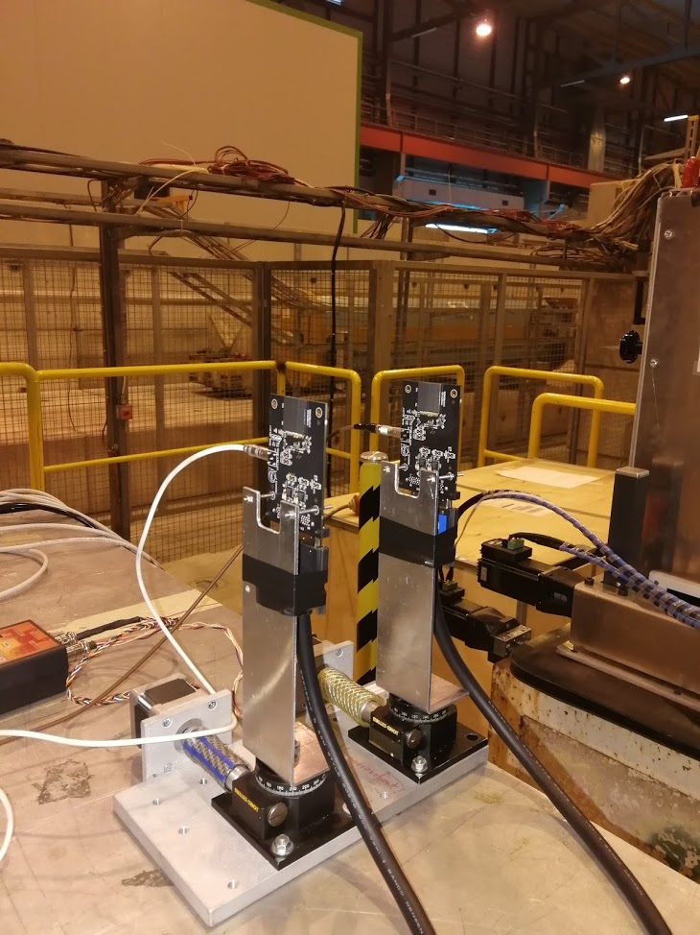
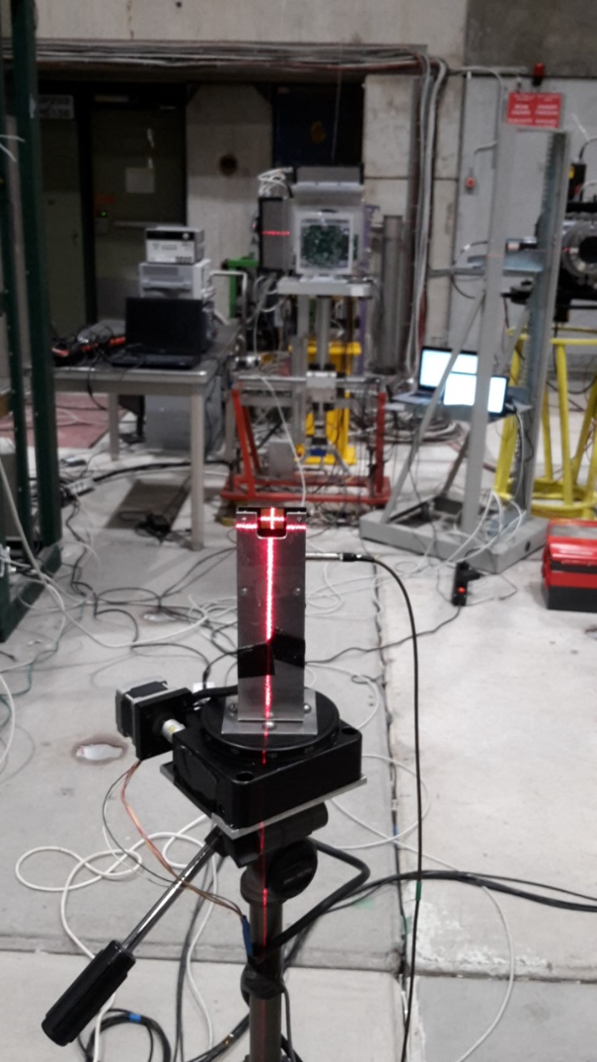
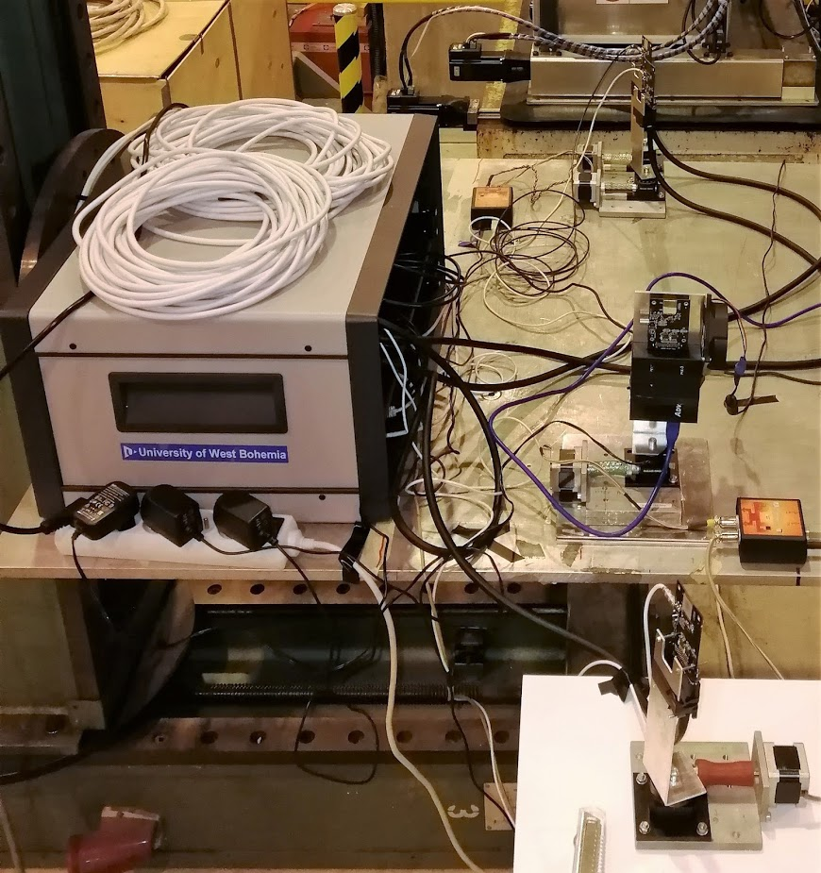
Setup
Timepix3 detectors with different sensor materials (3D, GaAs:Cr, ...)
Timepix3 based detector for space application
Timepix4 R/O system
ATLAS-TPX3 device

