Slide 1

PICSEL / RD21
M. Deveaux, GSI (presenter)

Slide 2
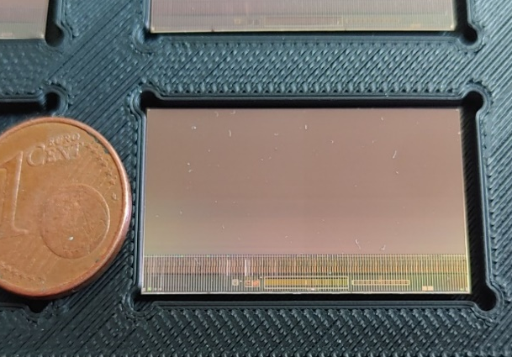
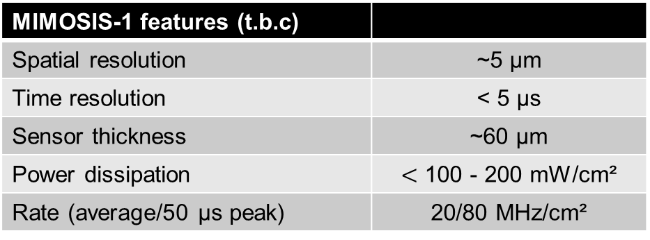
Scientific goal / Device under test
MIMOSIS-1 features (t.b.c)
Spatial resolution | ~5 µm
Time resolution | < 5 µs
Sensor thickness | ~60 µm
Power dissipation | $<$ 100 - 200 mW/cm²
Rate (average/50 µs peak) | 20/80 MHz/cm²
Users: FAIR / CBM (RD21), CERMLIN+
Scientific goals:
Measure detection efficiency for m.i.p.
Measure spatial resolution.
… as function of radiation doses, various system parameters.
Beam requirements:
Resonably stiff (> 100 GeV/c strongly preferred).
Muons, pions, any polarity, 10³-10⁵ / cm² and spill.
T4/H6 routinely used and found appropriate.

Slide 3
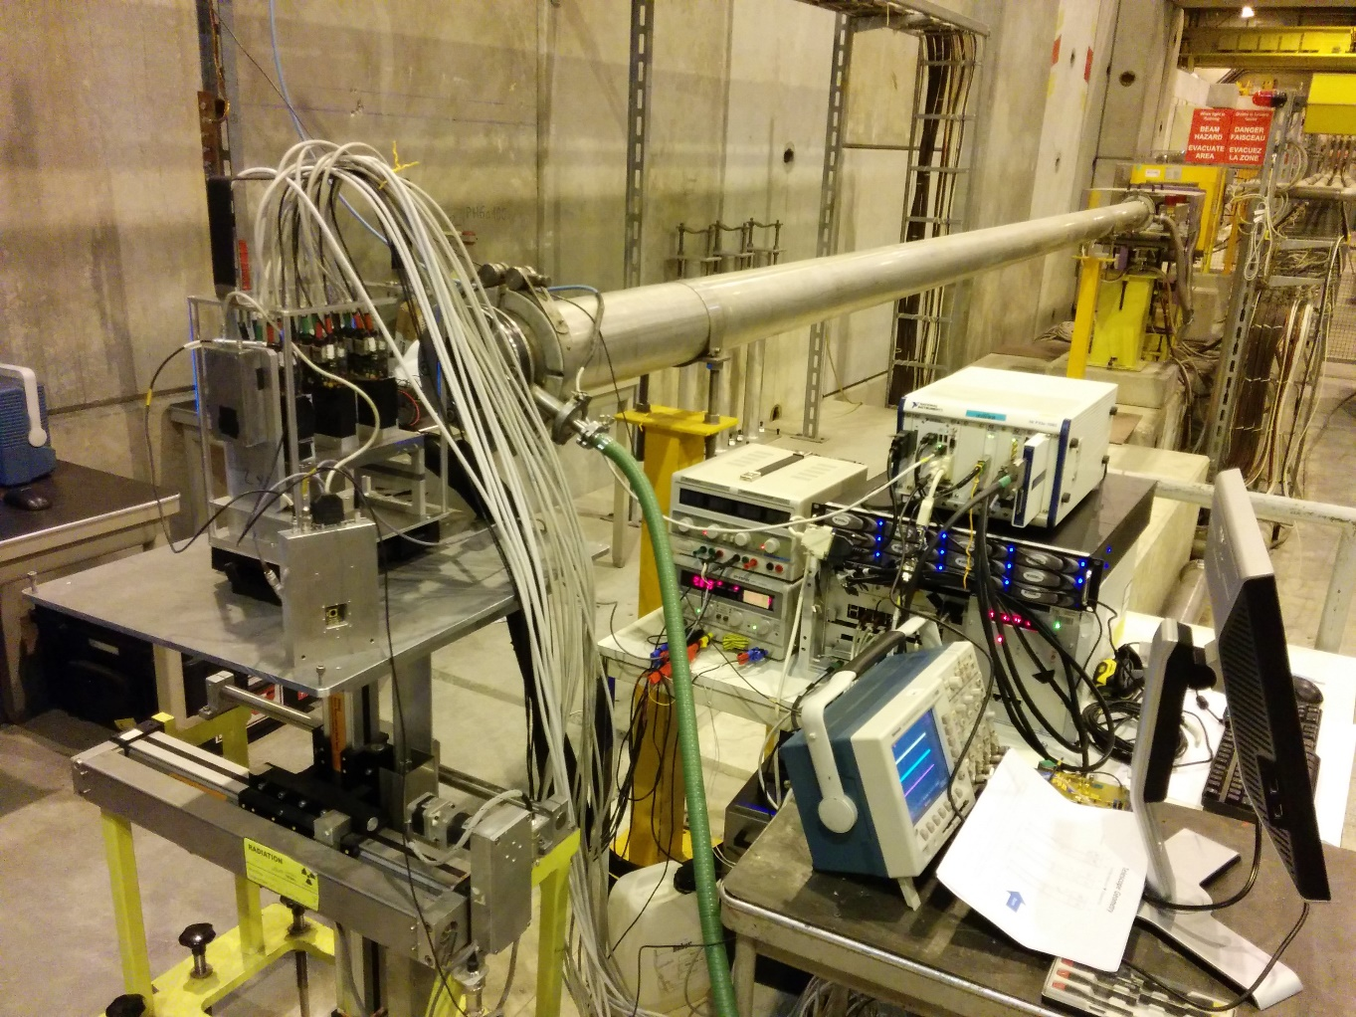
The beam telescope
Pixel telescope
Trigger Scintillator
DAQ crate
Power (20V max.)
Data storage (RAID)
Chiller
Risks:
Chiller: +/- 20°C, Glycol-Based (no risk).
Sensors: Max. +/-20V
Trigger Scintillator: 12 V voltage for PMT (t.b.c)
Mass: few 10 kg.

Slide 4
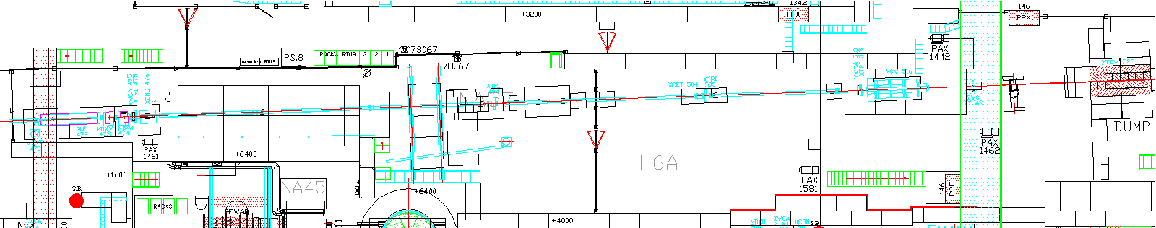
Preferred location and infrastructure
Position in H6A
Power:
220V – 11A (Chiller).
220V – 10A (other devices).
Cave infrastructure:
1 Gbit LAN to counting room, in place from previous tests.
XY-Table.
Counting house:
Work space: 2 tables for DAQ-system.
WLAN/LAN for remote access.
Installation time: ½ day.

