Slide 1
Patrol Training
Bastien Raë

Slide 2
Introduction
This procedure explains how to end ‘FREE ACCESS’ mode, in order to change to ‘CLOSED AREA’ mode, which allows re-establishing beam conditions in a secondary beam area (SBA).
N.B.: Procedures for the operation BEAM ON and BEAM OFFF vary slightly for the PS and the SPS areas. Differences are detailed explicitly in this document.
The zones, where the procedure of this document applies, are listed in EDMS 1138824

Slide 3
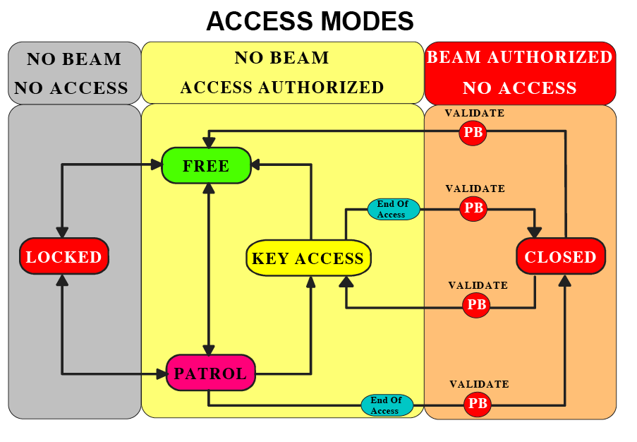
ACCESS MODES OF A SECONDARY BEAM AREA
‘CLOSED’ area: no access permitted, beam potentially present;
‘LOCKED’ area: no access possible (except for fire brigade and radiation protection)
‘ACCESS WITH KEY’: entering is possible by taking a key, one key per person entering (short KEY ACCESS)
‘FREE’ access: access without restrictions
‘PATROL’: It has a very limited duration and serves changing a zone status from “FREE” to any other mode.

Slide 4
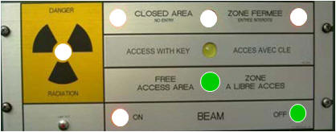
3. HOW TO PERFORM A PATROL
3.1 CHECK INITIAL CONDITION
To the right of the main access door (PPE) to a zone there is a panel with light diodes which indicate the area’s current access mode.

Slide 5
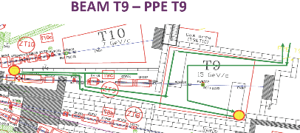
3. HOW TO PERFORM A PATROL
3.1 CHECK INITIAL CONDITION
Most user areas are equipped with judiciously placed search boxes (a plan on the PPE door shows where they are placed). Check the plan of the area for know where the search boxes are.
If the lights are flashing the search boxes need to be rearmed, once a box has been rearmed the lights become continuous.
Example of a plan showing Search Boxes

Slide 6
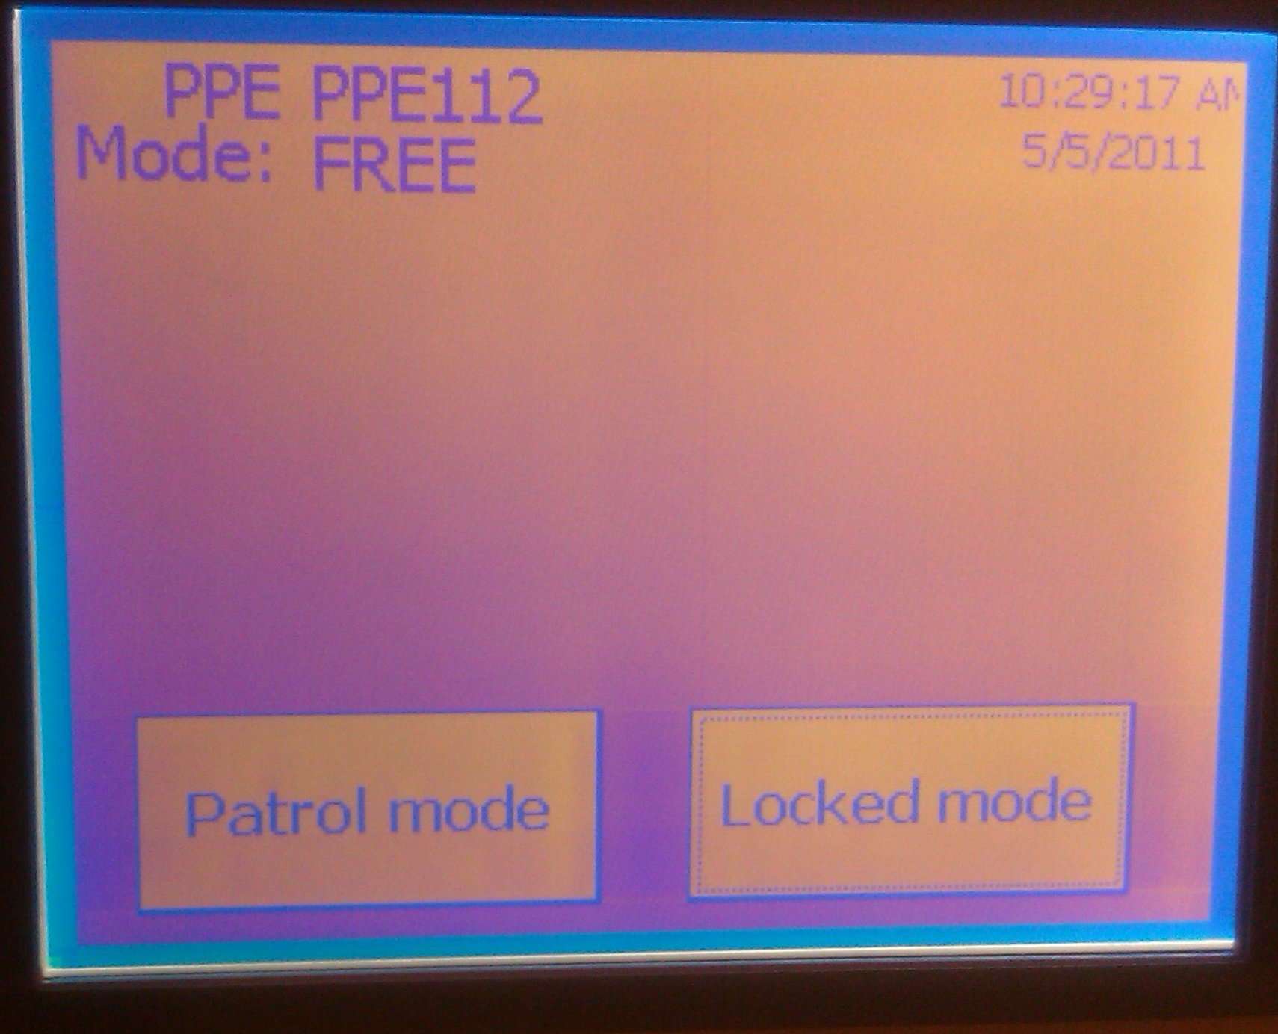

3. HOW TO PERFORM A PATROL
3.1 CHECK INITIAL CONDITION
The status of all doors of the zone is displayed on the touch panel.
Only the ‘CLOSED AREA’ state allows the beam to be switched on. A patrol is necessary to change from ‘FREE’ or ‘LOCKED’ mode to ‘KEY ACCESS’ or ‘CLOSED’ mode.
It’s not possible to change mode when the beam is enabled.

Slide 7
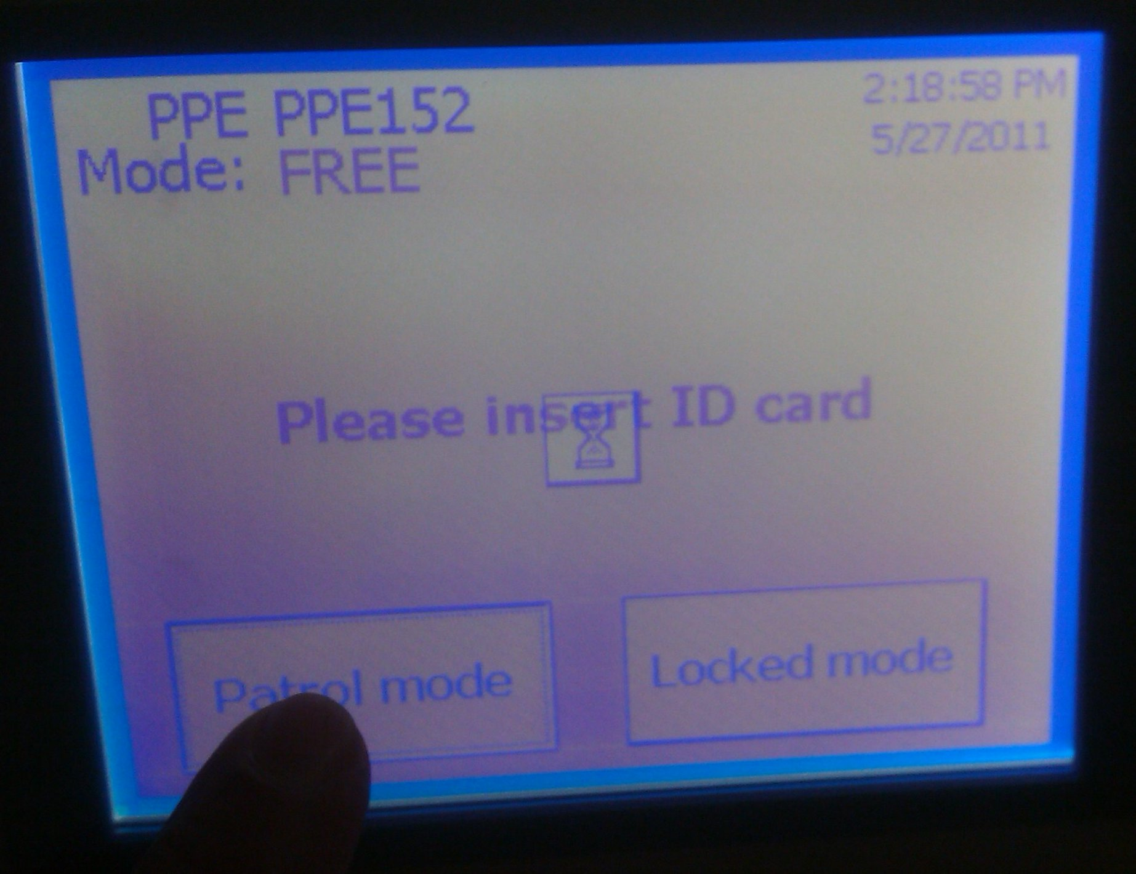
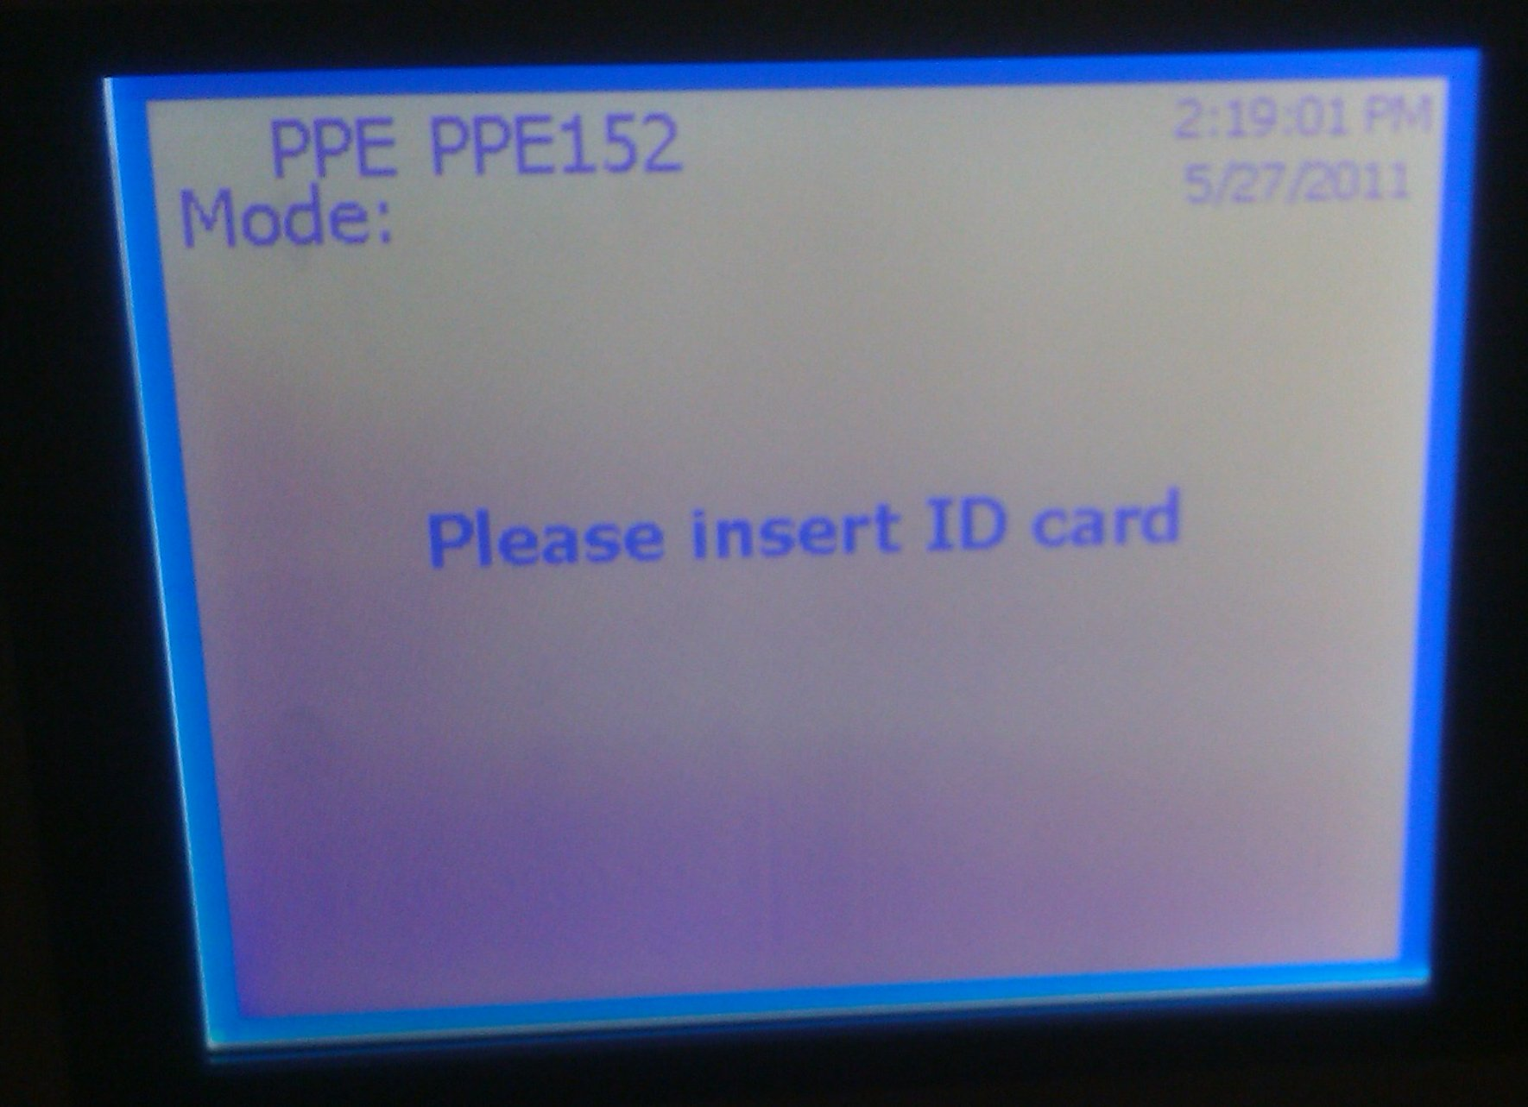

3. HOW TO PERFORM A PATROL
3.2 CHECKING THE ZONE
To start a patrol, the patroller must select ‘PATROL MODE’ on the touch screen to switch from ‘FREE ACCESS’ mode and then pass her/his personal dosimeter in front of the dosimeter reader

Slide 8
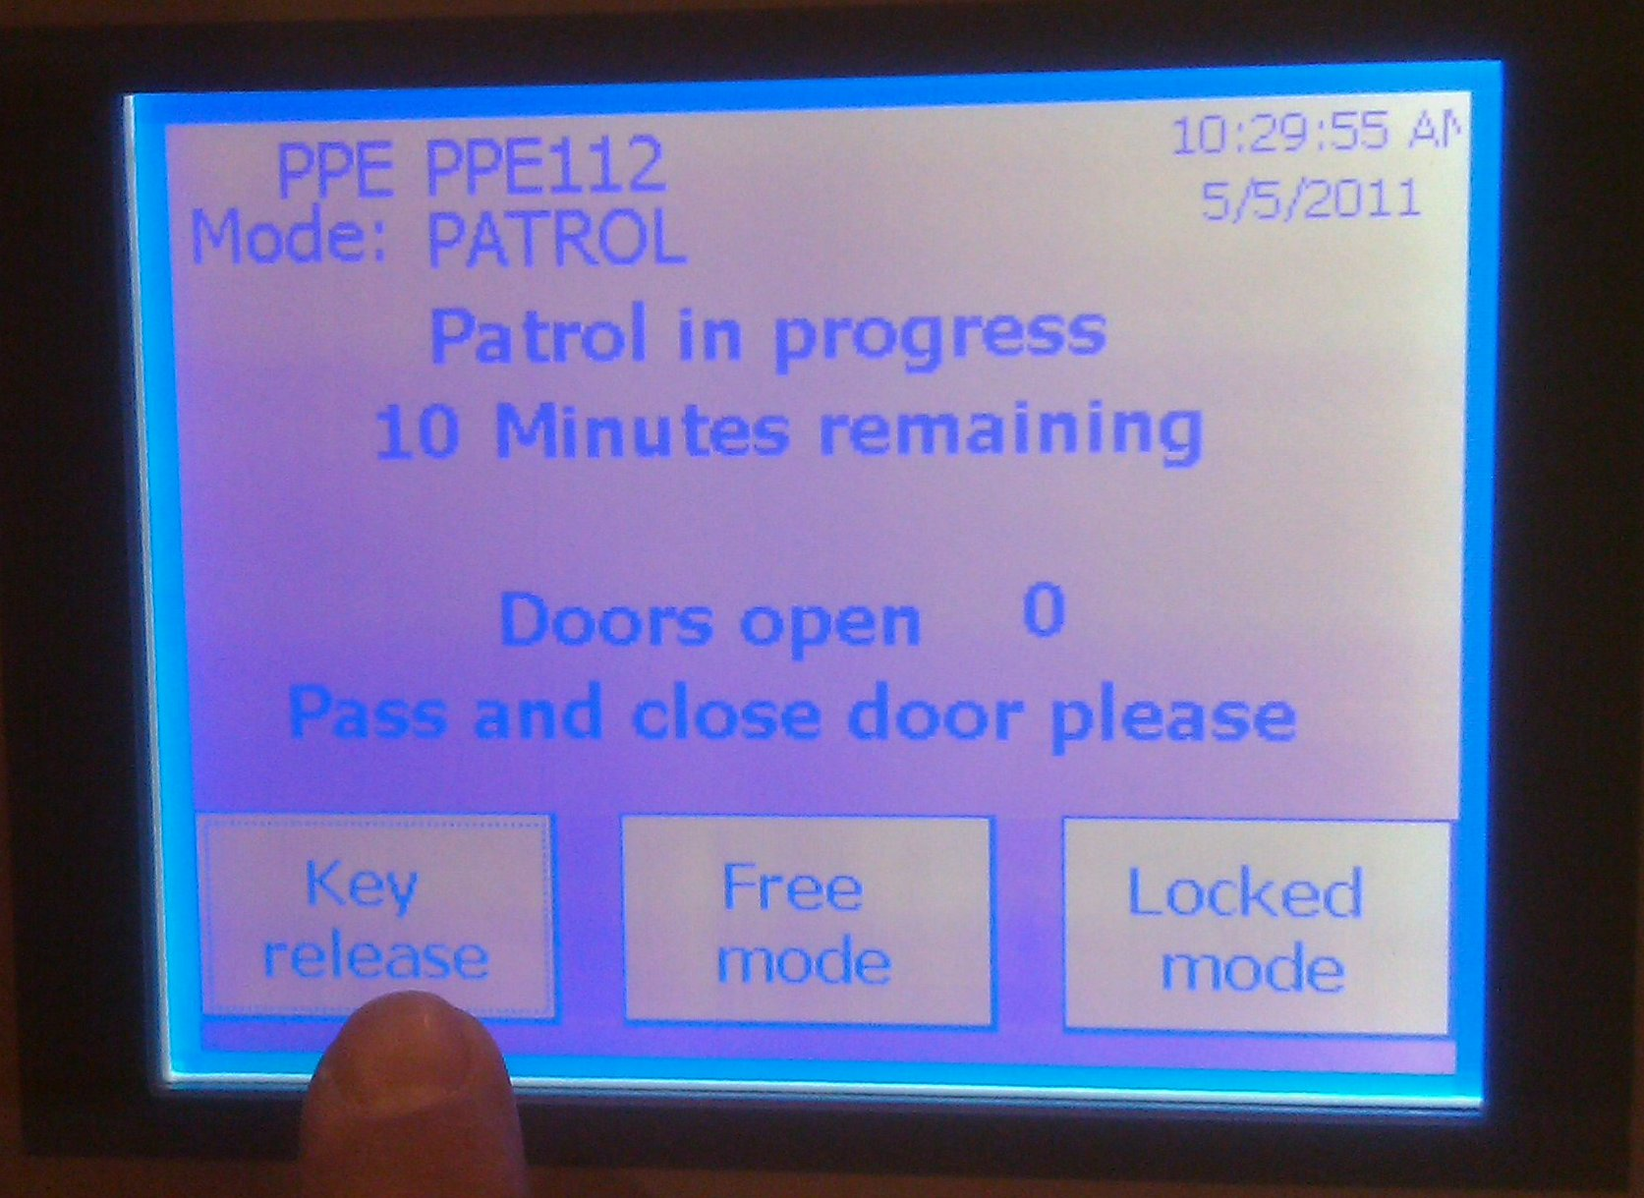
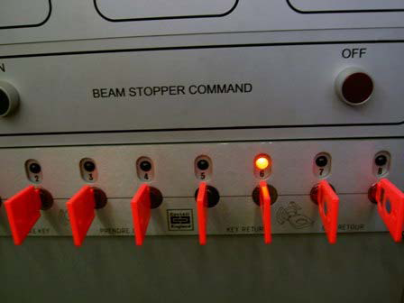
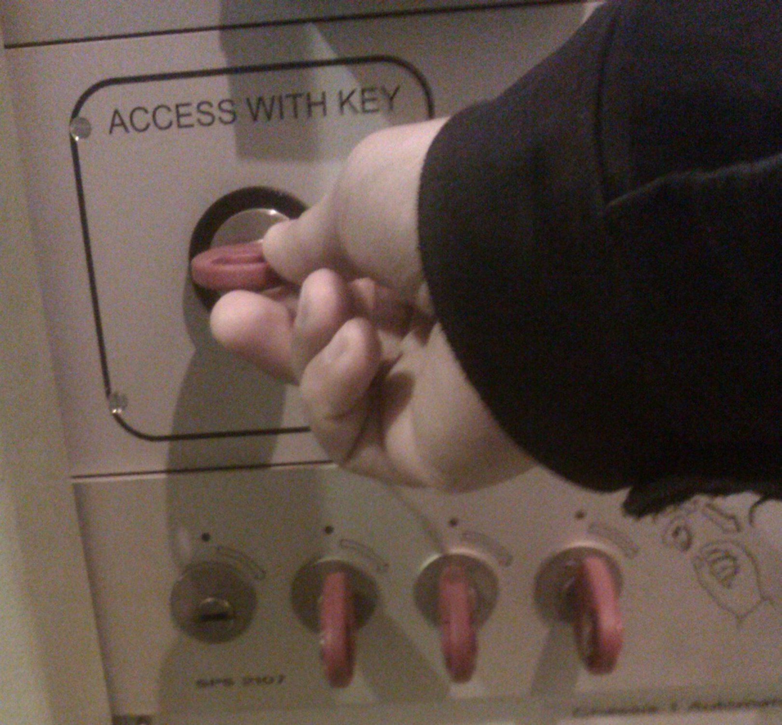
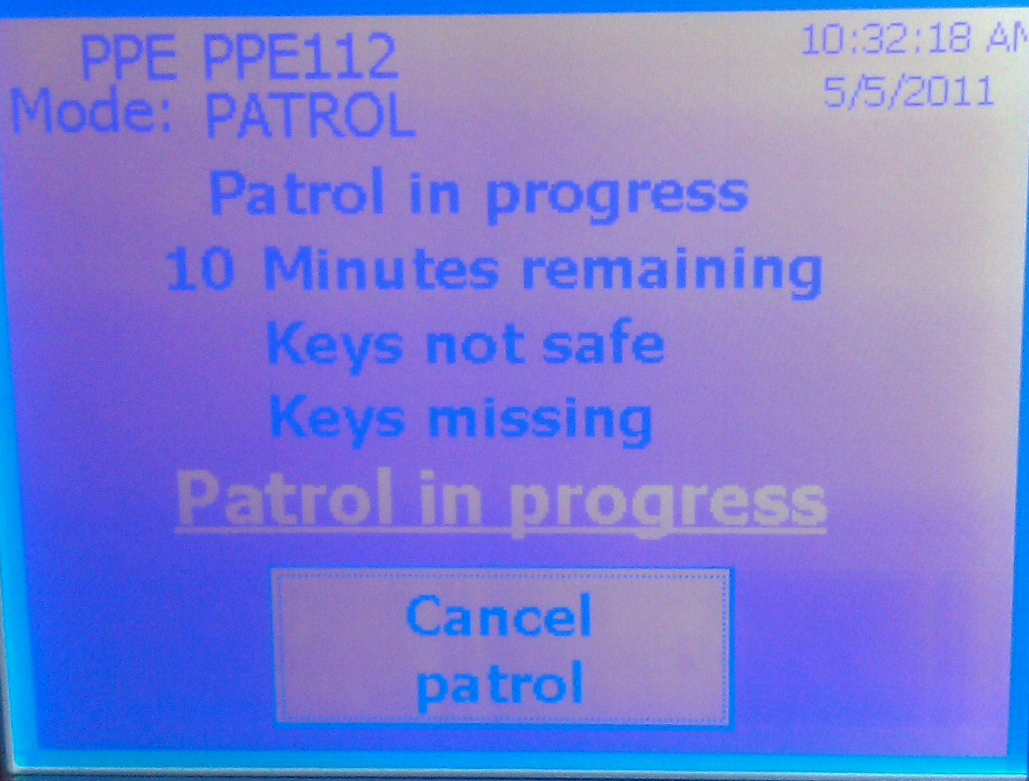
3. HOW TO PERFORM A PATROL
3.2 CHECKING THE ZONE
Each patroller has to take a key. You can get a key by pressing the ‘Key release’ on the touch screen.
Only the leader of the patrol must
be trained and authorised.
Take the key from the key distributor where a lamp lights up above (turn the key a quarter to the right and simply pull it out).
The screen then indicates a Key is missing.

Slide 9
3. HOW TO PERFORM A PATROL
3.2 CHECKING THE ZONE
Enter the zone using the key and check the zone:
Ensure that no people are remaining in the area checking hidden corners thoroughly; Please note that there is a (generous) time limit of 10 minutes performing the patrol.
Check that anything allowing illegal access to an area such as ladders are removed or at least made safe (i.e. put in horizontal position inside the area), that all shielding and fences of the zone are in place and that unnecessary material is removed.
All disarmed search boxes (lights flashing) must be progressively rearmed (light steadily on signals that the area has been or is being searched).

Slide 10
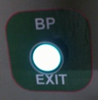
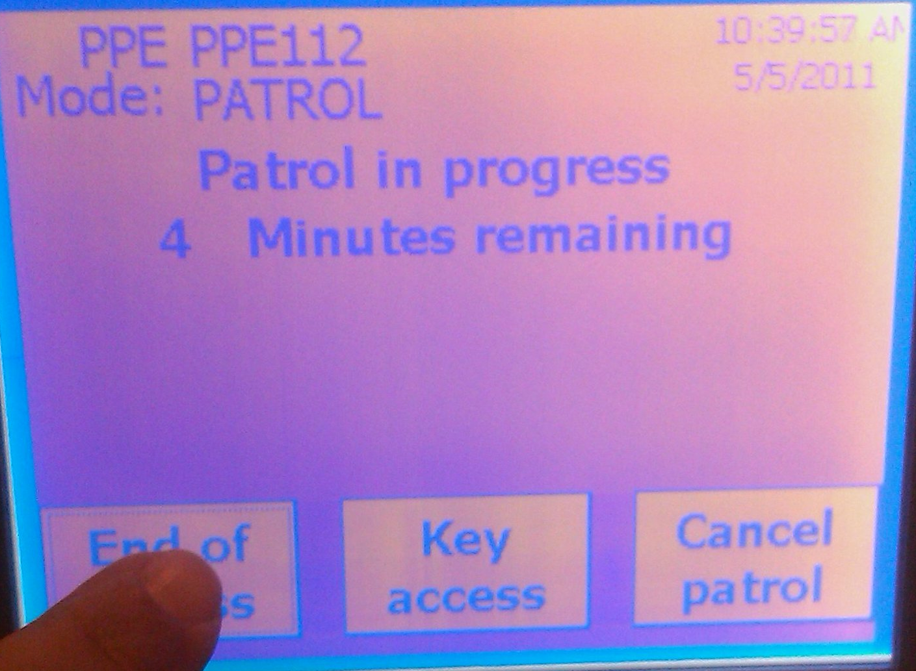
3. HOW TO PERFORM A PATROL
3.3 VALIDATING a Patrol
After the area has been patrolled, before leaving the zone, you should press the green button which is next to the door. Once the door shut, all of the keys shall be returned to the distributor.
Now that you are absolutely sure that no-one remains in the area, the ‘End of Access’ button on the touch screen must be selected.

Slide 11
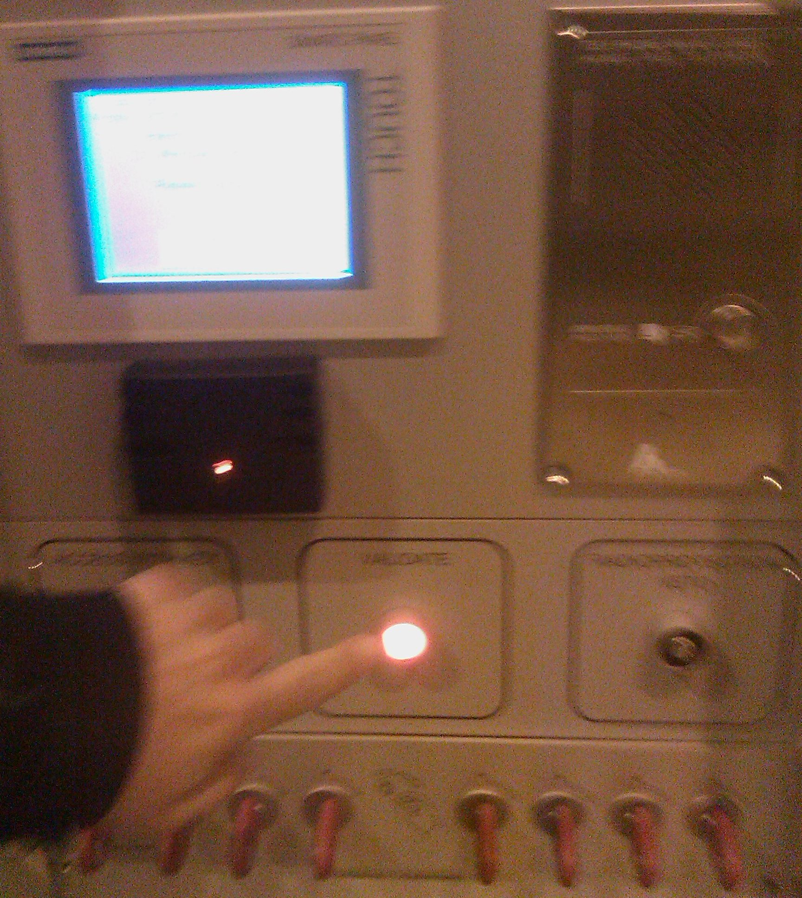
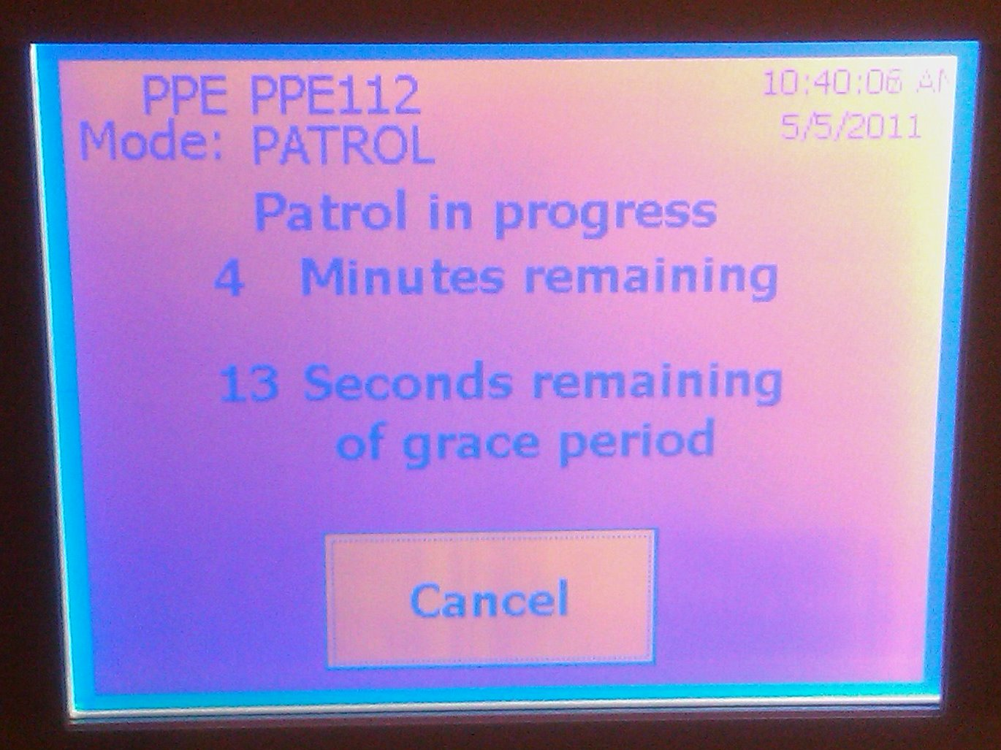
3. HOW TO PERFORM A PATROL
3.3 VALIDATING a Patrol
the patroller passes her/his personal dosimeter in front of the dosimeter reader.
After a ‘grace period’, you can validate the patrol pushing validate button

Slide 12
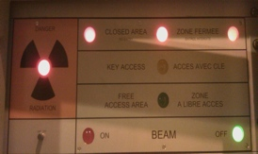

3. HOW TO PERFORM A PATROL
3.3 VALIDATING a Patrol
For the patrol to have been satisfactorily completed the patrollers must see the flashing lights active inside the area and on the panel. The beam can now be switched on from the beam terminal.
Light panel show that the area is closed

Slide 13
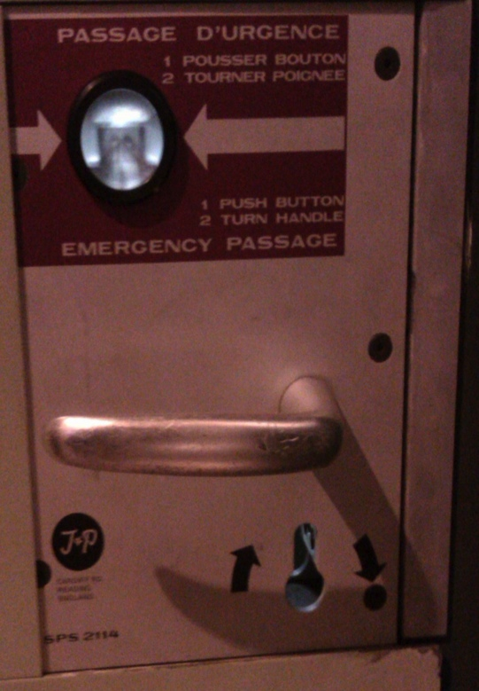
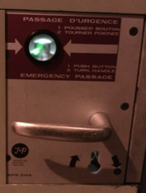
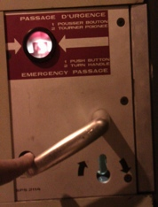

4. REMARK
4.1 EMERGENCY BUTTON
On each door there is a emergency button above the handle. It’s also give you information if you have enter or not.
YOU MUST USE THE EMERGENCY BUTTON ONLY IN CASE OF EMERGENCY !
Light is green,
you can enter
Emergency passage
Light is red,
you can’t have an access
Door handle

Slide 14
4. REMARK
  4.2 Rearming a forced door
If the emergency passage system has been used on a door of the area it will be necessary to rearm the lock using a key.
For the PS complex, only operators can rearm a forced door (dial 76677).
For the North Area, this pink key can be obtained from the CCC by the GLIMOS of the experiment.
If the door is not rearmed the area will stay in ‘FREE ACESS’.
Once you have the key, open the door
and insert the key in the lock.

Slide 15

4. REMARK
  4.3 Important NOTEs
Do not push the Emergency Passage button above the door handle, except in cases of real emergency. If it is pushed, a patrol will have to be done (the lock will have to be rearm) and this wastes a lot of time and effort and may (in some case) stop the whole area.
Once you have entered the area close the door behind you and keep YOUR key in YOUR pocket, to guarantee YOUR safety.
It is strictly forbidden to block an access door open. If a door remains open for a long time (≥ 30 s), the access point will automatically switch to FREE MODE as no safety can be guaranteed and many people may enter without a key.

Slide 16
4. REMARK
  4.4 CONTACT
If you have any question or problem please do not hesitate to contact :
During working hours (8:30 to 17:30) :
The Physicist responsible for you line
You can also send a e-mail to sba-physicists@cern.ch
At Any time you can call the CCC :
For the PS call : 76677
For the SPS call : 77500 or 70475

