Slide 1
5th KE4738 Technical Meeting : Adhesion
June 17th, 2021
Activity at CERN
Bharti Verma, CERN

Slide 2
Introduction
Adhesion is one of the important parameters of an impregnation system.
For this reason we have started a characterization of adhesion based on several test principles:
peel-off strength
shear strength
pull-off strength
The present focus is in the definition of the samples design & preparation and of the test methods.
This requires several iterations to achieve reproducibility and exact knowledge of the sample structure and behaviour, because these resins are very fluid.
The program consists of the characterization of the adhesion strength towards copper, stainless steel, glass tissue, polyimide, virgin and heat treated cable insulation, and also towards mica sheets employed in certain cases as “antistick” surfaces.
In parallel, it is desirable to also work on the methods to exploit experimental data into FEM models.

Slide 3
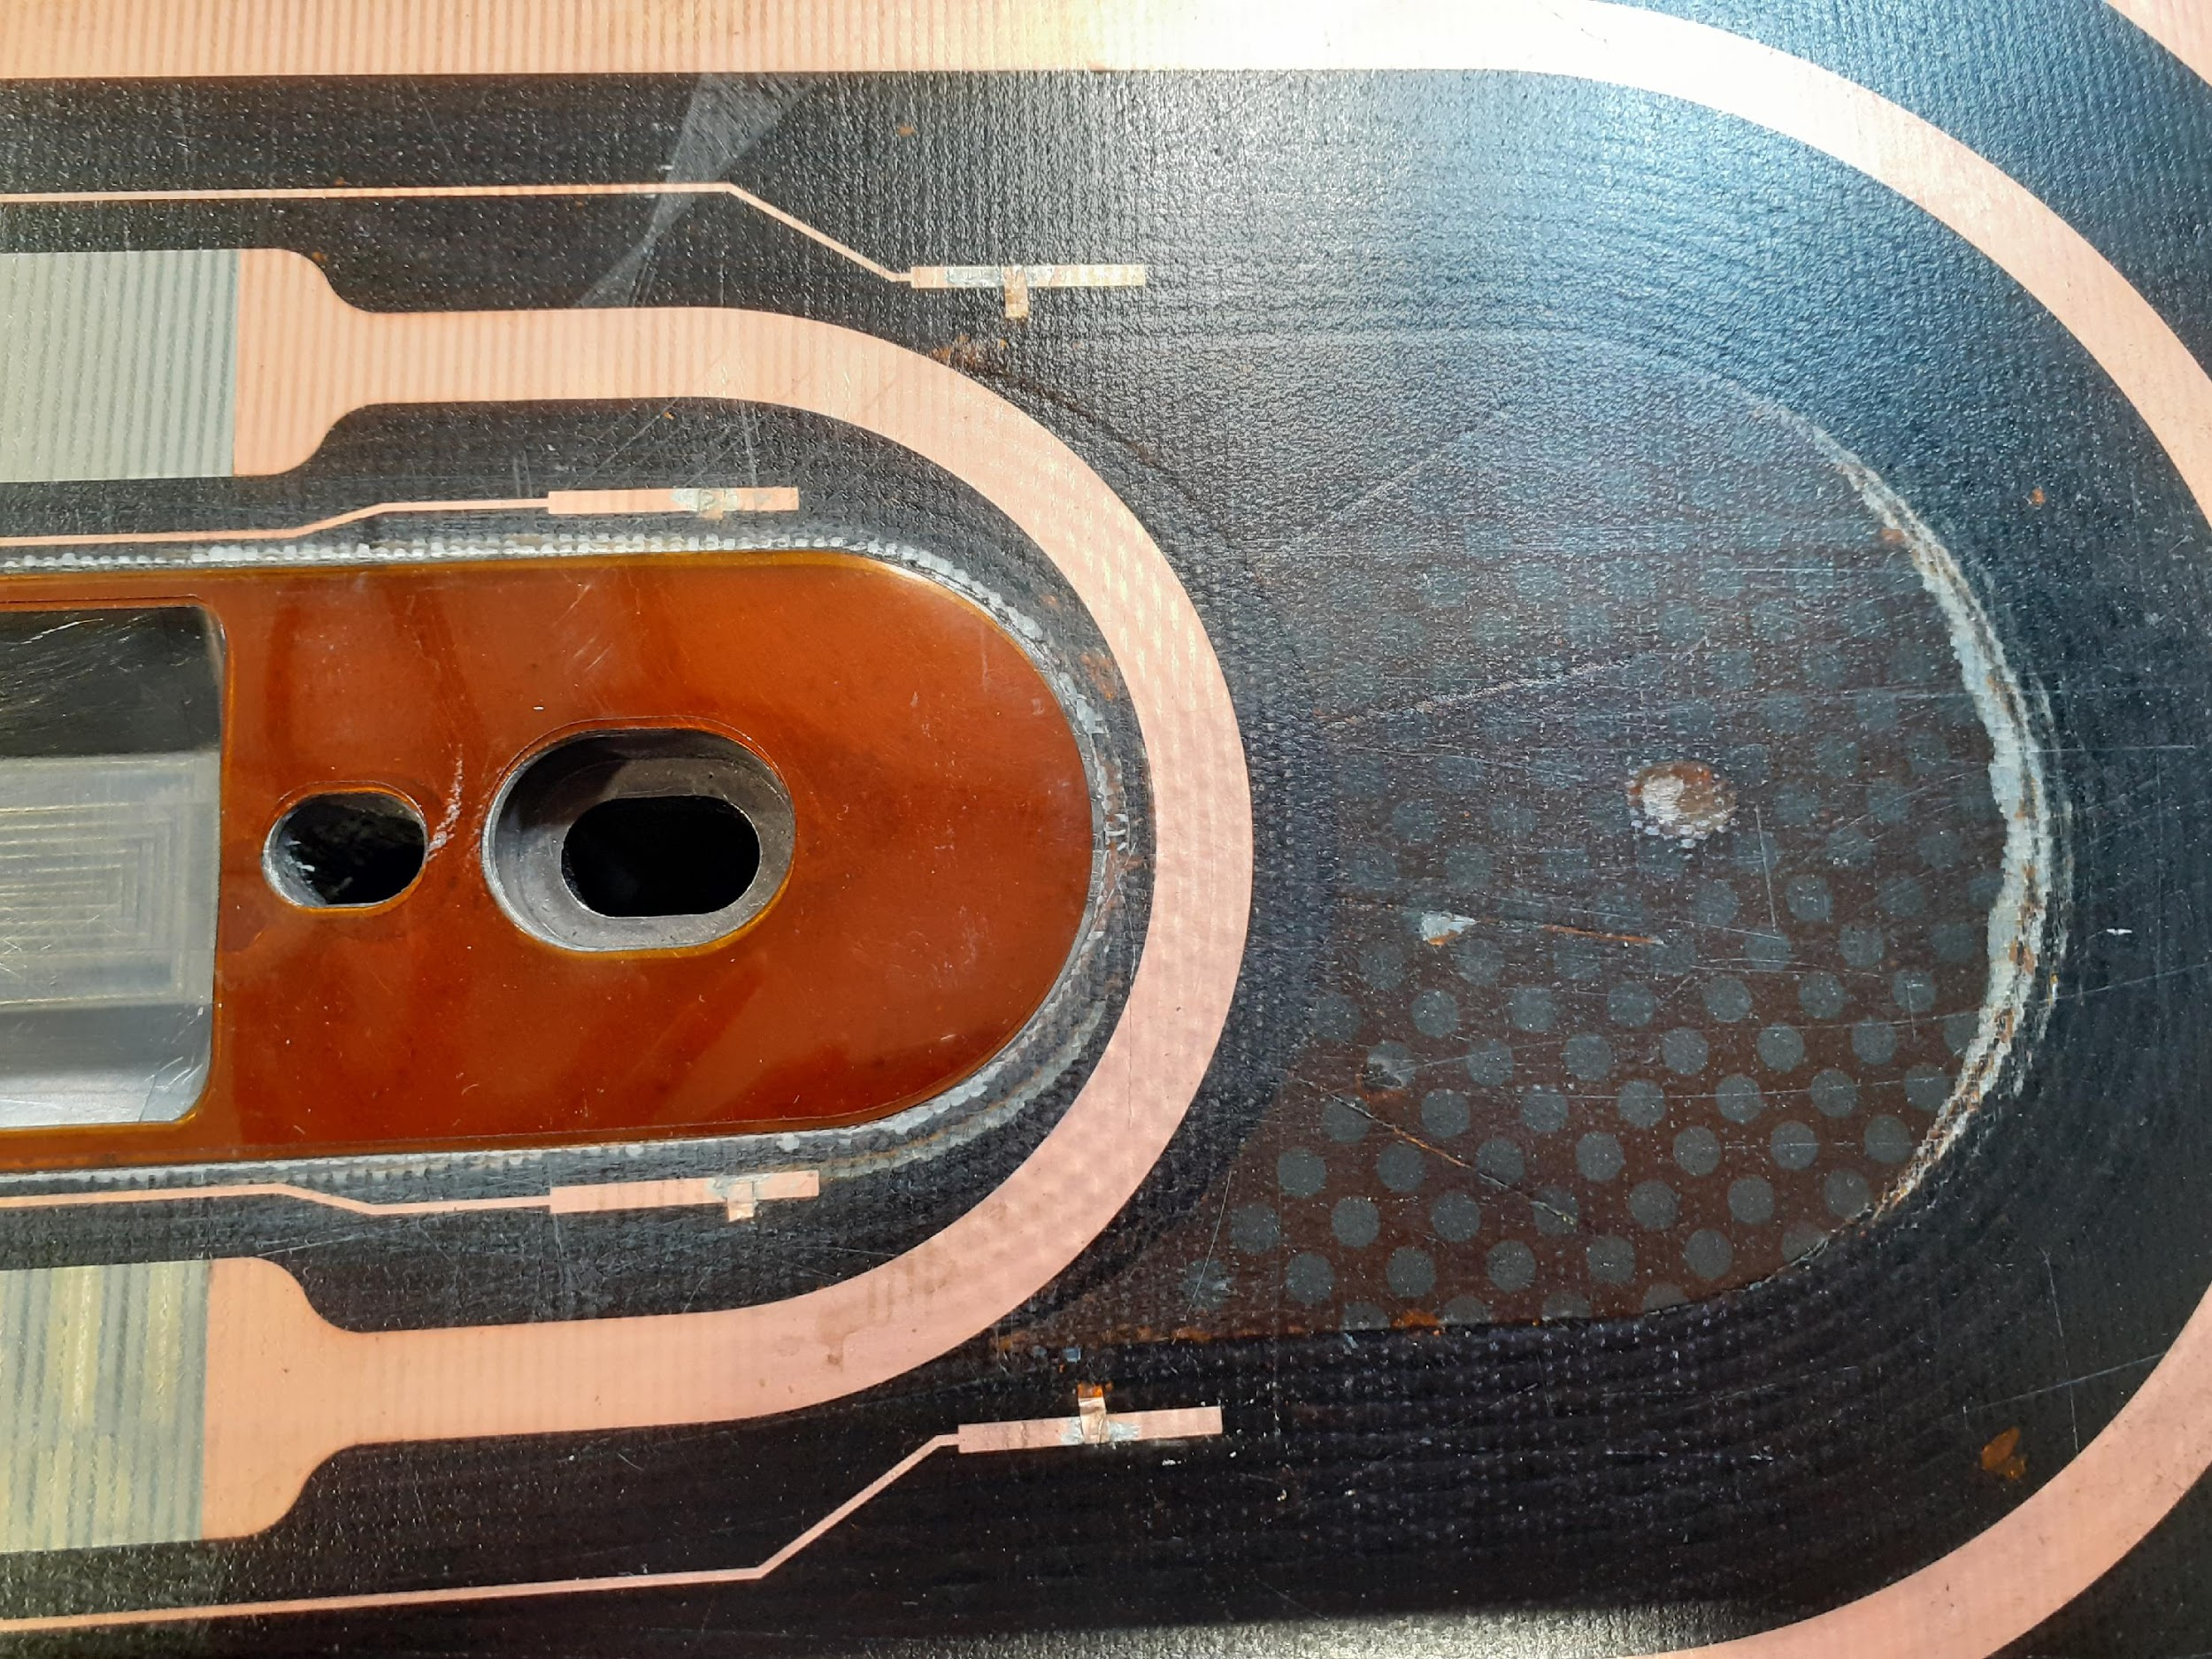
Why adhesion is important?
Functions of epoxy resin is to provide the magnet coils with the following:
Electrical insulation
Adhesion
Mechanical support
A magnet can quench if the resin is debonded.

Slide 4
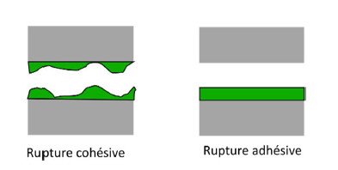
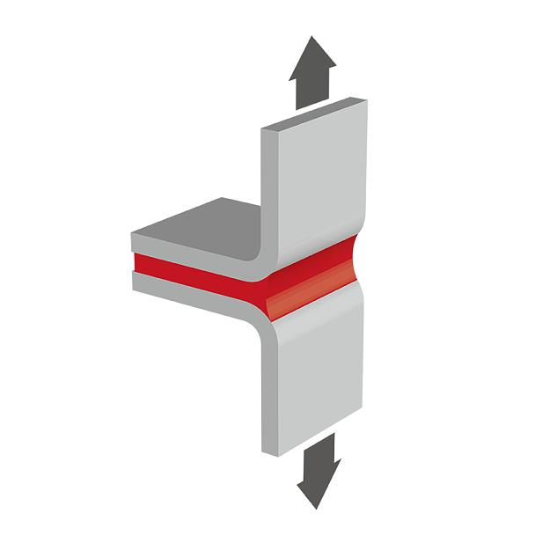
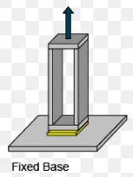
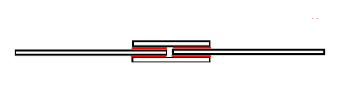
Some important definitions
Peel strength is the average load per unit width of bondline required to separate progressively a flexible member from a rigid member or another flexible member.
Peak load, is the maximum force recorded during a strength test.
Shear strength, in an adhesive joint, the maximum average stress when a force is applied parallel to the joint.
Cohesive failure, rupture of a bonded assembly in which the separation appears visually to be in the adhesive of the adherend.
Adhesive failure-rupture of an adhesive bond in which the separation appears virtually to be at the adhesive/adherend interface.
Cohesive failure
Adhesive failure
Double lap shear joint
T-Peel
Butt joint

Slide 5
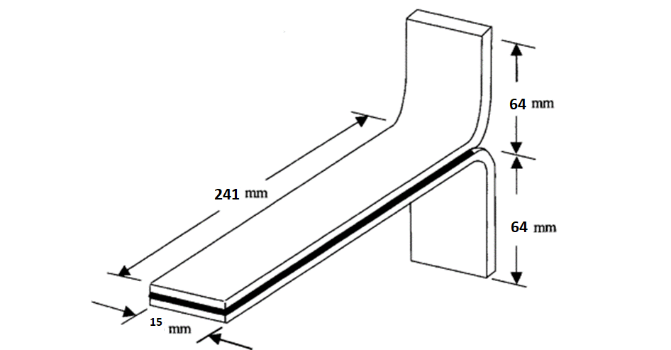
Methods
1. Sample Preparation
Specially prepared test panels 15 mm wide by 305 mm long, but bonded only over 241 mm of their length. (ASTM standard (D1876) )
2. Mold and assembly preparation
Cleaned the mold with acetone and applied demoulding agent.
Place the samples in the mold with the spacer. (horizontal and vertical)
Sealing joint in the groove.
After closing the mould with nuts and screws, applied CAF4 on the screws for vacuum sealing.
The mold was tested for its air-tightness to ensure there is no air leak by using a vacuum pump.

Slide 6
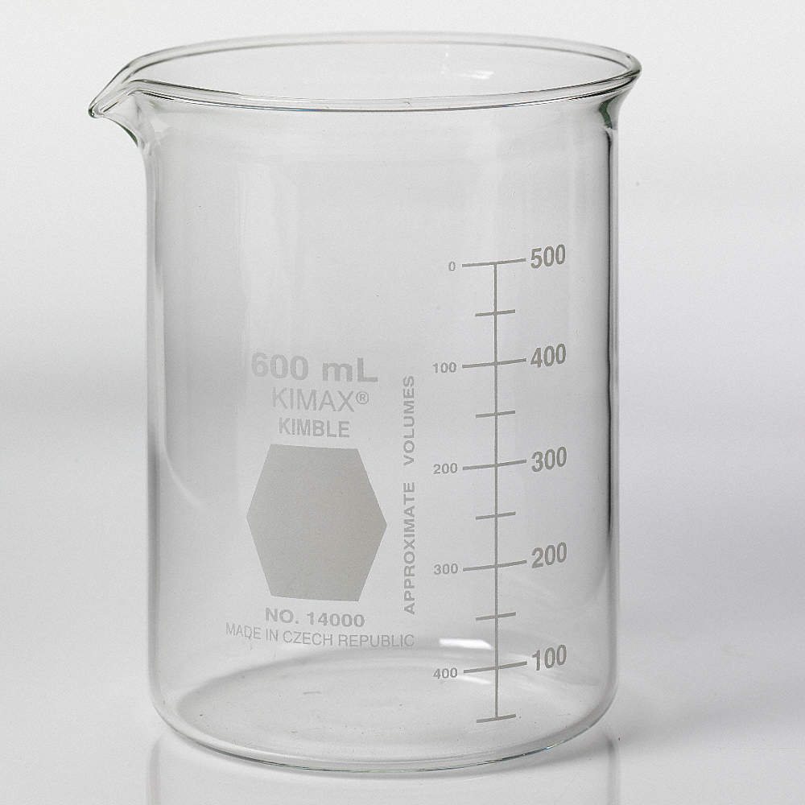
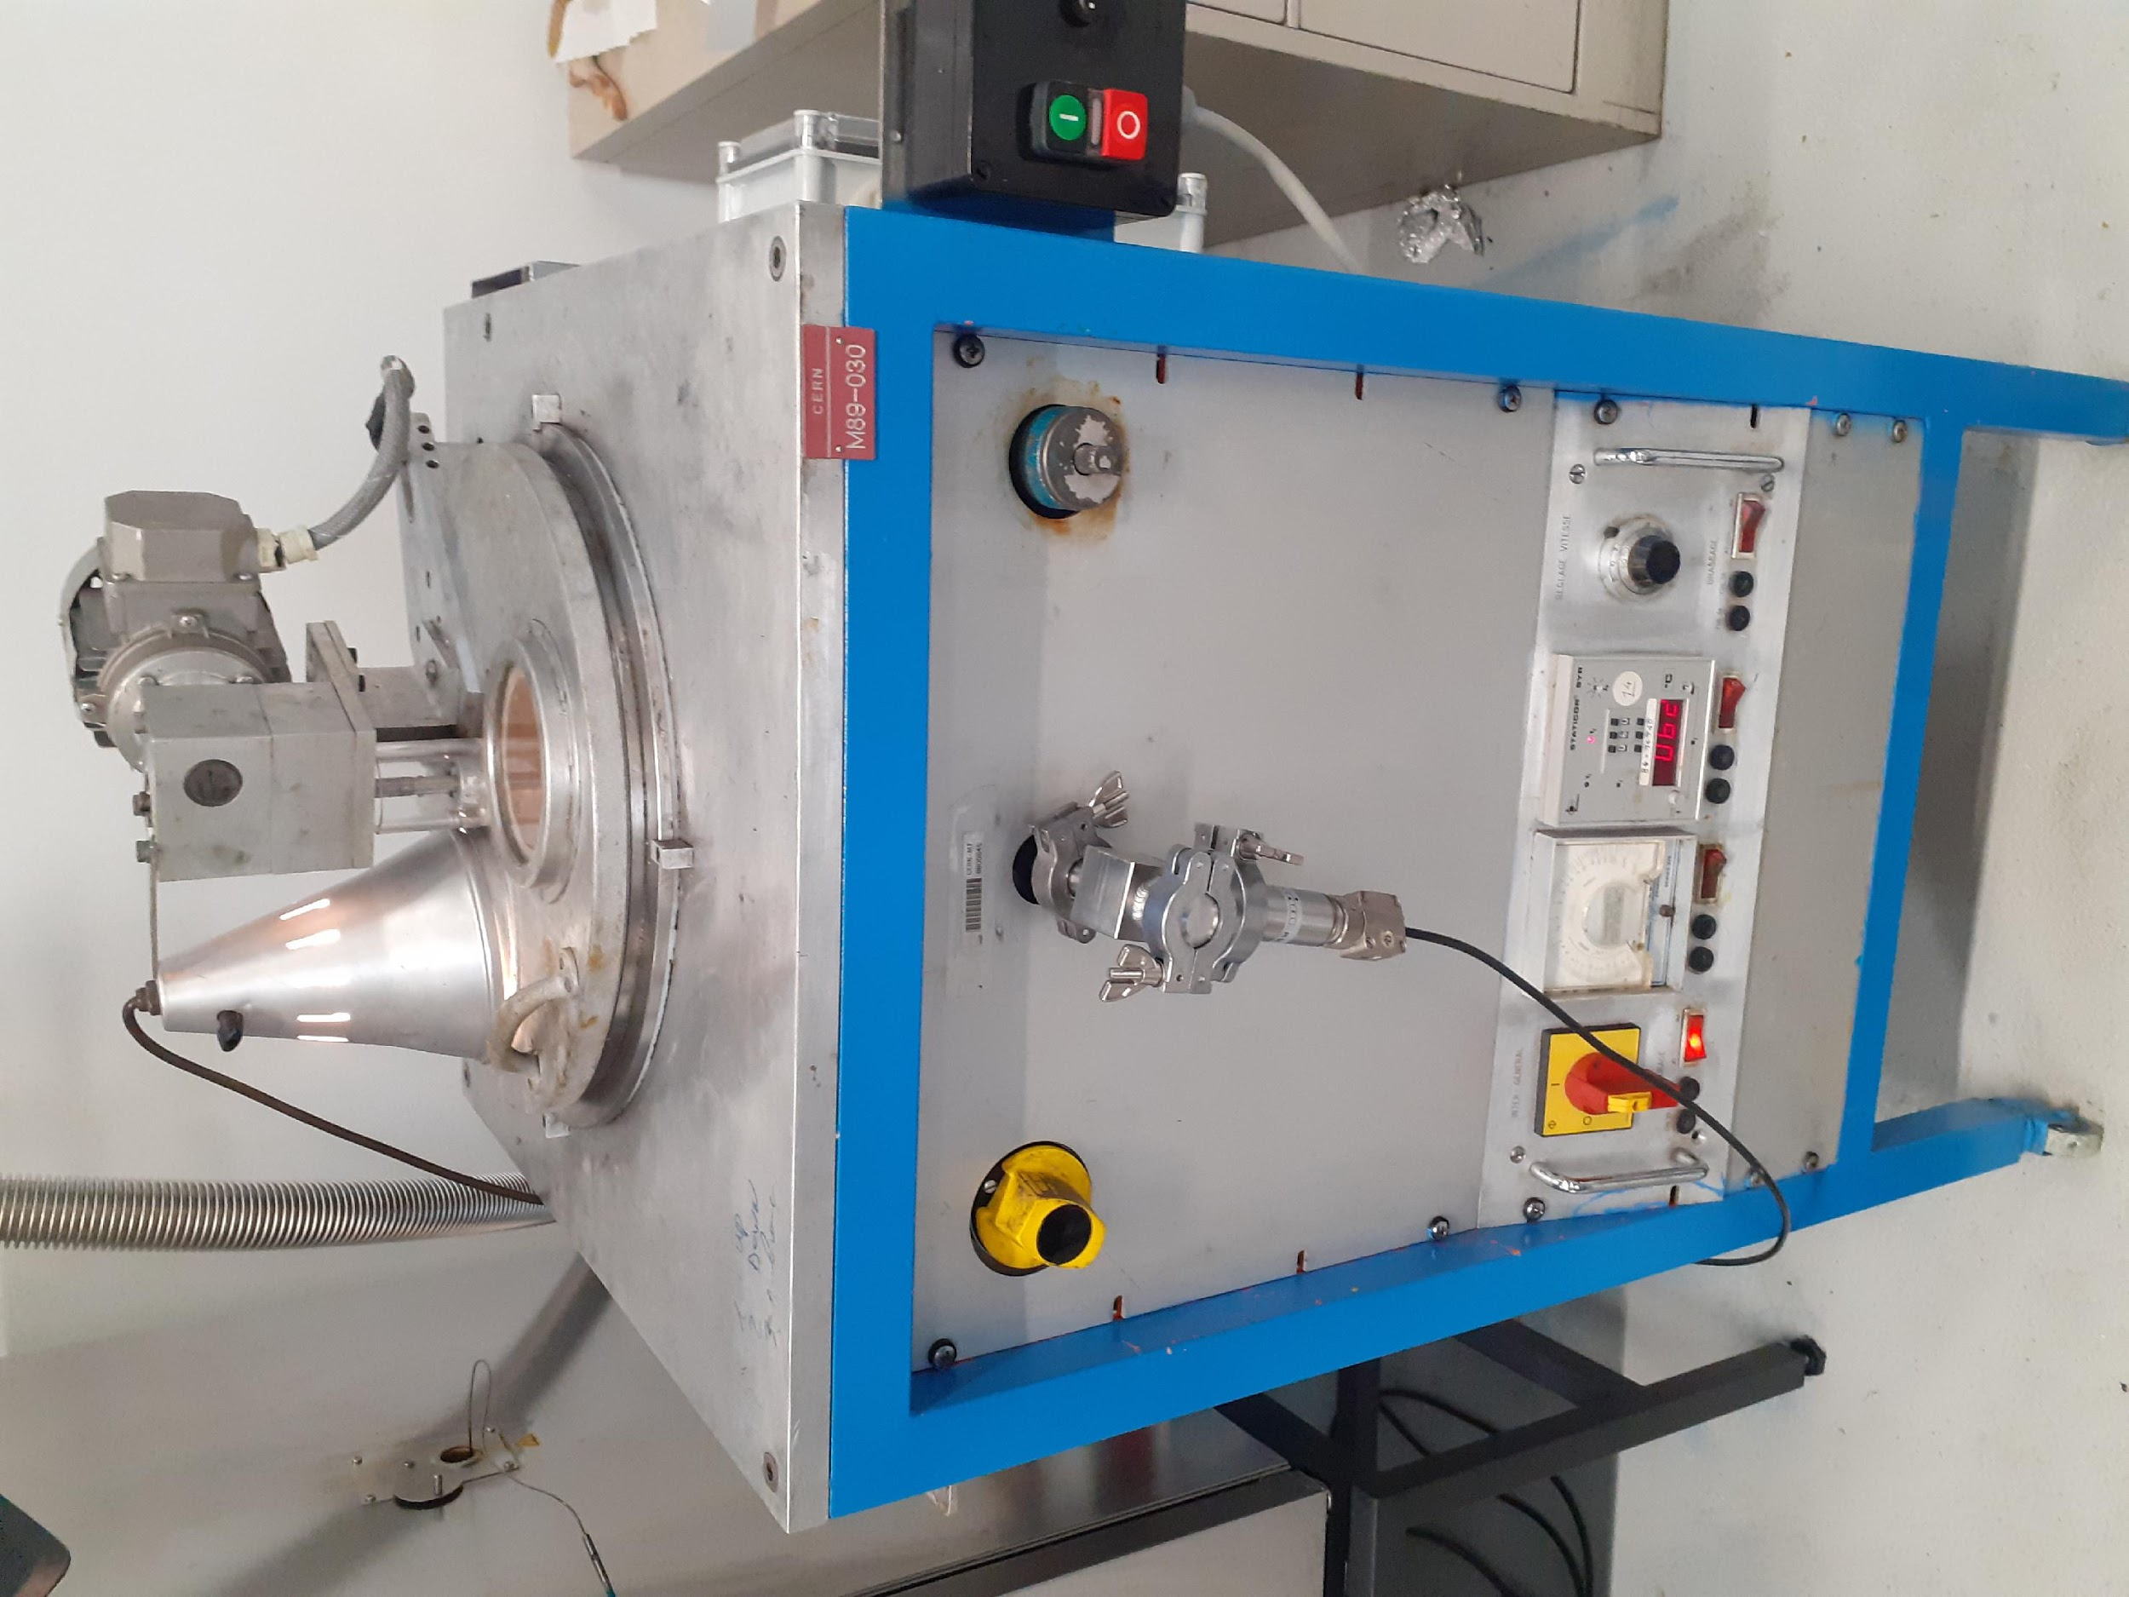
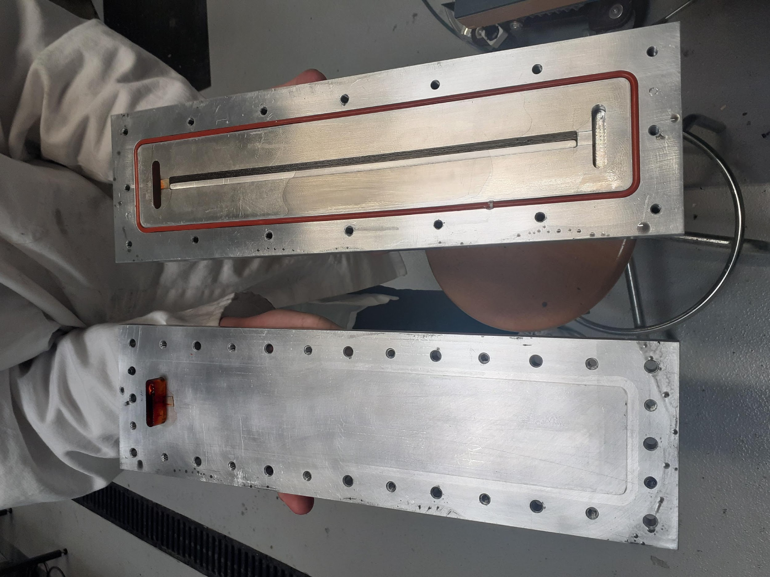
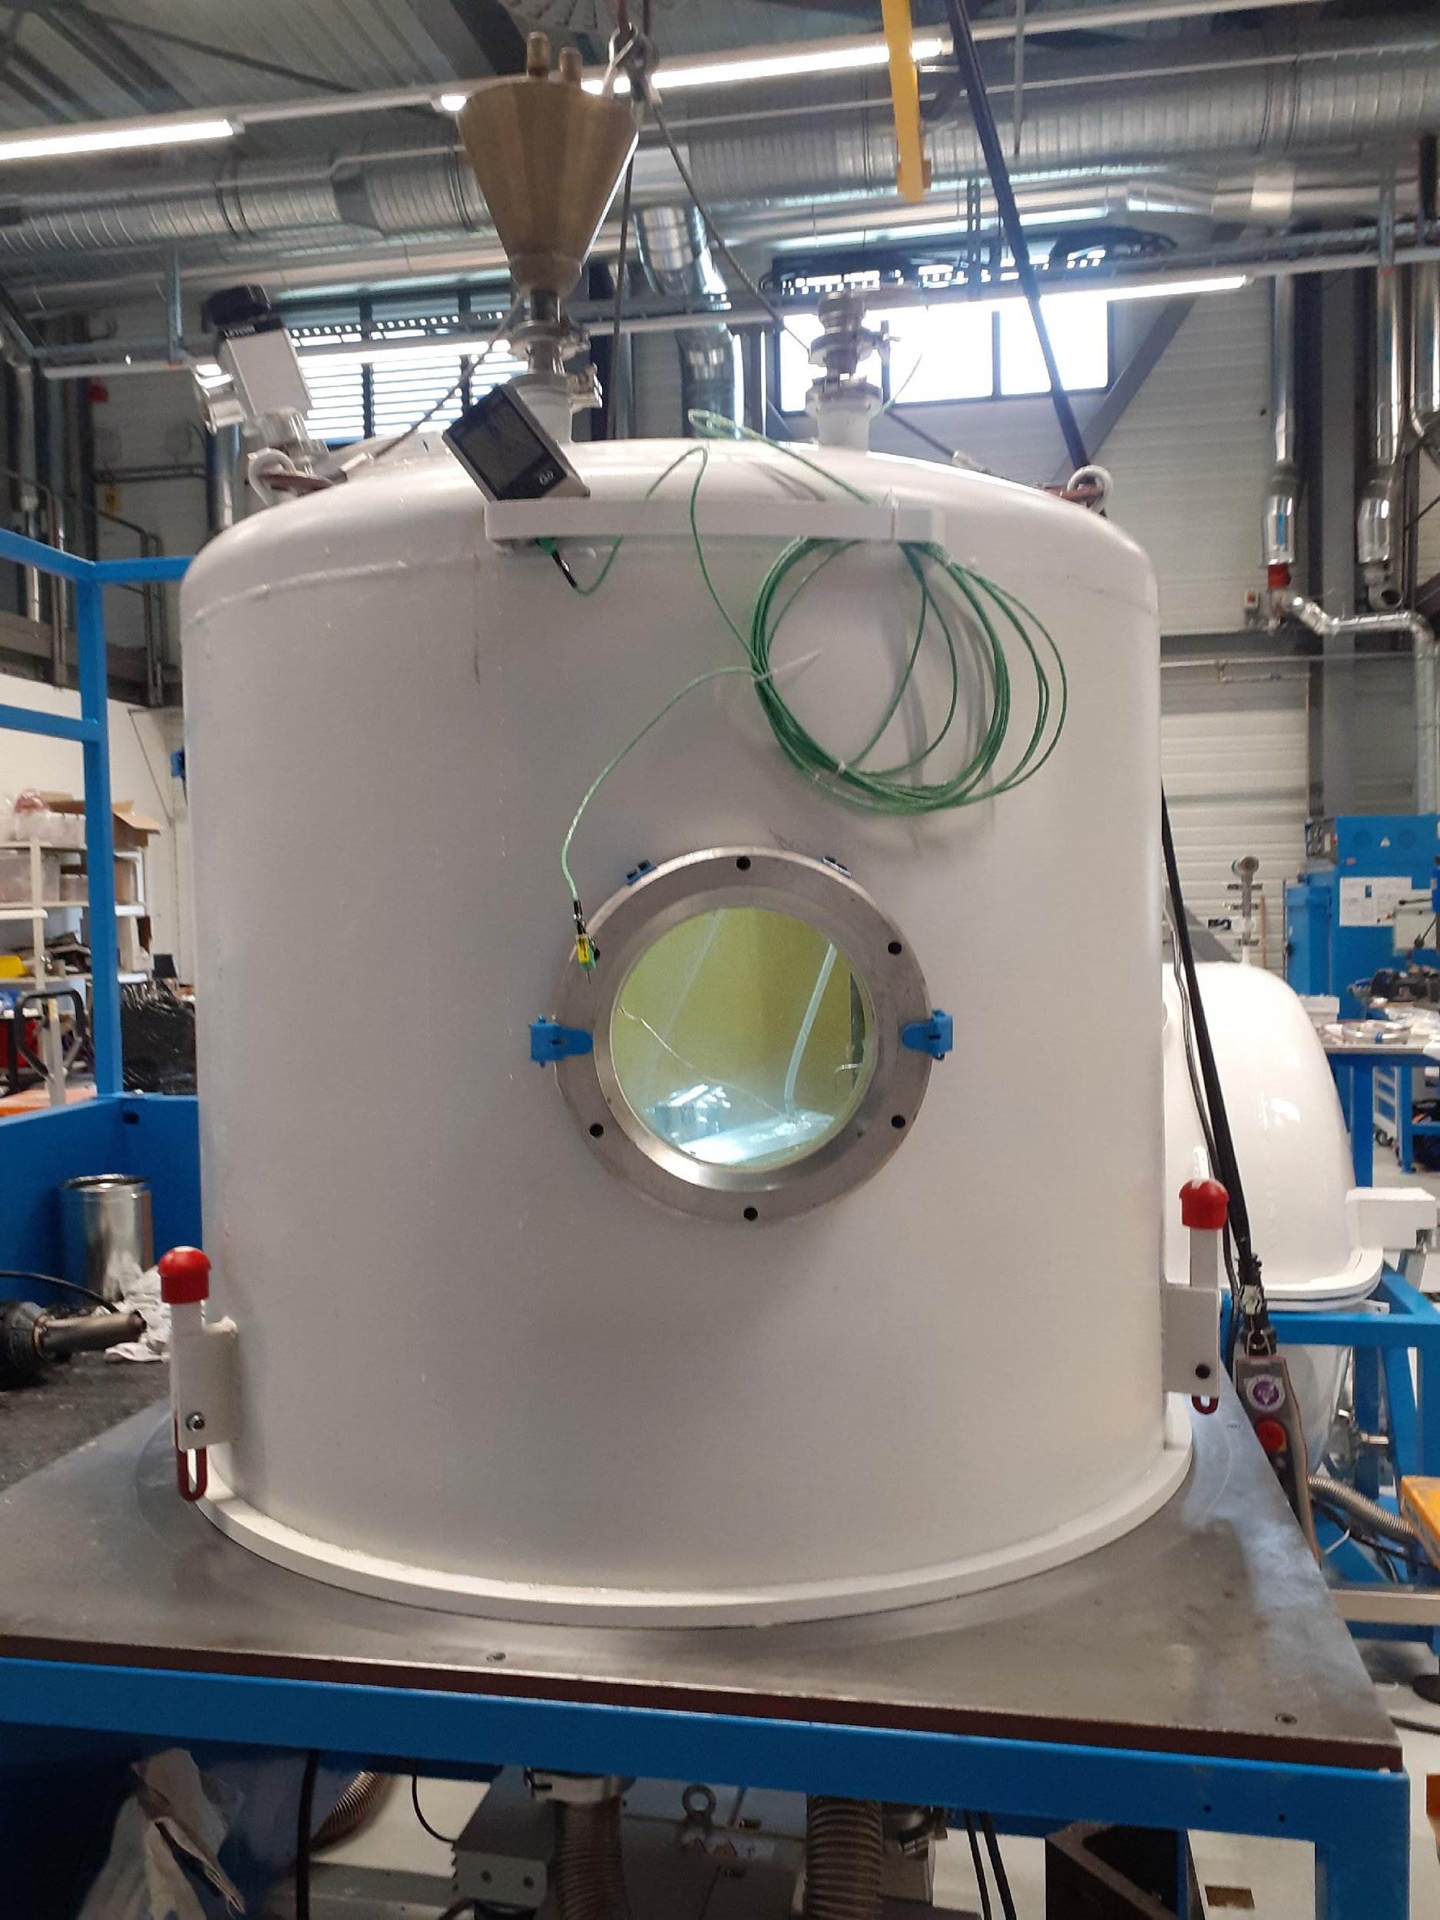
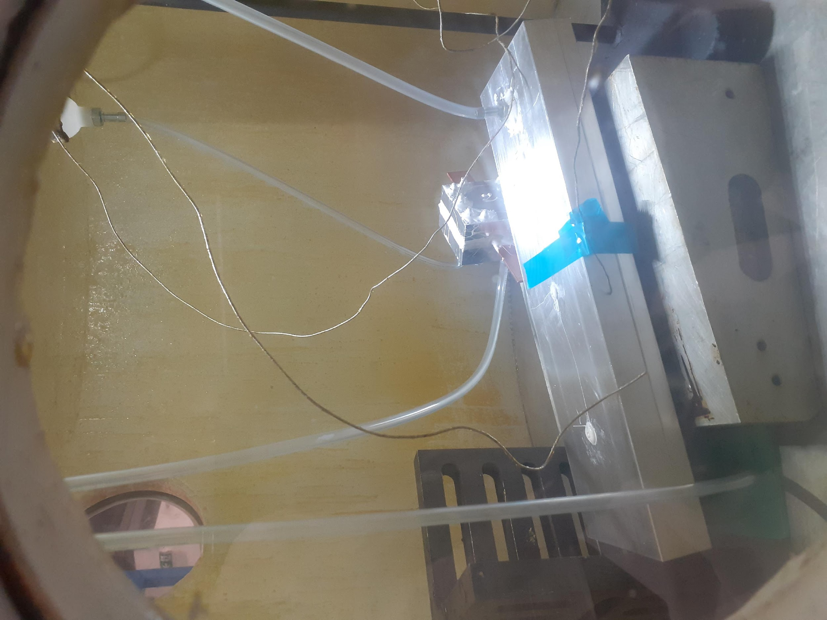
Methods
3. Resin Preparation
Part A at 60°C
Part B at 60°C
Part C
Mixing
Vacuum degassing till all bubbles are gone
4. Vacuum impregnation and curing
Inside of a vacuum impregnation system
Curing (110 °C for 5 h and 125 °C for 16 h)

Slide 7
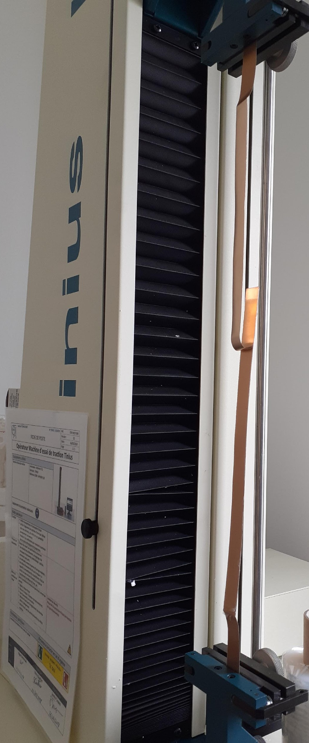
Methods
5. Testing samples
The testing has been performed in accordance with the ASTM standard (D1876) which is the standard test method for peel resistance of adhesives.
Tinius Olsen H5kT universal testing machine was used for conducting T-peel tests.
The unbonded ends of the test specimen were clamped in the test grips of the tension testing machine.
The load was applied at a constant head speed of 254 mm/min.

Slide 8
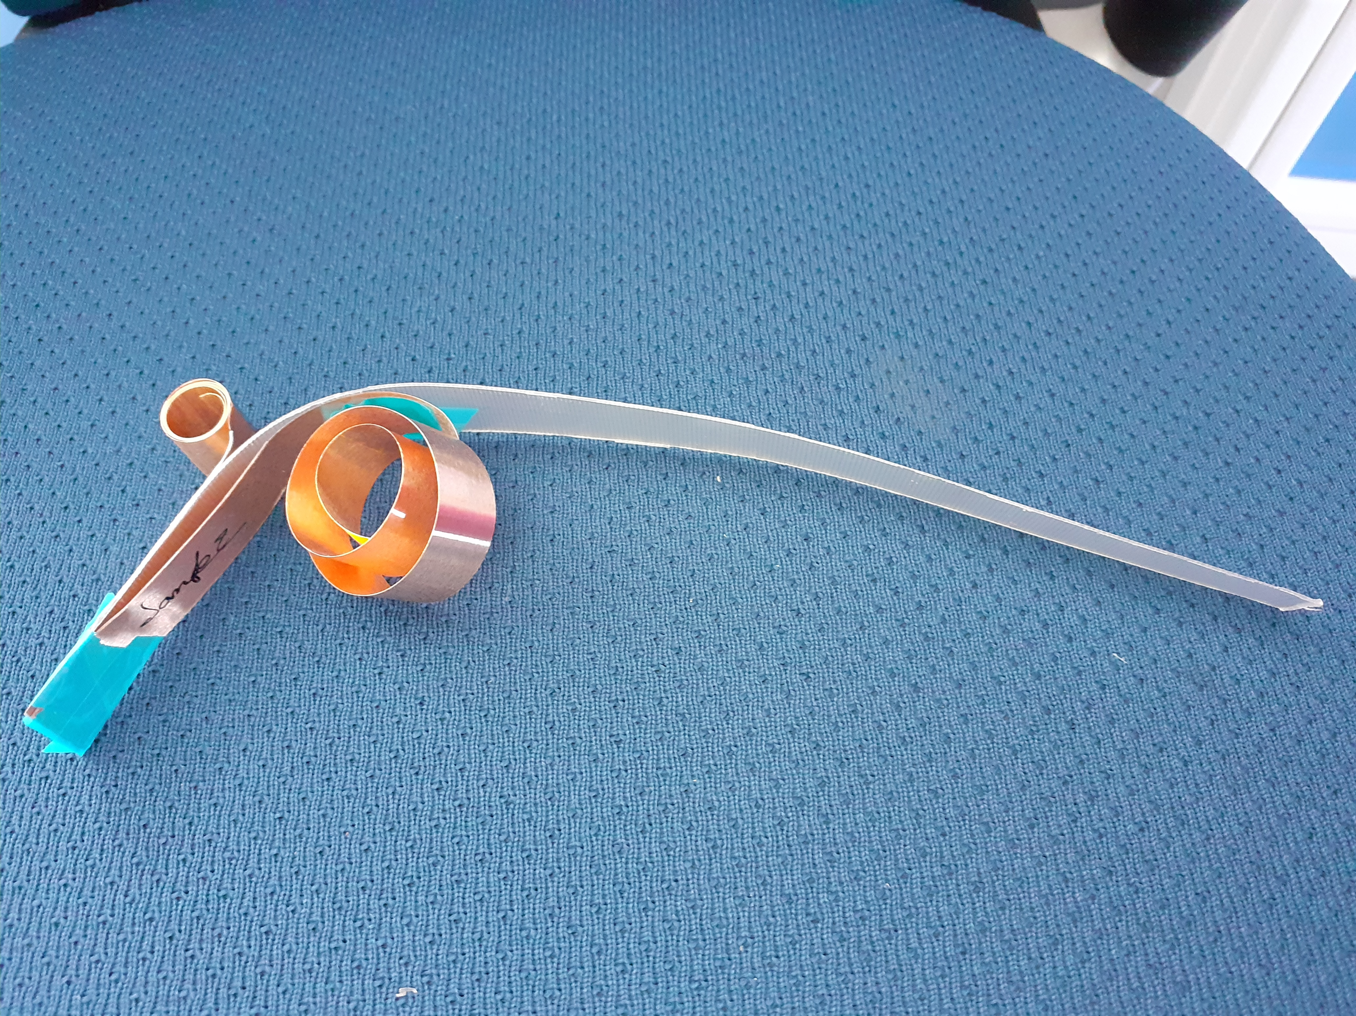
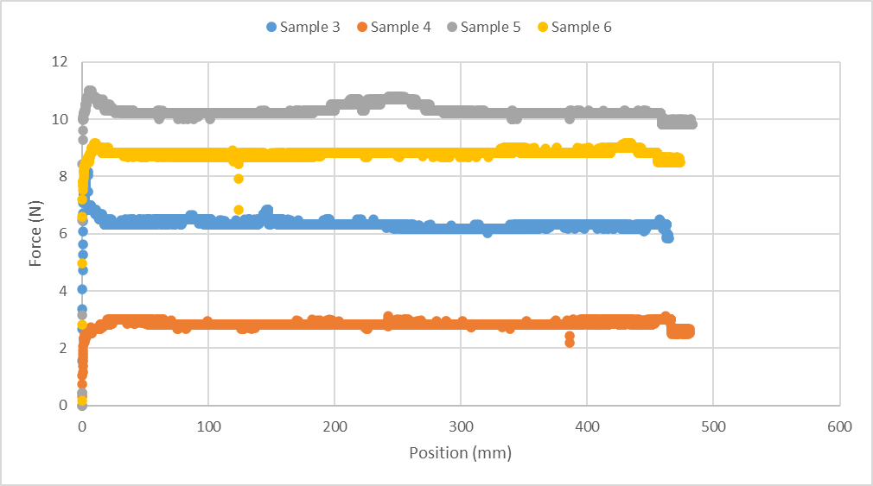
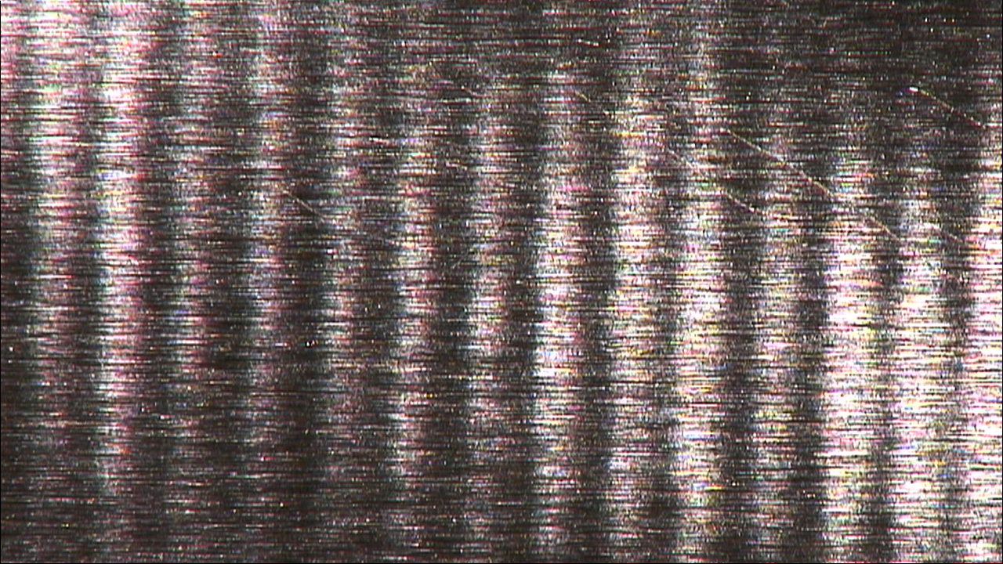

Copper with CTD101k
Copper surface before peel test
25X
Copper surface after peel test
25X
The adhesion graph is similar to what is expected from a T-peel test. After the peak, there is a constant trend and the force required to separate the adherends remain constant.
Behavior of rupture propagation: The force is maximum for initiating peeling then stabilizes and the detachment took place in a homogenous manner.
The adhesion between copper and CTD101K is disappointing
Type of failure: Adhesive failure
Possible reason: No surface treatment of copper, only cleaning with acetone, weak bonding strength of the resin.

Slide 9
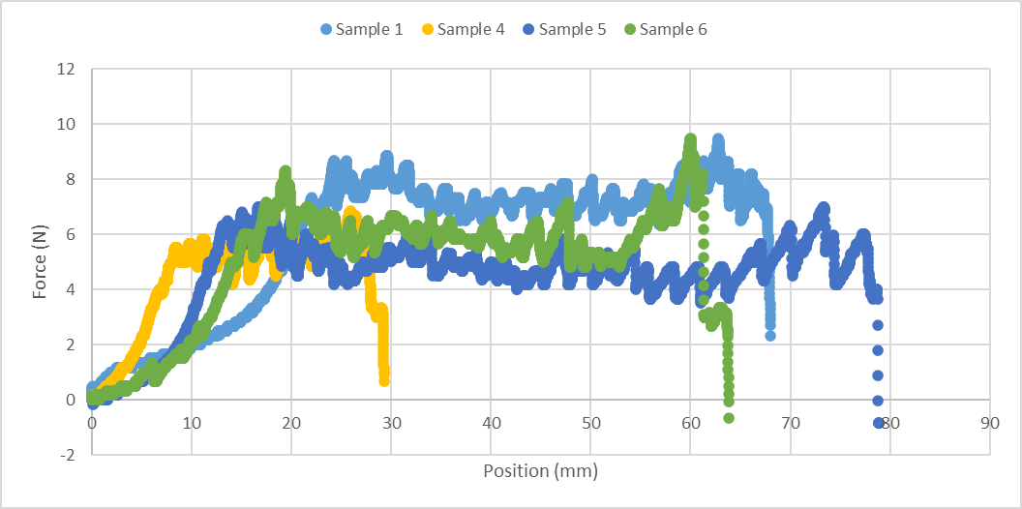
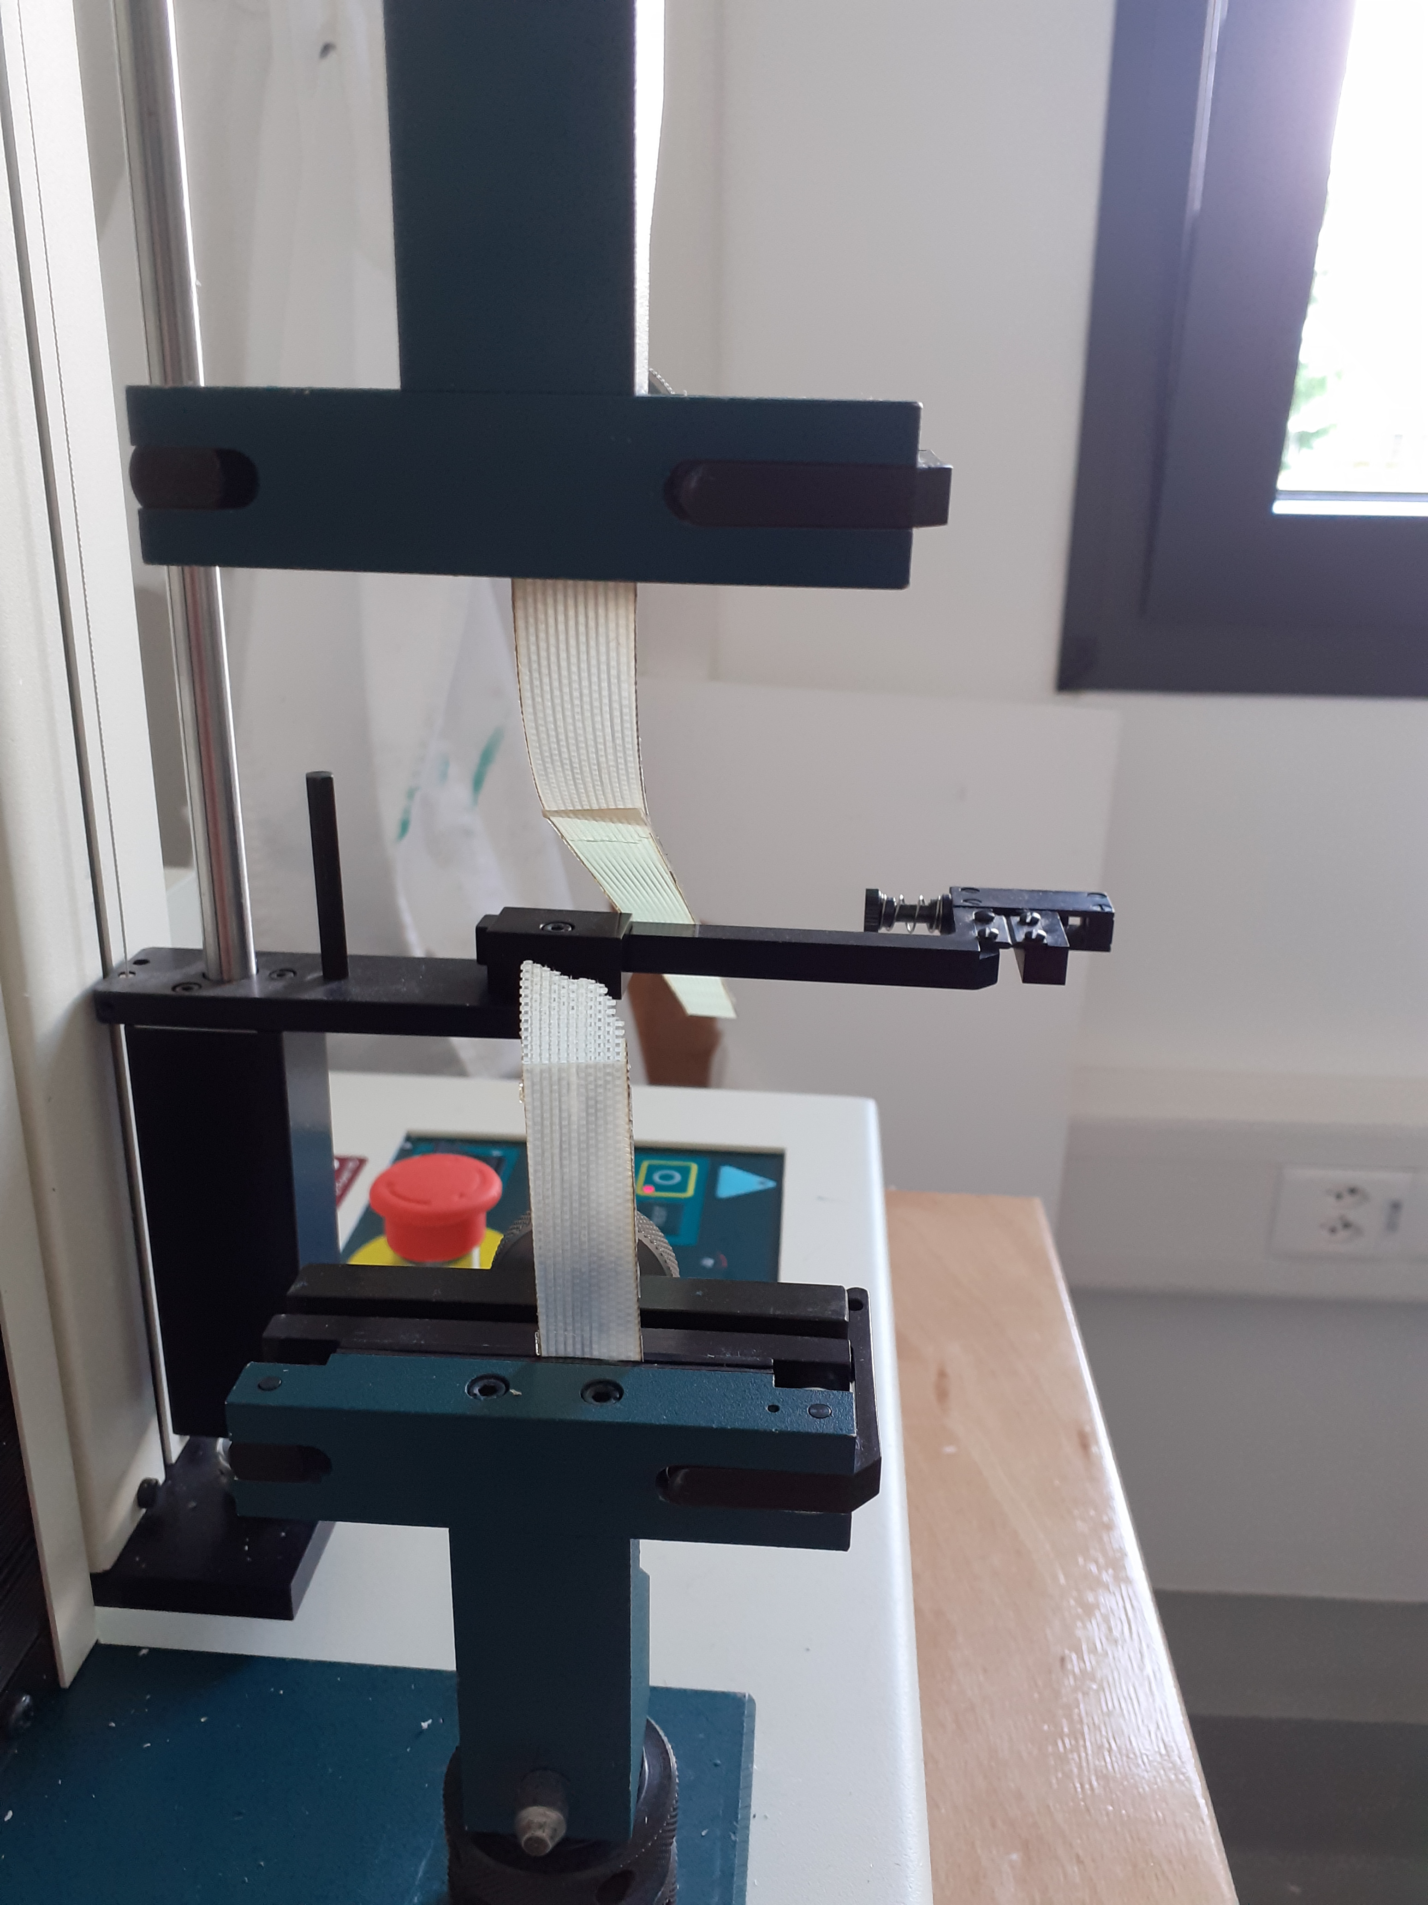
G-11 with CTD101k
The adhesion between G-11 and CTD101k is very strong.
The G-11 is fragile, so it breaks very early while testing
The G-11 breaks from within, but the bond between the G-11 and the resin did not break.
This reflects a cohesive rupture.

Slide 10
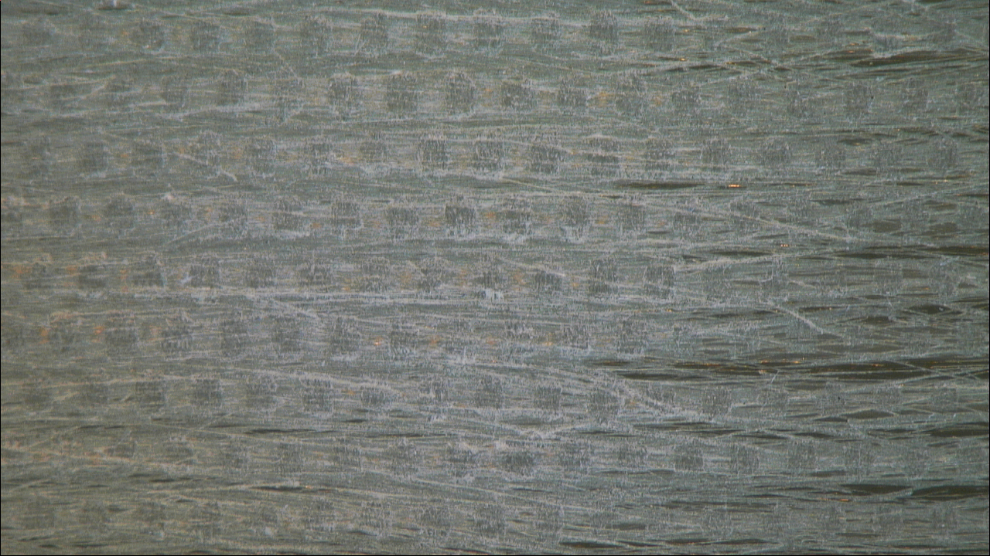
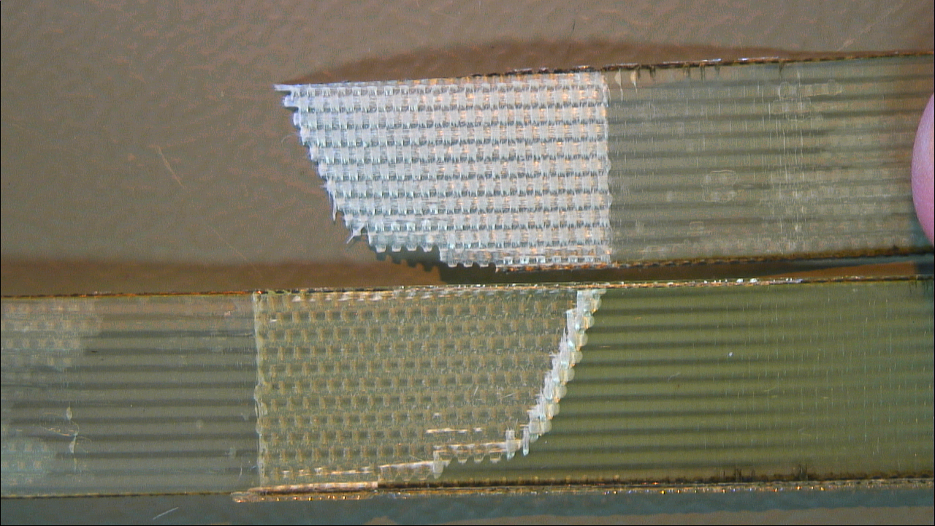
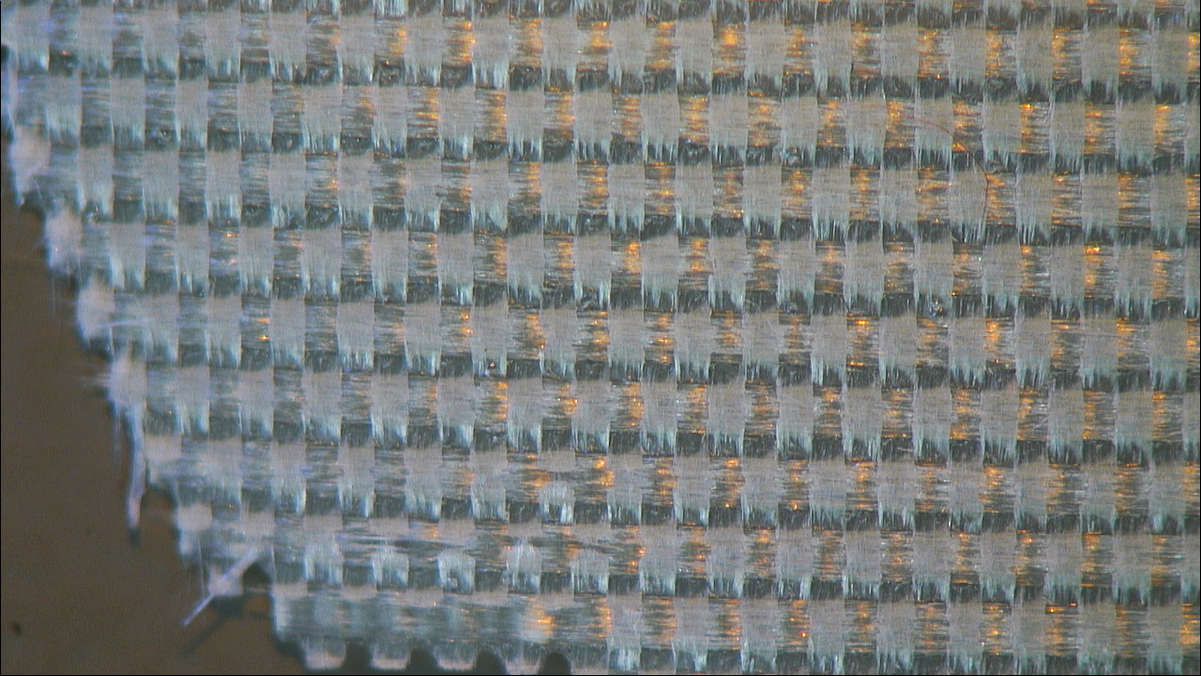
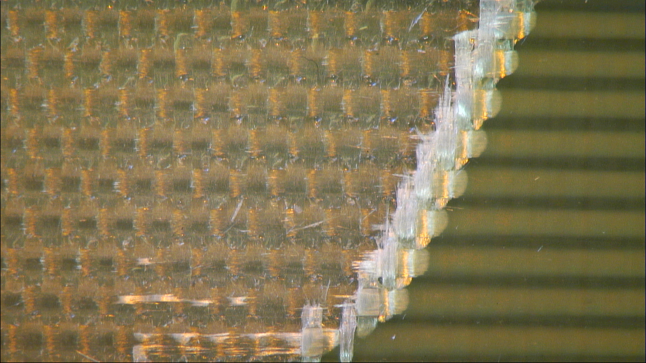
G-11 with CTD101k- Microscope pictures
25X
G-11 surface before peel test
15X
25X
25X

Slide 11
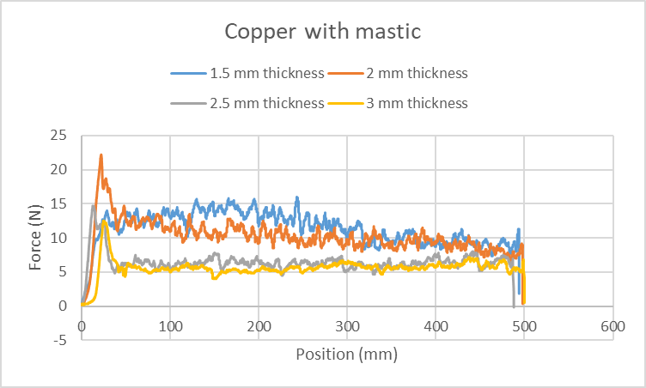
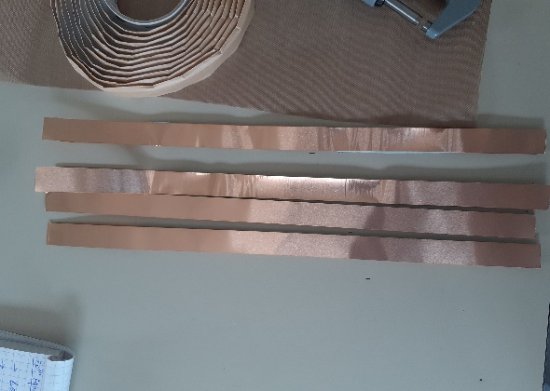
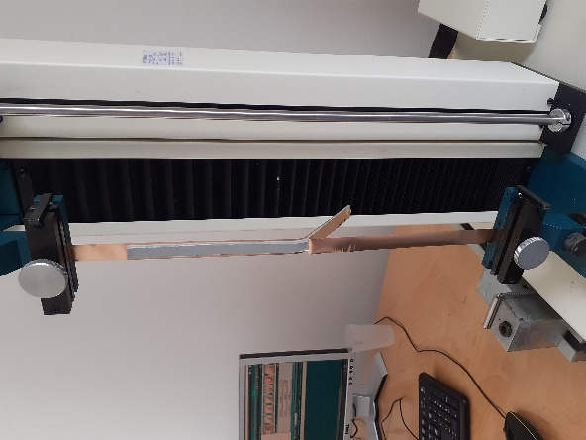

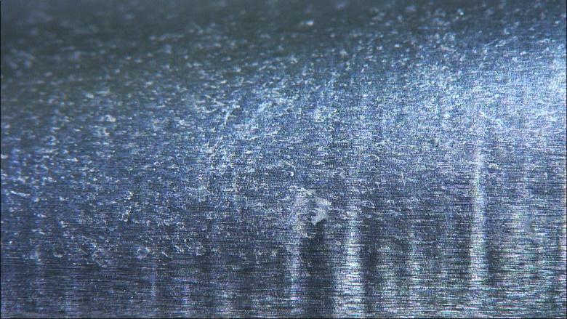
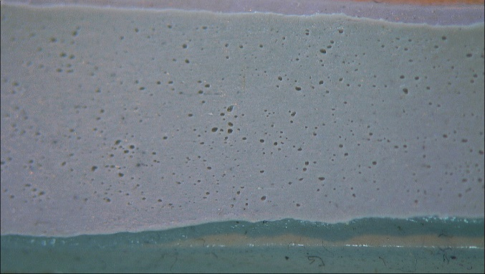
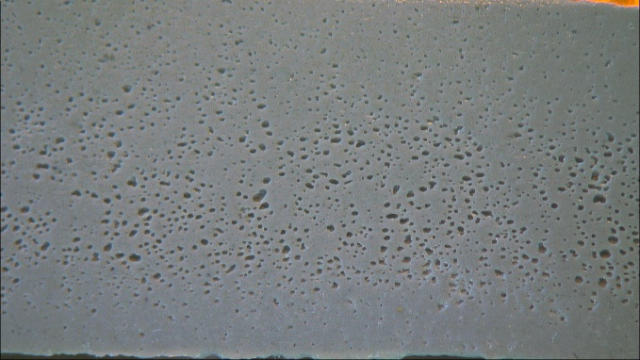
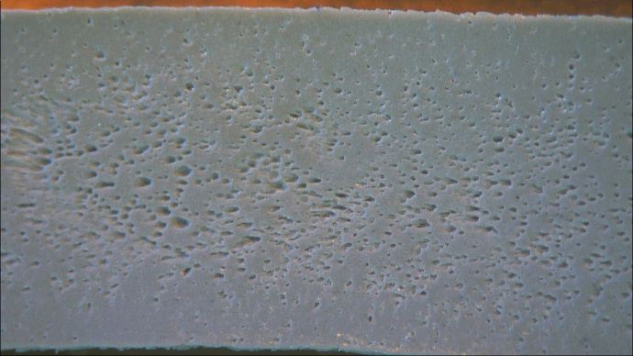
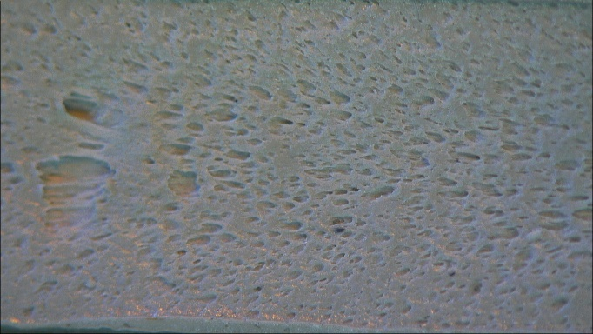
Copper with mastic (T-peel)
Experiments show that the lap joint strength increased as the thickness of the adhesive decreased. This is because the interface stresses increase as the bond line gets thicker. If the failure occurs close to the adhesive-adherend interface, a failure criterion based on the interface stresses explain that thin joints are stronger than thick joints. The maximum peel is 17.85 N, 11.8 N, 7.17 N, and 5.67 N for thickness 1.5 mm, 2 mm, 2.5 mm and 3 mm respectively. The average peel is 10.1 N, 9.13 N, 5.98 N, and 3.88 N for thickness 1.5 mm, 2 mm, 2.5 mm and 3 mm respectively.
Copper surface before test
Copper surface after test
25X
25X
3 mm
2.5 mm
2 mm
1.5 mm
Both adhesive and cohesive failure. Besides, the deformations/ voids in the mastic increased as we decreased the thickness because of the application of the roller used to vary the thickness of the mastic.

Slide 12
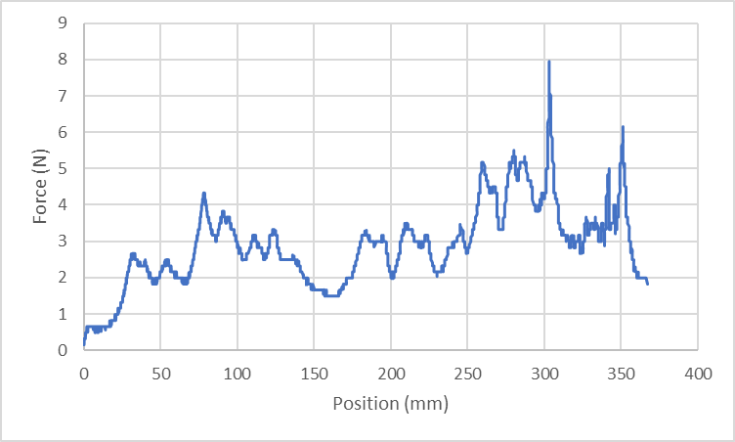
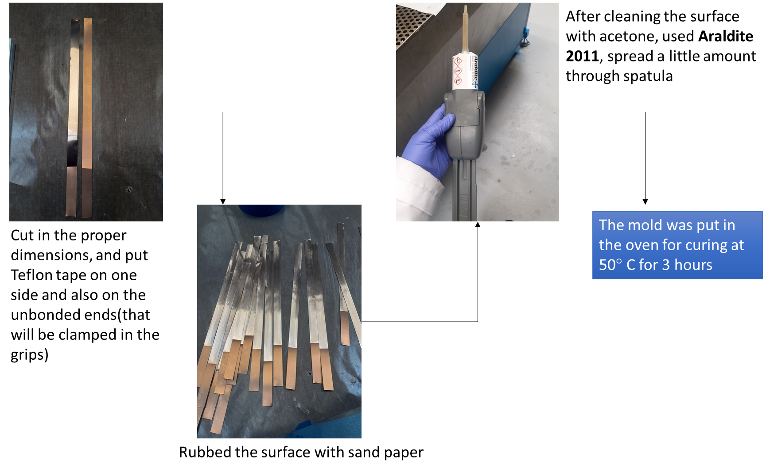
Copper with Araldite 2011
Araldite 2011 is a resin containing reaction products such as bisphenol A-(epicholohydrin); epoxy resin (average MW<700); N(3-dimethylaminopropyl)-1,3-propylenediamine; bisphenol F-epoxy resin; bisphenol A-epoxy resin
The graph has been obtained after curing at 50 degrees for 3 hours and inside the mold.
Still adhesion is not as good as expected. We believe that we need to improve the method for making the samples (for example, better wetting of the copper).

Slide 13
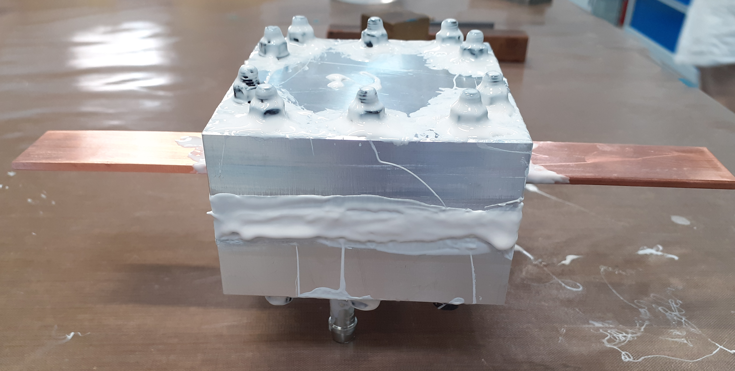
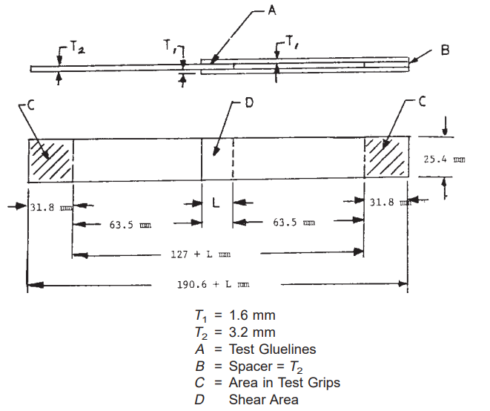
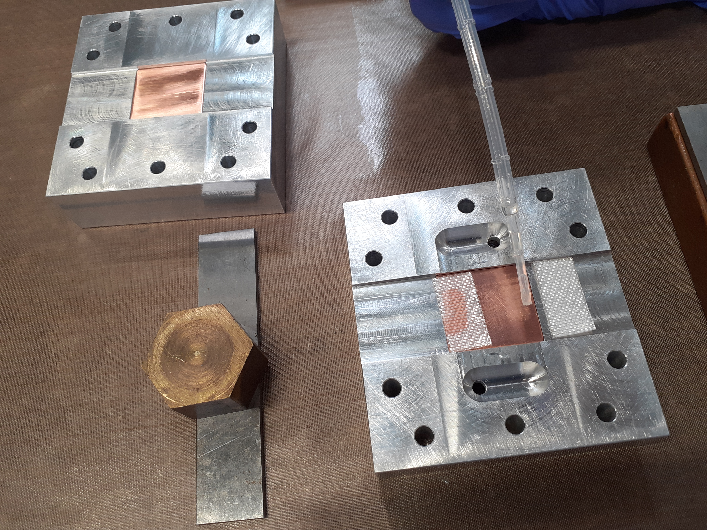
Work in progress
Double lap shear joint
The ASTM standard being followed is the ASTM D 3528-96 which is the Standard Test Method for Strength Properties of Double Lap Shear Adhesive Joints by Tension Loading.
One run was performed with copper and CTD101K. Unfortunately, we could not get our samples since the mould did not demould properly and we lost the adhesion.

Slide 14
Conclusion
We are still fighting to identify an optimal procedure for making representative samples for the Peel test.
We are setting up the manufacture of the samples for the shear strength tests.
The pull-off method is still under finalization.

