Slide 1
SPVD CDR Update
6 May 2021
Anne, Marvin, Sandro

Slide 2
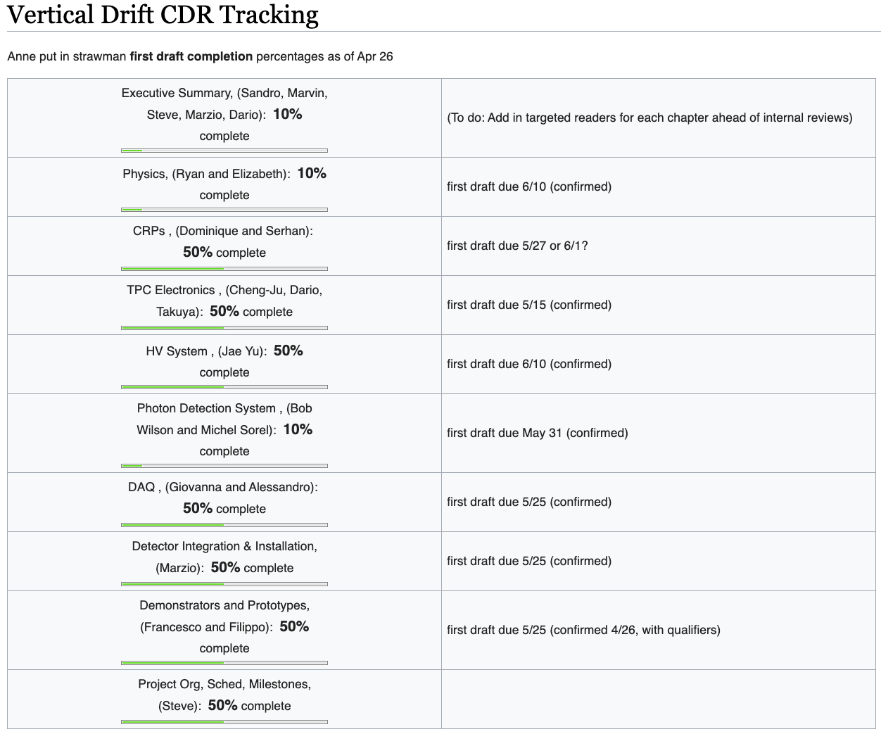
Status I
All initial meetings done
Have PoCs for all chapters
Have due dates for first drafts
Tracking in wiki

Slide 3
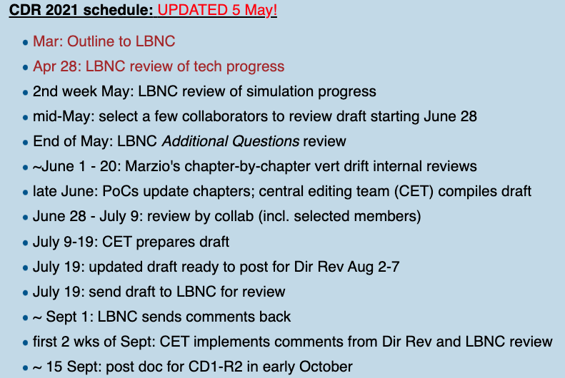
Status II
We met yesterday with LBNC (Jeff and Mont) to discuss process and schedule
  Meeting notes available under “Meetings”
Same PDF (19 April) posted on EDMS
  No updates, except new macros (next slide)

Slide 4
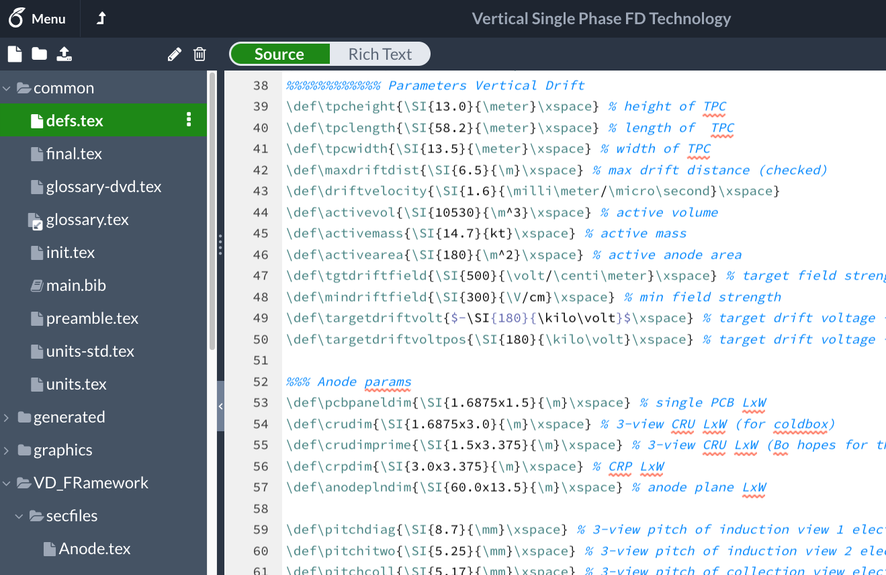
New macros in common/defs.tex file
Please
review,
correct any that are wrong or that change,
add new ones, and
USE!

