Slide 1

SY-BI
CWDM Link: SM-VTXx
EP-ESE/SY-BI Collaboration Seminar
Leonardo Marcon (EP-ESE-BE)
leonardo.marcon@cern.ch

Slide 2
BE-BI
CWDM Link: SM-VTXx
Outline:
  CWDM link
  VTRx/VTTx prototypes
  Production costs and timeline
  Early CWDM MUX irradiation results

Slide 3
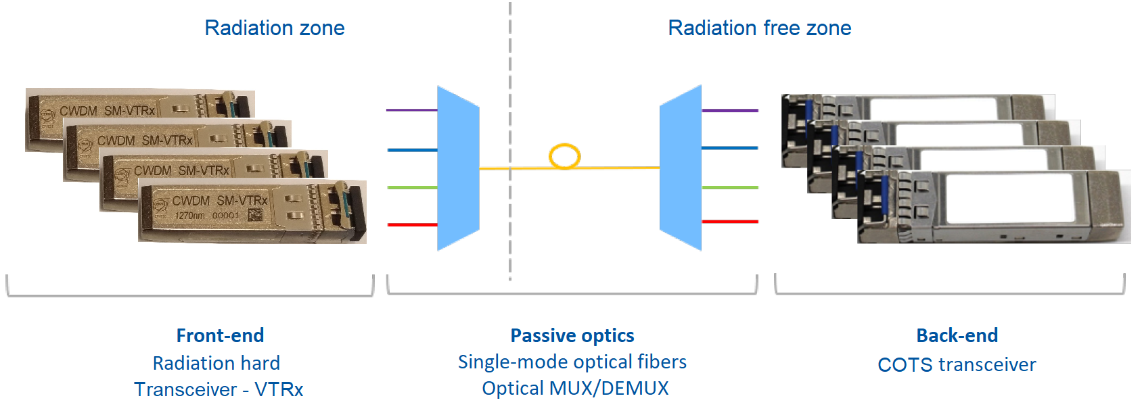
BE-BI
Introduction: CWDM Link
MUX
DE-MUX
Parameter | Value | Units
Uplink Bit Rate | Up to 4x10.24 | Gb/s
Downlink Bit Rate | Up to 4x5.12 | Gb/s
Wavelengths | 1270/1290/1310/1330 | nm
Total ionizing dose (TID) | 10 | kGy
Fluence | 5 · 10¹⁴ | n/cm² MeV neutrons
https://edms.cern.ch/ui/#!master/navigator/project?P:100606408:100606408:subDocs
https://www.itu.int/rec/T-REC-G.694.2-200312-I

Slide 4
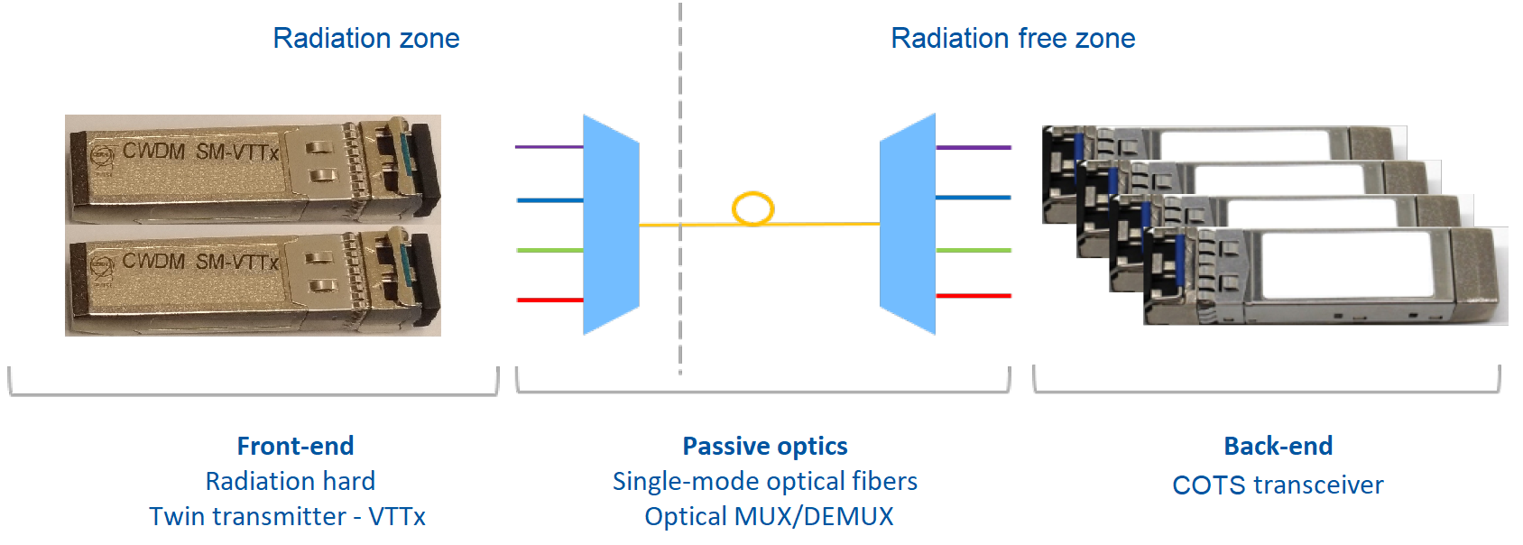
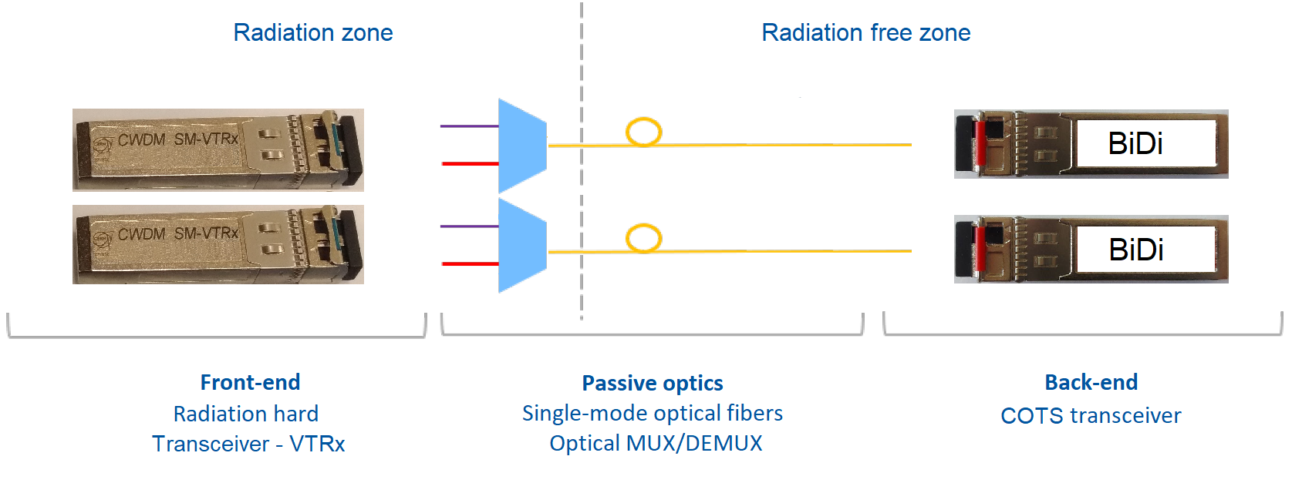
BE-BI
Introduction: CWDM Link

Slide 5
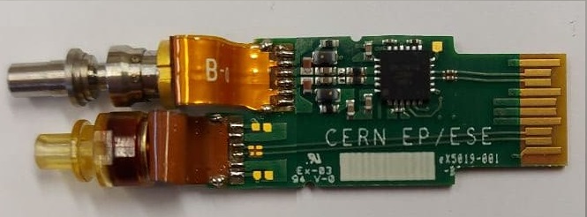
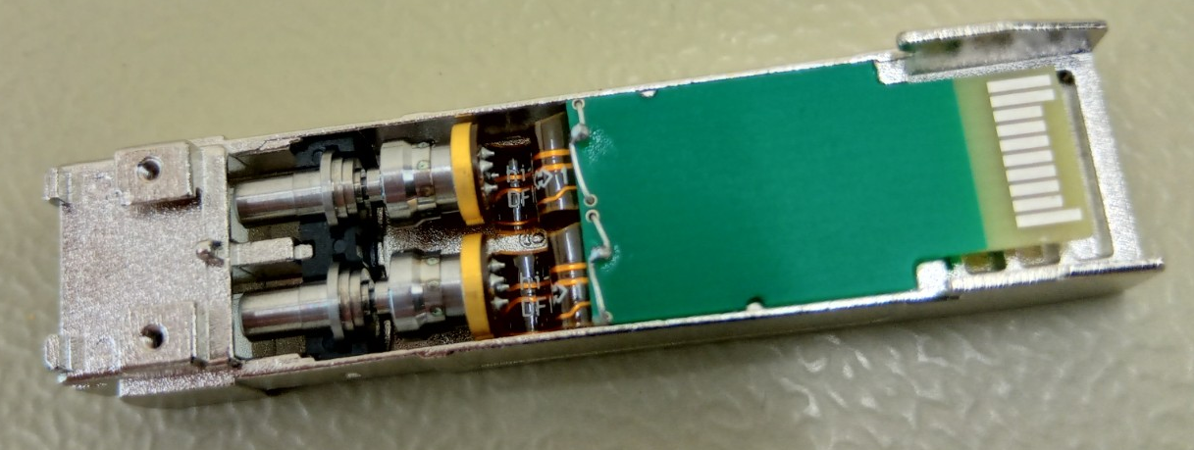
BE-BI
CWDM SM-VTRx/SM-VTTx
CWDM SM-VTRx
Single mode - transceiver
CWDM SM-VTTx
Single mode – twin transmitter
16 prototypes ready
16 prototypes in production
Components:
TOSA
ROSA + TIA
GBLD
Electrical components
PCB
SFP+ Metal case
Components:
2x TOSA
2x GBLD
Electrical components
PCB
SFP+ Metal case
Legend:
TOSA = Transmitter Optical Sub-Assembly GBLD = Laser Driver
ROSA = Receiver Optical Sub-Assembly TIA = Trans-Impedance Amplifier

Slide 6
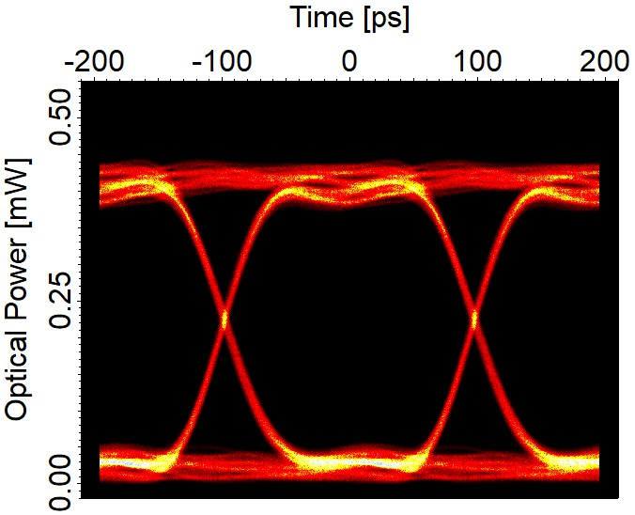
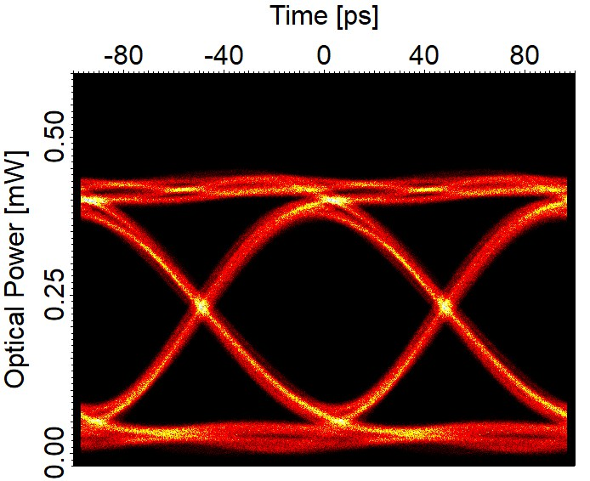
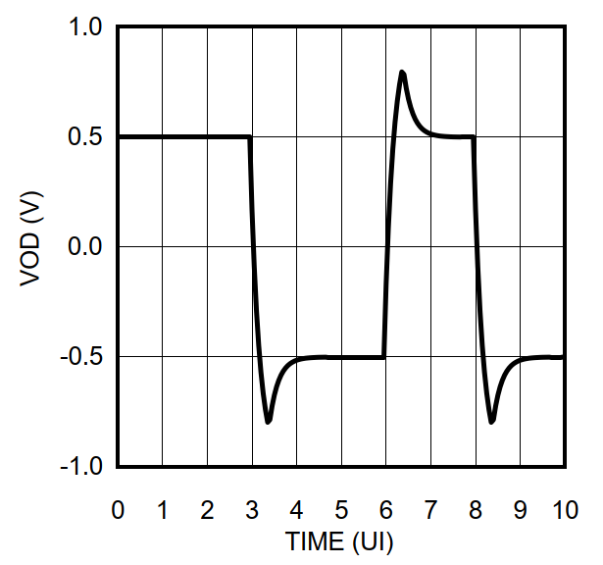
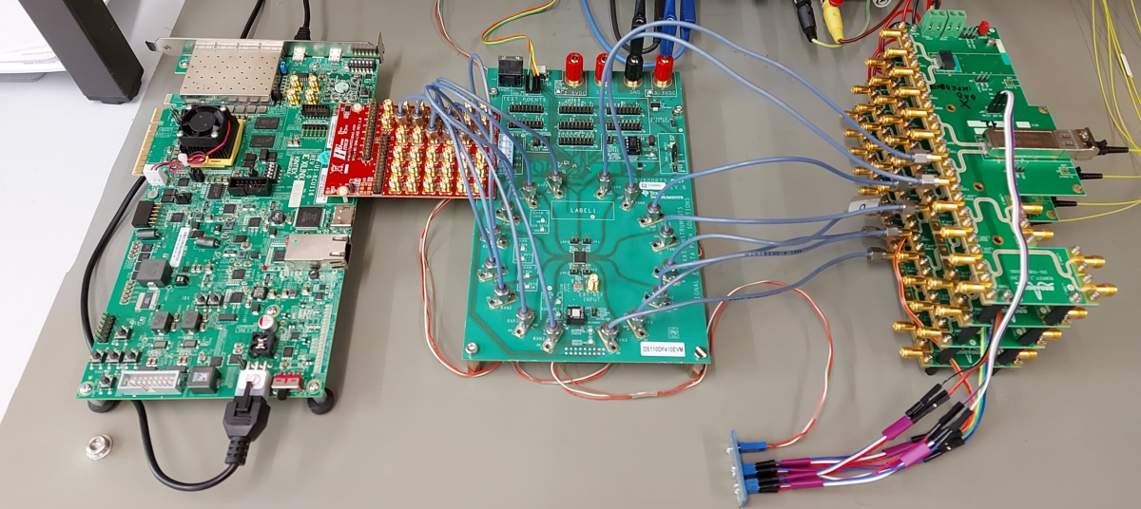
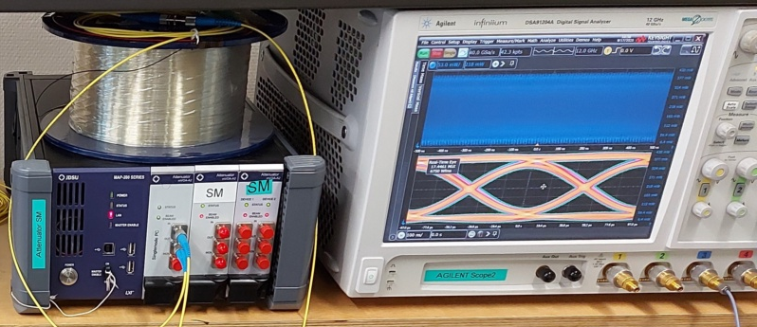
BE-BI
CWDM Link setup: Results
5 Gb/s
10 Gb/s
Pre-emphasis

Slide 7
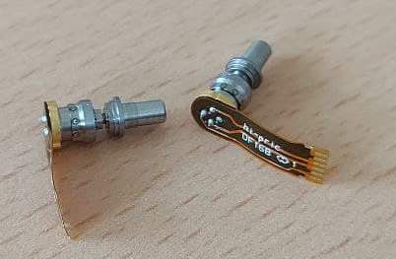
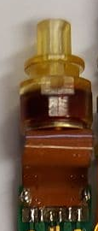
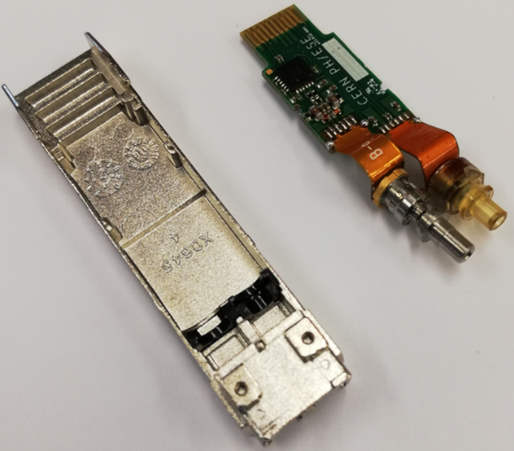
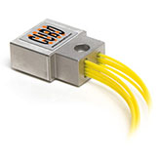
BE-BI
Updated production costs
Components:
TOSA
ROSA + TIA
GBLD
Metal case
MUX
Assembly
Procurement stage:
Waiting for Bid
Component identified and qualified
Waiting to order wafers
Component identified and qualified
Component identified and qualified
TBD
Quote (3000 VTTx + 3200 VTRx):
~500 kCHF
~200 kCHF (including TIA)
~70 kCHF
<25 kCHF
~950 kCHF
TBD
Total: 1.75 MCHF + Assembly

Slide 8
BE-BI
Updated production timeline
Components:
TOSA
ROSA + TIA
GBLD
Metal case
MUX
Assembly
ETA:
End 2021/2022
1.5 years process (estimated, can be started anytime)
1 year process, but long queue
no info (can be started anytime)
no info (can be started anytime)
1 year process (estimated)
2021
2022
2023
TOSA
ROSA + TIA
GBLD
Assembly
Metal case
MUX

Slide 9
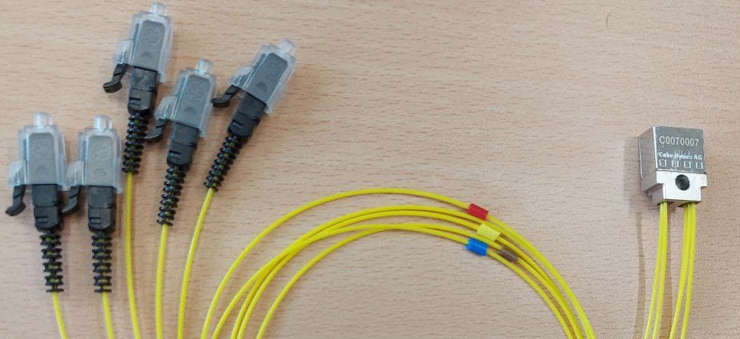
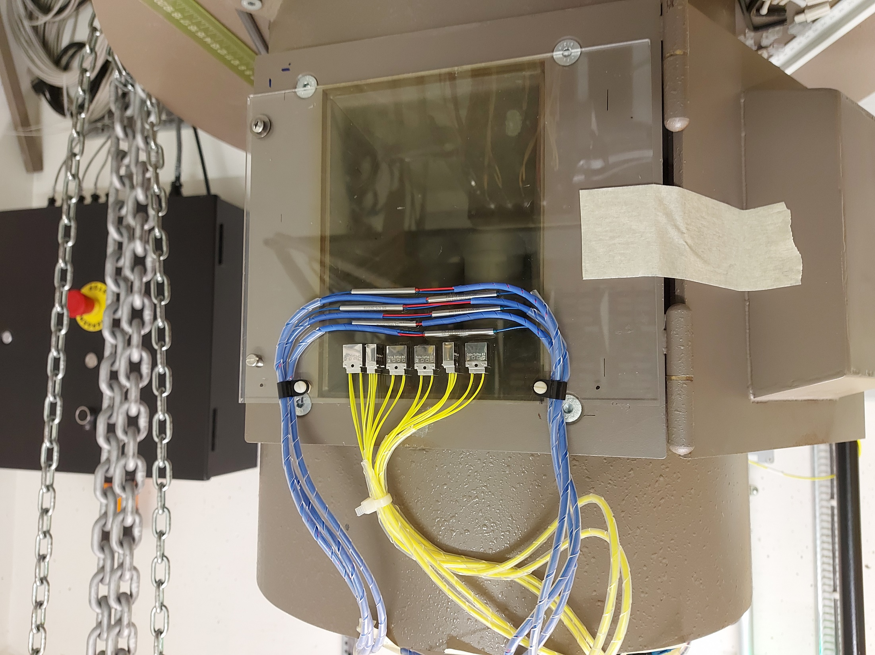
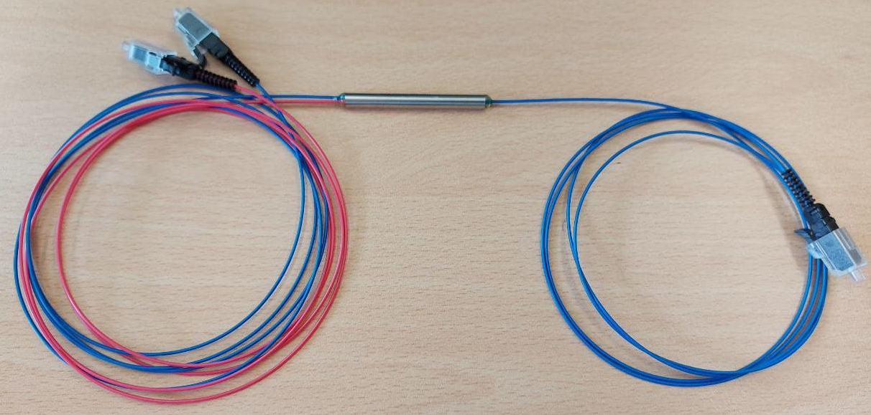
BE-BI
CWDM MUX irradiation tests
4 channel CWDM MUX
2 channel CWDM MUX
Gamma rays irradiation (Cobalt-60).
Irradiation started 3rd of May, stopped the 21st of May
Annealing started the 21st of May, stopped the 5th of June
Dose rate = 29.7 Gy/h
Total ionizing dose = 11.3 kGy

Slide 10
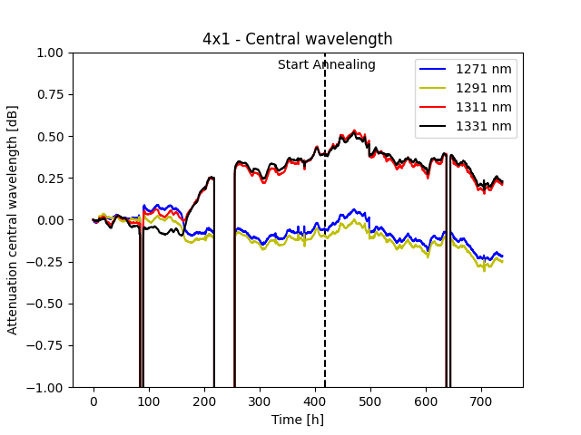
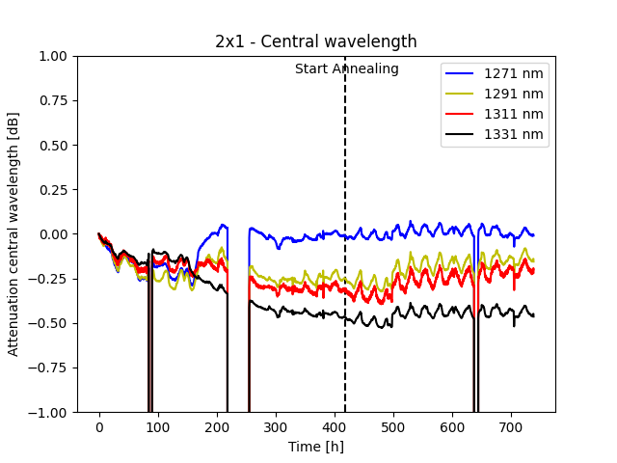
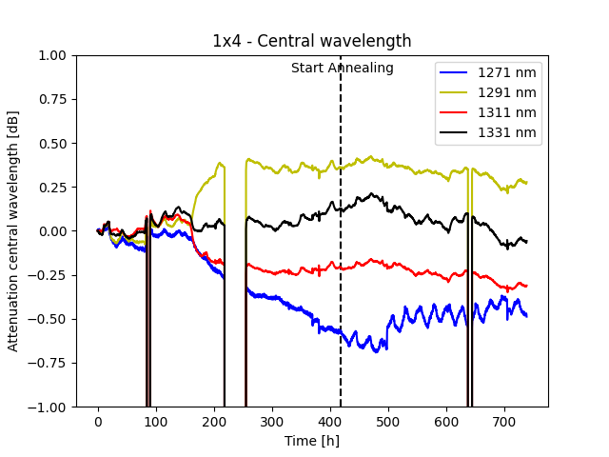
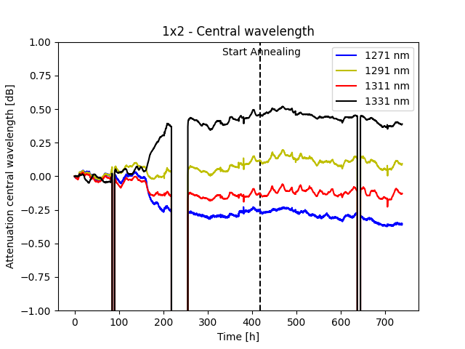
BE-BI
CWDM MUX irradiation tests
Something happened after 160h, further investigations are ongoing…

Slide 11
BE-BI
Progresses in the development of the CWDM SM-VTRx
Conclusions:
  CWDM VTXx prototypes (almost) ready
    Tests with front-end boards prototypes?
  Procurement of the components ongoing
    Pipelining what’s possible
  MUX qualifications almost completed
    Further analysis ongoing

