Slide 1
Beam instrumentation based on Electro-Optical detection
T. Lefevre for BI group
EP-ESE & SY-BI collaboration meeting - 14 June 2021

Slide 2
Outline
Electro-optical detection
Commercial products and R&D work
On-going work in SY-BI
Future needs and possible synergies with EP-ESE

Slide 3
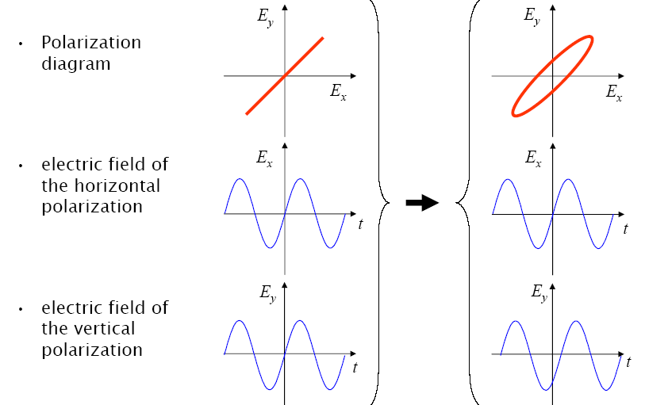
Electro-optical detection in Beam instrumentation
Aim : Convert Coulomb field of e-bunch or beam induced voltage signals into an optical intensity variation
How: Use the polarization/phase change of a laser beam which passes through a birefringent crystal itself polarized by the electric field of charged particle beams
Pockel/Kerr effect
probing laser pulse
EO crystal
Coulomb field
particle beam
Relative phase shift between polarizations
increases with the beam electric field

Slide 4
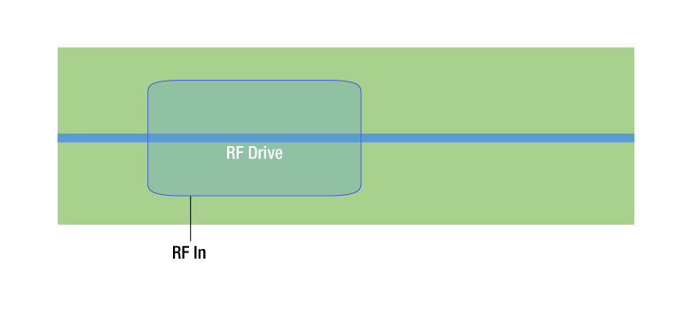
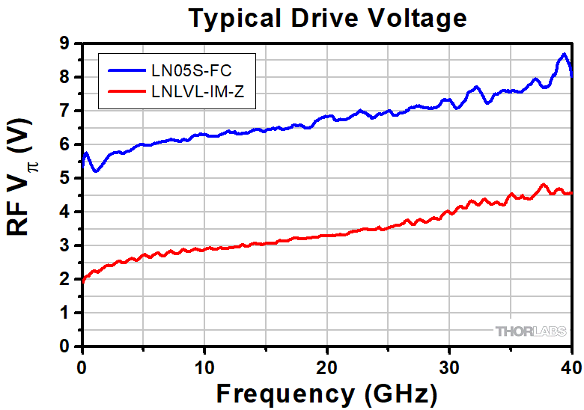
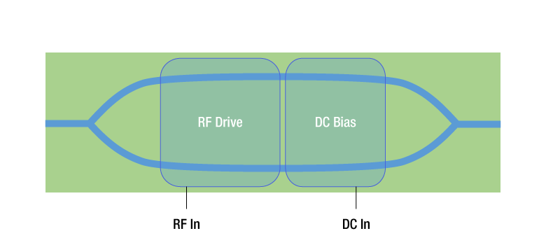
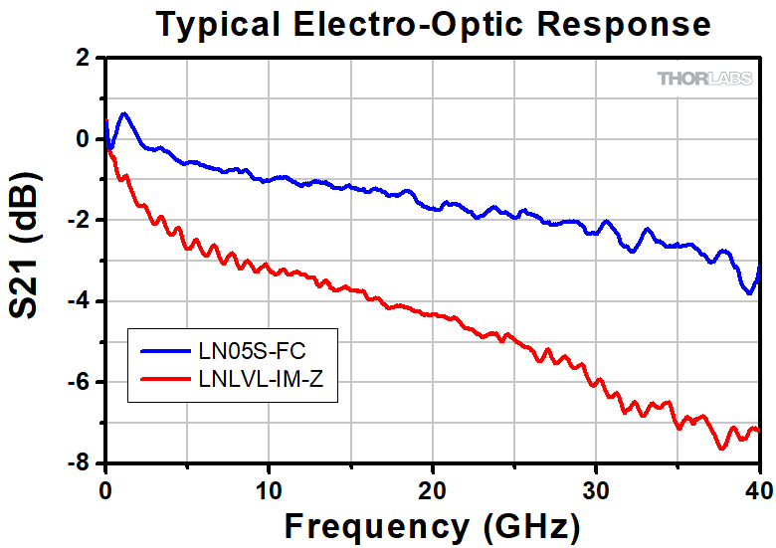
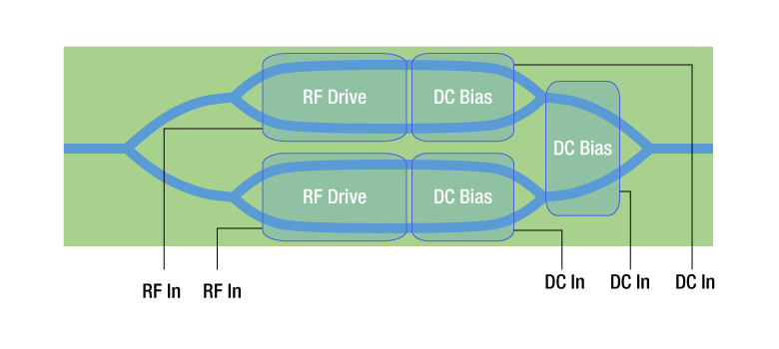
Electro-optical detection in Beam instrumentation
Commercial E-O modulators used in many applications in laser technology and telecommunications
Phase/intensity modulator
without/with polariser
Intensity modulator
using Mach-Zehnder interferometer
IQ Intensity modulator
using Mach-Zehnder interferometers

Slide 5
Electro-optical detection in Beam instrumentation
Commercial E-O modulators used in many applications in laser technology and telecommunications
LiNbO3, LiTaO3, GaAs, BGO, ..
Large bandwidth from DC to 50GHz

Slide 6
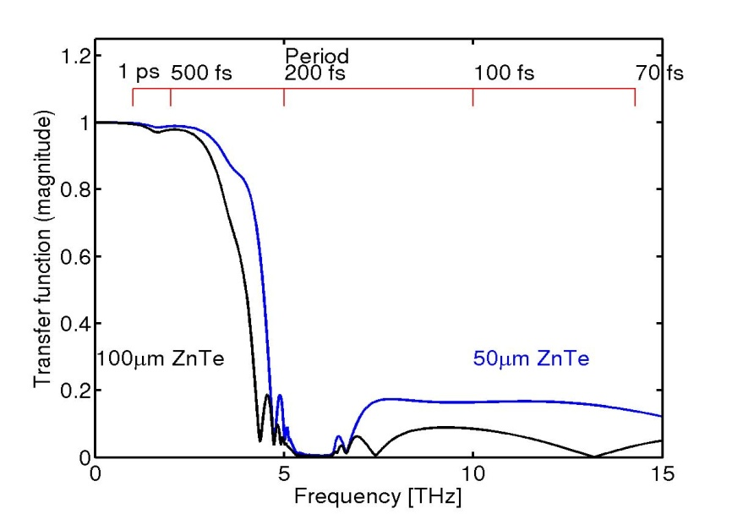
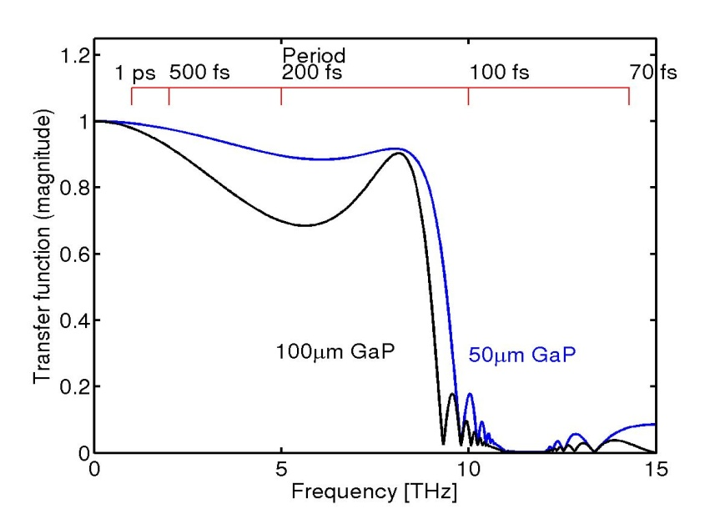
Electro-optical detection in Beam instrumentation
R&D on E-O techniques in accelerators for short bunch length monitoring (sub picosecond time response)
ZnTe
GaP
Thinner crystal - need higher power (short pulse) laser

Slide 7
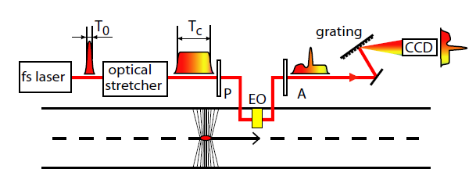
Electro-optical detection in Beam instrumentation
R&D on E-O techniques in accelerators for short bunch length monitoring (sub picosecond time response)
Spectral
Decoding
Encoding
Time to Frequency
Decoding
Frequency from Position
Time
Position
Wilke et.al., PRL 88 (2002) 124801

Slide 8
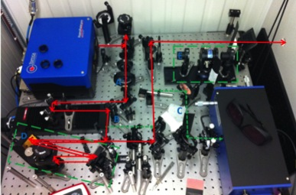
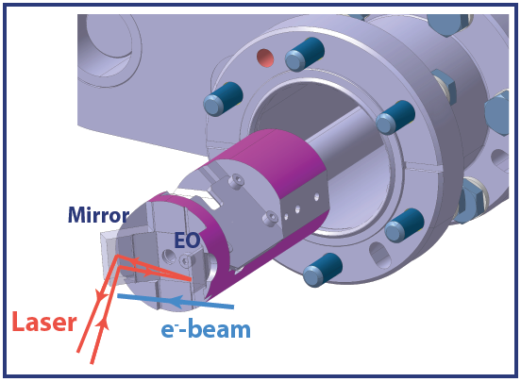
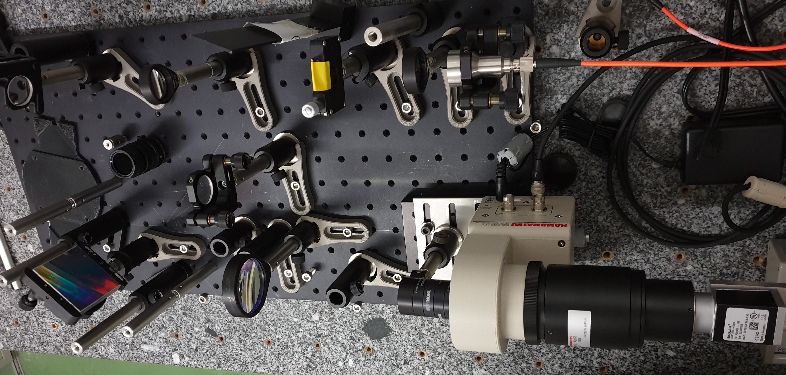
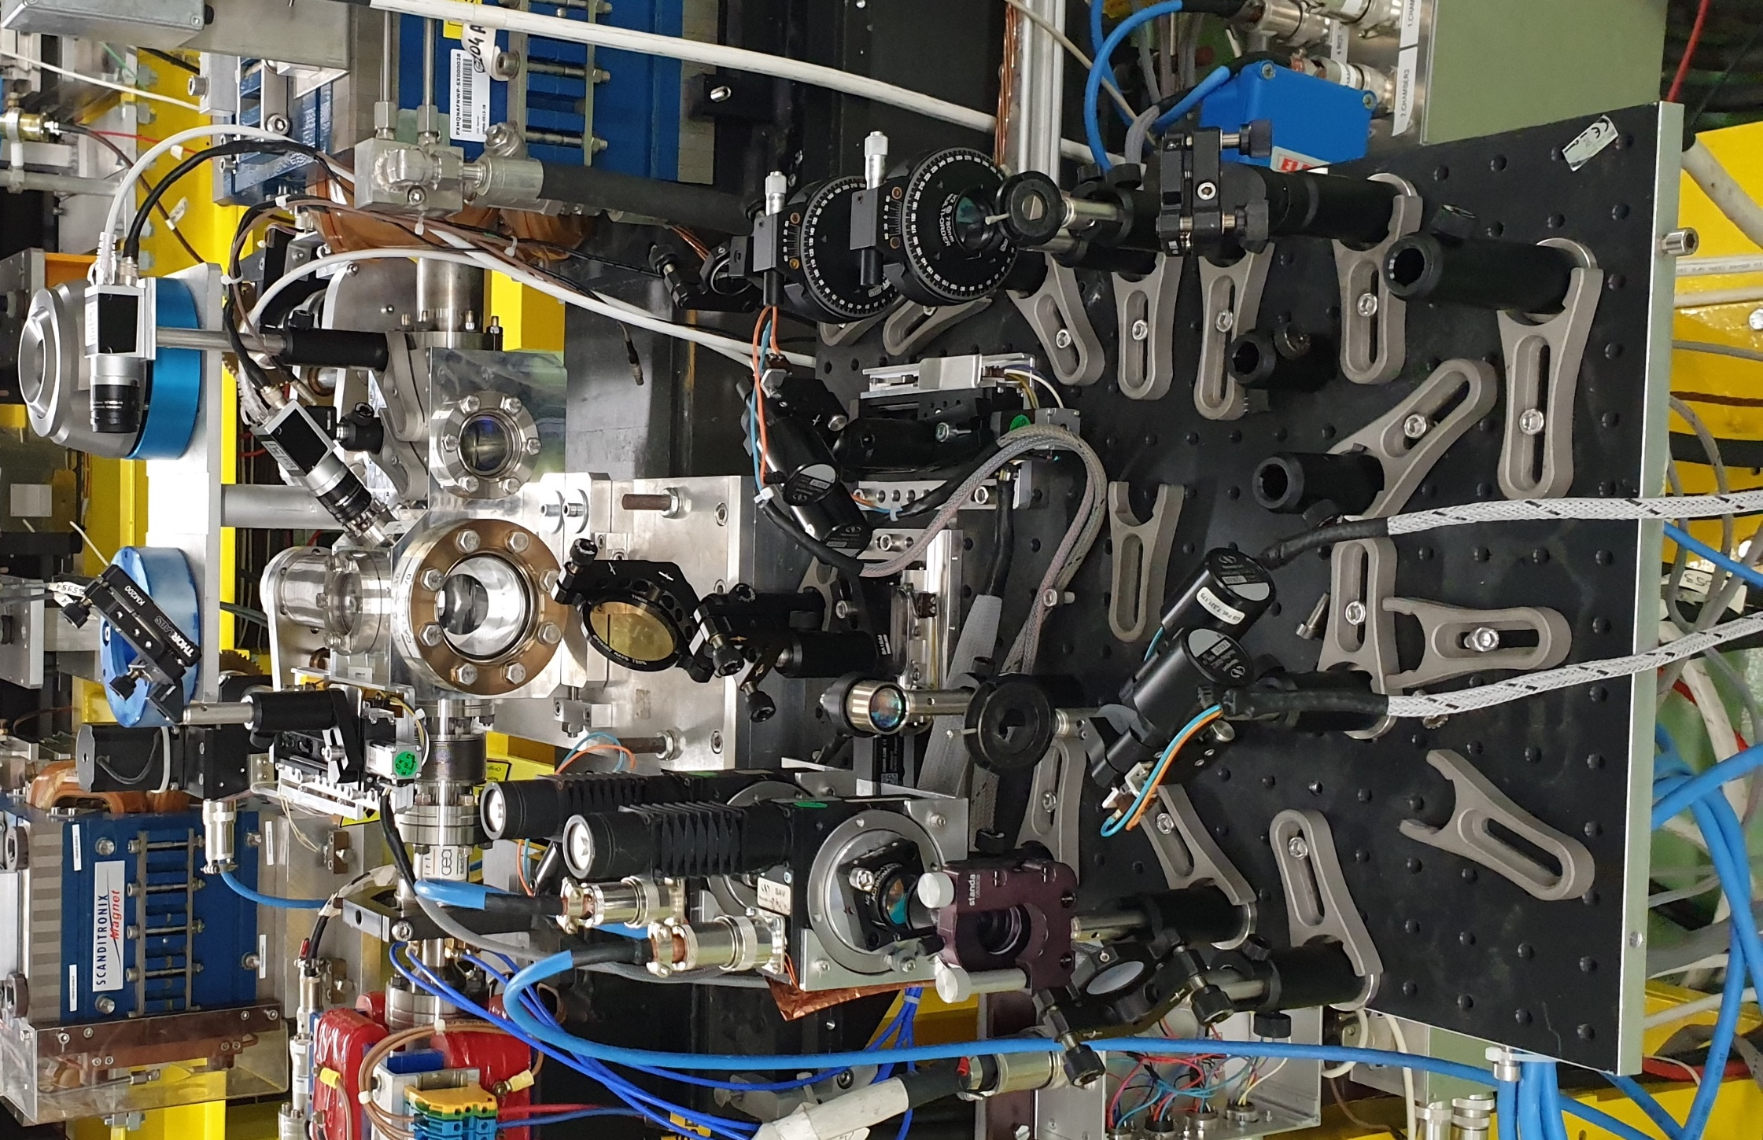
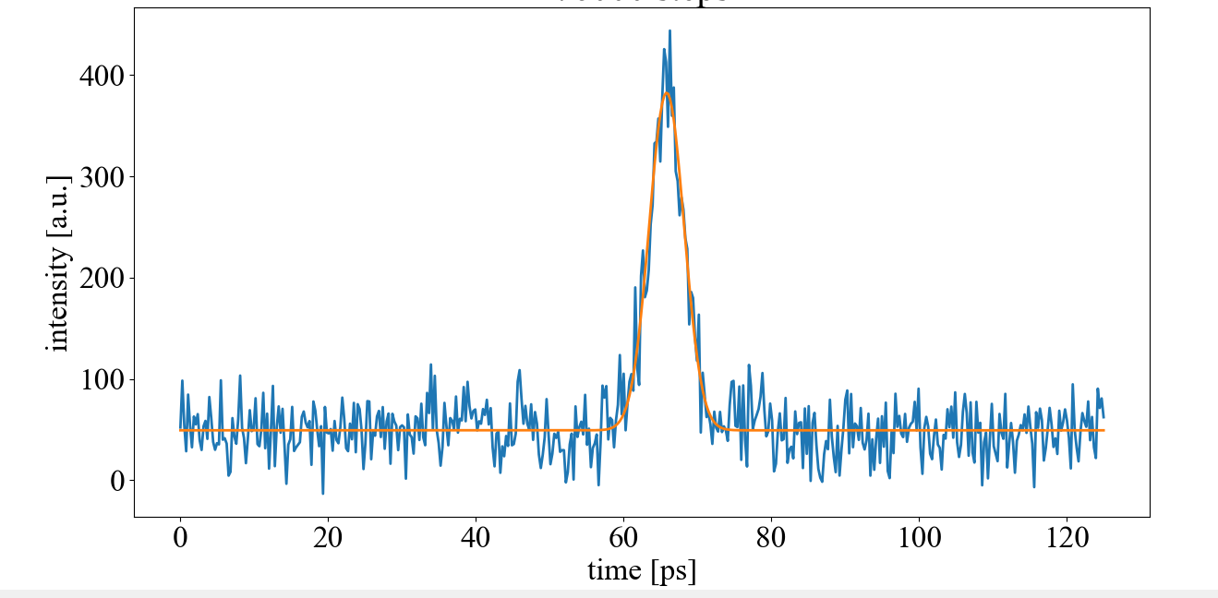
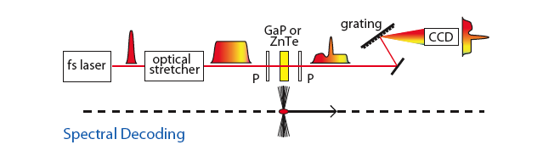
E-O systems in SY-BI
Spectral decoding EO system at CLEAR for short bunch length measurement
Er laser 780nm
150fs – 12ps
Spectrometer with grating and intensified gated CCD camera
ZnTe Crystal in between crossed polarisers
System being simplified for integration in AWAKE and upgraded for measuring 1ps long bunches
S. Mazzoni and E. Senes

Slide 9

E-O systems in SY-BI
EO development for high bandwidth (20ps resolution) intra-bunch beam position monitor at LHC
Button with custom brazed electrode
CST simulations
DC Laser at 780nm
  In-air fiber based EO waveguide
  encoding manufactured by UK industry
Collab. with RHUL

Slide 10
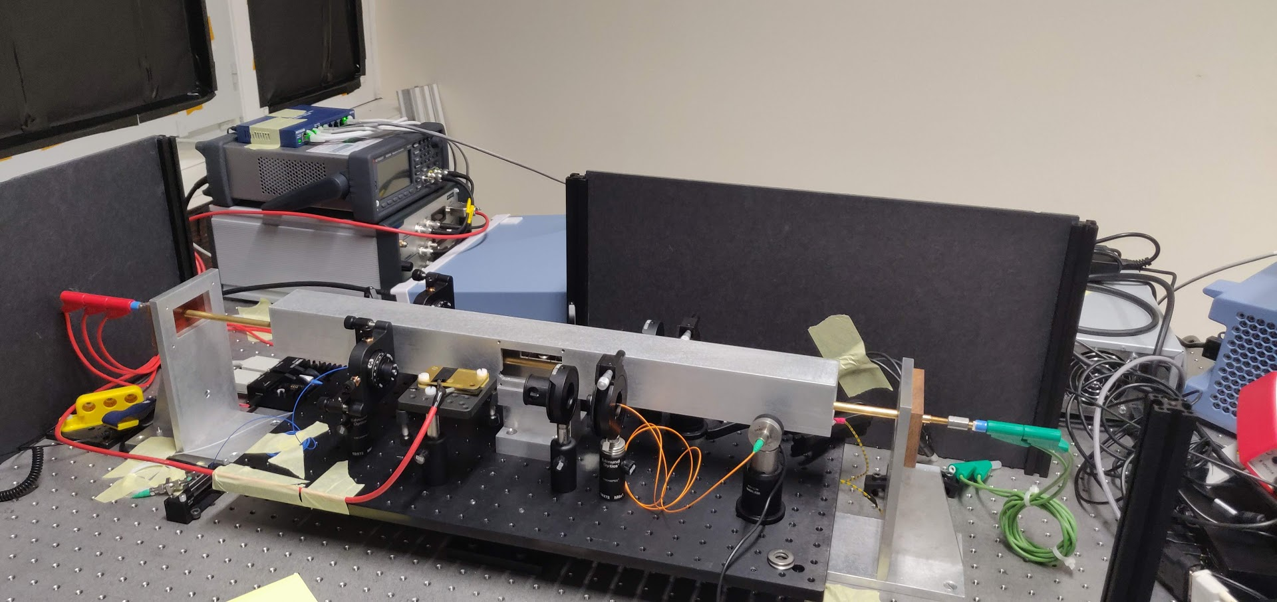
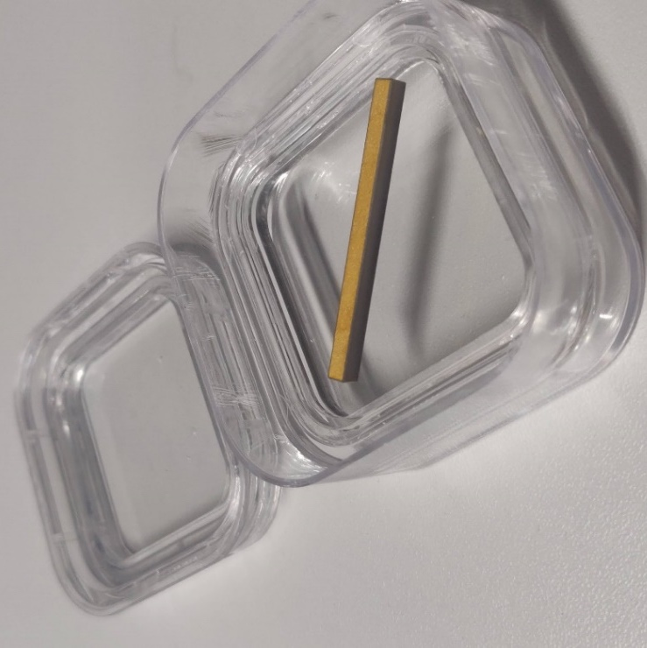
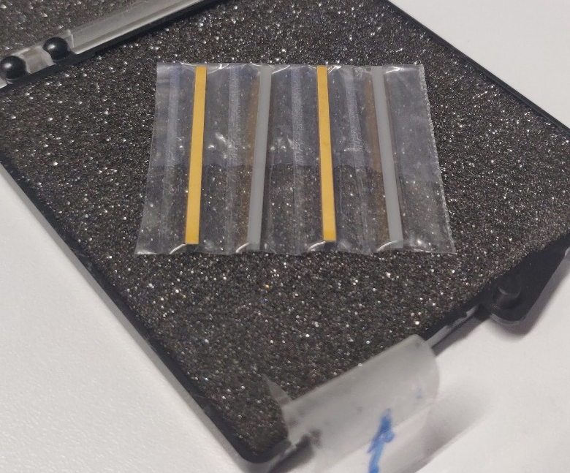
E-O systems in SY-BI
EO BPM measurement for DC beams in SPS
DC Bias
Modulation
signal
Feedback signal
Data processing system
z
E^{Opt}
Photodetector
Transmission
direction
x
External field
to measure
Transmission
direction
Laser at 1550nm
LiNbO3
LiTaO3
A. Cristiano and M. Krupa

Slide 11
E-O systems in SY-BI
All systems aim at fiber based solutions
Possibly generalising time stretch techniques (spectral decoding) to improve the time resolution

Slide 12
EO detection system for LHC
High-speed spectrometer
laser
25ns
40GHz EO modulator / PU
1ns
2ns
25ns
LHC Beam signal
Prism + 40 photo-detectors (600MHz)
δt = 25ps

Slide 13
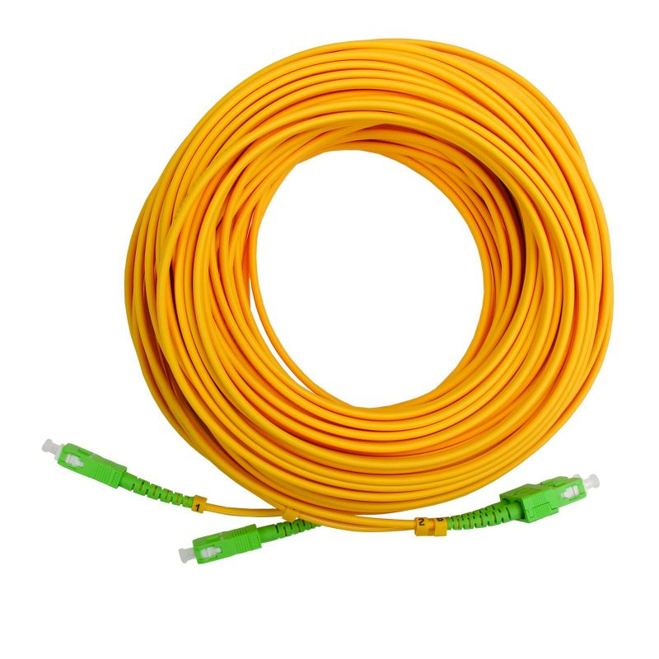
EO detection system for LHC
Laser temporal manipulation
Dispersive / fiber bragg grating
stretching
40MHz, 80mW
1560nm Laser system
Pulse duration 50 fs 2.5 ns
Peak power 16 MW 200 mW (30%loss)
High-speed spectrometer
laser
25ns
40GHz EO modulator / PU
1ns
2ns
25ns
LHC Beam signal
Prism + 40 photo-detectors (600MHz)
δt = 25ps

Slide 14
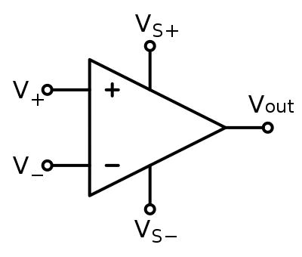
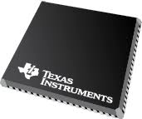
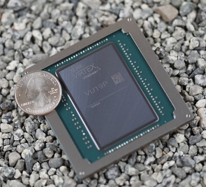
EO detection system for LHC
Laser temporal manipulation
Dispersive / fiber bragg grating
stretching
40MHz, 80mW
1560nm Laser system
Pulse duration 50 fs 2.5 ns
Peak power 16 MW 200 mW (30%loss)
High-speed spectrometer
laser
25ns
40GHz EO modulator / PU
1ns
2ns
25ns
LHC Beam signal
Prism + 40 photo-detectors (600MHz)
δt = 25ps
Signal
Conditioning
40 ADCs
(16bits, 40MSa/s)
Large FPGA
digesting a data flow of 25.6Gbit/s

Slide 15
EO detection system for LHC
Laser temporal manipulation
Dispersive / fiber bragg grating
stretching
40MHz, 80mW
1560nm Laser system
Equivalent Bandwidth of 40GHz
Time resolution of 25ps
Sensitivity would depend on EO modulator/photo-detectors noise/DR
Measuring all bunches (40MHz) - Ok
Acquiring larger number of turns – depending on DAQ
Pulse duration 50 fs 2.5 ns
Peak power 16 MW 200 mW (30%loss)
High-speed spectrometer
laser
25ns
40GHz EO modulator / PU
1ns
2ns
25ns
LHC Beam signal
Prism + 40 photo-detectors (600MHz)
δt = 25ps
Signal
Conditioning
40 ADCs
(16bits, 40MSa/s)
Large FPGA
digesting a data flow of 25.6Gbit/s

Slide 16
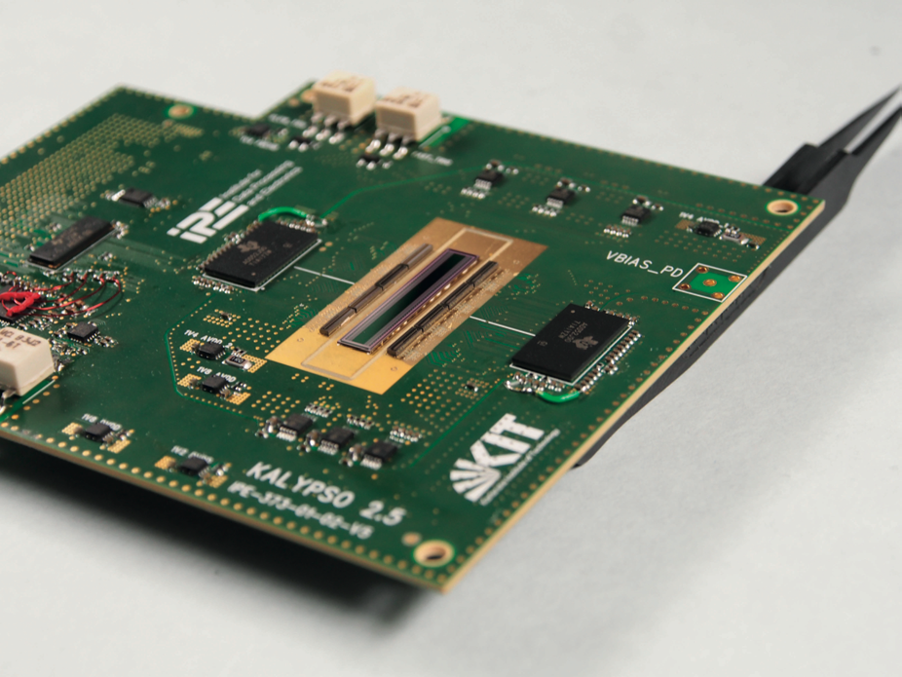
EO detection system for short bunches

Slide 17
Future…a fully integrated..
High rep rate chirped Fiber laser…. Stretching
…Custom fiber coupled EO modulator… Stretching
…Dispersive Grating…
… linear array of Si/InGaAs photosensor…
….ADC/FPGA

Slide 18
Thanks for your attention

Slide 19
100GSa/s -16bits (E-O) Oscilloscope (250kCHF)
Laser temporal manipulation
20kCHF
Dispersive
stretching
Splitting and
Frequency multiplication
50kCHF
Chirping
Longitudinal
shaping
100MHz, 80mW
1560nm Laser system
x 10
50 fs 5 ps 1.5 ns 1 ns Laser pulse duration
16 MW 140 kW 600 mW 400 mW Laser peak power
50GHz EO modulator
Prism + linear photo-detector array
40mW CW laser with periodic chirping
20kCHF
1ns 1ns 1ns
1ns
Signal to measure
High-speed spectrometer
100 channels
Output signal < 0.3 mW (0.3mA) per detector
10ps time resolution
40kCHF
Signal
Conditioning
100 ADCs
(16bits, 1GSa/s)
read-out system
FPGA digesting the data flow 100x16x10⁹ = 1.6Tbit/s
120kCHF

Slide 20
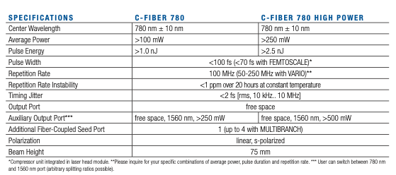
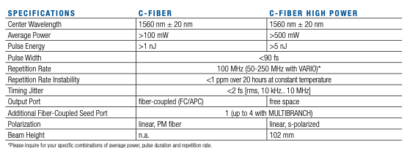
Laser for E-O detection at LHC
Central wavelength: 1560nm +/- 20nm
Spectral range(typ. <3 dB): ~ 20nm;
Output average power: 130mW (linear amplifier)
Repetition rate: 100MHz +/- 1MHz
Pulse width: prechirped to 1ns using 2 fiber bragg gratings
50kCHF with synchronisation
ΔFrev of few kHz

Slide 21
Time stretching for E-O detection at. LHC
Laser temporal manipulation
Dispersive
stretching
Study time streching methods
  Dispersion in long fibers
  Fiber bragg grating
  Combination of both
Characterise and optimise : spectral flatness vs peak power
  Work can start re-using the CLEAR EO laser system

Slide 22
Linear photodetector atLHC
Would also need to launch price enquiry : Need to work on specifications first

Slide 23
Linear photodetector for HT on LHC
Would also need to launch price enquiry : Need to work on specifications first

Slide 24

DAQ for HT at LHC
What exists on the Market ?
40 ADCs
(16bits, 40MSa/s)
Signal
Conditioning
FPGA
digesting a data flow of 25.6Gbit/s
ADS42JB69IRGCT
Arria 10 GX 660
48 transceivers
memory bandwidth of up to 128 Gbps
4k
16 Bit ADC
2 Inputs
220k/pieces
96 transceivers
memory bandwidth of up to 512 GBps
12k

