Slide 1
General information
G. Iadarola
ABP Computing Meeting – 23 Apr 2021

Slide 2
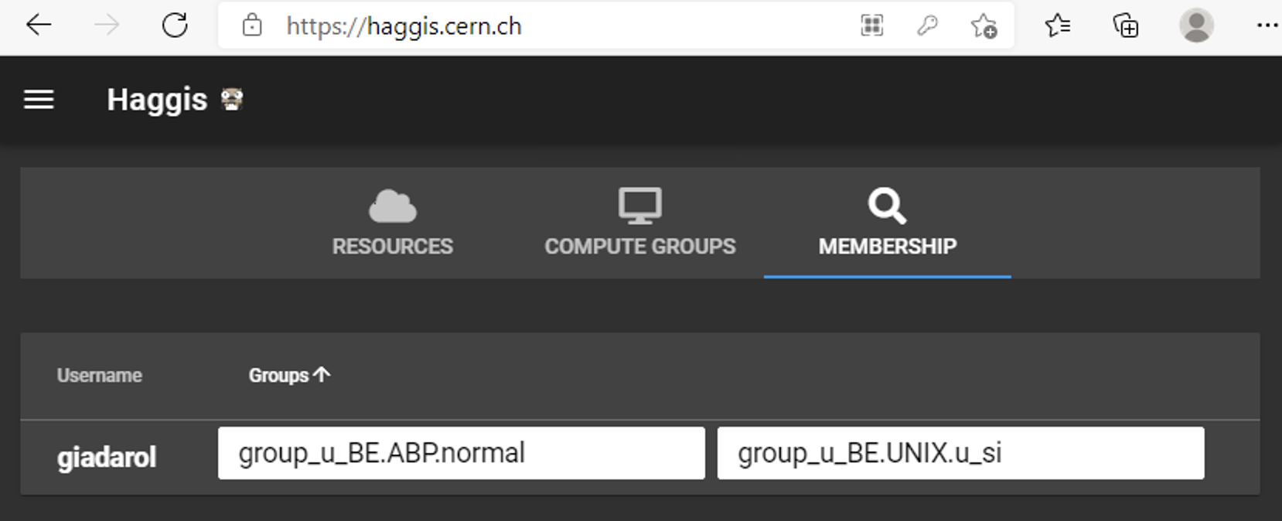
General information
Request from BE-CSS
  Is there interest from our side in using SWAN in the Technical Network
  Would we be interested in having PyJAPC in SWAN?
HTCondor queues
  Users from old e-groups (SLAP, ICE) have been redistributed
  Old e-groups have been discontinued → it should be transparent for users
    Let me know if you see anomalies
    You can can check on https://haggis.cern.ch/
Click here
used by htcondor
2

Slide 3
Thanks for your attention!

