Slide 1
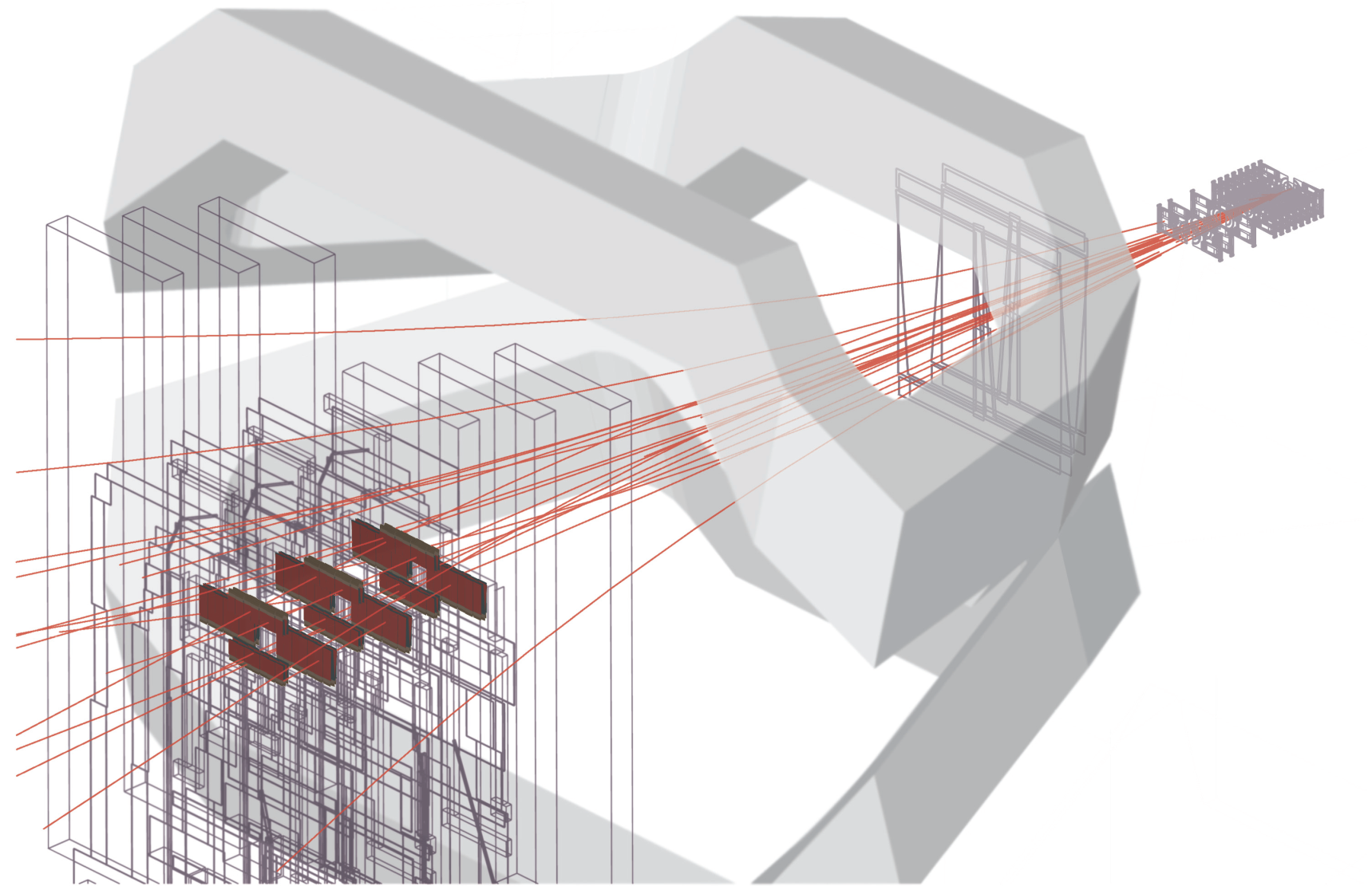
LHCb Velo electronics upgrade.
Jan Buytaert
C.E.R.N.
For the LHCb VELO Group.

Slide 2
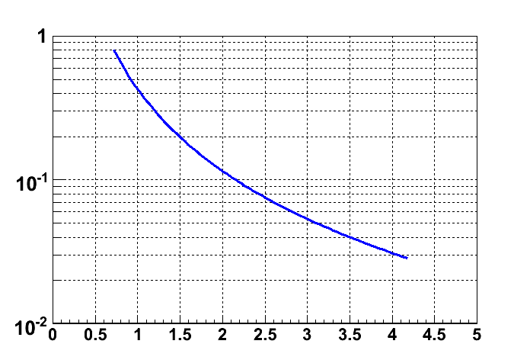
Vertex detector environment.
Particle occupancy per event (simulation)
Severe & non-uniform irradiation damage.
Dose after 100 fb⁻¹
500
~ 8 particles/cm²/event at r=7.5 mm
370 Mrad
or 8 10¹⁵ n_{eq}/cm².
n_{eq}cm⁻² x 10¹⁶
TID (MRad)
Particle Hits / Event / cm²
7 mm
50
radius (cm)
5
Curves fitted to A.r^{-1.9}
Radius (cm)
Luminosity (cm⁻²s⁻¹) | 2.10³² Current | 5.10³² | 10.10³² Phase 1 | 20.10³² Phase 2
A= | 0.98 | 1.46 | 2.46 | 4.80
    => Danger of thermal run away !
    => Silicon must be cooled to -10 ⁰C.
      The detector operates in 10⁻⁶ mbar vacuum.
      Access after installation is VERY difficult !

Slide 3
Pixel module.
  Sensor tiles: made of 3 readout asic’s on a single sensor, with a guard ring of 500 um.
  2 sensor tiles are mounted on opposite sides of the substrate.
  Substrate choices:
    Diamond : excellent mechanical and thermal properties: => low mass
    carbonfibre/TPG : as used for the present VELO.
  Prototype work will start using Timepix assemblies (‘module 0’)
Sensor tile
ASIC
~43mm
~15mm
ASIC
ASIC
Cooling channel
Top Sensor 150um
ASIC150um
Substrate 200um
Connector
ASIC150um
Glue 50um
Bot Sensor 150um
  If the TSV technology becomes accessible soon, single sided modules could be possible.

Slide 4
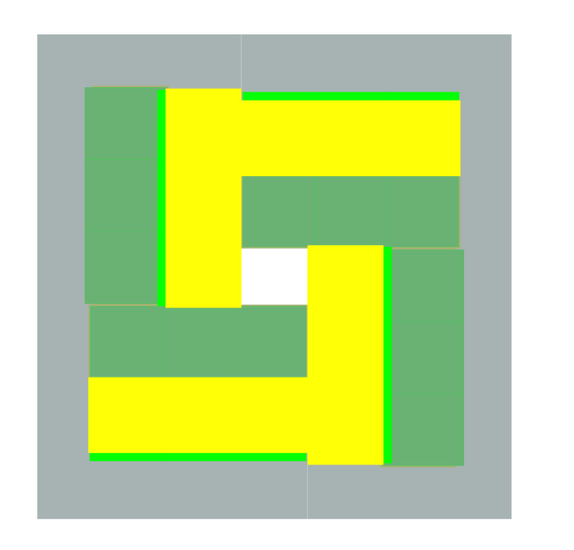
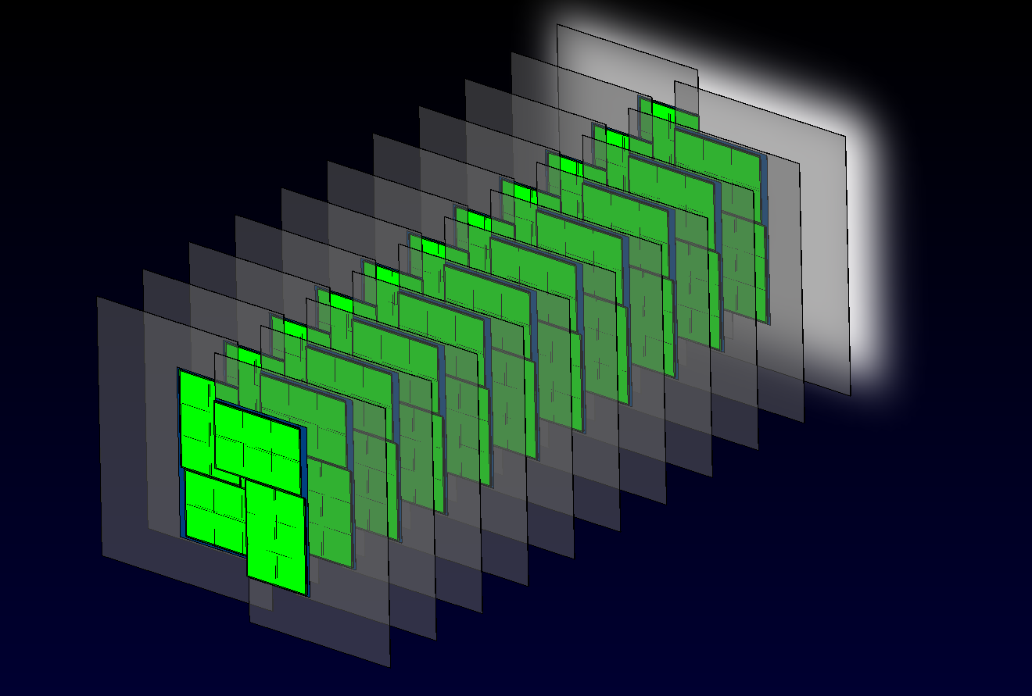
Pixel module & Detector layout.
top tiles in yellow, bottom tiles in green
A plane is made of 8 sensor tiles.
  active area is near 100% (except small gaps).
  Closest pixel is at 7.5 mm from the beam center.
Sensor tile
1.1 mm gap
    The full detector is composed of 26 planes.
    The modules on either side of the beam are staggered to create overlap regions.
    This layout has been simulated to be fully efficient (4 hit per track) in the LHCb acceptance 250x300mrad.

Slide 5
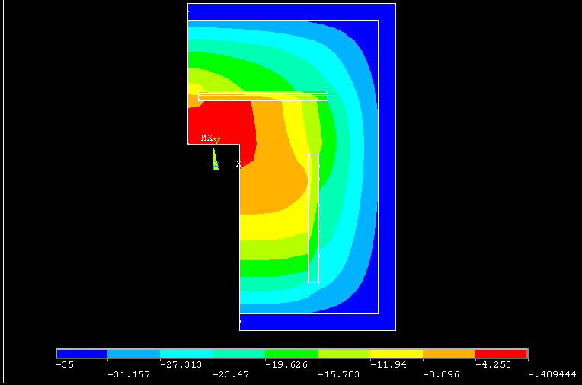
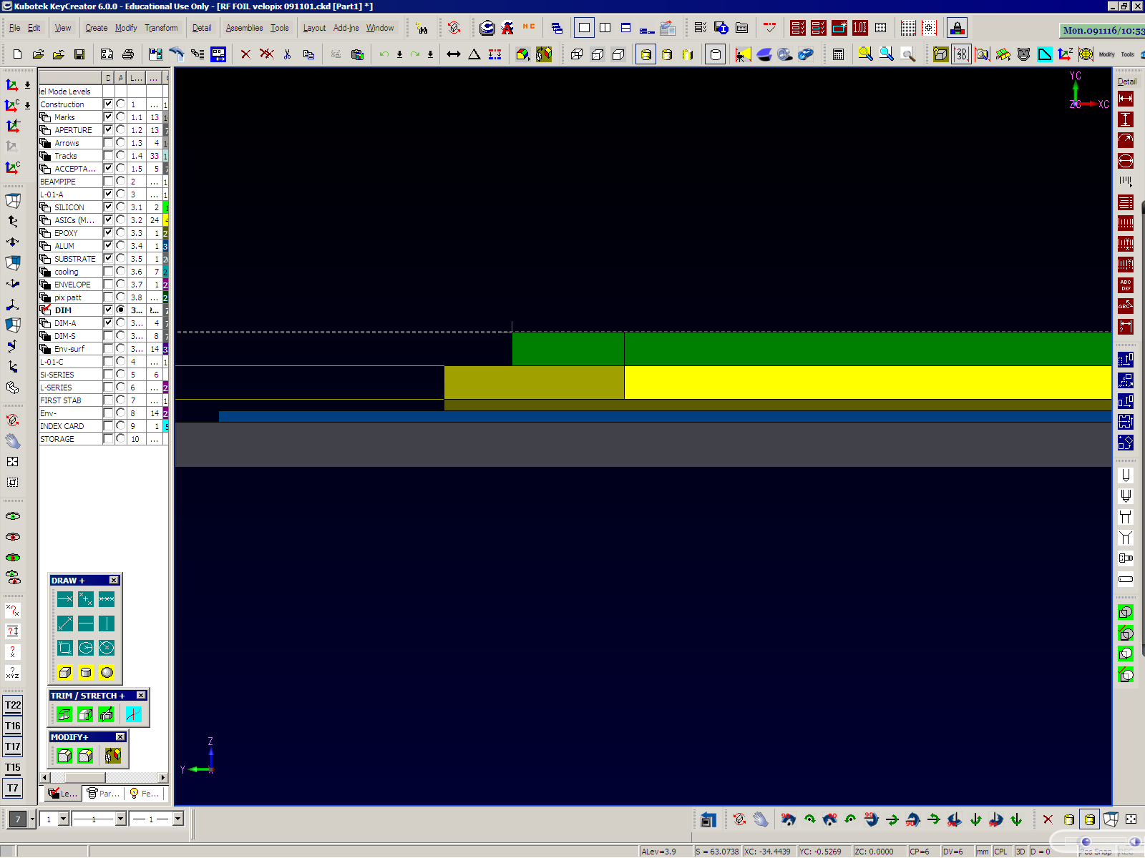
Module Cooling.
  Initial ANSYS simulations done.
  Model includes radial (r^{-1.9}) and temperature dependent leakage power generated in Si.
  Extreme conditions are just OK...
  Verifications with thermal mockups are planned.
CO² cooling
temp -35 C
Tip temp -4 C
Asic power = 1.5W/cm²
Bias voltage = 900V
After 10¹⁶ n_{equiv}cm⁻²
Material | Thermal Conductivity (W / m K)
Silicon | 150
ASICs | 190
Glue | 1
Aluminum | 200
CVD Diamond | 1600
Silicon 0.150
Epoxy 0.050
ASIC 0.150
Al 0.050
Substrate 0.200
All dimensions in mm

Slide 6
ASIC development: analog
We are collaborating with the Timepix2 design:
  Analog requirements overlap ~100%:
Input charge | Bipolar (h+ and e-)
Leakage current compensation | YES (both polarities)
Peaking time | ≤ 25ns
Preamp output linear dynamic range | < 40 Ke-
TOT linearity and range | <200 Ke- → Maximize linearity >200 Ke- → Monotonic response
ENC (σ_{ENC}) | ~75 e-
Detector capacitance | < 50 fF
Discriminator response time | < 2ns
Full chip minimum detectable charge | < 500 e-
Threshold spread after tuning | < 30 e-
Pixel analog power consumption | < 15-20 µW @ 1.2V
Full chip analog < 1.3W static.
(leaves 1.7 W for digital …)

Slide 7
ASIC development: digital
Timepix2:
  Digital functionality :
    Simultaneous Time-over-threshold and time identification.
    Sparse and data driven readout.
    High speed output links >N x 500Mbit/s.
    Many features still under discussion.
  Peripheral logic and DAC’s from Medipix3
  Total power budget <1.5W/cm² @ 1.2 V. ⬄ <3W full chip
  Radiation hardness TID 400Mrad, but not SEU.
Final VELOpix will be derived from Timepix2 :
  Only modifications in digital parts : Clustering, formatting & buffering, SEU protection.
  Addition of multi-Gbit output links.

Slide 8
Data rates
Numbers at highest occupancies:
    average particle rate per ‘hottest’ asic ~ 5 particles/25ns = 200MHz
    average pixel cluster size ~3: (pessimistic assumption, 300um Si)
Information bits per pixel : 32 !
      4 bit : Time over Threshold value.
      12 bit : bunch identification
      16 bit : pixel address.
=> Single asic data production can reach 19 Gbit/s !
30% data reduction can be achieved by clustering data: 13.6Gbit/s
    share the bunch id (12bit) between clustered pixels,
    ‘share’ address bits (by special encoding).
    must be done before column readout, i.e. inside pixel array !
    most efficiently done in units of 4x4 pixels = “Super pixel”

Slide 9
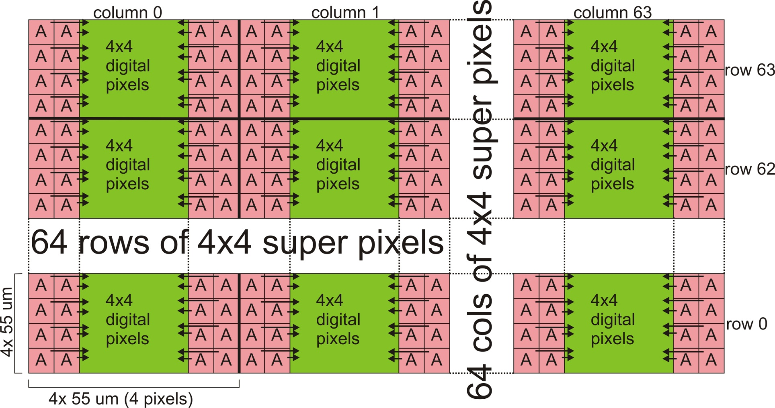
Super pixel
Super pixel layout:
  group digital logic in a single area.
    Advantages:
      Space saving : some functional blocks can be common (time-multiplexed).
      More efficient distribution of power and global signals.
      Better analog/digital isolation.
      Digital column logic is synthesized with standard library. Ease, reliability, yield …
    Disadvantages:
      Bonding pads on top of digital circuit:
        => digital feedback in analog frontend. Shielding ?
      Non-uniform analog input capacitance:
        => Only small effect
220 um
~140 um
A
A
A
A
A
A
A
A
220 um
Super pixel
Digital
A
A
A
A
A
A
A
A
    Status:
      Analog part under development (Xavi Llopart)
      The verilog code for digital column exists and has been laid out. Final simulations are done. We will have realistic power estimates soon. (Tuomas Poikela)
      It would be extremely useful to have a ‘low speed/low power’ library for IBM 130nm ! Would result in a big saving in area and power !

Slide 10
Pixel matrix readout architecture.
16x
Super pixel
Pixel matrix readout architecture
  Internal bus speeds:
    Column bus : 8bit@40MHz=320 Mbit/s
    Output bus : 16bit@320MHz=5 Gbit/s
  Total ASIC output : ~16Gb/s.
  Buffering in :
    Super pixel : 2 clusters
    Super pixel group FIFO : ~400 bit
    Output FIFO: multi kbyte
Simulation shows losses< 0.5% in highest occupancy conditions.
Analog
frontend
Analog
frontend
Analog
frontend
Cluster
logic
buffer
4x
Super pixel
Super pixel
FIFO
Super pixel
Super pixel
Super pixel group
16x
Super pixel group
Super pixel group
Super pixel group
Super pixel group
Column bus
Super pixel
column
EOC
logic
40MHZ
320MHz
16x
Super pixel
column
Super pixel
column
Periphery &
Output port
Super pixel
column
Super pixel
column
Output bus
~ 4Gb/s
FIFO
Serializer
Driver
4 x

Slide 11
ASIC design. Data reduction
Address encoding in 4x4 super pixel :
  “Row hit indicator” : indicate which rows have hits (4 bit, always present).
  0 to 4 “row hit patterns” : indicate which pixels in row are hit (4bit).
  Super pixel address : 12 bit.
  Examples:
  Gain compared to individual pixel address :
  Overall 20% data reduction
  Alos: reject large multiplicity event :
    If hit > N then no readout.
    N is configurable and rejection can be de-activated.
Super pixel
Super pixel
X
0 0 1 1
0 1 0 0
Row hit indicator
Row hit indicator
X
X
X
0100
0010
0011
0110
0010
# hits | Individual address | Row hit encoding
1 | 16 bit | 20 bit
2 | 32 bit | 24 bit
3 | 48 bit | 28 bit
4 | 64 bit | 32 bit

Slide 12
ASIC design. Data reduction
Sharing across super pixel boundaries :
  Only in 1 direction (column)
  some limitations may lead to wrong or no clustering. But never loss of data.
  Results in ~10% data reduction.
Super pixel n
X1
Hit X1 will be transferred
to super pixel n+1
X2
Super pixel n+1

Slide 13
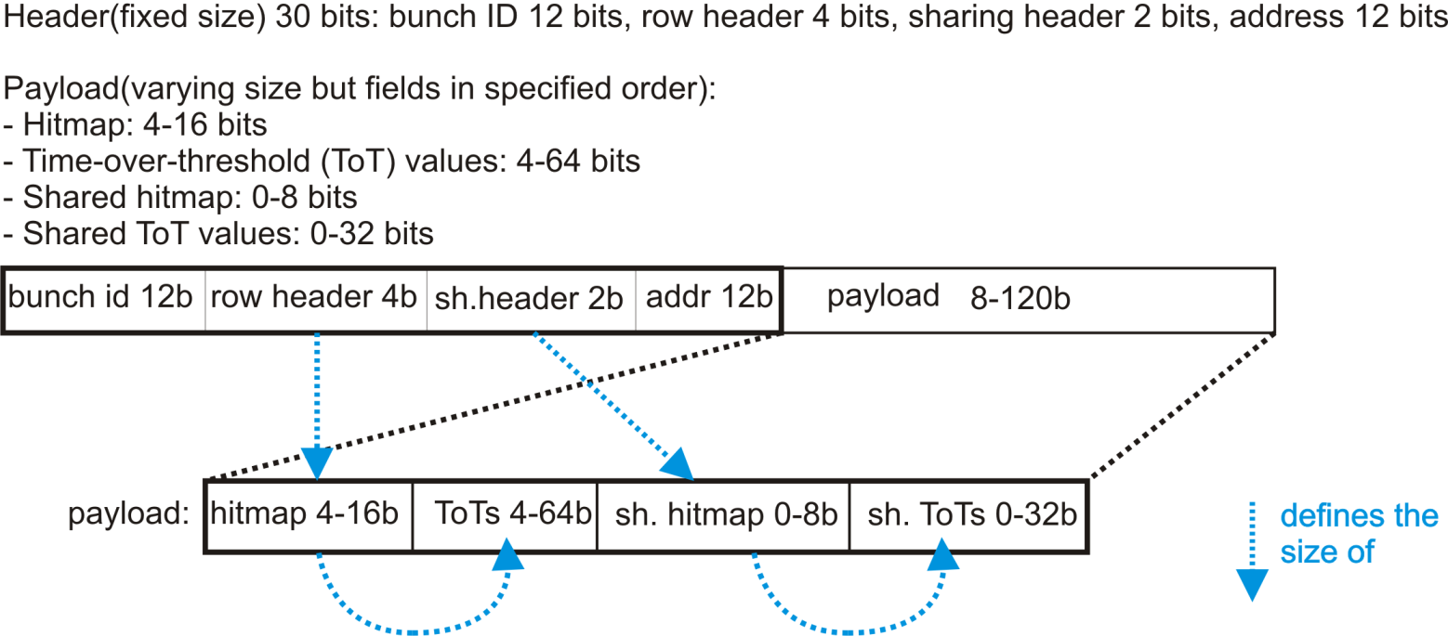
Packet format

Slide 14
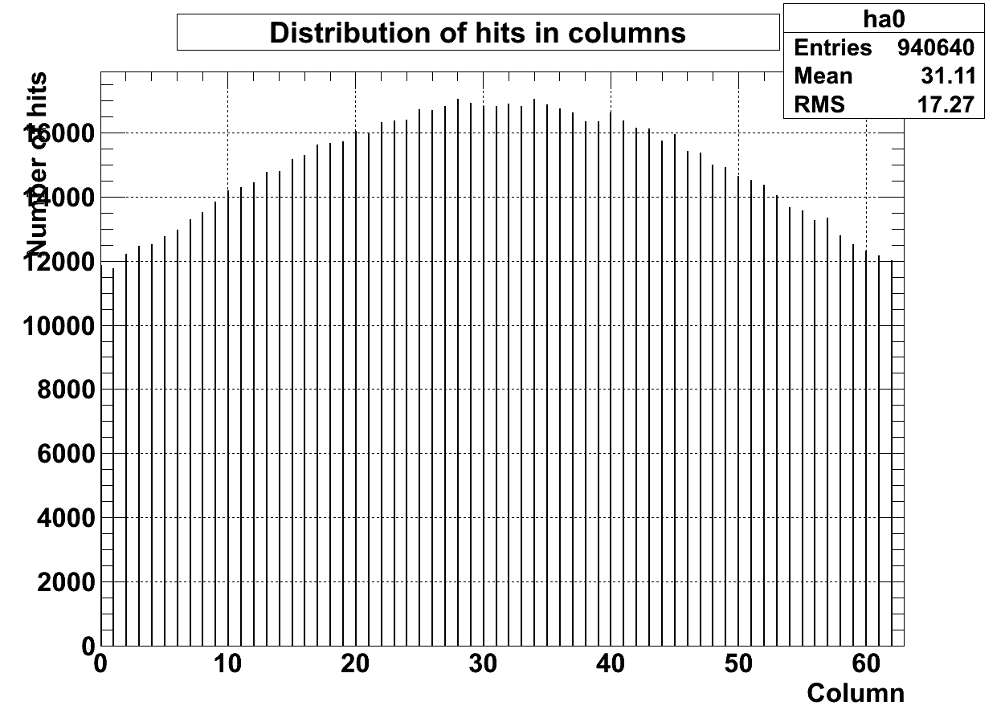
Simulations with Gauss/Boole data
Most exposed asic

Slide 15
Simulations with Gauss/Boole data
Column | Efficiency (only missing packets)* | Efficiency (correct packets) | FIFO buffer size, # words, header/data | Avg. data rate, Mbps | Proportional and absolute area of FIFO
28 | 99.150 % | 98.916 % | 3/9 | 241.450
28 | 89.816 % | 88.906 % | 4/8 | 218.606
28 | 99.264 % | 99.120 % | 4/9 | 241.748
28 | 99.341 % | 99.192 % | 4/10 | 241.924 | 14.7 %, 16612 um²
28 | 99.395 % | 99.264 % | 4/11 | 242.050
28 | 99.407 % | 99.276 % | 4/12 | 242.072 | 15.7%, 18000 um²
28 | 99.413 % | 99.282 % | 4/14 | 242.089
28 | 99.401 % | 99.240 % | 5/10 | 242.057
28 | 99.497 % | 99.383 % | 5/12 | 242.303
28 | 99.563 % | 99.473 % | 6/12 | 242.458
28 | 99.677 % | 99.623 % | 8/16 | 242.723
28 | 99.731 % | 99.695 % | 10/20 | 242.863
28 | 99.749 % | 99.719 % | 12/24 | 242.908
28 | 99.77 % | 99.74 % | 16/32 | 242.97
More simulations still needed. Investigate margins.

Slide 16
Readout of one VELO half :
2x24 Differential
Cu links@4Gb/s ~ 1.5m
2x24 x optical links@4Gb/s ~60m
vacuum feed-throughs
Electro-optical
Tell 40 (96 input links)
Network interface
Vacuum tank
26 ‘half’ planes
1248 optical links
13 Tell40

Slide 17
Tell 40 issues.
Possible tasks in Tell40:
  Re-order the VELOpix packets in time ?
    VELOpix produce non-time-ordered packets.
  Aggregate the packets from the same event :
    Group clusters with same time identification.
    Remove redundant time-id (12bit) ?
    less packets , reduced network traffic.
  Perform correct clustering:
    ‘Superpixel cluster’ may contain 2 or more clusters : split ?
    Combine clusters in ‘row dimension’ ? VELOpix cannot combine across superpixel in row direction.
  Correct data per pixel for gain and offset non-uniformity ?
  Compute a cluster center position ?
    Big data reduction !
    Reformat (total charge, position) ?
    Eta-weighted interpolation: non trivial ! Also, don’t know the track angle !
  Add alignement constants ?
    Could save CPU time ?
One Tell40 will also provide the configuration and fast control signals (GBT-SCA) to 2 ‘half planes’

