Slide 1
LHCb Upgrade Electronics
Mailing list:
Go to simba.cern.ch, search for lhcb-upgrade-electronics
Link to upgrade electronics meetings:
http://lhcb-elec.web.cern.ch/lhcb-elec/html/upgrade.htm
          Meetings in 2010:
          14th October
          9th December

Slide 2
News: Front-end Simulations
set limits
Velo: Jan
RICH: Stephan + Robert
OT: Mirco
Calo: Frederic
Muon: Caterina
TELL40: Guido
TFC: Federico
Monte-Carlo: Tomasz
Monte-Carlo Physics Generator
Front-end “processing”
Data compression + buffering
Formatting (headers, GBT)
TELL40 processing + buffers
Tomasz running MC at 4 different lumi’s
Sub-detectors simulate front-end processing
=> Input data to TELL40 simulation

Slide 3
News
ACTEL irradiations happening now (Syracuse)
……. presentation in October
Next meeting October 14th:
combine with online to discuss ECS
Short presentation from each sub-detector on:
New ECS interfaces for upgrade (eg GBT)
Old ECS interfaces to maintain

Slide 4
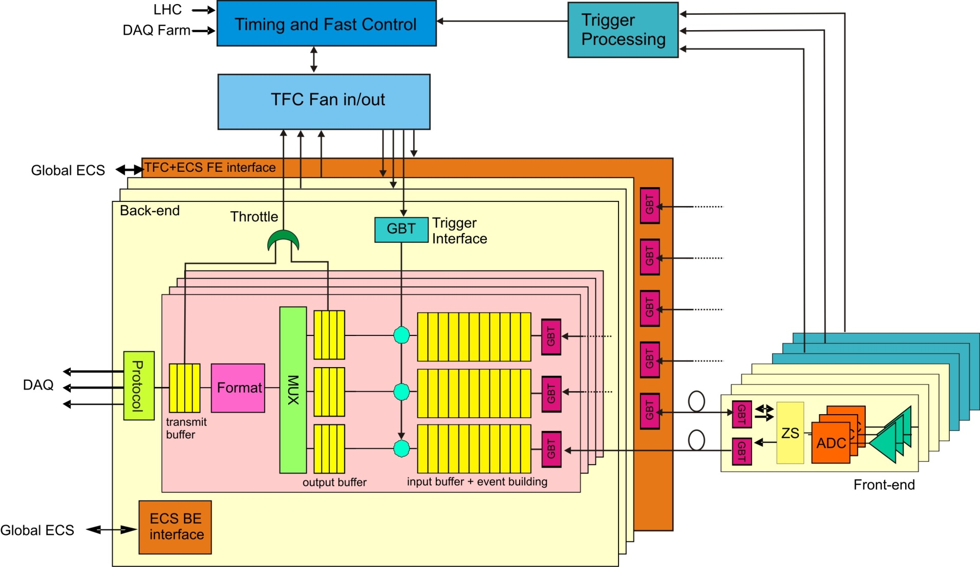
Architecture

