Slide 1

Progress with RF Characterisation facility at STFC
2nd IFAST WP9 Meeting
24th September 2021
Daniel Seal
Lancaster University/Cockcroft Institute
daniel.seal@cockcroft.ac.uk

Slide 2

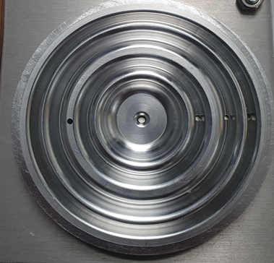
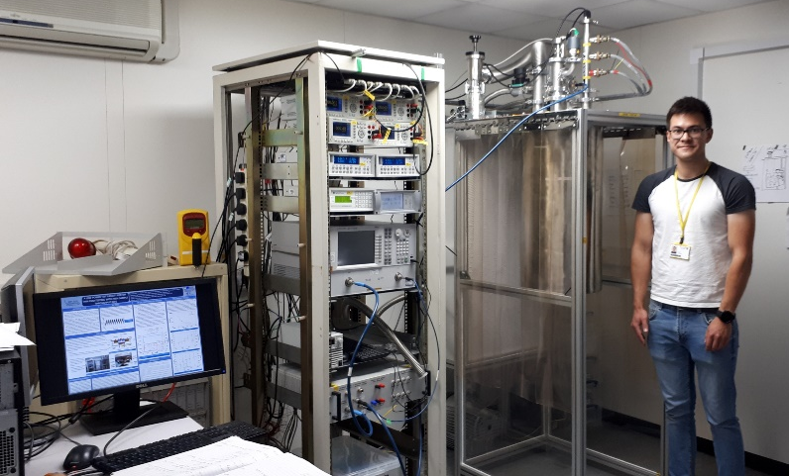
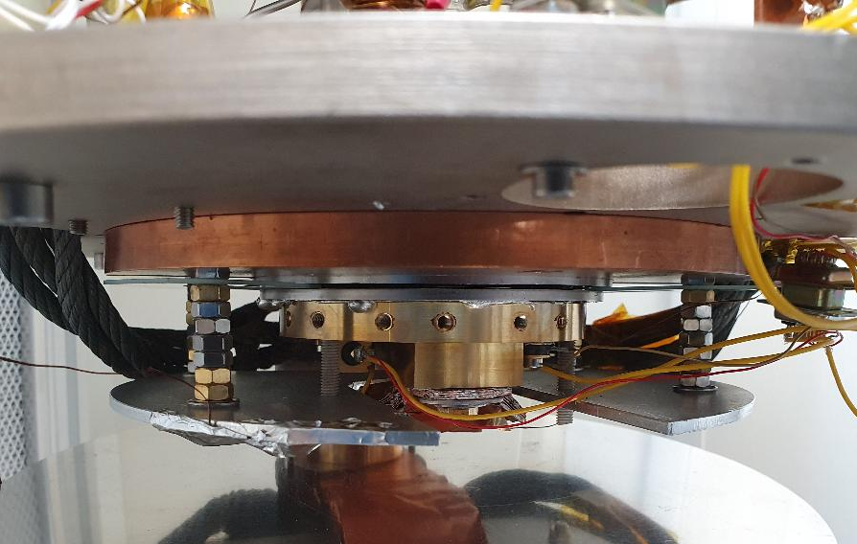
The Facility
Measurements of R_{S} with RF-DC compensation using Nb choke cavity (3 choke or 2 choke)
Test planar samples 90 - 110 mm diameter with 2 to 3 day turnaround between tests
So far allows measurements of
  R_{s} under RF at 7.8 GHz
  T_{S} = 4 to 10 K
  RF Power up to 1 W
  B_{s,pk} ≤ 0.8 mT
Initial tests with bulk Nb discs
First measurements of Nb coated Cu discs have been made
~ 100 mm
Stage 2 plate ~ 4 K
G-10 Spacers
Sample
Sample holder
Sample Plate
Cavity

Slide 3
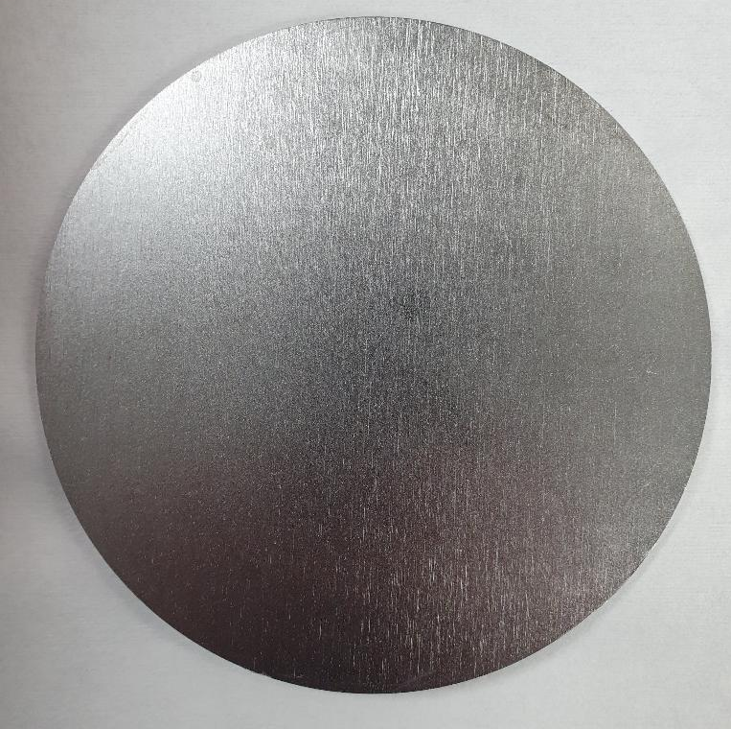
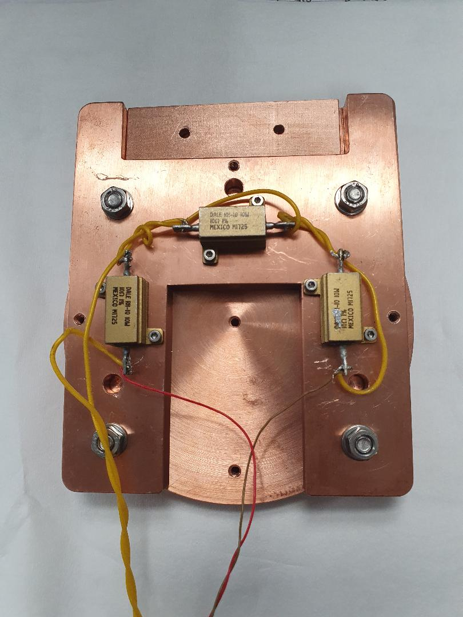
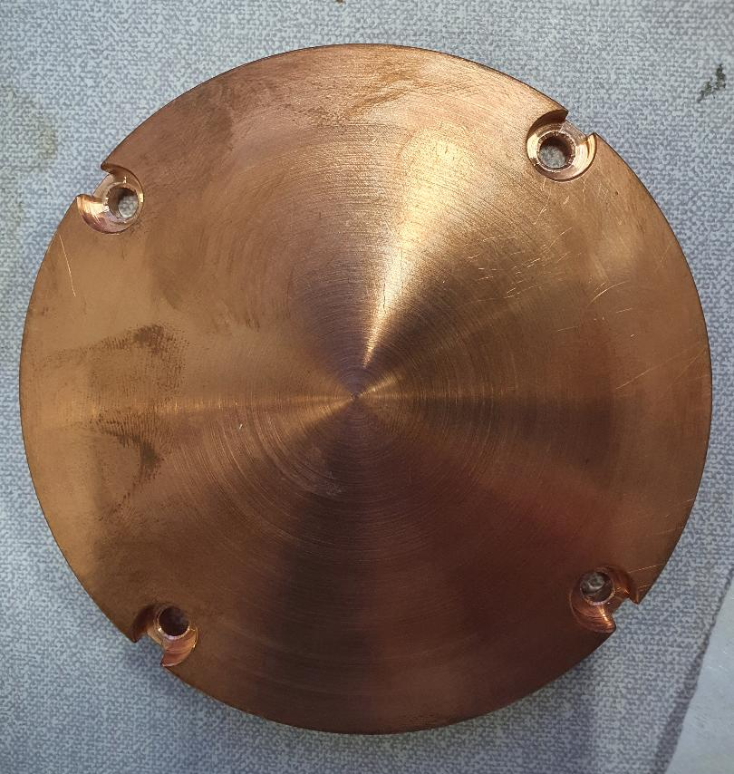
Samples
Sample
Sample Holder
Design 1
Sample heated to ~ 160°C and indium brazed to sample holder in separate facility
Use with Nb and Cu discs 100 mm in diameter
Thermometers only mounted to sample holder
Design 2
Sample bolted to sample holder around edge for improved thermalisation
Different sample design – Use with Cu discs ~ 110 mm diameter with drilled hole discs
Avoids indium brazing
Thermometers can be mounted directly to sample
3
2nd IFAST WP9 Meeting 24th September 2021

Slide 4
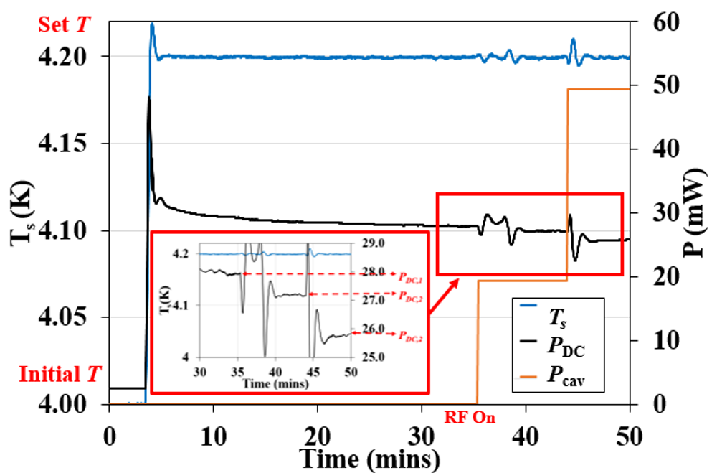

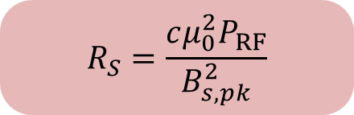
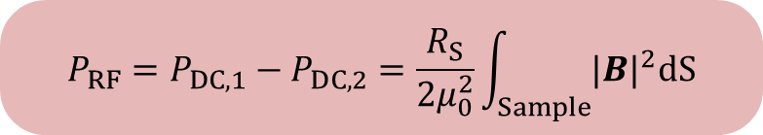
Measurements – RF-DC Compensation
Sample thermally isolated from cavity
Cavity at fixed temperature
Doesn’t require a high cavity Q
Only stored energy limited by choke leakage
$$B_{s,pk}^{2}=B_{s,pk}^{2}\left(1J\right)×U$$
$$P_{RF}=P_{DC,1}−P_{DC,2}=\frac{R_{S}}{2μ_{0}^{2}}\int_{Sample}{{|B|}^{2}dS}$$
$$R_{S}=\frac{cμ_{0}^{2}P_{RF}}{B_{s,pk}^{2}}$$

Slide 5
Preliminary Results
Bulk Nb Sample with 3 choke cavity
Testing effect of various treatments due to no BCP available:
(1) Isopropanol
(2) Clean with acetone followed by UPW (lowest R_{res})
(3) 600°C Bake – possibility to reduce Q-disease
(4) Post-milling
R_{S} (1)
R_{S} (2)
R_{S} (3)
R_{S} (4)
R_{BCS}

Slide 6
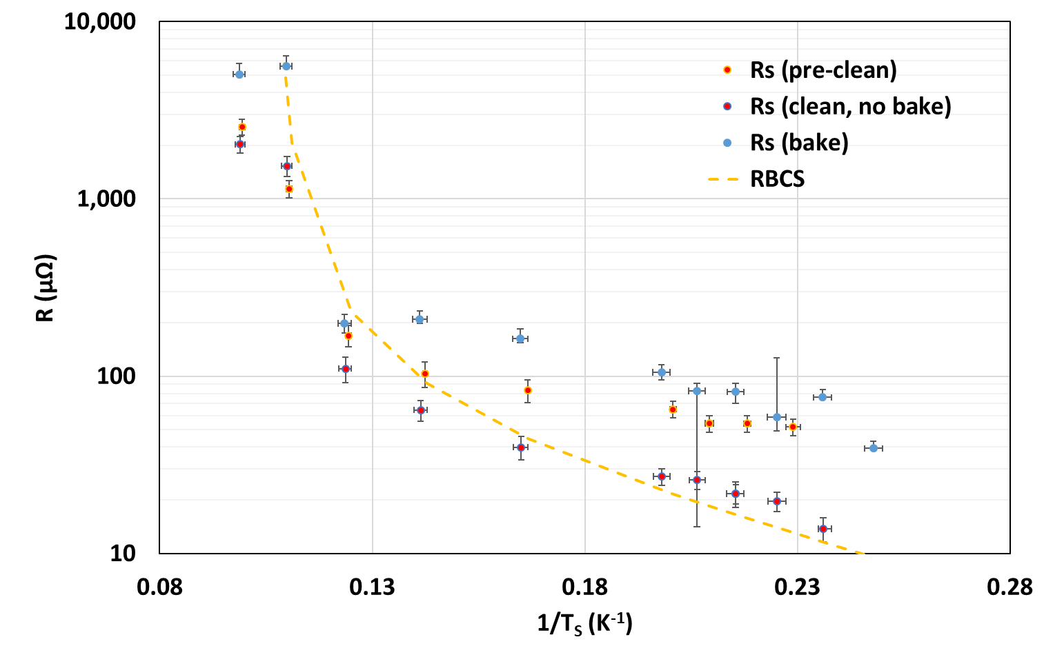
2nd Bulk Nb Sample with 3 choke cavity
Testing effect of various treatments due to no BCP available:
(1) No treatment
(2) Cleaning with acetone followed by UPW (lowest R_{res})
(3) 600°C Bake – possibility to reduce Q-disease
R_{S} (1)
R_{S} (2)
R_{S} (3)
R_{BCS}
Plan to repeat both Nb Sample tests after BCP at INFN

Slide 7
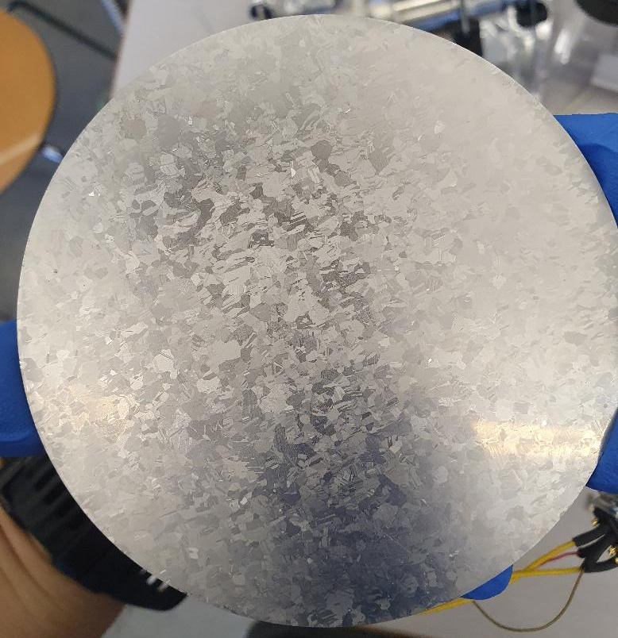
Nb on Cu Sample with 3 choke cavity (deposited by Reza Valizadeh at DL)
Deposition of Nb on Cu sample heated for 4 days at 600°C
Cu mechanically polished with diamond abrasive
Surface analysis yet to be made

Slide 8
Summary and Future Plans
Facility for measuring R_{S} of planar samples is operational:
  Planar sample diameter: 90 – 110 mm
  Frequency: 7.8 GHz
  Temperature range: > 4 K
  RF Power up to 1 W
Main advantage: Quick sample turnover – able to test at least 2 samples per week
System can be used in addition to QPR
Higher resonant frequency (7.8 GHz) and lower power compared with QPR and limited to one frequency
Testing of Nb on Cu samples is underway
Send cavity + bulk Nb sample(s) to INFN for BCP before re-measuring

Slide 9
Thank you for listening
Daniel Seal
Lancaster University/Cockcroft Institute
daniel.seal@cockcroft.ac.uk

