Slide 1
CLIC Zero, cost & schedule considerations
R. Corsini

Slide 2
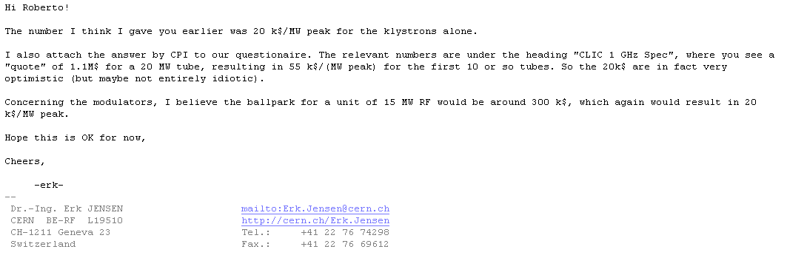
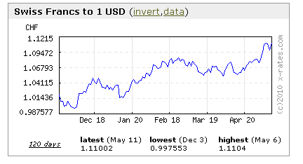
Klystrons/Modulators, cost per MW – initial assumption
From Erk:
        20 k$ / MW for a klystron
        Similar number for a modulator
        Cost of 15 MW unit = 2 x 300 k$ = 600 kCHF
        I assumed as well ~ 200 kCHF per structure
N.B.: I assume everywhere 1 $ = 1 CHF

Slide 3
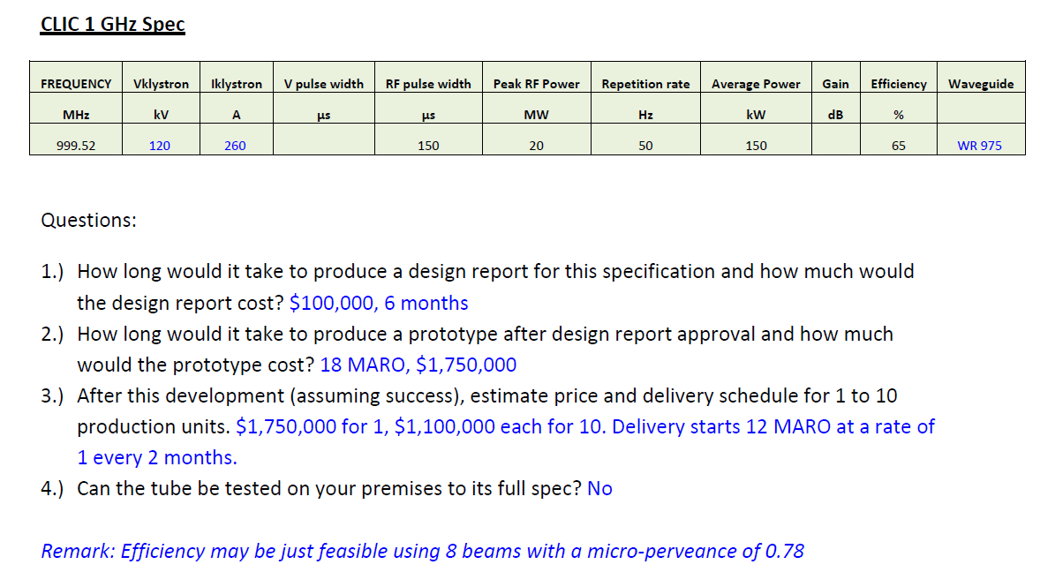
CPI Evaluation

Slide 4
Learning curve

Slide 5
Conservative assumptions on RF units
Consider:
      500/600 k$ for a 15 MW klystron, for a production of about 40/60 units
      Similar number for a modulator
      Cost of a 15 MW unit = 1000/1200 kCHF
      Assuming ~ 200 kCHF per structure
      Total cost for RF unit plus structure 1200/1400 kCHF

Slide 6
Costing the CLIC facilities (I)
Had refined costing spreadsheet, introducing a few (more realistic?) assumptions
No major changes with previous version for the same cost of RF units. For example, assuming the optimistic cost
  (Total cost for RF unit 600 kCHF plus 200 kCHF structure)
Results (linac + ring/TBA areas):
  DBA 200 MeV 87 MCHF
  CLIC Zero- 103 MCHF + 84 MCHF = 187 MCHF
  CLIC Zero 183 MCHF + 84 MCHF = 267 MCHF

Slide 7
Costing the CLIC facilities (II)
Using the costing spreadsheet, assuming conservative costs for RF power sources (20 + 20 k$ /MW) & using the learning curves
  (Total cost for RF unit 900/1200 kCHF plus 200 kCHF structure)
Results (linac + ring/TBA areas):
  DBA 200 MeV 119 MCHF
  CLIC Zero- 139 MCHF + 84 MCHF = 223 MCHF
  CLIC Zero 240 MCHF + 84 MCHF = 324 MCHF

Slide 8
Scaling with RF units cost

Slide 9
DBA 200 MeV

Slide 10
DBA-, CLIC Zero-

Slide 11
CLIC Zero

Slide 12
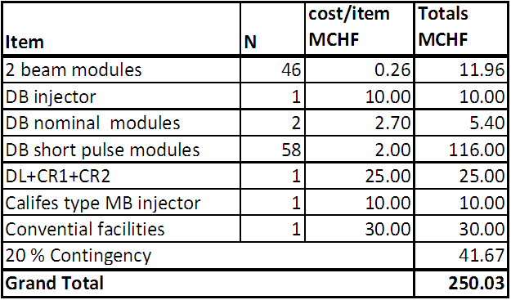
CLIC Zero (Hans costing)
Material only

Slide 13
Schedule ?
 | 2010 |  |  |  | 2011 |  |  |  | 2012 |  |  |  | 2013 |  |  |  | 2014 |  |  |  | 2015 |  |  |  | 2016
 | 1 | 2 | 3 | 4 | 1 | 2 | 3 | 4 | 1 | 2 | 3 | 4 | 1 | 2 | 3 | 4 | 1 | 2 | 3 | 4 | 1 | 2 | 3 | 4 | 1 | 2 | 3 | 4
CTF3 TBTS operation | inst. | 1-2 structures, beam loading, breakdown kick
CTF3 TBL operation | inst. |  | Deceleration 8 PETS |  | final decelerator test (16 PETS, 50%)
Modules lab | initial tests, installation 2 modules |  |  |  | further tests, installation 4 modules |  |  |  | testing |  |  |  |  |  |  |  | pre-series production, industrialization
Modules CTF3 |  |  |  |  |  |  |  | 1 module inst. |  | testing 1 module |  | 3 modules inst. |  | testing 3 modules |  |  |  |  |  |  | > upgrades?
CTF3 phase feedback | design, hardware tests |  |  |  |  |  |  | installation |  | testing
CTF3 TBL+ |  |  |  |  |  |  |  | installation |  | commissio-ning |  | RF testing, potential upgrades
CLIC DB injector & linac | design & hardware construction |  |  |  |  |  |  |  | installation |  |  |  | commissioning |  |  |  | staged upgrade & testing
RF structures construction | precision metrology, fabr. procedures |  |  |  | up to 40 structures built, establish precision machining at CERN or elsewhere, 5 μm tolerances achieved |  |  |  |  |  |  |  |  |  |  |  | more than 200 structures built, final cost optimization, pre-series with industry
RF test infrastructure | CERN test stand inst. |  | CERN test stand testing and upgrades (at least two slots) |  |  |  |  |  | continue testing with increased capabilities, CERN or elsewhere, up to 10 slots |  |  |  |  |  |  |  | testing, up to 200 accelerating structures plus PETS and RF components
Prototypes of critical components | technical choices, design |  |  |  | construction, hardware tests |  |  |  |  |  |  |  |  |  |  |  | finalization, performance & cost optimization, industrialization for large scale components

Slide 14
Schedule ?
Tentative schedule for CLIC R&D 2010-2016 (Away Day)

