Slide 1
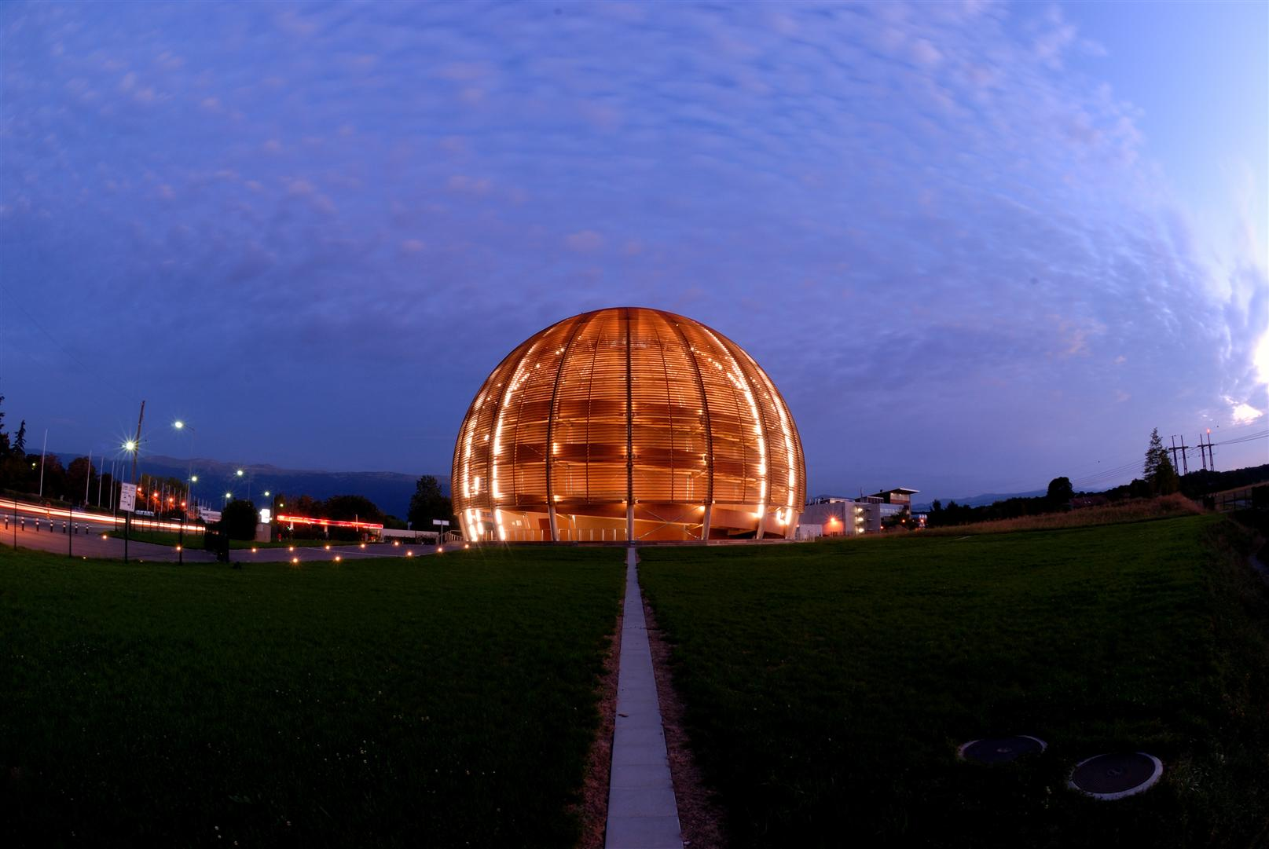
New Accelerator Projects
J.P.Delahaye/CERN
Focusing on High Energy Colliders (> 10 GeV!)
  Not covering nuclear physics, photon science, LBL neutrinos,…
  Apologies to ESS, FAIR, XFEL, etc…..
Thanks to the (many) experts who kindly provided me (consciously or not) with updated information and slides:
R.Aleksan, B.Barish, R.Bailey, M.Biagini, O.Boine-Frankenheim, O.Bruning, E.Colby, W.Fischer, B.Foster, M.Harrison, S.Holmes, R.Garoby, M.Giorgi, G.Hanson, M.Izawaki, J.Jowett, M.Klein, JP.Koutchouk, P.Lebrun, V.Litvinenko, K.Long, M.Masuzawa, T.Roser, L.Rossi, D.Schulte, G.Trubnikov, B.Tschirhardt, K.Yokoya, A.Wagner, F.Zimmermann,

Slide 2
Taking advantage of (but not summarising)
Session 14 (24/07/10) “Future Machines and Projects”
Co-chairs: K.INSOO, M.SHOCHET, S.STAPNES
B.BARISH: The Global Design Effort for the International Linear Collider
B.FOSTER: Governance of the International Linear Collider Project
D.SCHULTE: CLIC Progress and Status
E.COLBY: Present Limits and Future Prospects for Dielectric Acceleration
P.KOOIJMAN: Status of KM3NeT
M.GIORGI: The SuperB Project
M.IWASAKI: The SuperKEKB accelerator status
G.TRUBNIKOV: The heavy ion collider project NICA/MPD at JINR/Dubna
M.KLEIN: The Large Hadron Electron Collider (LHeC) Project
B.TSCHIRHART: Project-X at Fermilab
K.LONG: The International Design Study for the Neutrino Factory
G.HANSON: The Research and Development Program towards an Energy-Frontier Muon Collider
R.BAILEY: LHC machine upgrades

Slide 3
Conclusion: Personal Remarks
Large number of ambitious accelerator projects with promising performances in the near (and short term) future
  Towards energy and/or luminosity frontiers
  Complementary aspects of various particles species
High Energy Physics requirements extremely demanding with challenging parameters
  Entering into the new territories: TERASCALE
  High Energy or/and High (Integrated) Luminosity
  High performance, high availability, long lifetime, luminosity leveling….
J.P.Delahaye
ICHEP 2010 (28/07/10)

Slide 4
Creative and Strong R&D
New projects more and more challenging:
  Larger, more powerful, more expensive not an option
  Technology above present standard
Innovative ideas and breakthrough on novel technologies = key for HEP adventure
  Innovation and imagination = a MUST!
  Previous presentation
Aggressive R&D imperative
  Beam and Technology related
  Cost and power consumption mitigation
  Ambitious Test Facilities to address feasibility
J.P.Delahaye
ICHEP 2010 (28/07/10)

Slide 5
Global Collaborations
More and more time and (M&P) resources required from first ideas to project proposal
  Launch R&D early,
  Explore ALL possible options of schemes and technologies (anticipating future Physics requests)
  Realistic status & schedule estimates:
    preserve credibility & make reasonable plans
Global Collaboration mandatory from the R&D phase to construction and operation
  Best use of limited resources & available expertise
  Inspired from successful collaborations on Detectors
J.P.Delahaye
ICHEP 2010 (28/07/10)

Slide 6
Plea for a Global Coordination (initiated by ICFA)
Global strategy of new accelerator projects in truly world-wide collaboration:
  Defining all various Projects and Technology options worth exploring
  Global teams made of world-wide experts taking advantage of synergies to address common issues (generic R&D) of various projects
  Preparing together plethora of project proposals to cover Physics Landscape: ready for window opportunity
  Collaborative/Competition: Experts in Collaboration, Technology & Projects options in Competition
  Joining resources on (few) selected projects
J.P.Delahaye
ICHEP 2010 (28/07/10)

Slide 7
Conclusion
Future HEP Projects (beyond LHC) will be:
GLOBAL!
Collaborations!
Innovative ideas and technology breakthroughs
  R&D, R&D , R&D
Globally Coordinated Strategy
or will not be!
J.P.Delahaye
ICHEP 2010 (28/07/10)

Slide 8
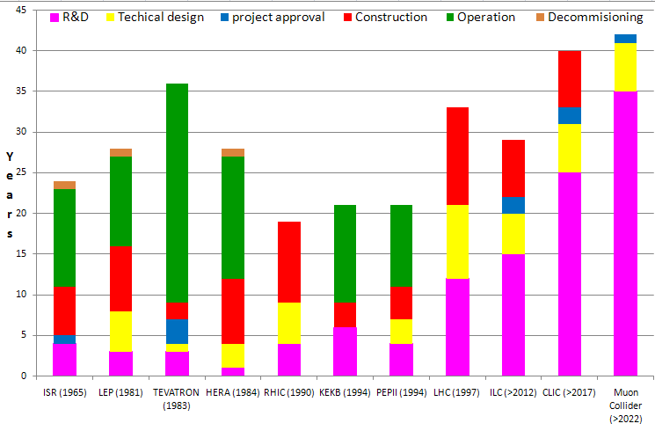

Slide 9
Synergies between projects: Generic R&D

Slide 10
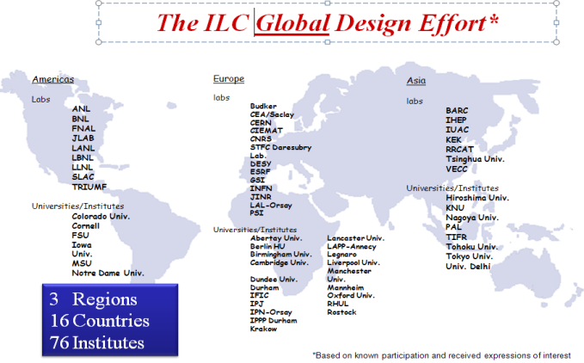
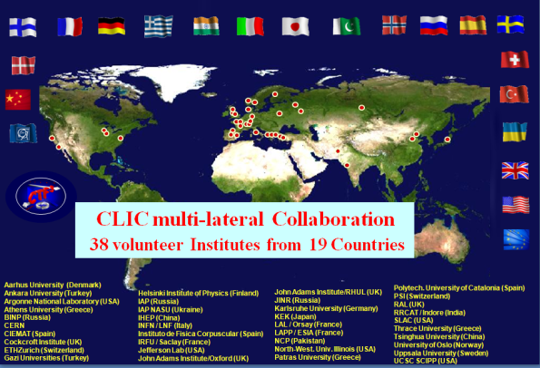
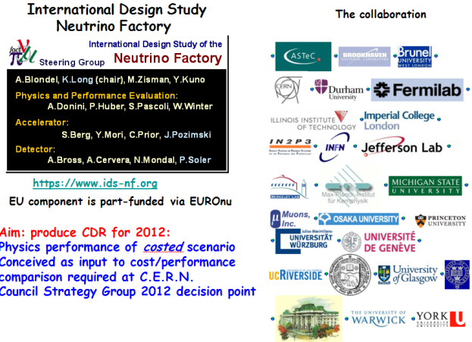
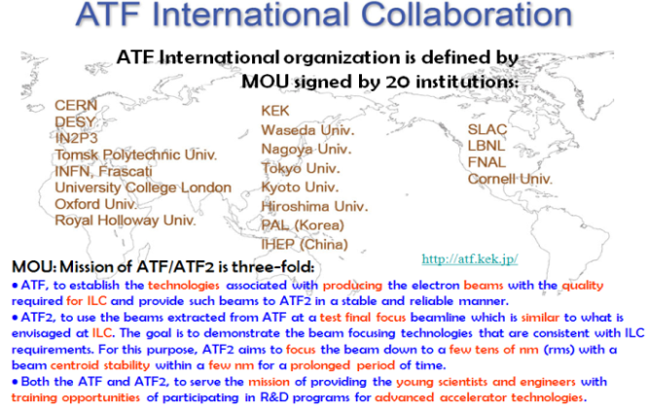
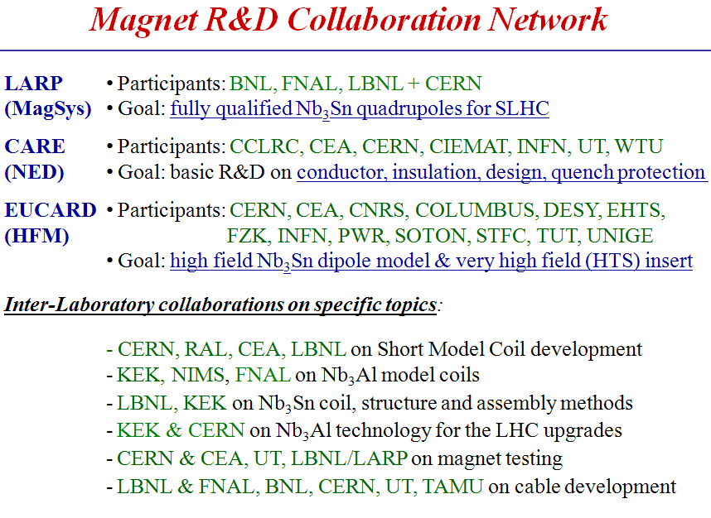
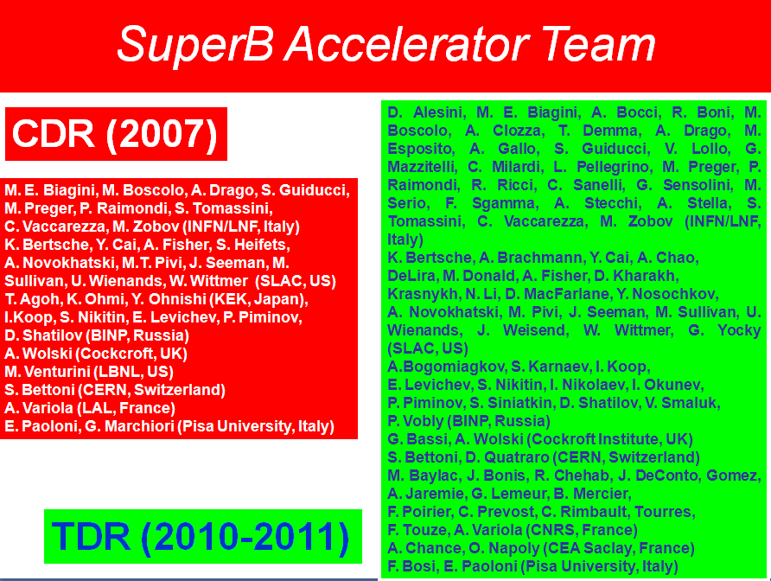


Global Collaborations (Examples of)
European Commission supported Coordination of Accelerator R&D
coordination & support of European distributed
R&D Infrastructure and joint R&D programme
Starting end 2010: http://www.eu-tiara.eu
Integrated Activity:EUCARD http://eucard.web.cern.ch/EuCARD/

Slide 11
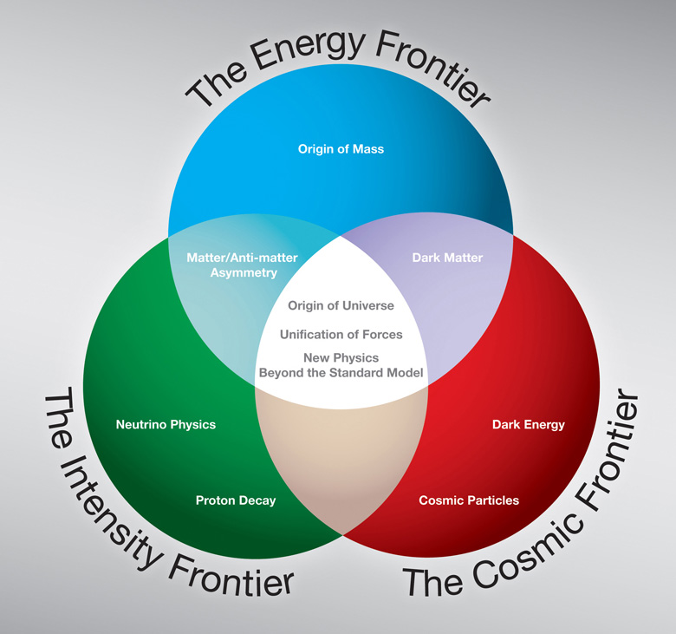
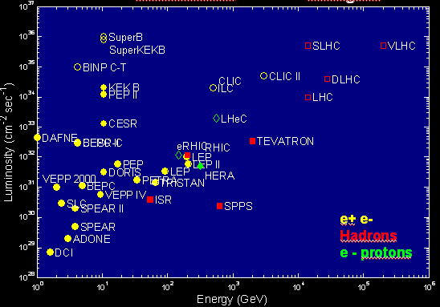
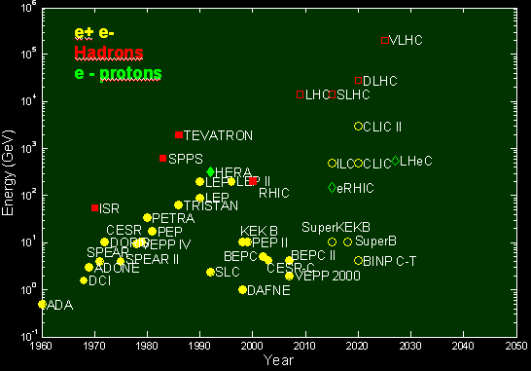
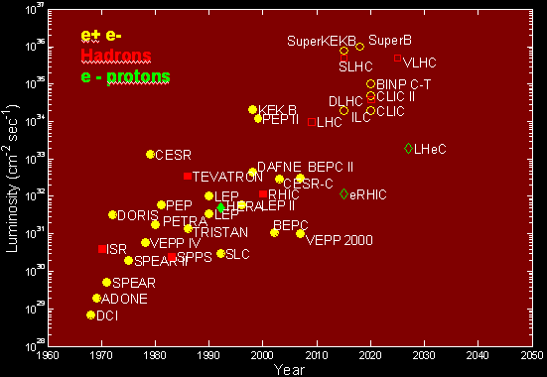
Trends of
HEP facilities
Luminosity
factories
Energy
frontier
Courtesy of
M.Biscari
EPS-HEP09
Hadrons
X10 /27y
Hadrons
X10 /11y
X10 / 8.5y
Leptons
X10 /33y
Leptons
X10 /17y
Towards Energy frontier
Towards Luminosity frontier

Slide 12
Complementary facilities of various particle species
Hadrons/Hadrons
Leptons/Leptons
Species | Present | Future
Protons | TEVATRON | LHC HL-LHC VL-LHC
Ions | RHIC | RHIC II LHiC
Frontier | Present | Future
Energy | LEP | ILC CLIC Muon Collider
Lumin | KEKB PEPII | SuperKEK SuperB
New
Physics
Hadrons/Leptons
Neutrinos
Present | Future
Super- Kamiokande MINOS CNGS | LBNE/Project X Neutrino Factory
Species | Present | Future
Energy | HERA | LHeC
Lumin. |  | ELIC ERHIC
12

Slide 13
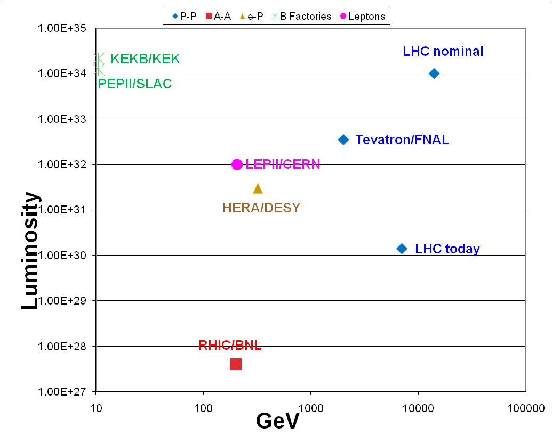
Present HEP colliders at Energy/Luminosity frontiers
B Factories
Leptons
Protons
e-/Hadron
Ions

Slide 14
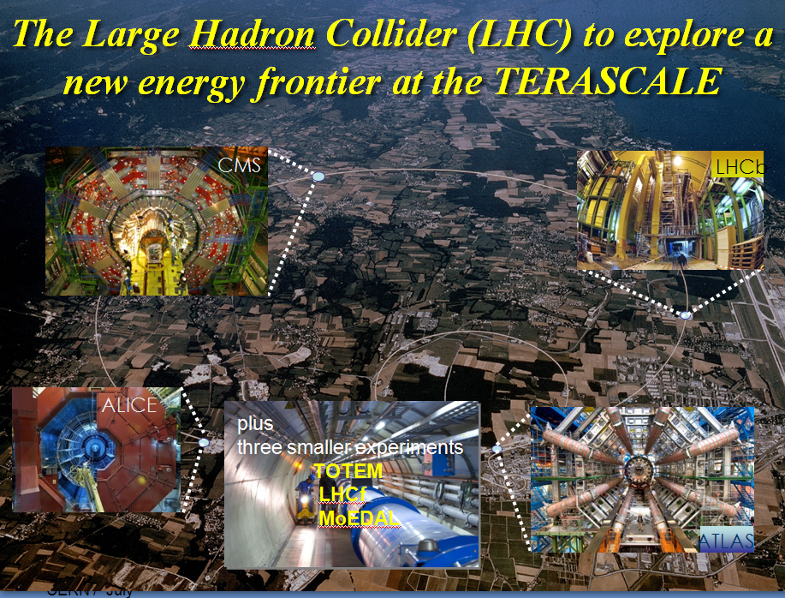
LHC/Tevatron lum. = 20
LHC/Tevatron energy = 14
HL-LHC/LHC luminosity = 5
HE-LHC/LHC energy = 2.4

Slide 15
LHC parameters evolution
Nominal High-Luminosity High-Energy
 | LHC | HL-LHC | HE-LHC
Collision energy [TeV] | 14 | 14 | 33
Peak/leveled luminosity [10³⁴ cm⁻²s⁻¹] | 1.0 | 7.9/5.0 | 2.0/2.0
integrated luminosity per year (1900h) [fb⁻¹] | 57 | 250 | 100
events per crossing | 19 | 150 | 76
# bunches / beam | 2808 | 2808 | 1404
bunch population [10¹¹] | 1.15 | 1.7 | 1.29
Beam current [A] | 0.58 | 0.86 | 0.32
Luminosity leveling | no | θ_{c} , V_{crab} or β* | ε_{x,y}
initial transverse normalized emittance [μm] | 3.75 | 3.75 | 3.75 (x),1.84 (y)
number of IPs contributing to tune shift | 3 | 3 | 2
maximum total beam-beam tune shift | 0.01 | 0.01 | 0.01
IP beta function [m] | 0.55 | 0.14 | 1.0 (x), 0.43 (y)
full crossing angle [μrad] | 285 (9.5 σ_{x,y}) | 0 (509) | 175 (12 σ_{x0})
dipole field [T] | 8.33 | 8.33 | 20
dipole coil aperture [mm] | 56 | 56 | 40-45
stored beam energy [MJ] | 362 | 504 | 479
SR power per ring [kW] | 3.6 | 5 | 62.3
longitudinal SR emittance damping time [h] | 12.9 | 12.9 | 0.98
luminosity lifetime [h] | 23 | 4 | 13

Slide 16
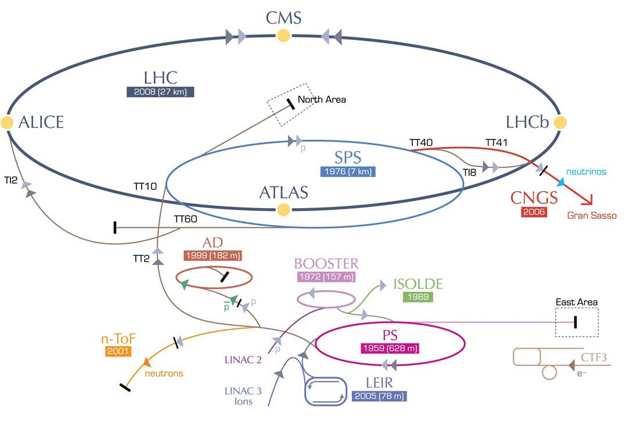
HL-LHC – LHC modifications
IR upgrade
(detectors,
low-β quad’s,
crab cavities, etc)
~2020-21
SPS enhancements
(anti e-cloud coating,RF,
impedance), 2012-2021
Booster energy upgrade
1.4 → 2 GeV, ~2015
Linac4,
~2015

Slide 17
HE-LHC – LHC modifications
HE-LHC
2030-33
SPS+,
1.3 TeV, 2030-33
2-GeV Booster
Linac4

Slide 18
LHC upgrade issues and R&D
Issues | High Luminosity LHC | High energy LHC
Super-Cond. quadrupoles | 15 T for low beta @IR | for IR and Ring
Super-Conducting dipoles |  | 20 T (Nb3Sbn, HTS)
Fast cycling SC magnets |  | For 1.3 TeV injector
Mini beta operation | Chromatic correction and large aperture of matching section | Cryogenic handling of SR heat load
Crab cavities | Novel compact design compatible with machine protection
Machine protection (500 MJ beam power) | Collimation with high effic, & reliability, low impedance | Cryogenic handling of SR heat load
Luminosity leveling | Control q_{c} , V_{crab} or b* | Control emittances
Dynamic vacuum |  | Synchrotron radiation

Slide 19
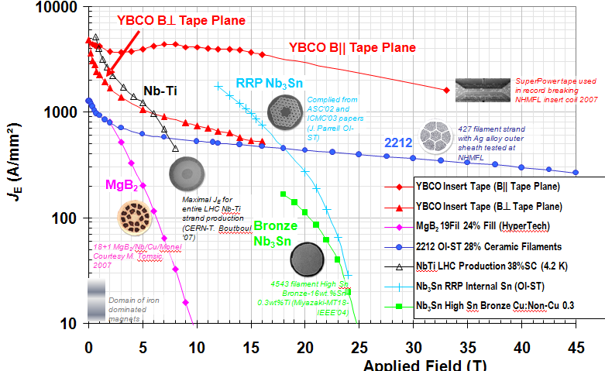
Super-ConductinHIGH FIELD MAGNETS
High Field Super-Conducting magnet R&D
HL-LHC:L = 5 10³⁴
Low β quads(15T)
LHC upgrades
HE-LHC: E_{cm} = 33 TeV
Dipoles (20T)
15 to 24 T Possible Super-conductors: Nb₃Sn existing up to 17-18 T
High Temperature SC : Bi-2212 (existing) or YBCO (small tapes only)
Promising but lots of R&D

Slide 20
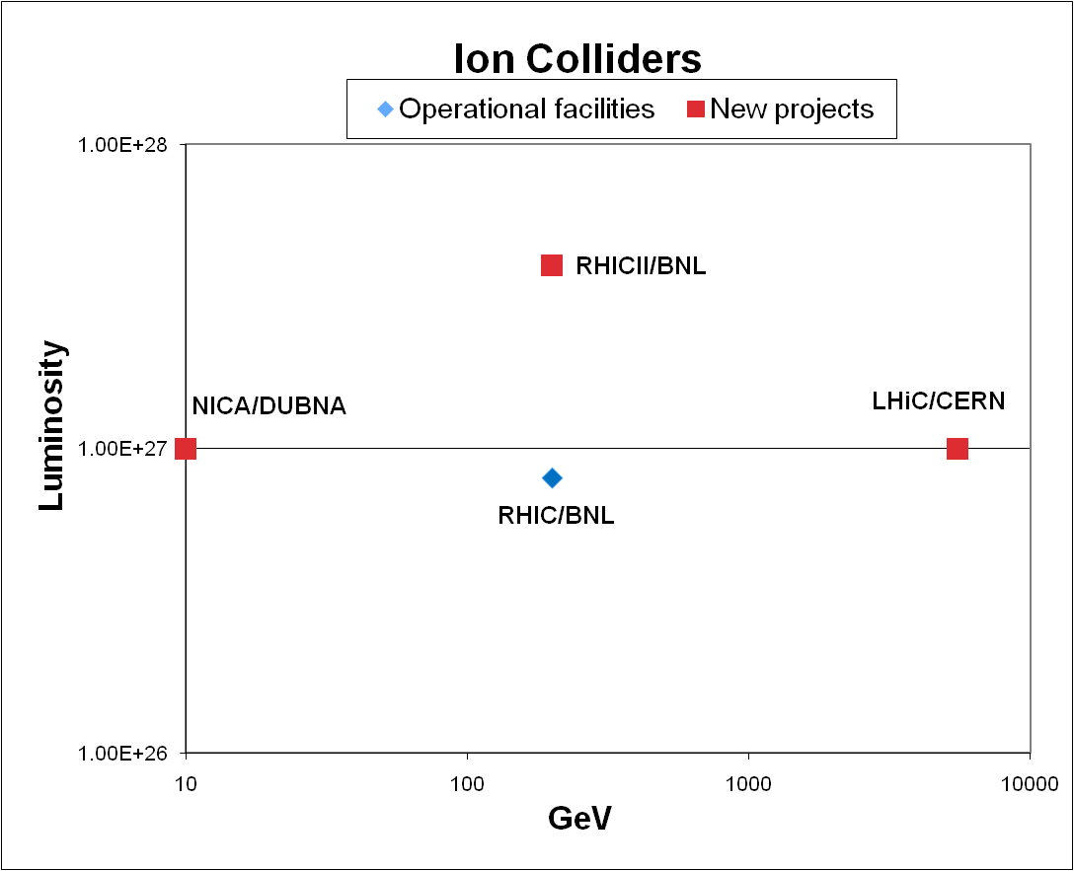
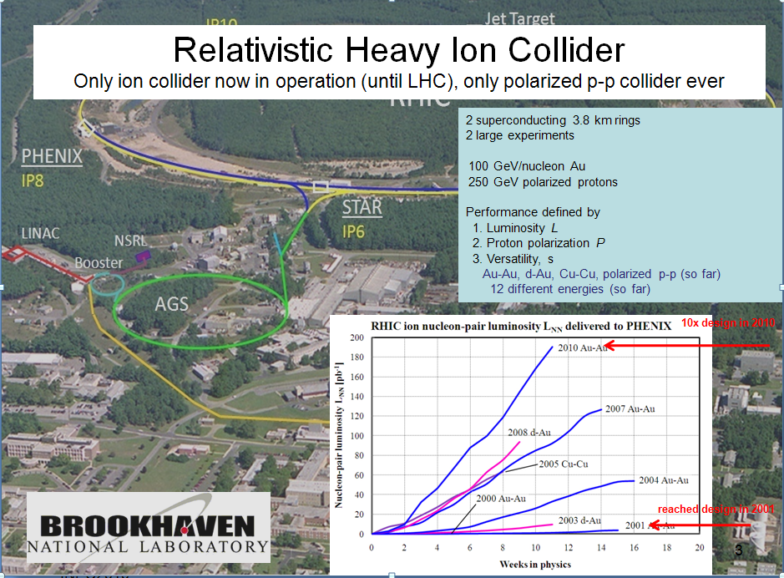
RHIC II/RHIC integrated luminosity = 5
NICA/RHIC energy = 1/22
LHiC/RHIC energy = 28

Slide 21
Ions Colliders Parameters
 | Parameters | NICA | RHIC II | LHiC
Ions | Energy (GeV/Nucleon) | 1-4.5 | 100 | 2760
 | Luminosity (10^27) | 1 | 4 | 1
 | Ions | Au-Au | Au-Au | Pb-Pb
 | Number bunches | 34 | 111 | 592
 | Ions/bunch (10^7) | 100 | 100 | 7
 | Emittances H/V ([μm] | 30/0.03 | 2.5 | 1.5
 | Stored energy (MJ) |  | 0.4 | 3.8
Protons | Energy(Gev/Nucleon) | 12-25 | 250 | Later?
 | Luminosity (10^30) | 1.1 | 300 | ?
 | Polarisation (%) | 70 | 70 | 0

Slide 22
Major issues of Ions Colliders
Issues | NICA | RHIC II | LHiC
Peak Luminosity and Luminosity lifetime | Intra-beam scattering |  | Beam losses from EM interactions
Intensity limits |  |  | Nuclear reactions in collimators
Remedies | Stochastic cooling with bunched beams |  | New “cryo-collimators”
 | High voltage elect. cooling
Efficient and high quality magnets | Super -ferric SC magnets
Effective energy scan | Flexible lattice

Slide 23
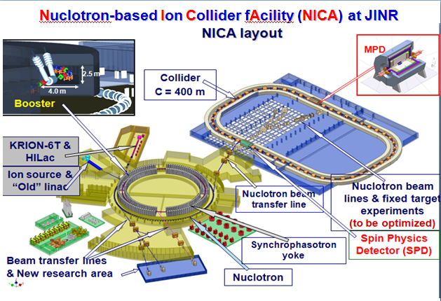
All rings (Booster, Nuclotron and Collider) are superconducting synchrotrons based on 2 Tesla super-ferric magnets (Nuclotron technology);

Slide 24
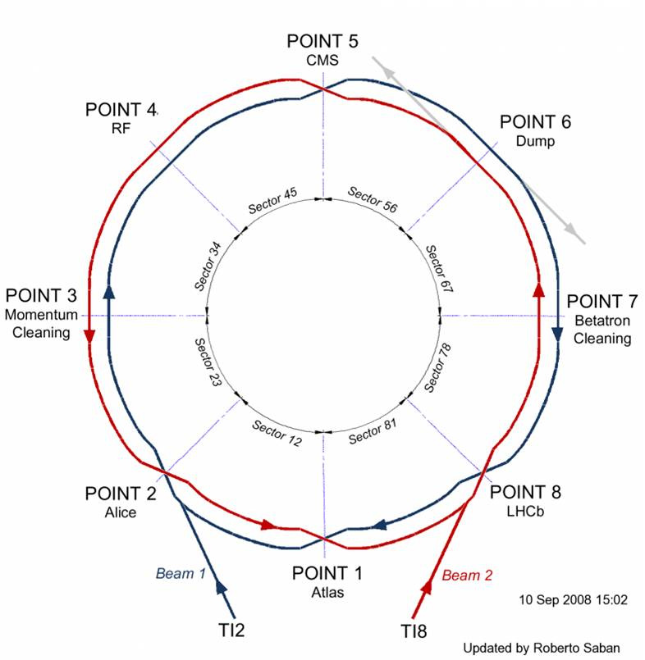
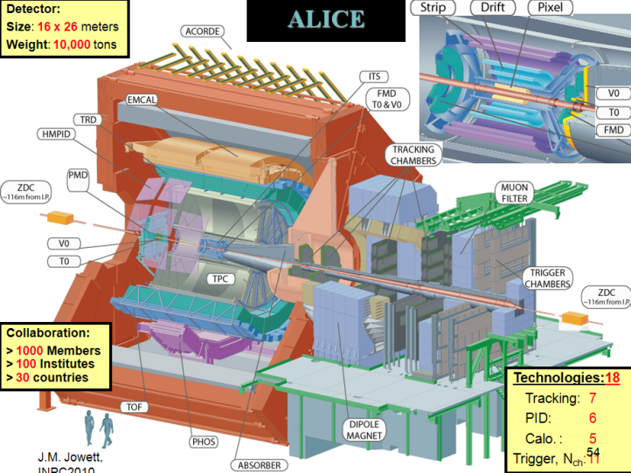
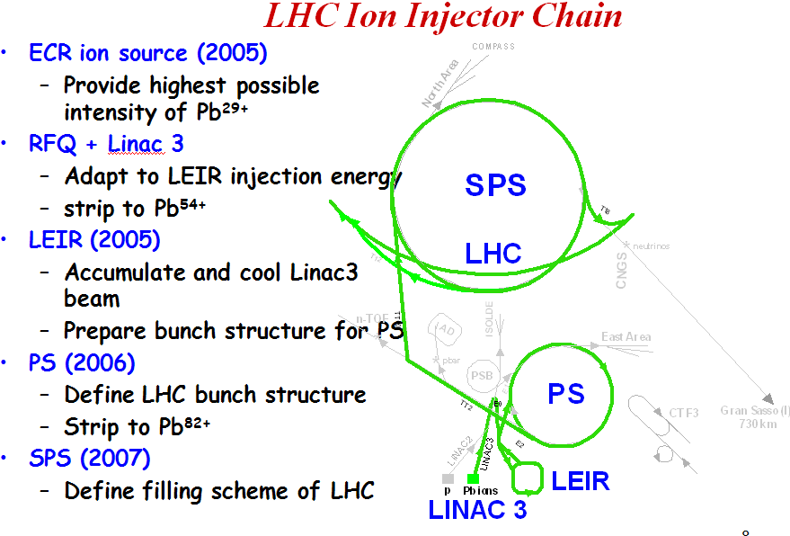
Large Hadron Ion Collider (LHiC)
1 month/year for heavy-ion program (Starting Nov 2010)
initially ²⁰⁸Pb⁸²⁺- ²⁰⁸Pb⁸²⁺
Later p-Pb, lighter A-A…

Slide 25
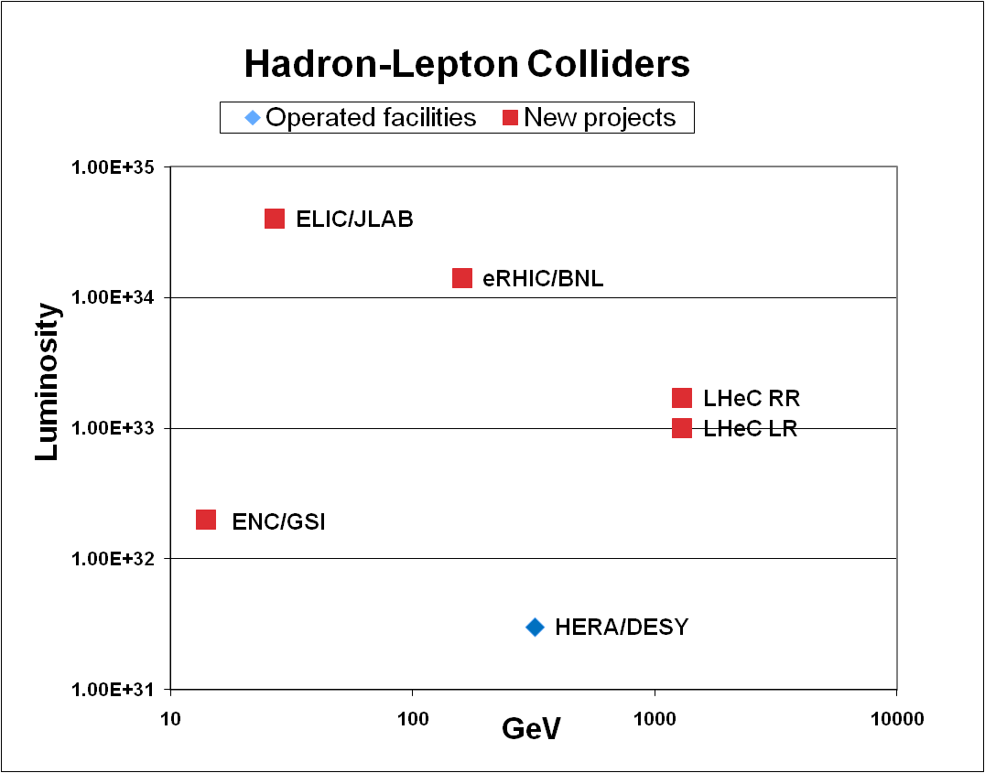


Two options for e-:
Ring:
ENC,ELIC, LHeC RR
Energy Recovery Linac:
eRHIC, LHeC LR
Review @IPAC10
V.Litvinenko/BNL
ELIC&eRHIC/HERA
Luminosity = 10³
LHeC/HERA luminosity = 50
LHeC/HERA energy = 4

Slide 26
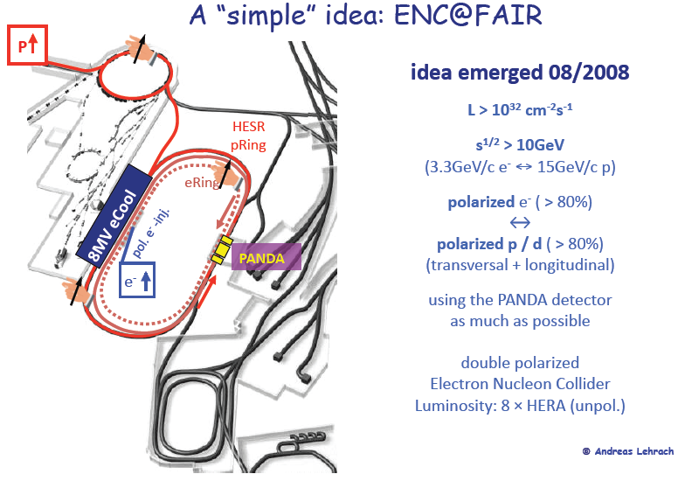
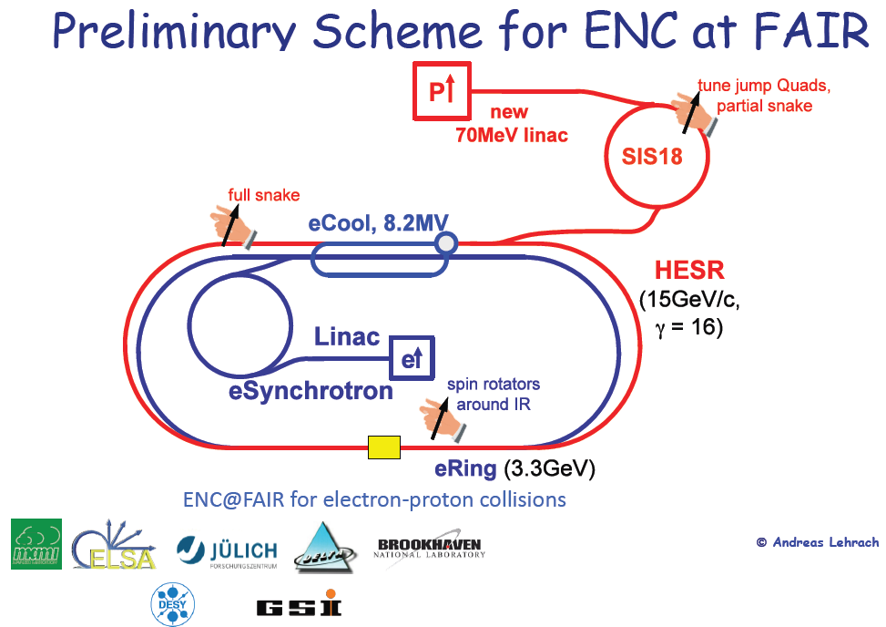
ENC @ FAIR
Taking advantage of the “existing” FAIR / HESR
15 GeV proton ring

Slide 27
ELIC at JLAB
Taking advantage of the existing CEBAF 12 GeV electron accelerator
MEIC first stage collider
Serves as a large booster to the full energy collider ring
p
prebooster
SRF Linac
Ion Sources
Circumference | m | 1800
Radius | m | 140
Width | m | 280
Length | m | 695
Straight | m | 306
p
p
ELIC collider ring
MEIC collider ring
electron ring
Interaction Point
e
e
e
injector
Ion ring
Vertical crossing
12 GeV CEBAF
Stage |  | Max. Energy (GeV/c) |  | Ring Size (m) |  | Ring Type |  | IP#
 |  | p | e | p | e | p | e
 | Low | 12 | 5 (11) | 630 |  | Warm | Warm | 1
 | Medium | 60 | 5 (11) | 630 |  | Cold | Warm | 2
 | High | 250 | 10 | 1800 |  | Cold | Warm | 4

Slide 28
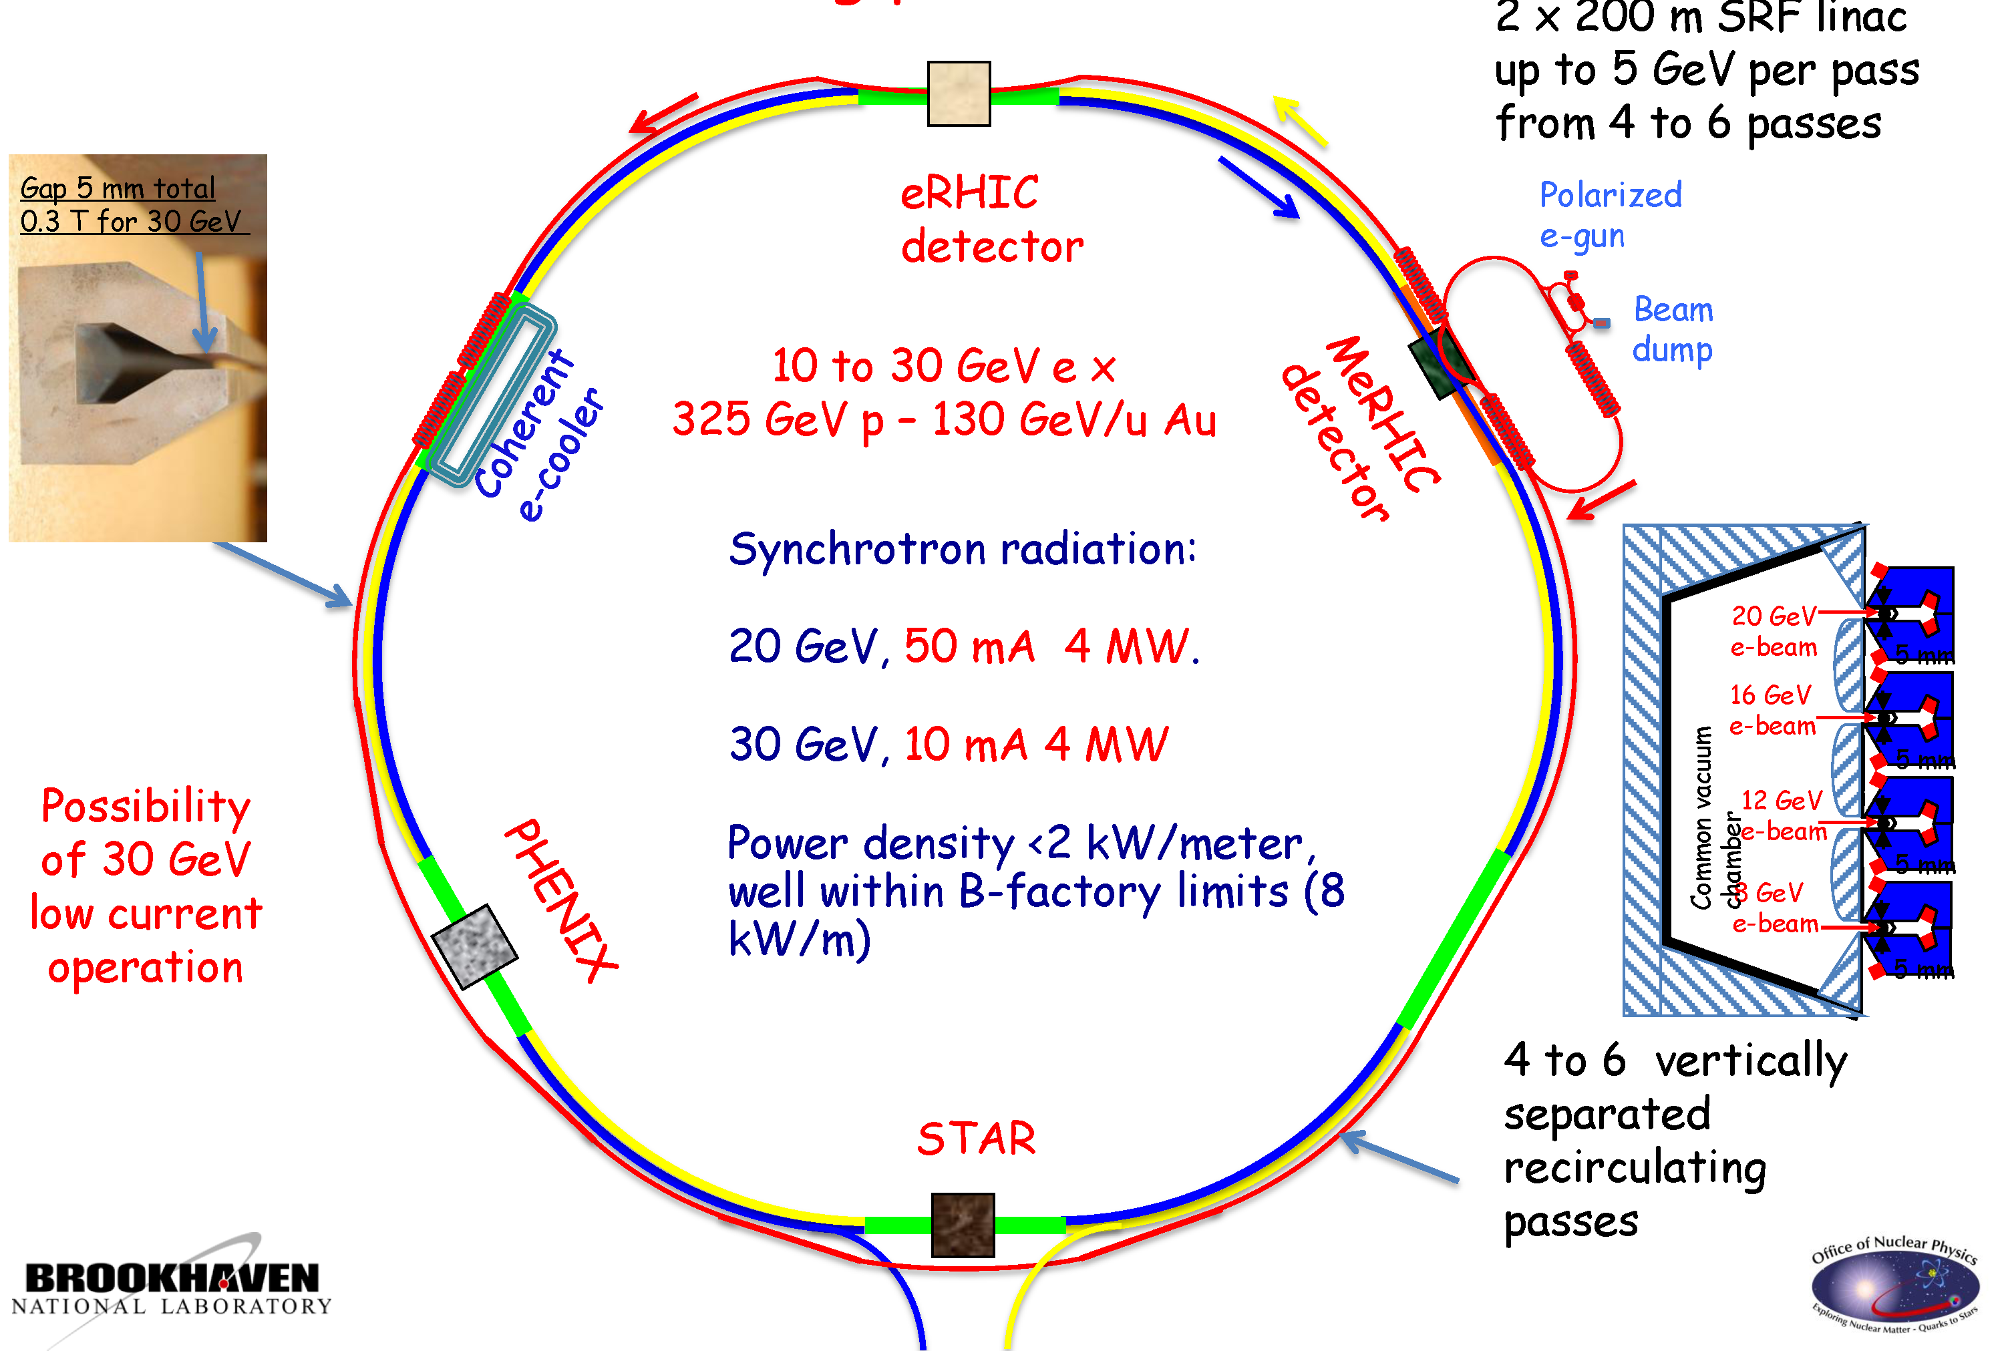
eRHIC @ BNL
Taking advantage of the existing RHIC 130 GeV/u Au ring
First stage
4 Gev e- X
250 GeV p
100 GeV/u Au
Notes:
adding additional linacs as well as recirculating passes in RHIC tunnel

Slide 29
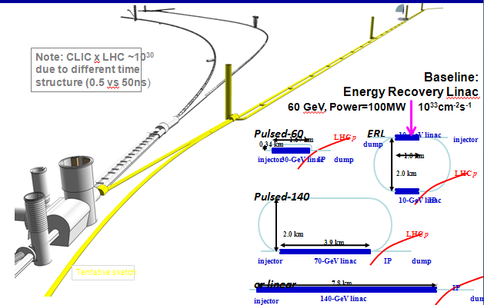
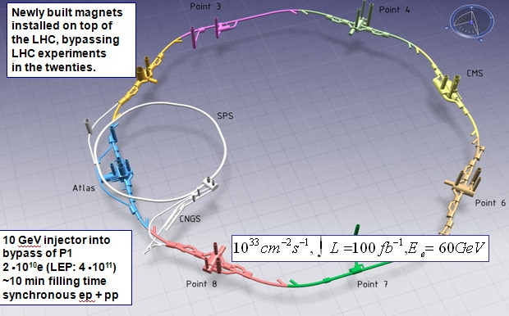
LHeC – Two options
Taking advantage of the existing LHC proton ring 7 TeV (to 16.5 TeV in HE)
RR LHeC:
new ring
in LHC tunnel,
with bypasses
around
experiments
ILC type SC-RF structures and beam
LR LHeC:
recirculating
linac with
energy
recovery
RR LHeC
e± injector
10 GeV,
10 min. filling time

Slide 30
Hadron-Lepton Collider Parameters
Parameters | ENC | ELIC | eRHIC | LHeC
option | RR | RR | LR | RR | LR
P-A/e- energy [GeV] | 15/3.3 | 60/3 | 325/20 | 7000/60 | 7000/60
√(S) [GeV] | 14 | 27 | 160-102 | 1296 | 1296
luminosity [10³² cm⁻²s⁻¹] | 2 | 400 | 140 | 17 | 10
P/e- polarization [%] | 80/80 |  | 70/80 | /40 | /90
P/e- bunch popul. [10⁹] | 5.4/23 | 11/60 | 200/24 | 170/26 | 170/2.0
P/e- bunch length [mm] | 0.3/0.1 | 5 | 49/20 | /10 | /0.3
P/e- bunch interval [ns] | 19 |  | 74 | 25-50 | 25-50
P/e- tr. emit. ge_{x,y} [μm] |  | 0.8/75 | 1200/25000 | 3.75/580,290 | 3.75/50
IP beam size s_{x,y} [μm] |  |  |  | 30, 16 | 7
full crossing angle [mrad] |  |  |  | 0.93 | 0
geometric reduction H_{hg} |  |  |  | 0.77 | 0.91
Energy Recovery efficien. | - | - | 94? | - | 94%
average current [mA] |  | 860/4800 | 420/50 | 131 | 6.6
tot. wall plug power[MW] |  |  |  | 100 | 100

Slide 31
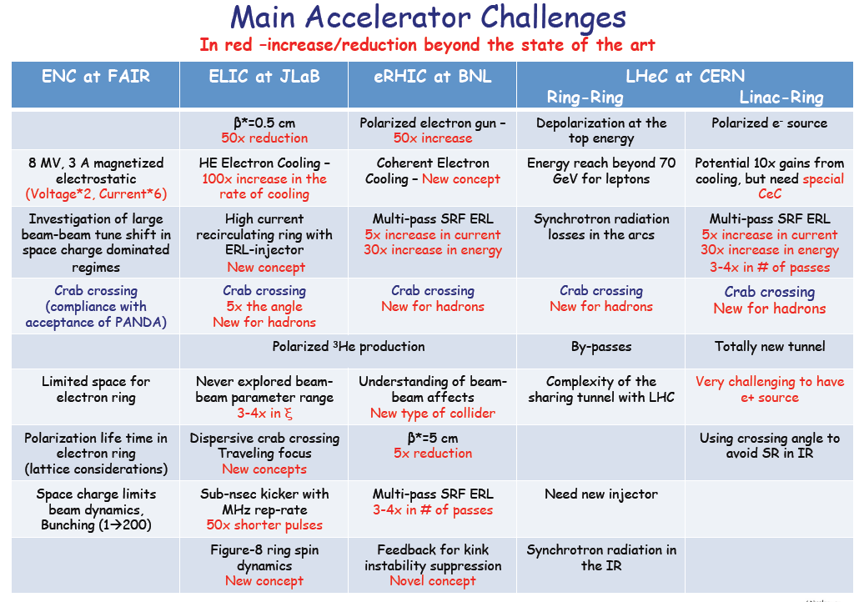
Review @IPAC10
V.Litvinenko/BNL

Slide 32
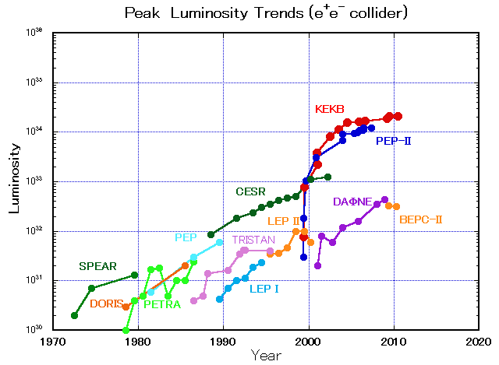
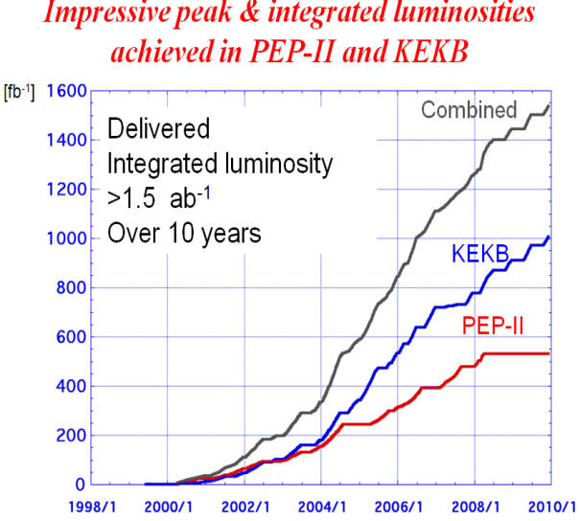
B Factories (PEPII&KEKB) to SuperB and
SuperKEKB @ high luminosity frontier
SuperB
SuperKEKB
10³⁶
40 times higher luminosity
Next generation
B-factories
KEKB

Slide 33


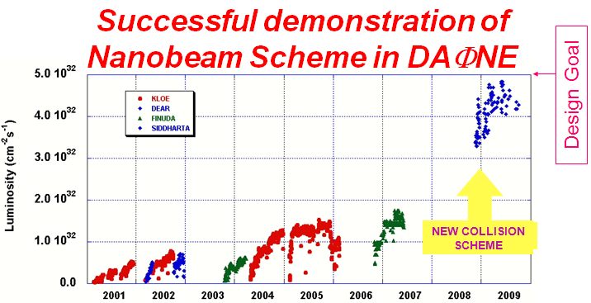
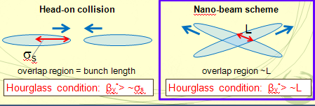
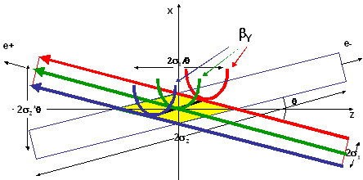
Novel “nanobeam scheme”
(P.Raimondi/LNF)
Standard design based on larger beam currents and stronger focusing of short bunches with crab cavities at IP:
⇒ larger power consumption, high ξ_{y,} Challenges from HOM heating, Bunch lengthening by coherent Synchrotron Radiation (CSR).
Very small beam spot-size (nm) with large crossing angle (LPA)
  Inspired from Linear Colliders Beam Delivery developments
Long bunches (high charge) and collisions at highly focused region only
θ_{c}
Crab-crossing
KEKB

Slide 34
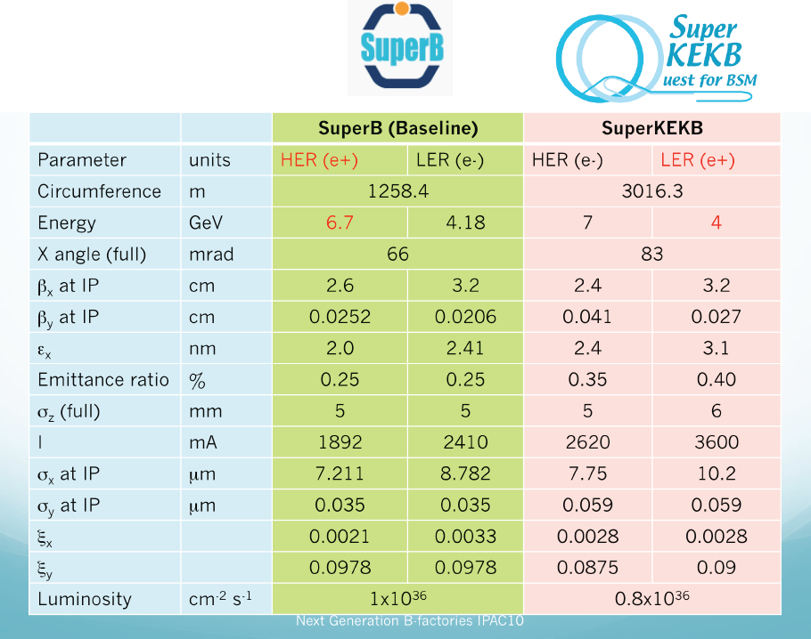
Major parameters
B Factories

Slide 35
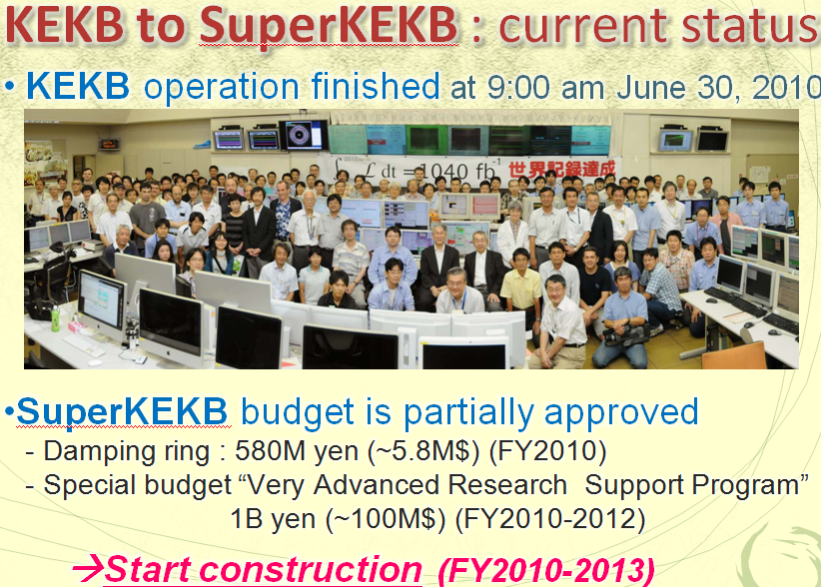
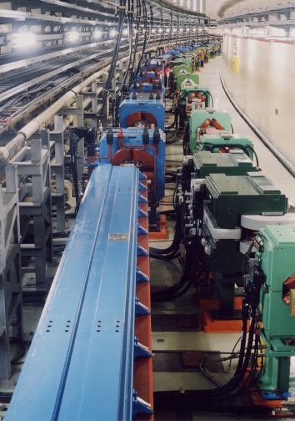
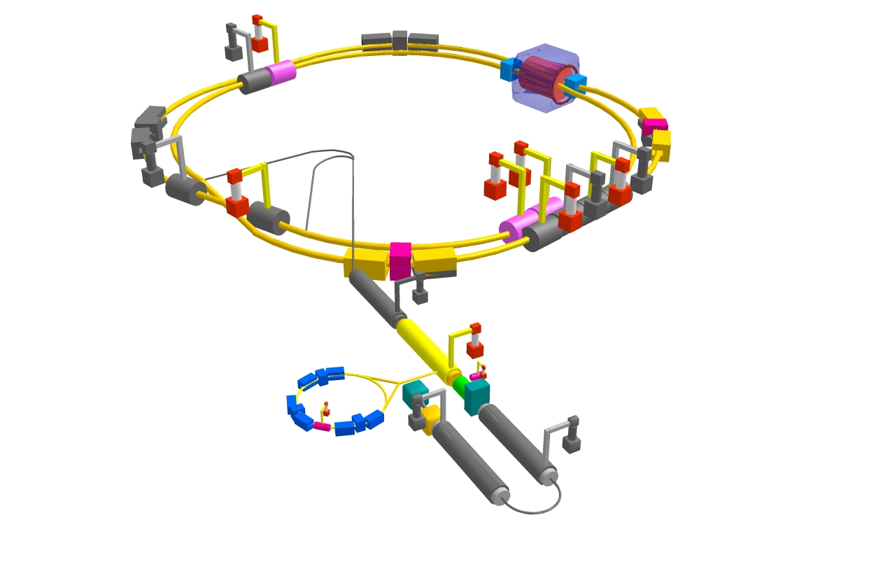

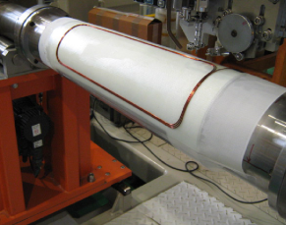

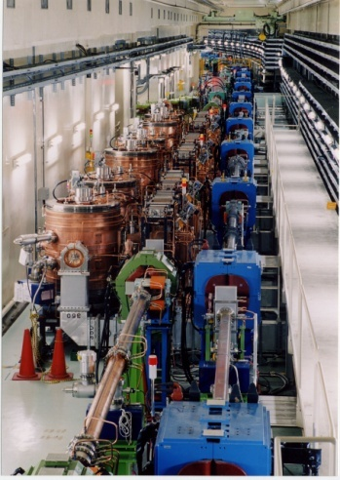

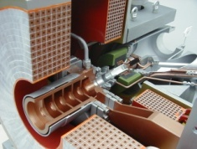
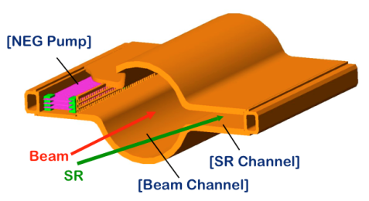
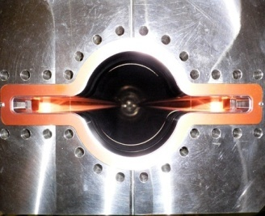
KEKB to SuperKEKB How to upgrade
Colliding bunches
Belle II
New IR
e- 2.6 A
New superconducting /permanent final focusing
quads near the IP
New beam pipe
& bellows
e+ 3.6 A
Replace short dipoles with longer ones (LER)
Partially funded (100 M$)
Add / modify RF systems for higher beam current
Low emittance positrons to inject
Positron source
Redesign the lattices of HER & LER to squeeze the emittance
Damping ring
New positron target / capture section
TiN-coated beam pipe with antechambers
Low emittance gun
Low emittance electrons to inject
To get x40 higher luminosity

Slide 36
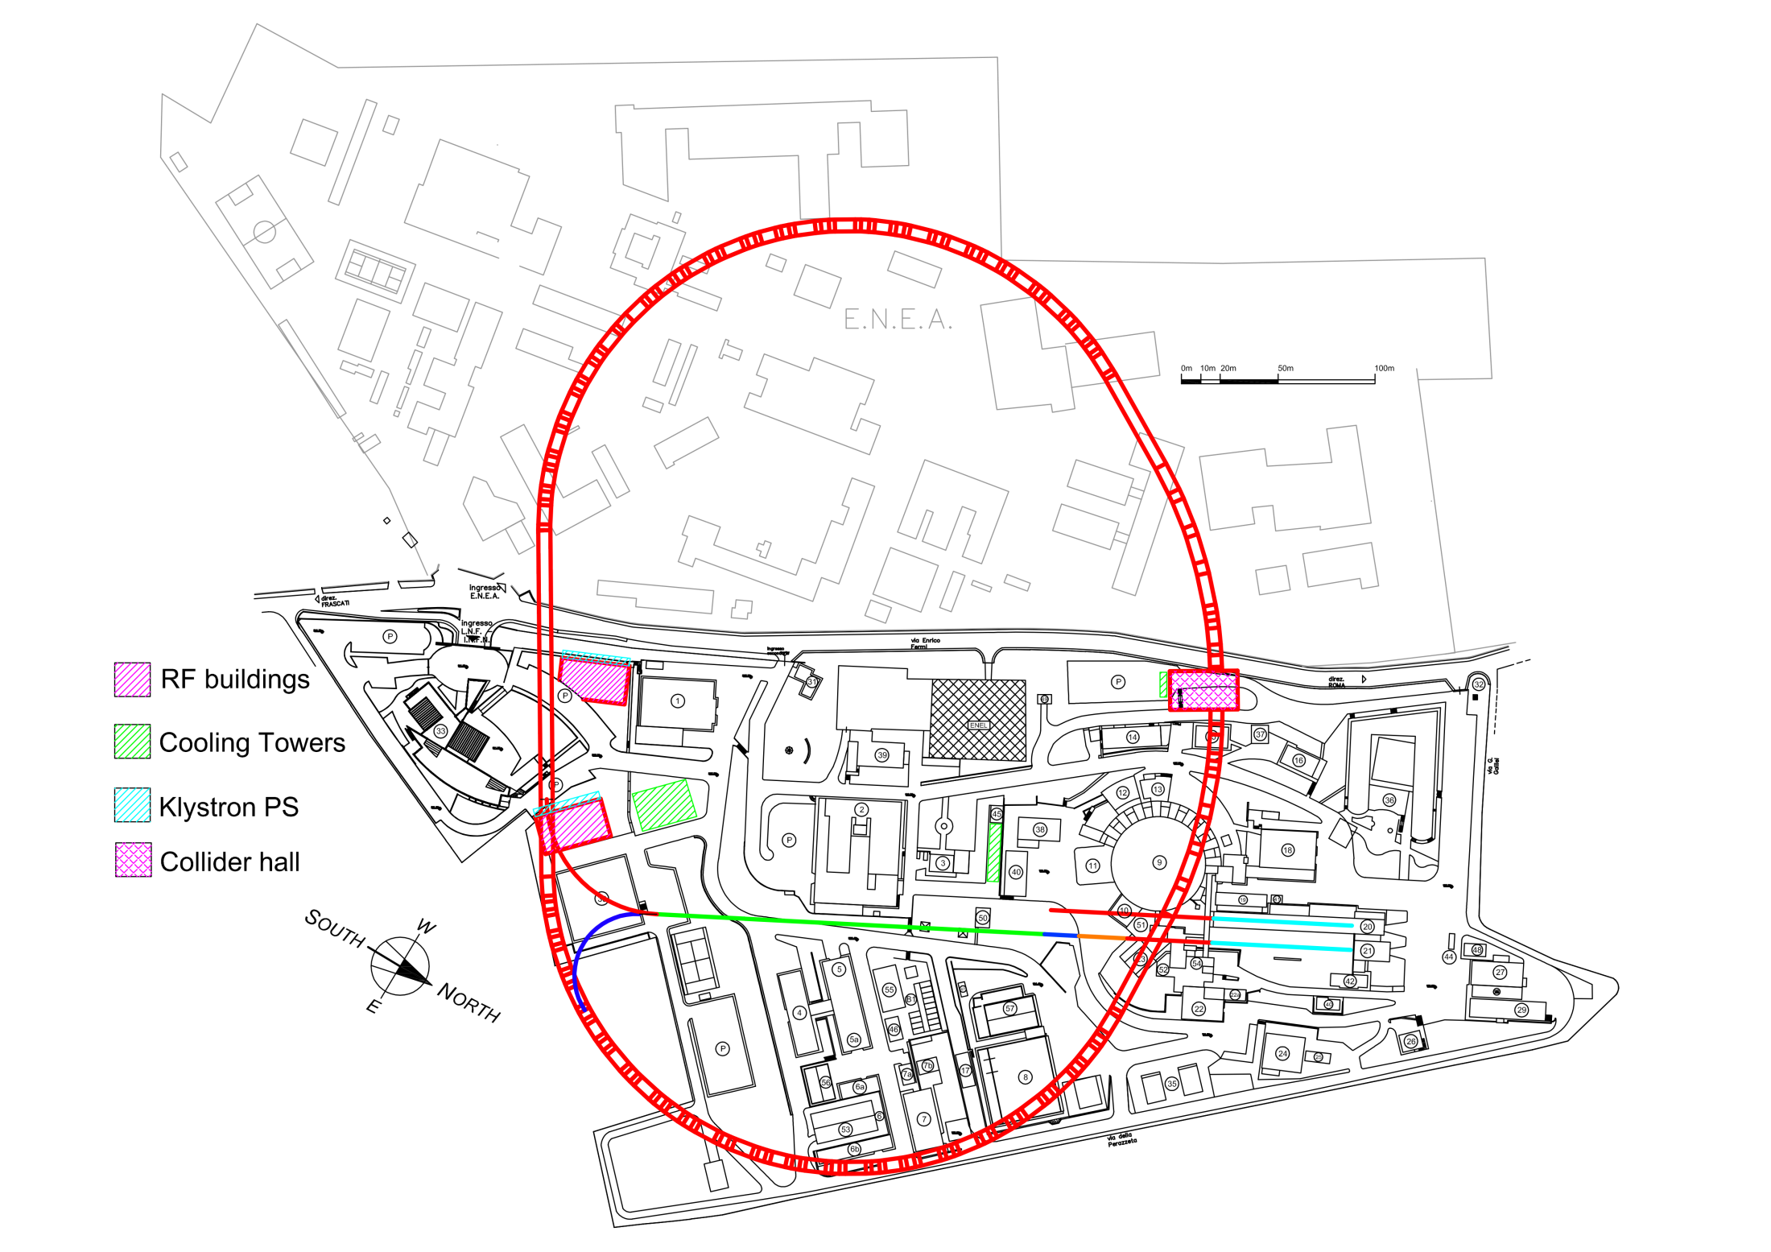
SuperB at Frascati
CDR in 2009: http://arxiv.org/abs/0709.0451
LER arc
Detector:
http://fr.arxiv.org/abs/1007.4241)
Waiting for approval
HER arc
Circumference 1.258 km (March,2010)
Collider hall
66 mrad crossing angle
RF
DaΦne
e+
e-
LER arc
Collaboration: INFN, SLAC, IN2P3, BINP, Canada
Damping ring
HER arc
HER and LER arcs are parallel to each other in the H-plane, separated by 2.1 m.
SuperB WS, March, 2010

Slide 37
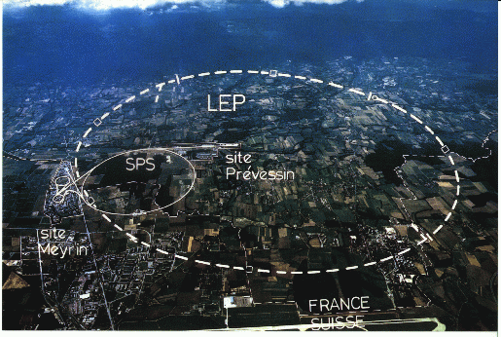
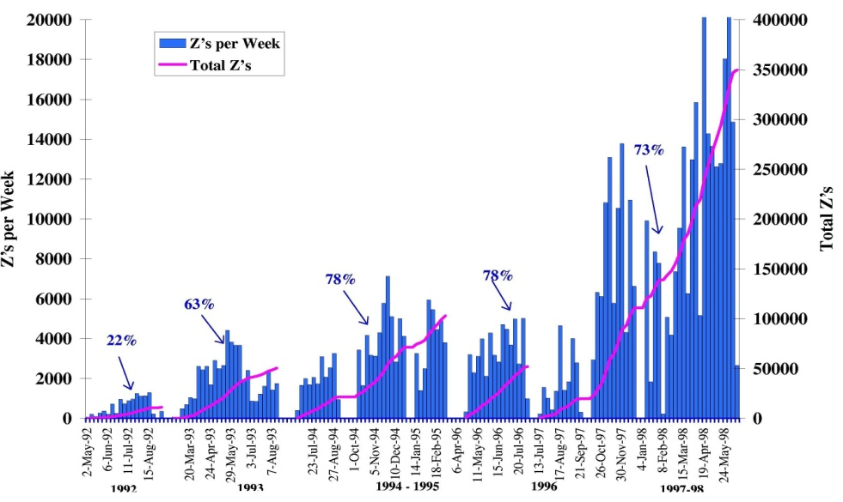
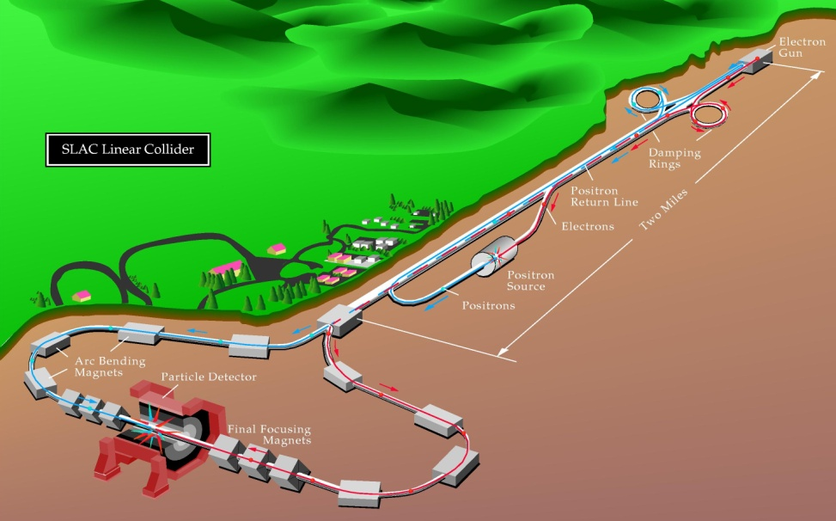
Lepton Colliders at the Energy Frontier
CLIC/SLC energy = 20
CLIC/SLC luminosity = 10⁴
Energy lost per turn
by synchrotron radiation
ρ = 3 km

Slide 38
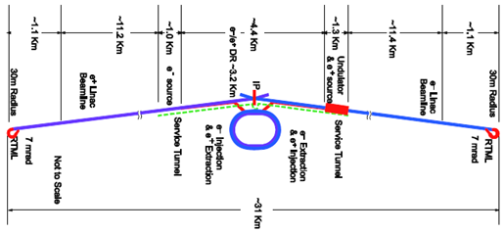
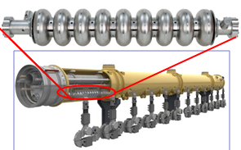
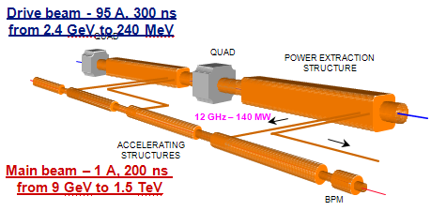


Linear Collider layouts http://www.linearcollider.org/cms http://clic-study.web.cern.ch/CLIC-Study/
ILC 0.5 TeV – 30 km
ILC 1 TeV – 50 km
CLIC 3 TeV: 48 km
CLIC 0.5 TeV: 13 km

Slide 39
Linear Collider main parameters
Technology | ILC | CLIC
Centre-of-mass energy (GeV) | 500 | 500 | 3000
Total (Peak 1%) luminosity (10³⁴⁾ | 2.0(1.5) | 2.3(1.4) | 5.9(2.0)
Total site length (km) | 31 | 13.0 | 48.3
Loaded accel. gradient (MV/m) | 31.5 | 80 | 100
Main linac RF frequency (GHz) | 1.3 (Super Cond.) | 12 (Normal Conducting)
Beam power/beam (MW) | 20 | 4.9 | 14
Bunch charge (10⁹ e+/-) | 20 | 6.8 | 3.72
Bunch separation (ns) | 176 | 0.5
Beam pulse duration (ns) | 1000 | 177 | 156
Repetition rate (Hz) | 5 | 50
Hor./vert. norm. emitt (10⁻⁶/10⁻⁹) | 10/40 | 4.8/25 | 0.66/20
Hor./vert. IP beam size (nm) | 640/5.7 | 202 / 2.3 | 40 / 1
Hadronic events/crossing at IP | 0.12 | 0.19 | 2.7
Coherent pairs at IP | 10 | 100 | 3.8 10⁸
Wall plug to beam transfer eff | 9.4% | 7.5% | 6.8%
Total power consumption (MW) | 216 | 129.4 | 415

Slide 40
Status and major issues of Linear Colliders
ILC
0.5 TeV upgradable to 1 TeV
Mature SC-RF technology (TESLA- Flash- XFEL)
CDR in 2007, TDR in 2012
Global Intern. collaboration & organisation (GDE)
CLIC
extension in multi-TeV range
Novel scheme of Two Beam Acceleration (TBA): CTF1,2,3
CDR in 2011, TDR in 2016
Multi-lateral Int. Collaboration of 38 volunteer Institutes
Extremely fruitful collaboration between CLIC and ILC
Taking advantage of common issues and great synergies
Common IWLC Workhop (18-22/10/2010 @ CERN)
Towards single Linear Collider community and….
Possibly future joined project based on Physics requests (LHC results) and technology choice as best trade off between performance, maturity, risk, cost, etc….
Specific issues
SC-RF with high accelerating field and production yield
Damping Ring; long train of bunches
Electron cloud instability
Positron generation (undulators)
Two Beam acceleration (TBA)
12 GHz NC RF with high acc. field and low Break-down rate
Preservation of beam quality in strong wake field environment: (alignment,stability,feedbacks)
Short interval (0.5ns) between bunches
Common issues:
Generation of electrons and positrons with small emittances
Focusing to nm beam sizes
MWatts beam power generation and handling
Conventional facilities (tens kms of underground tunnels)

Slide 41







Successful ILC Super Conducting RF developments in global collaboration
STF @ KEK
Under construction
first beam 2011
ILC RF unit test
NML facility @ FNAL
Under construction
first beam 2010
ILC RF unit test
TTF/FLASH @ DESY
~1 GeV
ILC-like beam
ILC RF unit(lower gradient)

Slide 42


Addressing all major CLIC technology
key issues in CLIC Test Facility (CTF3)
Demonstrate Drive Beam generation
(fully loaded acceleration, beam intensity and bunch frequency multiplication x8)
Demonstrate RF Power Production and test Power Structures
Demonstrate Two Beam Acceleration and test Accelerating Structures
PULSE COMPRESSION
FREQUENCY MULTIPLICATION
magnetic chicane
150 MeV e-linac
30 GHz test stand
3.5 A - 1.4 μs
Delay Loop
Combiner Ring
CLEX (CLIC Experimental Area)
TWO BEAM TEST STAND
PROBE BEAM
Test Beam Line
Photo injector tests,
laser
28 A - 140 ns
Infrastructure from LEP
total length about 140 m

Slide 43






Test Facilities on Linear Colliders Common Issues
ATF/KEK: ultra low emittance
and nanometer beam sizes
CESR-TA/Cornell:Electron cloud
e+
e-
CLIC Damping Ring

Slide 44


Muon Collider possible alternative
for Multi-TeV Lepton Collider ?
Limited synchroton radiation and beamstrahlung due to high mass:(m_{μ} / m_{e} ~ 207)
COMPACT
  Fits on FNAL laboratory site
MULTI-PASS ACCELERATION
  Cost Effective
MULTIPASS COLLISIONS IN
A RING (~1000 turns)
  Relaxed emittance requirements
  & hence relaxed tolerances
NARROW ENERGY SPREAD
  Precision scans, kinematic constraints
TWO DETECTORS (2 IPs)
- ΔT_{bunch} ~ 10 μs … (e.g. 4 TeV collider)
  Lots of time for readout
  Backgrounds don’t pile up
(m_{μ}/m_{e})² = ~40000
  Enhanced s-channel rates for
  Higgs-like particles
COST
PHYSICS
Beamstrahlung in
any e+e- collider
δE/E ∝ γ²

Slide 45


Muon Collider Schematic
√s = 3 TeV
Circumference = 4.5km
L = 3×10³⁴ cm⁻²s⁻¹ μ/bunch = 2x10¹²
σ(p)/p = 0.1%
ε_{⊥N} = 25 μm
β* = 5mm
Rep Rate = 12Hz
Proton source: Upgraded PROJECT X (4 MW, 2±1 ns long bunches)
10²¹ muons per year that fit within the acceptance of an accelerator
Neutrino Factory as first possible step towards Muon Collider
Large number of synergies, identical Front End

Slide 46



Muon Collider Issues&Challenges, R&D
Limited muon lifetime: 2 microsec: Race before death!
Muon generation in large emittance : Cooling by 10^5 (6 planes)
    MWatts proton beam power generation and target
Radiations in machine and detectors:
- Novel scheme & technology:
Challenging R&D
Feasibility addressed in Test Facilities
NOW
MAP PLAN
Key component models

Slide 47



Project X at FNAL: 3 MW proton source
A neutrino beam for long baseline
neutrino oscillation experiments:
  > 2 MW proton source at 60-120 GeV
High intensity, low energy protons for kaon, muon, and nuclear experiments
  >2 MW operations simultaneous with the neutrino program
A path toward a muon source for a possible future Neutrino Factory and/or a Muon Collider
  Ugrade potential to 2-4 MW at ~5-15 GeV
1300km to Dusel/South Dakota
Strong synergy
with ILC SCRF
3 GeV, 1 mA CW superconducting linac
  3 MW beam power for rare processes prog;
  flexible beam provision for multiple users
  Options for 3-8 GeV acceleration:
  CS or (1.3 GHz) pulsed linac
  Main Injector utilized for neutrino prog.

Slide 48

Possible future HEP facilities at Energy/Luminosity frontier
B Factories
Protons
Leptons
E-/Hadrons
Ions

Slide 49
Tentative schedule new projects
European Strategy
For Particle Physics
Future facility specif. from LHC Physics?
Today
LHC = 1 fb⁻¹
66 fb⁻¹
336 fb⁻¹
3070 fb⁻¹

