Slide 1
Updated TDR schedule & resources

Slide 2
Status in June (CASC 22nd June)
The TDR plan was more or less consistent with the MTP in terms of overall resources and spending profile
however:
  Concern about available manpower (2250 FTE CERN limit and APT data)
  Concern about potential cost increases (modules, rings…)
  Concern about “CLIC Demonstrator”
I was then asked to come back with a plan including CTF3++ and CLIC Zero options with reviewed costs and a realistic schedule, potentially extending beyond the TDR phase and 2016
In the meanwhile, a new MTP has been presented to the Council, which completely changed the scenario …

Slide 3
MTP 2010
(June)

Slide 4
MTP 2010 compared to TDR plans (June)
Good overall agreement between MTP 2010 (as presented) and TDR plans
Difference in personnel/material split
  Goes in the right direction
  It’s likely to be optimistic in TDR
TDR plans:
  Assume 50% additional contribution from outside CERN from 2012 (20% up to 2011)
  See later for other details

Slide 5
Personnel: Comparison with APT

Slide 6
TDR plans – schedule and scope (June)
 | 2010 |  |  |  | 2011 |  |  |  | 2012 |  |  |  | 2013 |  |  |  | 2014 |  |  |  | 2015 |  |  |  | 2016
 | 1 | 2 | 3 | 4 | 1 | 2 | 3 | 4 | 1 | 2 | 3 | 4 | 1 | 2 | 3 | 4 | 1 | 2 | 3 | 4 | 1 | 2 | 3 | 4 | 1 | 2 | 3 | 4
CTF3 TBTS operation | inst. | 1-2 structures, beam loading, breakdown kick
CTF3 TBL operation | inst. |  | Deceleration 8 PETS |  | final decelerator test (16 PETS, 50%)
Modules lab | initial tests, installation 2 modules |  |  |  | further tests, installation 4 modules |  |  |  | testing |  |  |  |  |  |  |  | pre-series production, industrialization
Modules CTF3 |  |  |  |  |  |  |  | 1 module inst. |  | testing 1 module |  | 3 modules inst. |  | testing 3 modules |  |  |  |  |  |  | > upgrades?
CTF3 phase feedback | design, hardware tests |  |  |  |  |  |  | installation |  | testing
CTF3 TBL+ |  |  |  |  |  |  |  | installation |  | Commissio-ning |  | RF testing, potential upgrades
CLIC DB injector & linac / CLIC 0- | design |  |  |  |  |  | component construction (injector) |  |  |  |  | installation (inj) |  | commissioning (inj) |  |  | staged upgrade & testing
RF structures construction | precision metrology, fabr. procedures |  |  |  | up to 40 structures built, establish precision machining at CERN or elsewhere, 5 μm tolerances achieved |  |  |  |  |  |  |  |  |  |  |  | more than 200 structures built, final cost optimization, pre-series with industry
RF test infrastructure | CERN test stand inst. |  | CERN test stand testing and upgrades (at least two slots) |  |  |  |  |  | continue testing with increased capabilities, CERN or elsewhere, up to 10 slots |  |  |  |  |  |  |  | testing, up to 200 accelerating structures plus PETS and RF components
Prototypes of critical components | technical choices, design |  |  |  |  |  |  |  | construction, hardware tests |  |  |  |  |  |  |  | finalization, performance & cost optimization, industrialization for large scale components
Other systems, Civil Engineering… | detailed program definition |  |  |  | first phase (CDR baseline) |  |  |  |  |  |  |  |  |  |  |  | second phase (new baseline ?, project implementation plan)
Beam physics studies | CDR activities, feasibility studies |  |  |  |  |  | Performance and cost optimization |  |  |  |  |  |  |  |  |  | new baseline? Preparation for commissioning, operational scenarios…
Completion of present CTF3 program ☺
CTF3+ (phase feedback, TBL+, 3 CLIC modules and moderate upgrade, ~ 6 modules) 😐
CLIC modules in lab 😐
CLIC DB Injector (or reduced CLIC Zero, but limited resources for the moment) 😐
RF structure and components, RF testing 😐
Technical activities, prototyping (FD alignment, kickers, vacuum, diagnostics…) ☹
Civil engineering, cost studies… ☹
Beam physics studies ☹

Slide 7
TDR plans – resources per activity (June)

Slide 8
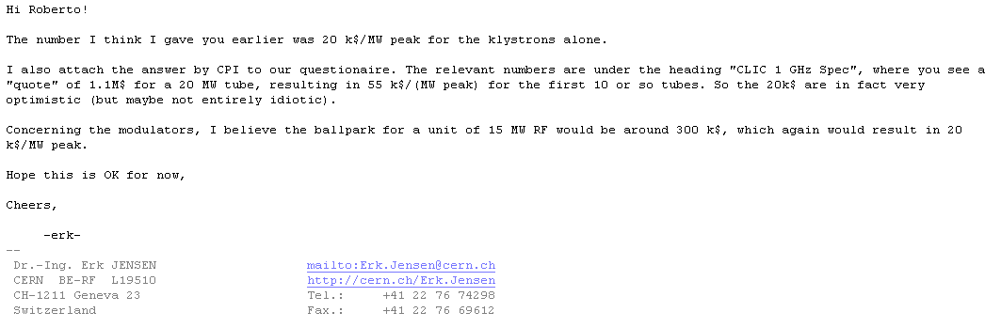
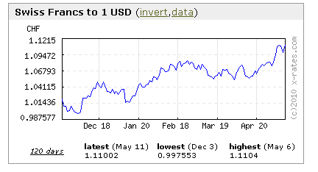
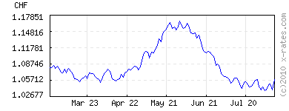
Klystrons/Modulators, cost per MW – initial assumption
From Erk:
        20 k$ / MW for a klystron
        Similar number for a modulator
        Cost of 15 MW unit = 2 x 300 k$ = 600 kCHF
        I assumed as well ~ 200 kCHF per structure
N.B.: I assume everywhere 1 $ = 1 CHF

Slide 9
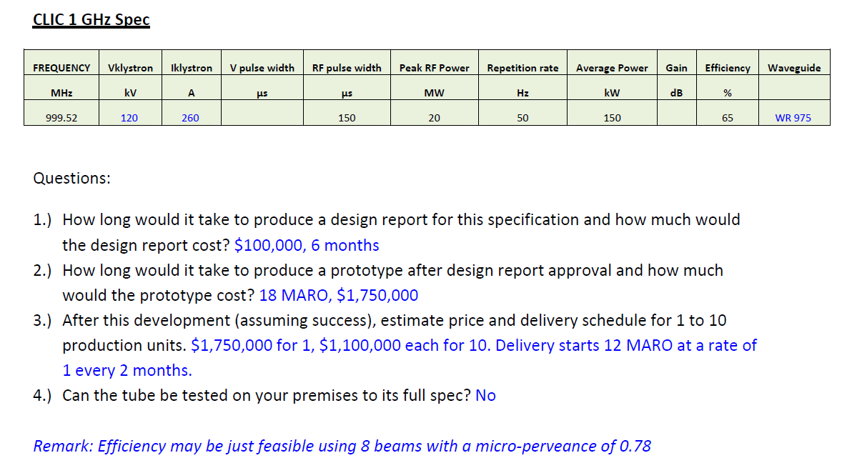
CPI Evaluation
  73 - 117 k$/MW

Slide 10
Learning curve
  ~ 40 k$/MW

Slide 11
Conservative assumptions on RF units
Consider:
      500/600 k$ for a 15 MW klystron, for a production of about 40/60 units
      Similar number for a modulator
      Cost of a 15 MW unit = 1000/1200 kCHF
      Assuming ~ 200 kCHF per structure
      Total cost for RF unit plus structure 1200/1400 kCHF

Slide 12
Scaling with RF units cost
  DBA 200 MeV 119 MCHF
  CLIC Zero- 223 MCHF
  CLIC Zero 324 MCHF

Slide 13
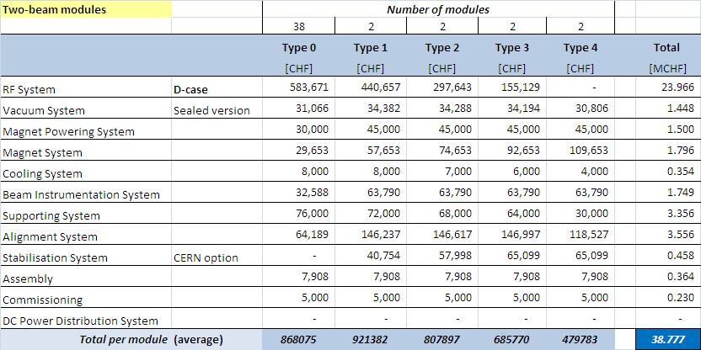

New inputs on cost
G. Riddone – Two-Beam Modules
  From 500 kCHF/module to ~ 850 kCHF/module
  ~ 800 kCHF/module
B. Jeanneret – D.B. Ring Complex
  From 25 MCHF to 79 MCHF

Slide 14
CLIC Zero updated cost
  DBA 200 MeV 119 MCHF
  CLIC Zero- 290 MCHF
  CLIC Zero 400 MCHF

Slide 15
CTF3 ++ updated cost
  Spending profile
  [kCHF]
  Present program
  (TBL+, phase feedback, up to 6 modules)
  Additional resources for energy upgrade and up to 20 modules

Slide 16
CLIC Zero cost

Slide 17
CLIC Zero cost & schedule

Slide 18
CLIC Zero & CTF3 ++
tentative schedules
  2017 – First operation of full DB linac
  2019 – Commissioning rings, PB injector,
  decelerator
  (CLIC Zero -)
  2014 – First results from DB injector
  2013 – One year of running for phase feedback & TBL+, 3 Modules commissioning
  Beyond 2020 – CLIC Zero running
  2016 – One year of running for CTF3++

Slide 19
TDR plan, including CLIC Zero and CTF3++

Slide 20
… compared to new MTP

Slide 21
Overall comparison of integrated resources

Slide 22

Overall comparison of integrated resources – M & P

Slide 23
Total cost per activity (including collaborators)
  K CHF

Slide 24
Without CLIC Zero…

Slide 25
Without CLIC Zero…

Slide 26
Without CLIC Zero…

Slide 28
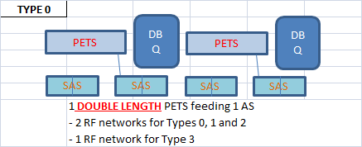
CTF3 ++
G. Riddone, 20.05.2010

Slide 29
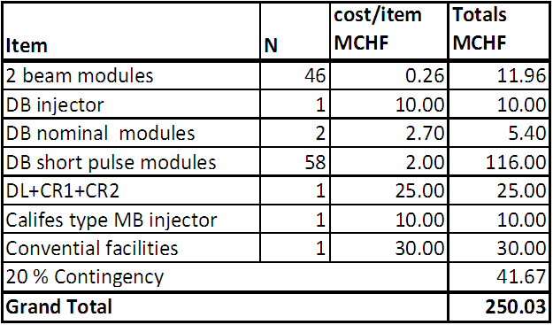
CLIC Zero (Hans costing)
Material only

Slide 30
Schedule ?
Tentative schedule for CLIC R&D 2010-2016 (Away Day)

Slide 31
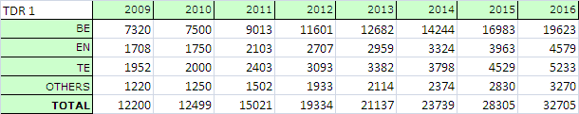
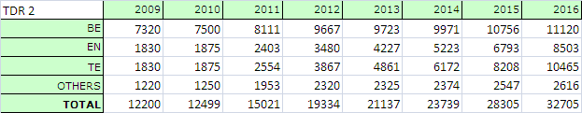
Personnel: Distribution between Departments
Took present APT - personnel part, to get present distribution
Two assumptions:
  Direct scaling keeping present ratio (nr. 1)
  Reduce BE fraction, arrive at almost even distribution in 2015 (nr. 2)
nr. 1
nr. 2
nr. 1
nr. 2

Slide 32
Personnel: Comparison with APT, per Department
Assumed scenario nr. 2
At present, manpower resources in APT are
  decreasing for BE
  about constant for EN, TE

Slide 33
Costing the CLIC facilities (I)
Had refined costing spreadsheet, introducing a few (more realistic?) assumptions
No major changes with previous version for the same cost of RF units. For example, assuming the optimistic cost
  (Total cost for RF unit 600 kCHF plus 200 kCHF structure)
Results (linac + ring/TBA areas):
  DBA 200 MeV 87 MCHF
  CLIC Zero- 103 MCHF + 84 MCHF = 187 MCHF
  CLIC Zero 183 MCHF + 84 MCHF = 267 MCHF

Slide 34
Costing the CLIC facilities (II)
Using the costing spreadsheet, assuming conservative costs for RF power sources (20 + 20 k$ /MW) & using the learning curves
  (Total cost for RF unit 900/1200 kCHF plus 200 kCHF structure)
Results (linac + ring/TBA areas):
  DBA 200 MeV 119 MCHF
  CLIC Zero- 139 MCHF + 84 MCHF = 223 MCHF
  CLIC Zero 240 MCHF + 84 MCHF = 324 MCHF

