Slide 1
Some brainstorming ideas for the design of Linac4-RFQ3
Hermann Pommerenke (SY-RF-MKS)
6 May 2021

Slide 2
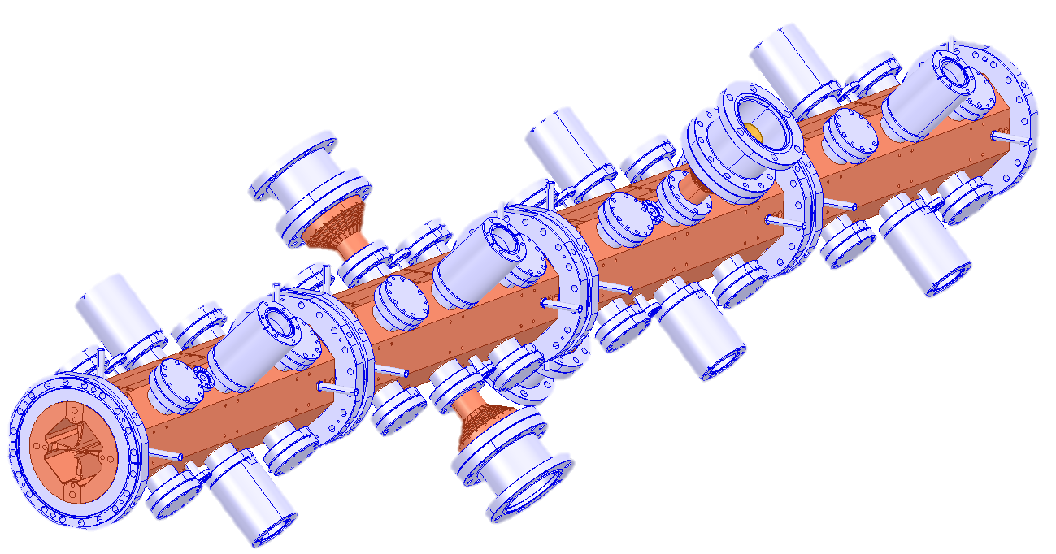
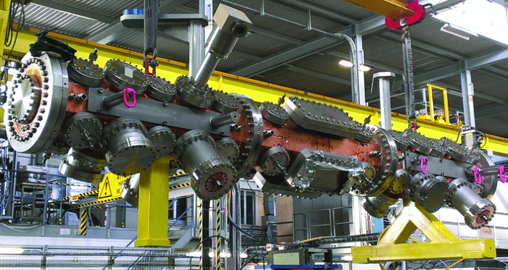
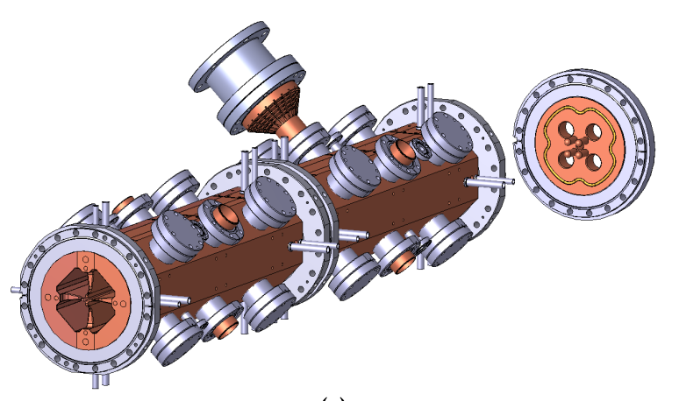
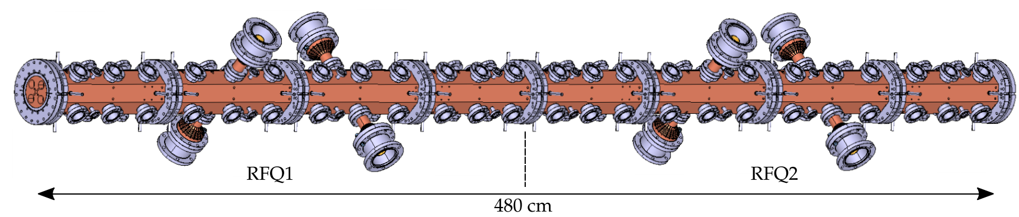
Recent RFQs developed at CERN
…
Linac4-RFQ
352 MHz
3 m
HF-RFQ
750 MHz
2 m
PIXE-RFQ
750 MHz
1 m
Carbon-RFQ
750 MHz
4.8 m
C. Rossi et al., „Commissioning and operational experience gained with the Linac4-RFQ at CERN”, Proc. Linac14, 2014
commissioned 2018
(now with AVO ADAM)
operational,
work in progress on spare and upgrade
Beam dynamics & RF design completed early 2020,
now mechanical design by CIEMAT
RF measurements &
tuning completed in 2020

Slide 3
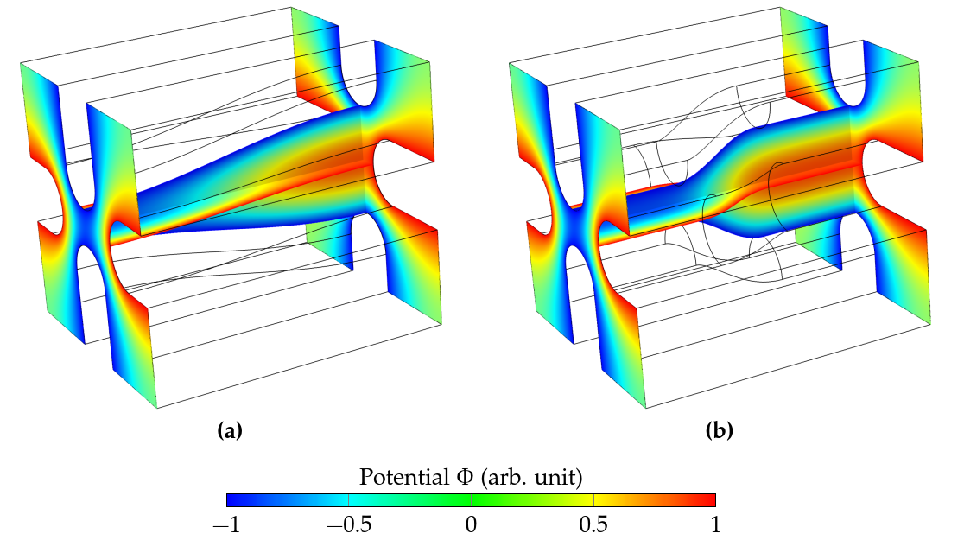
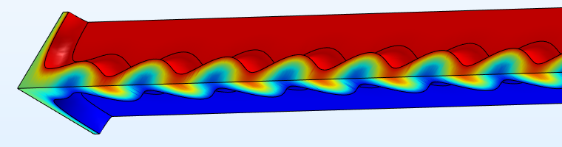

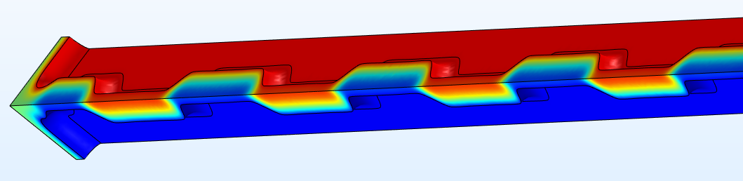
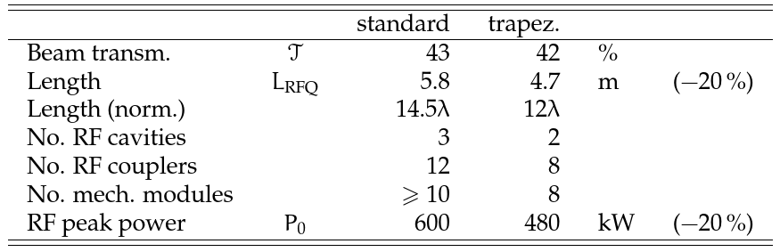
Trapezoidal electrodes/vanes
concentrate more electric field in the gap (equivalent to reducing gap length in DTL)
standard vanes
standard vane
Φ (a.u.)
trapezoidal vane
trapezoidal vanes
what can we gain? (Example: Carbon-RFQ)

Slide 4
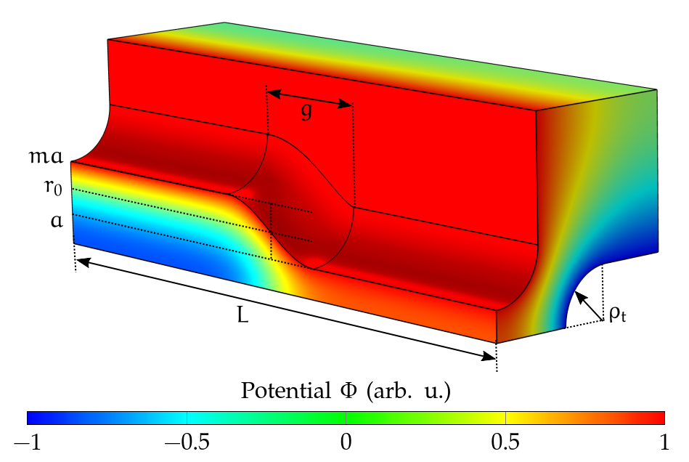
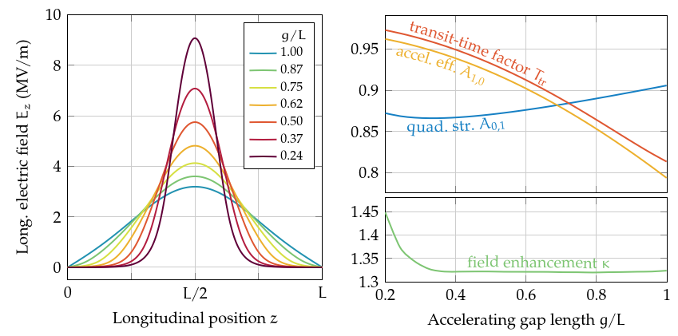
The trapezoidal vane - details
many degrees of freedom:
m : modulation
L : length
r0: mid-cell aperture
g : accelerating gap length [not in standard vanes]
ρ_{t} : transverse vane tip radius
maximum steepness
purely sinusoidal

Slide 5
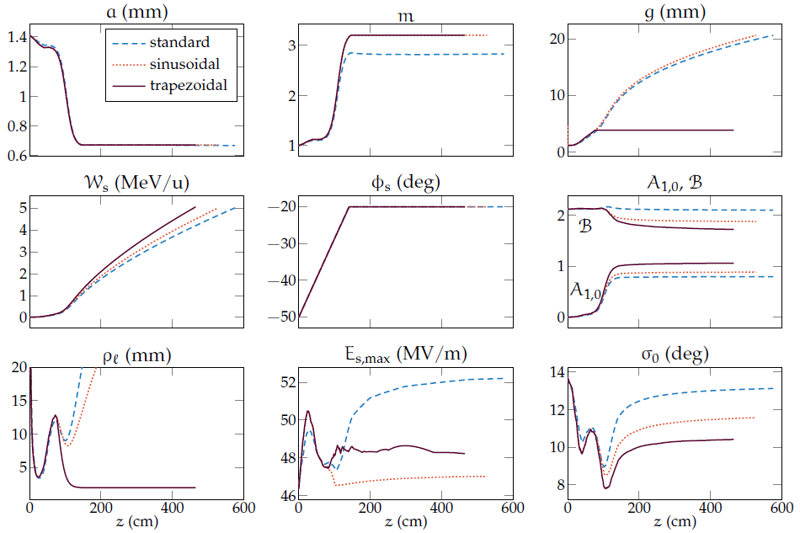
Standard vs. sinusoidal vs. trapezoidal RFQ
a – minimum aperture, m – modulation factor, g – accelerating gap length, W_{s} - synchronous energy,
Фs – synchronous phase, A_{1,0} – acceleration efficiency, B – focusing strength, ρ_{l} – longitudinal radius of curvature, E_{s,max} – max. surface electric field, σ₀ transverse phase advance per focusing period (zero-current)

Slide 6
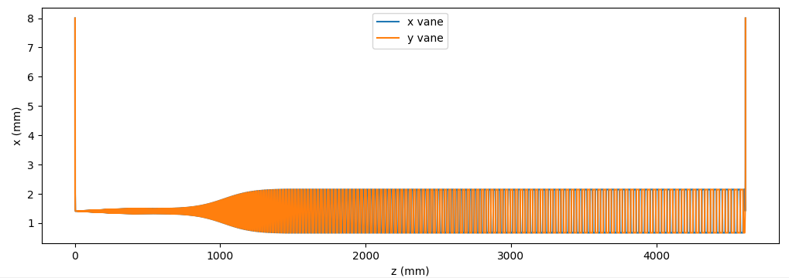
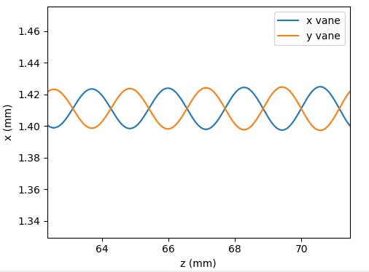
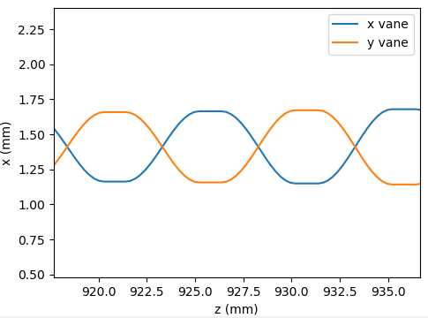
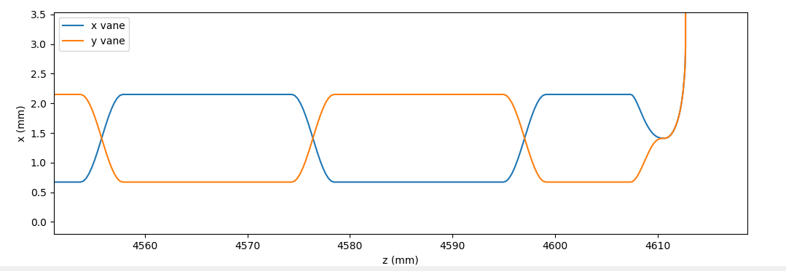
Profile of trapezoidal vanes

Slide 7
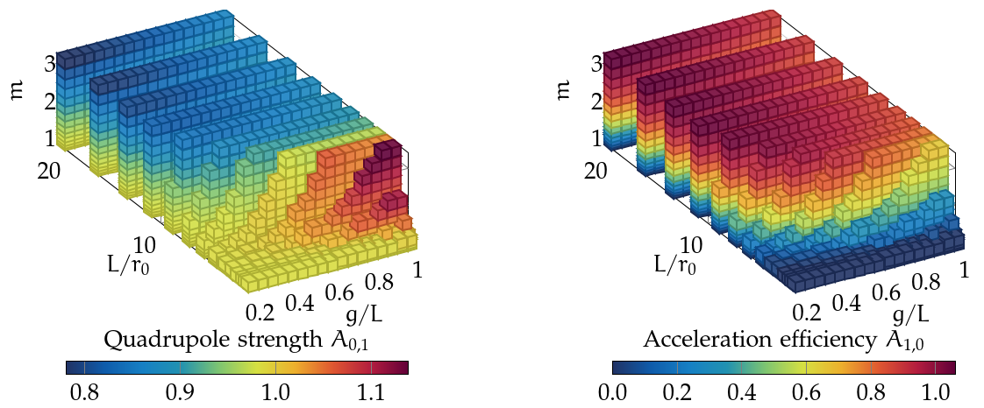
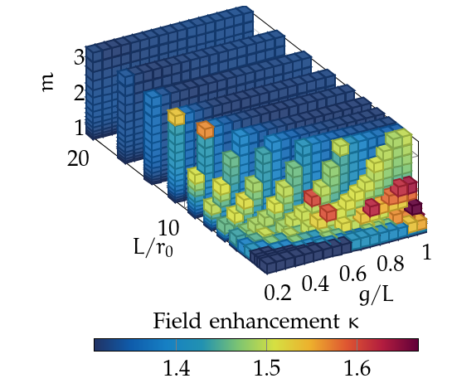
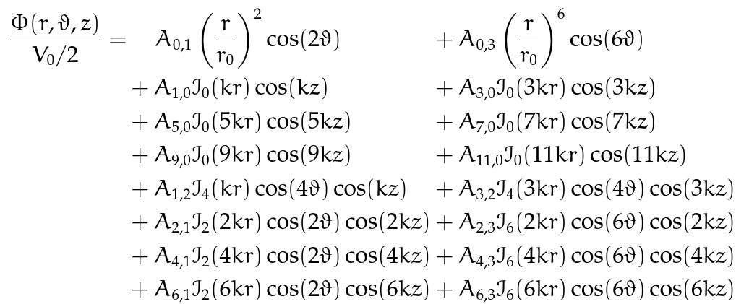
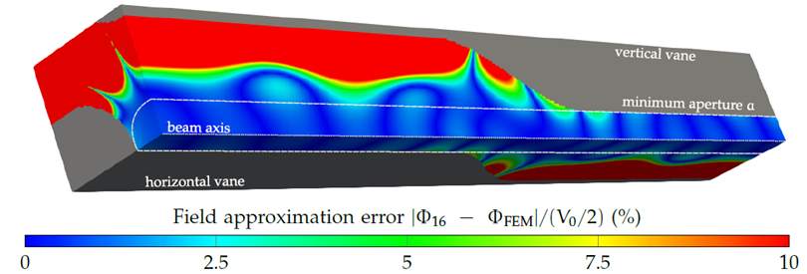
Sixteen-term potential function
RFQ electric fields commonly described by multipole expansion (typically 8 terms)
for trapezoidal vanes we need more terms!
precomputed in lookup tables (COMSOL)
quadrupole
acceleration

Slide 8
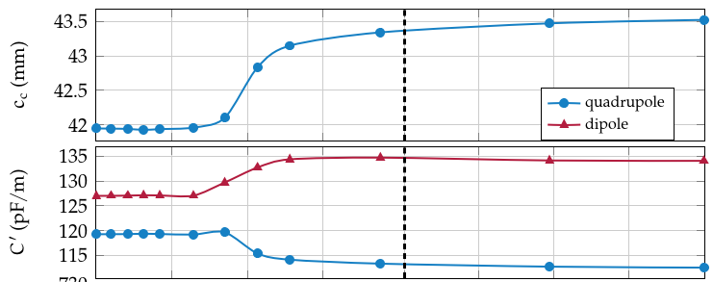
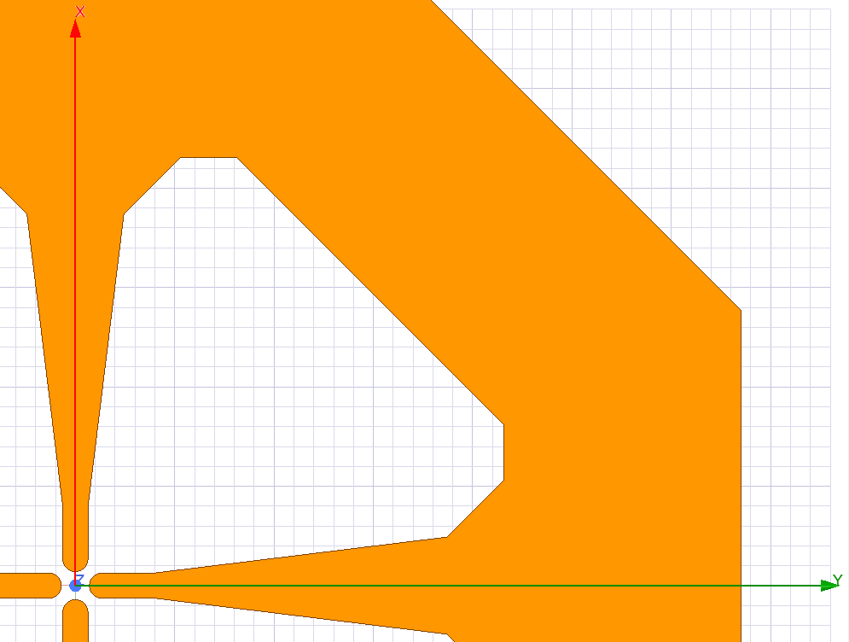
Capacitance with trapezoidal vanes
ideal cavity
dimension
capacitance
c
b = (c+19mm)/sqrt(2)

Slide 9
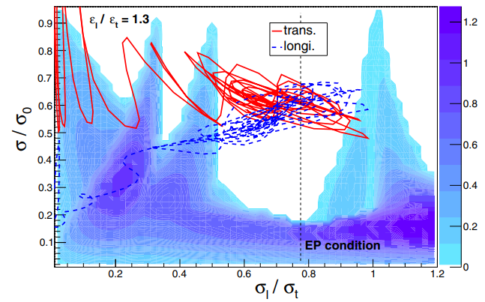
Some other ideas
non-uniform voltage
  voltage becomes additional tapered parameter
  can be advantageous for beam dynamics
  and maximum surface fields
  RF design more challenging, more difficult to tune
  Examples: LEDA-RFQ, IFMIF RFQs,
  FETS RFQ, J-PARC RFQs, XiPAF RFQ
equipartioned RFQ design (R. A. Jameson)
  natural balance of transv./long. forces
  to minimize emittance growth
  from space charge
  Examples: IFMIF RFQ, J-PARC epRFQ
Y. Kondo, T. Morishita, R. A. Jameson, „Development of a radio frequency quadrupole linac implemented with the equipartitioning beam dynamics scheme”, Phys. Rev. Accel. Beams 22, 120101 (2019)

Slide 10
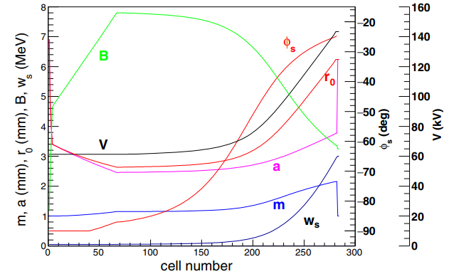
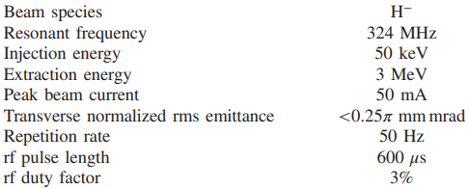
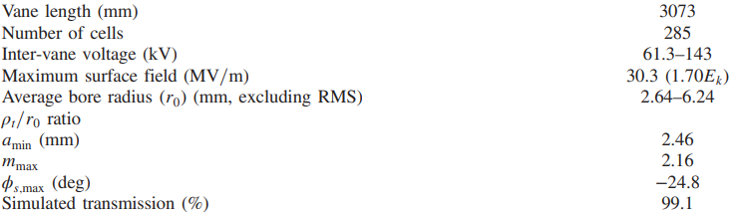
Example: J-PARC epRFQ
Y. Kondo, T. Morishita, R. A. Jameson, „Development of a radio frequency quadrupole linac implemented with the equipartitioning beam dynamics scheme”, Phys. Rev. Accel. Beams 22, 120101 (2019)

Slide 11
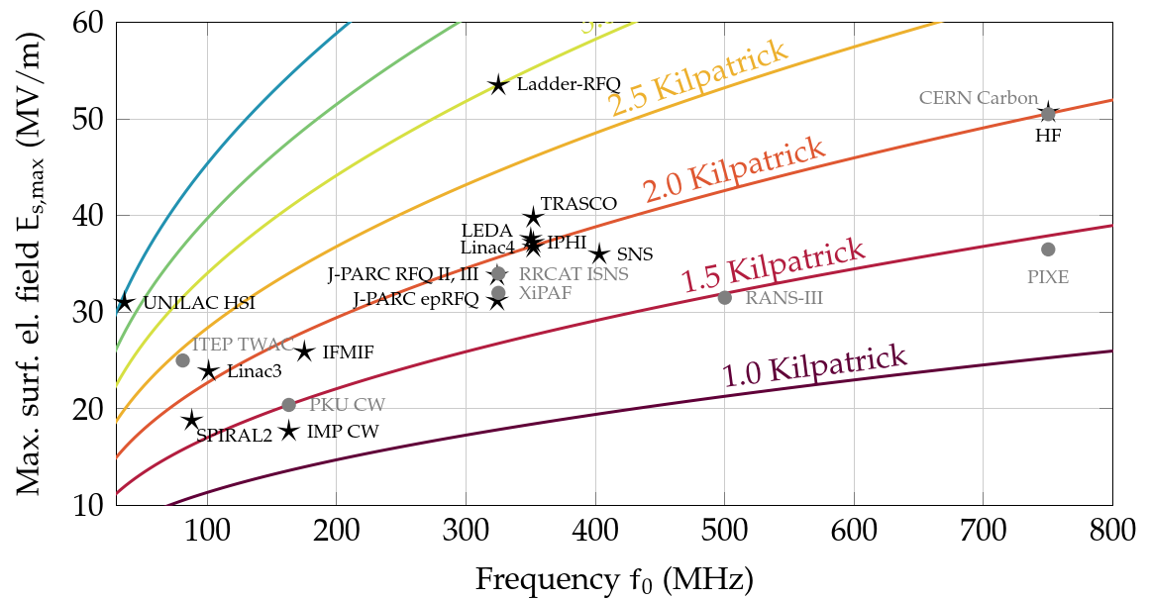
RFQs worldwide – Kilpatrick criterion
Kilpatrick criterion is used for most RFQ developments
(common design choices CW-RFQ: <=1.8 Kp, pulsed RFQ: <=2.0 Kp)
but: during commissioning: more can often be achieved:
experiment
design

Slide 12
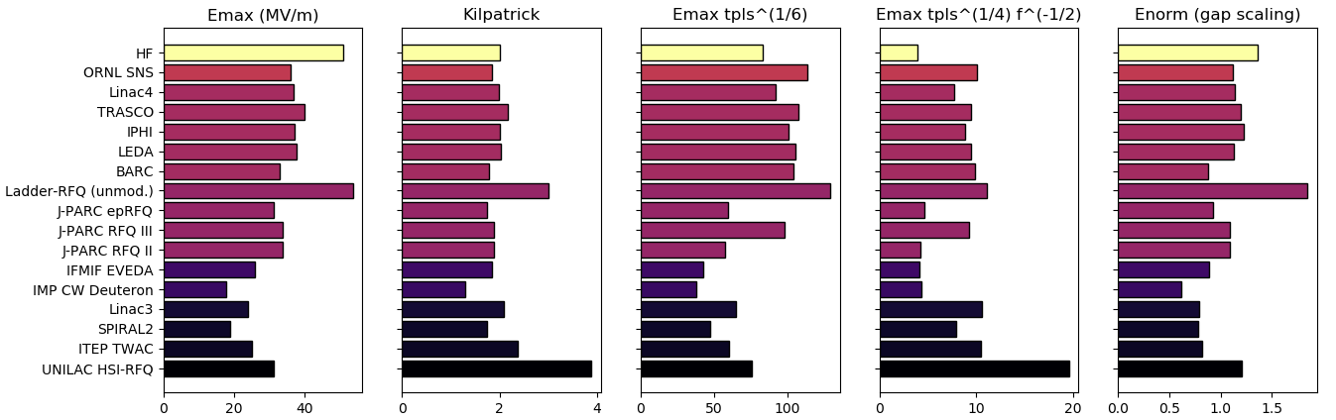


„Gap scaling“ and other quantities for RFQs
$E_{norm}=\frac{V}{V_{DC}}⋅{\left(\frac{d_{DC}}{d}\right)}^{0.7}$
d = V/E_{max} (not too far from RFQ r0)
where
V = max. measured inter-vane voltage
E_{max} = max. measured surface field
V_{DC} = 7747 V, d_{DC} = 100 µm from DC experiment (I. Profatilova https://indico.cern.ch/event/925403/contributions/3889048/attachments/2050505/3436872/20200604_WP_RFQ3_design_Introduction.pdf)

Slide 13
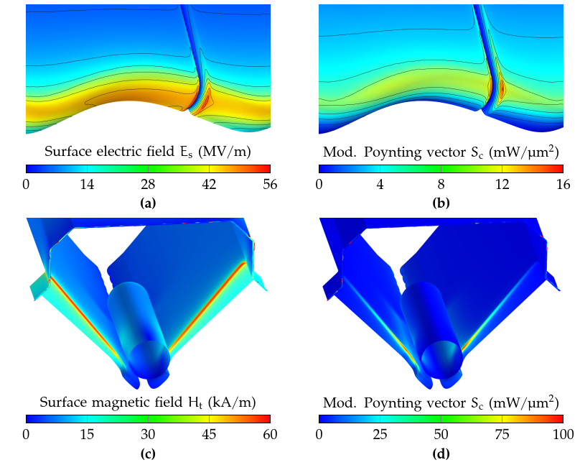
What about Sc and RF pulsed heating?
Example: proton HF-RFQ: t_{pls} = 20 us, f₀ = 750 MHz
Emax on vane tip (2.0 Kilpatrick)
small hotspot on inter-module gap
(2.2 Kilpatrick)
Sc maximum is not on vane, i.e. not in location of breakdowns
E & H are well-separated in RFQ
Sc maximum is located on undercut edge next to dipole rod
not critical either, scaled threshold at 20 us: 860 mW/um²
Hmax on vane undercut edge
resulting pulsed heating:
ΔT = 1.8 K (critical: 40…100 K)

Slide 14
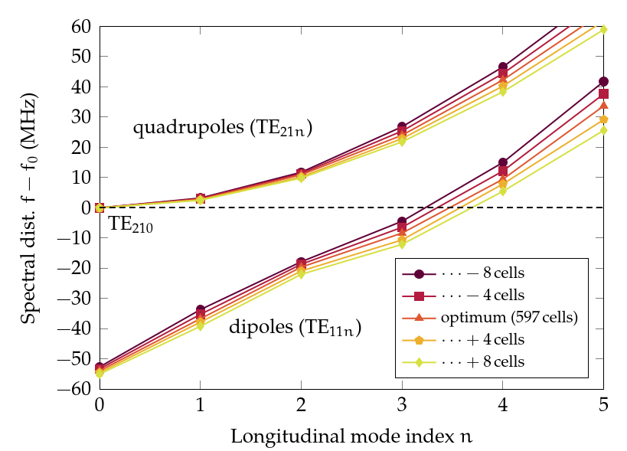
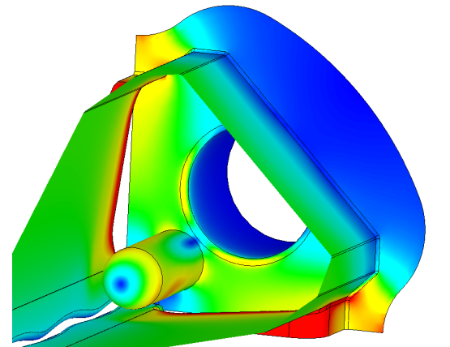
Dipole-mode detuning by length adjustment
maximum spectral margin from operating mode (TE210) to dipole modes is crucial for field stability
„classic“ techniques: dipole stabilization rods (DSR, used in L4-, HF-, PIXE-RFQ),
vane coupling rings, coupling windows …
Carbon-RFQ detuned using length adjustment only, no DSRs necessary
would not need these

