Slide 1
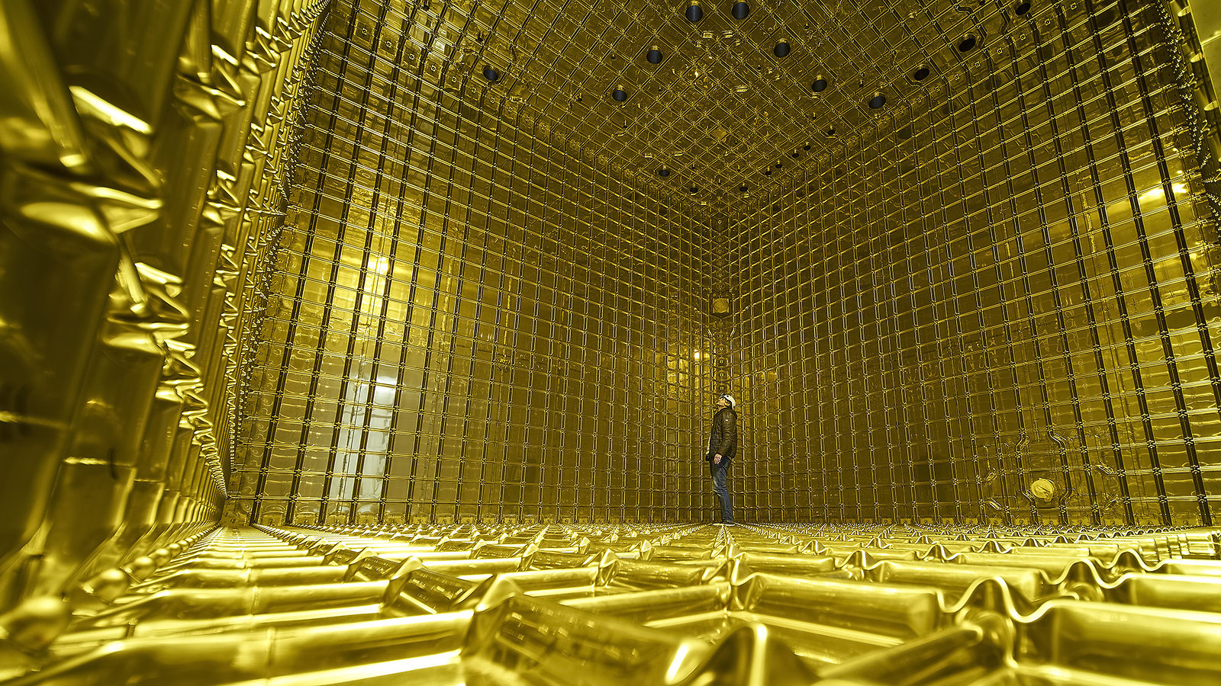
Neutrino Oscillations
Stefan Söldner-Rembold
University of Manchester
Academic Training Lecture Programme
May 2021

Slide 2
Lecture 2
Reactor measurements of θ₁₃ CP violation, and current long-baseline experiments

Slide 3
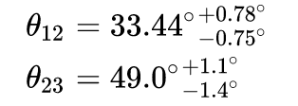
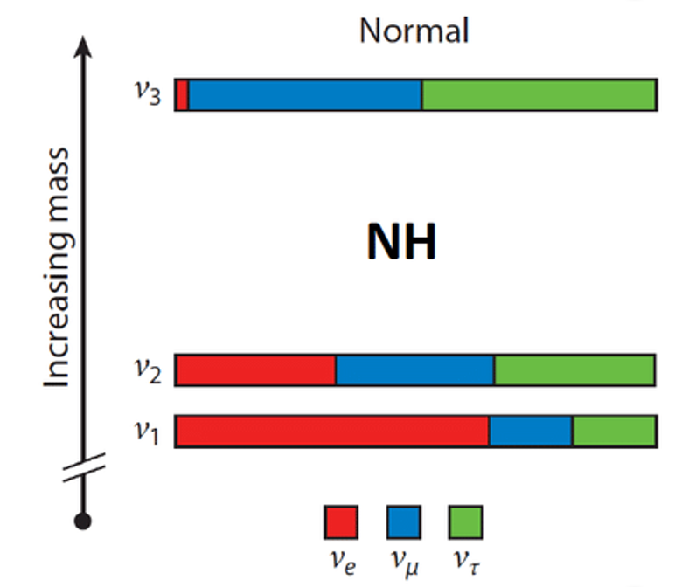
PMNS Matrix
solar
“reactor”
atmospheric
Θ₁₂ and θ₂₃ are large (“maximal” mixing)
Angle θ₁₃ is small and mixes 𝜈_{e} with 𝜈₃
CPV term (δ) ∝ θ₁₃
Look for 𝜈_{e} mixing driven by Δm²₃₂

Slide 4
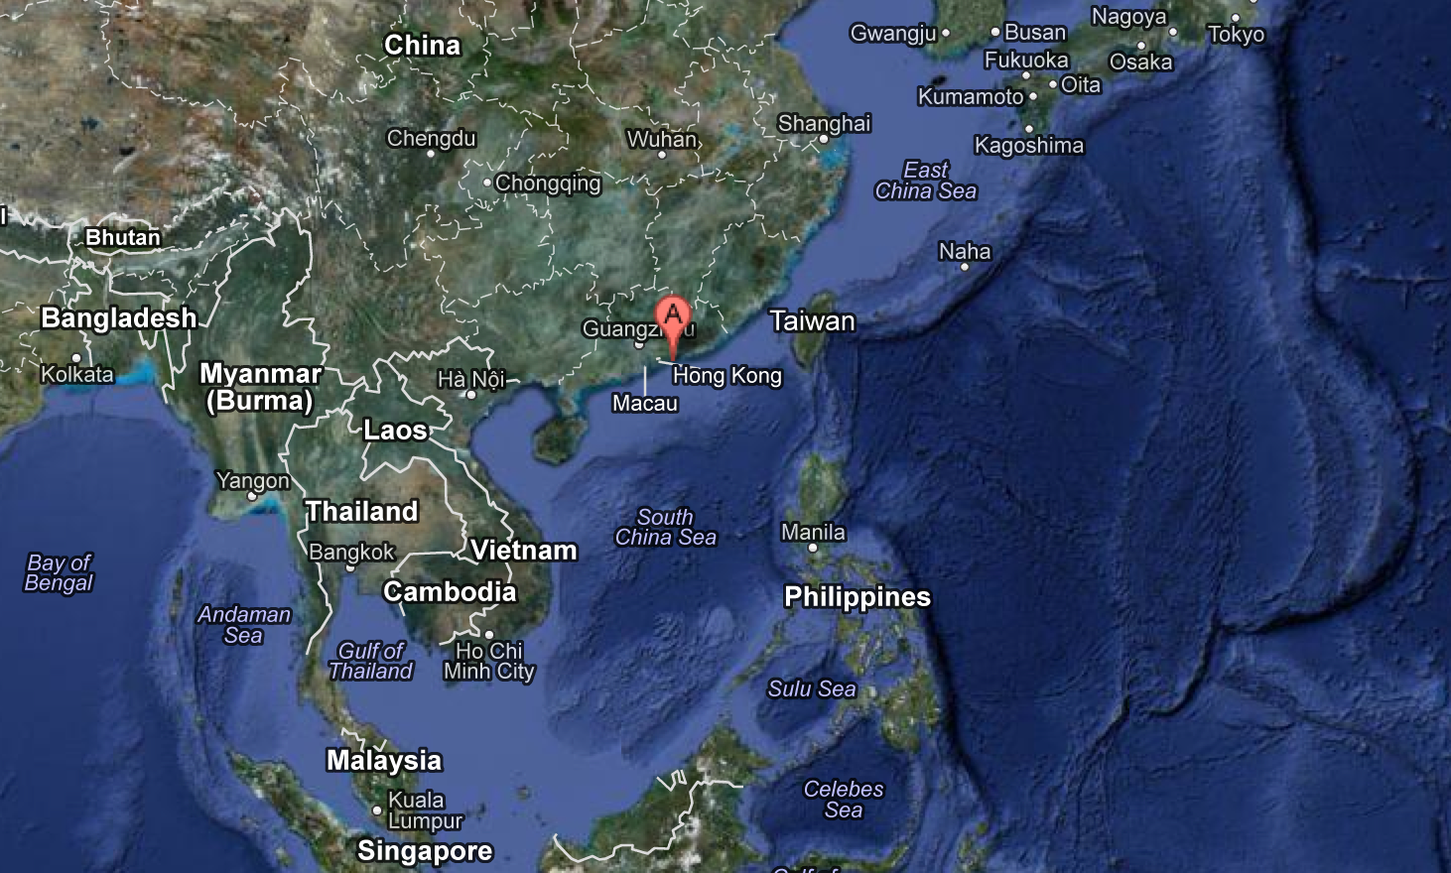
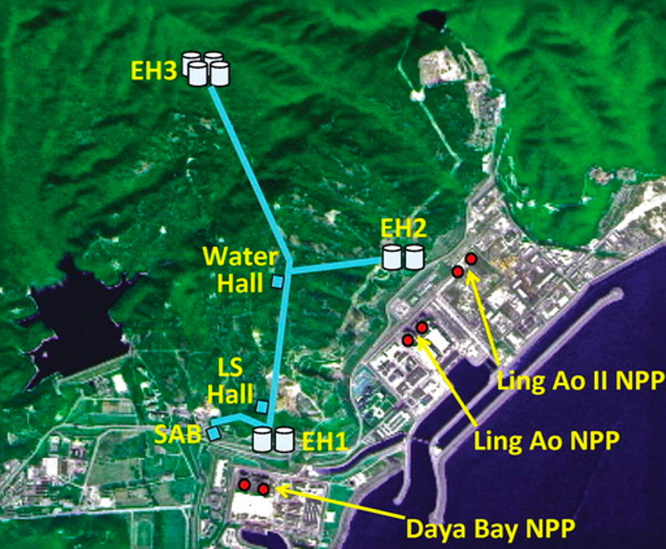
Daya Bay reactor

Slide 5
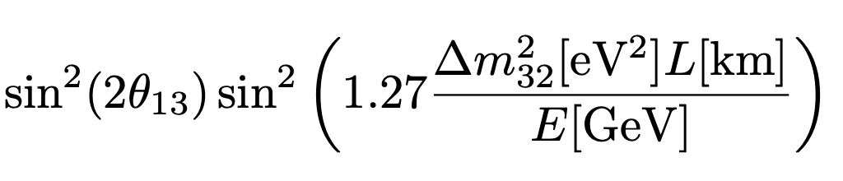
“Reactor” Oscillations
“Survival probability” for anti-𝜈_{e} from the reactor (E ≈ 3 MeV)
Daya Bay:
Near Far
Juno KamLAND
J. Ling, Neutrino 2020

Slide 6
Daya Bay Layout

Slide 7
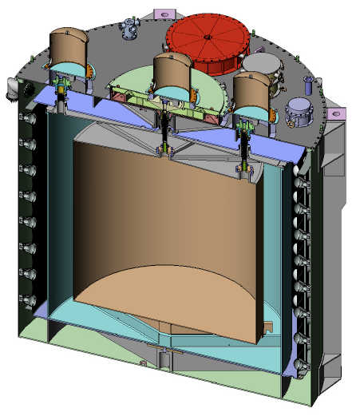
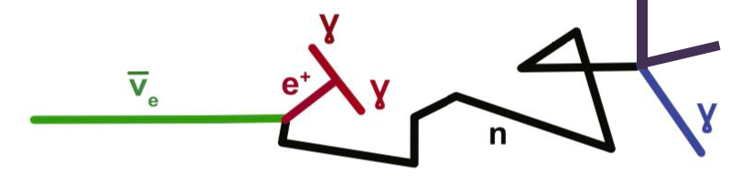
Daya Bay detectors
Each of the 8 detector is 20 tons.
Photomultiplier tubes
Inverse 𝛽 decay
Scintillator, loaded
with gadolinium
(high neutron capture
cross section)
Scintillator buffer
(no gadolinium)
Inner acrylic tank

Slide 8
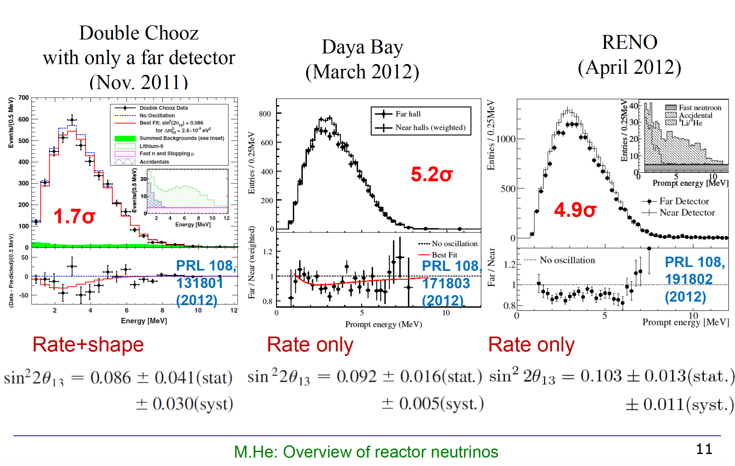
Original θ₁₃ measurements (Far/Near)
M.He, NNN

Slide 9
θ₁₃ measurement (Daya Bay)

Slide 10
PMNS Matrix
solar
reactor
atmospheric
Small angle θ₁₃ mixes 𝜈_{e} with 𝜈₃
Look for 𝜈_{e} mixing driven by Δm²₃₂
Reactor: anti-𝜈_{e} disappearance
Accelerator: 𝜈_{e} appearance in 𝜈_{𝜇} beam → sensitive to θ₁₃ and 𝛿

Slide 11
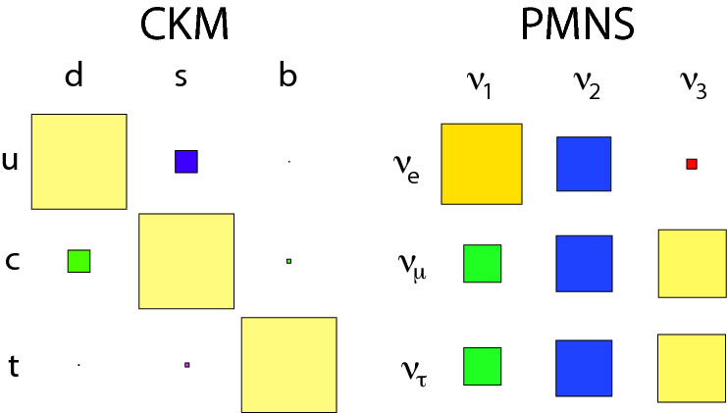
CKM vs PMNS
The CKM matrix is almost diagonal, while the PMNS matrix is almost uniform.

Slide 12
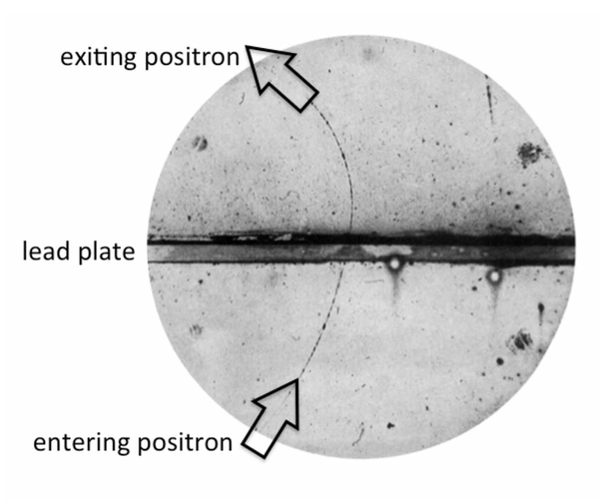
Matter and Anti-matter
Paul Dirac
Dirac equation predicts anti-particle states (1928)
Positron discovered by C.D. Anderson in 1932

Slide 13


Matter-antimatter asymmetry (“CP violation”)
A tiny (≈10⁻¹⁰) asymmetry between particle and anti-particles led to our matter dominated universe
One of the conditions for this asymmetry is violation of CP symmetry
The observation of CP violation involving neutrinos could provide support for a theory called Leptogenesis
Baryon number violation
CP violation
Departure from thermal equilibrium

Slide 14
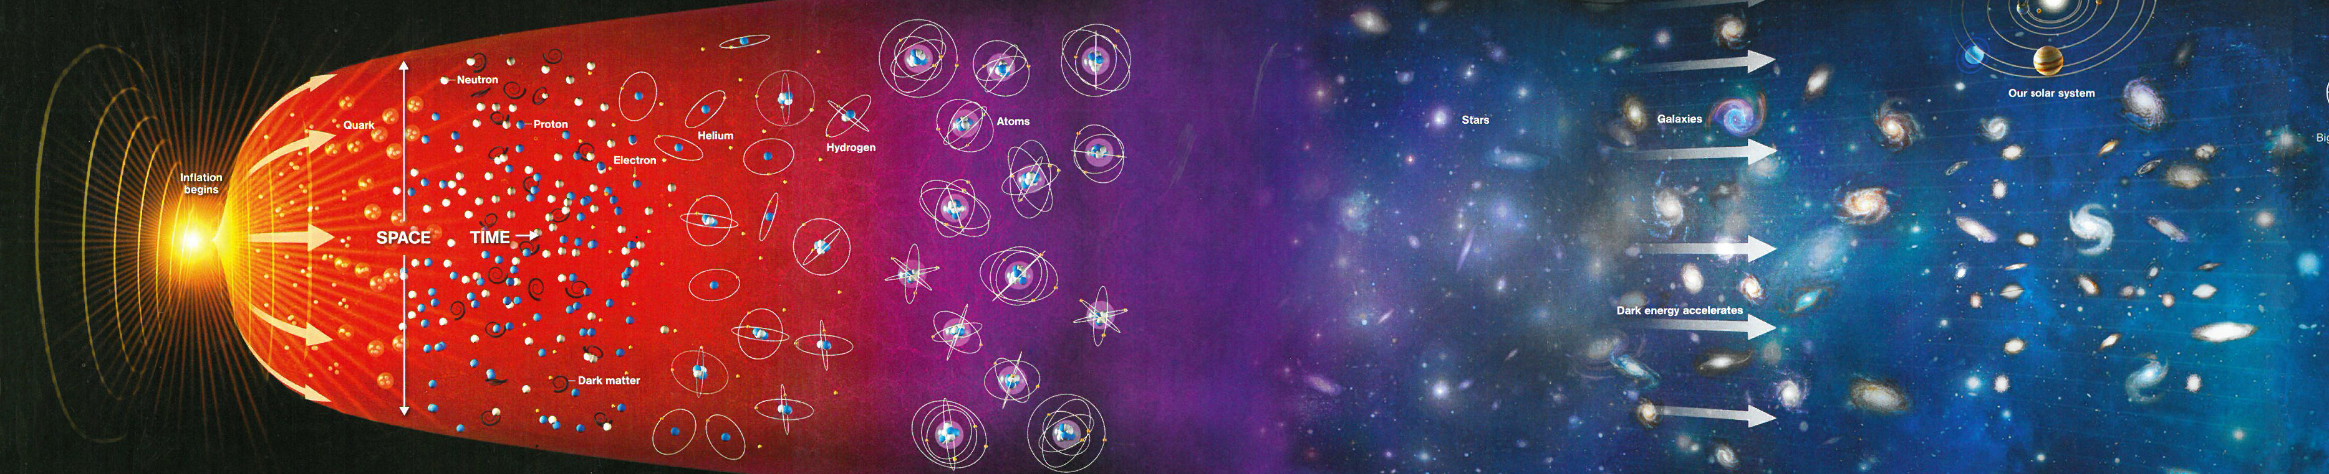
CP violation
A 2x2 ”rotation” matrix is real, whereas a 3x3 rotation matrix is imaginary (phase 𝛿).
CP violation (the difference between a process and its CP conjugate) is only possible when the matrix is imaginary (3 generations!).

Slide 15
CP violation
The same is true for the CKM matrix, where CP violation has been observed for quark processes.
CP violation in the quark sector is too small to describe the matter dominance in the Universe.
Discovery of CP violation with neutrinos would lend support to the Leptogenesis model – Leptogenesis would happen at large scales, e.g. through a heavy right-handed neutrino N_{R} (see-saw mechanism).

Slide 16
CKM vs PMNS – an aside
Neutrinos differ from quarks (Dirac particles), as they can be their own anti-particles (Majorana particles).
This gives rise to additional complex phases in the PMNS matrix.
These complex phases appear on the diagonal of the matrix so they have no impact on neutrino oscillations.

Slide 17
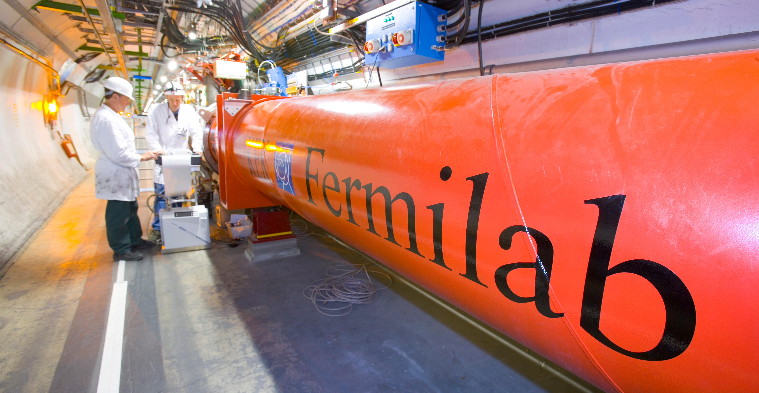

Slide 18
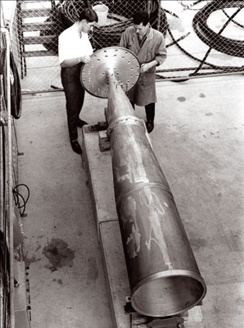
Making a neutrino beam
As neutrinos are neutral, they cannot be focused, and a magnetic horn is thus used to focus the pions.
Invented by Simon van der Meer at CERN

Slide 19
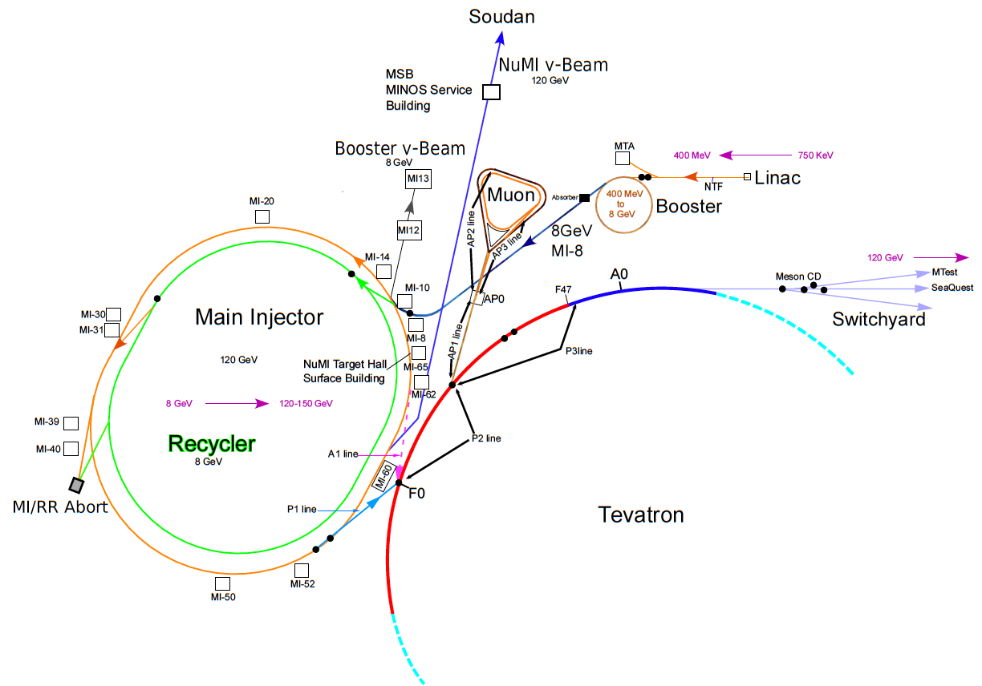
Fermilab NuMI beam

Slide 20
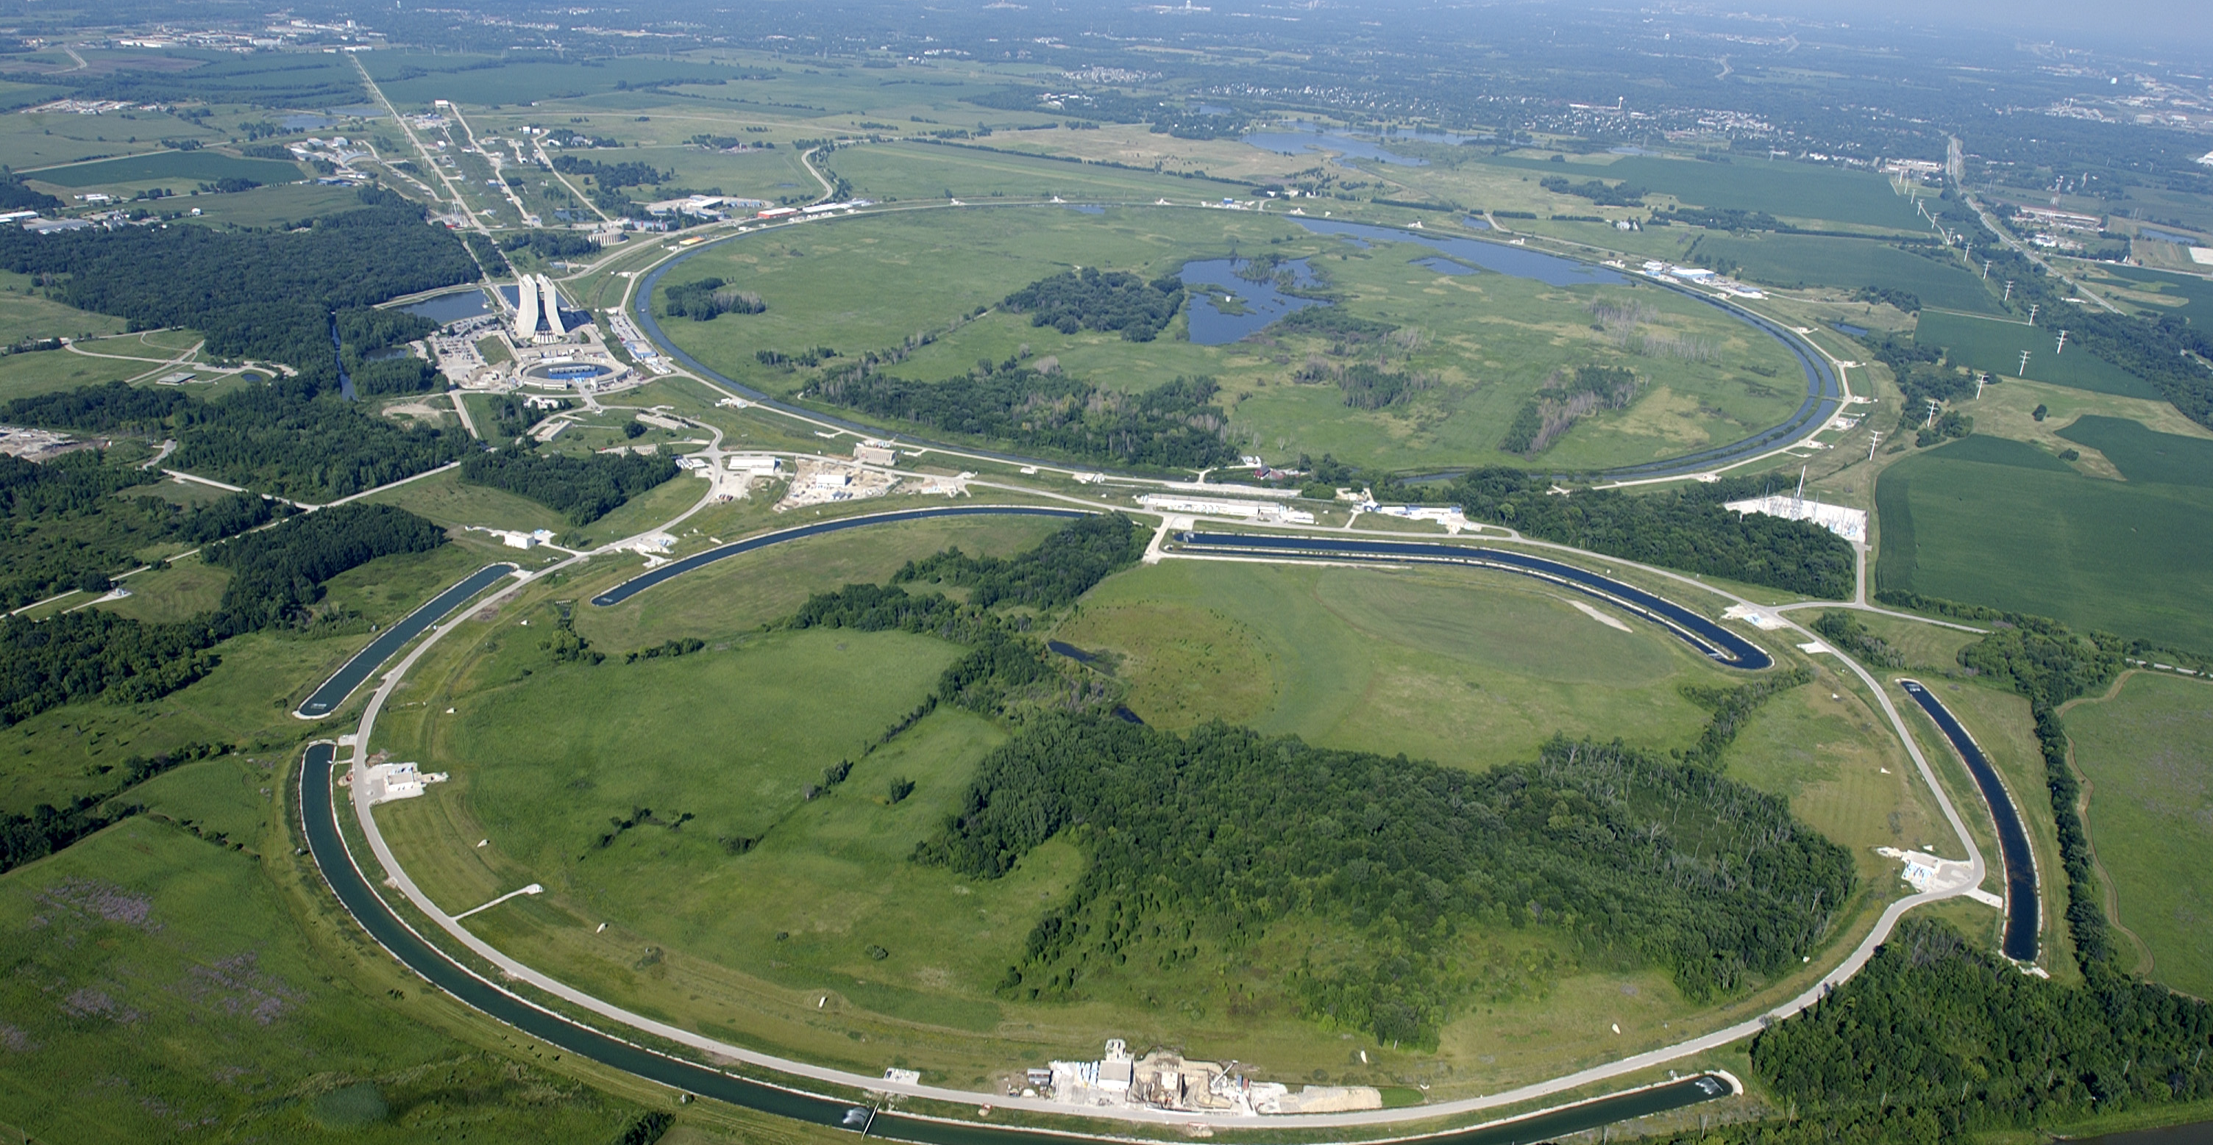

Slide 21
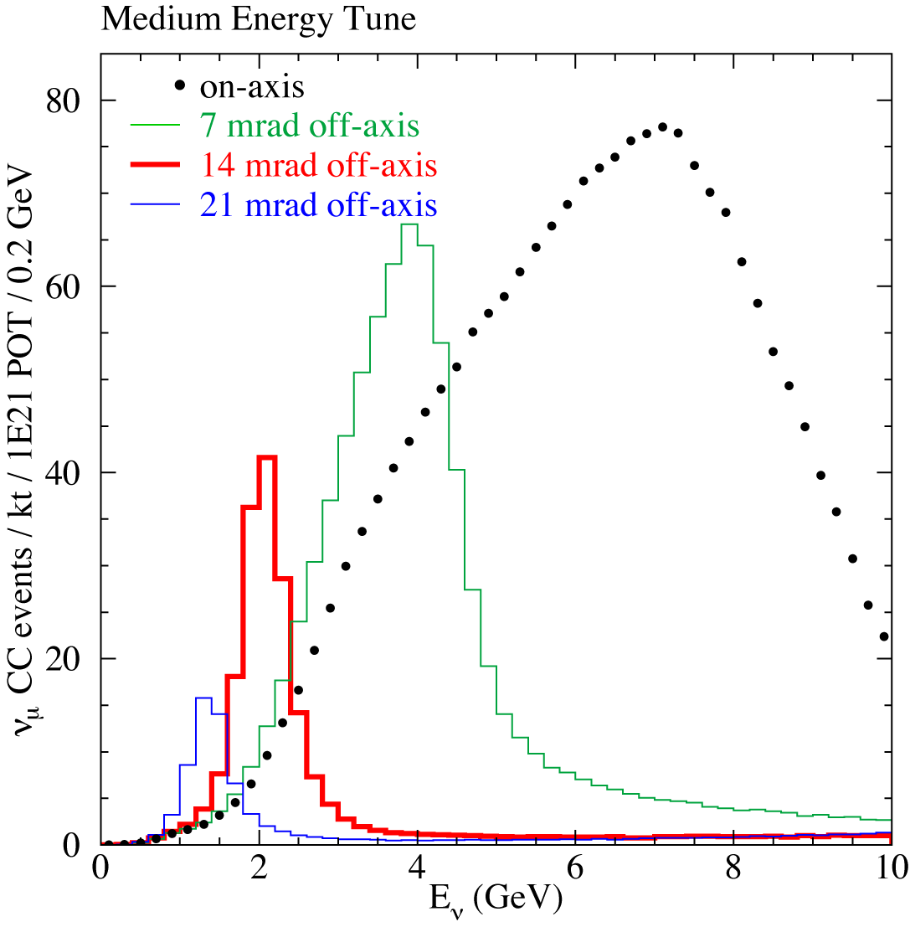
Making a neutrino beam
Pion decay at rest:
Boost into lab system:

Slide 22
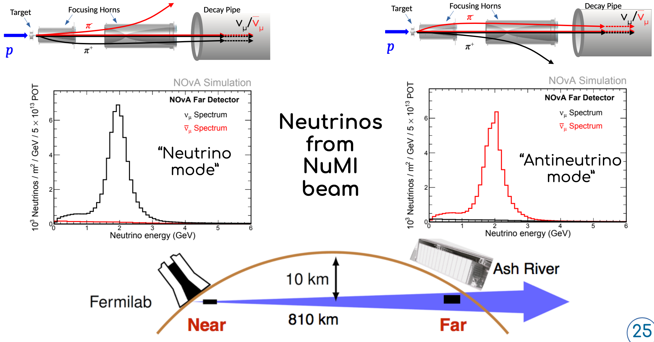
Forward/Reverse Horn Current

Slide 23
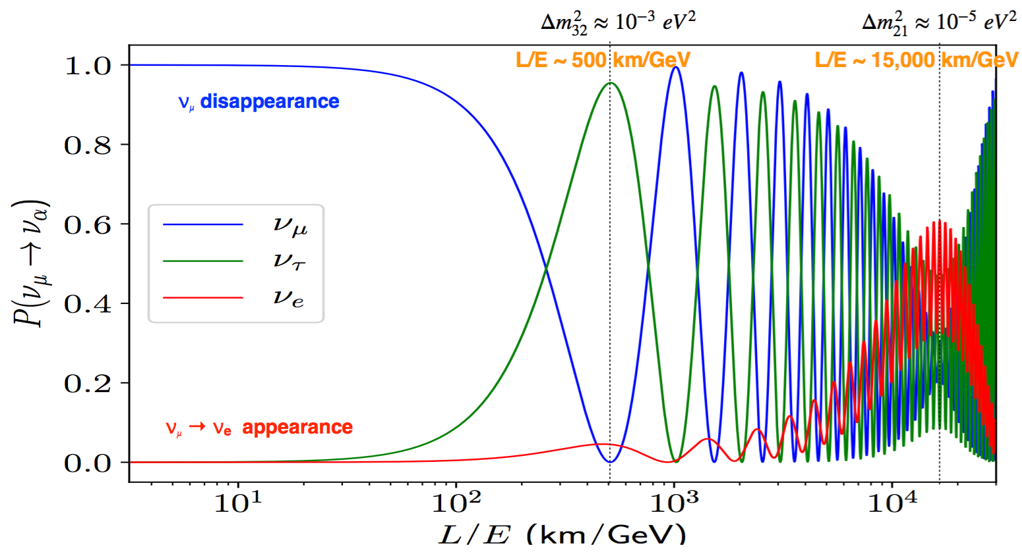
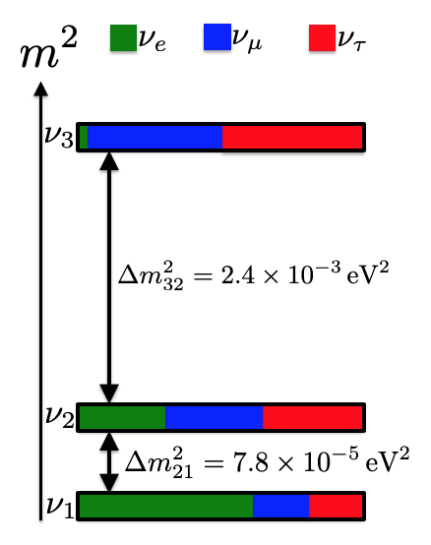
Finding the oscillation maximum
L/E ∼ 1700 km/GeV
Typical neutrino beam energy is around 2.5 GeV
Baseline/Neutrino energy

Slide 24
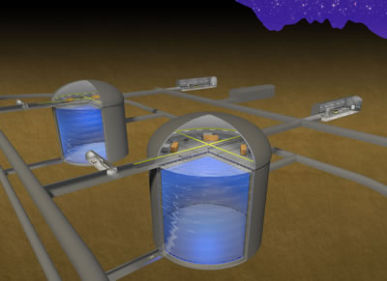
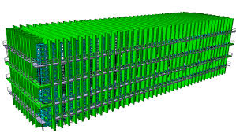
Optimizing L/E for neutrino oscillations
L ≈ 300 km
L/E = 300 km /0.6 GeV = 500 km/GeV
no matter effects; first oscillation maximum.
use narrow width neutrino beam (off axis) with E < 1 GeV
Water Cherenkov (T2K,HK)
L = 1300 km
L/E = 1300 km/2.5 GeV = 500 km/GeV (1st max),
L/E = 1300 km/0.8 GeV = 1700 km/GeV (2nd max)
matter effects; first and second oscillation maximum.
use broad-band neutrino beam (on axis).
Liquid argon (DUNE)

Slide 25
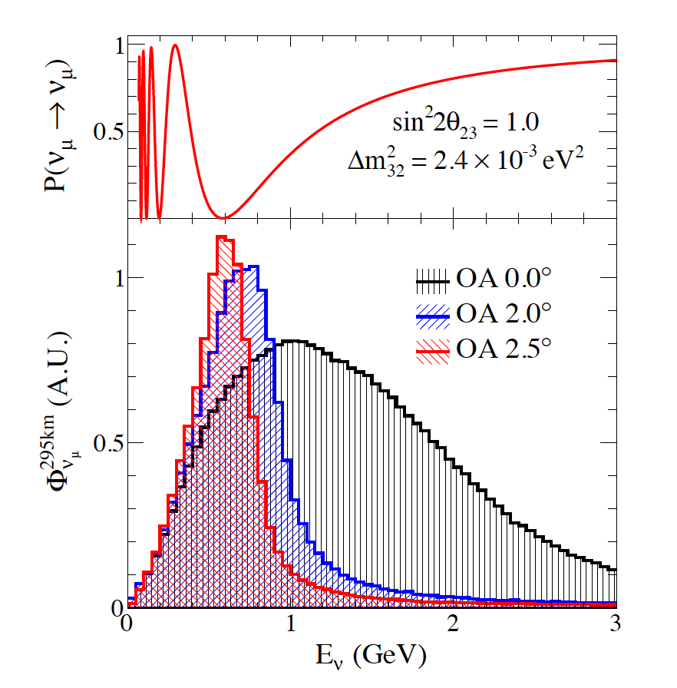
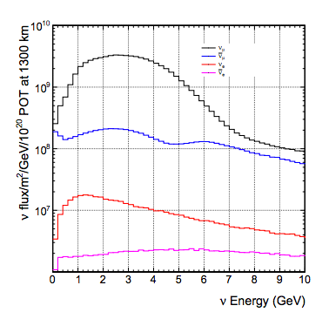
Off-axis vs on-axis beams
T2K at 2.5 degrees
DUNE on-axis beam

Slide 26
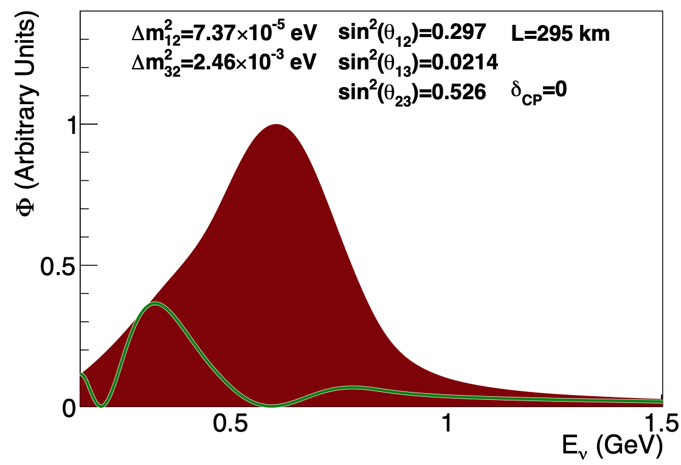
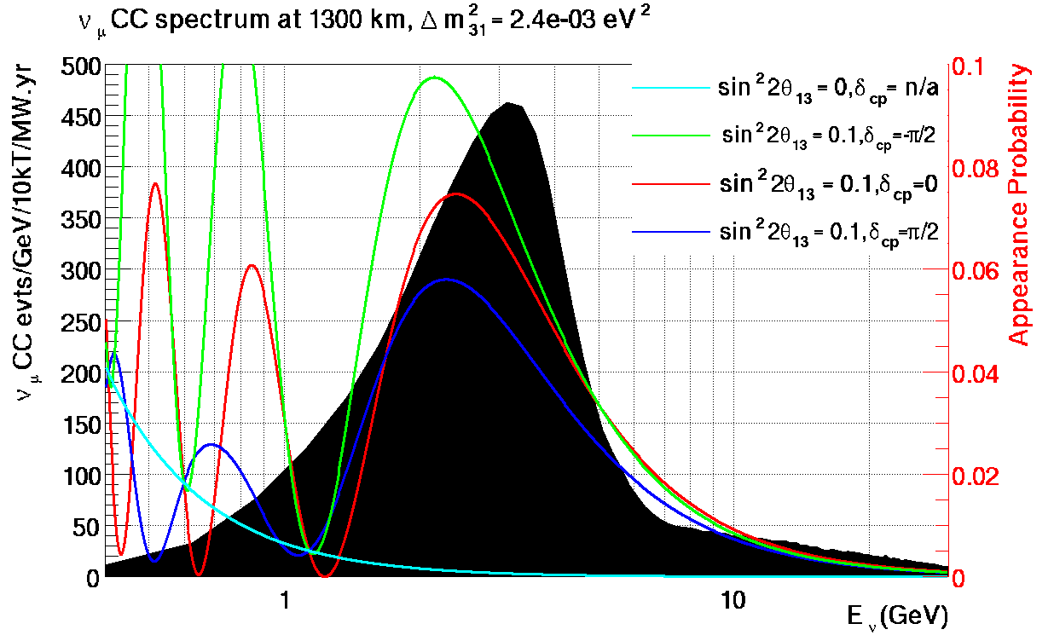
Off-axis vs on-axis beams
T2K at 2.5 degrees
DUNE on-axis beam

Slide 27
How to measure LBL neutrino oscillations
Measure flavour change as a function of energy over a long distance.
Starting with a muon-neutrino beam, we observe muon-neutrino disappearance and electron-neutrino appearance.
We measure event rates and not the flux directly.
Measurement is a convolution of the oscillation probabilities P, the neutrino flux 𝛷, the cross sections 𝜎, and the detector response T.

Slide 28
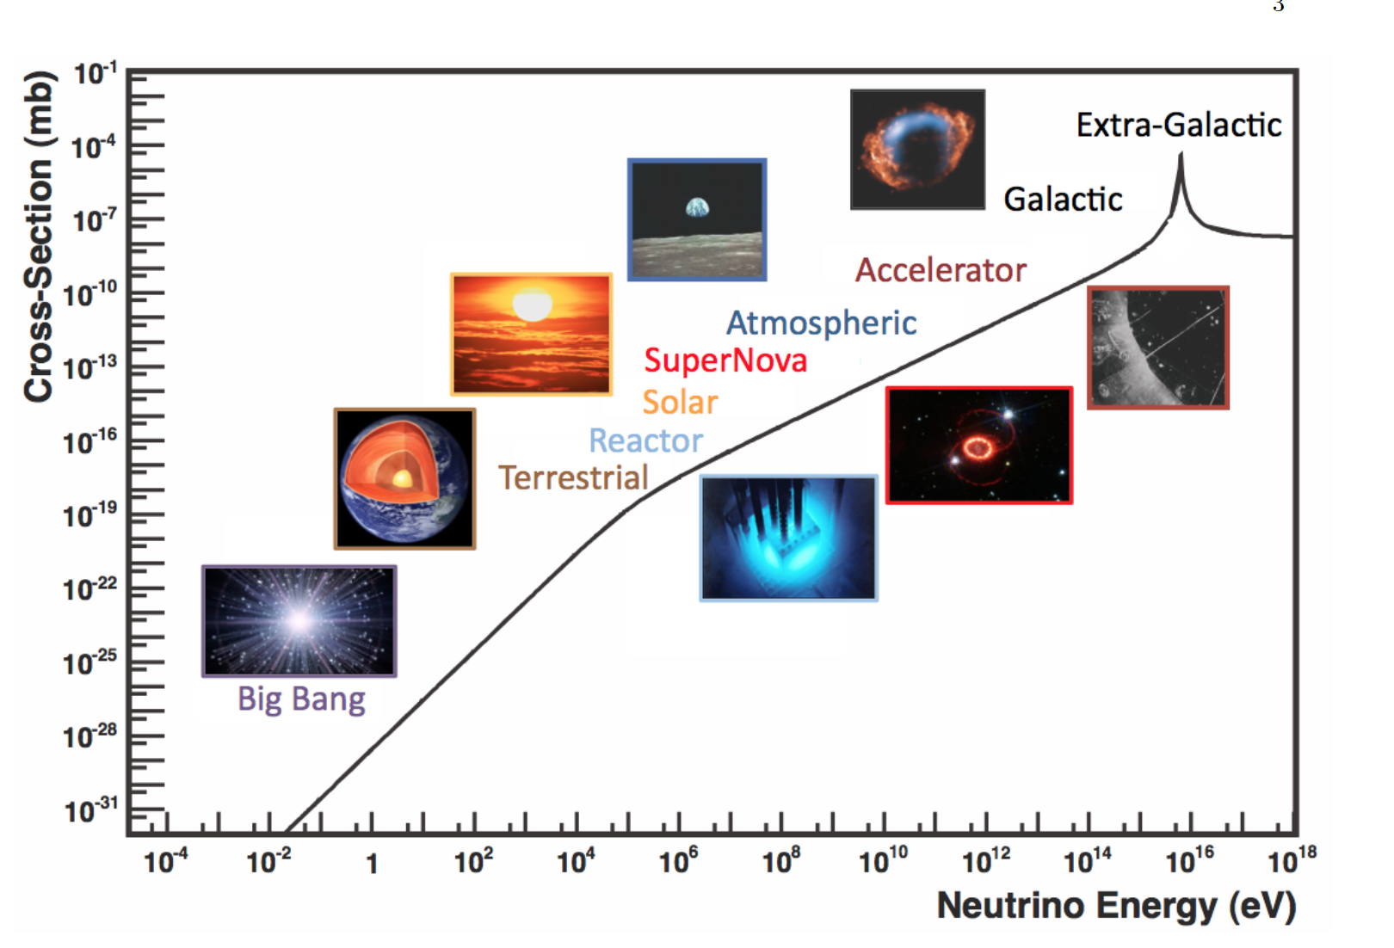
Neutrino sources, flux, and cross sections
C. Spiering, arXiv:1207.4952
J. Formaggio, G.P. Zeller, arXiv:1305.7513

Slide 29
Neutrino-nucleon interaction
ν_{l}
ν_{l}
ν_{l}
l⁻
Z
W
n
n
n
p
Elastic scattering
Quasi-elastic scattering
(lowest energies)
ν_{l}
l⁻
ν_{l}
l⁻
W
π⁺
W
Hadrons
Δ⁺⁺
p
p
p
Resonance
(Energies ~1 GeV)
Deep inelastic scattering
Highest energies (>1 GeV)

Slide 30
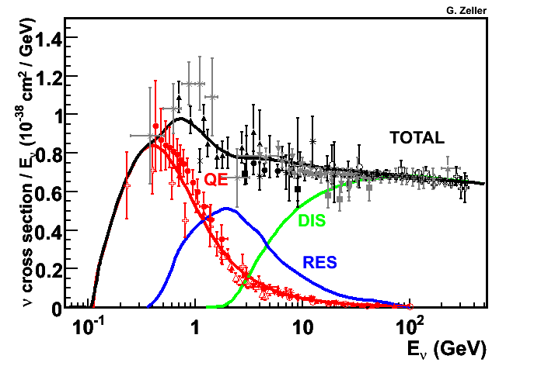
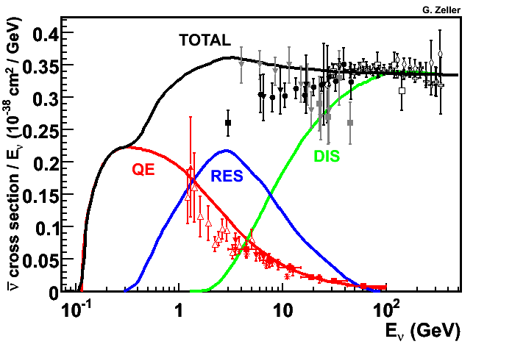
Neutrino-nucleon interactions and cross sections
Muon neutrino data
Neutrinos
At lower energies, quasi-elastic dominates.
At higher energies, resonance production and deep-inelastic scattering
An important systematic limitation for long-baseline neutrino experiments
Interaction modelling will affect energy reconstruction.
Anti-neutrinos

Slide 31
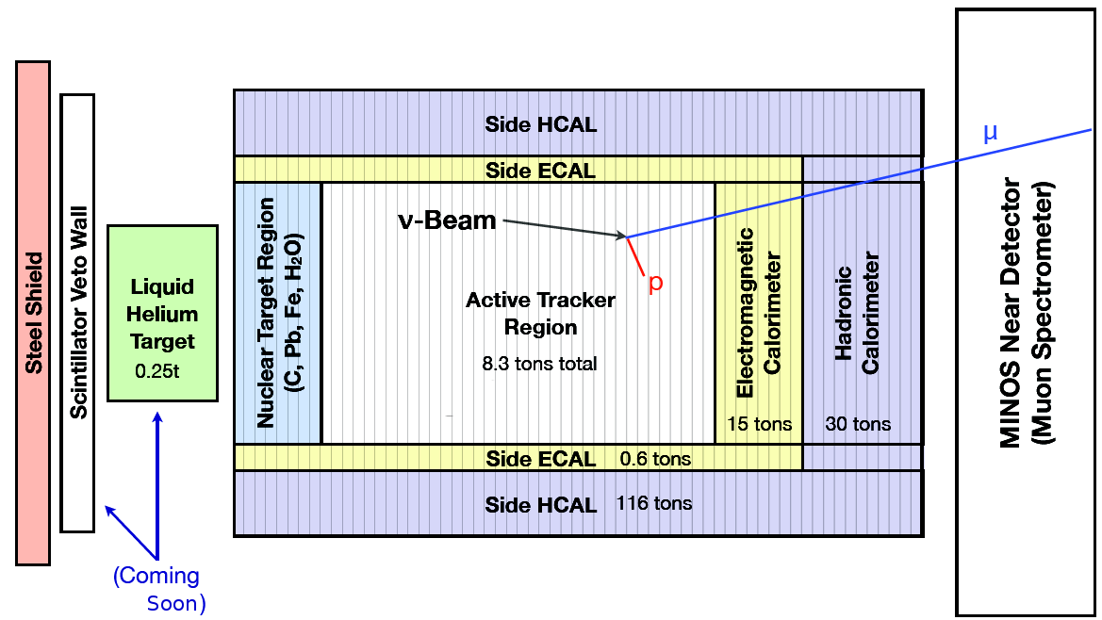
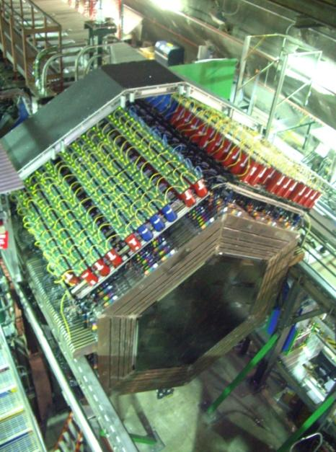
Measuring neutrino cross sections with MINERνA
muon neutrinos

Slide 32
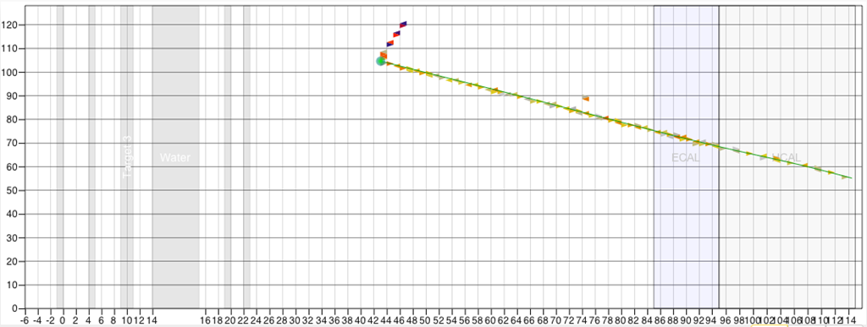
MINERvA ν_{μ} quasi-elastic interaction
Quasielastic scattering
n
p
W
Proton
ν_{μ}
μ⁻
Muon

Slide 33
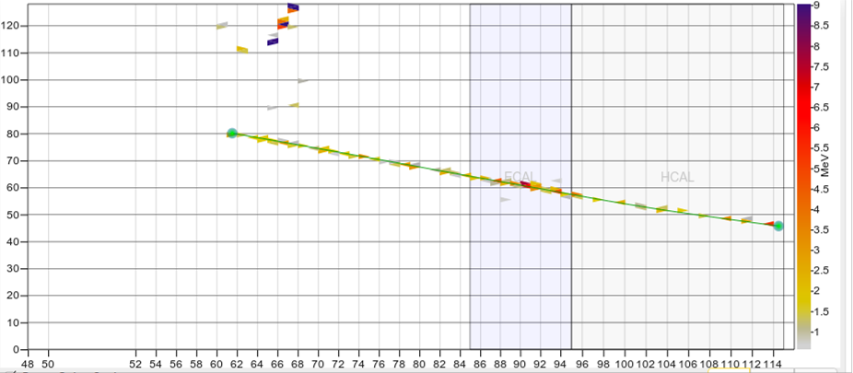
MINERvA ν_{μ} quasi-elastic interaction
Quasielastic scattering
p
n
Neutron
W
ν_{μ}
μ⁺
Antimuon

Slide 34
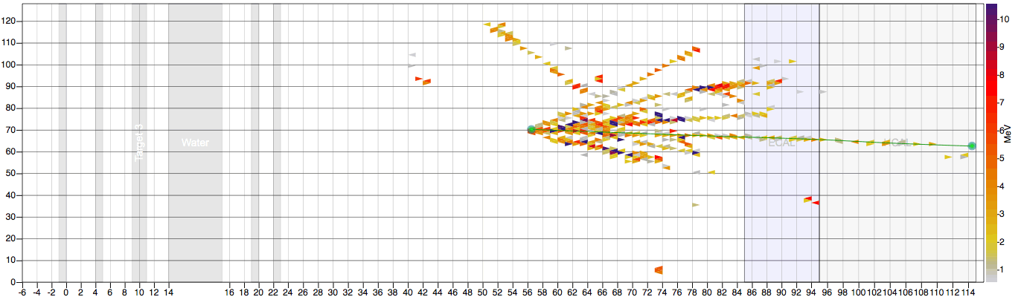
MINERνA deep inelastic scattering event
ν_{μ}
μ⁻
W
Hadrons
p
Deep inelastic scattering

Slide 35
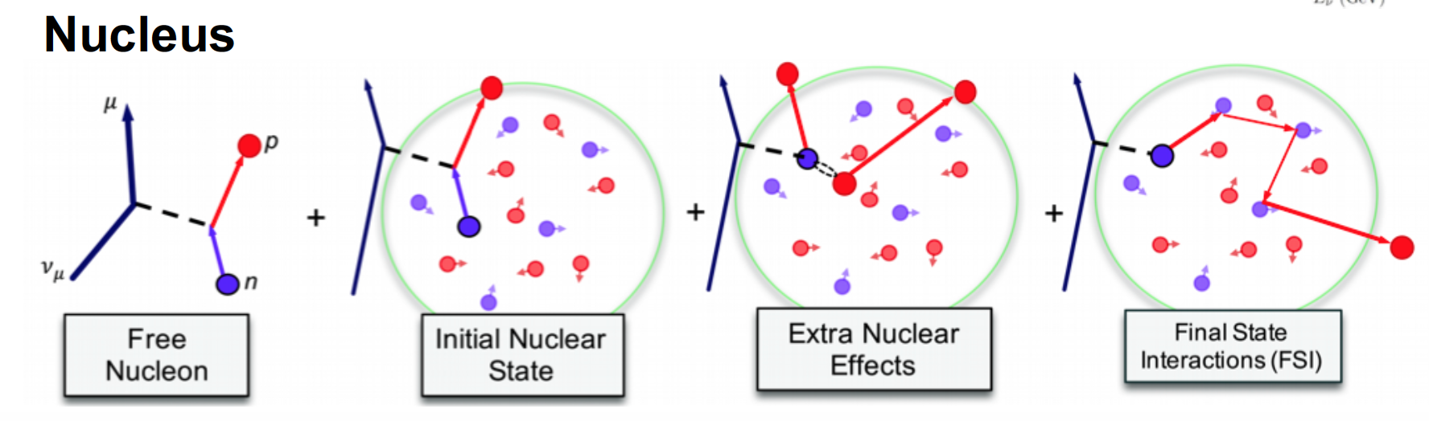
Another Complication
Need to understand nuclear effects – which are messy!
Some effects can be mitigated by use of same nuclear targets

Slide 36
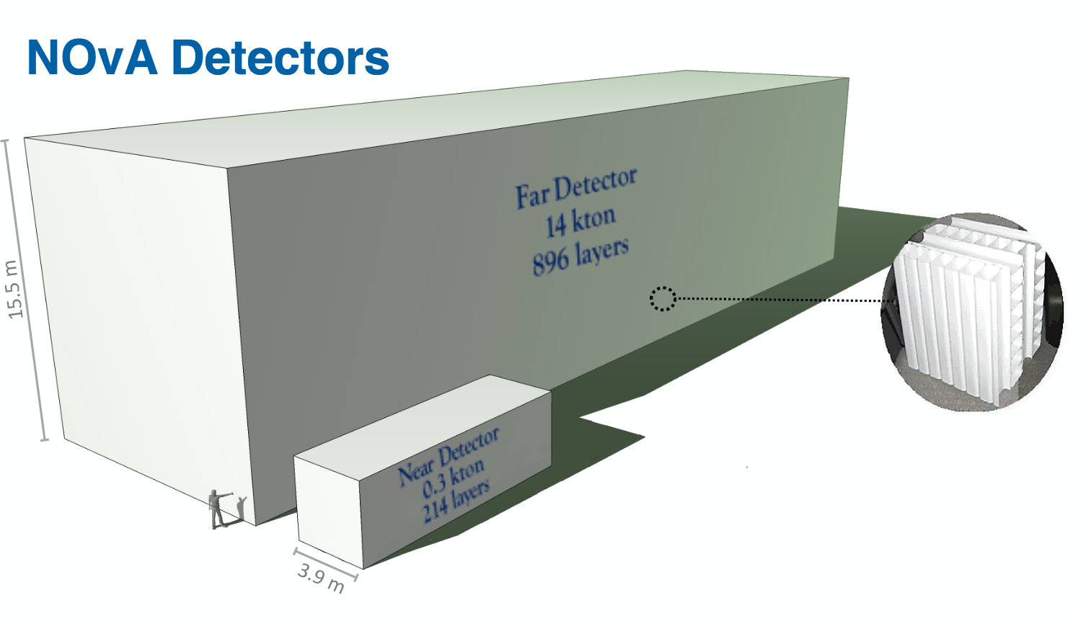
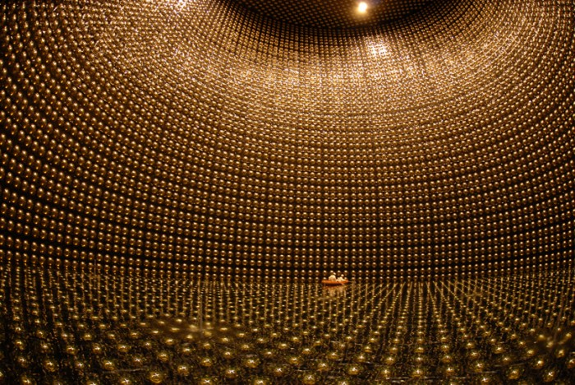
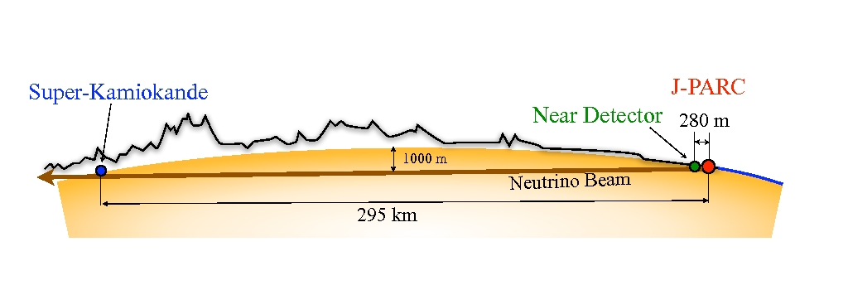
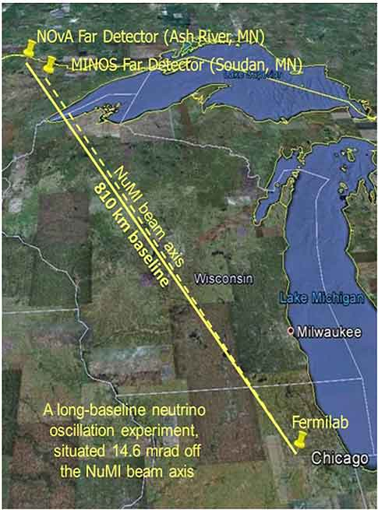
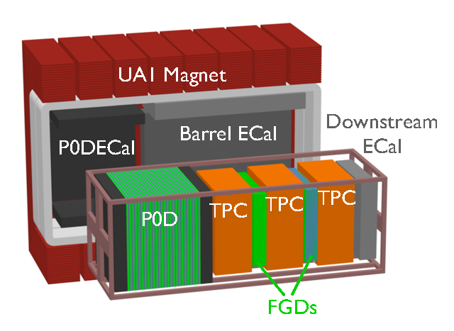
Operating Long-baseline experiments
T2K baseline:
295 km
NOvA baseline:
810 km

Slide 37
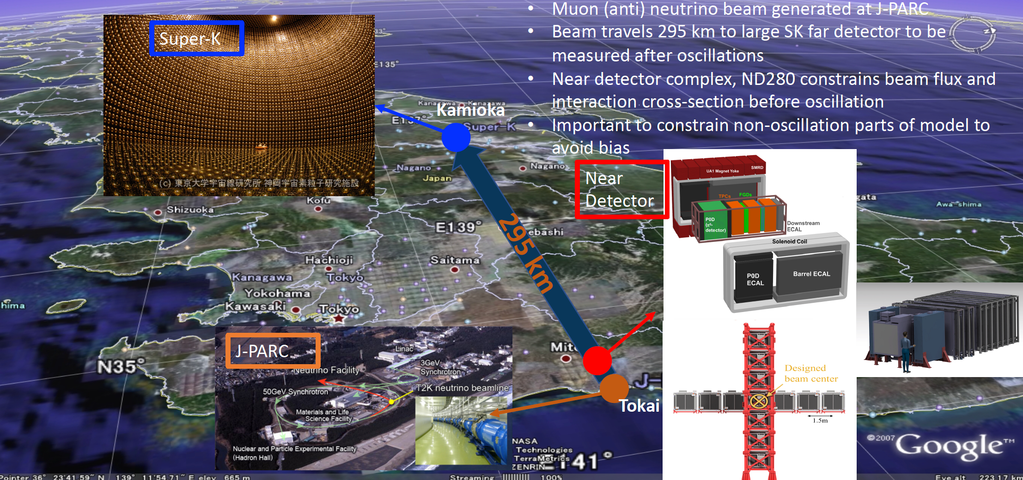
T2K Experiment
P. Dunne,
Neutrino 2020

Slide 38
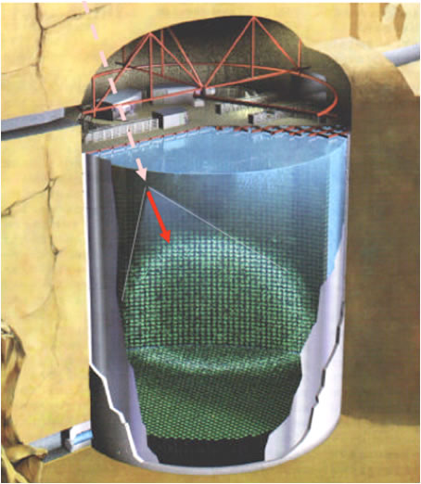
Super-Kamiokande
50,000 tons of water surrounded by 11,000 PMTs (20 inch).
1 km rock overburden
39.3m in diameter and 41.4m in height
Cherenkov
cone
e ⁻
43º

Slide 39
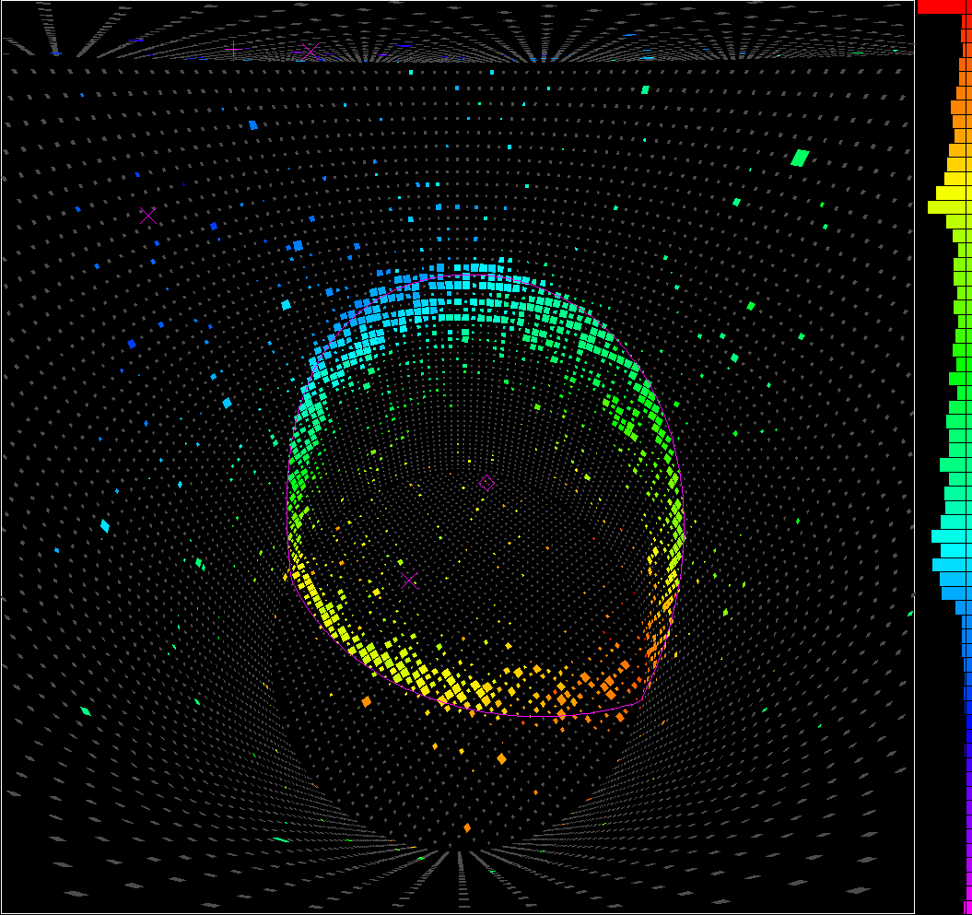
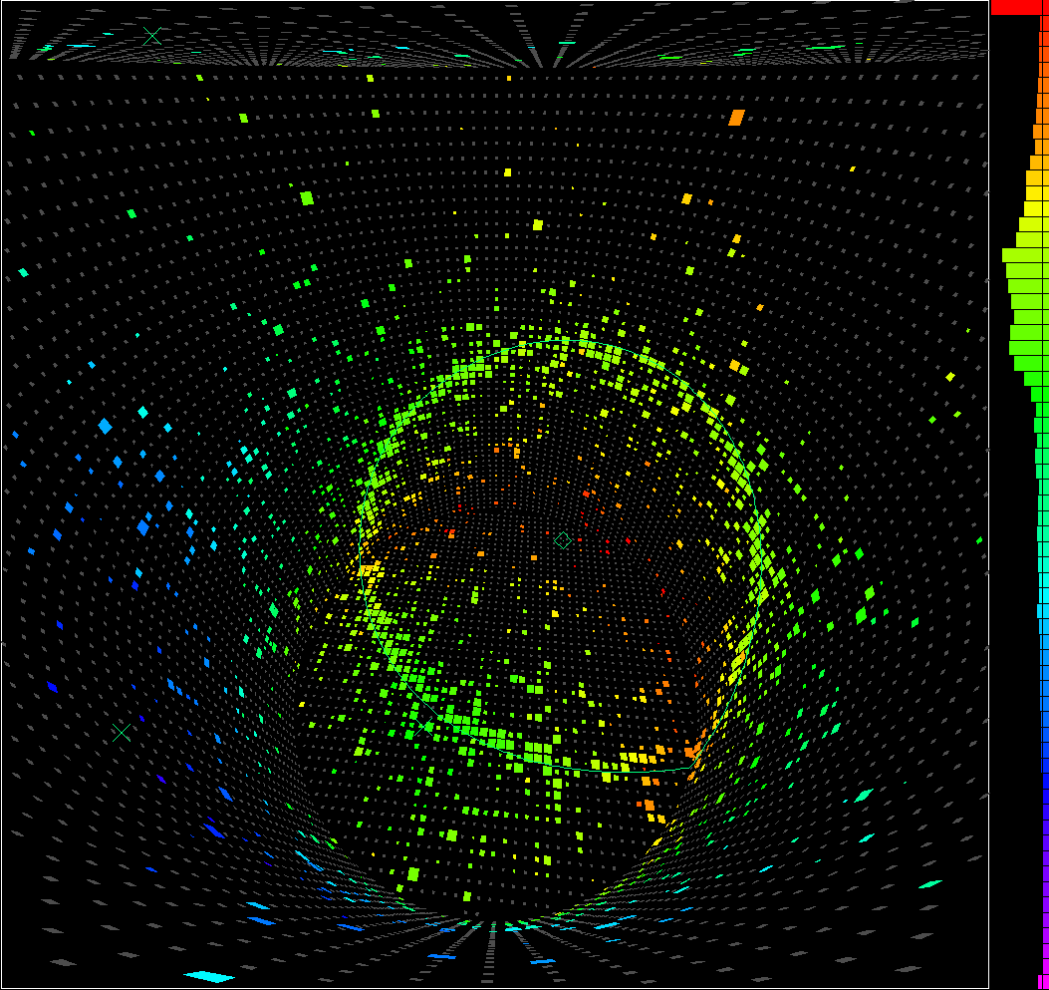
Super-Kamiokande – electron or muon ring?

Slide 40
Super-Kamiokande – electron or muon ring?

Slide 41
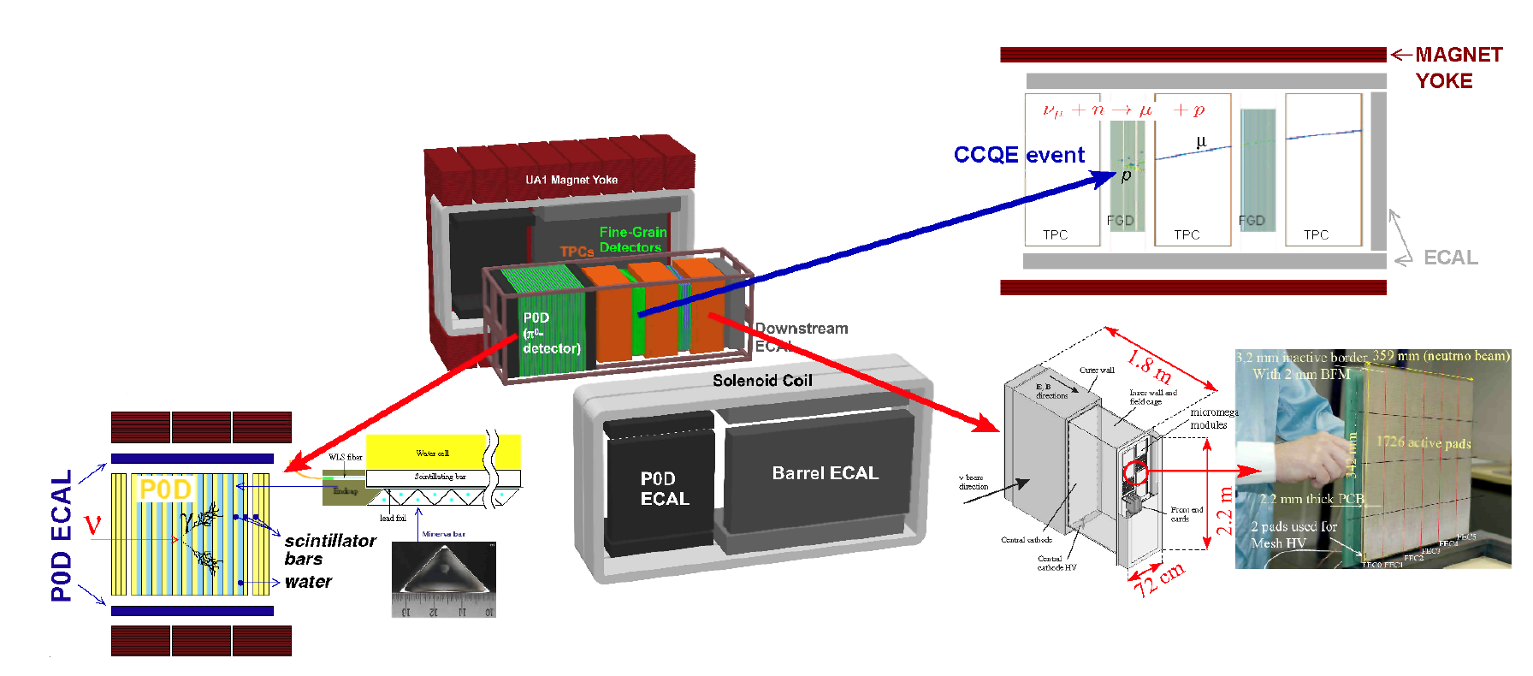
The T2K Near Detector (ND280)
Different technology/target for near and far detector

Slide 42
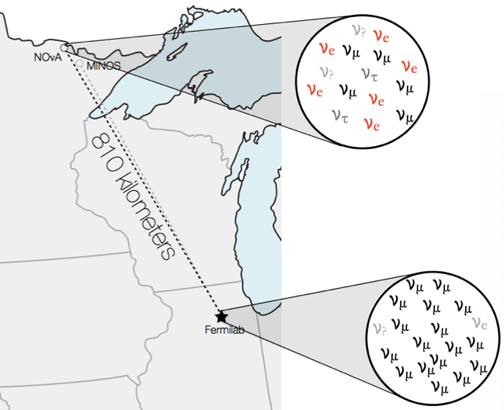
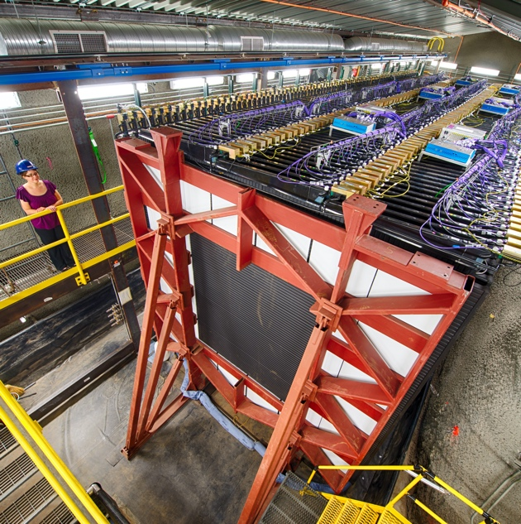
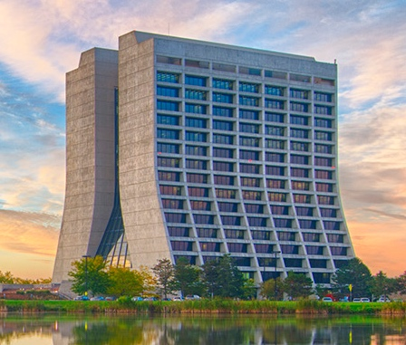
NOvA Experiment
NuMI beam: ν_{μ} or ν̅_{μ}
2 functionally identical, tracking calorimeter detectors
  Near: 300 T underground
  Far: 14 kT on the surface
  Placed off-axis to produce a narrow-band spectrum
810 km baseline
  Longest baseline of current experiments.

Slide 43
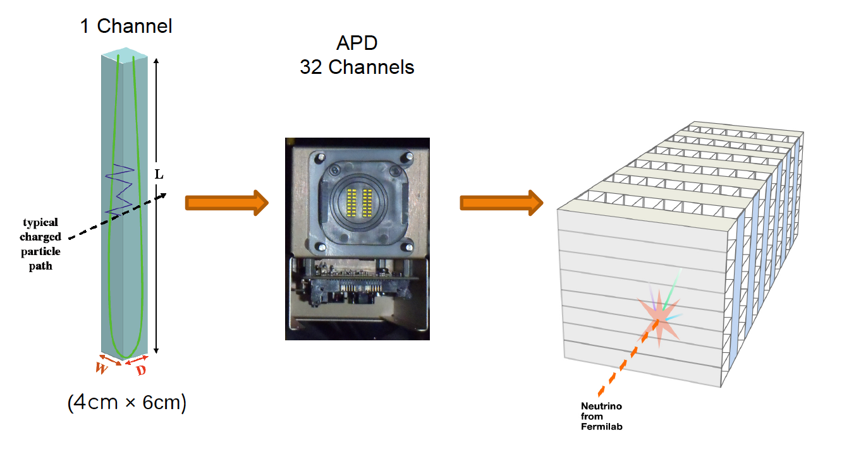
NOvA is on the surface..
14 kt Far Detector
Equivalent Near Detector
Liquid scintillator (oil)
Readout by APDs

Slide 44
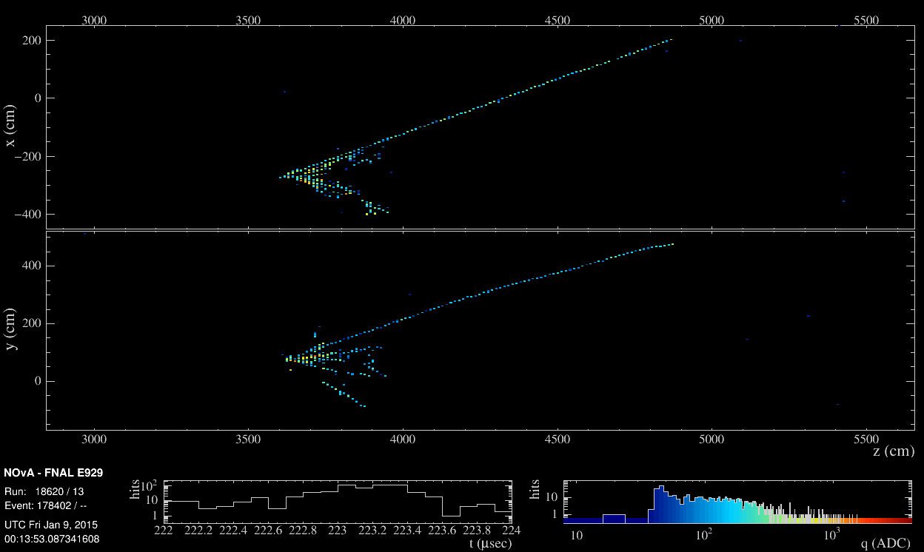

NOvA Detector
West
East
Up
muon
Beam direction
Hadronic recoil
NOvA uses Convolutional Neural Networks (CVNs) to reconstruct images.
Down

Slide 45
ν_{μ} and ν̅_{μ} disappearance at the NOvA Far Detector
ν_{μ}
ν̅_{μ}
Alex Himmel,
Neutrino 2020
211 events, 8.2 background
105 events, 2.1 background

Slide 46
ν_{e} and ν̅_{e} appearance at the NOvA Far Detector
ν_{e}
ν̅_{e}
Total Observed | 82 | Range
Total Prediction | 85.8 | 52-110
Total Bkgd. | 26.8 | 26-28
Total Observed | 33 | Range
Total Prediction | 33.2 | 25-45
Total Bkgd. | 14.0 | 13-15
Alex Himmel,
Neutrino 2020
>4σ evidence of ν̅_{e} appearance

Slide 47


ν_{μ} and ν̅_{μ} disappearance at the T2K Far Detector (SK)
ν_{μ}
ν̅_{μ}
Muon-like rings

Slide 48


ν_{e} and ν̅_{e} appearance at the T2K Far Detector (SK)
ν_{e}
ν̅_{e}
electron-like rings (0 π⁰)

Slide 49

Extracting the Information
J. Wolcott

Slide 50
Extracting the Information
Simultaneous fits of
Data samples in Near and Far Detector
Flux model, incl. beam monitor and hadron production (NA61-SHINE)
Cross section models
Detector models for Near and Far Detector
Error correlation matrix
Oscillations Parameters
J. Wolcott

Slide 51
To give you a “flavour”
Electron-neutrino appearance is sensitive to the CP phase.
Mass ordering effect depends on electron density N_{e}.
Simultaneous determination of mass ordering and CP phase only possible with long-baselines by fitting the energy dependence of the flux modulation (unless we add atmospheric data).

Slide 52

CP Violation Phase
Sensitivity to combination of CP phase and mass ordering.
Normal ordering slightly preferred (1σ)
Exclude IO, δ = π/2 at > 3σ
Disfavour NO, δ = 3π/2 at ~2σ
CP conversation (0,𝜋) excluded at 90% confidence level
Normal ordering preferred

Slide 53
The Status Quo
Current data are inconclusive – expect some improvements with further running
Need next-generation experiments to discover CPV and resolve mass ordering

