Slide 1
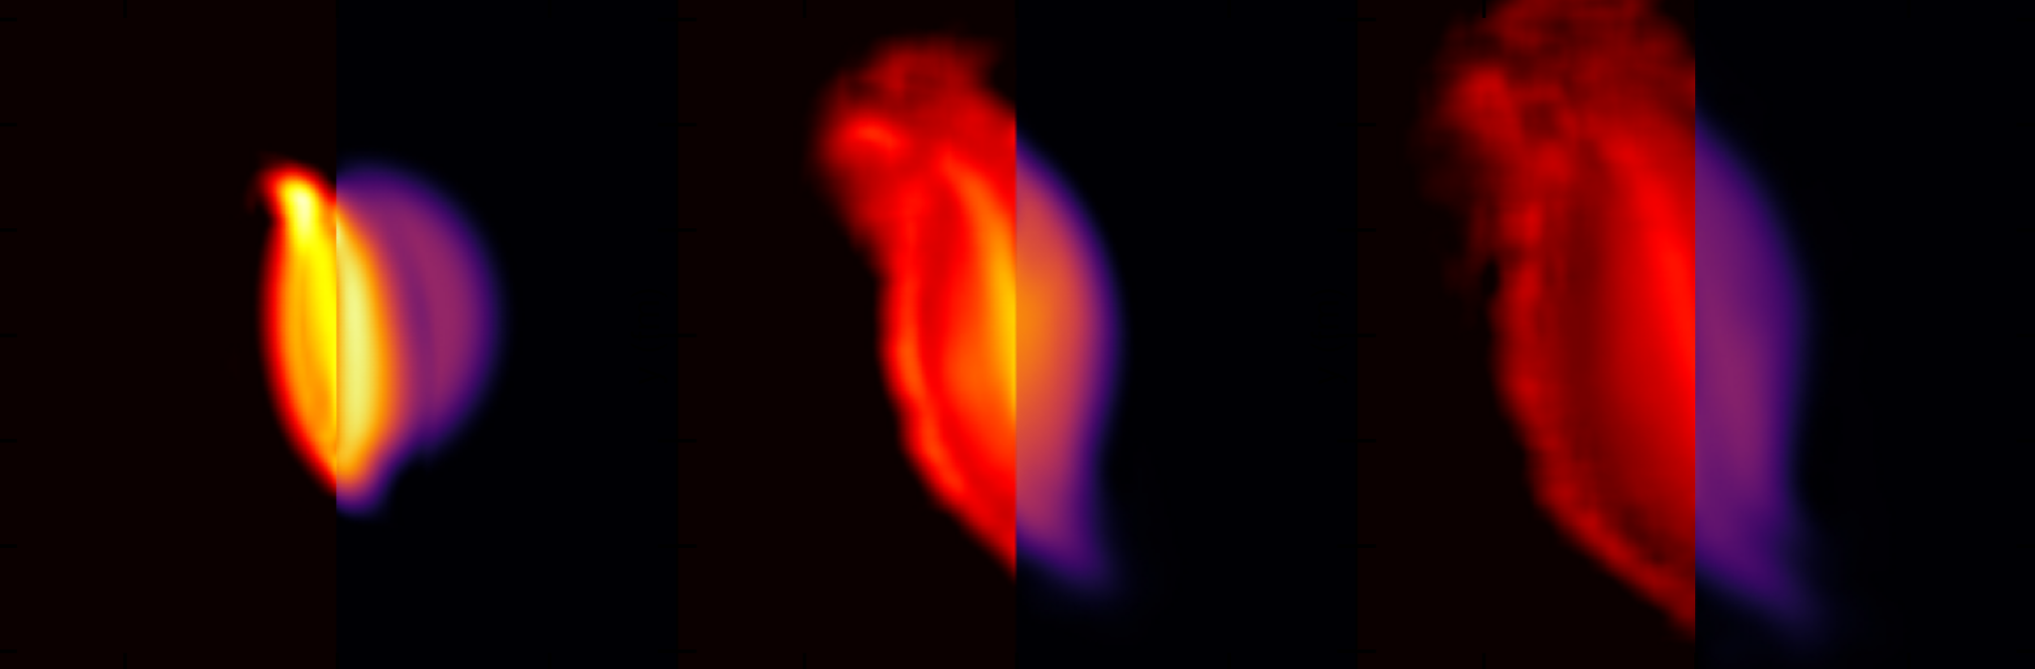
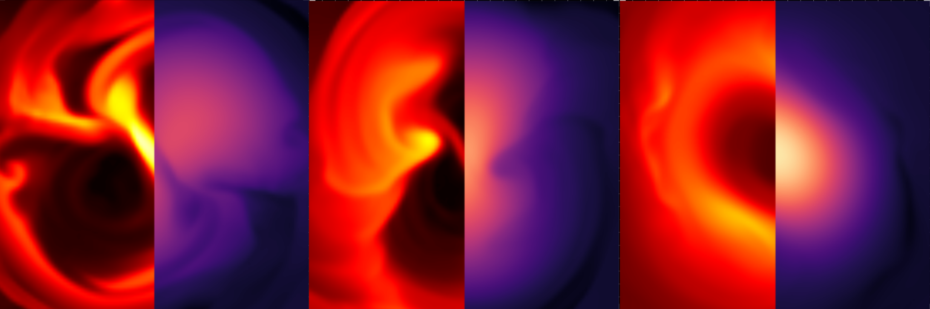



Dynamics of the QCD matter in heavy ion collisions and binary neutron star mergers
Strangeness in Quark Matter, Busan, Republic of Korea, 15 June 2022
Anton Motornenko

Slide 2
Thanks to:
M. Bleicher, V. Dexheimer, M. Hanauske, A. Heger, P. Jakobus, E. Most, B. Müller, Y. Nara, M. Omana Kuttan, L. Rezzolla, J. Steinheimer,
and H. Stöcker
2201.01622 [nucl-th]
2201.13150 [nucl-th]
2204.10397 [astro-ph.HE]

Slide 3
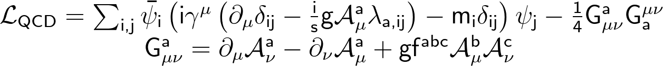
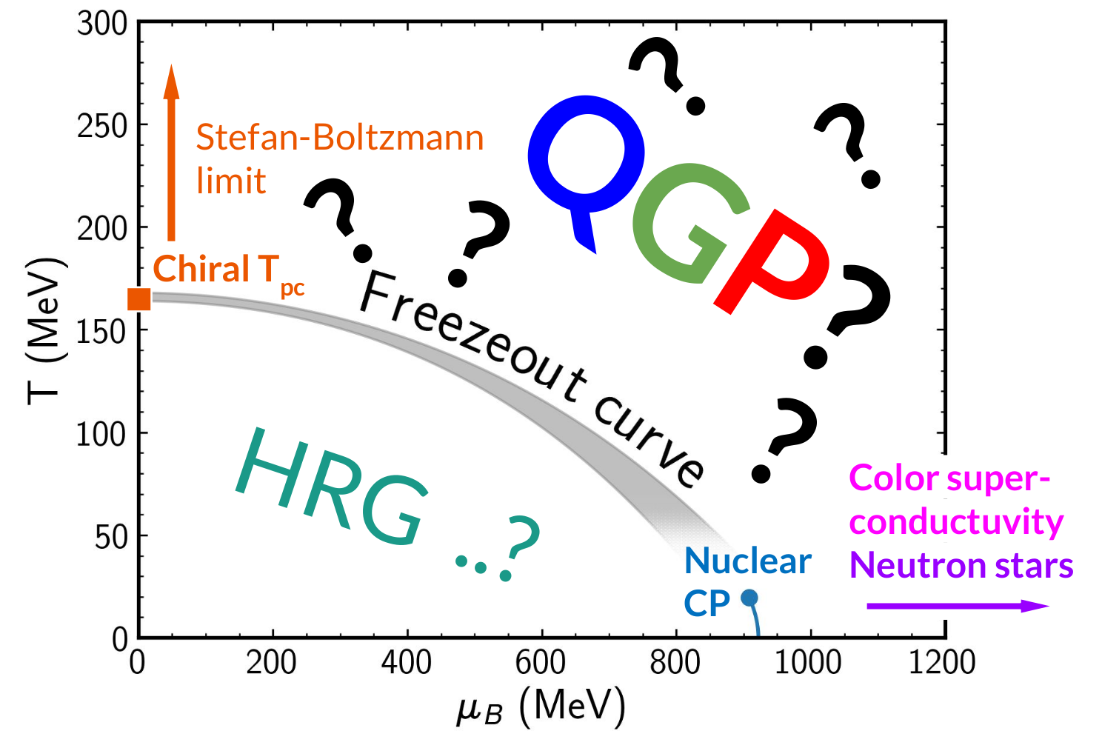
QCD phase diagram
?
How to map the well established QCD theory to its phase diagram?
1

Slide 4
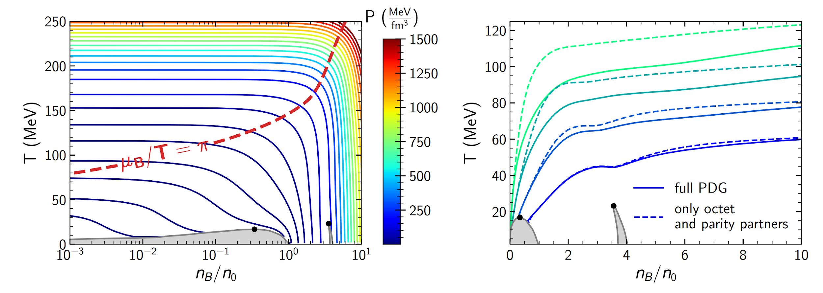
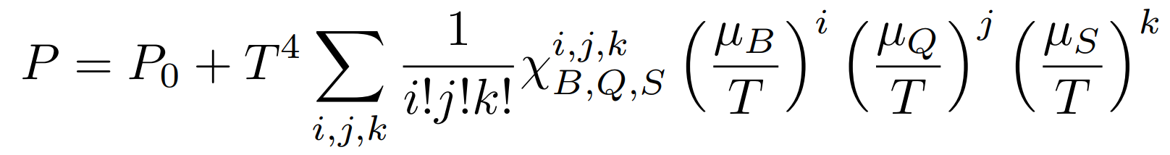
Beyond the lattice data
AM, Vovchenko Steinheimer, Schramm, Stoecker, Nucl.Phys.A 1005 (2021) 121836
First-principle lattice QCD data can be used at µ_{B} > 0 by Taylor expansion:
With limited radius of convergence
(see recent progress at P. Parotto talk on Wednesday).
At finite densities the transition to fermion-dominated matter changes isobaric lines.
There is need for phenomenological models!
Lines of CMF constant pressure. The grey shaded regions: mixed phases by nuclear liquid-vapor and chiral phase transitions. Black dots — critical endpoints.
2

Slide 5


Beyond the lattice data
AM, Vovchenko Steinheimer, Schramm, Stoecker, Nucl.Phys.A 1005 (2021) 121836
First-principle lattice QCD data can be used at µ_{B} > 0 by Taylor expansion:
With limited radius of convergence.
At finite densities the transition to fermion-dominated matter changes isobaric lines.
There is need for phenomenological models!
Bulletpoints from theory overview:
(see Joseph Kapusta talk on Monday)
Lines of CMF constant pressure. The grey shaded regions: mixed phases by nuclear liquid-vapor and chiral phase transitions. Black dots — critical endpoints.
2

Slide 6
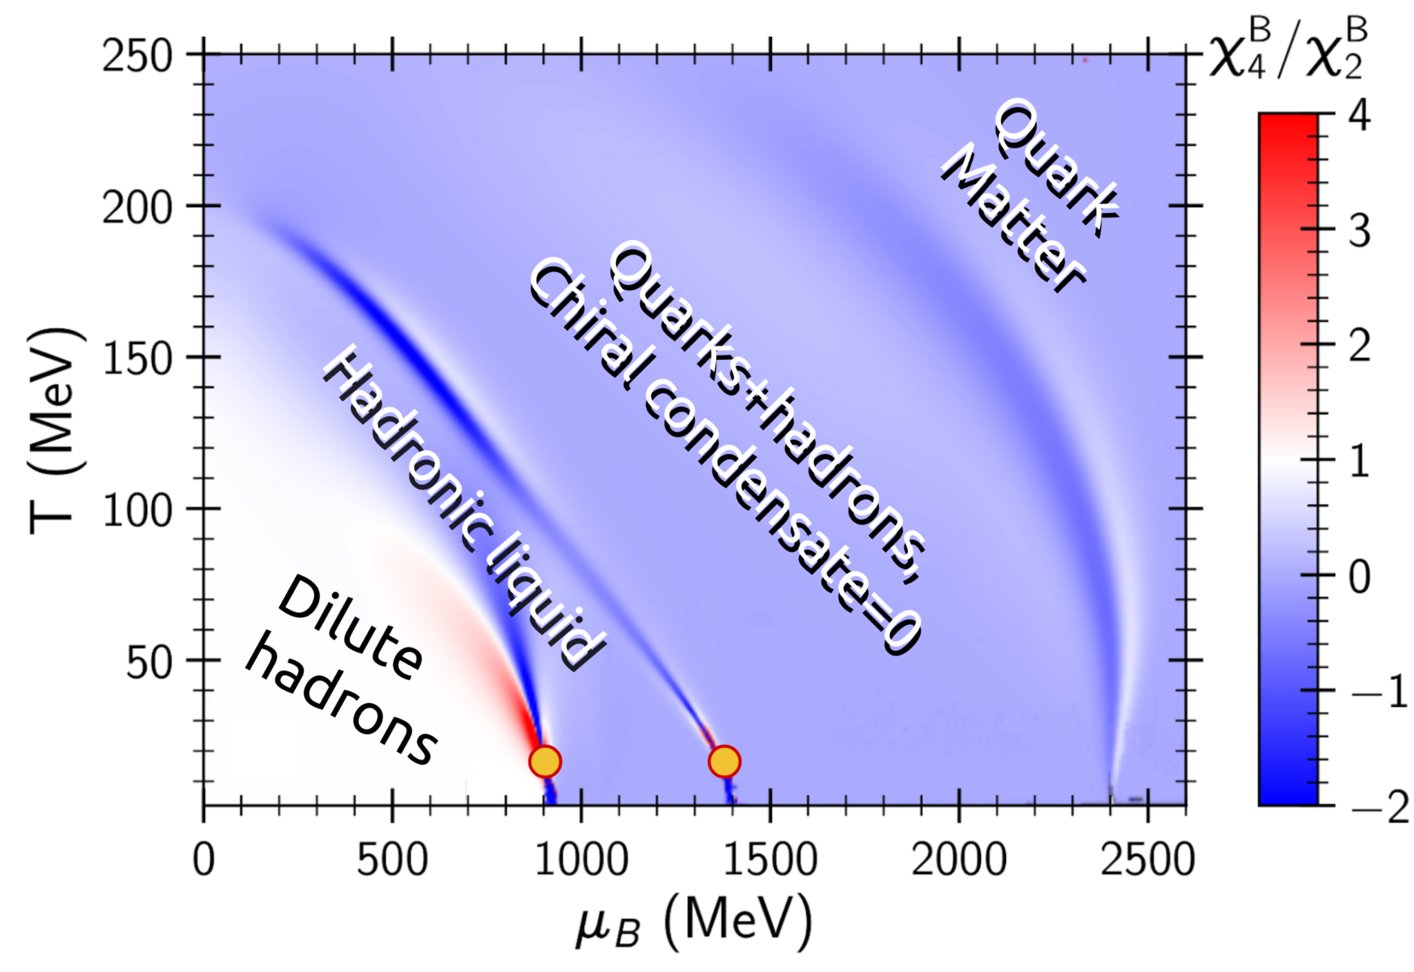

An approach for QCD EOS: CMF model
Chiral Mean Field model is a single framework for QCD thermodynamics, can be used for
analysis of lattice QCD data
description of nuclear matter
modeling of heavy ion collisions
as well as neutron star description
Papazoglou, Schramm, Schaffner-Bielich, Stoecker, Greiner, nucl-th/9706024
Papazoglou, Zschiesche, Schramm, Schaffner-Bielich, Stoecker, Greiner, nucl-th/9806087
Dexheimer, Schramm, 0901.1748
Steinheimer, Schramm, Stoecker 1009.5239
AM, Steinheimer, Vovchenko, Schramm, Stoecker, 1905.00866
CMF
AM, Steinheimer, Vovchenko, Schramm, Stoecker, Phys. Rev. C 101, no.3, 034904 (2020)
3

Slide 7
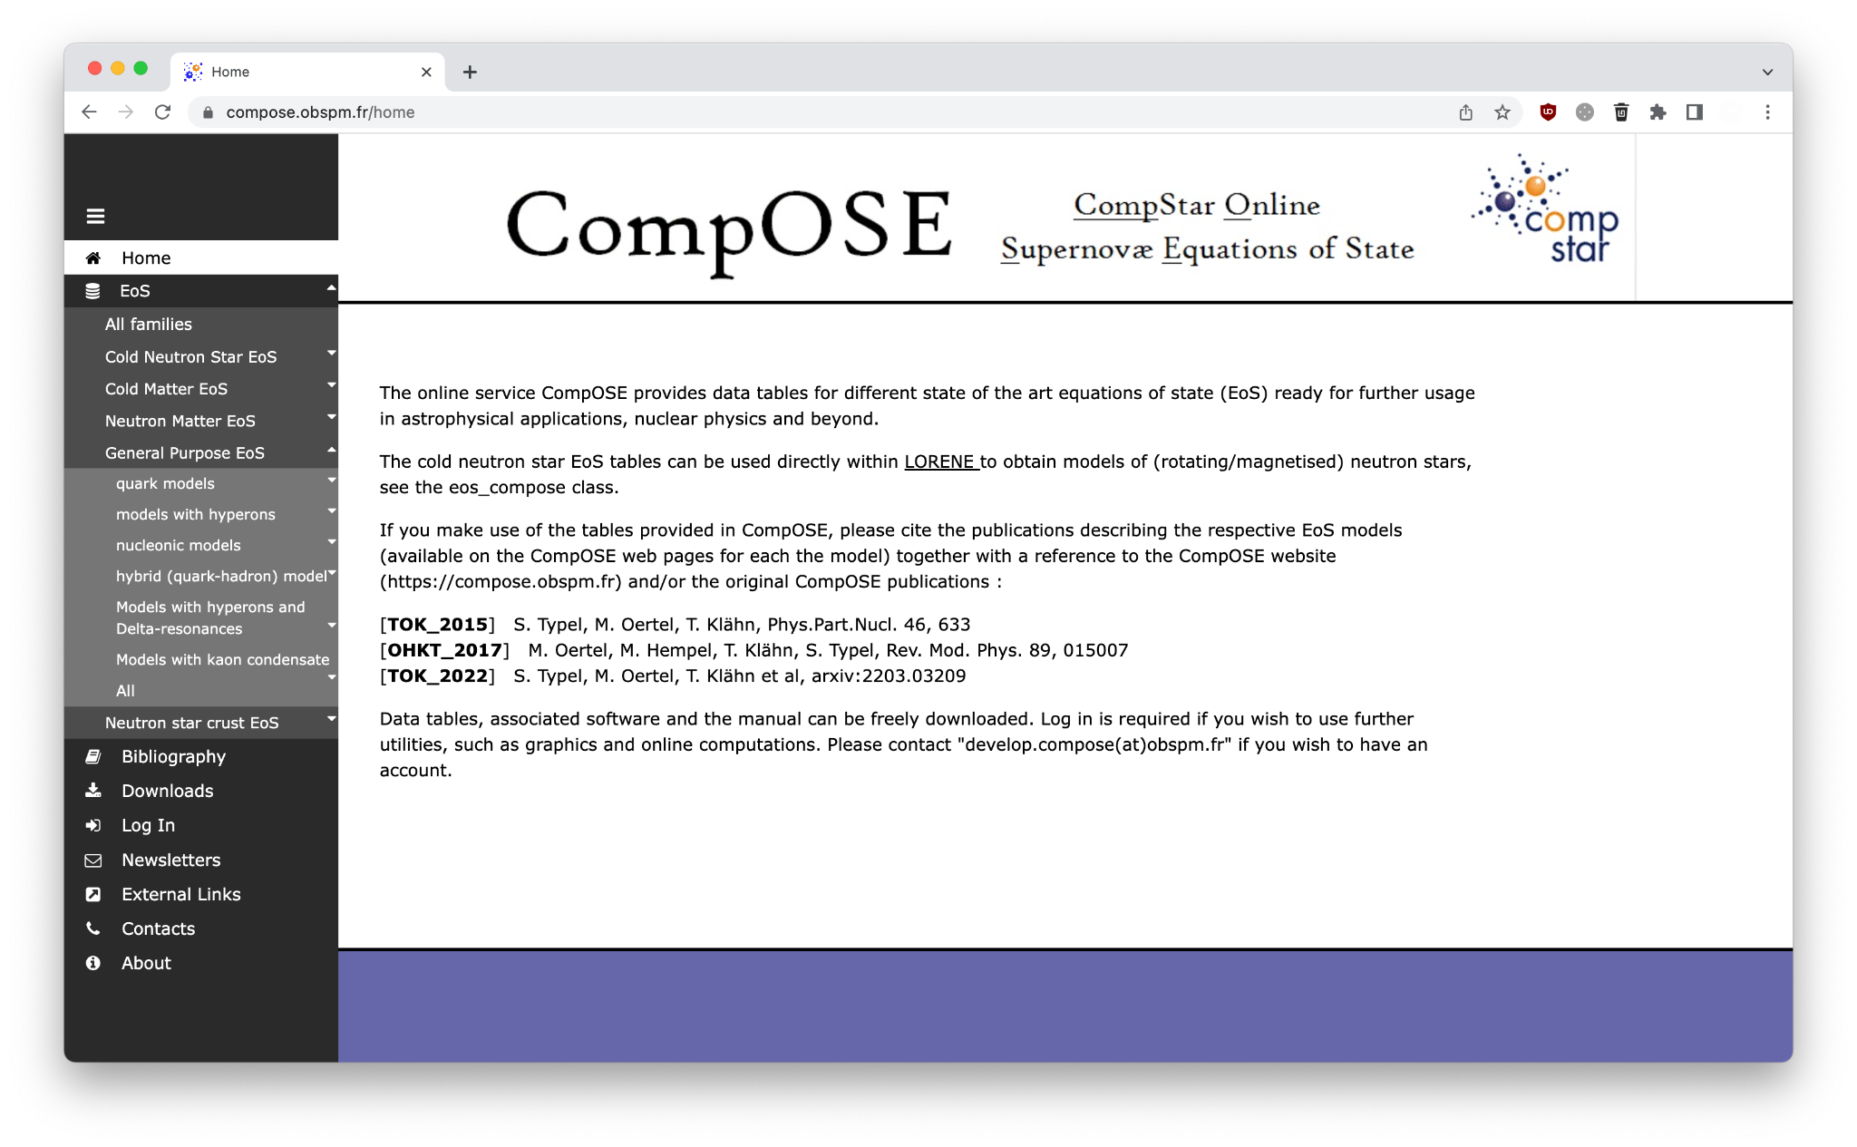
Separate EOS for astrophysics
4

Slide 8
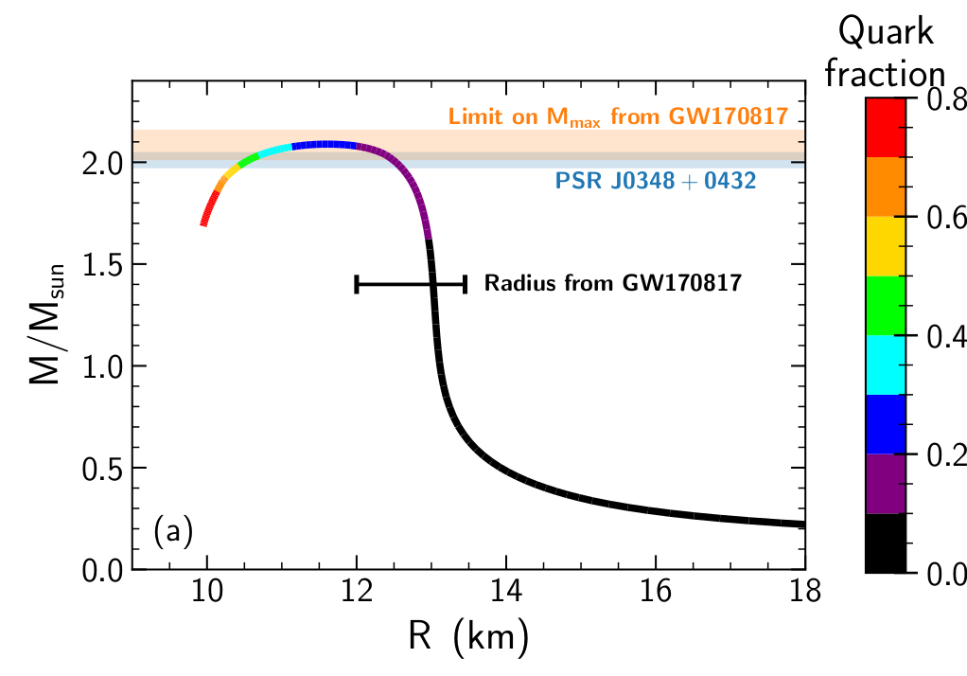
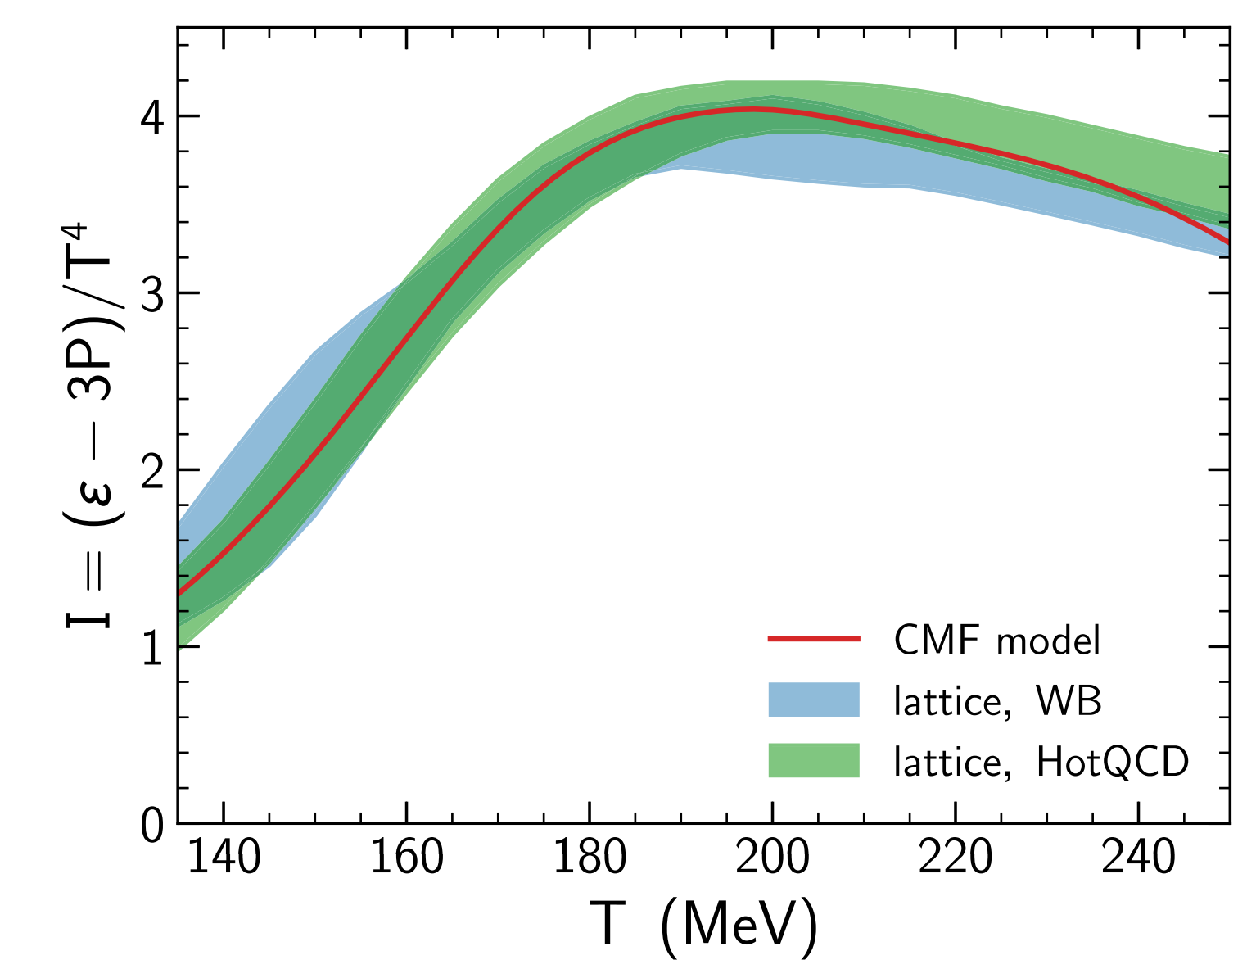
Separate Universal EOS for astrophysics and HIC
CMF n_{B}=0
CMF T=0
5

Slide 9
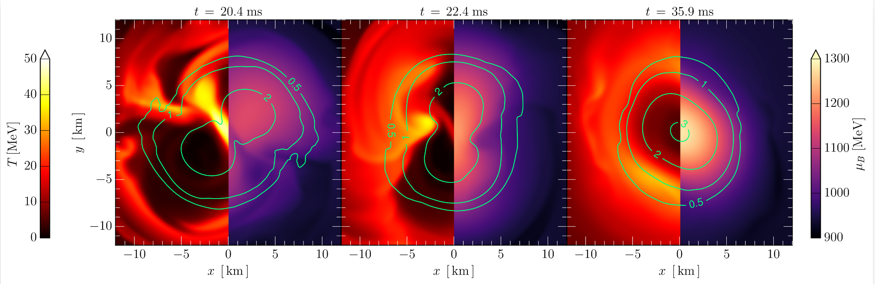
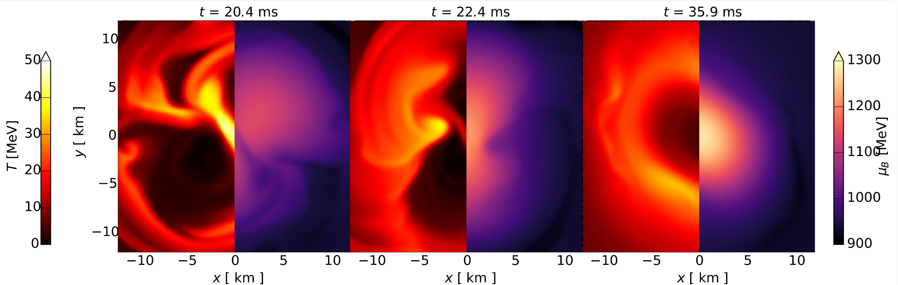
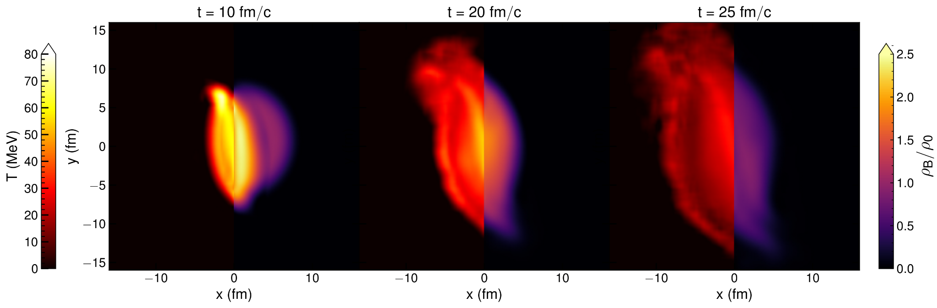
Separate Universal EOS for astrophysics and HIC
CMF BNSM
CMF — single equation of state for full hydrodynamic modeling of both heavy ion collisions and neutron star mergers!
CMF
HIC
5

Slide 10
HIC vs BNSM: comparison
In the following we use ideal relativistic hydrodynamics, no viscosity and dissipations
Binary Neutron Star Mergers
General-relativistic magneto- hydrodynamics
Frankfurt/IllinoisGRMHD (FIL) code
with Einstein Toolkit
Etienne, Paschalidis, Haas, Mosta, and Shapiro, 1501.07276 [astro-ph.HE]
Most, Papenfort, and Rezzolla, 1907.10328 [astro-ph.HE]
F. Loffler et al., 1111.3344 [gr-qc].
Heavy Ion Collisions
Relativistic flux-corrected SHASTA code
Boris, and Book, J. Comput. Phys. 11, 38 (1973)
Rischke, Bernard, and Maruhn, arXiv:nucl-th/9504018
Both codes require equation of state as an input
6

Slide 11
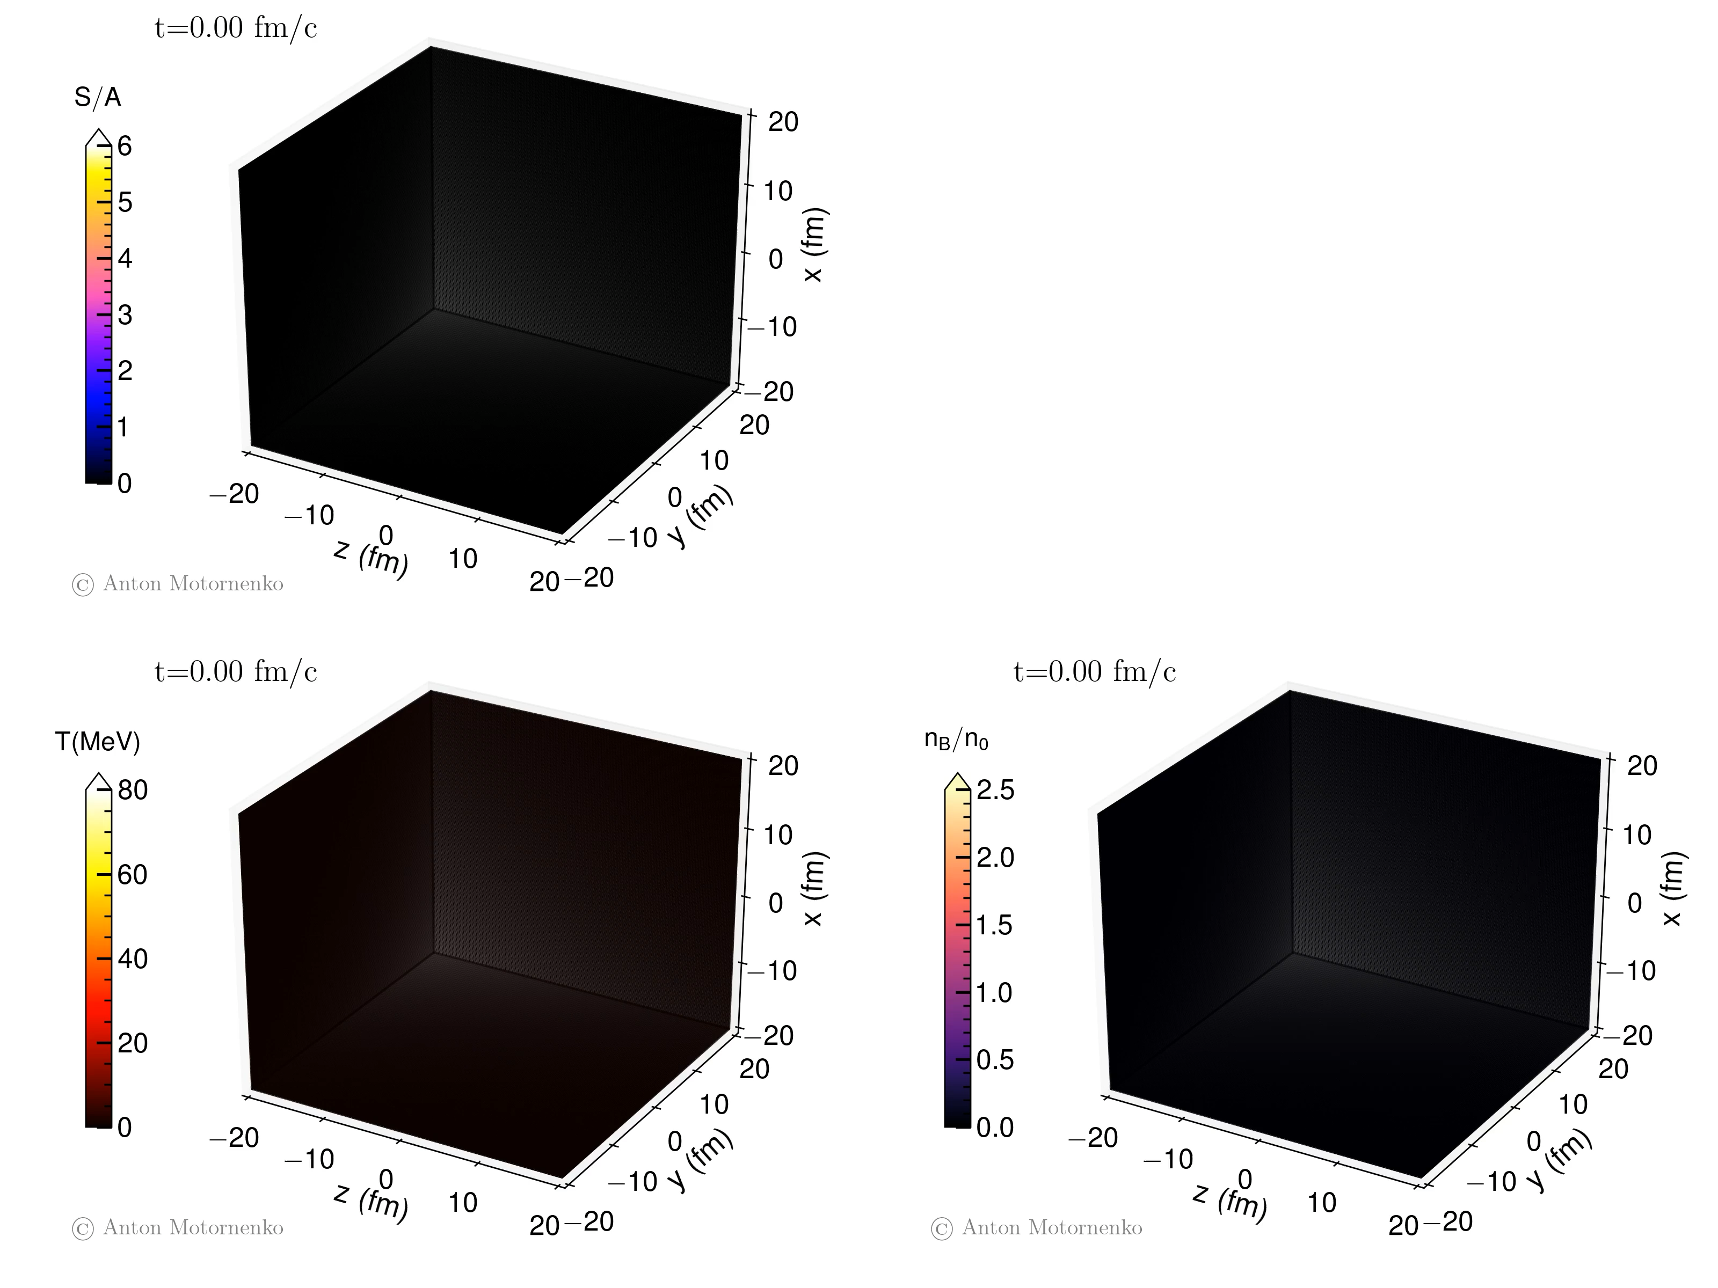
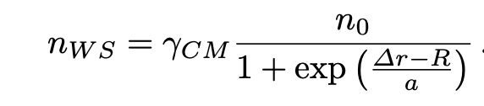
Heavy ion collision evolution
Au+Au collision at Elab=450 MeV
Nuclei are initialised with Woods-Saxon
distributions:
7

Slide 12
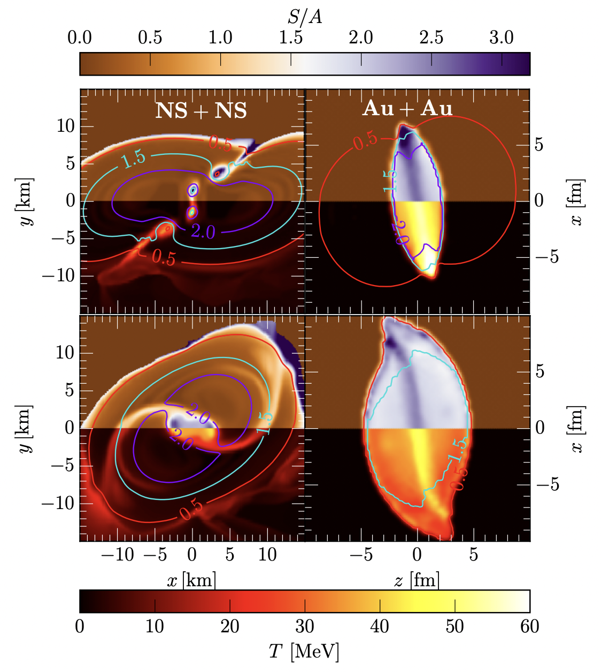
HIC vs BNSM: comparison
Geometry and scales are drastically different.
Thermodynamic conditions are similar!
Entropy per baryon S/A (top colormaps) and temperature T (bottom colormaps) for a BNS merger of mass M_{tot} = 2.8 M_{sun,} and Au + Au HIC at E_{lab} = 450 MeV.
Colored lines mark density contours in units of n_{sat.}
The snapshots refer to t = −2, 3 ms before and after merger for the BNS, respectively, and to t = ±5 fm/c before and after the full overlap for the HIC.
Most, AM, Steinheimer, Dexheimer, Hanauske, Rezzolla, Stoecker
e-Print: 2201.13150 [nucl-th]
8

Slide 13
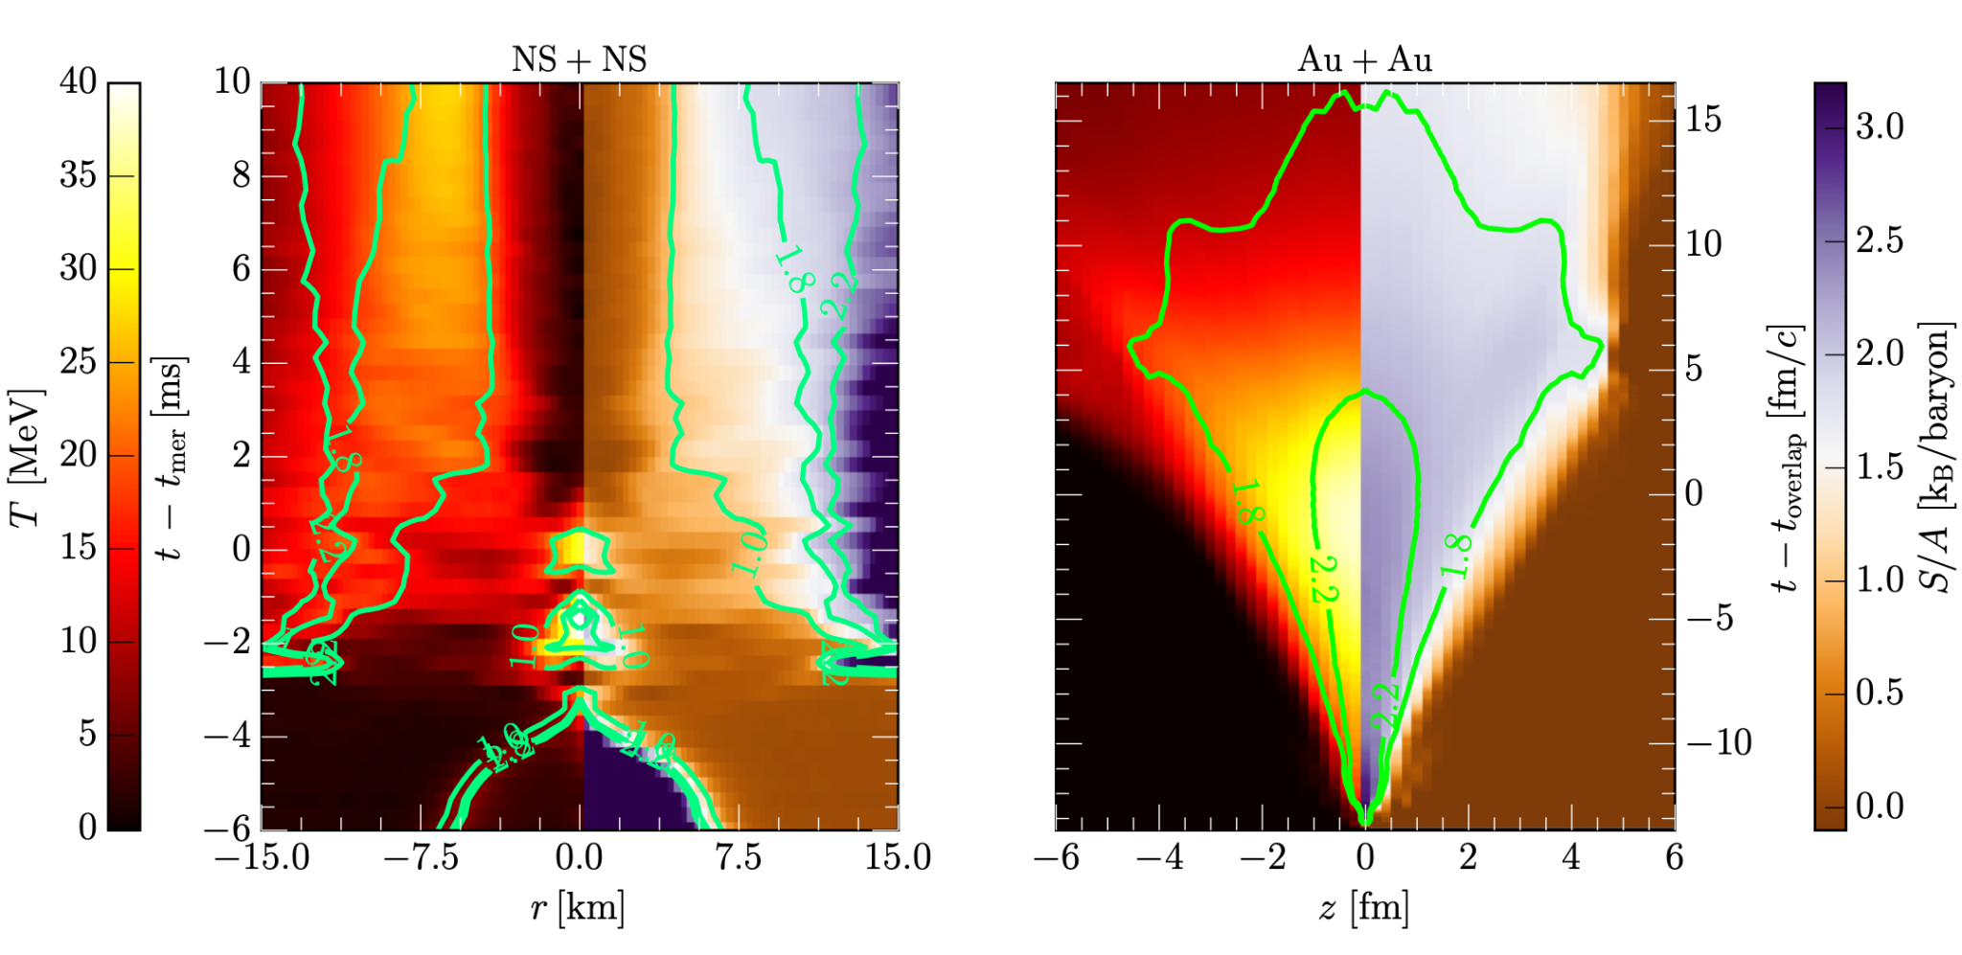
HIC vs BNSM: comparison
Spacetime diagrams for the evolution of the temperature and entropy.
The green contours correspond to lines of constant entropy per baryon S/A=1.8, 2.2.
HIC:
The whole system
expands with approx.
constant entropy
BNSM:
Entropy is localized
in a “ring” structure
Most, AM, Steinheimer, Dexheimer, Hanauske, Rezzolla, Stoecker
e-Print: 2201.13150 [nucl-th
9

Slide 14
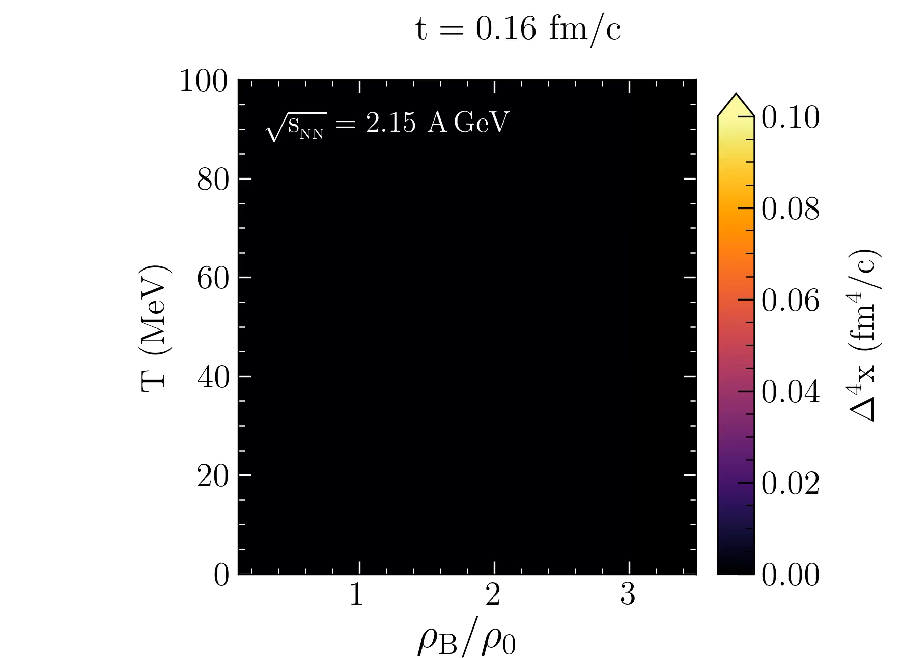
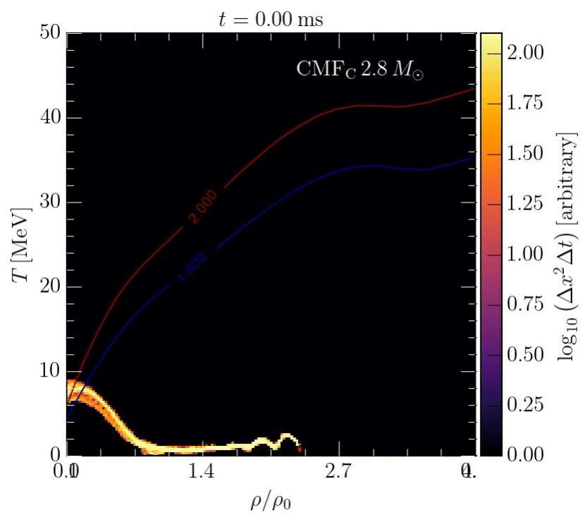
HIC:
The whole system
expands with approx.
constant entropy
BNSM:
Entropy is localized
in a “ring” structure
CMF
BNSM
CMF
HIC
BNSM movie by Elias Most
10

Slide 15
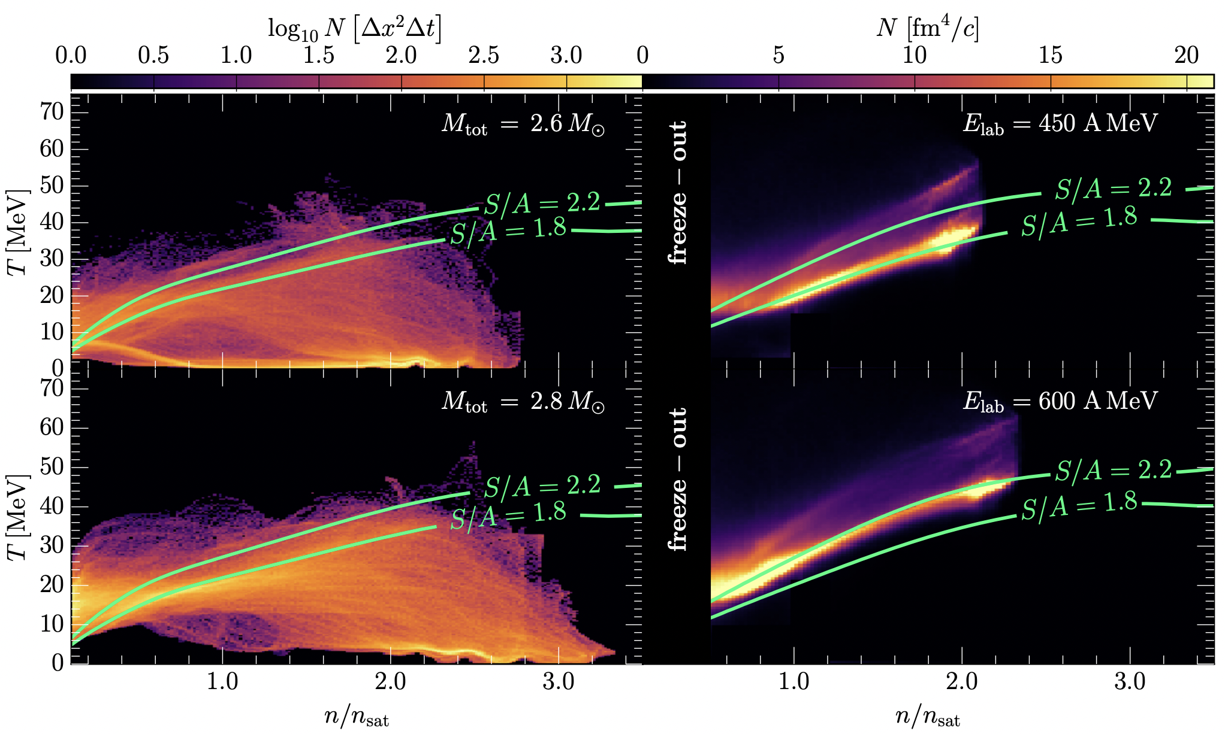
HIC vs BNSM: comparison
Regions of the QCD phase-diagram probed by BNS mergers and by HICs. The colorcode reports the number of cells N in the various spacetimes having a given value of temperature and density. The green lines show contours of constant entropy per baryon. Only cells with density above freeze-out, n > 1/2 n_{sat}, are shown for the HIC.
11

Slide 16

HIC vs BNSM: comparison
Physical conditions of BNSM can be studied in present and future HIC experiments, bridging 18 orders of magnitude in length scale, from microscopic ion collisions to macroscopic astrophysical compact objects.
Regions of the QCD phase-diagram probed by BNS mergers and by HICs. The colorcode reports the number of cells N in the various spacetimes having a given value of temperature and density. The green lines show contours of constant entropy per baryon. Only cells with density above freeze-out, n > 1/2 n_{sat}, are shown for the HIC.
11

Slide 17
Predictions for experiments
How to relate Bulk matter evolution to microscopic picture? So a comparison with experiment can be done…
?
MADAI.us
Cooper-Frye at these low energies is problematic!
12

Slide 18


Predictions for experiments
How to relate Bulk matter evolution to microscopic picture? So a comparison with experiment can be done…
Bulletpoints from theory overview:
(see Joseph Kapusta talk on Monday)
?
MADAI.us
Cooper-Frye at these low energies is problematic!
12

Slide 19
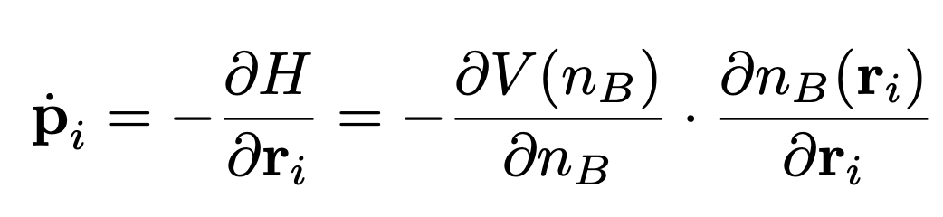
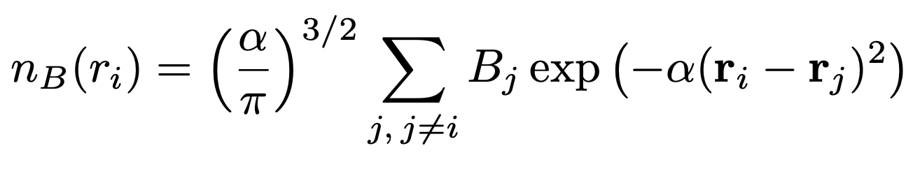
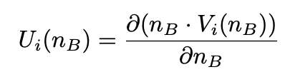

Predictions for experiments: QMD approach
Hamiltons equations of motion in a transport model (UrQMD) can be calculated as:
Density nB is calculated by assuming that each particle can be treated as a Gaussian wave packet:
The mean field potential energy per baryon can be related to a density dependent single particle energy:
In the CMF model (or any other EOS) the single nucleon potential at T = 0, can be calculated from the self energy of the nucleons:
Omana Kuttan, AM, Steinheimer, Stoecker, Nara, Bleicher
e-Print: 2201.01622 [nucl-th]
13

Slide 20
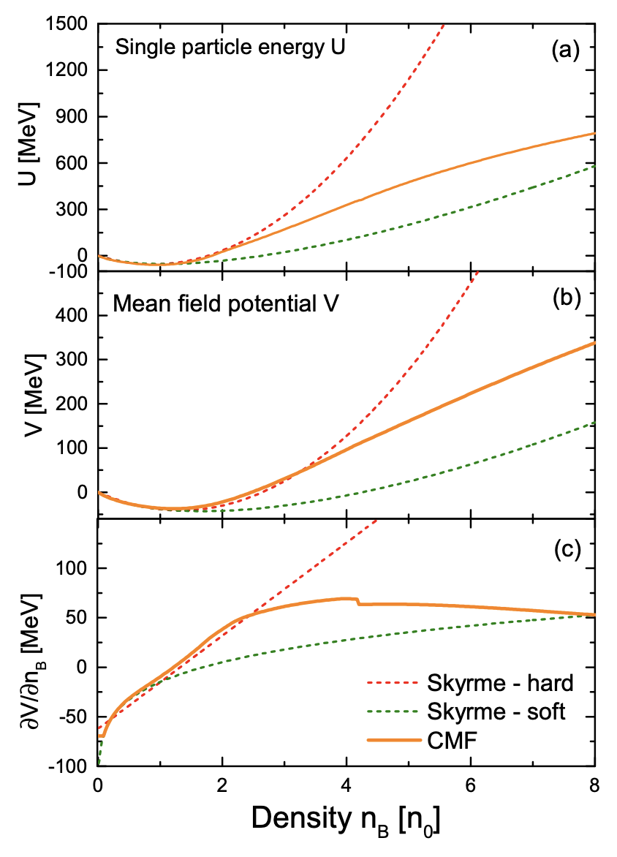
Predictions for experiments: QMD approach
CMF features:
A nuclear incompressibility compatible with experimental observations.
Stiff at super-saturation densities: explains astrophysical observations.
”Softens” at even higher densities due to the slow approach to the high density limit of a free gas quarks.
14

Slide 21
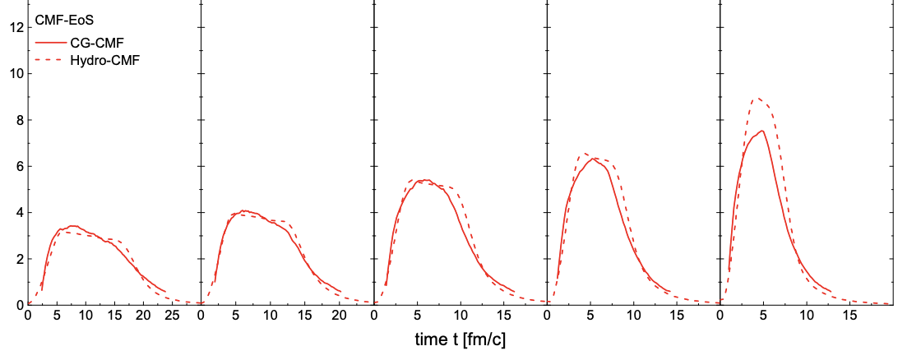

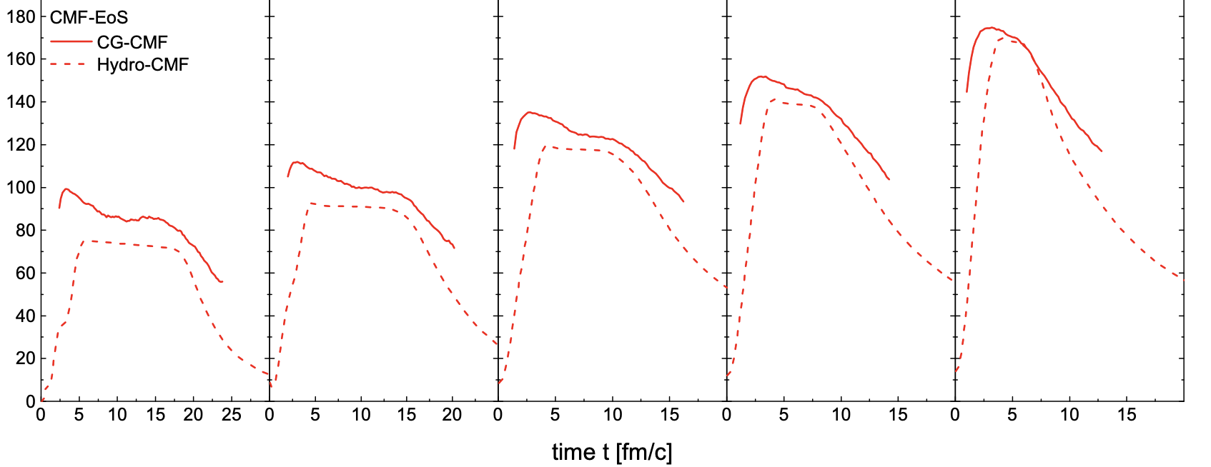

Comparing QMD approach and hydro: central cell
central cell 2x2x2 fm³
The bulk evolution of the density in this new description agrees well with a relativistic 1-fluid simulation with the CMF equation of state.
The initial compression depends dominantly on the underlying EOS and only marginally on the model used for the dynamical description.
The compression is reproduced and thus predictions for experiment can be done!
15

Slide 22
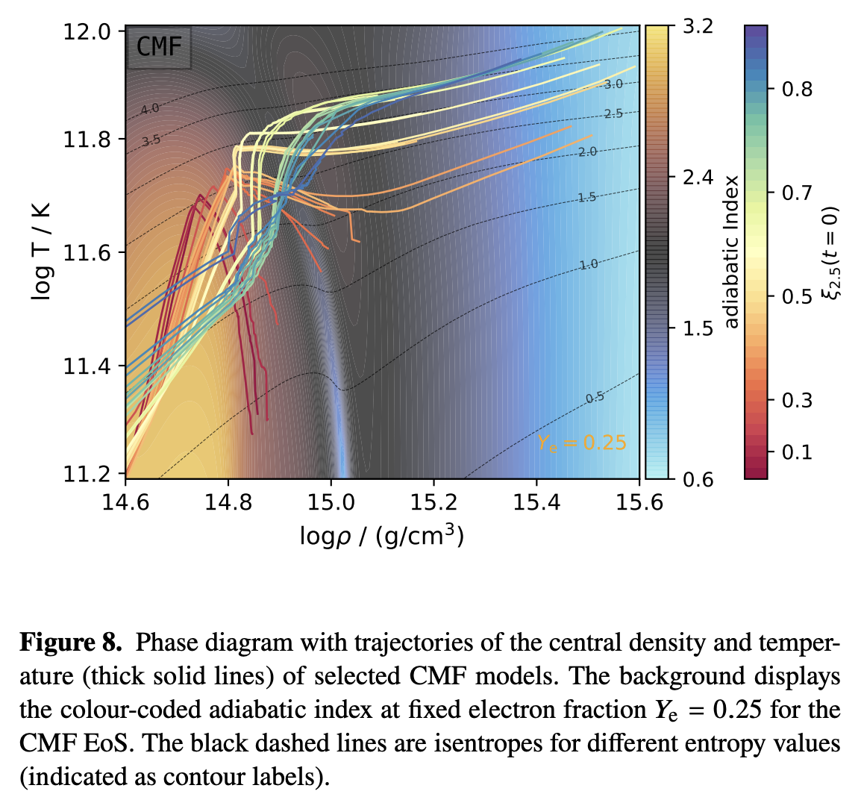
Supernova explosions: another application of CMF
~85 MeV
~13 MeV
~225 MeV/fm³
~1.5 ɛ0
~2225 MeV/fm³
~15 ɛ0
Jakobus, Müller, Heger, AM, Steinheimer,
and Stoecker,
e-Print: 2204.10397 [astro-ph.HE]
16

Slide 23
Supernova explosions: another application of CMF
~85 MeV
Bulletpoints from theory overview:
(see Joseph Kapusta talk on Monday)
…. and supernova!
~13 MeV
~225 MeV/fm³
~1.5 ɛ0
~2225 MeV/fm³
~15 ɛ0
Jakobus, Müller, Heger, AM, Steinheimer,
and Stoecker,
e-Print: 2204.10397 [astro-ph.HE]
16

Slide 24
Summary
CMF + relativistic hydrodynamics
=
Binary Neutron Star Mergers
simulations of
Astrophysical conditions can be probed by low energy nuclear collisions
Predictions for laboratory experiments can be done by UrQMD with density dependent equation of state
Heavy Ion Collisions
Supernova
Explosions
Thank you for the attention!
17

Slide 25
Backup

Slide 26
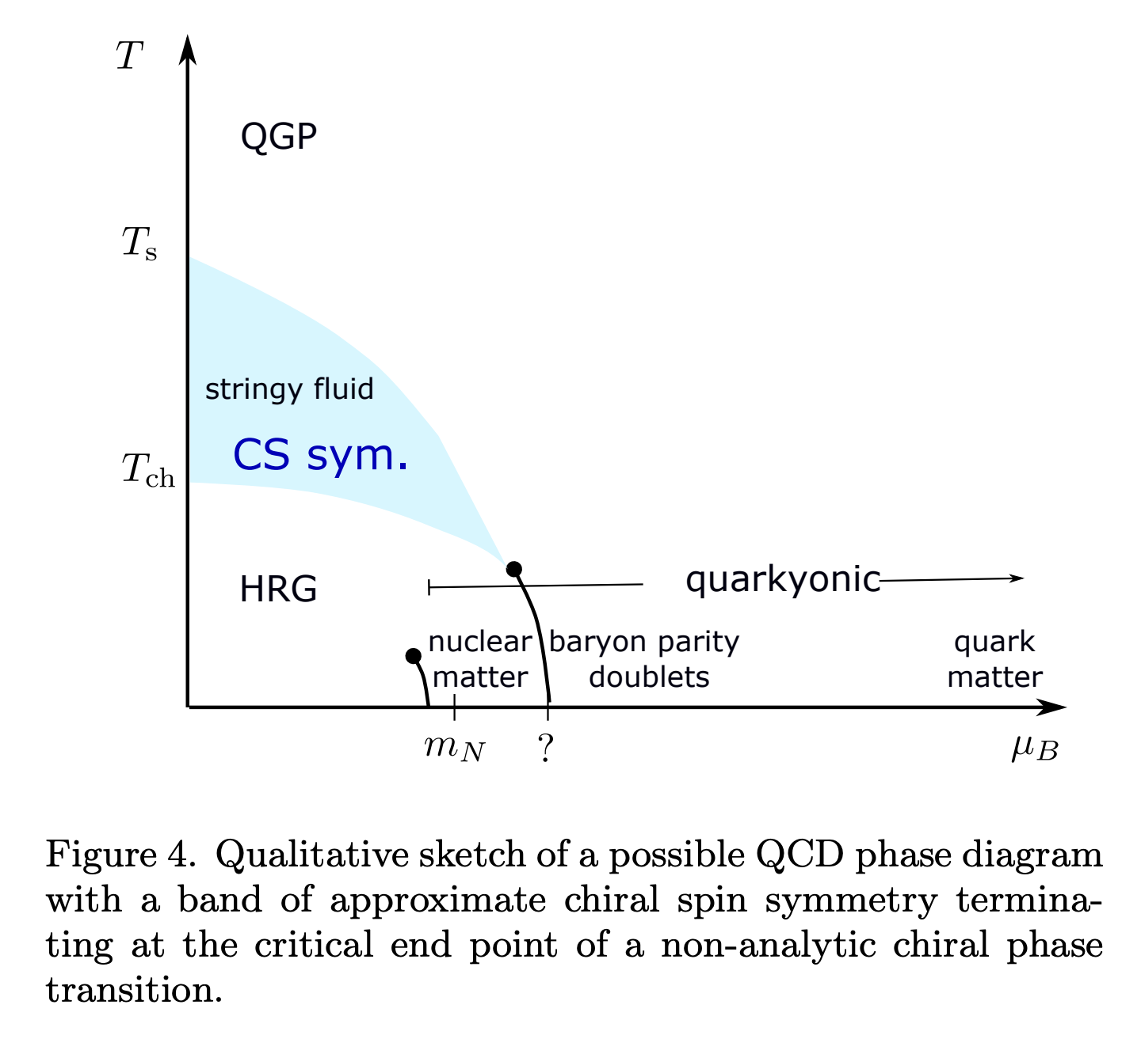
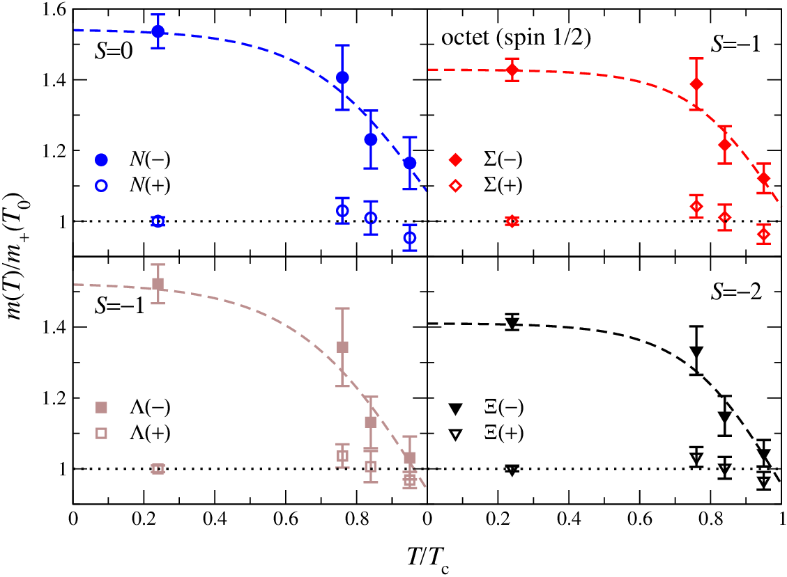
Lattice QCD based qualitative phase diagram
Aarts et al., e-Print: 1710.08294 [hep-lat]
Glozman, Philipsen, Pisarski, e-Print: 2204.05083 [hep-ph]
3

Slide 27
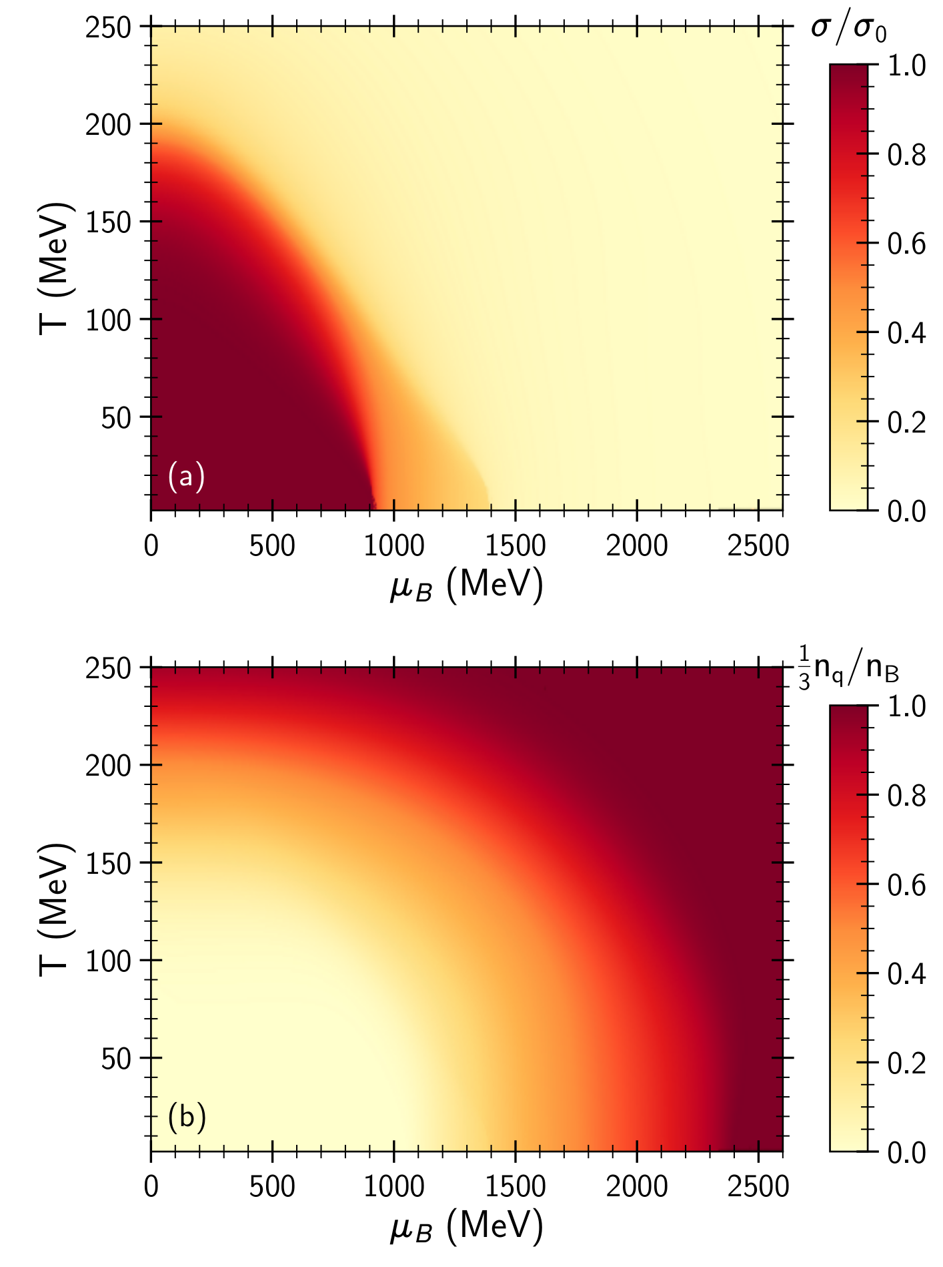
The CMF phase diagram
AM, Steinheimer, Vovchenko, Schramm, Stoecker, Phys. Rev. C 101, no.3, 034904 (2020)
Chiral condensate
Three transitions:
hadron gas ➜ hadronic liquid ➜ chiral symmetry restoration ➜ quark matter
Two critical points:
nuclear CP:
T_{CP}≈ 17 MeV chiral CP:
T_{CP}≈ 17 MeV
Quark fraction
4

Slide 28
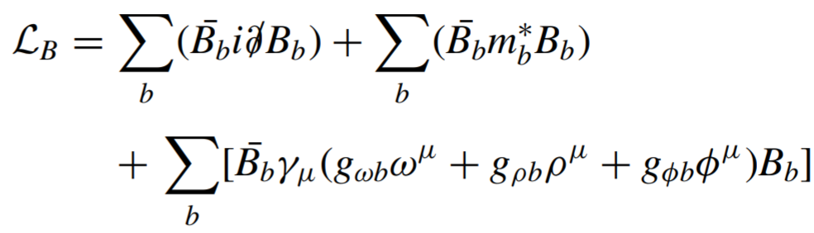
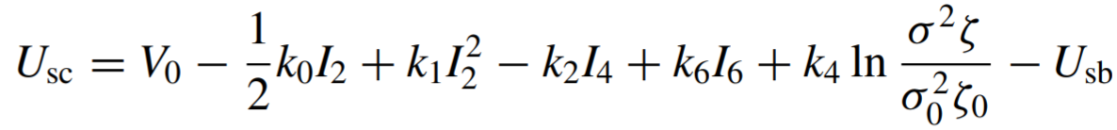
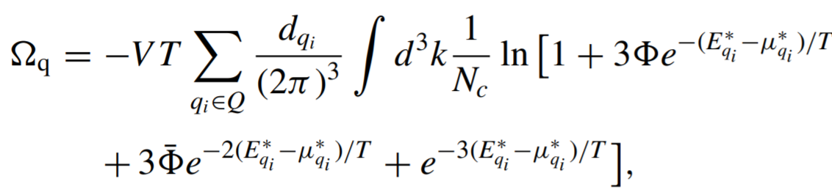

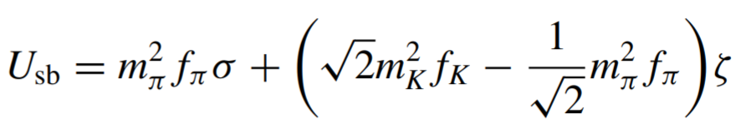
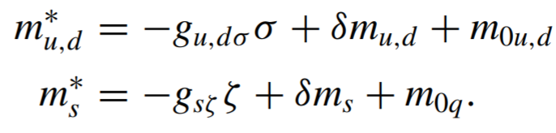
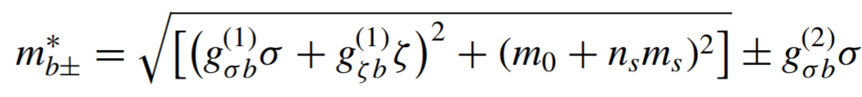
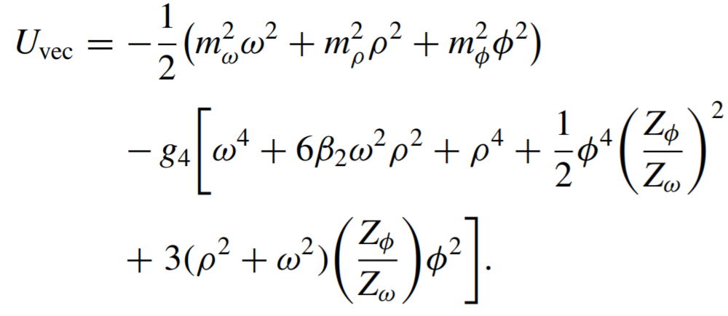
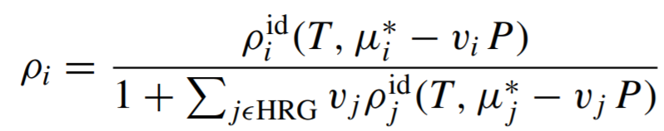
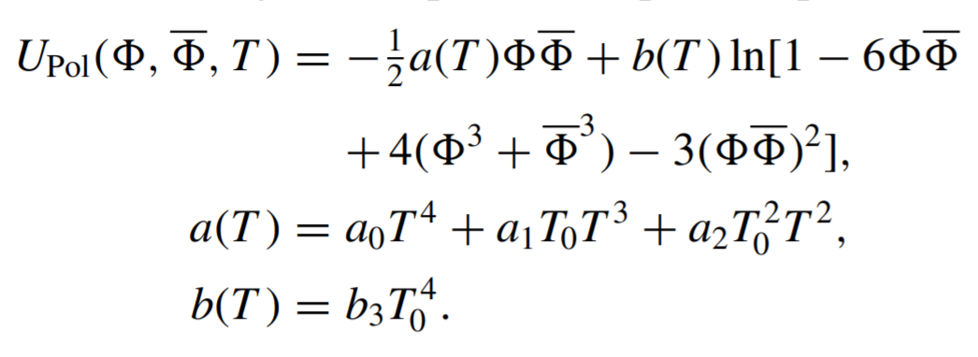

The CMF model
Baryon octet:
Attractive scalar fields:
u,d,s quarks:
Repulsive vector mean fields:
Hadrons:
Polyakov loop:
6

Slide 29
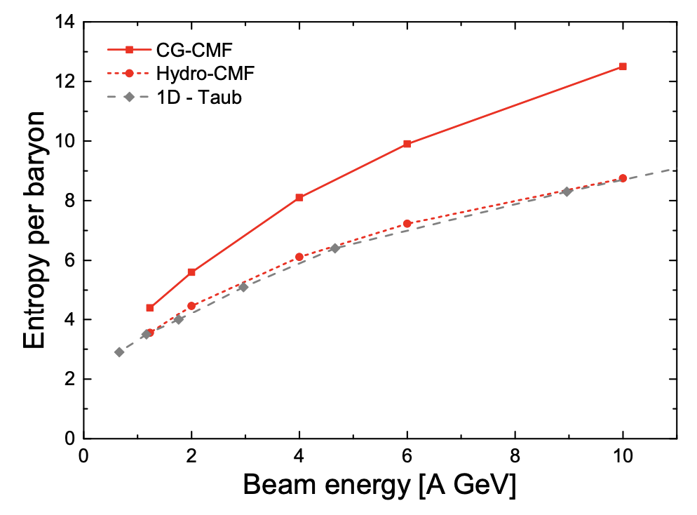
Entropy production: hydro vs QMD

Slide 30
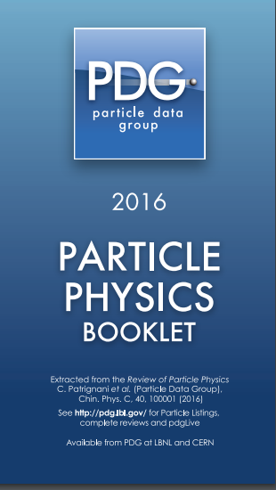
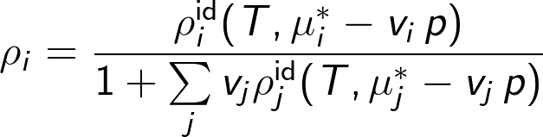
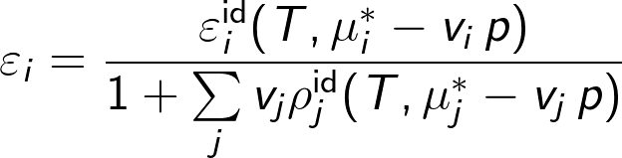
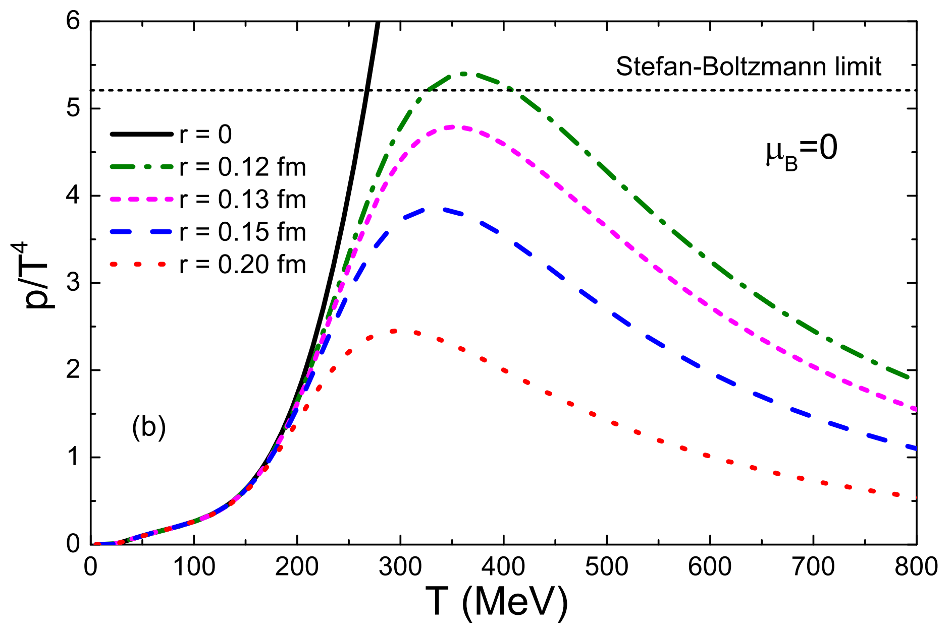
Hadronic part: QCD matter at low densities
PDG list of known hadrons is included with Excluded Volume interactions.
EV suppress hadrons at high energy densities.
EV of baryons: 1 fm³
EV of mesons: 1/8 fm³
EV triggers the switch between hadron and quark degrees of freedom: hadron pressure is suppressed as function of T and 𝜇_{B} — quarks are dominant at high densities.
V. Vovchenko, D. Anchishkin, M. Gorenstein, 1412.5478
13
V. Vovchenko, D. Anchishkin, M. Gorenstein, 1412.5478

Slide 31
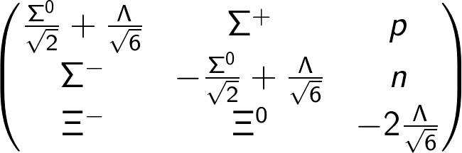
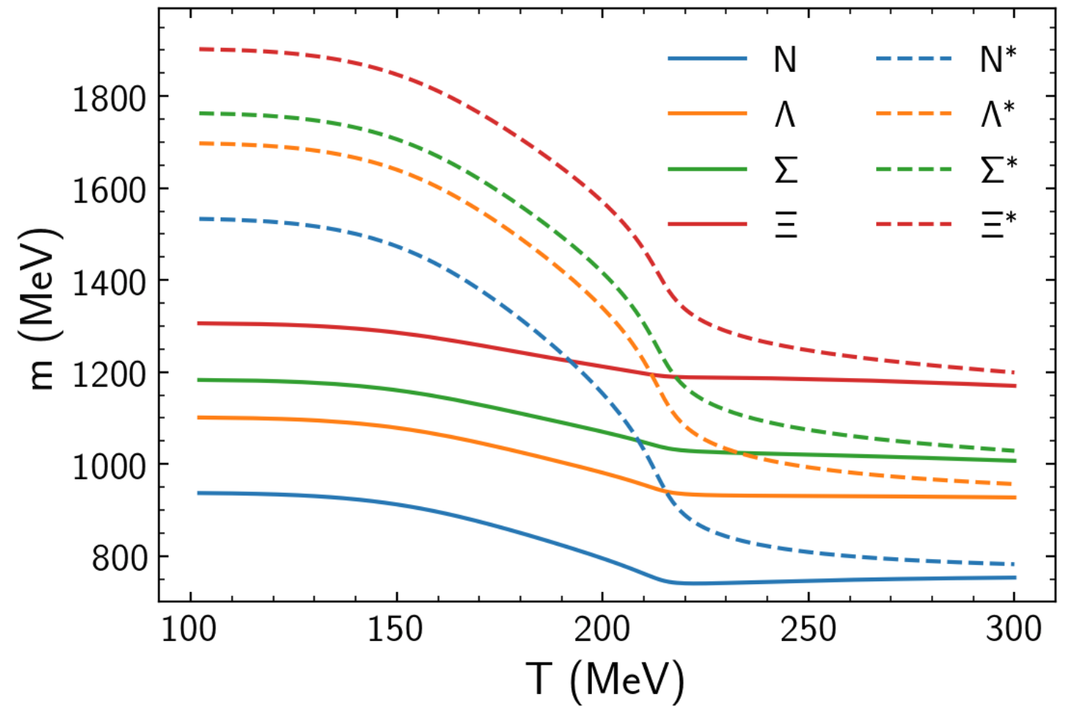
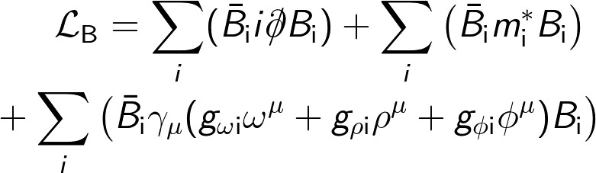
SU(3)_{f} octet and parity doubling
We include all states of the SU(3)_{f} baryon octet:
together with their parity partners (G. Aarts et al., 1710.08294), i.e. states with the same quantum numbers but opposite parity. Those interact within SU(3)_{f} σ model:
with effective masses generated by chiral fields σ and 𝜻:
‘+’ stands for positive and ‘−’ for negative parity states
9

Slide 32
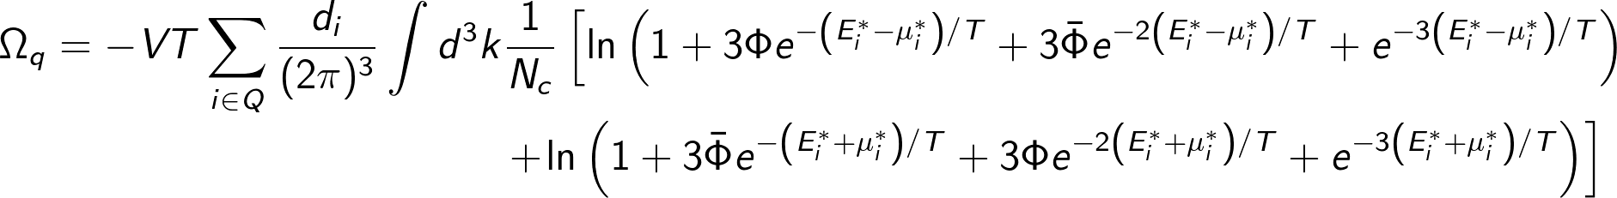
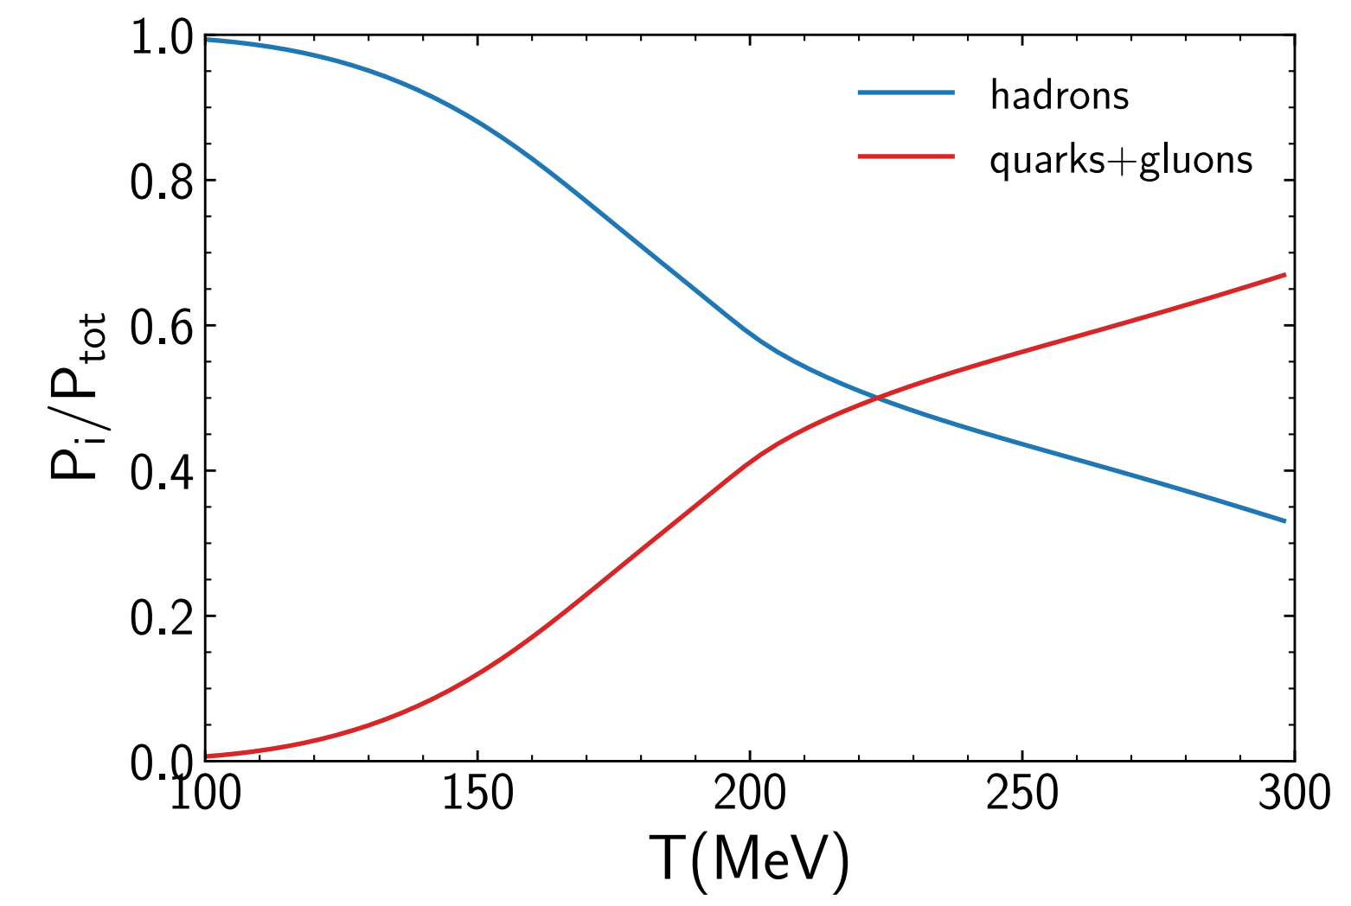
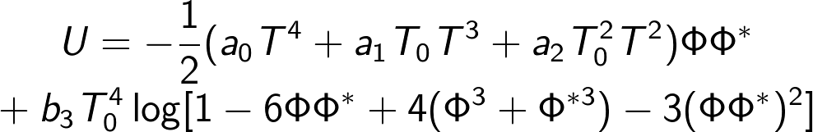
Including Quarks: PNJL-like approach
Quarks are included within PNJL inspired approach:
Polyakov loop Φ — is deconfinement order parameter:
Φ=0 — no quarks, Φ=1 — free quarks.
Φ is controlled by the potential U(Φ):
Fukushima, hep-ph/0310121
Roessner, Ratti, Weise, hep-ph/0609281
14

Slide 33


The CMF phase diagram
Motohiro, Kim, Harada, Phys.Rev.C 92 (2015) 2, 025201
Quark
Matter
Parity doublet model with only hadron d.o.f
Quarks+hadrons,
Chiral condensate=0
Hadronic liquid
Dilute
hadrons
The phase transitions are only driven by hadrons. Deconfinement is always smooth.

Slide 34

Importance of HRG list
CMF Isentropic trajectories, lines of constant entropy per baryon S/A with:
the full particle list (solid);
only the stable baryons+quarks (dashed), mesons and resonances are neglected.
Note the increase of temperature for the isentropes where the mesons and resonances are neglected.

