Slide 1
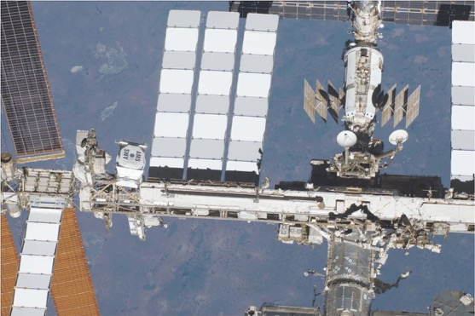
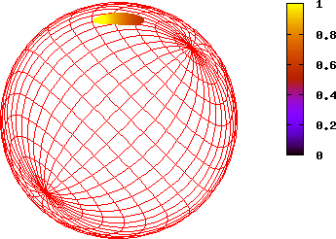
The Masses and Radii of Neutron Stars Observed by NICER
Sharon Morsink
Department of Physics, University of Alberta, Edmonton, Canada
NICER Light Curves Working Group:
Slavko Bogdanov (chair), Zaven Arzoumanian, Keith Gendreau, Anna Bilous, Deepto Chakrabarty, Devarshi Choudhury, Alexander Dittmann, Sebastien Guillot, Alice Harding, Wynn Ho, Fred Lamb, Jim Lattimer, Renee Ludlam, Simin Mahmoodifar, Cole Miller, Sharon Morsink, Chanda Prescod-Weinstein, Paul Ray, Ron Remillard, Thomas Riley, Tuomo Salmi, Tod Strohmayer, Serena Vinciguerra, Anna Watts, Michael Wolff, Kent Wood.
Strangeness in Quark Matter, Busan, Republic of Korea, June 15 (11pm MDT), 2022

Slide 2
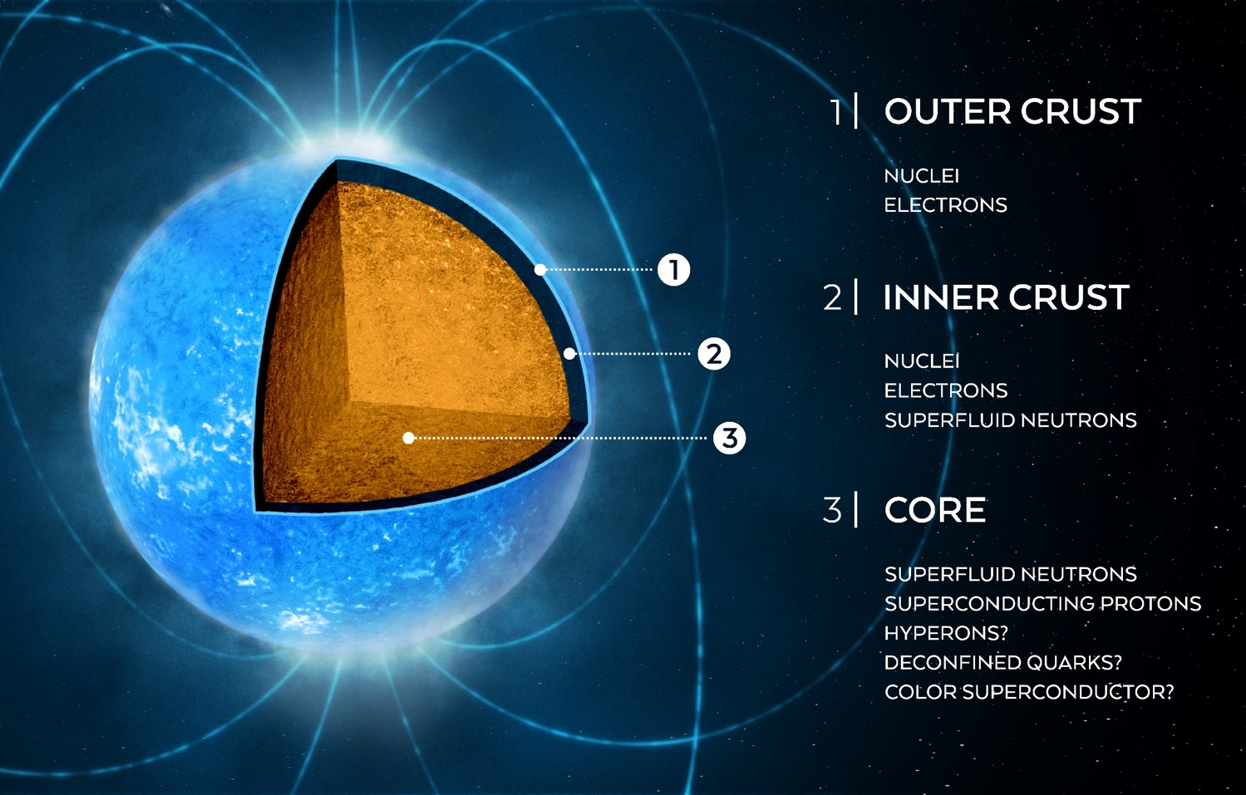
The neutron star interior
Figure: Watts et al. 2016
Notes:
Brief intro to states of matter in the neutron star interior.

Slide 3
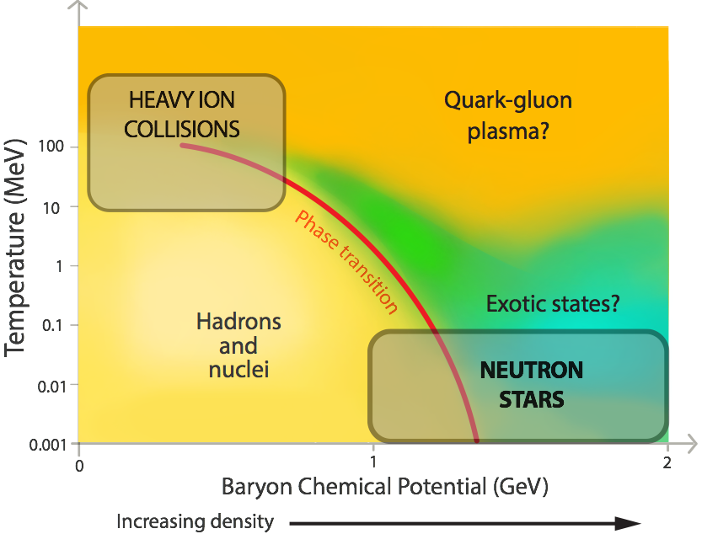
Possible Phase Diagram for Dense Matter
Concept: G. Baym
Figure: Watts et al. 2016
Notes:
Explain briefly now NS studies fit into the more general picture of testing the strong force, link to the follow-on talks by Andrew Steiner (GW, cooling) and Sherry Yennello (lab experiments).

Slide 4
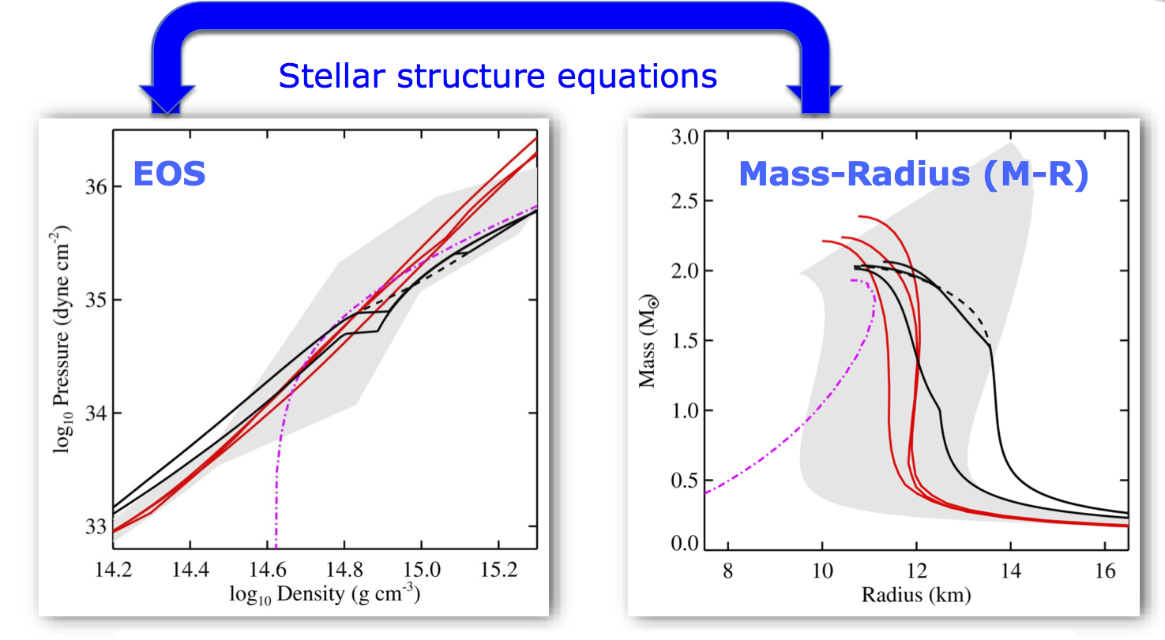
Equations of State vs Mass-Radius Curves

Slide 5
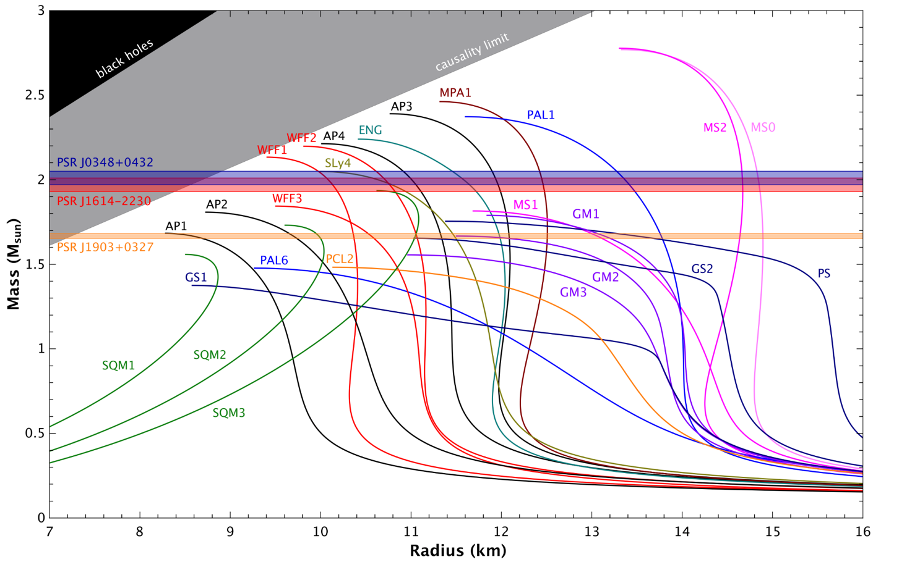
The neutron star mass-radius relation
PSR J0740+6620
PSR J0437-4715
Credit: N. Wex

Slide 6
How to measure Radius with X-rays?
View X-rays emitted by the surface
Types of Methods:
  Non-pulsed emission from whole surface = measure surface area; Quiescent LMXBs, X-ray Bursts (Chandra, XMM, Athena)
  Pulsed emission – look for effects of gravitational field (ie mass and radius) on time variations of flux; millisecond period X-ray pulsars

Slide 7
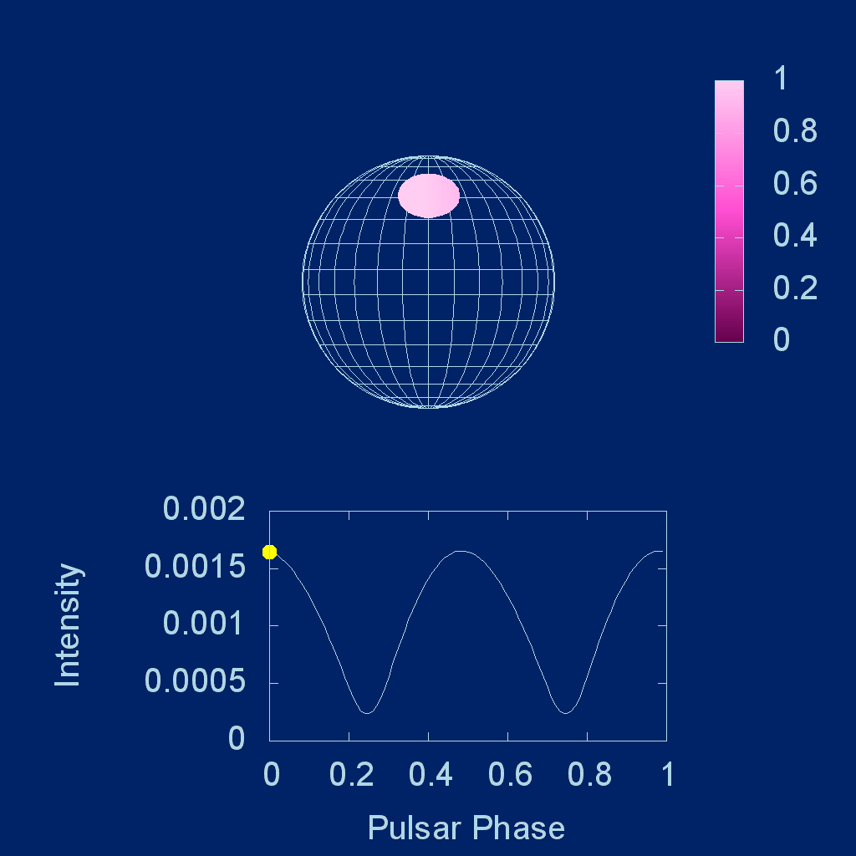
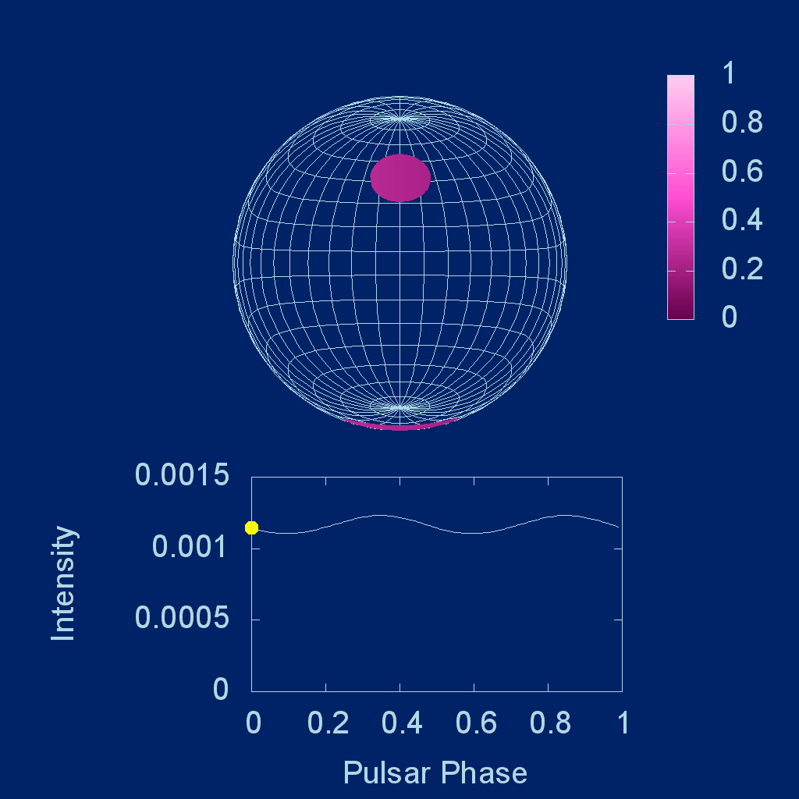
Dependence of Pulse Profiles on M/R
M/R = “compactness” affects light-bending
Larger M/R → less modulation
Newtonian Gravity
General Relativity M/R = 0.25
Notes:
v/c = 0.1 (equator) spot centres at pi/4; bolometric flux; same temperature in frame of star; gravitational redshift.

Slide 8
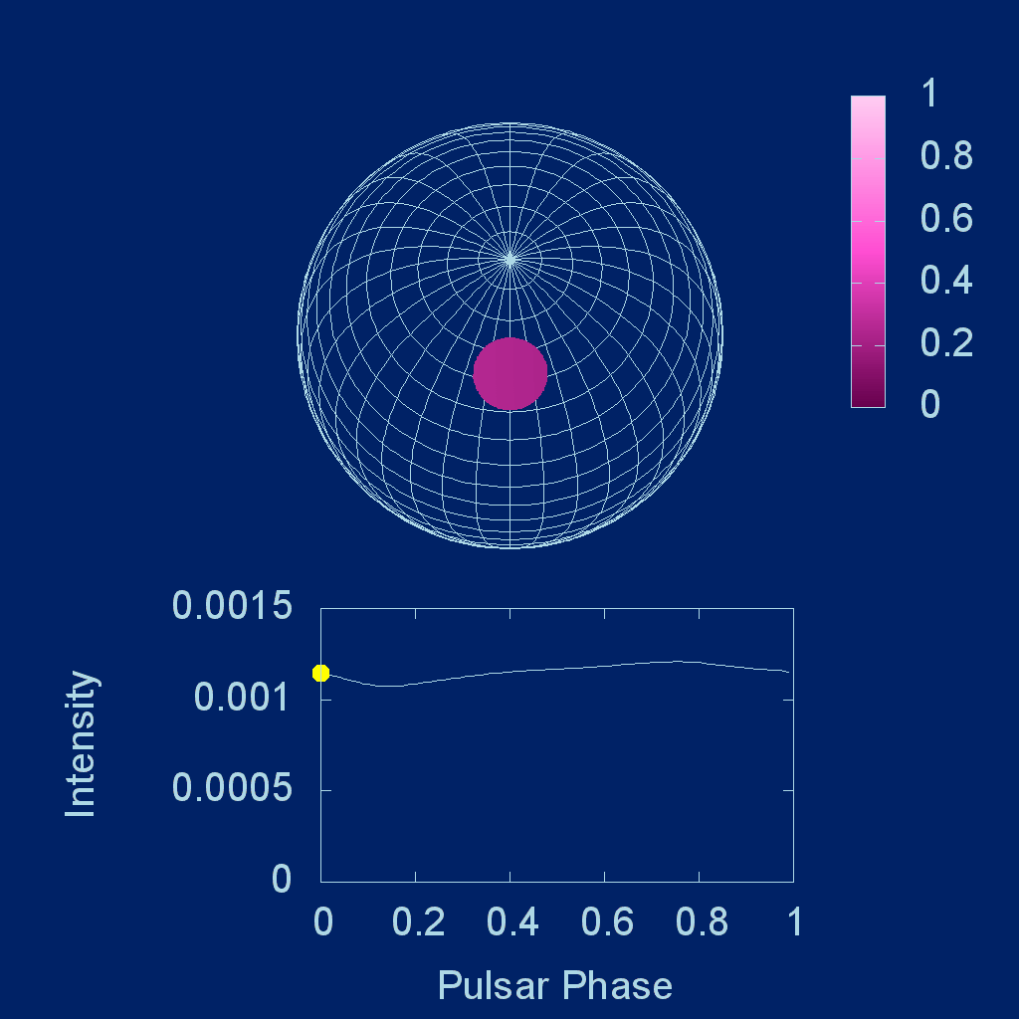
Effect of Observer’s Viewing Angle
30 deg from Spin Axis
90 deg from Spin Axis
Notes:
M/R = 0.15; v/c = 0.1

Slide 9


Effect of Rotational Speed ∝ R sini sinθ
v/c = 0.01 v/c = 0.2 (harmonics)
Notes:
M/R = 0; equatorial spots to show maximum doppler

Slide 10
Anisotropic Emission
Modulation: Normal beaming (A) gives higher pulsed fraction than anti-beaming (C )
timing asymmetries: peak emission occurs earlier for C than for A
Pulse shape: double-peaks or flattened peaks possible with C
Anisotropy depends on the photon wavelength.
We require phase resolved spectroscopy!
A = Beamed towards the normal
B = Isotropic emission
C = Beamed towards the surface

Slide 11
X-ray Timing Telescopes
RXTE – Rossi X-ray Timing Explorer (1995-2012) X-ray timing
XMM – great energy resolution, +timing mode
AstroSAT – Indian RXTE-like mission
NICER – great timing AND spectroscopy – designed for pulse profile observations!!!!
Future:
  eXTP, StrobeX = RXTE x 10 + spectra
  + polarization (eXTP)!!!

Slide 12
The Neutron Star Interior
Composition Explorer
PI: Keith Gendreau Science Lead: Zaven Arzoumanian

Slide 13

Installed on the ISS in June 2017

Slide 14
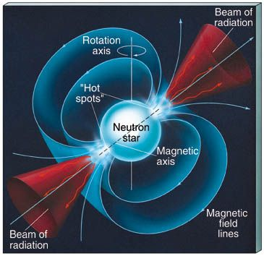
NICER 's Key Science Objective
Constrain the equation of state of bulk nuclear matter through precise mass and radius measurements of several neutron stars.
Targeting (mainly) thermal emission from rotation-powered MSPs and using the pulse profile modeling technique
Ė ≈ 10^{33–34} erg/s, L_{X} ≈ 10^{30–31} erg/s
Soft, thermal X-ray emission from hot spots
Non-magnetic (0 G, effectively B < 10¹⁰ G)
hydrogen or helium atmosphere
Non-transient (always “on”) and non-variable

Slide 15
NICER Target List for M-R Constraints
 | Spin Period (ms) | Distance (pc) | Mass * (M☉) | NICER Rate (photons/ks)
PSR J0437−4715 | 5.76 | 156.79±0.25 | 1.44±0.07 | 1319
PSR J0030+0451 | 4.87 | 325±9 | isolated | 314
PSR J1231−1411 | 3.68 | 440 | ? | 210
PSR J2124−3358 | 4.93 | 410₋₇₀⁺⁹⁰ | isolated | 100
PSR J0614−3329 | 3.10 | ~ 550 | ? | 27
PSR J1614−2230 | 3.15 | 670₋₄₀⁺⁵⁰ | 1.928±0.016 | 18
PSR J0740+6620 | 2.89 | 1140₋₁₅₀⁺¹⁷⁰ | 2.08±0.07 | 15
* Masses from radio timing for pulsars in a binary.
Notes:
Energy resolution is comparable to (very slightly worse than) CCDs on Chandra and XMM.
Timing resolution comparison is based on absolute XMM capability, including clock drifts on orbital & longer timescales.
Sensitivity comparison with XMM is based on “typical” PN background, including low-level flaring that is almost inevitable.

Slide 16
NICER Target List for M-R Constraints
 | Spin Period (ms) | Distance (pc) | Mass * (M☉) | NICER Rate (photons/ks)
PSR J0437−4715 | 5.76 | 156.79±0.25 | 1.44±0.07 | 1319
PSR J0030+0451 | 4.87 | 325±9 | isolated | 314
PSR J1231−1411 | 3.68 | 440 | ? | 210
PSR J2124−3358 | 4.93 | 410₋₇₀⁺⁹⁰ | isolated | 100
PSR J0614−3329 | 3.10 | ~ 550 | ? | 27
PSR J1614−2230 | 3.15 | 670₋₄₀⁺⁵⁰ | 1.928±0.016 | 18
PSR J0740+6620 | 2.89 | 1140₋₁₅₀⁺¹⁷⁰ | 2.08±0.07 | 15
Expect results later in 2022! Best statistics on this one!
ApJL 2019, inferred mass near 1.4 M_{sun}, 1.9 Msec exposure in 2019
Fermi LAT gamma ray pulsar, X-ray pulsations 1st detected by NICER!
ApJL 2021, high mass, denser interior important for supra-nuclear physics!
* Masses from radio timing for pulsars in a binary.
Notes:
Energy resolution is comparable to (very slightly worse than) CCDs on Chandra and XMM.
Timing resolution comparison is based on absolute XMM capability, including clock drifts on orbital & longer timescales.
Sensitivity comparison with XMM is based on “typical” PN background, including low-level flaring that is almost inevitable.

Slide 17
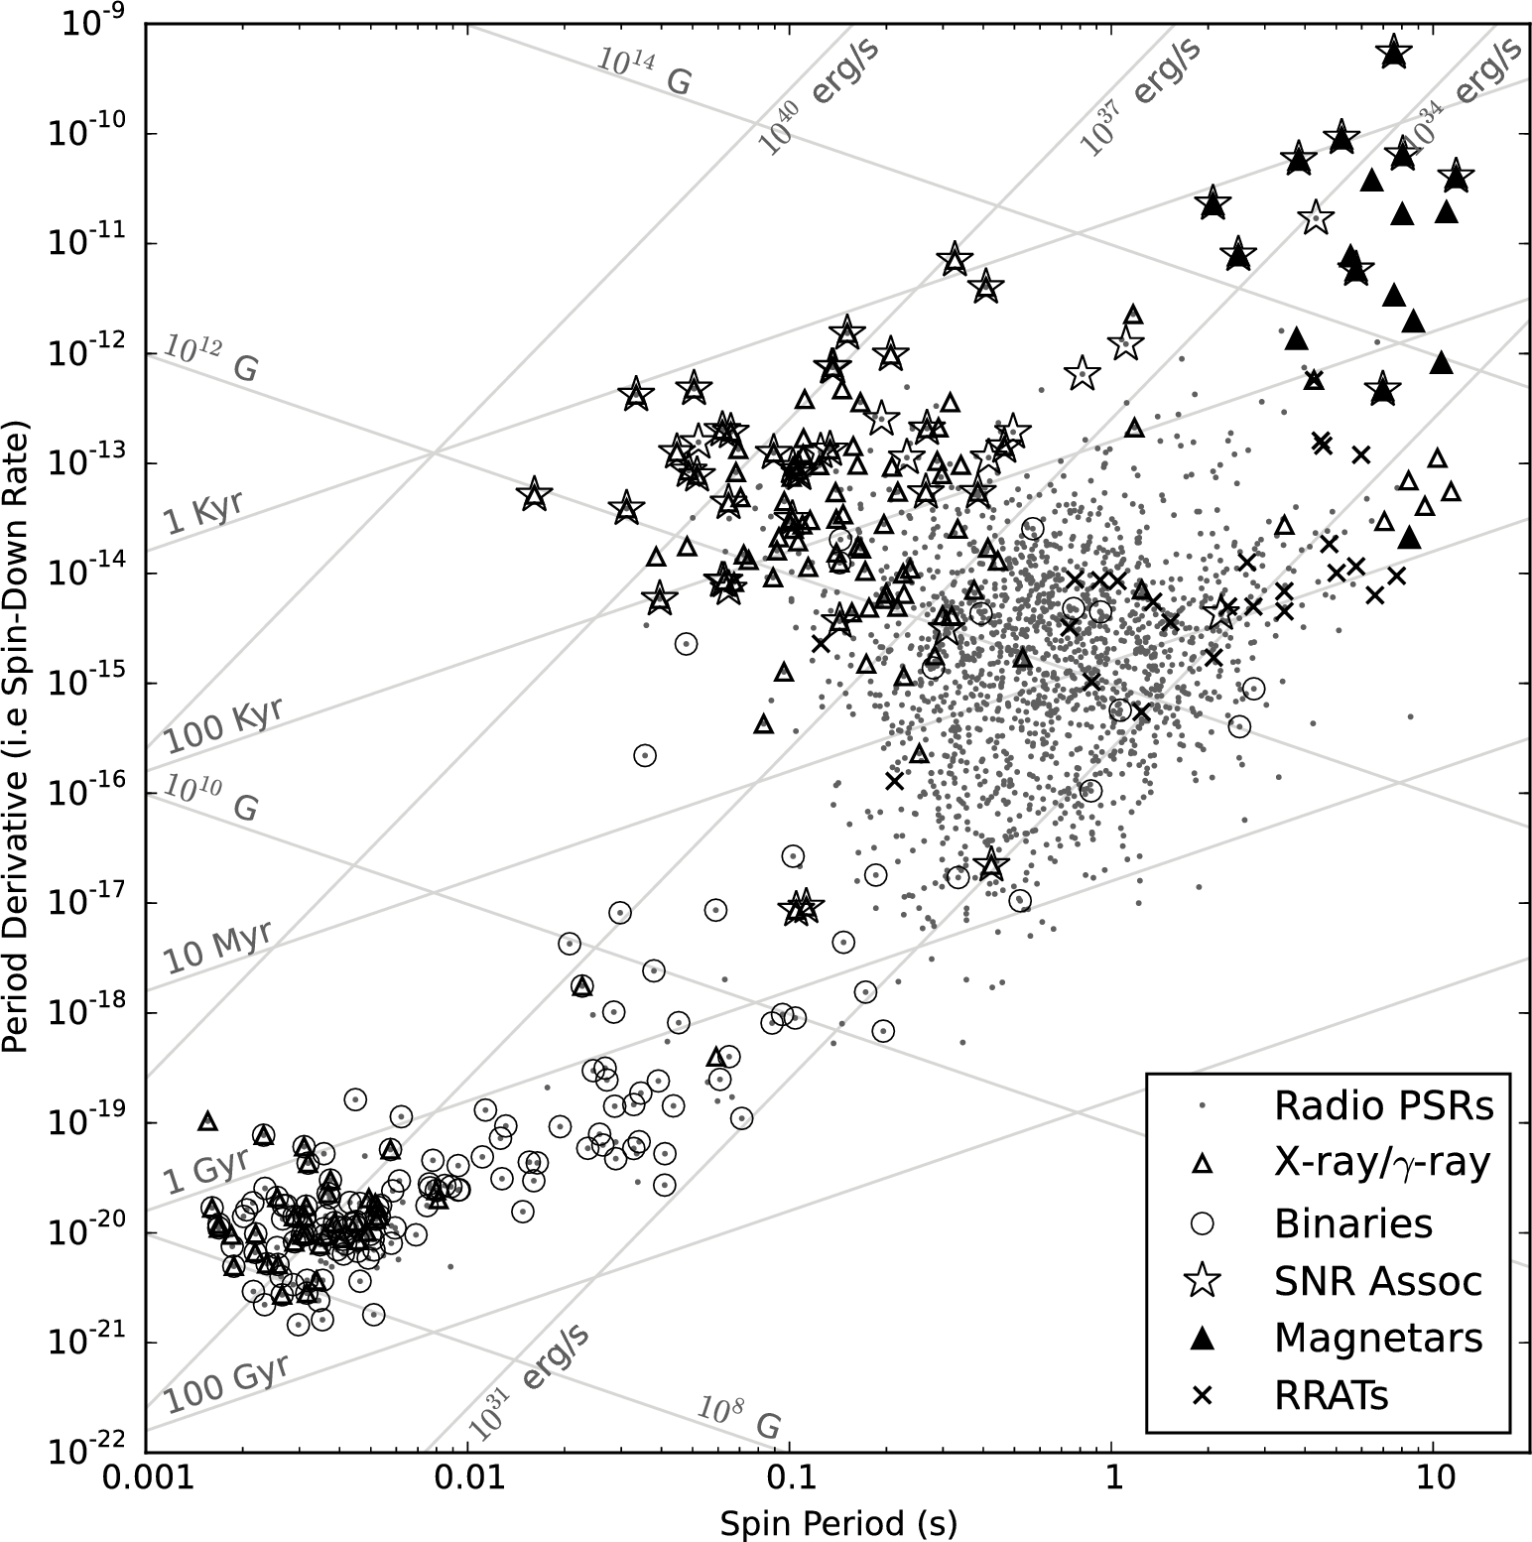
Pulsar P-Pdot Diagram
Rapid Change in Spin
From Essential Pulsar Astronomy by Scott Ransom
NICER Targets
Stable spin
Fast spin
Slow spin

Slide 18
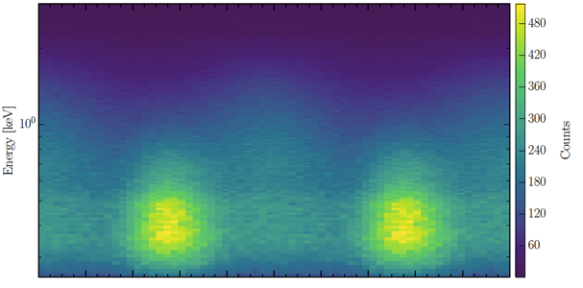
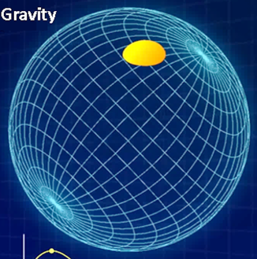

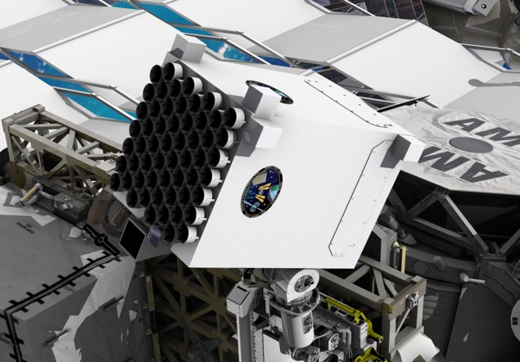
The Pulse Profile Modelling process
Pulse profile data: Phase, Energy
Lightcurve model:
Emission, Relativistic ray-tracing
Energy (keV)
Counts
Phase (cycles)
Instrument properties
Inference code: Likelihood calculation,
statistical sampling
Mass-radius
EOS (nuclear physics)
Notes:
Overview of essential elements of our analysis process.
Data - phase bin -energy channels. Sources are highly stable, ephemeris used for fold.
Lightcurve Model: This generates a synthetic pulse profile for a given set of parameters including those setting the exterior space-time (M, R, spin rate), the surface emission pattern (temperature distribution, beaming function or atmosphere model), observer inclination, distance, interstellar hydrogen column density, and background.
The Instrument Response Function: This determines how a specific detector would process the model incident signal. The Redistribution Matrix File (RMF) and Auxiliary Response File (ARF) will map, for example, from energy space into detector channels, and take into account the overall efficiency of the detector.
An Inference Code: Bayesian inference codes couple likelihood evaluations (evaluating the probability of obtaining the data from the model for a given set of parameters) and a set of priors for those parameters with a sampler that explores the parameter space to determine the posterior probability distributions of the various model parameters.
End product - either M, R or EOS model parameters. Focus for now on M, R.

Slide 19
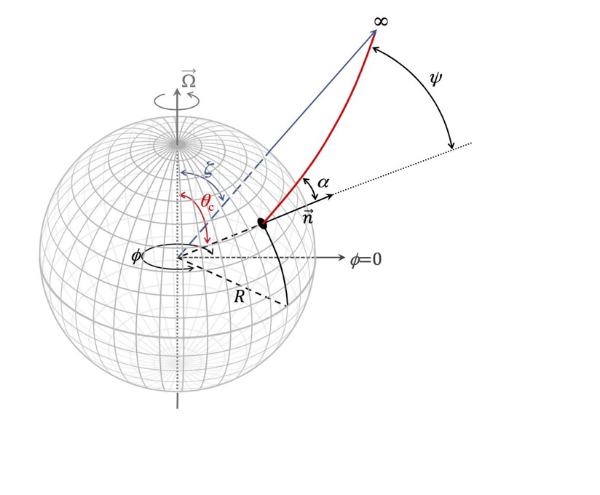
Model Geometry and Relativistic Effects
Rotating star with oblate shape
Two or more X-ray emitting "hot-spots"
Relativistic effects:
Light bending in a Schwarzschild geometry
Gravitational redshift
Doppler shifts
Relativistic aberration
Propagation time differences
Spot co-latitudes θ_{c1} , θ_{c2}, …
Relative phase of the spots
Spot angular radii ρ_{1,2}
Observer inclination ζ
Relation between ψ and α depends on M/R
(Miller & Lamb 1998; Beloborodov 2002; Poutanen & Gierlinski 2003; Poutanen & Beloborodov 2006; Morsink et al. 2007; Lo et al. 2013; Miller & Lamb 2015; Bogdanov; Ozel & Psaltis et al. ; Strohmayer & Mahmoodifar; Watts et al. , … )
Notes:
Energy resolution is comparable to (very slightly worse than) CCDs on Chandra and XMM.
Timing resolution comparison is based on absolute XMM capability, including clock drifts on orbital & longer timescales.
Sensitivity comparison with XMM is based on “typical” PN background, including low-level flaring that is almost inevitable.

Slide 20
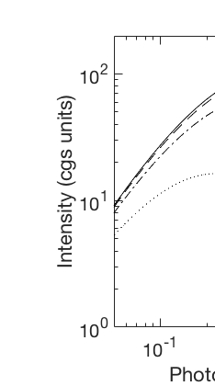
Hot Spot Model Atmospheres
Magnetic polar caps of MSPs are heated by energetic return current from magnetosphere
log(g) = 14.2
Surface likely covered by light element atmosphere (see Zavlin, Pavlov, & Shibanov 1996)
The NICER team employs NSX non-magnetic atmosphere models, H and He, for pulse profile fitting (Ho & Lai 2001; Ho & Heinke 2009)
Variation of surface gravity due to rotation (AlGendy & Morsink 2014)
Hydrogen
Emission normal to surface
Emission tangent to surface
Notes:
One figure of NSX-H (with Wynn Ho’s permission and credit) showing for one value of T, log(g), and 4 or 5 emission angles.
Comments about gravitational settling - lightest element on top
Hydrogen atmosphere most likely
McPhac, NSX-H with either full or partial ionization, and NSX-He

Slide 21
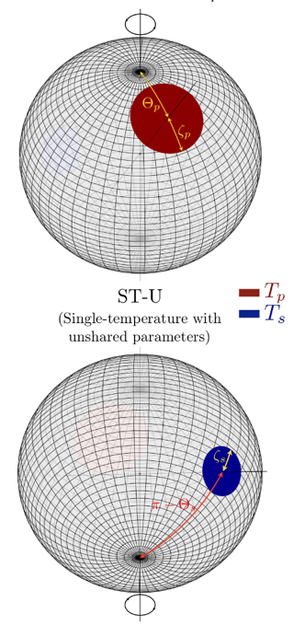
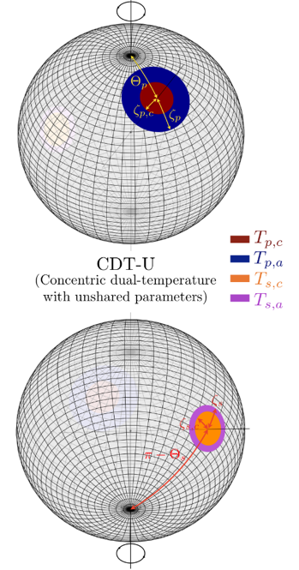
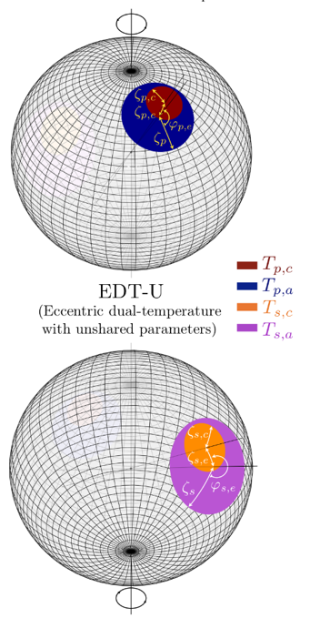
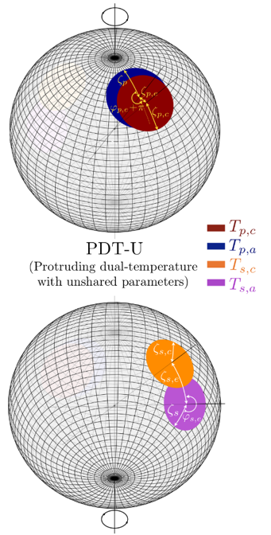
Amsterdam Spot Shapes
Two-cap models of increasing surface pattern complexity.
Northern rotational hemisphere
Southern rotational hemisphere
Courtesy of Tom Riley & Anna Watts
Notes:
AMS are focusing on family of dual polar cap models, different patterns for each cap. Also looking at parametrizing instrument response uncertainty.
Figure shows the different surface patterns we are exploring: ST, CDT, EDT, PDT.

Slide 22
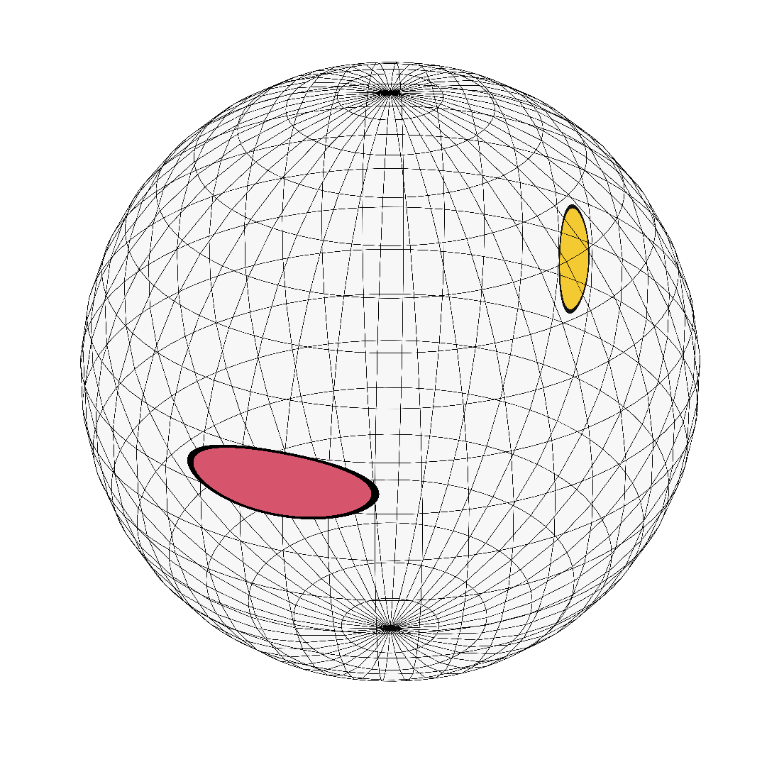
Illinois-Maryland Spot Shapes
Two or more hot spots, allowing for elongated spots with arbitrary overlap
Courtesy of Alex Dittmann, Fred Lamb, & Cole Miller
Notes:
AMS are focusing on family of dual polar cap models, different patterns for each cap. Also looking at parametrizing instrument response uncertainty.
Figure shows the different surface patterns we are exploring: ST, CDT, EDT, PDT.

Slide 23
NICER Data Analysis Parameters
Up to 4 spots at arbitrary locations, sizes, & temperatures; mimic complex shapes
Hydrogen atmosphere (with He possible)
Mass, radius, observer inclination, distance with reasonably large range of priors
Effects due to rotation introduced using oblate approximation
ISM extinction
Filtering/Background/Instrument Response
Bayesian parameter estimation using multiple codes (based on MCMC and/or nested sampling)

Slide 24
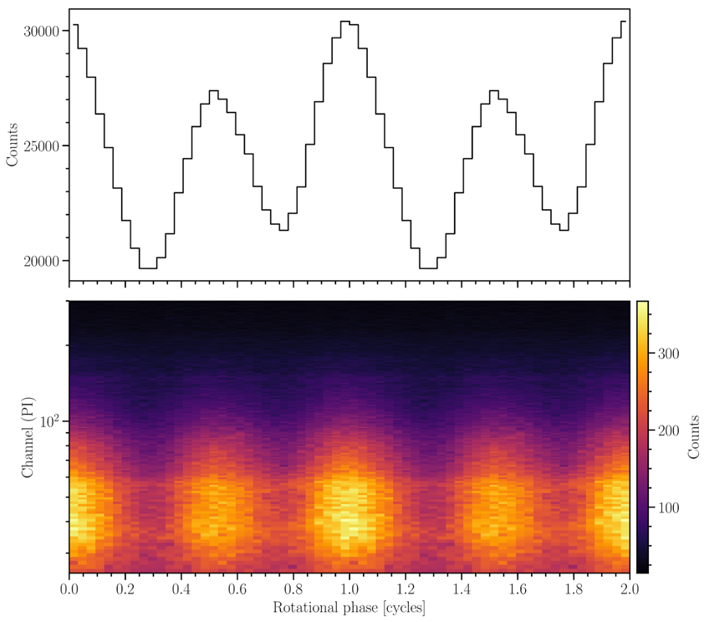
J0030 Lightcurve (2019 dataset)
3.0 keV
0.3 keV
Bogdanov+, ApJL 2019

Slide 25
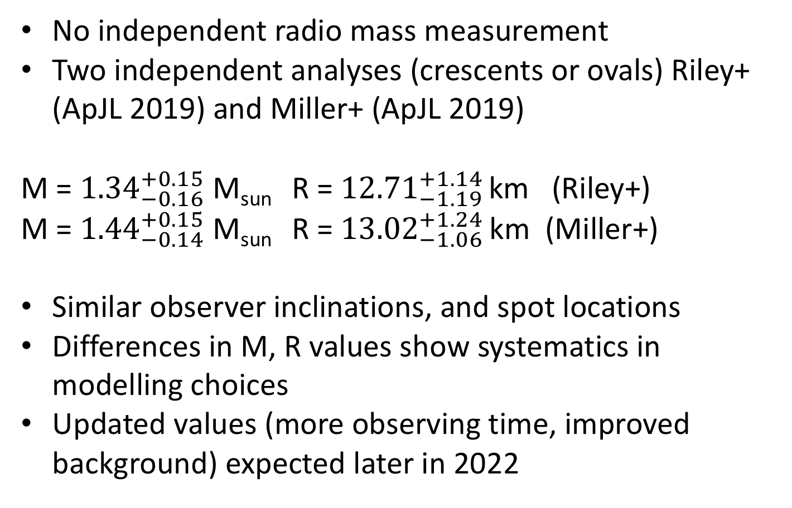
First Results on J0030
No independent radio mass measurement
Two independent analyses (crescents or ovals) Riley+ (ApJL 2019) and Miller+ (ApJL 2019)
M = ${1.34}_{−0.16}^{+0.15}$ M_{sun} R = ${12.71}_{−1.19 }^{+1.14}$km (Riley+)
M = ${1.44}_{−0.14}^{+0.15}$ M_{sun} R = ${13.02}_{−1.06 }^{+1.24}$km (Miller+)
Similar observer inclinations, and spot locations
Differences in M, R values show systematics in modelling choices
Updated values (more observing time, improved background) expected later in 2022

Slide 26
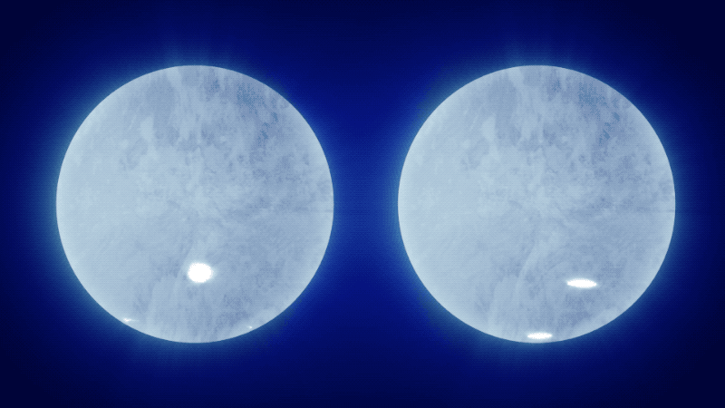
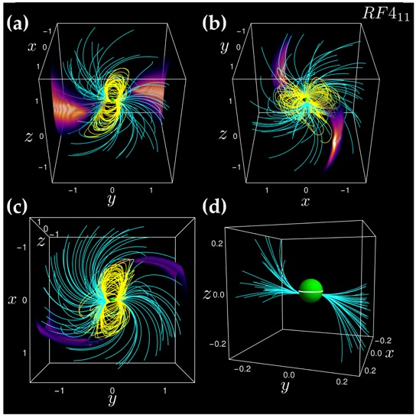
Inferred Spot Geometries
observer
Riley+2019 Miller+2019
Non-dipole magnetic field
Example: Offset dipole + quadrupole
Kalapotharakos, Wadiasingh, Harding, & Kazanas ApJ (2021)
Kalapotharakos + 2021

Slide 27
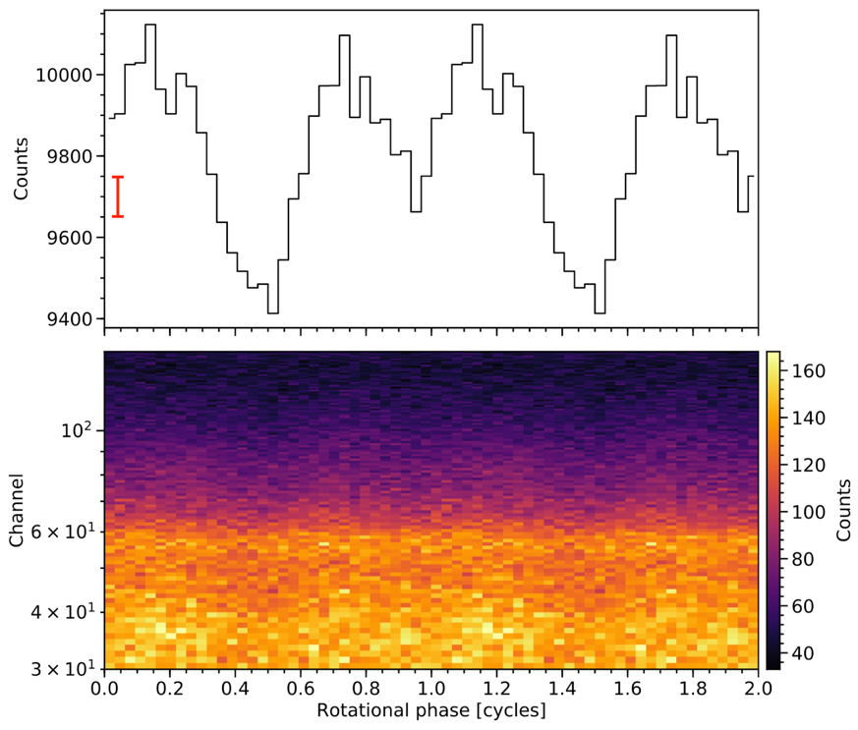
PSR J0740 Lightcurve
X-ray pulsations detected at 15 𝞼 significance!
2.0 keV
0.3 keV
Wolff+ ApJL 2021

Slide 28
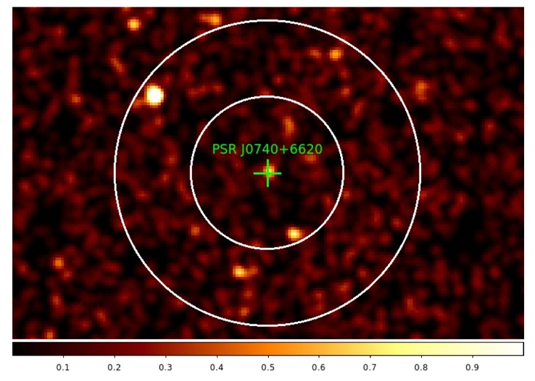
XMM Image of Region Near PSR J0740
NICER is a “one-pixel” telescope
No information about location of unpulsed emission
J0740 is very faint
Bright (harder) Active Galactic Nucleus and diffuse background
AGN
Wolff+ ApJL 2021

Slide 29
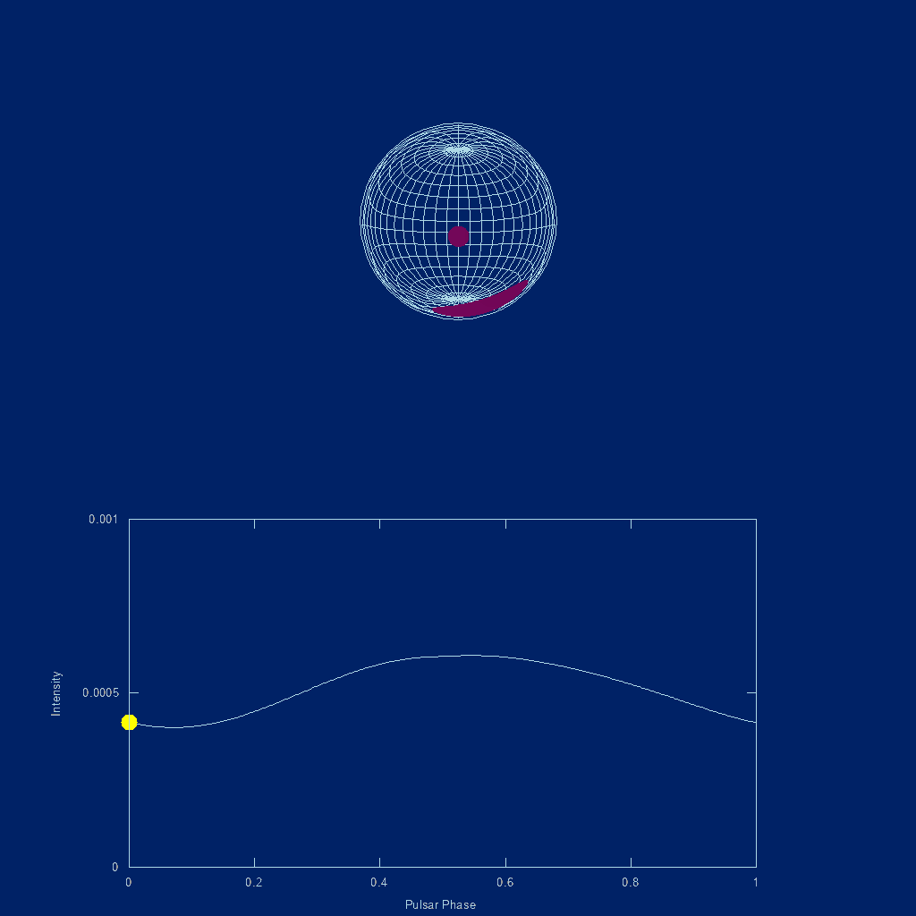
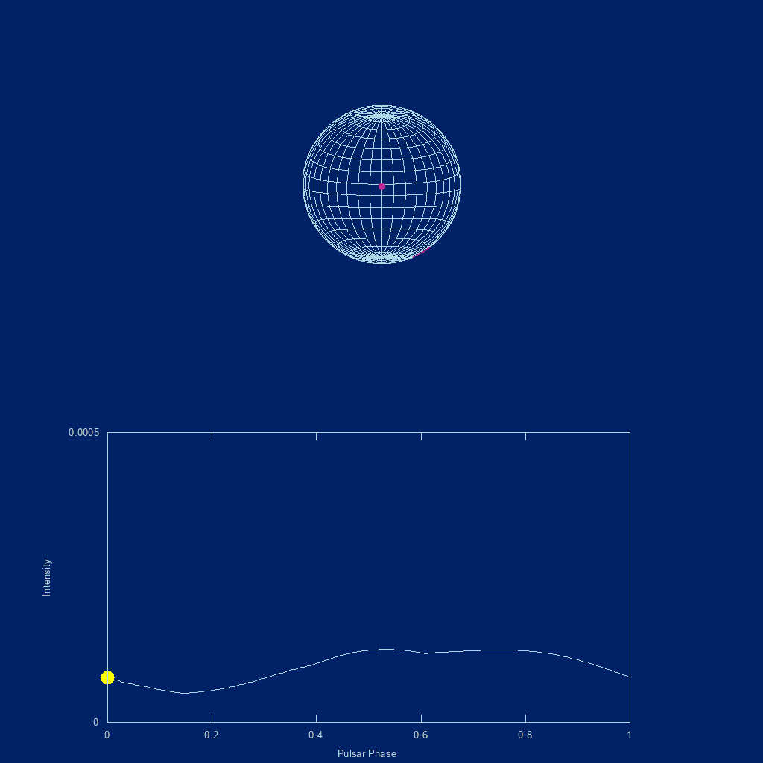
Effect of Adding Information about XMM Background
NICER ONLY
NICER + XMM
Some of unpulsed signal comes from the spot pattern
Inferred unpulsed background is small
Smaller radius, larger spots
Less unpulsed signal comes from the spot pattern
Inferred unpulsed background is larger
Larger radius, smaller spots
Adding XMM background information INCREASES inferred radius.

Slide 30
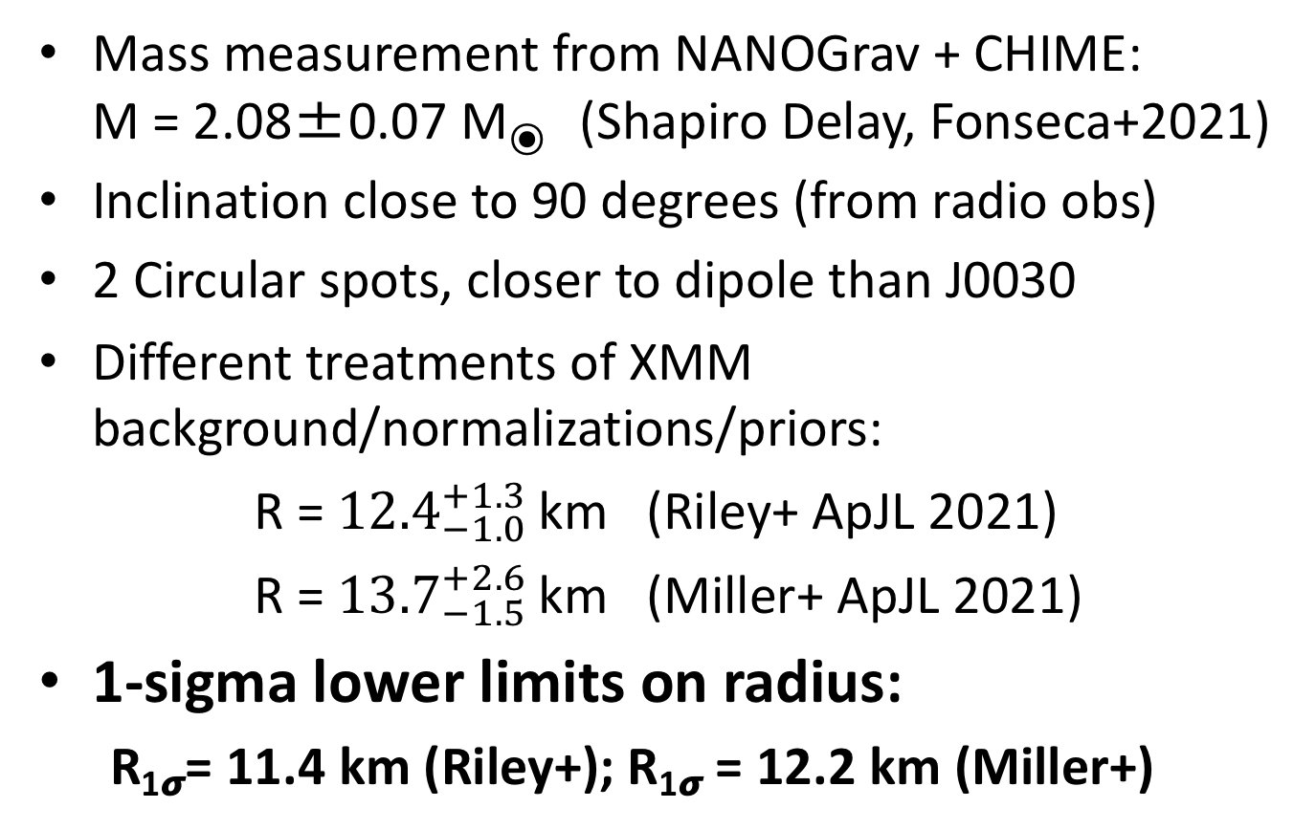
First Results on J0740
Mass measurement from NANOGrav + CHIME: M = 2.08±0.07 M⦿ (Shapiro Delay, Fonseca+2021)
Inclination close to 90 degrees (from radio obs)
2 Circular spots, closer to dipole than J0030
Different treatments of XMM background/normalizations/priors:
R = ${12.4}_{−1.0 }^{+1.3}$km (Riley+ ApJL 2021)
R = ${13.7}_{−1.5 }^{+2.6}$km (Miller+ ApJL 2021)
1-sigma lower limits on radius:
  R_{1𝞼}= 11.4 km (Riley+); R_{1𝞼} = 12.2 km (Miller+)

Slide 31
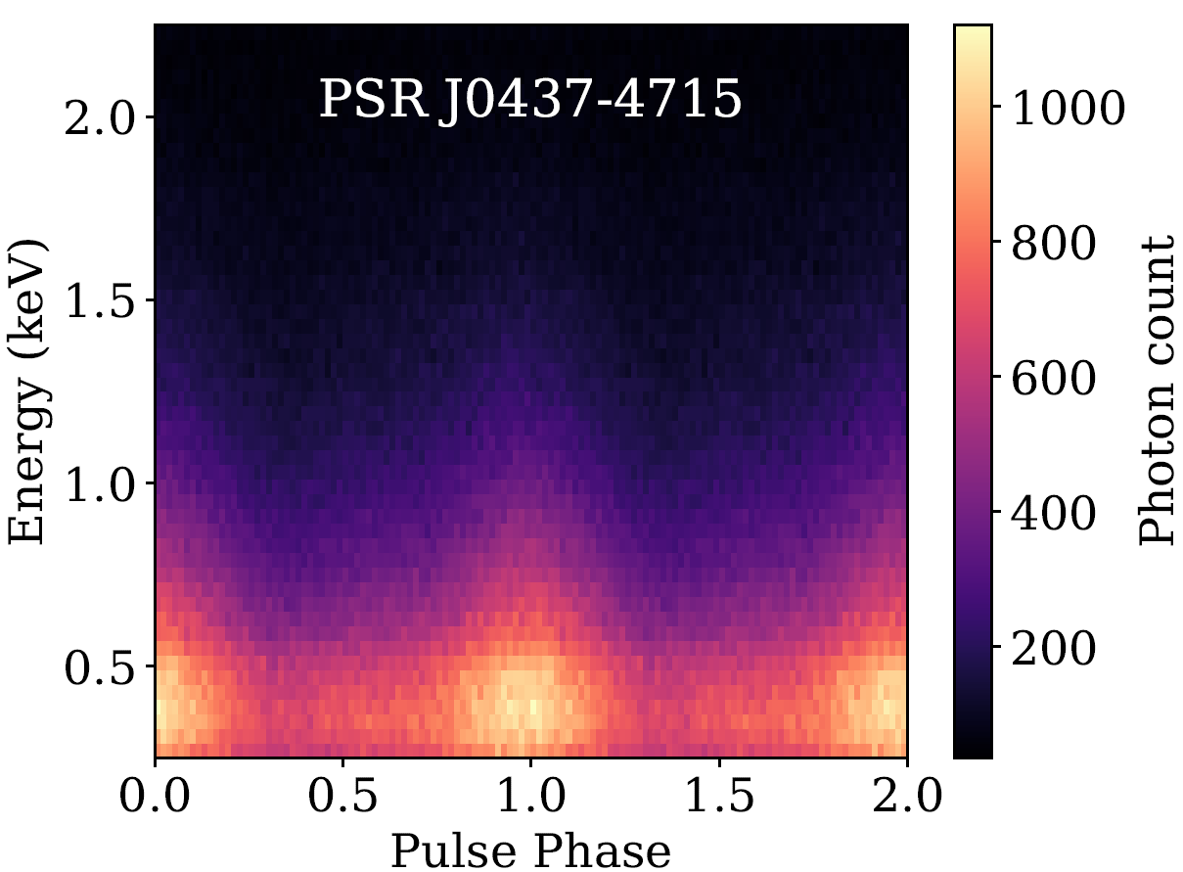
Next: J0437
We expect best radius measurement
Precisely known value of mass and observer’s viewing angle from radio observations
Complication of contamination from background AGN in same field of view
Results from J0437 and other pulsars in 2022

Slide 32
NICER Results on Core Science
First precise measurement of mass through pulse-profile modelling (J0030)
Radius inferred for 2 pulsars (J0030, J0740) with masses that differ by 0.5 M_{sun}
Later this year
  New results for J0437 (with precise radio prior for mass, inclination, distance)
  Updated mass & radius results for J0030 & J0740 with improved precision
THE NICER LIGHTCURVE MODELING WORKING GROUP
Slavko Bogdanov (chair), Zaven Arzoumanian, Keith Gendreau, Anna Bilous, Deepto Chakrabarty, Devarshi Choudhury, Alexander Dittmann, Sebastien Guillot, Alice Harding, Wynn Ho, Fred Lamb, Jim Lattimer, Renee Ludlam, Simin Mahmoodifar, Cole Miller, Sharon Morsink, Chanda Prescod-Weinstein, Paul Ray, Ron Remillard, Thomas Riley, Tuomo Salmi, Tod Strohmayer, Serena Vinciguerra, Anna Watts, Michael Wolff, Kent Wood.
With thanks to Teru Enoto, Andrea Lommen, Matthew Kerr, Michi Bauböck, Feryal Özel, Craig Markwardt, Dimitrios Psaltis, Jack Steiner, & others

