Slide 1


Exotic Particles
Su Houng Lee
Why is it interesting to measure Exotics in Heavy Ion Collision
Will use X(3872) and Tcc (D⁰D⁰π⁺) as examples
Acknowledgements:
Yonsei group : W. Park, A. Park, J. Hong, S. Noh, H. Yoon, D. Park,
External: C. M. Ko, Sungtae Cho, Sanghoon Lim, Yongsun Kim
+ ExHIC collaboration

Slide 2
Some perspectives
Hadrons
Meson
Nucleus
Baryon
Neutron
q
q
q
q
π
q
Proton
-2003- X(3872) and +
-2015- Pc states
Exotic Hadrons
Tetraquark
Pentaquark
q
c
Compact configuration
q
c
q
c
q
q
c
or
Molecular configuration
q
c
q
c
q
c
q
q
c
Which structure? → short distance vs long distance interaction
2

Slide 3
I: Short distance:
Perspectives from a quark model

Slide 4
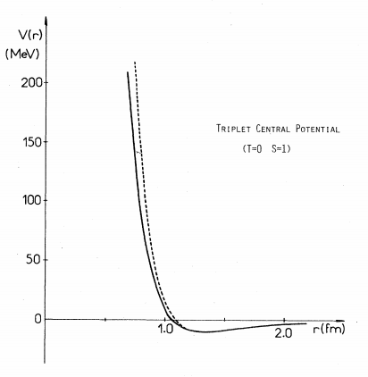
There are attractive channels
QCD HAL collaboration
Paris Potential
QCD HAL collaboration
4

Slide 5
Quark Model perspectives on Interaction at short distance – Kinetic term
☞ When brought together need to overcome Additional Kinetic energy
Β
Β
1
2
4
5
3
6
→ To have a compact configuration, short range attraction should be larger than 100 MeV
5

Slide 6
Quark Model perspectives on Interaction at short distance – color-color interaction
N-N interaction at short distance
☞ Color-Color interaction is not important for short range N-N interaction
1
2
1
2
4
5
6
3
4
3
6
5
6

Slide 7
Quark Model perspectives on Interaction at short distance – color-spin interaction
☞ Color-spin interaction for 2 body:
 | Q-Q |  |  |  | Q-Q
Color | A | S | A | S | 1 | 8 | 1 | 8
Flavor | A | A | S | S
Spin | A(0) | S(1) | S(1) | A(0) | 0 | 0 | 1 | 1
K | -8 | -4/3 | 8/3 | 4 | -16 | 2 | 16/3 | -2/3
☞
7

Slide 8
Quark Model perspectives on Interaction at short distance – Lattice comparison
☞ NN force in SU(2) spin 1 vs spin 0 channel: comparison to lattice
QCD HAL collaboration
→ comparison
☞ H dibaryon channel: Flavor 1 vs Flavor 27
8

Slide 9
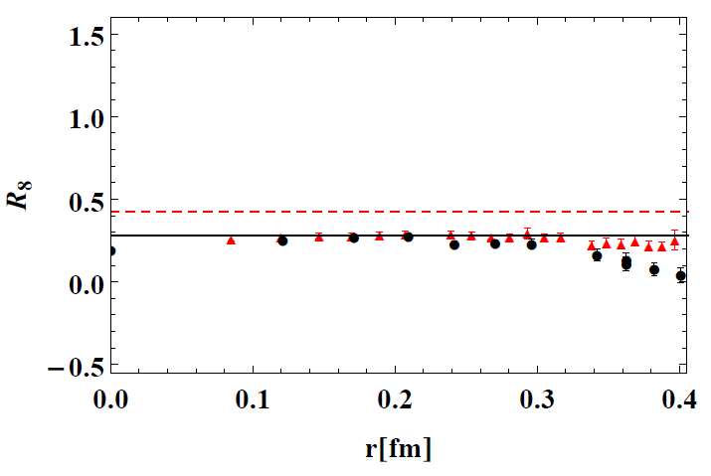
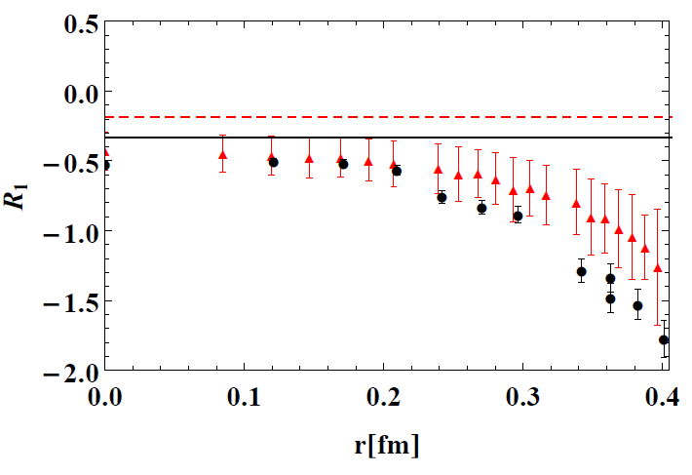
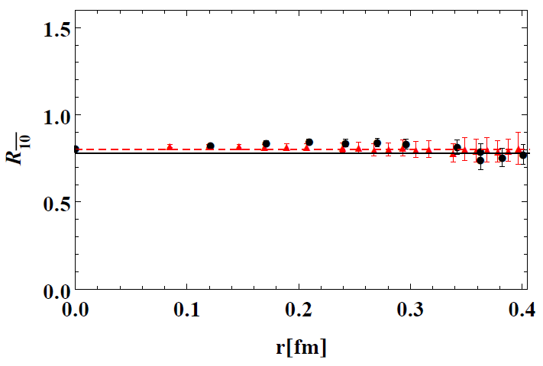
Full quark model calculation vs Lattice – A.Park, Lee, Inoue, Hatsuda, EPJA 56(20203,93
More test in SU(3)
☞ Comparison to Lattice calculation
9

Slide 10
K factor and attraction for X(3872) and Tcc : W. Park, Lee, NPA924(2014) 161
X(3872): Belle 2003
Assuming typical hadron size →
Too small to be compact
T_{cc}(3875): LHCb 2021
Lowest Eigenvalues
Note: addition Kinetic Energy -> +100 MeV
10

Slide 11
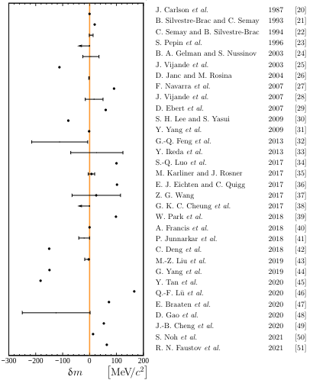
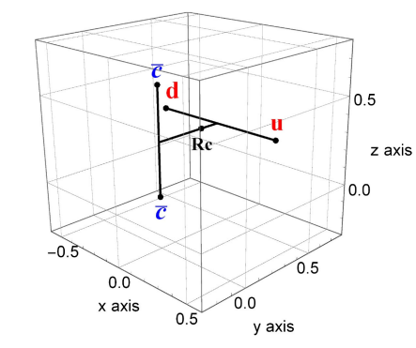
Full Quark Model calculation for Tcc: S.Noh, W.Park, Lee, PRD10(2021)114009
☞ Binding depends sensitively on parameters:
-2021- Tcc(3875) LHCb coll.
S. Noh et al. in preparation
Tcc is an attractive channel
and depending on
could be a compact 4-quark state
- X(3872) can not be compact !!
11

Slide 12
II: Long distance:
Perspectives from the p-exchange

Slide 13
p-exchange potential for Deuteron, X(38722) and Tcc: N.A. Tornqvist (94)
☞
☞
☞
13

Slide 14
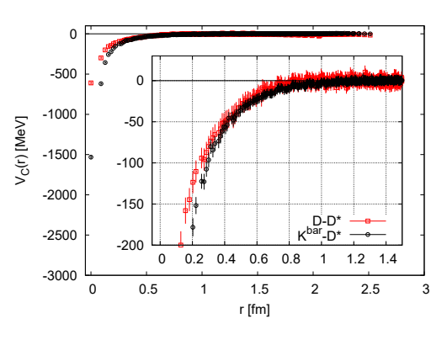
Attraction expected from quark Model: S.Noh, A.Park, D.Park Lee (in preparation)
T_{cc}(3875)
(S. No, W. Park, SHL, PRD10 (2021)114009 )
☞ Consistent to Lattice (HAL QCD): Phys. Lett. B 729 (2014) 85
14

Slide 15
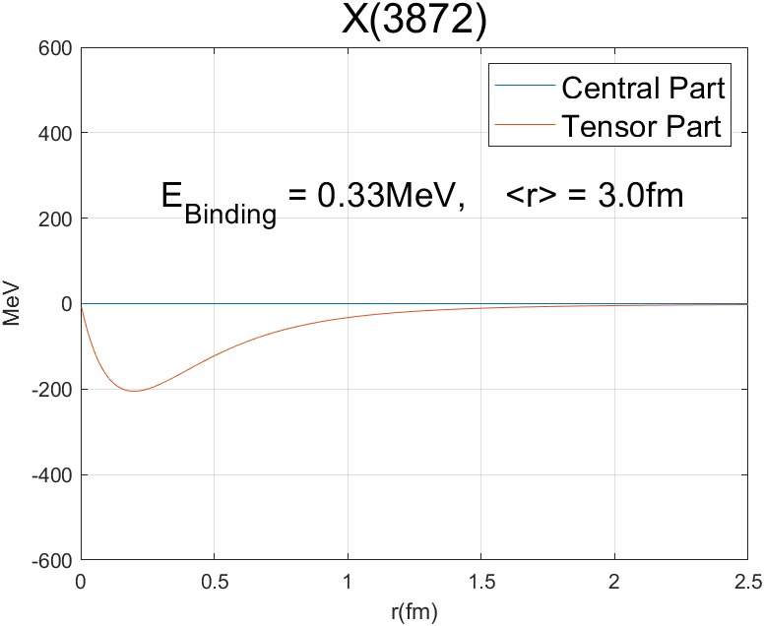
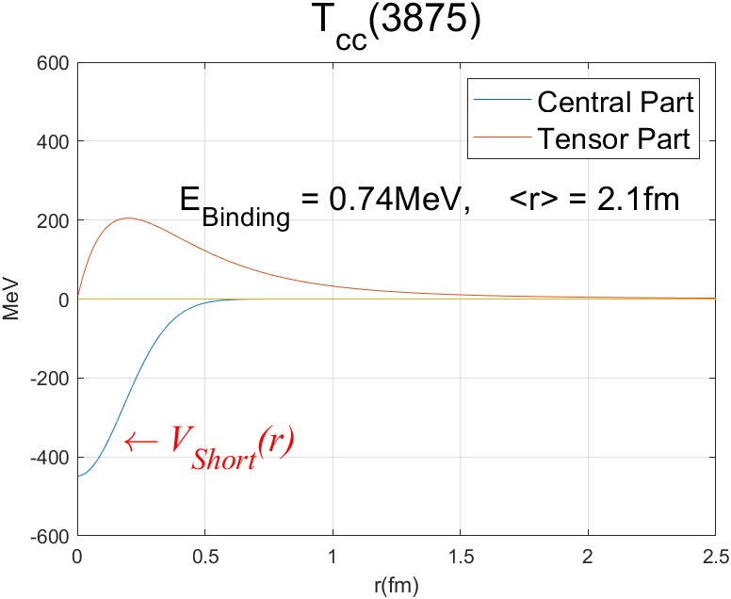
p-exchange potential with short range attraction: D. Park et al. (in preparation)
☞
15

Slide 16
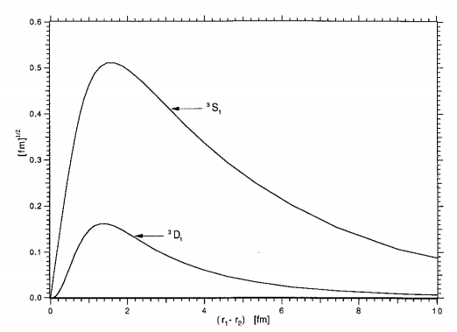
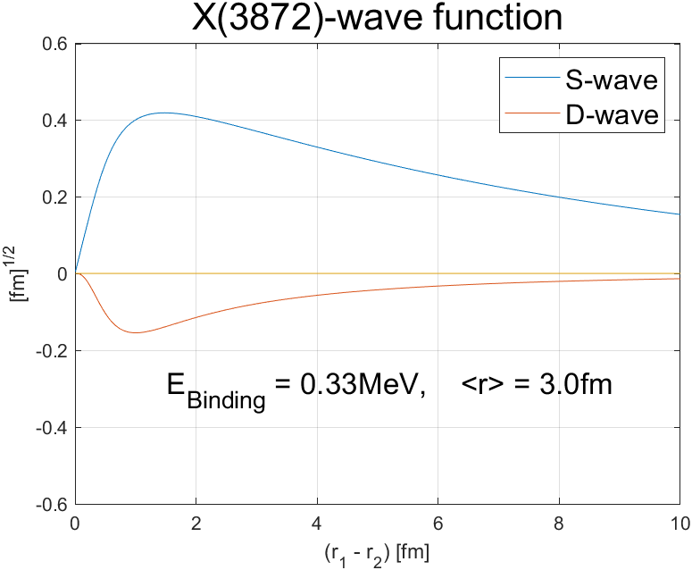
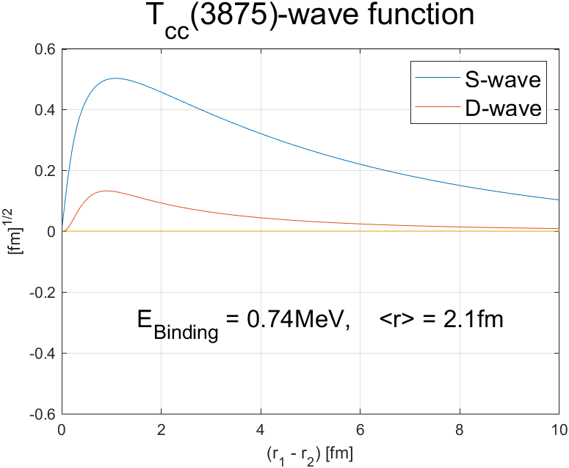
☞ Wave functions:
Similar to that of Deuteron

Slide 17
Why measure X(3872) and Tcc in Heavy Ion Collision
Expectation for structure of X(3872) and Tcc
 | quark content /meson content | V_{Short} (Lee et al. ) | V_{π} (Tornqvist 1994) | S/D mixing | Structure
X(3872) |  | small | Attractive | Attractive | Molecule
T_{cc}(3875) |  | Attractive | Repulsive | Attractive | Compact or Molecule
X should be a molecular configuration
But Tcc can either be compact multiquark or molecular configuration
→ Identifying the structure will be important
→ Can be done by measuring them in Heavy Ion collision

Slide 18
III: Measuring Exotics in Heavy Ion Collision:

Slide 19
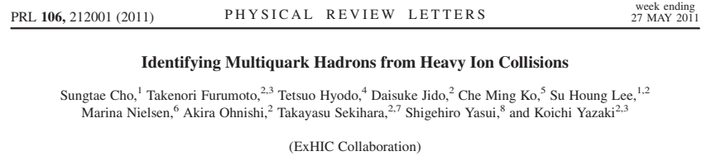
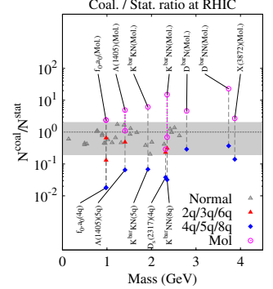
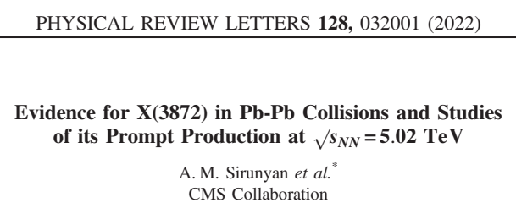
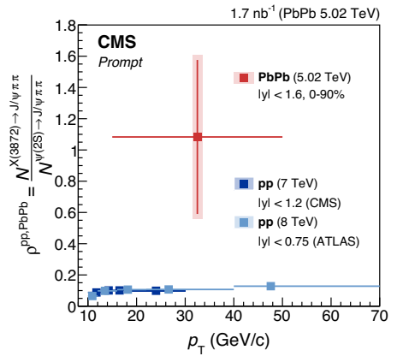
Original prediction from ExHIC collaboration (Theory)
Theory prediction
Experiment
19

Slide 20
Hadron Production in Heavy Ion Collision
Compact Multiquark formation via
quark coalescence + fit to normal hadron production
Hadronic Molecule formation via hadron coalescence + observed hadron distributions
T
T_{C}
T_{μ}
T_{F}
τ
QGP
Hadron phase
1 fm/c
5 fm/c
7 fm/c
17 fm/c

Slide 21
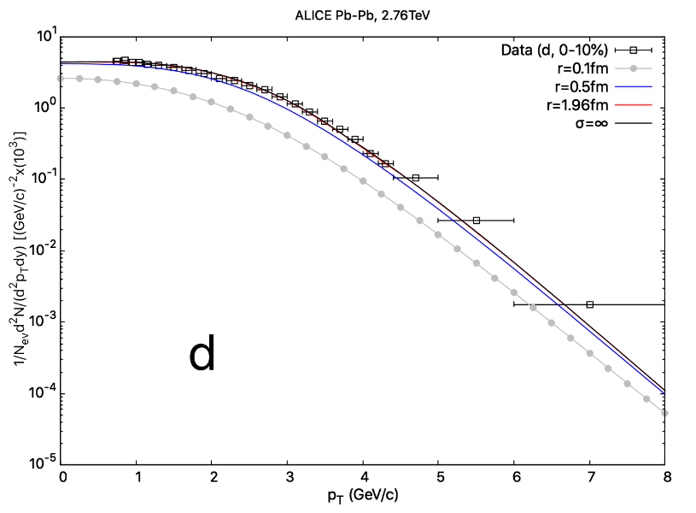
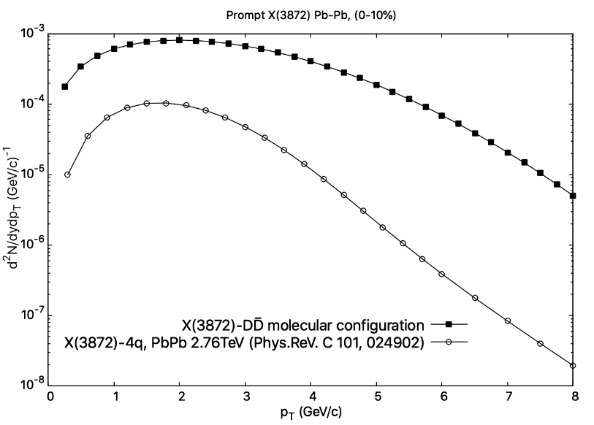
Predictions for Pt distribution: H Yoon Pararllel Talk Wed 12:10 Resonances and Hypernuclei
☞ Using coalescence model
Input:
Observed proton P_{T} distribution
Output:
Deuteron Pt distribution
X(3872)
Tcc if Molecular structure
Input:
Observed D D* P_{T} distribution
Tcc if Compact multiquark
S. Cho, Lee PRC101(2020)024902

Slide 22

Summary
☞ Heavy collision: When strong short attraction exists (K factor) compact multiquarks are formed at hadronization point
If no short attraction but strong pion attraction exist,
molecular configurations will form
at kinetic freeze-out point
Will have different production rates and Pt distribution
☞ Discriminating configuration will constraint short distance physics
→ Important step towards understanding confinement and dense matter

Slide 23
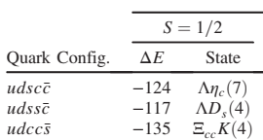
Additions - 1
Searched all compact pentaquark candidates: Park, Cho, Lee PRD99(2019)094023

Slide 24
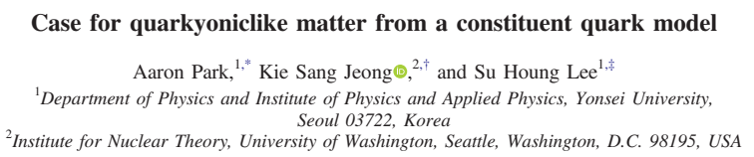
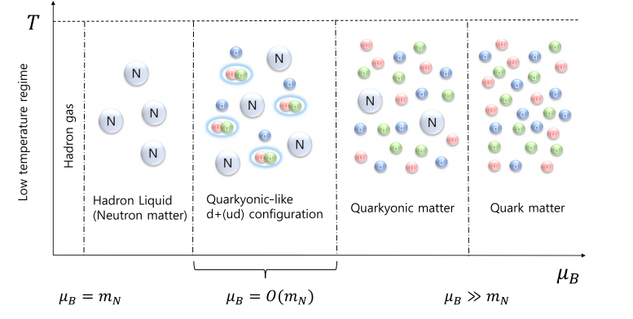
Additions - 2
2. Study production of Molecule, compact states, resonance states in heavy ion collision → study and model dynamics of multiquark configuration
→ All the way to confinement and deconfinement in QCD : Need input from multiquark configurations

Slide 25
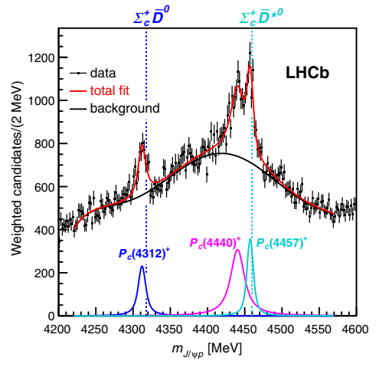
Additions - 3
3. Other Explicitly exotic state observed :
Exotic | X(3872) | Tcc(3875) | X(5568) | Pc(4312)
Quark
Threshold |  |  | Non near | →
4. Most compact multi-quark candidates have more than one heavy quarks
(hidden or open)
But now experiments can observe them
→ Heavy Ion collision could be an EXOTICA FACTROY !!

