Slide 1
FD2-VD DAQ CDR:
Slow Control overview and requirements
Xavier Pons
CERN
June 18, 2021

Slide 2
Contents
Introduction
protoDUNE Single Phase Slow Control Layout
Vertical Drift Detector Control System DDCS
Vertical Drift Detector Safety System DDSS
Requirements
Vertical Drift Today: Coldbox, Facility Test
Conclusion

Slide 3
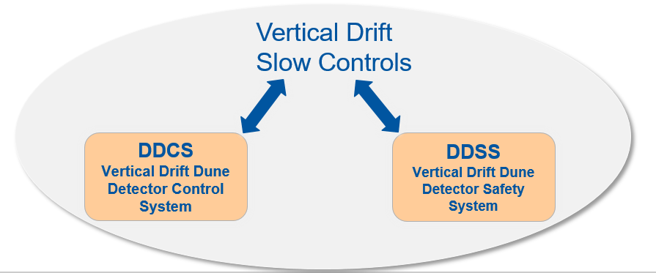
Introduction
The Vertical Drift Slow Control SC is assured by two subsystems:
        Detector Control System DDCS
        Detector Safety System DDSS
Communicating, exchanging data, controlled, operated by the Vertical Drift Slow Controls

Slide 4
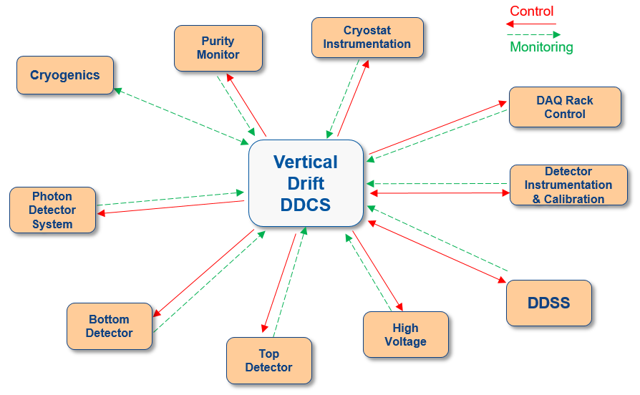
Introduction. DDCS
The Detector Control System DDCS involves all the subsystems and elements (hardware and software) that integrate the detector allowing its correct operation and supervision.
Original from protoDUNE SinglePhase CW 01/2019

Slide 5
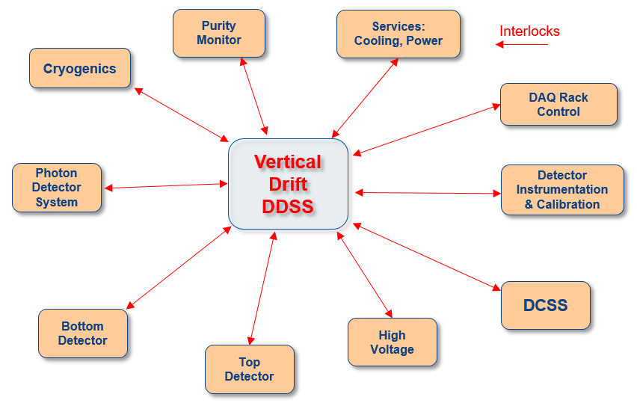
Introduction. DDSS
The Detector Safety System DDSS assures the safety of the detectors , including all subsystems and elements (hardware and software) that integrate the detector, allowing the operation in safe conditions

Slide 6
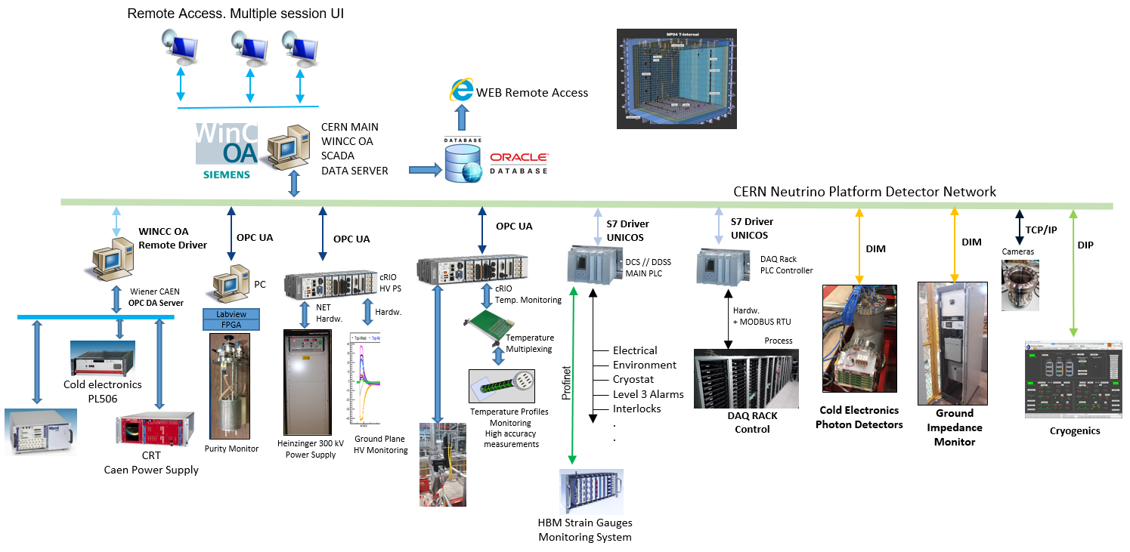
protoDUNE Single Phase Slow Control Layout

Slide 7
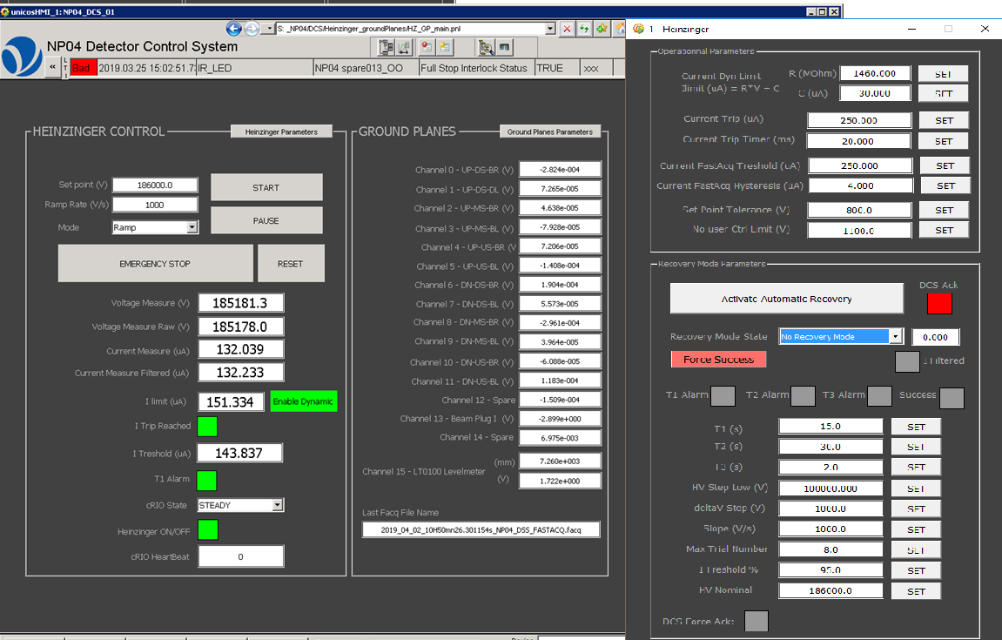
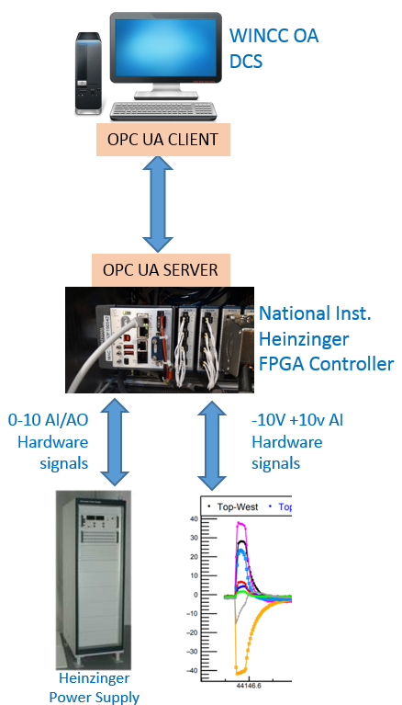
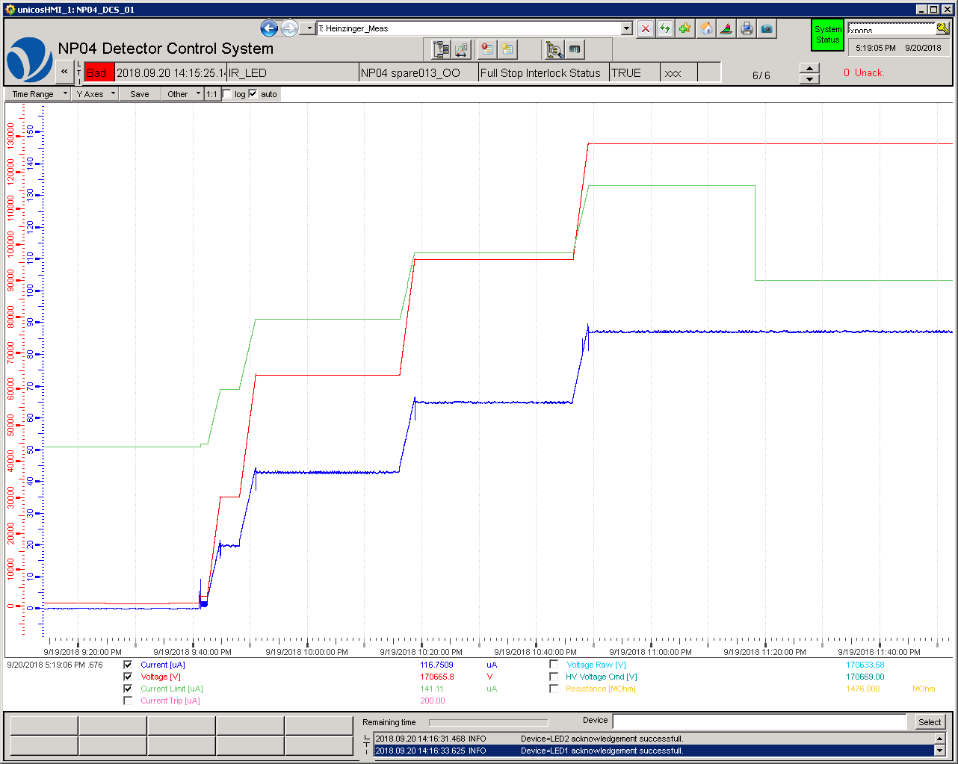
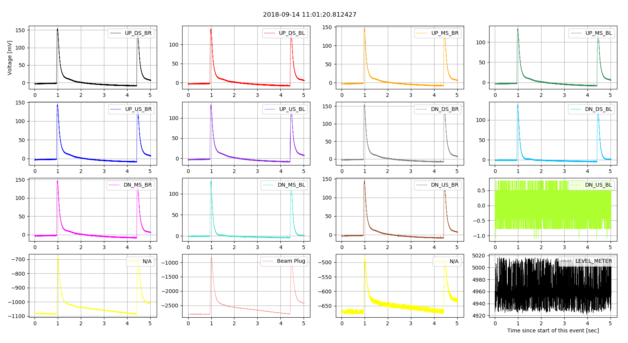
protoDUNE Single Phase Slow Control. HV integration Example
The data is transmitted to Real-Time controller, connected and integrated to the SCADA DCS program by means of the OPC UA driver for HV control, operation and monitor.
Slow Control
SCADA Software
VD SC SCADA
Heinzinger HV Control Panel
Ground Planes & Beam Plug discharge
event on 14/09/2018
Ramp up by steps on 20/09/2021 at 9:40 PM

Slide 8





Vertical Drift DUNE Detector Control System Layout. DDCS
Remote & Multiple
session UI
WEB User Interface
Only Monitoring
DDSS SCADA
USER INTERFACE
Vertical Drift
DDCS SCADA
Vertical Drift Detector Network
DDSS
DUNE Detector Safety System
Power Supplies Wiener, CAEN Other
High Voltage System
Instr. & Calibration Systems
Services & Facilities:
Electrical
Cryostat
Cryogenics
Environment
…
Top Detector
Bottom Detector
Photon Detector

Slide 9
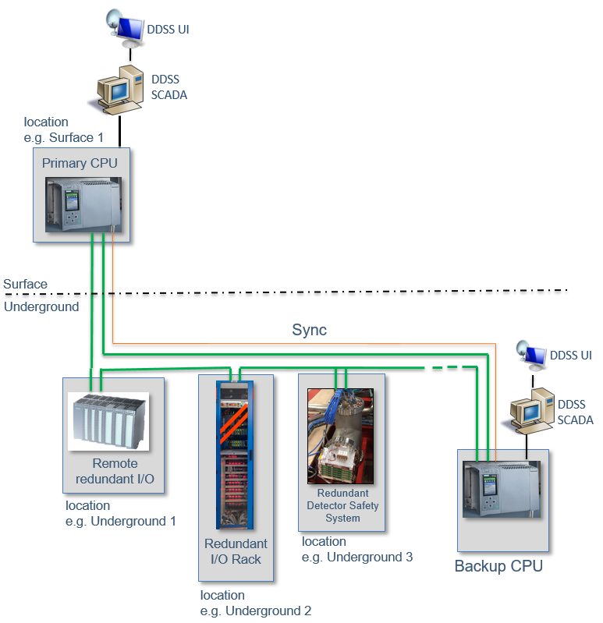
Vertical Drift DUNE Detector Safety System Layout. DDSS
Highly reliable and available, as well simple and robust
A cost-effective solution for experiment safety
Operated permanently and independently of the DDCS state
Able to take the immediate action to protect the equipment
Scalable, that it may evolve with the experiments during their assembly, commissioning and operation
Maintainable over the lifetime of the experiments
Connectable to other detector, subdetector or any other equipment of the detector
The core of the DDSS is the redundant PLC, e.g. SIEMENS S7-400H.
The two S7-400 CPUS synchronized with optical fiber, run the same code, comparing their states, in case of problem in one CPU, the redundant takes over
The two S7-400 CPUS are mounted in different locations (e.g. one underground the other in the surface)

Slide 10



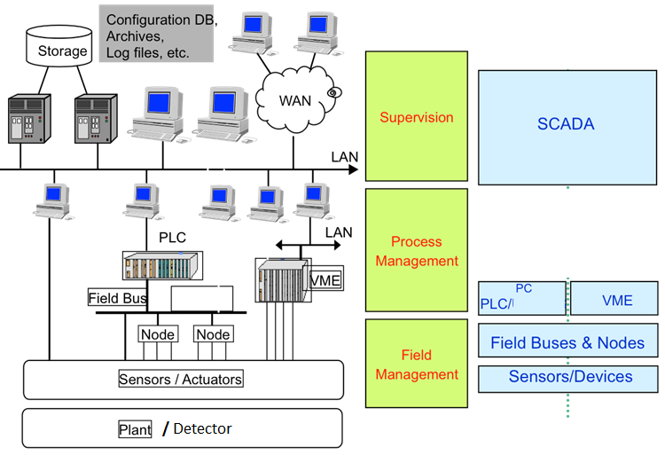




Slow Control requirement. Connectivity
The essential point of the Slow Controls is the connectivity
The openness to a comprehensive range of drivers or protocols
Vertical Drift DDCS gives priority to the OPC UA
Hardware
Drivers/
Protocols

Slide 11
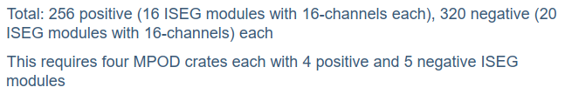

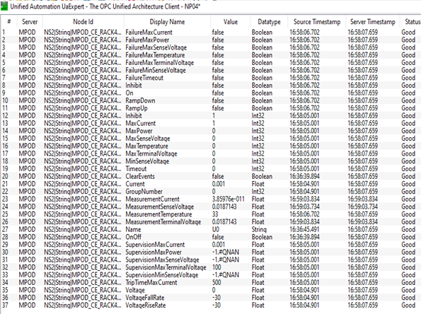
Slow Control Requirement. Scalability
From M. Verzocchi, Bottom Detector
Single Phase Cold Electronics
6 Low Voltage Channels
36 HV Channels
X 37 OPC items /channel 1110 items
Total amount of WIENER channels = 678 channels
X 37 OPC items /channel = 25086 items
The Slow Controls has to provide the tools to facilitate and simplify the configuration, operation and archiving of such amount data/channels

Slide 12
Supervisory or Scada Software Requirements
Homogeneity. Ideally the SC provides a homogeneous environment into which all its parts can be integrated
Scalability
        To connect to different subsystem and devices
        Capacity to handle huge amounts of data.
Openness.
        Possibility of parallel developers
        Comprehensive range of drivers and Connectivity
        Priority to the OPC UA
Data Archiving & Data retrieving
User Interface. Data reporting, trending…
        Multi-user system. User interface
        Access Control. User rights
        Web User Interface, Mobile User Interface (only monitoring)
Redundancy (Passive or Active), suitable.

Slide 13
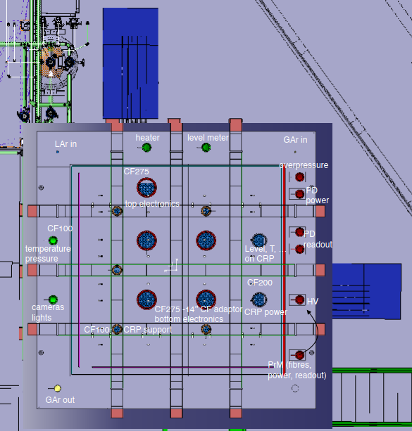
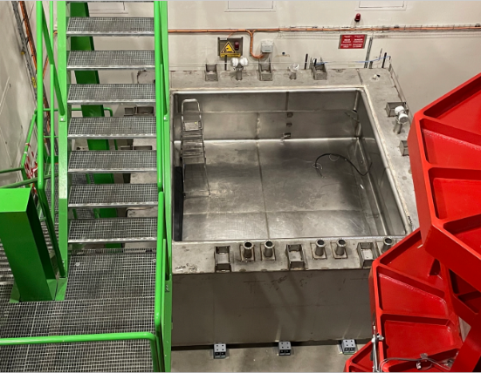
Vertical Drift Today. Coldbox
The VD coldbox is being installed using the Dual Phase protoDUNE infrastructure including the isolation detector ground.
5 racks will be installed close the coldbox for allocating the detector and slow control equipment.
The SC will be based in the WINCC OA SCADA and using the facilities already in place for the Dual Phase Detector.
Discussions are ongoing to define the specifications of the VD Slow control (DDCS and DDSS), the subsystems and the instrumentation
        The cryogenics SC already well defined and
        The instrumentation is already listed and the ports are assigned
First VD Coldbox layout including rack arrangement a port assignment

Slide 14
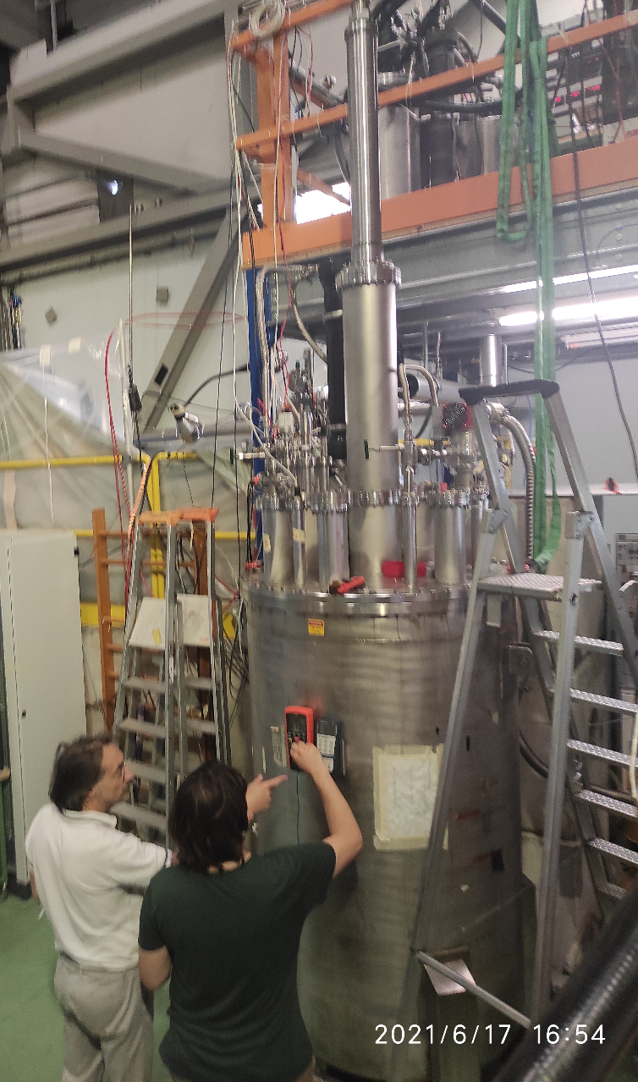
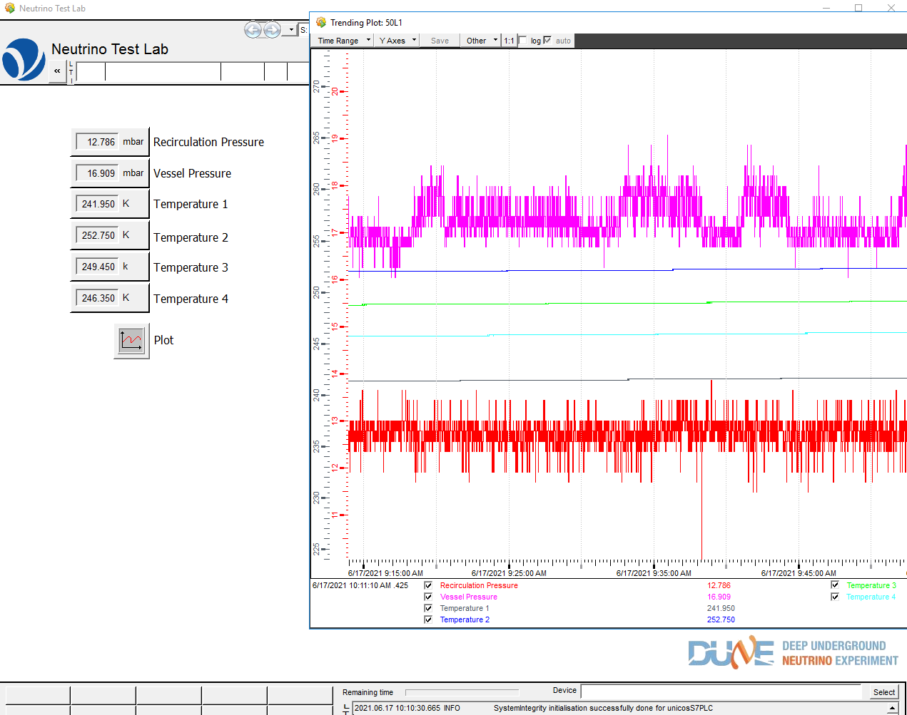
Vertical Drift Today. Neutrino Test Lab
Due to the high requests, a Slow Control project is being prepared for neutrino test facilities at CERN, mainly at Building 182
The aim of this project is to support the validation of the different tests that are ongoing:
    Vertical Drift 50 liters test
    300 kV High Voltage Feedthrough test
First NU Test Lab panel for CERN 50 Liters test
300 kV feedthrough test setup

Slide 15
VD SC CDR Summary
We have a conceptual design for the Vertical Drift Slow Controls.
This design follows the majority of the detectors as well the industrial control system standards
The main requirements are understood but they will be completed first in the Coldbox and later in protoDUNE
The team is not yet in place, meanwhile the project is driven by the CERN team in the interim

Slide 16
Backup

Slide 17

OPC (Open Platform Communications)
OPC Data Access
OPC Data Access is a group of client-server standards that provides specifications for communicating real-time data.
Is based on Microsoft Windows technology using the COM/DCOM (Distributed Component Object Model) for the exchange of data between software components.
OPC Unified Architecture
OPC UA was designed to enhance and surpass the capabilities of the OPC Classic specifications
  Functional Equivalence
  Platform Independence
  Security
  Extensible
See more on: https://opcfoundation.org/

Slide 18
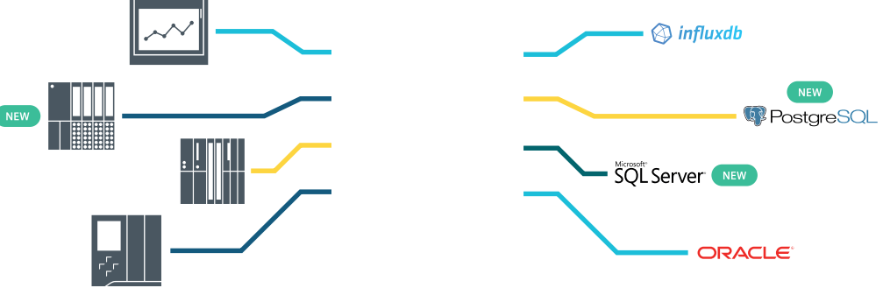
Data storage
Vertical Drift Slow Controls

