Slide 1
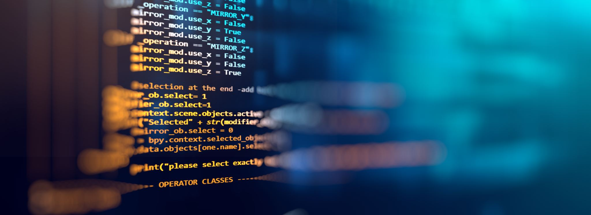
DAQ Development : process, infrastructure & tools
Alessandro Thea

Slide 2
Outline
Code and tools
DAQ software stack
Code management
Build system & distribution
Firmware
Development model
Planning
Outlook
Cycle
Requirements
System design
Team

Slide 3
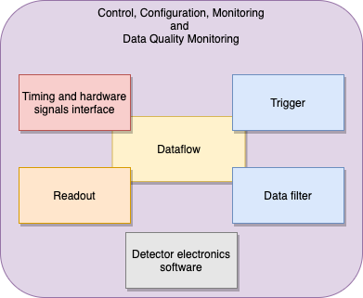



System Composition
Software-based system with some firmware elements
Firmware
  Timing and readout
Software
  Custom DAQ framework for data readout/processing/storage
    + detector electronics control interface
  Mix of custom & off-the-shelf solutions in CCM, DQM

Slide 4
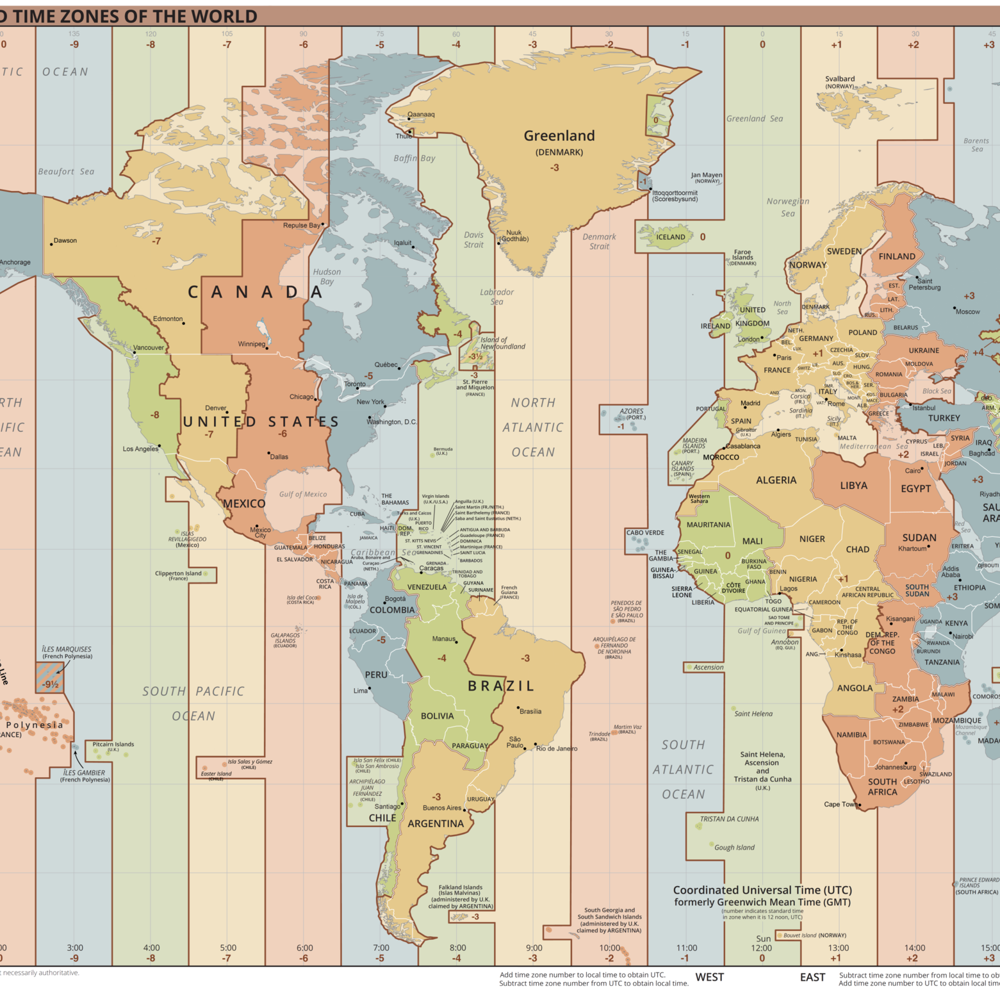

DAQ team
International
  Spread over several TZ
  Mixture of different expertise
  No-chances for in-person interactions
  since February 2020
Small
  Developments are prioritized and carried out somewhat sequentially

Slide 5
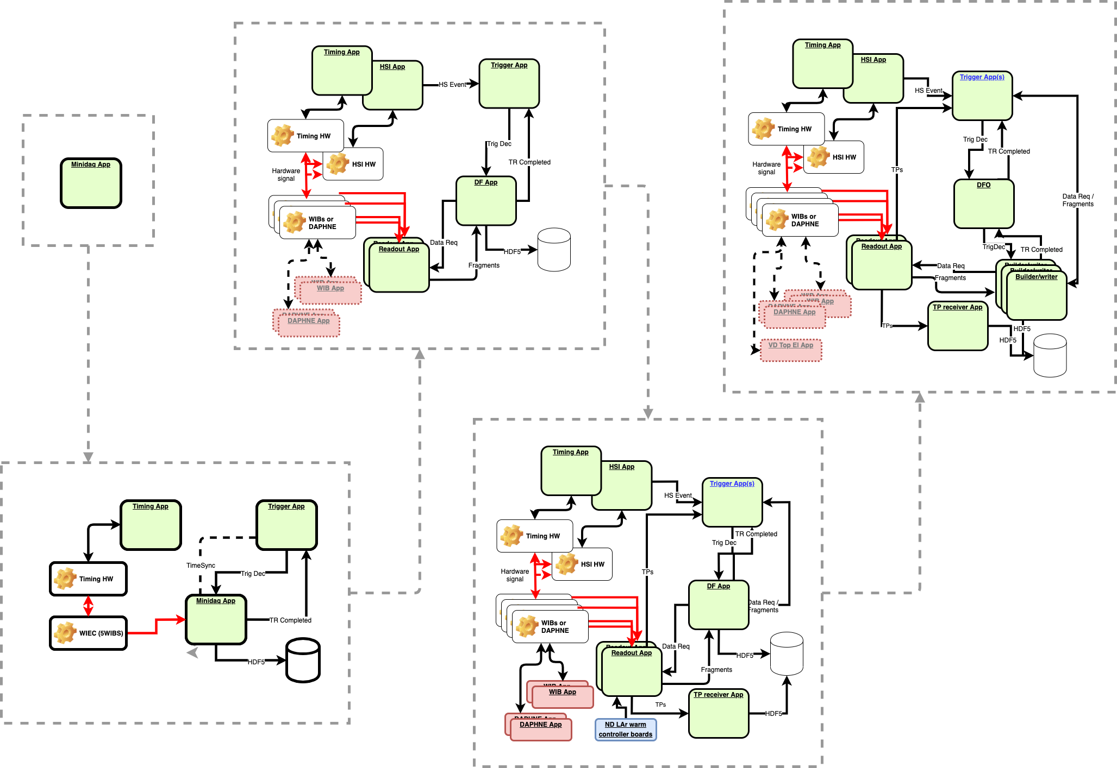
DEVELOPMENT PLAN
May 21
Oct 21
Release-based, driven by
  Short-term DAQ & DUNE milestones: complete system for PD-HD-II by Q1 2022; Support for coldbox run(s) in 2021
  Team distribution: keep engagement high with short release cycles (by-monthly) & release goals aligned with project milestones.
Each release characterized by a reference system layout
Hybrid incremental/iterative development model
  new elements added and existing interfaces updated at each release
Plan aligned with Vertical Drift milestones
Nov 20
Feb 21
Jul 21
Single-process "mini" DAQ
Separate trigger and daq processes
Coldbox test release (postponed)
Multi readout processes
Complete system
CE integration
CE and PDS integration
ICEBerg Support @ FNAL
HSI application
TP streaming
VD TDE support
Multiple builder processes

Slide 6
Development Cycle
Development cycles are aligned with releases
Release goals are discussed/confirmed in the DAQ coordination team, and specifications agreed upon
Implementation carried out within the consortium WGs
2 weeks ahead of the release date: pre-release distribution – semi-final version of tools, external dependencies and core packages
On release date: final build & 24h “cooldown” period (11th hour bugs and patches)
Distribution and announcement to the consortium
Specifications
(Coordination Team)
Implementation
(Working groups)
Pre-release - tools and core packages
Release candidate
Testing
Distribution and announcement

Slide 7



DAQ application software
See talk by K.Biery
  Code organised in packages
    “package” basic versionable entity
  Programming languages:
    C++
    jsonnet for data-structure definition
    Python for configuration and scripting
  Code hosted on GitHub
  Deployed on CVMFS as UPS products
  25 DAQ packages in the latest release (dunedaq-2.6)

Slide 8
DAQ Software stack
OS: Centos7/Scientific Linux 7
Old. Dictated by CERN/FNAL support, for compatibility with expected computing environment at the labs
Basic tools: gcc, python, cmake…
Moved away from ancient system versions
External libraries and tools: boost, highfive, felix,…
Either pre-compiled by SciSoft or compiled and packaged by DAQ
Patches only allowed for compilation purposes
External build scripts versioned and tagged as part of every release
33 externals in the last release (centrally provided)
DAQ – core components
i.e. packages required to build modules and applications
Logging, error reporting, application framework
DAQ / Detector – application components
i.e. packages implementing modules and applications
Felix readout interface, trigger record builders, data writers, …
Selected versions available pre-compiled via FNAL-SciSoft

Slide 9
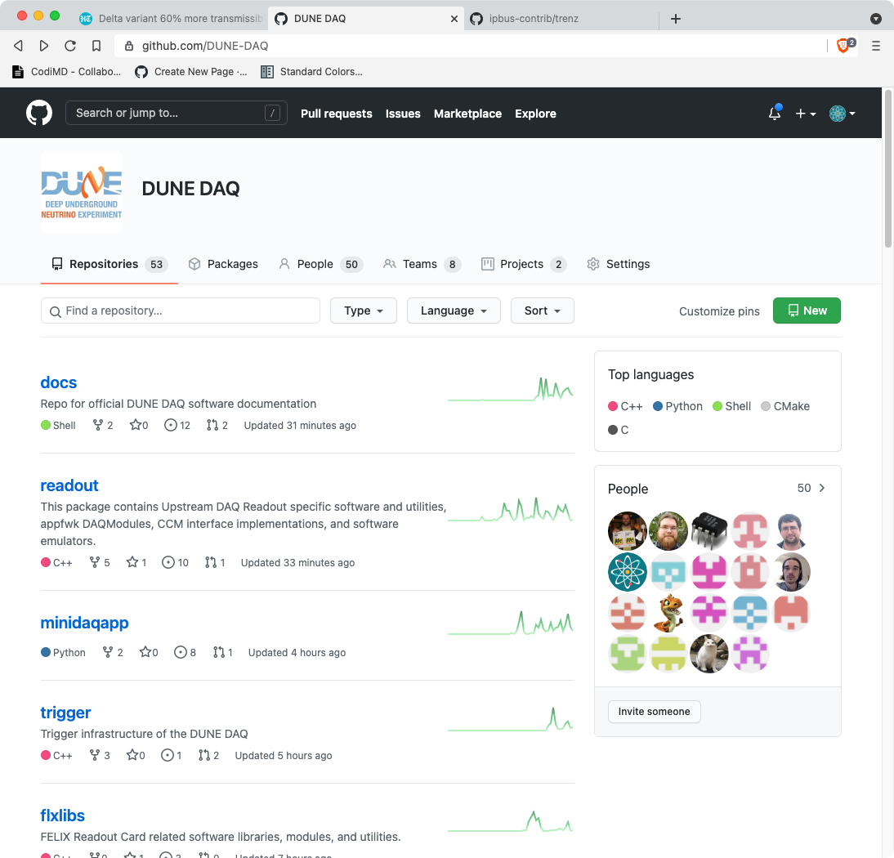
DAQ code hosting
GitHub: good balance between features and flexibility
  Offers access control, task management, wikis and continuous integration
  No need for FNAL / CERN accounts for new users
DUNE-DAQ Organisation
  53 repositories, 50 users and growing

Slide 10

DAQ PackagE
  Application software elementary block
    Versioned, each in a dedicated git repository
    with a defined set of dependencies
    Corresponds to a cmake package
  Enforces standard package structure
  Supported by cmake extension (daq-cmake).
    Easily add components (library, plugins, etc..)
    Generate code from schema files
    Standardize build and installation targets
flxlibs
├── cmake
│ └── flxlibsConfig.cmake.in
├── CMakeLists.txt
├── docs
│ ├── Configure-the-FELIX-card.md
│ ├── README.md
│ └── ...
├── include
│ └── flxlibs
├── plugins
├── python
│ └── flxlibs
├── schema
│ └── flxlibs
├── scripts
├── src
└── test
└── apps
Example: flxlibs

Slide 11

Build system
  Toolset to streamline the development of DUNE DAQ packages (daq-buildtools).
  Main functions
    Create lightweight, self-contained C++ / python
    work-areas based on a DAQ release
      Where one or more DAQ packages can be easily checked out and compiled
    Guide the developer through the stages of the build
    (cmake project generation, build, installation, …)
    Run unit-tests
    Perform code linting/formatting
    Provide a runtime environment for testing newly compiled code

Slide 12

Packaging
DAQ Software distributed as UPS (Unix Product Support) products
  Easily configurable to distribute additional elements together with header and libraries (e.g. schema files, python modules)
  And to make them available via environment manipulation
  Native support for concurrent installation of multiple versions of each product on the same machine
  Large pool of packages and tools in UPS format made available by FNAL SciSoft pre-compiled
Ongoing: evaluating SPACK (https://spack.io/) as a potential, more modern alternative

Slide 13
DISTRIBUTION
DAQ Software primady distribution channel: CVMFS (CernVM-File System) service
  Tarballs and docker images also available
Repositories hosted at FNAL
  dunedaq.opensciencegrid.org, production:
  DAQ releases, ups products pools, build tools
  dunedaq-develop.opensciencegrid.org, development:
  nightly builds, experimental ups products
Updates available world-wide in O(1h) to any CVMFS client
  no user intervention required

Slide 14
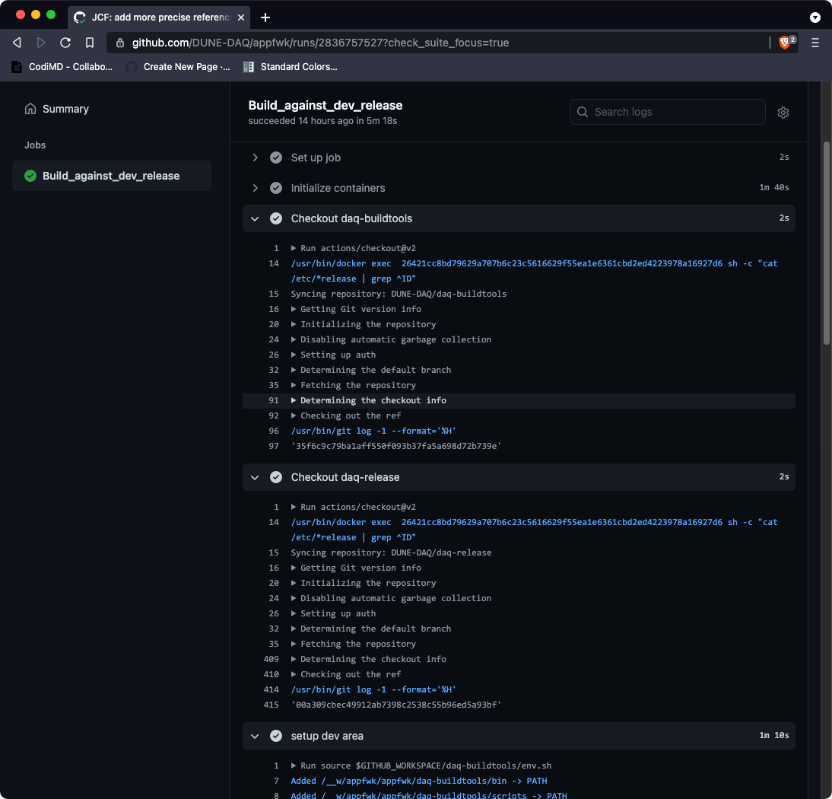
Continuous integration and Nightly Builds
Two tier CI setup, based GitHub actions
  Full build of all packages (develop branch) every night
  Single repo: build against the last successful nightly at every commit

Slide 15
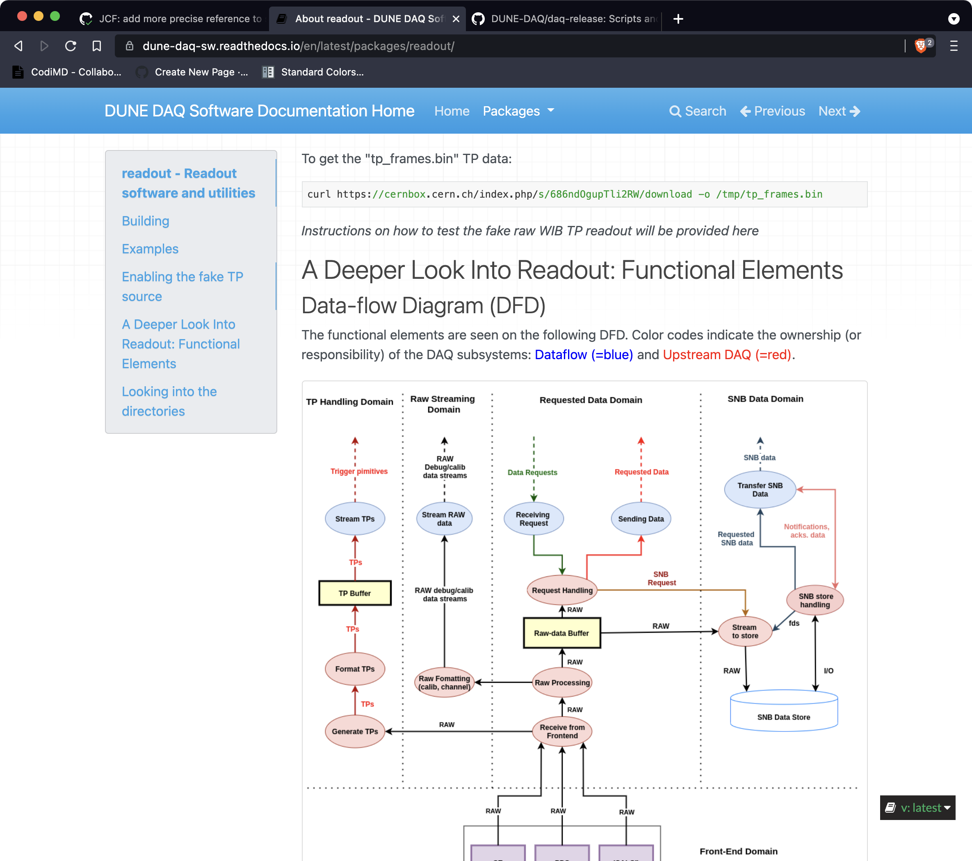
Documentation
Online documentation hosted on readthedocs.io
Generated from the content of docs/ in each DAQ package
Documentation sources in Markdown
Native support for multiple concurrent versions

Slide 16
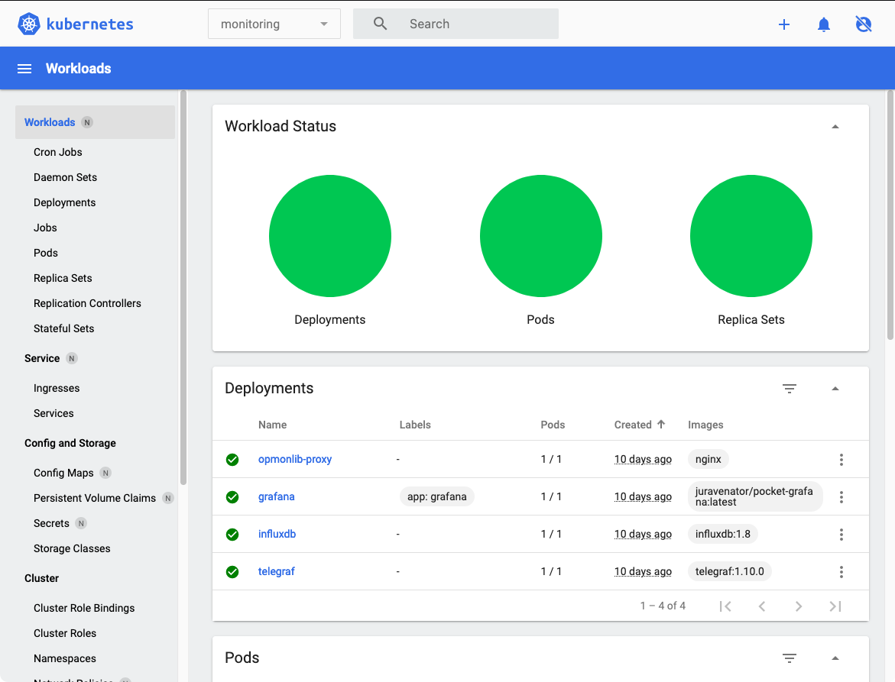
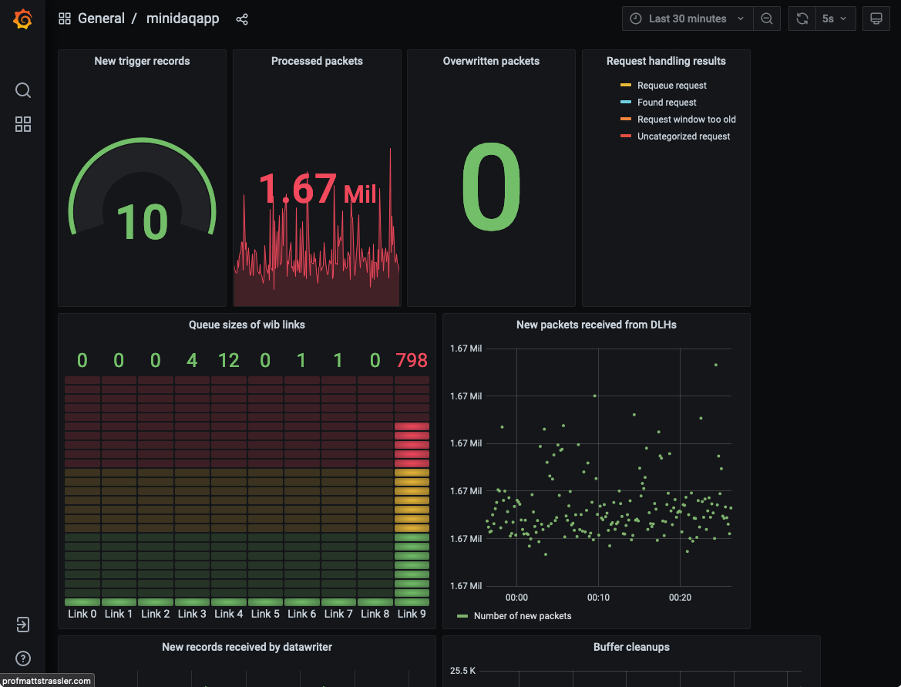
serviceS distribution
Prototyping the use of Kubernetes + Docker for distributing CCM/DQM services to small installations and testbeds
Promising solution for delivering complex configurations with small effort
Prototype under evaluation (pocket) includes
  Monitoring: InfluxDB+Grafana
  Logging: ELK stack

Slide 17
DAQ FIRMWARE
Code organisation similar to software
Firmware “package” basic versionable entity
1 package 1 git repository
with different granularity
Just 6 packages between timing and readout
Of larger complexity – multiple projects per package
Languages
VHDL
Tcl for scripting
Toolsets
Xilinx Vivado & MentorGraphics Questasim
Code hosted on GitLab at CERN

Slide 18
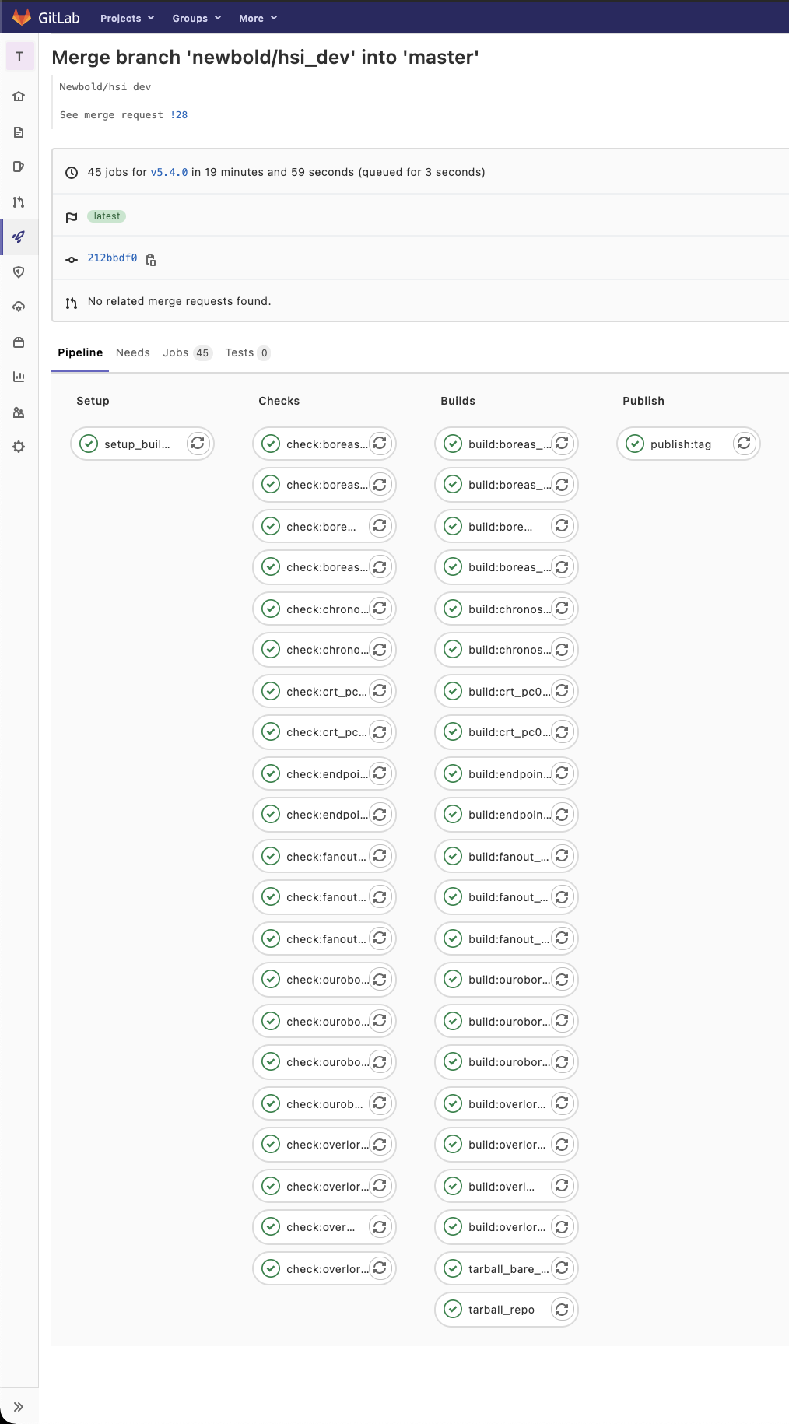
BUILD SYSTEM, CI and DISTRIBUTION
Build system
  IPBbus Builder – Initially developed in CMS
  Defines standard package structure, streamlines the typical simulation and sythesis workflow
Continuous integration
  Simulation and builds triggered at every commit, full builds for Merge requests
Automatic distribution
  MR and tags build products automatically uploaded to EOS, including address tables and build logs
Timing system firmware CI

Slide 19
SummarY
A solid development process has been devised by DAQ consortium in the last year
for both software and firmware
A complete set of tools has been created to support the process from code checkout to products distribution
A release-based development plan is in place
R&D continues to improve tool and coverage
aligned with HD and VD project milestones
e.g. SPACK, Kubernetes, etc...

