Slide 1
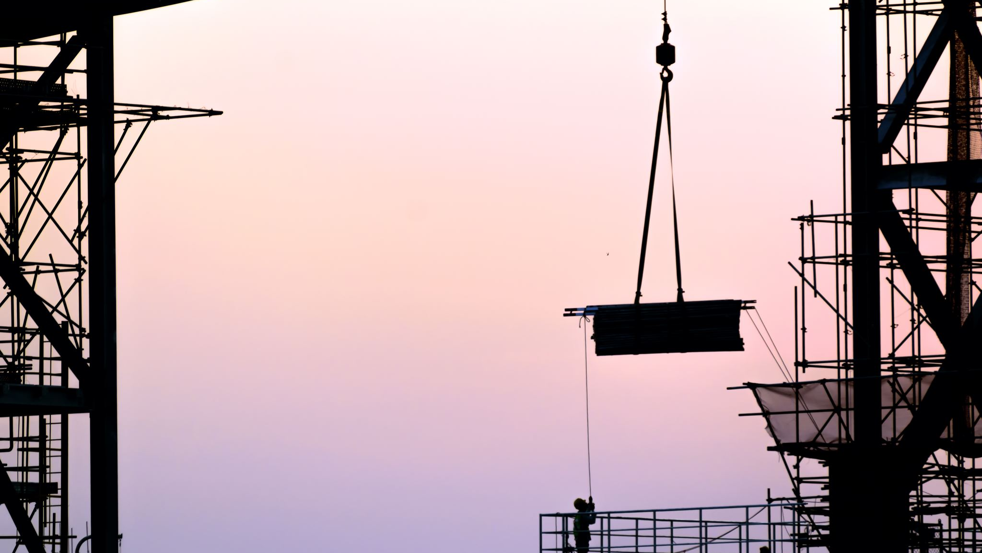
R&D towards the final system
Alessandro Thea

Slide 2
Synchronisation and Timing DistributioN
FD2-VD Top and Bottom electronics use different technologies to achieve syncronisation and receive timing information
  Bottom electronics: DTS (developed from "Single Phase")
  Top electronics: White-Rabbit based
Both timing systems independently meet DUNE DAQ timing requirements
Non-negligible costs/effort would be required to completely switch to a single VD timing sytem
DAQ and Top-electronics experts think that the two systems can conceptually interoperate and saitsfy the overall DUNE timing requirements

Slide 3
Timing DISTRIBUTION
High-level requirements
All detector data structures are marked with a unique sample ID (SID)
Formerly known as “timestamp”
The SID is common across all subsystems in a module
The SID increases monotonically at the DUNE base clock frequency
a 64b firmware counter clocking at a common clock frequency,
initialised at a common time to a common value across all subsystems
SIDs are applied in FE electronics and are thereafter immutable
Most DAQ entities only see sparse data, and must align data from many sources

Slide 4
Practical Requirements
Each FE system must be aligned to a common reference
Where SIDS are applied
Common clock frequency
Common SID alignment
An initialisation event is when the SID in an FE system is aligned with the current master SID
All FE systems must be able to re-synchronise their SID at any point, to allow entering / leaving without a global restart
Data formats at DAQ input
All data structures must be marked with the SID
All packets should be marked with the SID to reserve the option to split or steer network data in future evolutions of the readout system
Derived from common GPS
Clocks locked everywhere in detector at nano-second

Slide 5
R&D towards AN integrated system
Discussion between DAQ and TDE timing experts ongoing
  First meeting on June 14
  Timing experts agree that inter-operating the two systems is (conceptually) possible
  It’s possible to anticipate a combination of WR and DTS protocols
Short term: configm relative stability of the two systems planned on a short timescale - outlined in previous talk
Details of the integrated system to be worked out in follow-up meetings between experts
  Targeting the second half of the VD coldbox test (Q1-Q2 2022) for complete demonstration
  And NP02-VD for a full system test

Slide 6
FD2-VD Detector readouT
40G ethernet readout baseline for FD2-VD TDE readout
FELIX 100 Gbps FULLMODE readout baseline for BDE readout
  Data reception
  On FPGA pre-processing (TP generation)
  DMA to transfer host
From the DAQ perspective
  Ethernet is “just” a different data transport layer
  No impact on the DAQ architecture, once proper abstraction is put in place
    Standard data format, receiver architecture, etc.

Slide 7
Ethernet readout Strategy& Plan
Maximise the symmetry with FELIX-based readout
  Maintain the capability for data-preprocessing and DMA
  Investigate solution that maximise the code and tool re-use
R&D Plans
  Short term : establish dataflow with 40G/100G NIC
  Medium term : identify viable FPGA-based solutions for 40G readout
    And prototype key functions: reception, processing, DMA
    Results presented by DP at the CERN collaboration meeting give confidence that this is doabe
  Long term : re-implement the full upstream readout path based on ethernet
    Target demonstration at NP02-VD

Slide 8
Triggering - VD High-Energy
Working right now on looking at existing HE algorithms on VD strips/geometry
Will depend on signal/noise model for VD strips
Radiological rates/channel may be different
Pitch of collection wires will have an impact
CAVEAT: quantitative results subject to availability of VD simulation samples
VD simulation (including detector response) is still undergoing active development
No reference configuration yet
  Noise model, backgrounds, geometry need to be settled
50% at 12 MeV
Intended for triggering on beam, atmospherics, and PDK
HD
Applies to following
slide as well

Slide 9
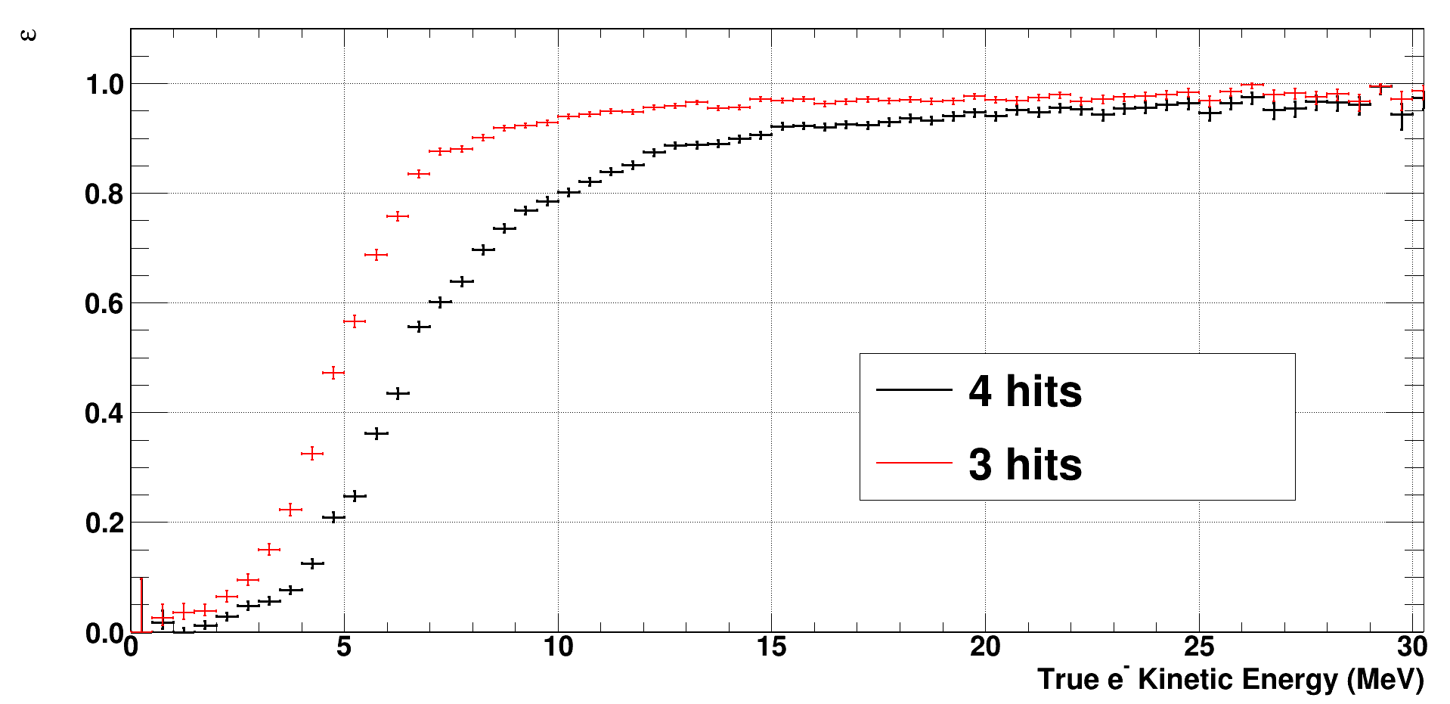
Triggering - Moving Lower in E
Region-of-Interest (ROI) Readout
Can have a higher trigger rate if data/trigger is smaller size:
Halve readout window
Write out only CRPs with trigger activity (TA)
Use a much narrower readout (100 μs) window around hits (“zero suppression”)
Fully localize TA and use 100 μs window for readout
TA
HD
Threshold set so background rate ~ 10 Hz
Of course, ROI can depend on type of Trigger Candidate
50% at 5 MeV
HD
Single electrons
Need to examine impact of VD - Can apply existing algorithms to simulation, maybe 2 months
Thiago Bezerra

Slide 10
Triggering - Induction strip TPs
Induction strips TPs will help with neutron/electron discrimination
But noise level is about 20-30%
higher than collection
But helps in using topology
HD
HD
D. Pershey
More complete “reconstruction” can be done in High-Level Filter
Need to examine impact of induction strip orientation on fiducialization,
but fewer anode planes in VD should help with this
Effort not started yet

Slide 11
Triggering- Including PDS
  Naturally inclusive trigger (e.g., Npe>threshold)
  Efficiency likely easy(-ier) to model and measure
  Can be fast
  Can reduce background rates via fiducialization
    maybe in high-level filter
  Noise uncorrelated with TPC
  In principle singlet/triplet PID can reject αs for very low-E program with u/g Ar
Careful study of background rates needed - in progress
Requires TPC+PDS simulation with good background representation

Slide 12
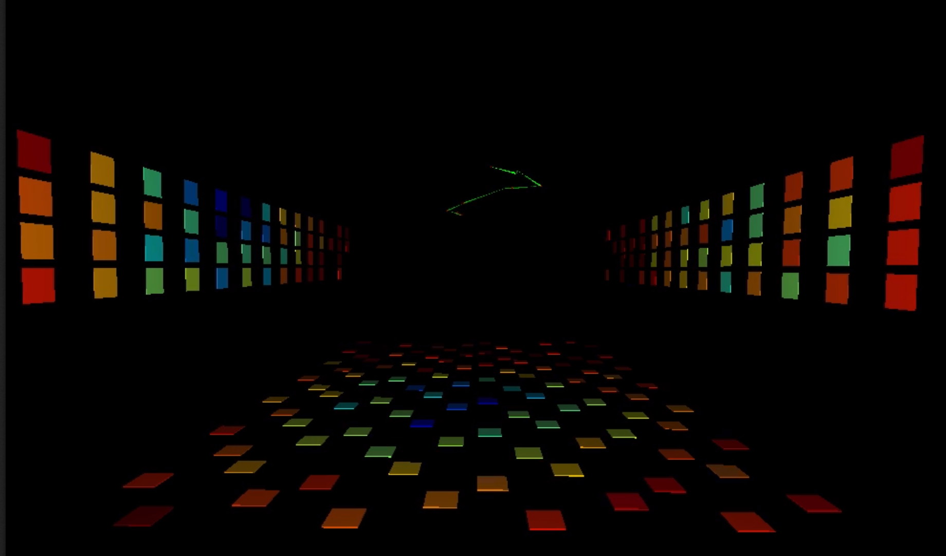
Including PDS
New tool (Chroma) for PDS simulation may help
5 MeV single electron event

Slide 13
TRIGGERING-Moving Even Lower in E
Include induction strips trigger primitives
  Very little pulse shape information at low energies
Write all of them continuously
Threshold is ~250 keV
Can run “offline” algorithms as sophisticated as desired
Data will be overwhelmingly ³⁹Ar
Requires TP definition from induction TP studies

Slide 14

Development needs towards final SC
Continue requirements capture & specifications
  Coldbox
  ProtoDUNE-II
  Formal interface documents
Choose the best suited SCADA tool based on
  Features
  Available experience
  People committed to developing and maintaining the system

Slide 15
Features required
Reliable SCADA
  Mature product (all typical features ready: data collection, alerting, visualization, scripted logic and sequences, …)
  Long term support and evolution
Support of all main industrial protocols, in particular OPC UA
  Extensibility to custom protocol connections
Scalability
  DUNE SC is large compared to many industrial plants
Multi-user and multi-developers support
  Essential for a scientific collaboration and not so common for industrial SCADA systems
Interface to powerful databases with effective data model for data archival and retrieval

Slide 16
Facilitating development
The SC team will create the framework and architecture to be able to integrate all systems coherently
The experts of the different consortia shall be able to contribute to the development of the SC for their subsystem
  Available SCADA training/documentation is an important aspect
  Exploring QUASAR as a tool to generate OPC UA servers (first discussions started with one CAL expert) to interface custom electronics
  Centrally setup model for versioning, CI, etc. and a workflow to move from development to production versions

Slide 17
Summary
DAQ R&D is carried out in the DAQ consortium jointly for FD1-HD, FD2-VD and ND
Areas where specific R&D effort will be required for FD2-VD are
  Synchronisation and Timing Distribution
  Ethernet readout integration
  Trigger studies
  Slow Control R&D
The DAQ consortium has the expertise to carry out these developments, in collaboration with the relevant cosortia in DUNE
The overall manpower remains a concern

Slide 18
BACKUP

Slide 19
Control, Configuration & Monitoring
Services and interfaces that allow the experiment to behave a coherent system
  Services for configuring the experiment
  Identifying and isolate faults, recover components, guarantee high uptime
  Fine-granied monitoring to inspect behaviour of the system in details
CCM still in early prototyping stage
  Significat R&D required to bring it to maturity
FD2-VD procedures to be developed ad-hoc

Slide 20
High accuracy signals 1 PPS, 10 MHz from GPSDO or other source (DUNE timing)
1PPS
10 MHZ
DTS master
WR Grand Master
DTS SID
WR E.N.
TDE DTS endpoint
Data to DAQ
DTS SID
DUNE SID
TAI TS
Xxxxx
Xxxxxx
Xxxxxxx
WR Switch
WR E.N.
DTS-WR conceptual interface
DTS SID
AMC
WR Switch
WR E.N.
WR E.N.
WR E.N.
WR E.N.
TDE µTCA crate
WR E.N.

