Slide 1
Bottom Electronics Overview and Requirements
Cheng-Ju Lin (Lawrence Berkeley National Lab)
Conceptual Design Review for Bottom CRP Electronics (FD2-VD)
28 May 2021

Slide 2
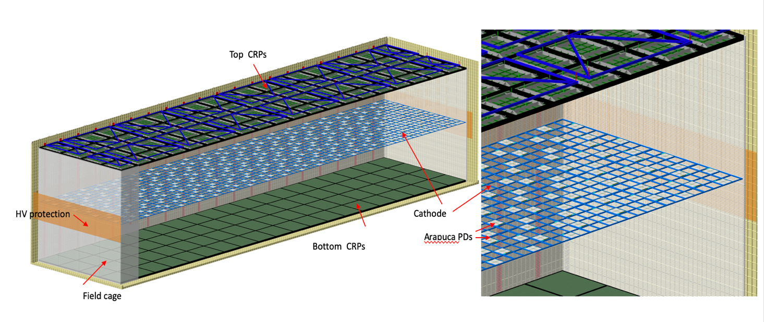
Bottom Cold Electronics
Bottom CRPs
Scope:
Responsible for the electronics to read out 80 CRPs at the bottom of the cryostat
Penetration and warm electronic crates
Power supplies (including bottom CRP bias and FC termination) and DDSS

Slide 3
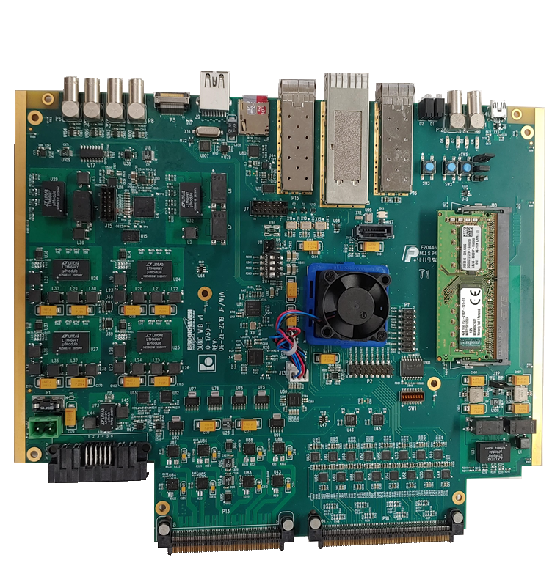
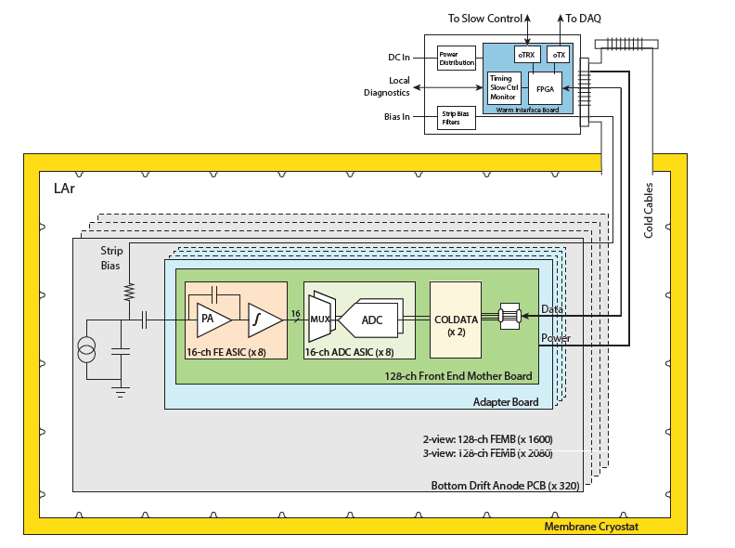
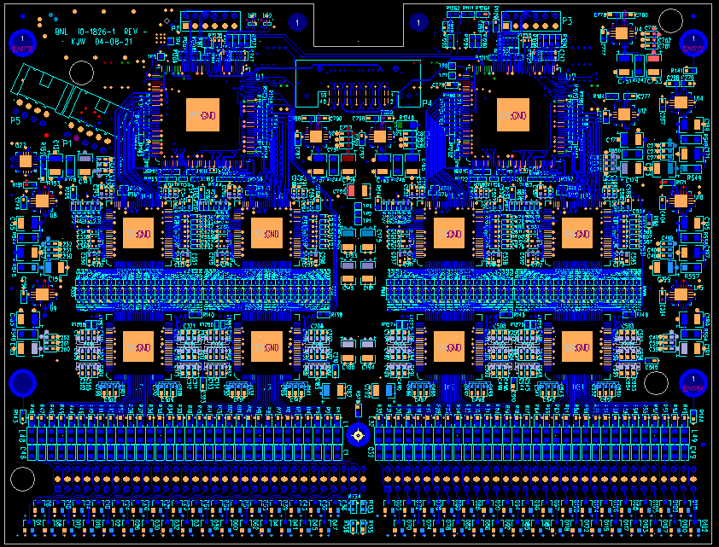
Bottom Cold Electronics
CE requirements are similar between HD and VD
Final version for FD1-HD will also be the ~version for FD2-VD
Frontend motherboard (FEMB) with 3 types of ASICs to readout CRP strips
FEMB mounted on the CRP to minimize noise. Digitized signal sent over long (~25m) cable to the warm electronics on top of the cryostat
Warm Interface Board
CE Block Diagram
Monolithic FEMB with 3-ASICs : LArASIC+ColdADC+COLDATA

Slide 4
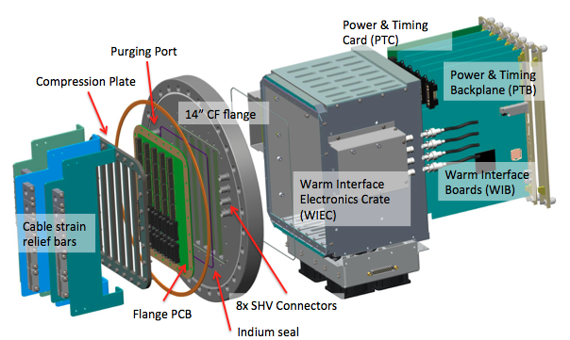
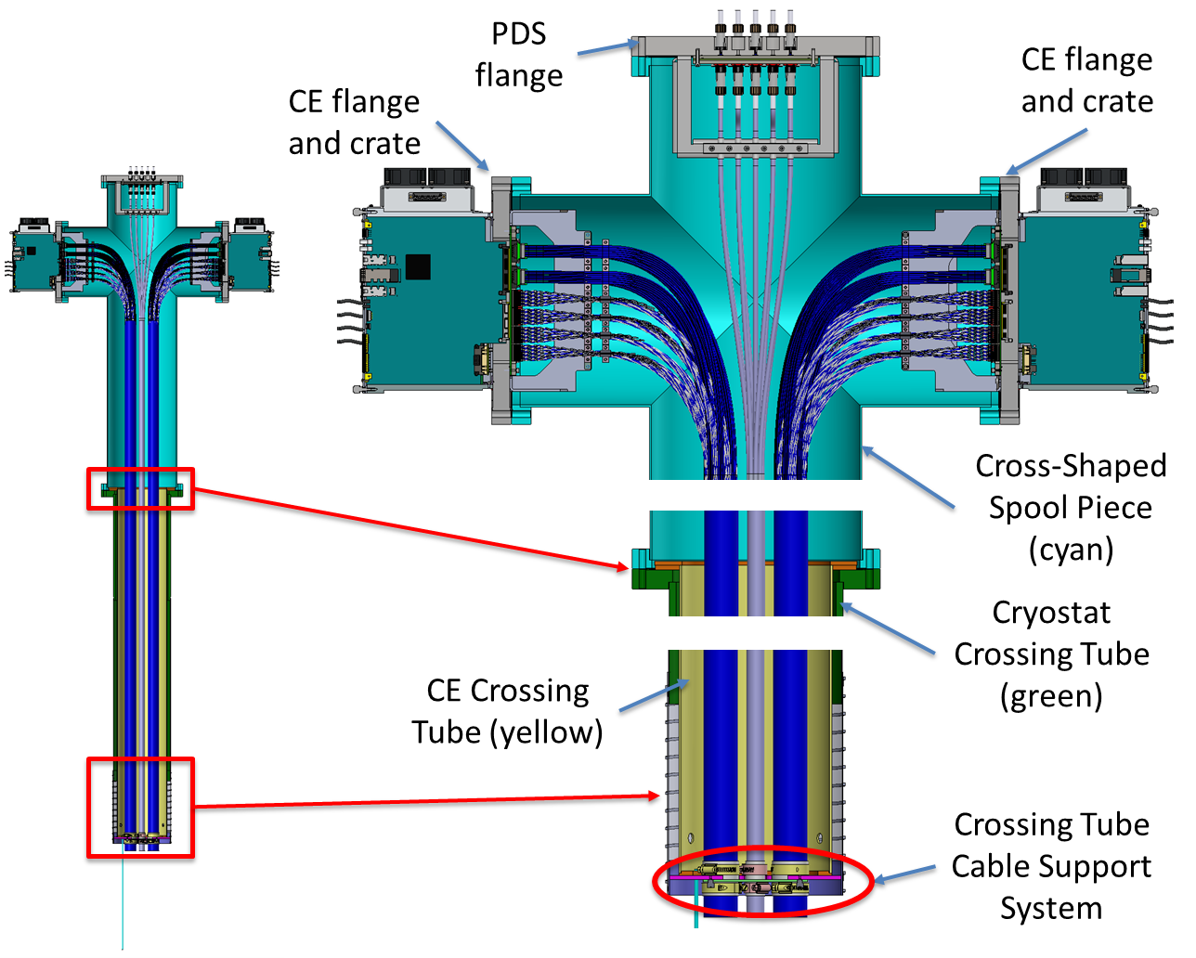
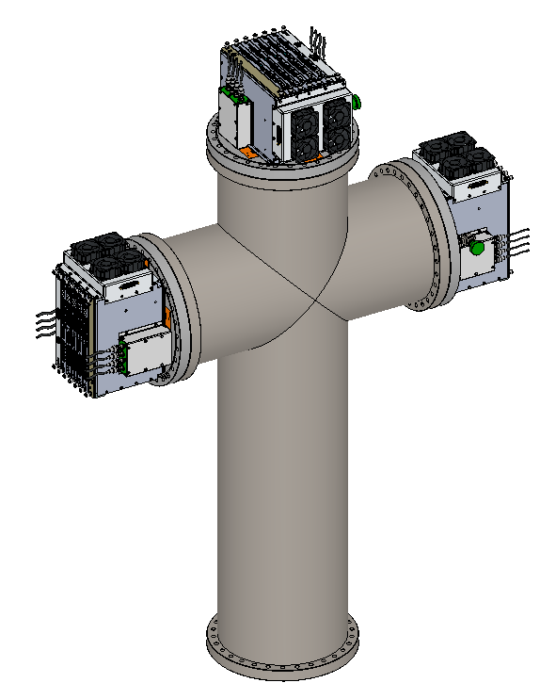
Warm Electronics
Warm Electronics Assembly
2-Crates Configuration
 | DUNE SP LArTPC (half drift) | Vertical Drift 3-view config
LV supplies | 25/2 | 17
Bias voltage crates | 5 | 4*
Bias voltage channels | 450 (+208 FC) | 160
DDSS panels | 30 | 18
Cryostat penetrations | 75/2 | 40
WIECs | 75 | 100
WIBs | 375 | 520
PTCs | 75 | 100
3-Crates Configuration
* Bottom CE also provides bias voltage to the field cage termination electrodes

Slide 5
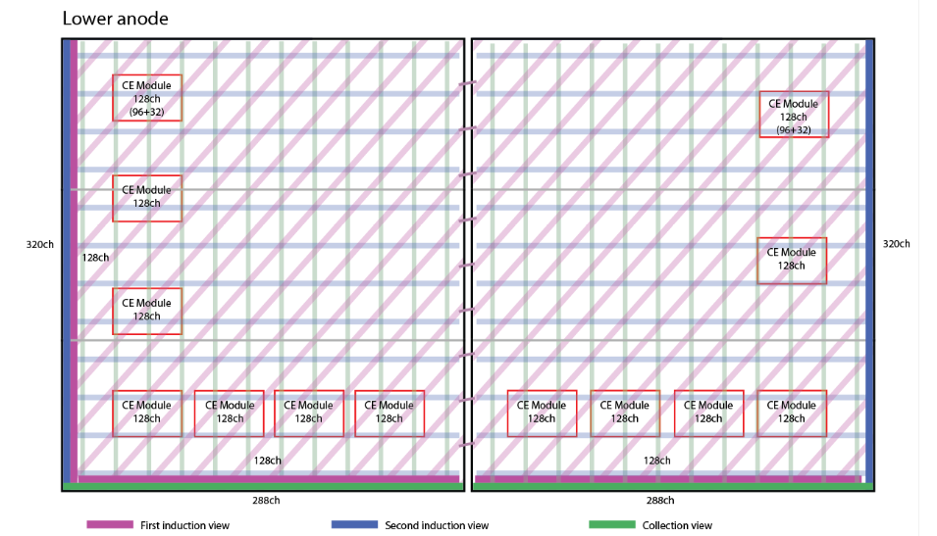
FEMB Layout on CRU (3-view design)
Each CRU pair has 1600 channels
Read out with 13 128-channel FEMBs
64 unused channels per CRU
Placement of FEMB on CRU
FEMB Mounting Concept on the
CRP Interface Board

Slide 6
Possible CE Changes for FD2-VD
Plan to keep design changes relative to FD1-HD to minimal
CRP Consortium expressed concern about the weight of the CE boxes. For FD2-VD, will use aluminum CE box instead of SS to reduce weight
Explore the possibility of connecting FEMB cables at the CRP Factory:
  CRP installation is dominated by cabling (~4 tech/hrs per CRP) and testing (~1.5 hrs)
  Have the FEMB cables pre-installed significantly simplifies the CRP installation inside the cryostat at SURF. Less fixture, manipulation and testing needed
  Connect short cables from FEMBs to a patch panel on the side of CRP
  May need a version of FEMB with a different connector
  Prototyping and testing ongoing. See Manhong and Shanshan’s talks for details
Cryostat penetration design may need to be modified to accommodate Photon Detector System and maybe also the FC support system
If White Rabbit Timing System is used for FD2-VD instead of the FD1-HD Timing system, significant modification to the warm electronics is needed. See Marco’s talk on “Warm infrastructures”
A request to change the CRP strip size. A change for CRP not CE. See Marco’s talk on “Interfaces”
Most other changes are minor (e.g. WIB firmware update for channel maps)

Slide 7
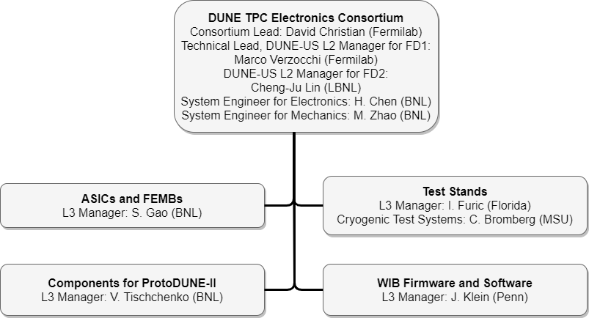
Institutions for FD2-VD Bottom CE
Expect most (if not all) institutions involved in FD1-HD CE to continue in similar roles for FD2-VD
QC test stands from FD1-HD will be re-used
ASIC/FEMB testings: BNL, FNAL, LBNL, MSU, LSU, UC-Irvine,
Cincinnati, Florida, Iowa State
WIB/PTC hardware, firmware, and
software: BNL, Florida, U. Penn
Cold Cables: BNL
Mechanical: BNL, CSU
Power supplies and Detector Safety System: BNL, FNAL
Integration and Installation: BNL, FNAL, LBNL
Recruiting more institutions (e.g. UC-Davis, Hawaii, SLAC, etc.) to help out with above and additional online/offline software tasks

Slide 8
Bottom CE Requirements
Executive Board held requirements for FD1-HD are also valid for FD2-VD
TDR ID | Name | Primary Text | Value
SP-FD-2 | System noise | The total system noise seen by each wire should be no more than 1000 enc of noise. It is expected that random noise on the FE amplifier will be the dominant contribution to the total system noise. | <1000 electrons
SP-FD-13 | Front-end peaking time | The FE peaking time shall be set so as to optimize vertex resolution. | 1 microsecond (goal: adjustable to be able to take advantage of lower noise if the noise depends on peaking time)
SP-FD-14 | SP signal saturation level | ~500,000 electrons | ~500,000 electrons (goal: Adjustable so as to see saturation in less than 10% of beam-produced events)
SP-FD-19 | ADC sampling frequency | The ADC sampling frequency shall be set so as to extract maximal information without unnecessarily increasing data rate. | ~ 2MHz
SP-FD-20 | Number of ADC bits | The ADC shall digitize the charge deposited on the wires with 12 bits precision | 12 bits
SP-FD-21 | SP cold electronics power consumption | The SP CE power consumption shall remain below 50 mW/channel | < 50mW/channel
SP-FD-25 | Non-FE noise contributions | All non-FE noise contributions shall be much lower than the targeted system noise level | << 1000 electrons

Slide 9
Bottom CE Requirements
Most consortium held requirements for FD1-HD are also valid for FD1-HD
Combination of requirements, design choice and specifications
TDR ID | Name | Primary Text | Value
SP-ELEC-2 | Gain of the SP TPC elec. front-end amplifier | Gain of the front-end amplifier | 10 mV/fC (adjustable in the range of 5-25 mV/fC)
SP-ELEC-3 | SP TPC elec system synchronization | Maximum time difference between ADC samples on different wires | 16 ns
SP-ELEC-4 | Number of channels per SP TPC elec front-end motherboard | Number of channels in each front-end motherboard | 128
SP-ELEC-5 | Number of links between the SP TPC elec FEMB and the WIB | Maximum number and speed of links used for data transmission between the FEMB and the WIB | 4 at ~ 1.28 Gbps
SP-ELEC-6 | Nunber of SP TPC elec FEMBs per WIB | Number of FEMB connected to each WIB | 4
SP-ELEC-7 | Data transmission speed between the SP TPC elec WIB and the DAQ backend | Each WIB should transmit data to the DAQ backend at a speed of 10 Gbps | 10 Gbps
SP-ELEC-8 | Maximum diameter of conduit enclosing the SP TPC elec cold cables | Maximum diameter of conduit enclosing the cold cables while they are routed through the APA frame | 6.35 cm

Slide 10
Bottom CE Requirements
Additional requirements or specifications under consideration at the CE Consortium level
Listing sample requirements here. See EDMS#2590797 for a complete list
Data transmission:
  FEMB can drive signal over cold cable > 25m (open eye diagram)
ADC linearity requirements: INL, DNL and ENOB
Warm interface crates, WIB, and PTC requirements:
  WIB calibration
  Clock jitter from WIB to FEMB
  PTC output voltage ripple, etc.
Power supply requirements:
  Current and voltage requirements
  Noise ripple, V/I readback rate, etc.
Offline physics requirements:
  ADC overflow logic
  Double pulse resolution
  Saturation recovery
  Channel-to-channel cross talk, etc.

Slide 11
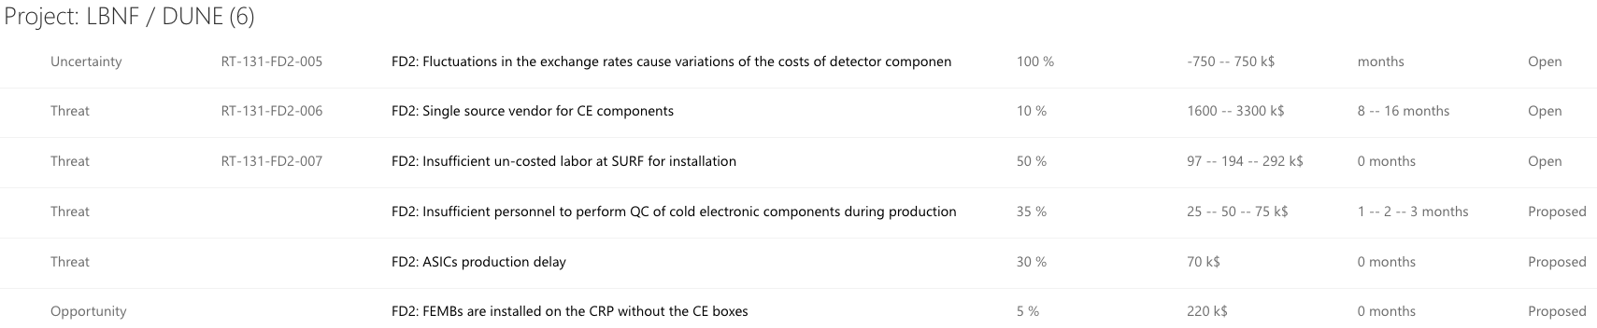
Bottom CE Risks
Have started to evaluate bottom CE risks and mitigation plans
A number of risks are already opened in the Fermilab risk registry
Will continue to define and refine risks associated with Bottom CE in the coming months

Slide 12
Summary
FD1-HD readout electronics can be used to readout CRPs with “minimal” modifications
Scope of the Bottom CE subproject is well defined. Some interface issues with other Consortia will need to be ironed out soon
A joint FD1 and FD2 team of collaborators are contributing to the CE efforts
Most FD1-HD requirements are applicable for VD with some additional ones unique to VD
Also in discussion with I&I to formulate the installation plan at SURF
System integration tests (See Serhan and Filippo’s talk) using the CERN cold box and NP02 to validate the design
See rest of the talks in this Review for more details

