Slide 1
FD2-VD Bottom CRP Electronics CDR:
Interfaces
Marco Verzocchi
Fermilab
Date

Slide 2
Contents
Reminder: interfaces for FD1-HD
Interface with the DAQ
Interface with the HV system
Interface with the photon detector
Interface with the CRP
Request to change the strip size on the CRP

Slide 3
Interfaces for FD1-HD
The main interface is “respect the grounding rules, please…..”
Interface documents available in https://edms.cern.ch/project/CERN-0000195974
Drafts available for every interface except for physics and algorithms (had 1st discussion a few weeks ago, need to write document)
All interface documents have gone through at least 2 revisions, most are fairly detailed and include engineering drawings

Slide 4
Interfaces for FD2-VD – DAQ
Have not yet had an explicit discussion with the DAQ consortium, but it would make a lot of sense to keep the interface between the two system exactly the same as for FD1-HD
  Need to decide whether to send the data ordered by plane (collection, induction 1, induction 2) like in the case of FD1-HD
  Many aspects of software interface between DAQ (CCM and SC modules) not yet fully defined (communication protocols, number of connections, architecture)
    Some of these are being discussed in the context of FD1-HD, expect to use same approach for FD2-VD
  Top CRP Electronics uses different timing distribution system. How is this going to be handled ? (discussed previous presentation)

Slide 5
Interfaces for FD2-VD – HV system (i)
TPC Electronics consortium provides bias voltage to field cage termination electrodes
  48 FC on the bottom of the detector (FC segmented in 20 sections along major axis of the cryostat, 4 sections in the end wall area)
  HV consortium wants us to provide bias voltage also for the 48 FC termination electrodes on the top of the detector
  Bottom of the detector
    Bias voltage goes from the WIENER MPOD crates to the CE flanges warm interface electronics crates, where the voltage is filtered (Bo Yu designs the filter card)
    Inside the CE flange SHV cable goes to the bottom of the detector where there is sufficient cable length to go to a termination card on the field cage
    The termination card also has a failsafe return for the ground current (AWG20 wire that is connected on the CE flange)

Slide 6

Interfaces for FD2-VD – HV system (ii)
TPC Electronics consortium provides bias voltage to field cage termination electrodes
  Not yet discussed / understood
    Does this distribution scheme work for the 8 connections on the end walls ?
    How do we route the cables for the field cage termination electrodes for the top field cages ? Which cryostat penetrations are we going to use ?
Where does the field cage hang from ?

Slide 7
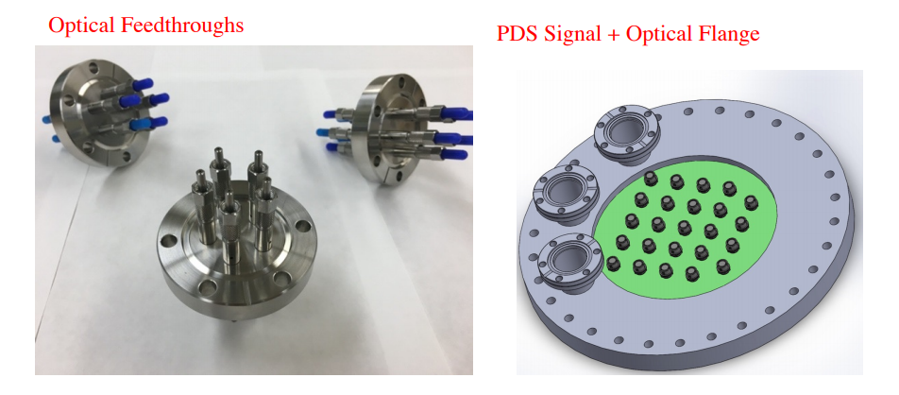
Interfaces for FD2-VD – PDS (i)
In FD1-HD the photon detector system uses the 3rd flange on the spool piece of the TPC electronics consortium cryostat penetrations
  We are responsible for cable routing (and some of the studies about cable routing): 20 PD cables + 4 RTD cables (from the APAs)
  This includes the fibers for the PD monitoring

Slide 8
Interfaces for FD2-VD – PDS (ii)
FD2-VD: no cables, just fibers
How many fibers ?
  Analog readout: 4288 fibers (22 fibers per 6” flange, ~200 flanges)
  Digital readout: 448 fibers (no redundancy)
No engineering on this yet
  With a 14” flange it is reasonable to be able to house ~120 fibers per flange
    This would require ~40 flanges
  It may be almost impossible to house 215 fibers per flange
    This is what is required if there are only 20 flanges available

Slide 9
Interfaces for FD2-VD – CRP (i)
FEMBs are mounted on the adapter cards
  Mechanical and electrical interfaces
FEMBs are housed in CE boxes (Faraday cages)
  Mechanical support
TPC Electronics consortium provides bias voltage to anode planes
  Interface via SHV connectors
FEMB cabling part of the interface
  Need cable restraint, need to understand whether we are going to have single cable between CE flange and FEMB or whether we have short permanent cable on the CRP and patch panel (easier installation, one extra point of failures)

Slide 10
Interfaces for FD2-VD – CRP (ii)
Most recent design of CRP support structure takes into account the needs of accessing the FEMBs / routing cables
Mount point for FEMBs/CE boxes on the adapter cards
TPC Electronics consortium replaced stainless steel with aluminum in the CE boxes (reduce weight by 50%)
Will investigate whether CE boxes are absolutely necessary next year during test of full CRP with TPC Electronics
Design so far has focused on “top” CRP (for cold box/ProtoDUNE-VD) with support structure above the CRP
Bottom CRP is different, need to take into account installation procedure in the design of the support structure

Slide 11
Changing the number of strips (i)
Current design of the CRU
  Collection: 576 strips (perpendicular to the beam)
  Induction 1: 384 strips (48 degrees)
  Induction 2: 640 strips (parallel to the beam)
Alternative design
  Collection: 608 strips (perpendicular to the beam)
  Induction 1 / 2: 496 strips (+/- 30 degrees)
In both cases:
  Total number of strips per CRP: 1,600
  13 FEMBs per CRU
  2 FEMBs each with 32 unused channels

Slide 12
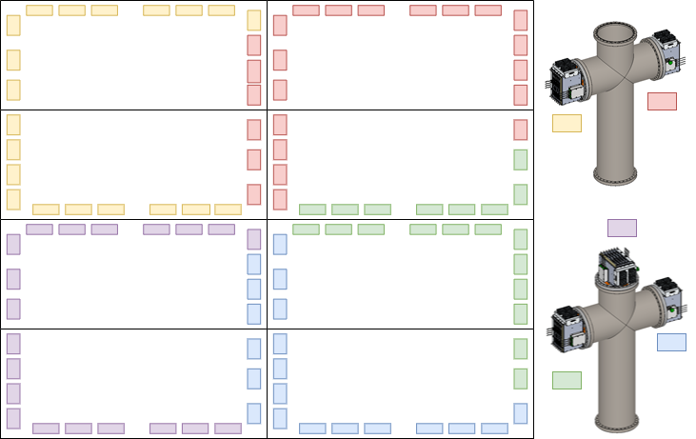
Changing the number of strips (i)
What are the consequences of having 13 FEMBs/CRU:
  You need 5 flanges on 2 cryostat penetrations to connect the 104 FEMBs (4 WIECs with 5 WIBs/20 FEMBs, 1 WIEC with 6 WIBs/24 FEMBs), 5 flanges for 4 CRPs

Slide 13
Changing the number of strips (ii)
This introduces all sorts of complications
  Bias voltage distribution at the CRU or CRP level
  Each CRP should be referenced to 1 flange
  But here 1 CRP is always referenced to 2 flanges, and in some cases the two flanges may be on different cryostat penetrations
Clearly this design is non-optimal
  From the point of view of keeping match between CRP and CE flange (desirable in order to minimize noise)
  [ASIDE: We are even sharing 1 WIB between 2 CRPs in this design (to avoid this increase the number of WIBs from 520 to 560, increase the number of crates with 6 WIBs from 20 to 60) ]

Slide 14
Changing the number of strips (iii)
Optimal design
  Match 1 CRP to 1 CE flange
  Maximum number of FEMBs per CRP: 24
  Maximum number of FEMBs per CRU: 12
  With no unused channels: 1,536 channels instead of 1,600
  4% reduction in the number of channels

Slide 15
Changing the number of strips (iv)
Other consequences
  Number of WIBs reduced from 520 (or 560) to 480
  Total number of FEMBs reduced from 2,080 to 1,920
  Total number of WIECs/PTCs reduced from 100 to 80
  Freed up 20 flanges for photon detector (increase from 20 to 40)
  Preliminary estimate of cost reduction: -$620k
Double the number of available flanges for PD: 20 → 40

Slide 16
Changing the number of strips (v)
Drawbacks ?
  Make the same change also for the top CRP ?
  Accept different anode plane design for top and bottom CRP ?
    Note that adapter cards are already different (top/bottom)
Double the number of available flanges for PD: 20 → 40

Slide 17
Going back to the interface with HV
Which cryostat penetrations support the field cage ?
If the field cage is supported by bottom CRP electronics cryostat penetrations
  One more reason to reduce the number of FEMBs / cold cables / WIBs / flanges used by bottom CRP electronics
  Compatibility between having mechanical support for field cage and fibers for photon detector ?
  Need to redesign completely the spool piece to support weight of several hundreds of kg
  Unclear we can fit cables for 48 FEMBs, fibers for the photon detector, and a rod / cable to support the field cage in the same 213.5 mm inner diameter tube

Slide 18
Conclusions
Work on interface with CRP ongoing but
  We need to look into support for bottom CRP (once the design of the CRP to be used in cold box tests and ProtoDUNE is completed)
  Shall we plan for a cold box test of a bottom CRP installed in the appropriate direction ?
  There are serious reasons to reconsider the design of the anode planes for the bottom CRP and reduce the number of strips per CRU to 1,536
Decision of support of field cage / needs of photon detector system for flanges may force us to reconsider the design of the cryostat penetrations / spool piece
Needs of other consortia for the cryostat penetrations used by the bottom CRP electronics ?

