Slide 1

Bottom Electronics CDR
FEMB Design Status
Shanshan Gao
05/28/2021

Slide 2
Content
FEMB Design for both HD and VD single-phase LArTPC
FEMB Roadmap
Integration Tests
Consideration of the EMI shielding box for FEMB
Consideration of Cabling
FEMB QC Plan
Summary

Slide 3
Using the horizontal drift electronics for the bottom CRUs
Electronics designed to be immersed in LAr, installed very close to the pickup electrodes, transmit digitized signals on long cold cables (9-22 m for the horizontal drift)
  Minimize noise / space required on feedthroughs
SBND FEMBs used to read out prototype in the CERN 50L prototype
  Promising performance with both 2-view and 3-view anode PCB prototype
The design of the FEMBs, WIBs, WIECs, services on top of the cryostat inherit from the horizontal drift detector (no change or minor revision)
  Production of detector components for the vertical drift detector will follow that of components for the horizontal drift detector
Heat generated by electronics is negligible
  Tests have been made at BNL with cryostat with LAr under pressure. At 14 m depth, no bubbles are released from heating elements with power density up to 4W/cm² → no bubble formation (gas boils bubbles collapse immediately under hydrostatic pressure)

Slide 4
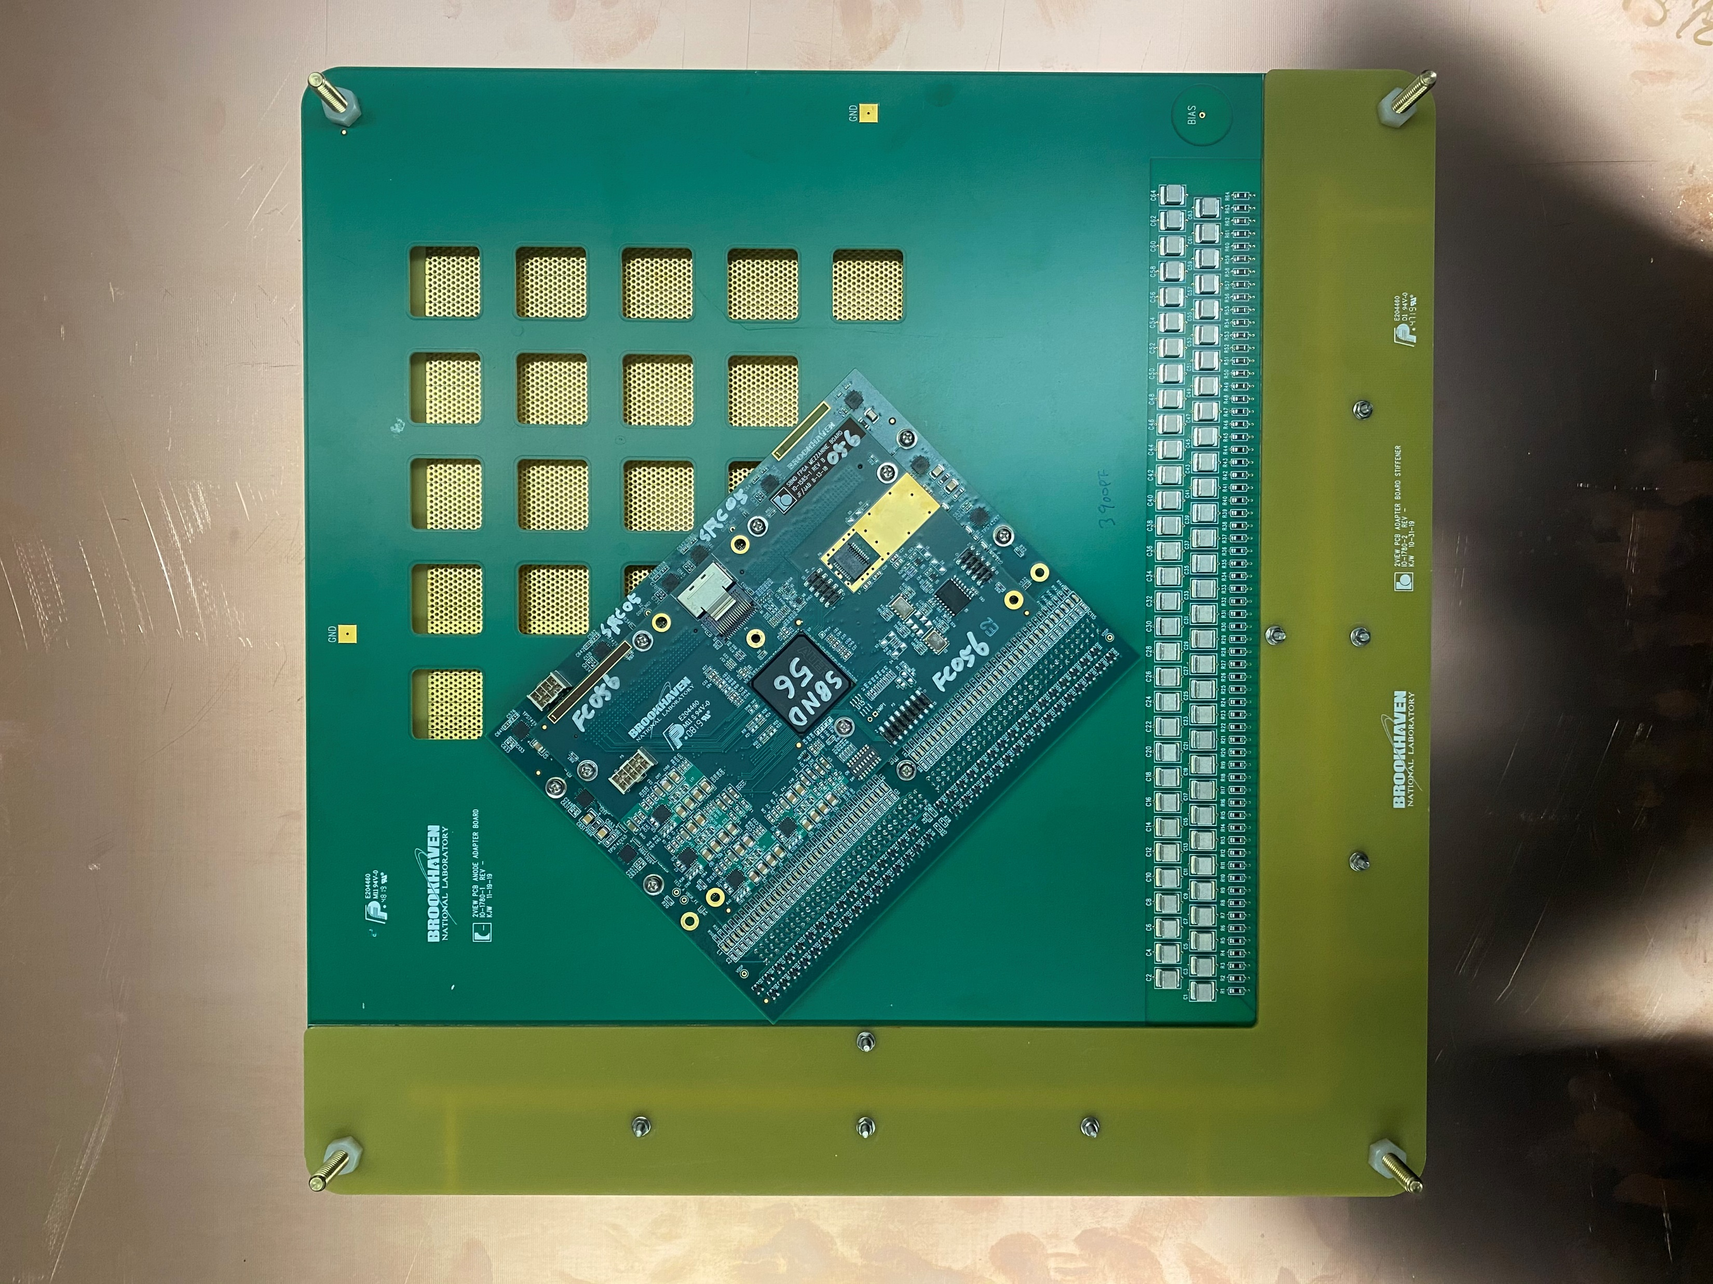
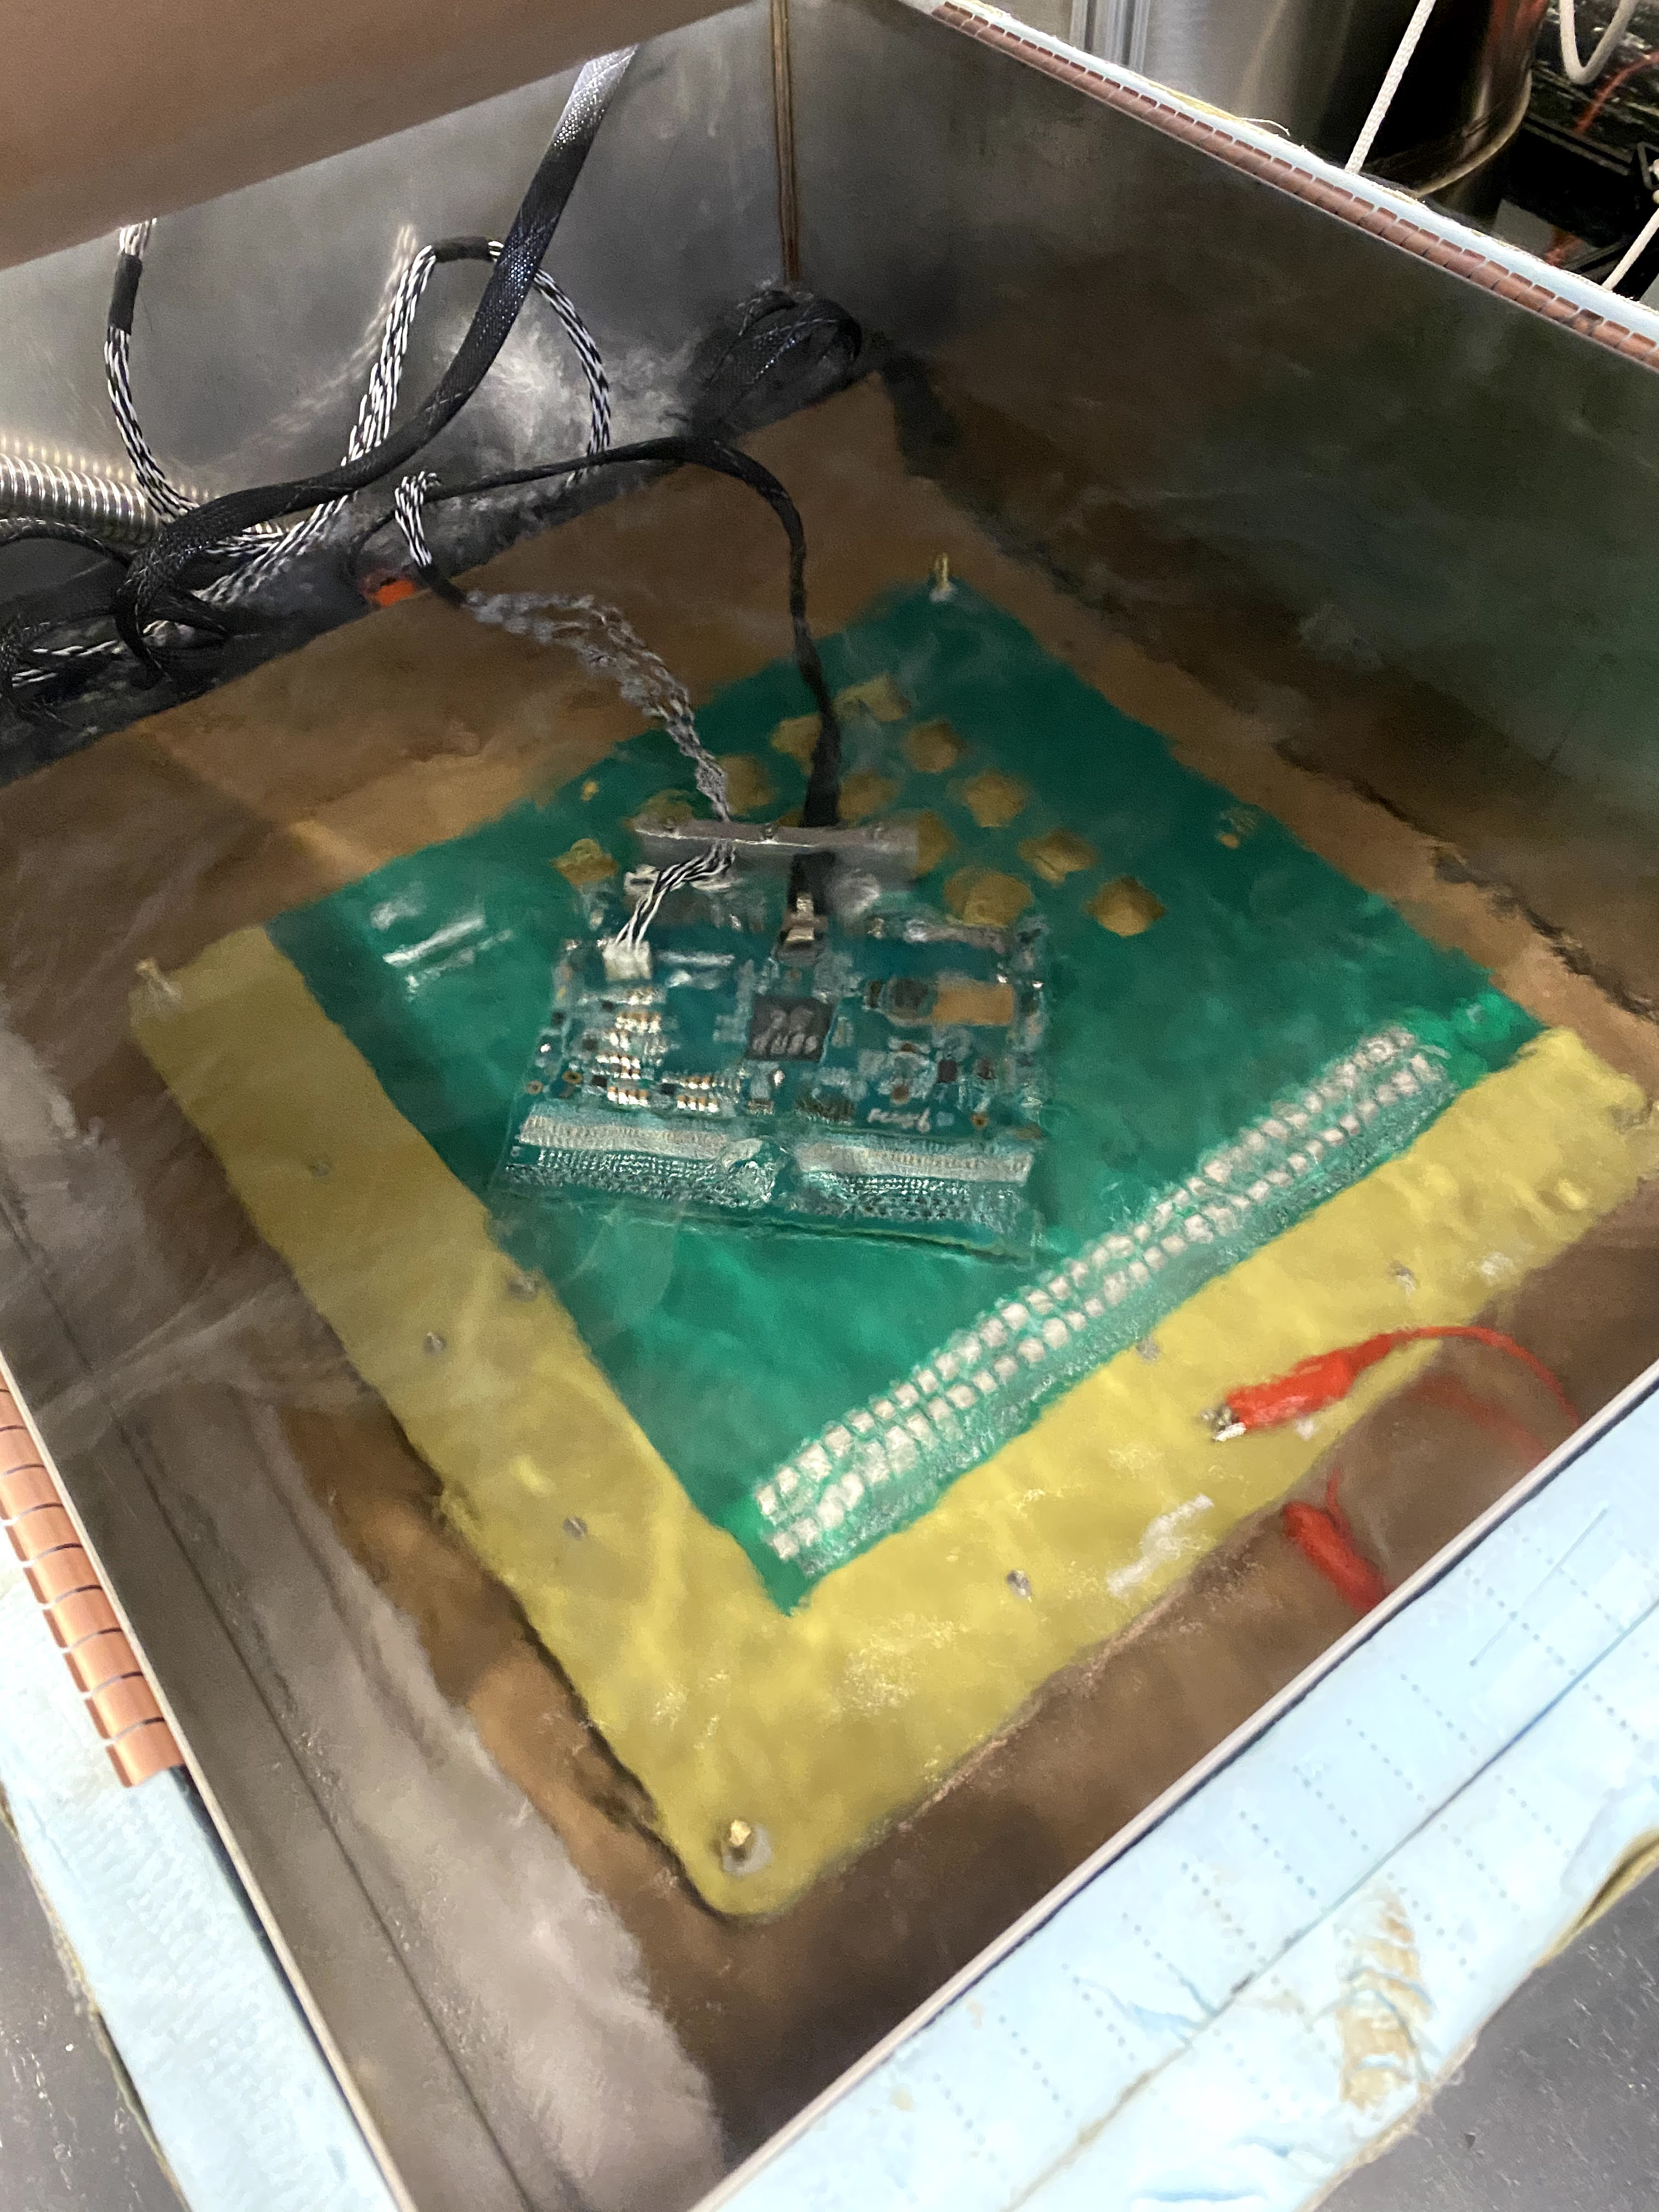
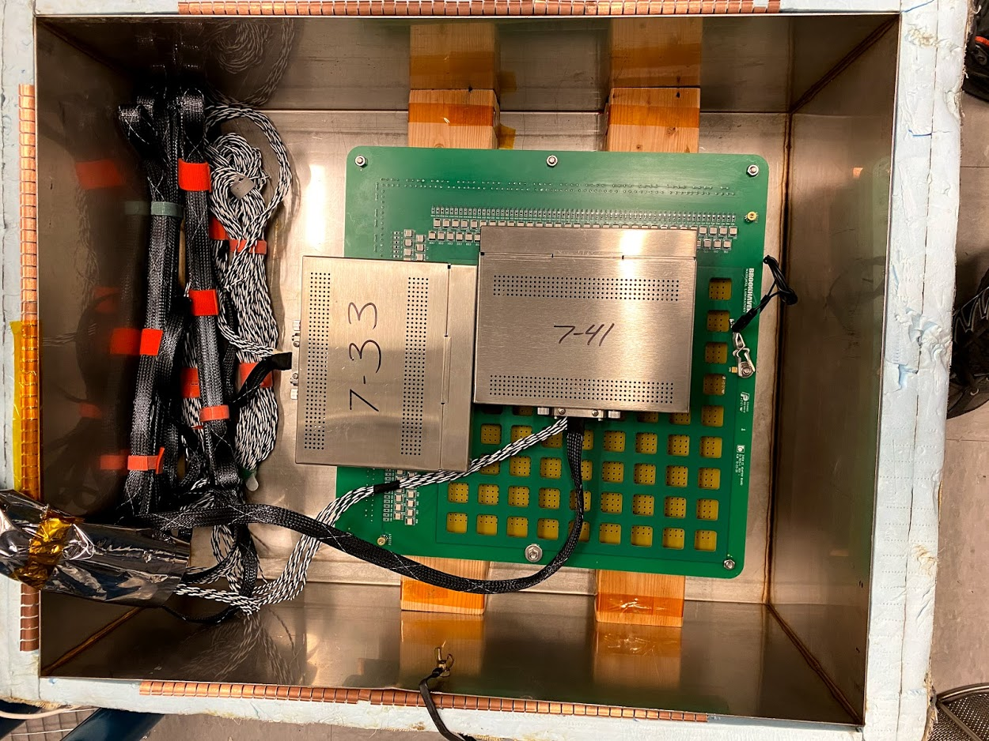
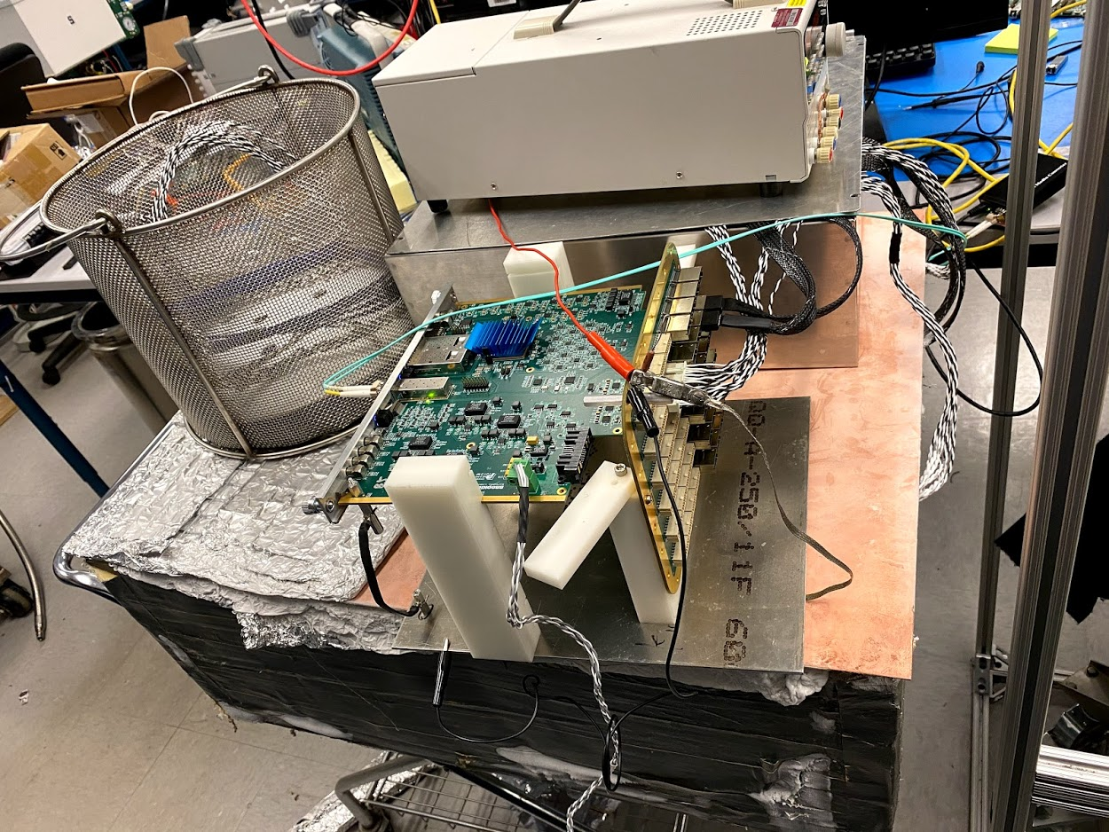
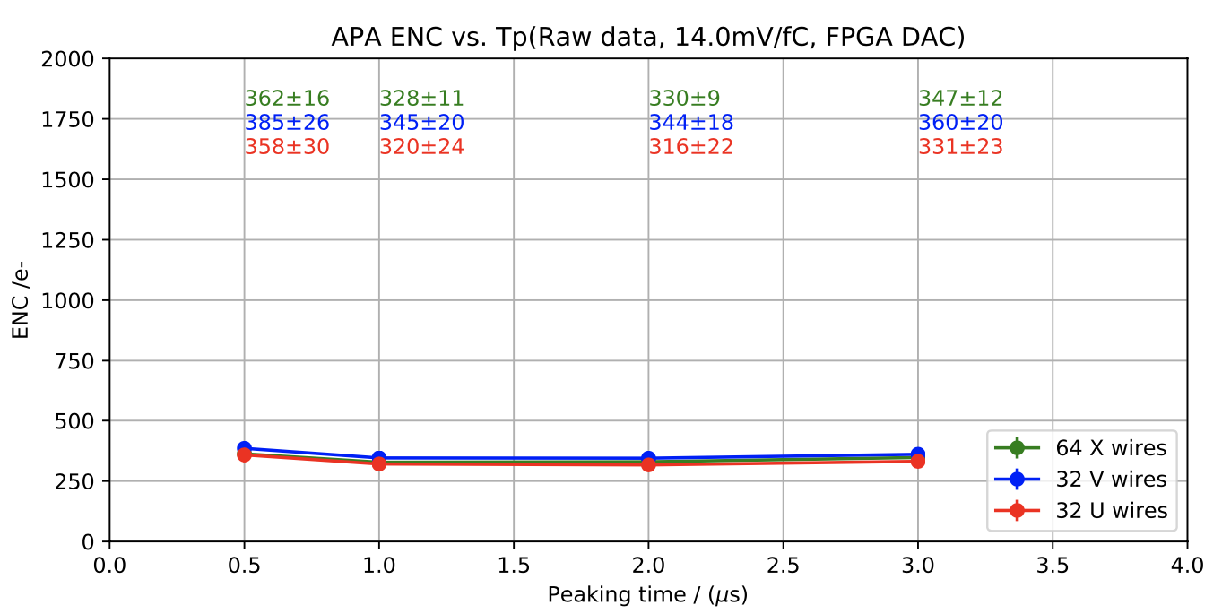
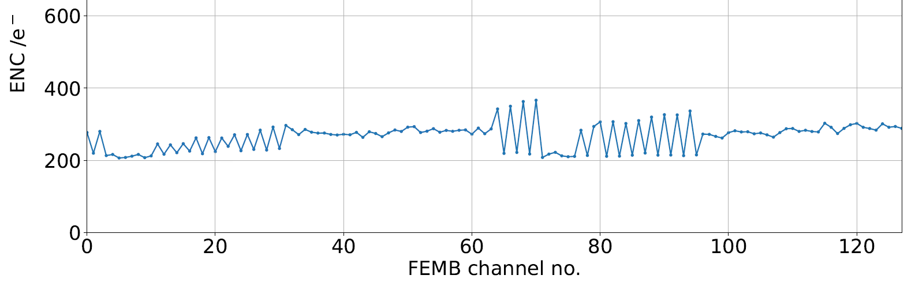
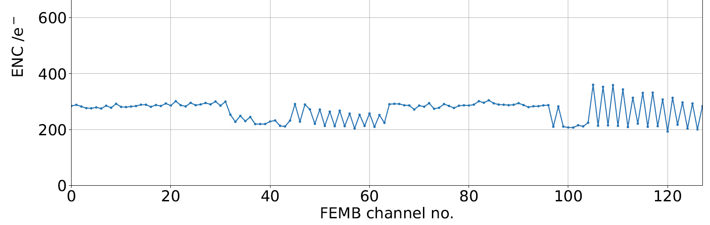
Using the horizontal drift electronics for the bottom CRUs
SBND FEMBs used to read out 2-view and 3-view anode PCB prototype
  Anode PCB, adapter board and CE were thoroughly verified at BNL in LN2
  2-view and 3-view anode PCB prototypes with integrated CEs have been working excellently at 50L setup
    Serhan Tufanli. Vertical drift anode PCB demonstrators with integrated bottom electronics. DUNE collaboration meeting, May 20, 2021
2-view anode PCB tested at BNL
3-view anode PCB with CE tested at BNL
FEMB#2
3-view
ENC at LN2
2-view
FEMB#1
3-view

Slide 5
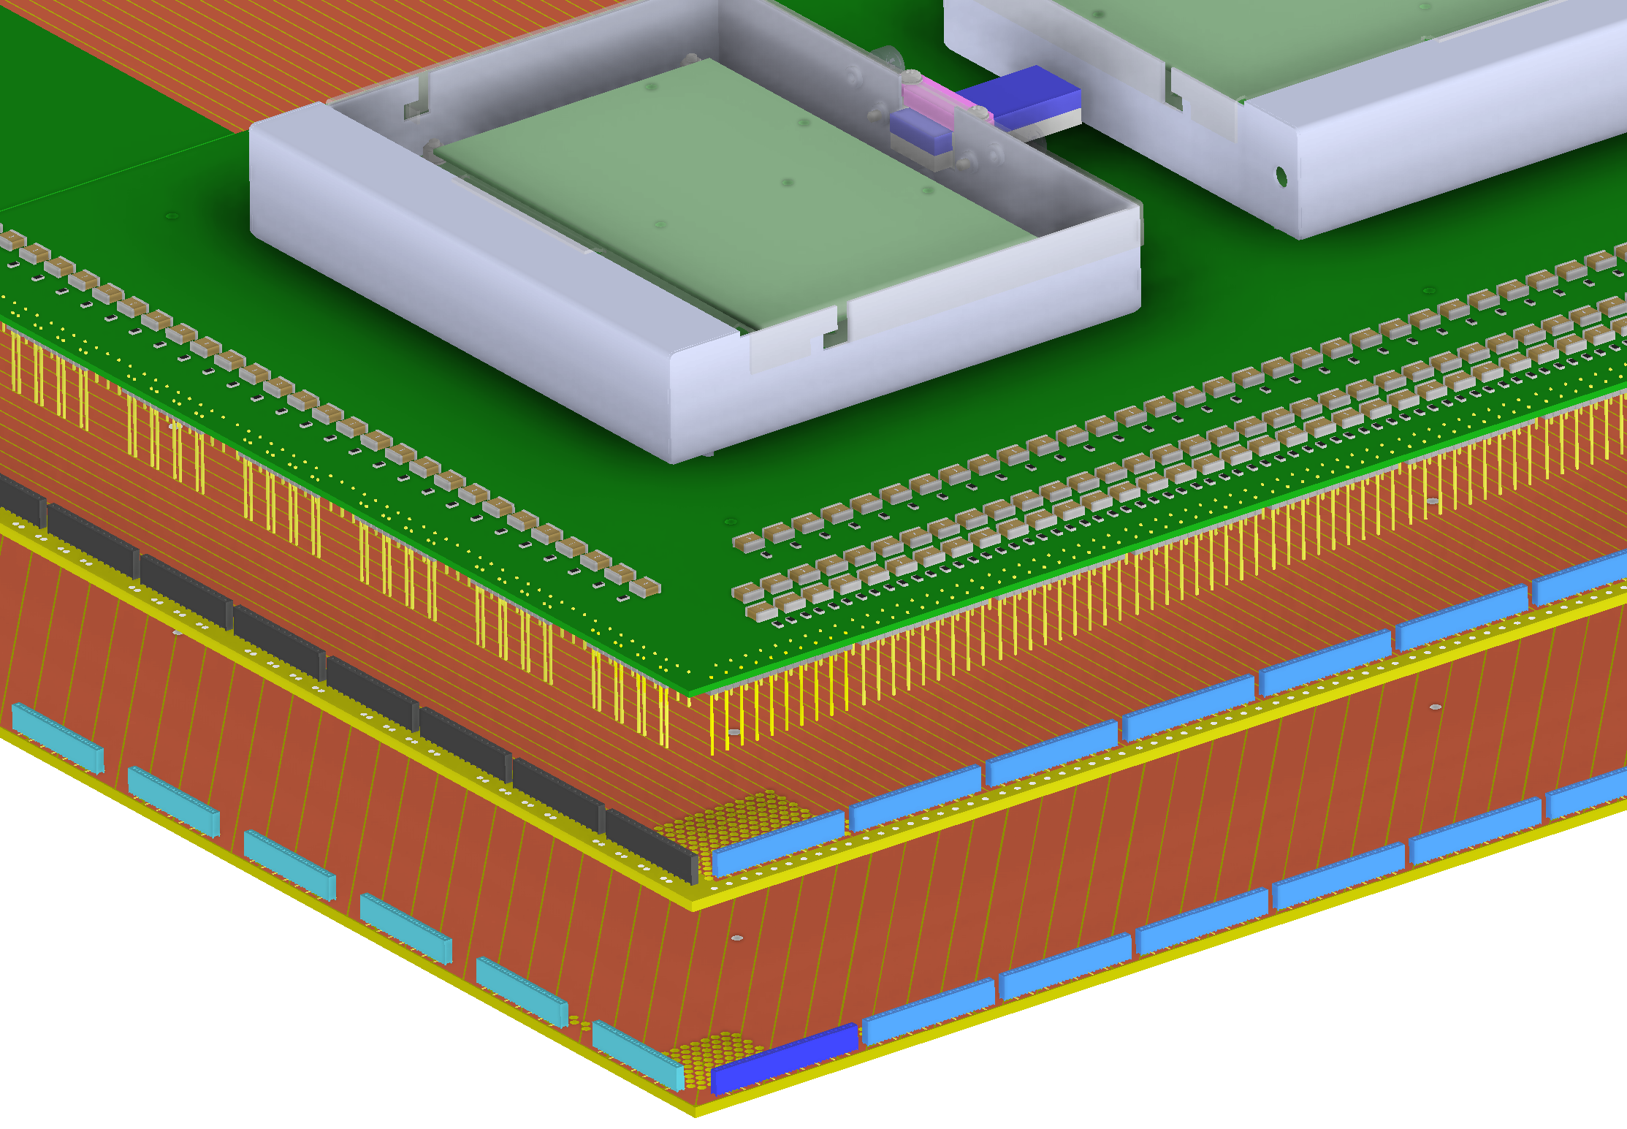
1st Cold Box 3-View Design : Bottom CRU Assembly Details
Slide from Yu Bo in DUNE collaboration meeting
8 unique CE adapter boards carries 13 CE modules, in addition to the high voltage coupling capacitors and current limiting resistors.
2 of the 13 modules on the CRU use 96 of the total of 128 channels.
Initial evaluation of the 50L 3-view setup at BNL showed noise pickup when the FEMBs are not enclosed the metal boxes.
To ensure good noise performance in the cold box test, the adapter boards, and composite frame holding the CRUs are designed to accommodate the CE boxes.
In the meantime, the CE boxes are being redesigned to be thinner, shorter, and lighter for the monolithic FEMBs.

Slide 6
Content
FEMB Design for both HD and VD single-phase LArTPC
FEMB Roadmap
Integration Tests
Consideration of the EMI shielding box for FEMB
Consideration of Cabling
FEMB QC Plan
Summary

Slide 7
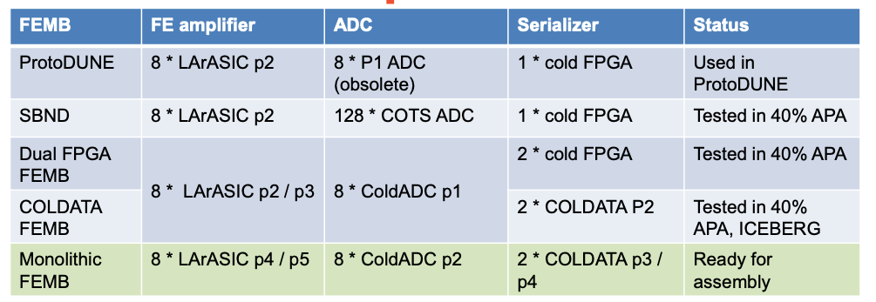
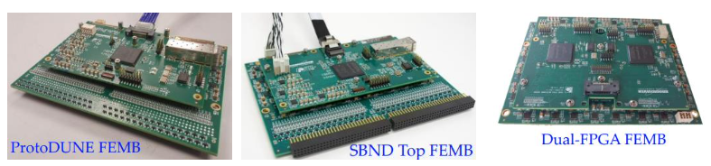
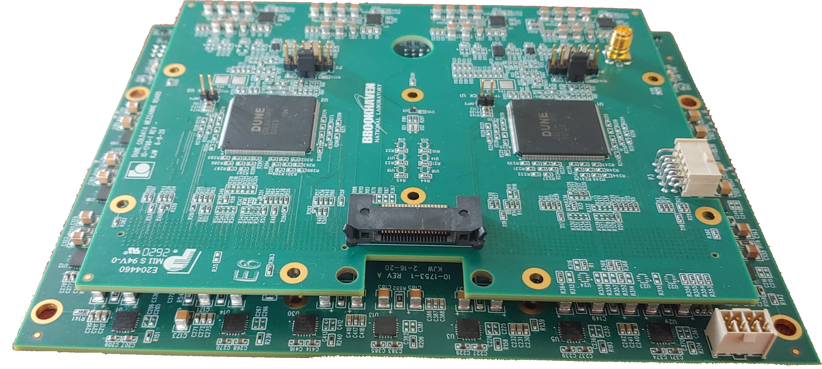
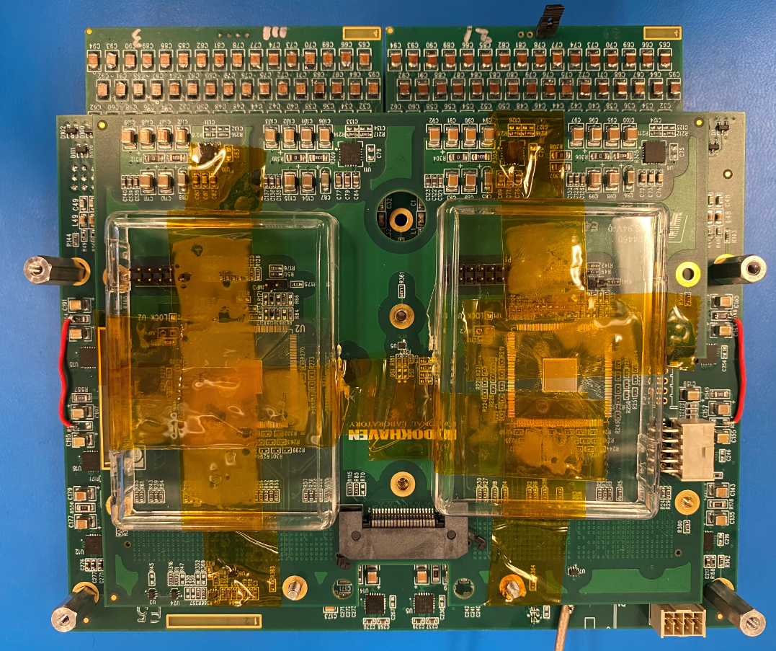
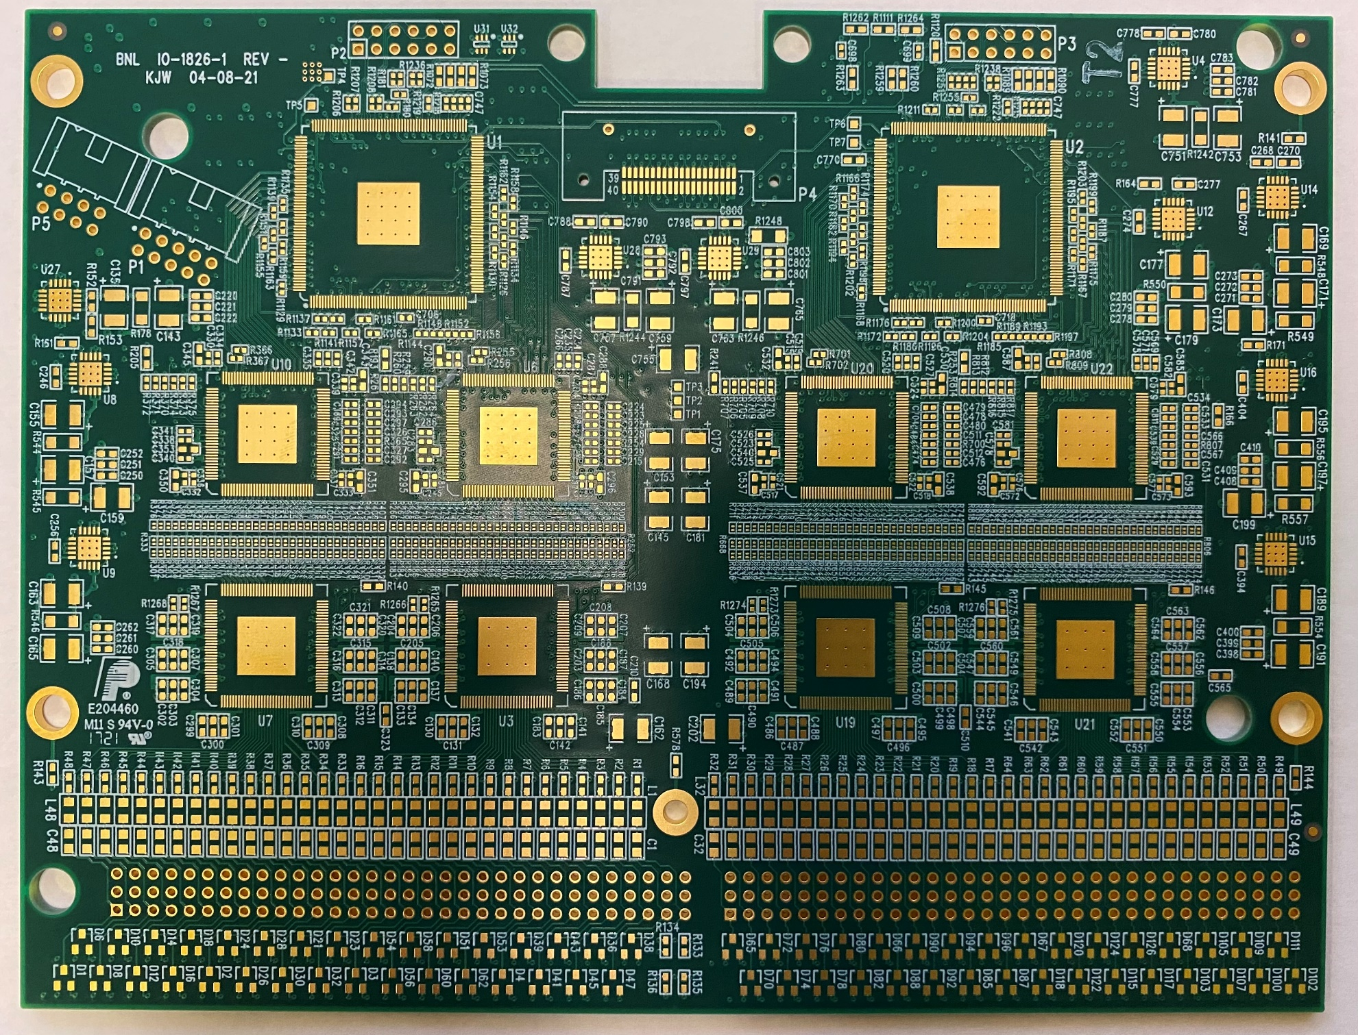
FEMB Roadmap
COLDATA FEMB (R0)
COLDATA FEMB (R1)
Monolithic FEMB (Final)

Slide 8
One final design iteration on the monolithic FEMB
minor revision, design changes do not present any risk
Reduce the cable plant between the FEMB and the CE flange
  Necessary for FD1-HD
  Reduction in the number of connections per FEMB is useful also for FD2-VD
Enhanced analog monitoring feature(requires COLDATA P4)
  8x LArASIC: each channel output, bandgap reference, and temperature
  1x ColdADC: Voltage references can be monitored
    Share the same path with LArASIC monitoring by the analog switch
Incorporate lessons learned from the first monolithic FEMB
  Possible layout optimization for better performance
  Mechanical optimization for assembly installation
    Locations of connectors, assembly holes, and etc.
FD1-HD to FD2-VD
  If patch panel and mini-SAS cable are chosen
    Minor revision to replace Samtec data connector to mini-SAS connector
  If CE box is removed
    New cable relief scheme should be considered

Slide 9
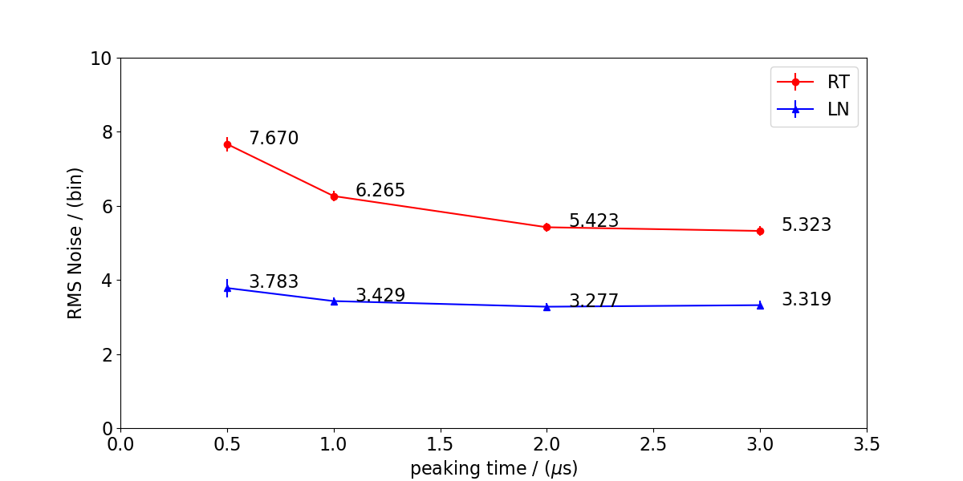
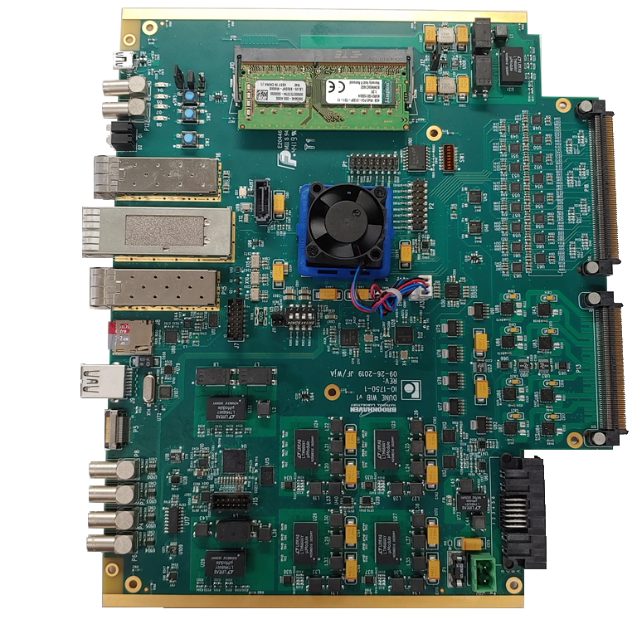
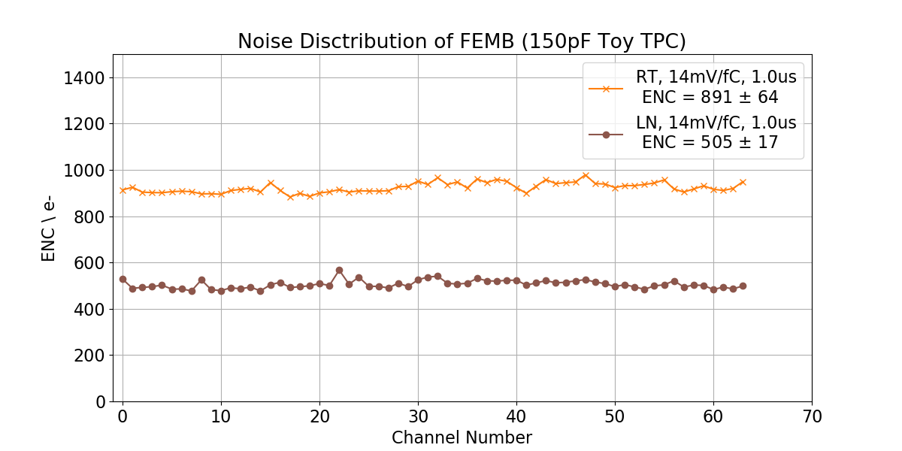
Latest Mezzanine 3-ASIC FEMB Characterization
Reported in the DUNE CE consortium meeting on 04/26/2021
  The latest Mezzanine 3-ASIC FEMB (intermediate FEMB towards the monolithic FEMB design) shows promising performance with the bench-top test stand at BNL
14mV/fC
Mezzanine 3-ASIC FEMB (R1)
Zynq+ WIB

Slide 10
Content
FEMB Design for both HD and VD single-phase LArTPC
FEMB Roadmap
Integration Tests
Consideration of the EMI shielding box for FEMB
Consideration of Cabling
FEMB QC Plan
Summary

Slide 11
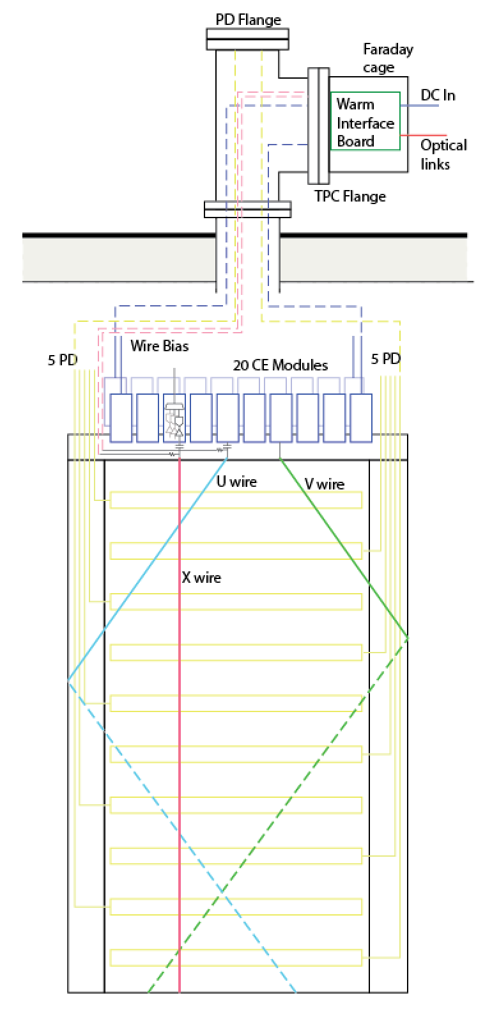
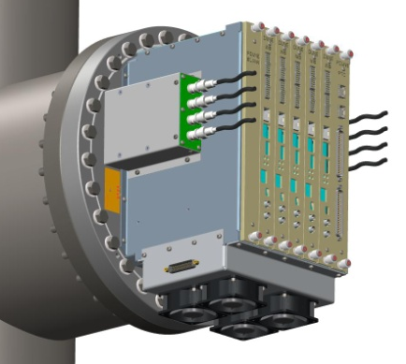
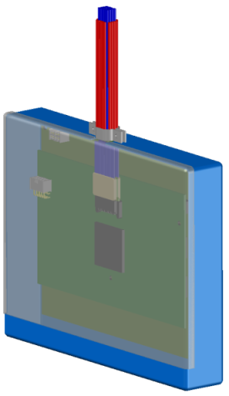
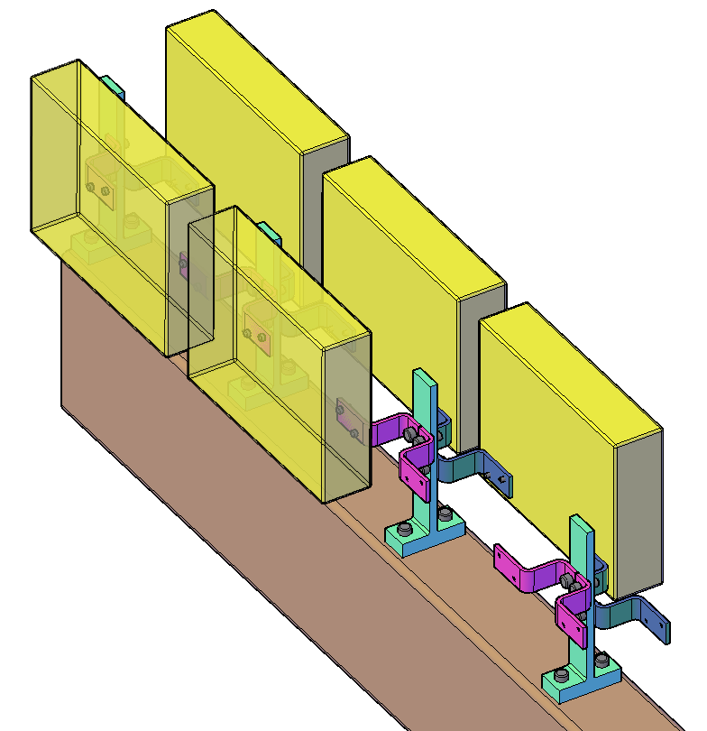
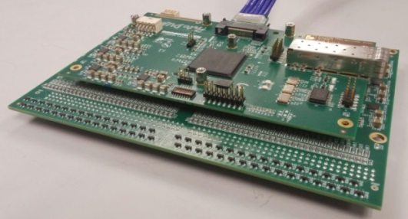
Integral System Design Concept
  A necessary (but not sufficient!) condition to achieve a good performance, the integral design concept of APA + CE + Feed-through, plus Warm Interface Electronics with local diagnostics and strict isolation and grounding rules will have to be followed
ProtoDUNE-SP
HD
BNL: 40% APA test stand (LN₂)
CERN: Cold box test stand (Cold N₂ gas)
Fermilab: ICEBERG test stand (LAr)
VD
BNL: CRP cold box (LN2) under construction
CERN: 50L for small prototype
CERN: CRP cold box (LAr)
Cold electronics module and its attachment to the APA frame

Slide 12
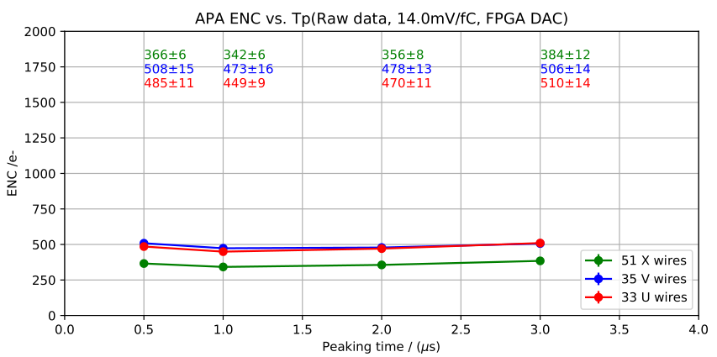
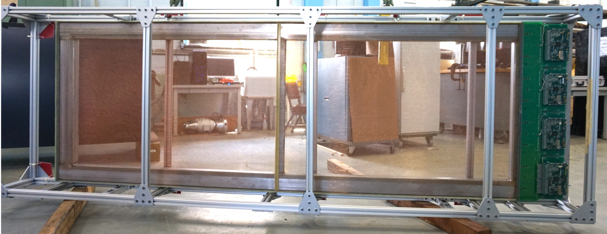
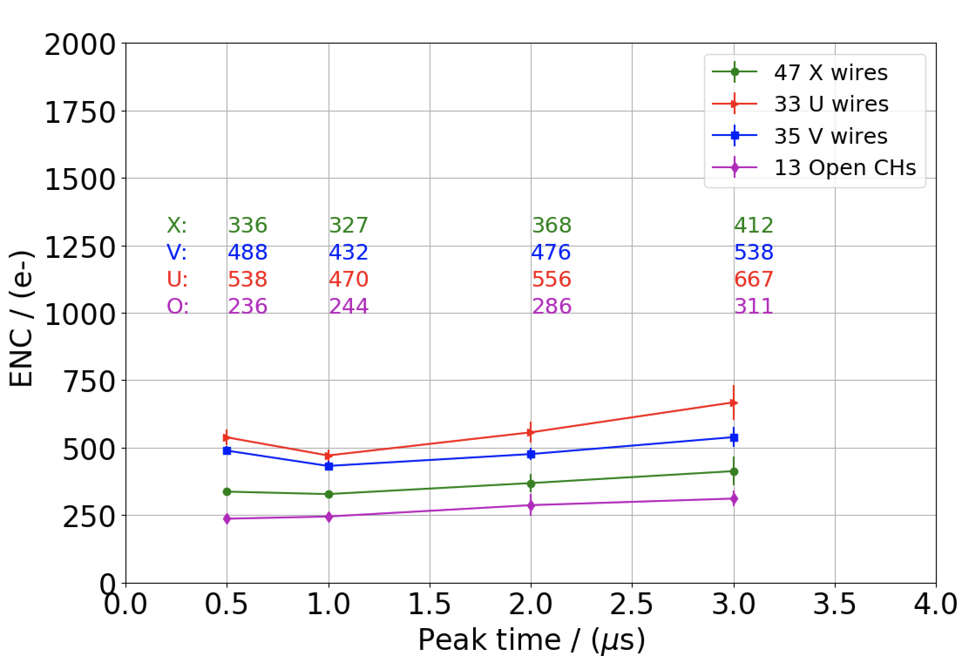
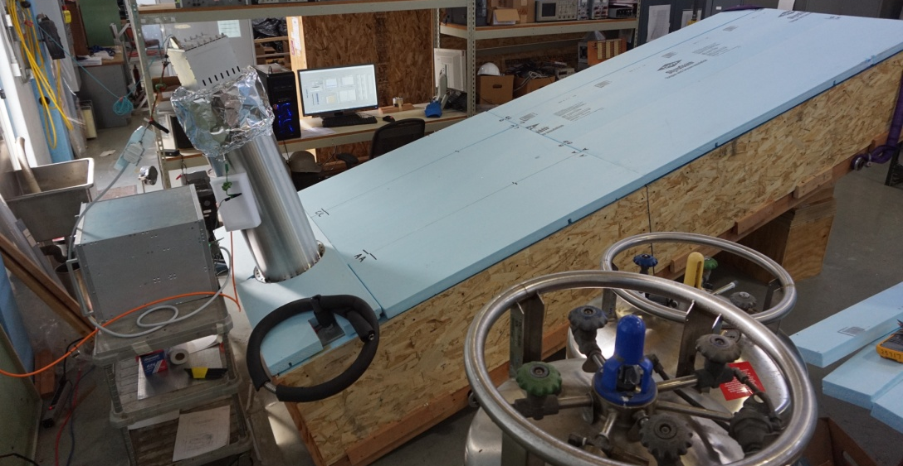
40% APA Integration Test Stand at BNL
LN2, APA Loc#B2
SBND FEMB
3-ASIC FEMB Prototype
LN2, APA Loc#B2
3-ASIC FEMB
Consistent with previous measurements with ProtoDUNE or SBND FEMB
40% APA Integration Test at BNL

Slide 13
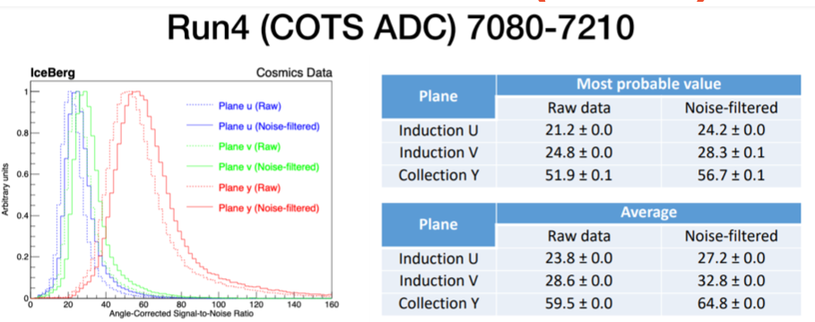
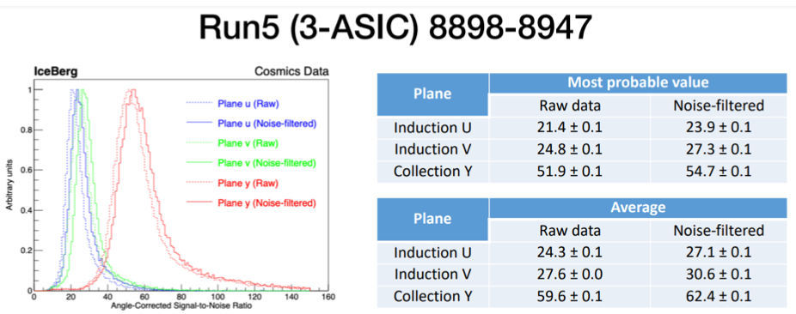
ICEBERG Test Result
3-ASIC FEMB has the similar level of noise compared to ProtoDUNE FEMBs, few % higher than SBND FEMBs based on the commercial off the shelf ADC.

Slide 14
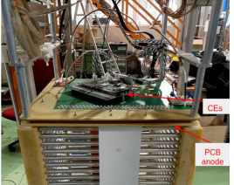
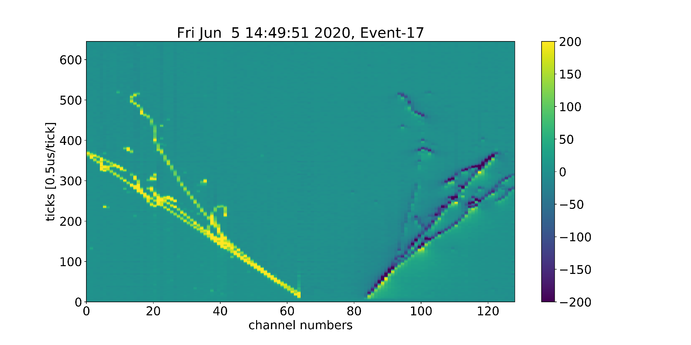
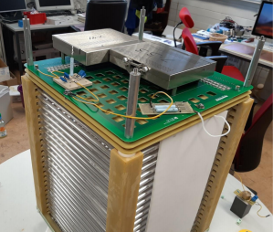
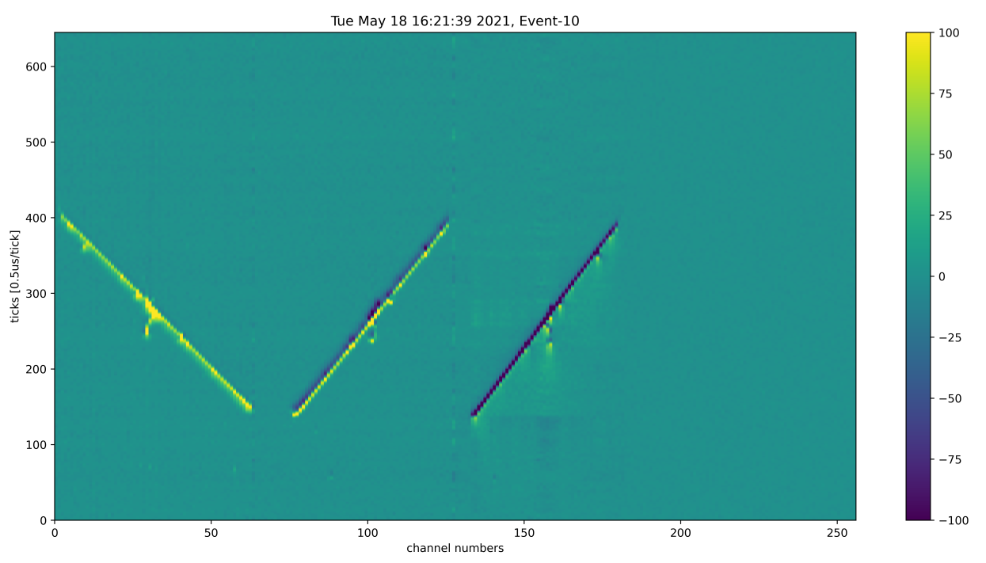
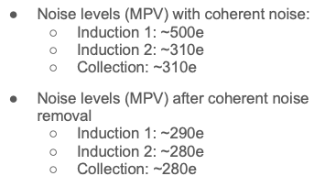
CERN 50L Setup
See Serhan and Filippo’s talk
Vertical drift anode PCB demonstrators with integrated bottom electronics
  Serhan Tufanli. DUNE collaboration meeting, May 20, 2021
2-view
ENC of 2-view at LAr
C = ~ 320 e
I = ~355 e
After coherent noise removal
~300 e for both C and I
2-view: FEMB without CE box
3-view
3-view: FEMB without CE box

Slide 15
Content
FEMB Design for both HD and VD single-phase LArTPC
FEMB Roadmap
Integration Tests
Consideration of the EMI shielding box for FEMB
Consideration of Cabling
FEMB QC Plan
Summary

Slide 16
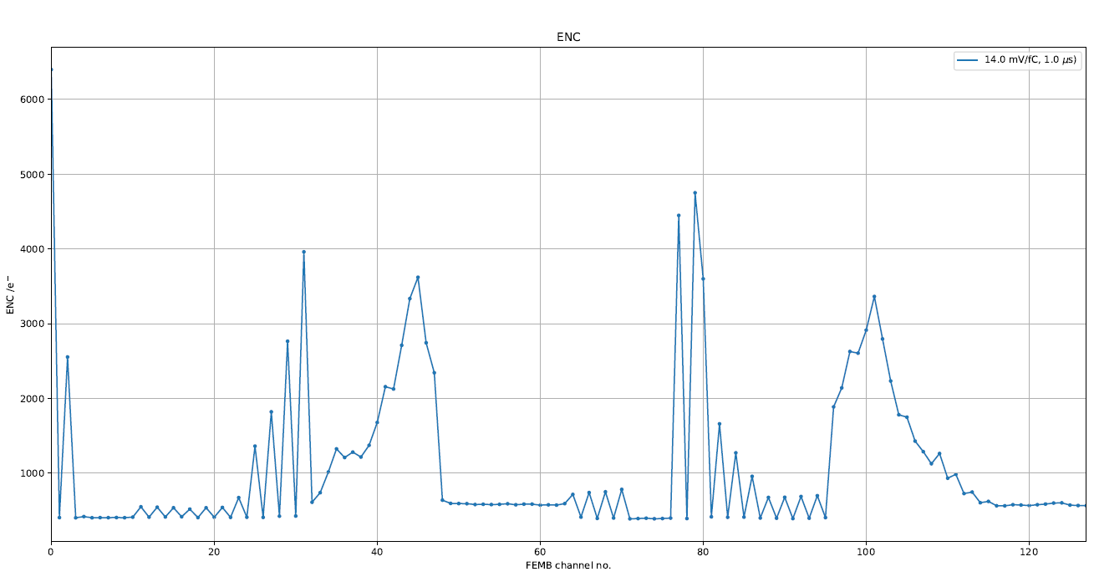
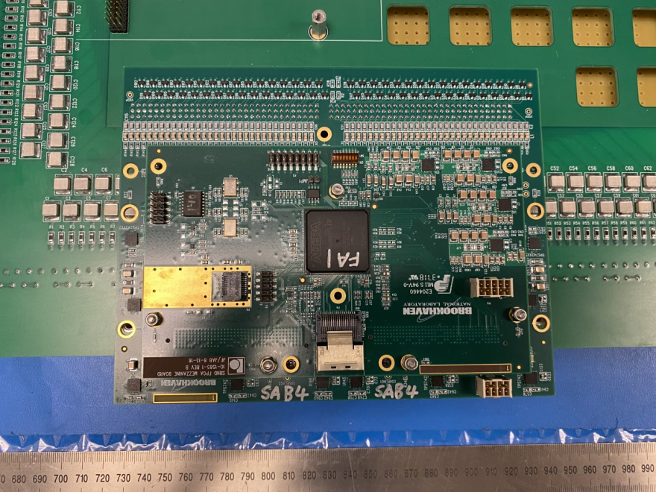
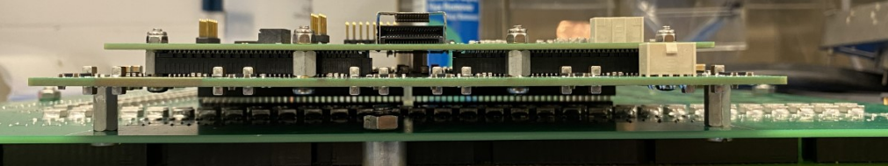
CE Box for 3-View Prototype
2-View Anode PCB
  The adapter board between FEMB and anode PCB has an entire copper plane to common ground, which provide good EMI shielding
  No trace or HV capacitor on the adapter board right under the FEMB
3-View Anode PCB
  The adapter board between two FEMBs and anode PCB has limited copper plane area
  Many traces and HV capacitors right under one FEMB, digitization (ADCs) emits noise to them.
    The placement of the FEMB module in this picture was due to space constraints inside the 50L cryostat. On the large CRPs, the FEMB are not placed directly above the fan-in traces
3-view
3-view
Higher than expected noise even at RT shows with the channels having traces on the adapter board under FEMB

Slide 17
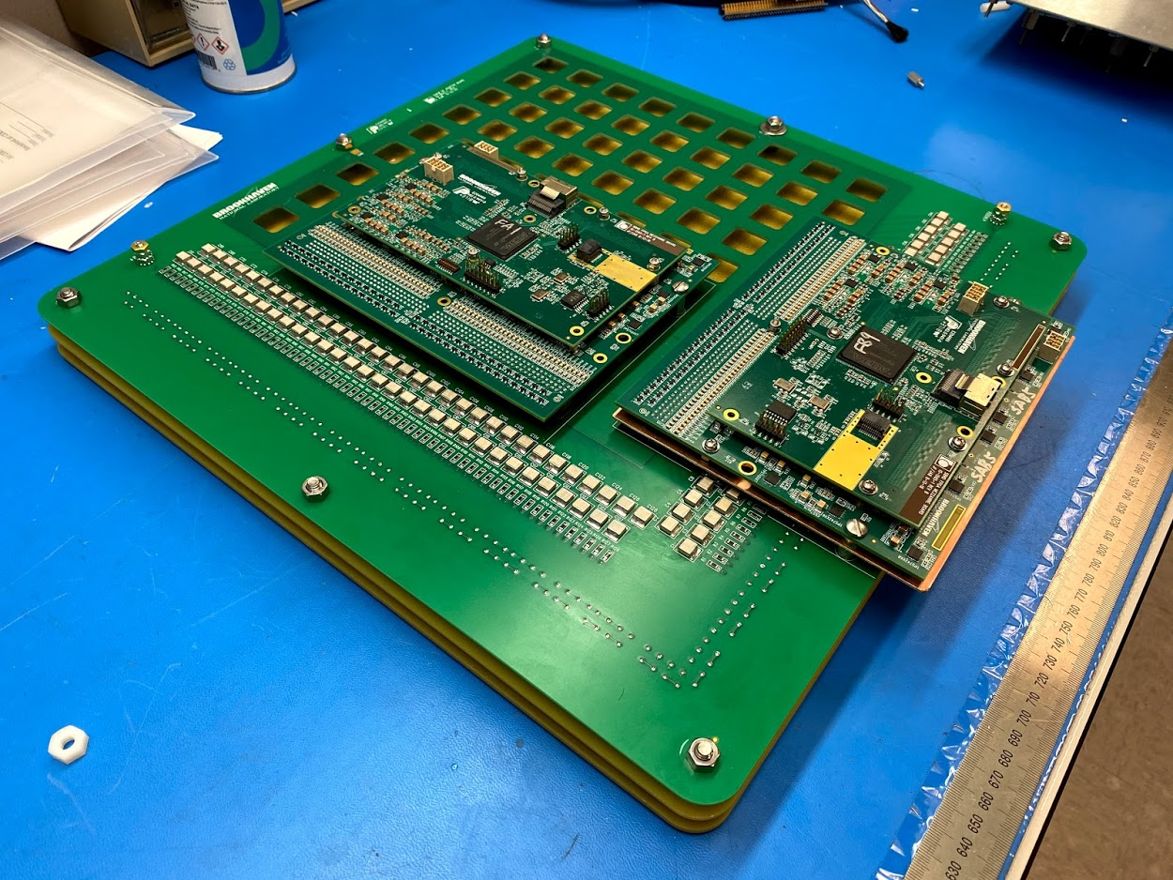
CE Box for 3-View Prototype
Adding a copper shielding plane between FEMB and the adapter board helps mitigate extra pick-up noise
CE boxes are added to provide sufficient shielding
The shielding plane under FEMBs can mitigate pick-up noise significantly at RT
At cryogenic temperatures, the shielding plane under FEMBs can mitigate the pick-up noise to an acceptable level but not optimal
  Digital devices (ADC, FPGA, COLDATA) on FEMB could be noise sources
  CE box is recommended since potential noise path in full-size CRU could be hard to control

Slide 18
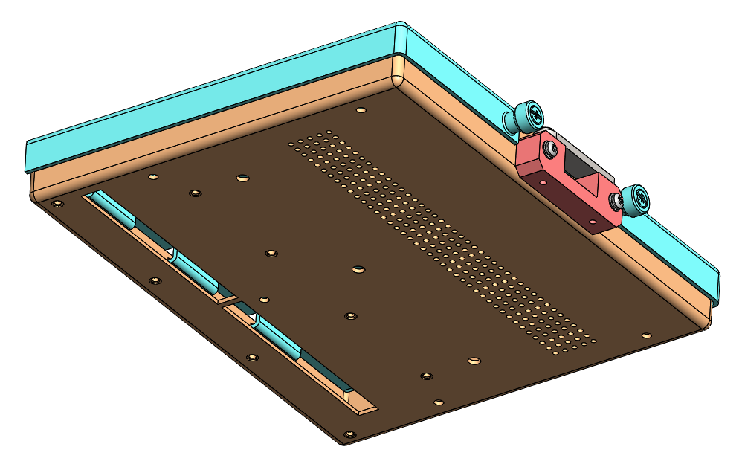
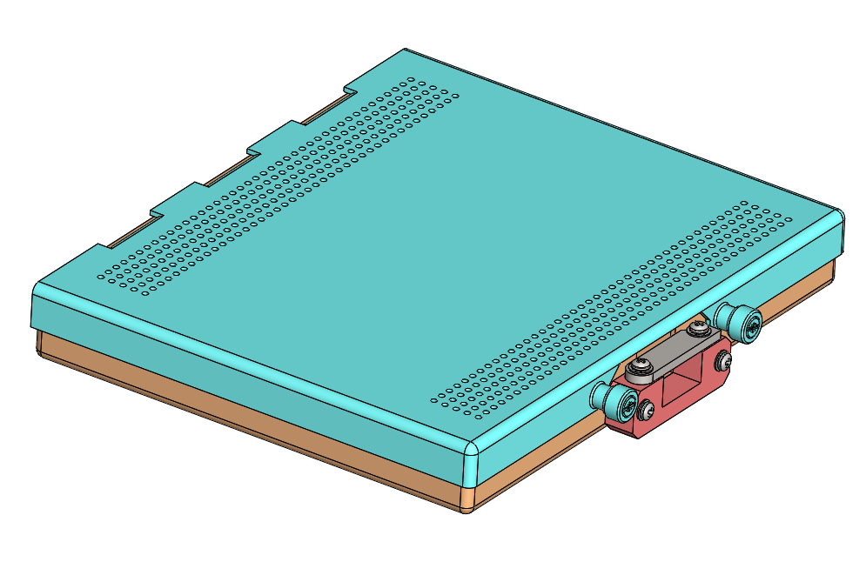
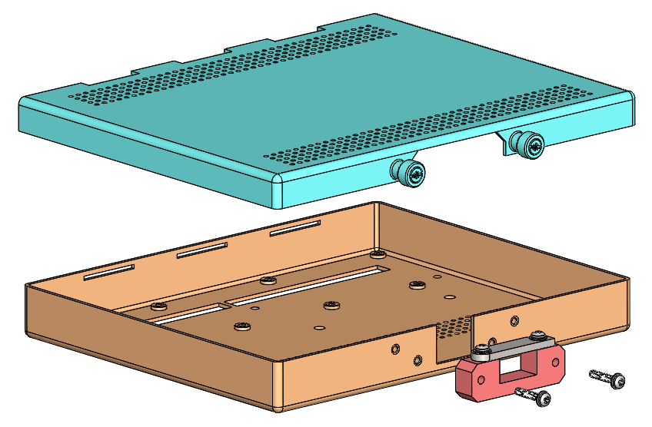
Thinner and lighter CE box in Aluminum
See Manhong’s talk
CE box is designed for the monolithic FEMB
The weight of CE box (without FEMB) is reduced from 767g to 394g

Slide 19
FEMB w/wo CE box for the CRP
FEMB with CE box
  Better EMI shielding to avoid anode PCB picking up noise from FEMB
  Easy for strain relief design
    Strain relief is on the CE box
  More freedom of CR adapter design and FEMB placement on the CRP
FEMB without CE box
  Much lighter, easy the requirement of the suspension design
  Redesign strain relief for cold cables attached to the FEMBs
  A shielding layer (entire copper plane) of the CR adapter board between FEMB and Anode PCB is necessary
NP02 cold box test can help make the decision
  Preliminary plan for a CRP testing in NP02 cold box
    FEMBs enclosed in CE boxes will be populated one CRU
    The other CRU will have FEMBs w/o CE boxes

Slide 20
Content
FEMB Design for both HD and VD single-phase LArTPC
FEMB Roadmap
Integration Tests
Consideration of the EMI shielding box for FEMB
Consideration of Cabling
FEMB QC Plan
Summary

Slide 21

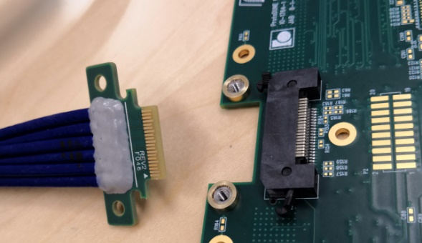
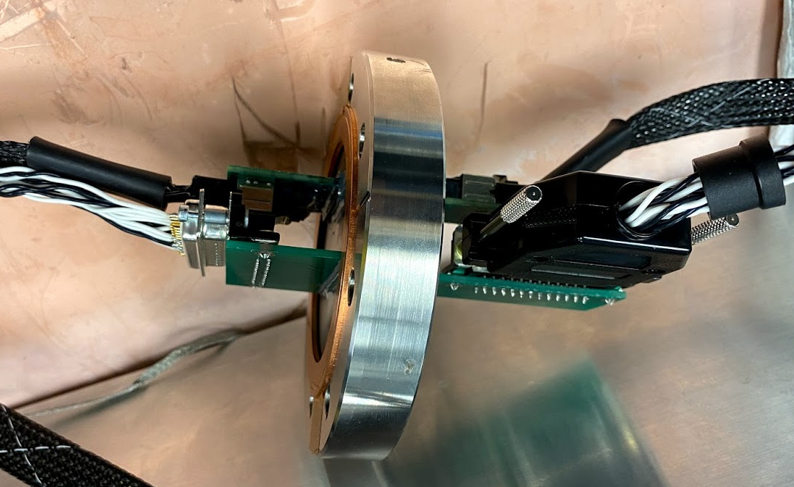
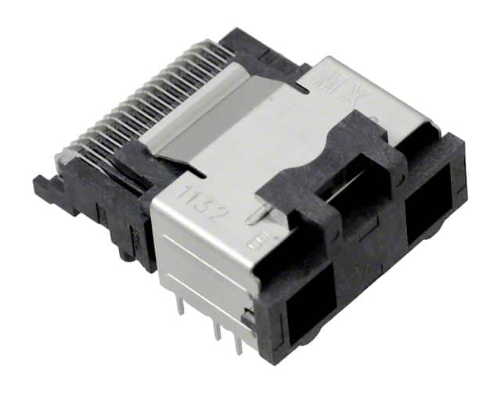
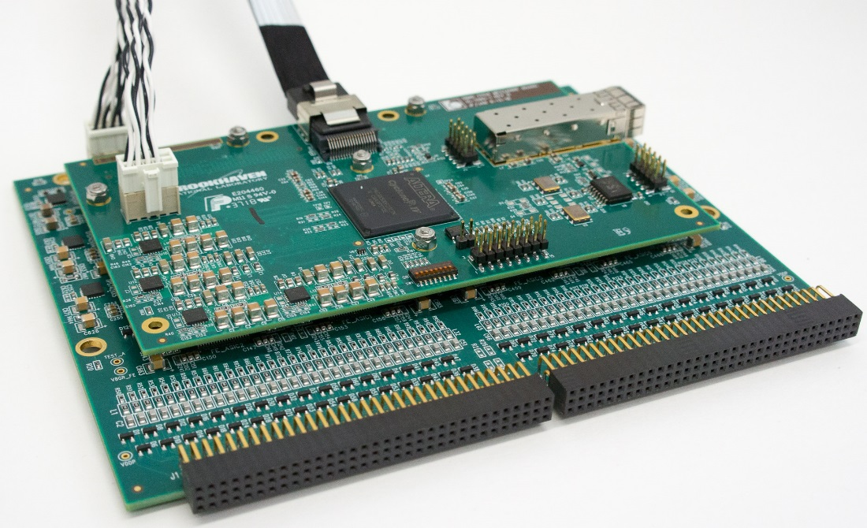
Cabling
COLDATA support high-speed link over 35m Samtec cable
Possible minor revision of FEMB from FD1 to FD2
  FD1: a signal cable from the CE flange to the FEMB
  FD2: 1) same single cable as FD1 (but longer, from 22m to 26m)
  2) a patch panel is also considered as an option
Samtec cable and connector
Mini-SAS cable and connector used in SBND
Verified 2 x 7m mini-SAS cables and an adapter board on flange for 50L setup
CE flange
DUNE long
Patch panel
1) Short Samtec cable
FEMBs
Samtec cable
2) Short Mini-SAS cable
The patch panel can simplify the installation
Both short Samtec cable and mini-SAS cable will be evaluated
  A prototype adapter board is designed to test the data transmission of COLDATA, and verify that the readout signals are not degraded by the insertion of the connector
Drawback: one extra connection increase the chance of point of failure

Slide 22
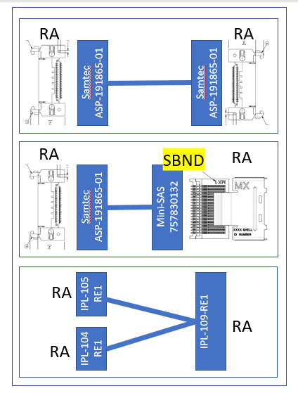
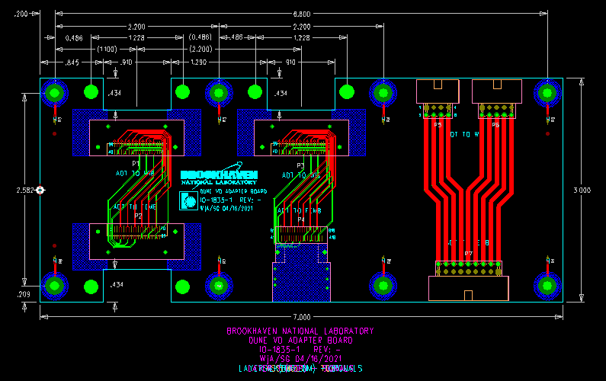
A prototype cable adapter is being fabricated
The prototype cable adapter
  To verify the feasibility of the patch panel
  Option 1: DUNE Samtec connector to DUNE Samtec connector
  Option 2: DUNE Samtec connector to mini-SAS connector (SBND)
  Option 3: Adapter for power distribution if power cable goes to the patch panel
Measurement to be done in the coming month

Slide 23
Content
FEMB Design for both HD and VD single-phase LArTPC
FEMB Roadmap
Integration Tests
Consideration of the EMI shielding box for FEMB
Consideration of Cabling
FEMB QC Plan
Summary

Slide 24
FEMB QC Plan
A comprehensive set of QA/QC tests carried out for all components to ensure reliable operation of FEMB
  DUNE FEMB QC plan is still under discussion
Lessons learned from ProtoDUNE-SP and SBND CE
  FEMB QA/QC procedures
    Post-assembly screening test before installation in CE box
      Get rid of defective FEMB assemblies
    Characterization both at RT and LN2 after assembly
      A whole assembly includes FEMB, CE box, cold power cable and data cable
    Reception checkout test (RT) is recommended
    Cold box integration test can further assure correct and reliable connection
Challenge for DUNE FEMB QC
  Ensure that QC procedures are applied uniformly at different test sites
  Online database for logging
ASICs/FEMBs task force was formed on 04/05/2021
  Weekly meeting since 04/19/2021

Slide 25
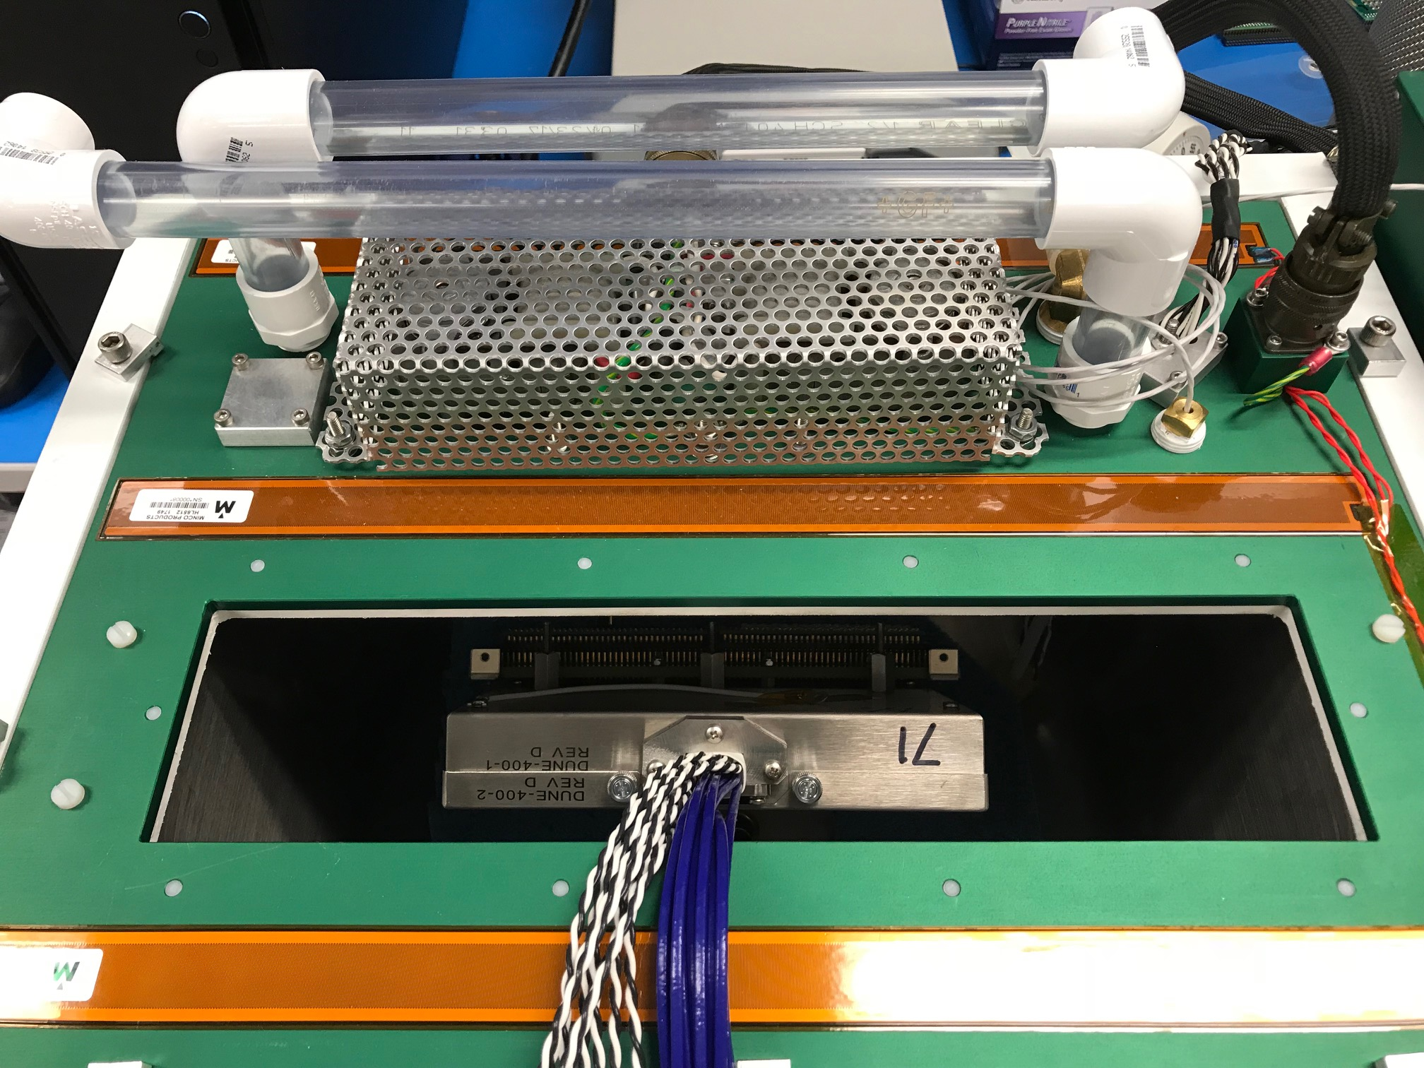
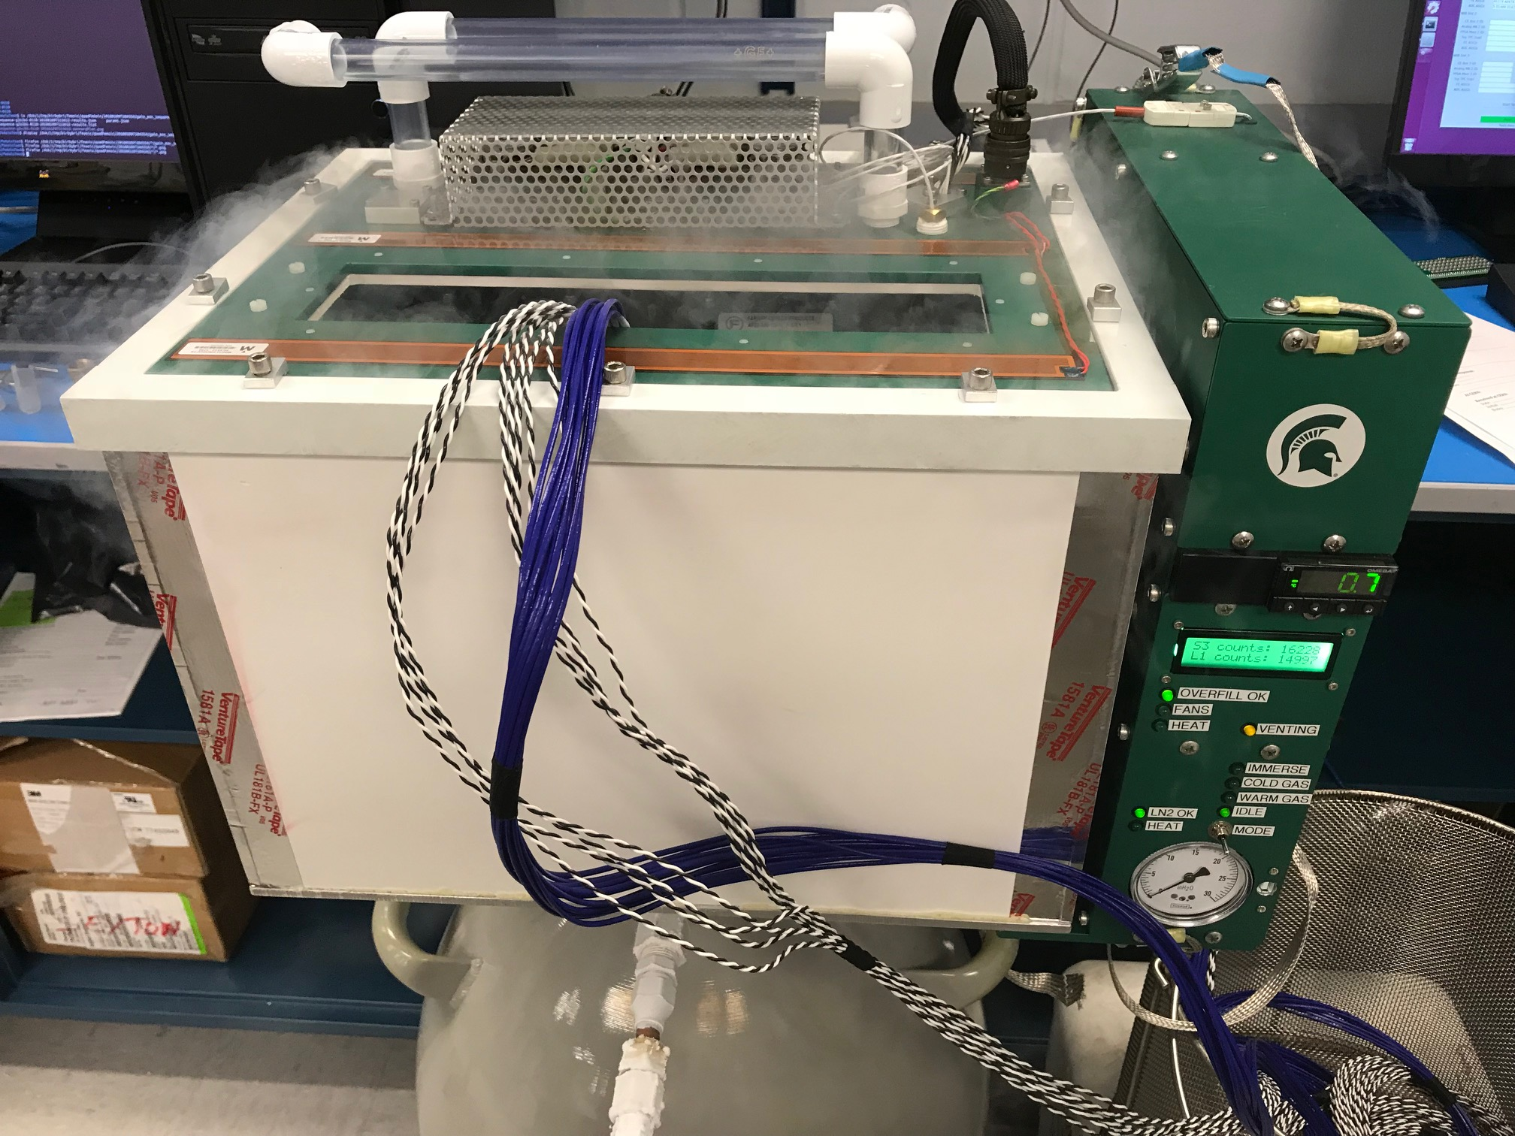
Example of ProtoDUNE FEMB QC Test
Power cycle test
  Power to FEMB cycled and simple baseline measurement performed
  5 iterations
Gain/ENC measurements
  17 separate gain/ENC measurements performed with different combinations of configurations
    Gain: 14mV/fC, 25mV/fC
    Shaping time: 0.5us, 1.0us, 2.0us, 3.0us
    Both FPGA-DAC and ASIC-DAC calibration
    One check of internal ADC clocks using nominal FE settings
Power / current monitoring
  Reads back FEMB voltages/currents measured on WIB
Summary PDF of test results created as part of the test automatically
MSU CTS

Slide 26
Summary
No issues with using the FD-1 cold electronics for the readout of the bottom CRUs in the vertical drift detector (FD-2)
  Identical to FD-1 HD FEMB design (See Cheng-Ju’s talk)
    Minor revision if the patch panel is presented
  3-ASIC FEMB solution meets all the DUNE needs
    See Dave’s talk
  Production of CE components for the vertical drift detector will follow that of components for the horizontal drift detector
    ASICs/FEMBs task force was formed
Continuous effort should be made for the integration test
  The integral system design concept is crucial
  50L setup shows the promising result (See Serhan and Filippo’s talk)
  Confidence of FEMB design is expected to be gained from the CERN cold box testing

