Slide 1

Feedthroughs and Cables
Bottom Electronics CDR
Manhong Zhao
05/28/2021

Slide 2
Contents
CE box and installation
CRP cabling and patch panel
Cryostat cabling and feedthrough
Summary

Slide 3
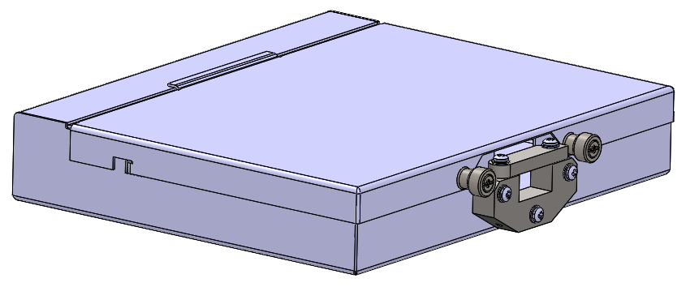
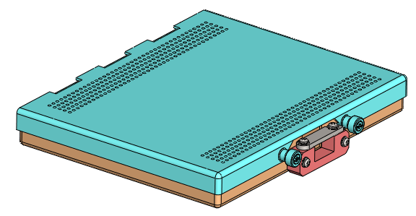
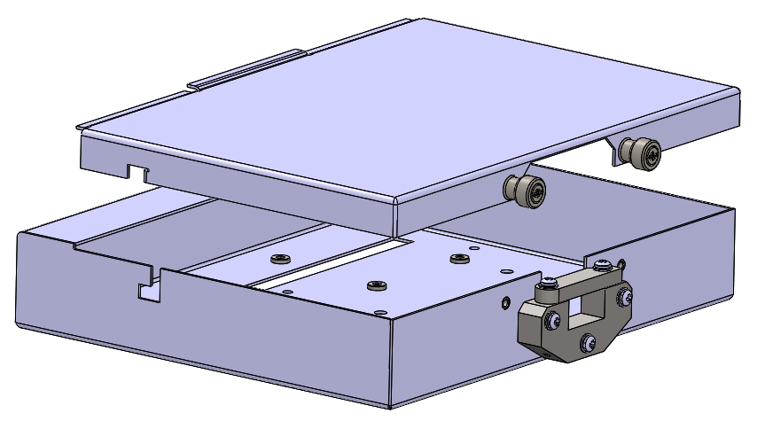
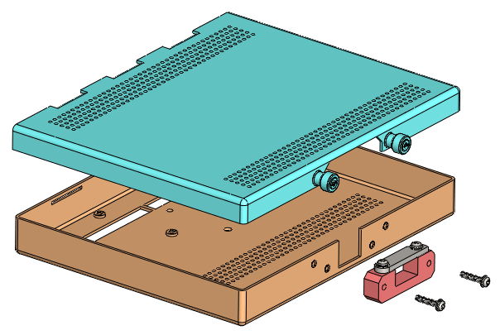
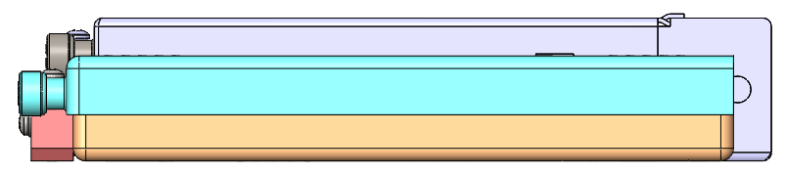
CE Box
Every FEMB is contained in a CE box, which provides mechanical support and cable strain relief.
ProtoDUNE CE box (Stainless Steel)
New thinner CE box (Aluminum)
Weight Reduction:
~50% (778g -> 394g)

Slide 4
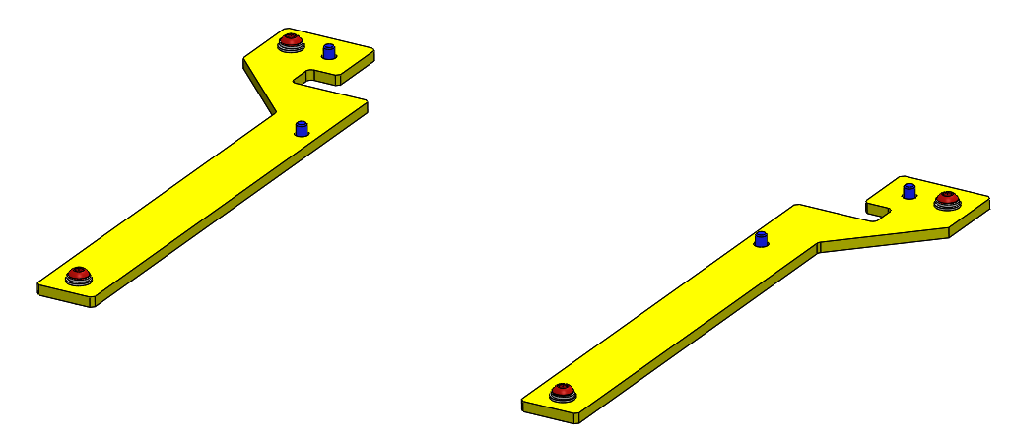
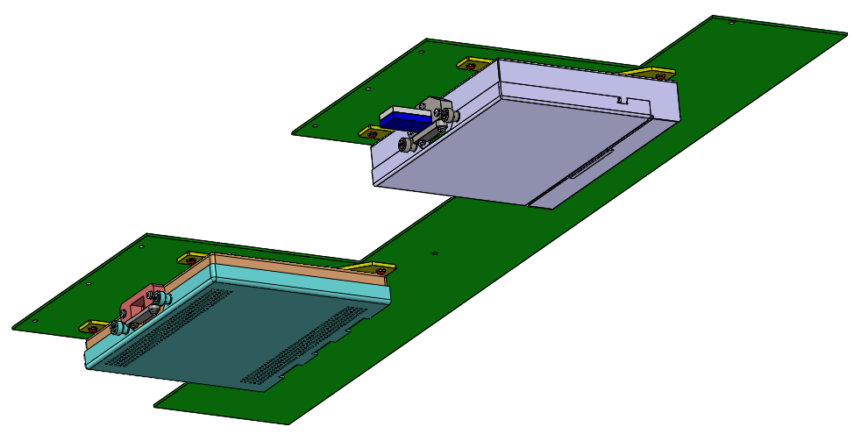
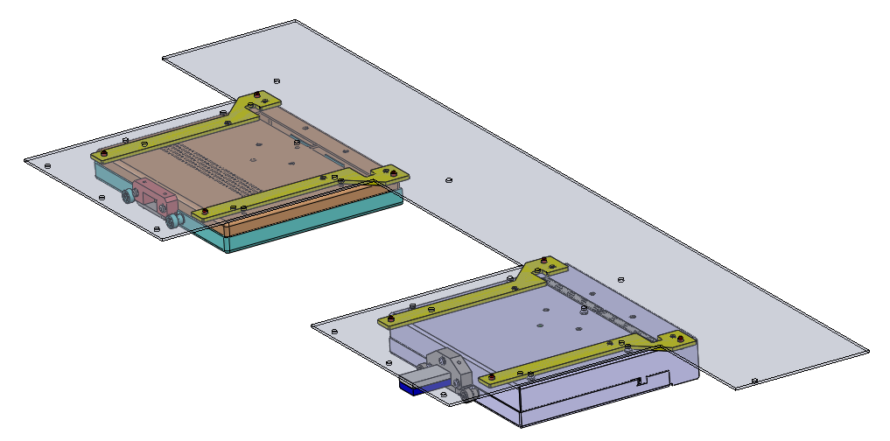
CE Box Installation
Each CE box is installed upside down on the CRP adapter board. The CRP should not deflect beyond its design limit due to CE box weight.
Two mounting bars are attached to a CE box with four screws (in blue). The assembly of CE box with mounting bars is then mounted on the adapter board with four screws (in red).
The mounting bar works for both CE box options.
The mounting bar secures the CE box on the adapter
board preventing the connector connection from
loosening due to gravity. It also makes it much easier
to mount or dismount the CE box on the adapter board.
CE mounting bars

Slide 5
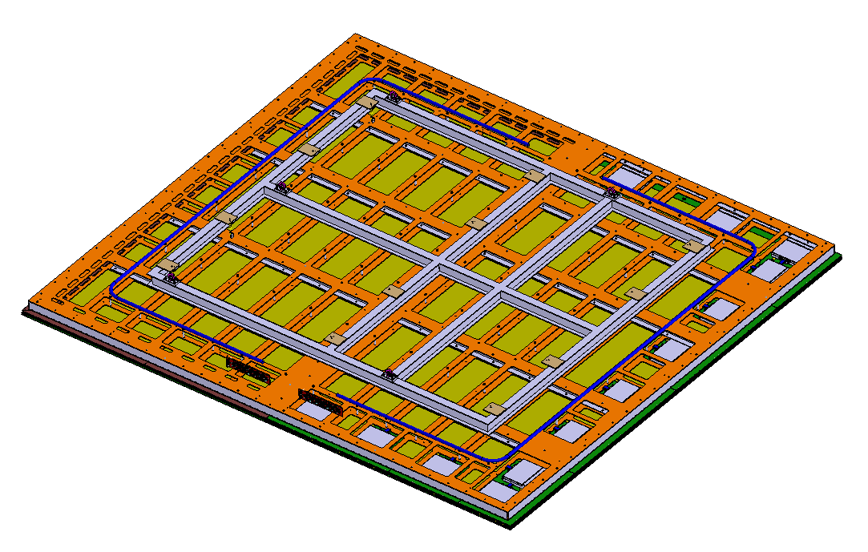
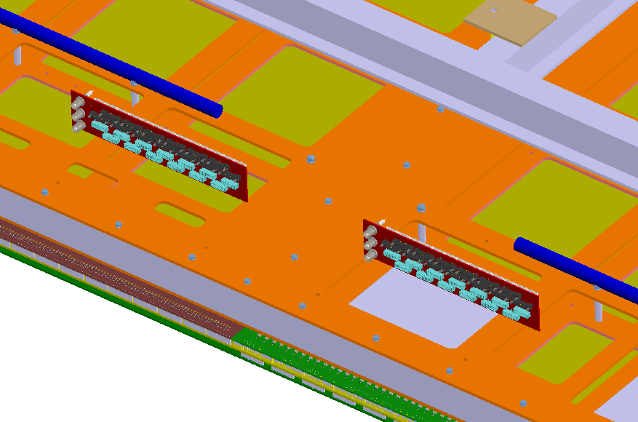
CRP Cabling
One CRP consists of two CRUs. There are 13 CE boxes installed on each CRU. In total, 26 CE boxes per CRP.
In one option of CRP cabling, two patch panels are installed on the CRP. 26 Mini-SAS cables are routed from the CE boxes to the patch panels.
The patch panels are mounted on the CRP support frame. Details are to be determined.
Strain relief and support to the cables are to be determined.
An alternative CRP cabling option is to have a single cable going from the CE flange on a feedthrough to the CE box.

Slide 6
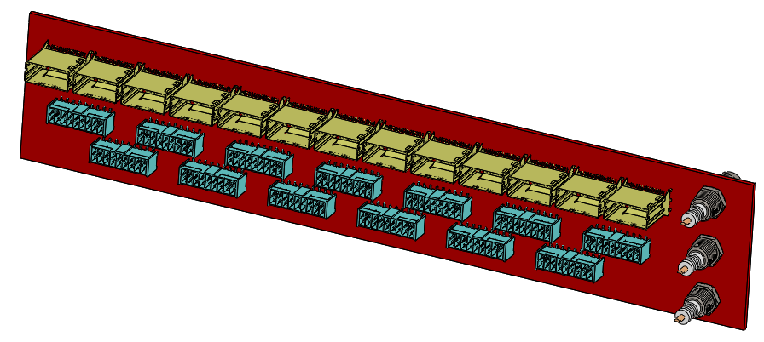
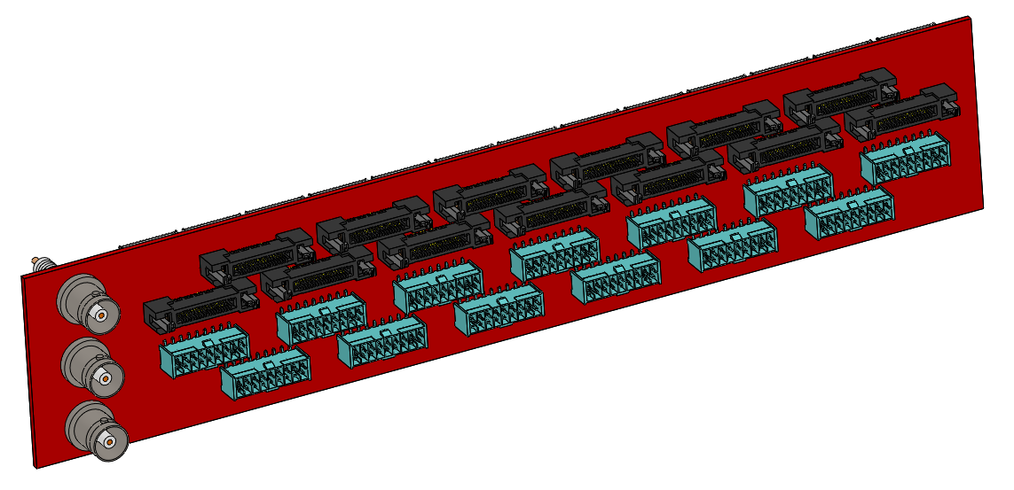
Patch Panel
A patch panel provides an interface between the CRP cabling and the cryostat cabling.
One side of the patch panel accepts Mini-SAS cables and connectors from the CE boxes.
The other side of the patch panel accepts SAMTEC cables and connectors from the cryostat cabling.
Cable strain relief features are to be determined.
This side accepts Mini-SAS cables and connectors from the CE boxes.
This side accepts SAMTEC cables and connectors from the cryostat cabling.

Slide 7
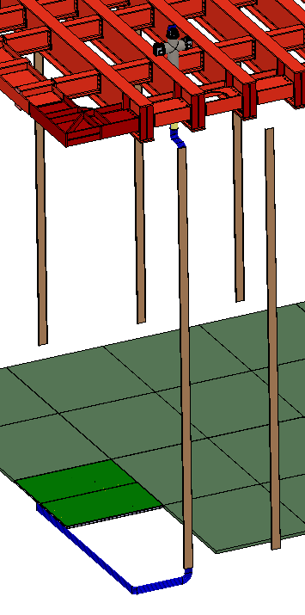
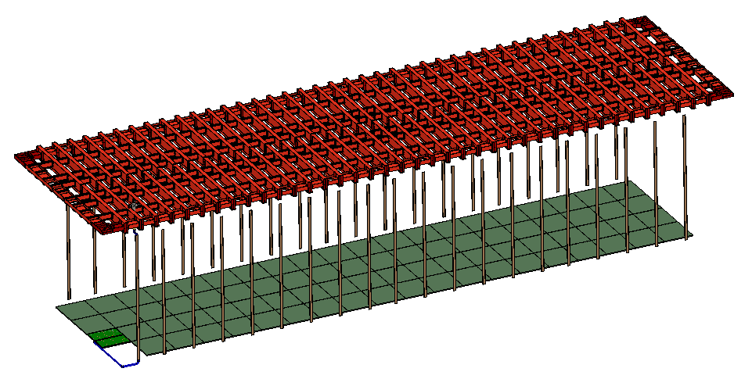
Cryostat Cabling
80 CRPs (4x20 CRPs, 160 CRUs) are installed on the cryostat floor.
I&I provides 40 cable trays with 20 on each side wall of the cryostat. Each cable tray serves 2 CRPs (26 x 2 CE cables).
I&I will run the cables inside the cryostat. CE makes the connection to WIEC and CRP.

Slide 8
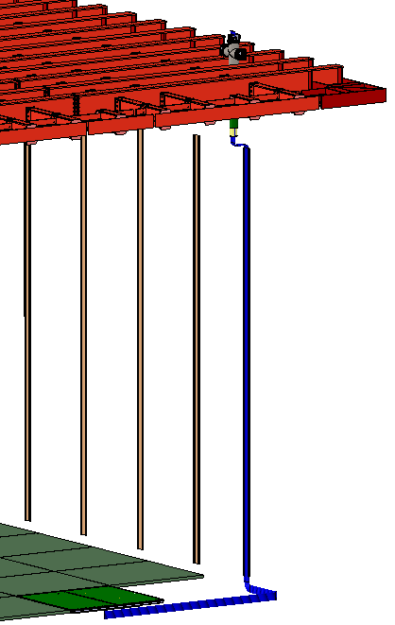
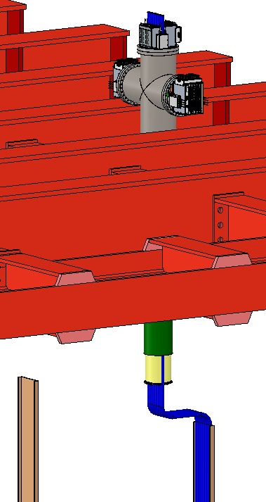
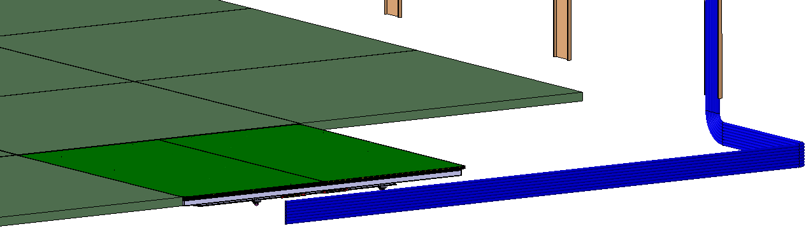
Cryostat Cabling
SAMTEC cables are inserted from the top of the cryostat through the cryostat penetrations and connected to the CE flanges. Inside the cryostat the cables are tied to the cable trays on the wall and laid down on the cryostat floor prior to the installation of the false floor. The cables are later connected to the patch panel once the bottom CRPs are installed.
Cable length from the patch panel to the CE flange is about 25m.
Cables from 2 CRPs can form 4 big cable bundles. Diameter of each big bundle is about 42mm. The cable tray size should be not smaller than 42mm x 168mm.
Alternatively, the cables can form 8 big cable bundles. Diameter of each big bundle is about 30mm. The cable tray size should be not smaller than 30mm x 240mm.

Slide 9
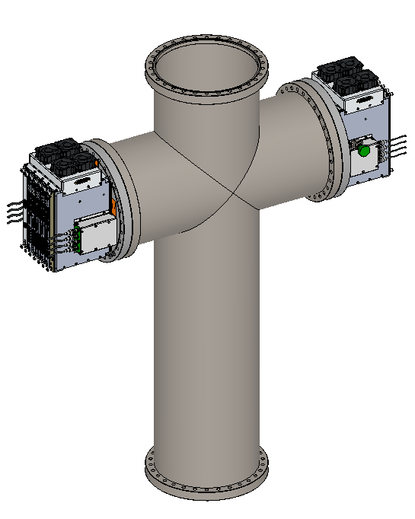
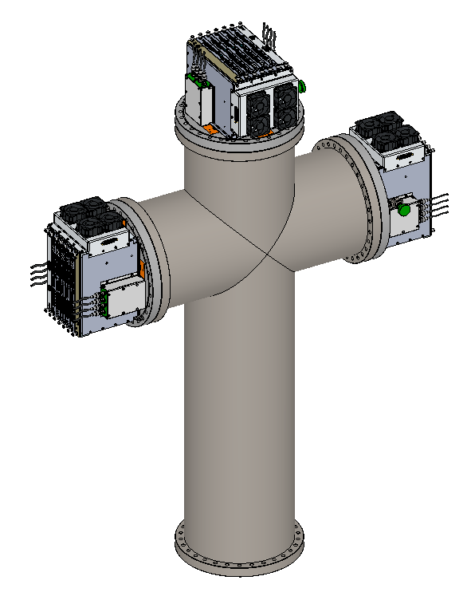
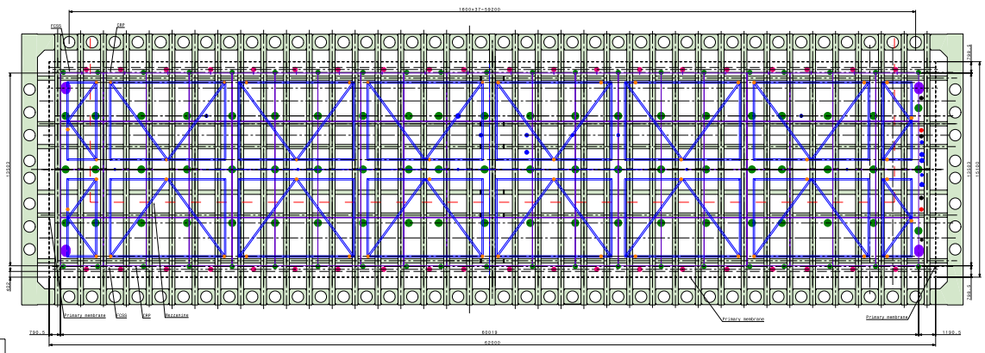
Feedthrough
2 WIECs mounted
There are 80 CRPs, and 26 FEMBs per CRP. In total 2,080 FEMBs.
520 warm interface boards (WIBs) are needed for the 2,080 FEMBs.
100 warm interface electronics crates (WIECs) are needed
  80 WIECs with 5 WIBs + 1 PTC each (400 WIBs, 80 PTCs)
  20 WIECs with 6 WIBs + 1 PTC each (120 WIBs, 20 PTCs)
There are 40 feedthroughs on the cryostat assigned to these WIECs. 20 feedthroughs with 2 WIECs mounted, and 20 feedthroughs with 3 WIECs mounted.
3 WIECs mounted

Slide 10
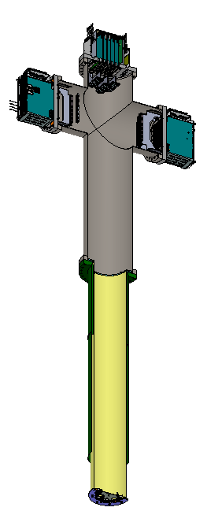
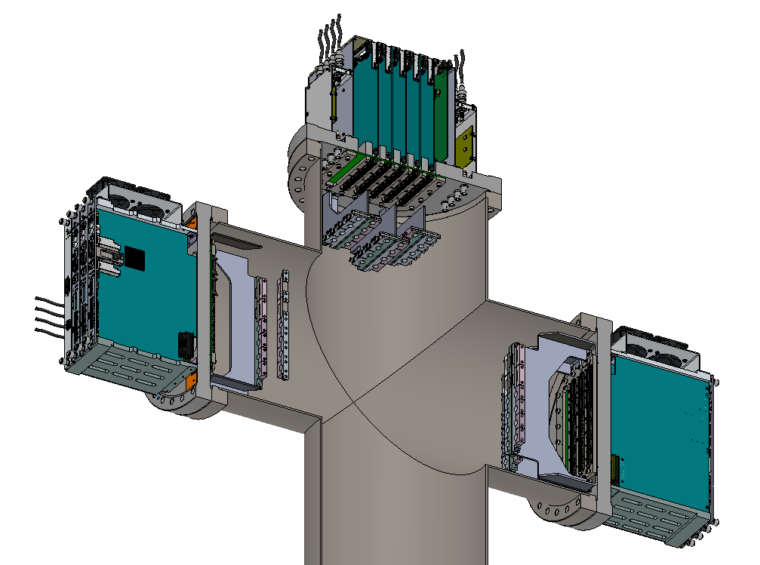
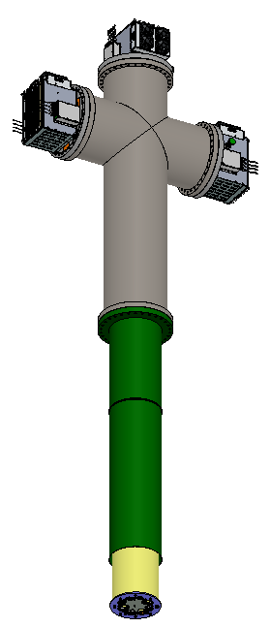
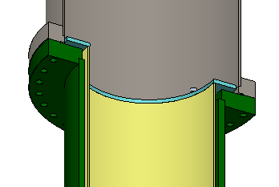
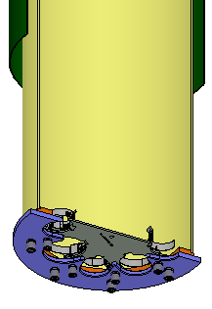
2 or 3 CE flanges and crates installed on the Spool Piece
Feedthrough
Brackets on CE flanges for cable strain relief.
Spool Piece
Cryostat Crossing Tube
CE crossing tube inserted in the cryostat crossing tube.
CE Crossing Tube
Cable clamp plate for cable strain relief. Modification needed.

Slide 11
Summary
Two CE box options are available. CE box mounting bars work for both CE box options and secure CE boxes on the CRP adapter board.
In one CRP cabling option, Mini-SAS cables connect CE boxes on a CRP to 2 patch panels. A patch panel provides an interface between the CRP cabling and the cryostat cabling. Details of cable support on CRP, patch panel installation and cable strain relief on patch panel are to be determined.
SAMTEC cables are pre-routed in the cryostat from the feedthrough to the floor along the side walls. The cables are later connected to the patch panel once the bottom CRPs are installed. Cable length from the feedthrough to the patch panel is about 25m.
An alternative CRP cabling option is to have a single cable going from the CE flange on a feedthrough to the CE box.
Feedthroughs are installed on the cryostat ceiling. Maximum three WIECs and flanges are provided for each feedthrough.

