Slide 1
FD2-VD Bottom CRP Electronics CDR:
Services on top of the cryostat
Marco Verzocchi
Fermilab
28 May 2021

Slide 2
Contents
Warm Interface Crates, WIBs, PTCs
Power and bias voltage distribution system
Cable and fiber plant on top of the cryostat
Interface to the DUNE detector safety system
Will discuss only detector option with 3-views (baseline)
Intention: keep design changes relative to FD1-HD to a minimum
  So far identified one necessary design change in the WIB firmware
Next presentation (Interfaces) will discuss proposal to change detector granularity
  This will have very little consequences on the detector design, just reduce count of components

Slide 3
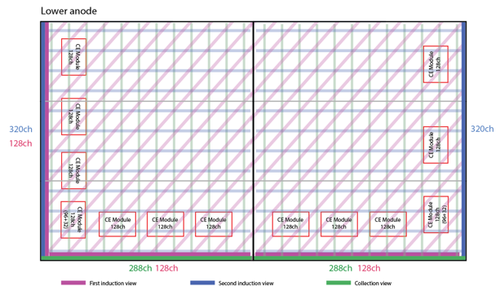
Numbers (i)
If we assume the readout with 3 views there are
  26 FEMBs per CRP, 80 CRP, i.e. 2,080 FEMBs
  There are 3,200 readout channels on each CRP
  13 FEMBs per CRU, 1,600 channels used out of 1,664
With 2,080 FEMBs need 520 warm interface boards (WIBs)
This translates into 100 warm interface electronics crates (WIECs)
  80 WIECs with 5 WIBs + 1 PTC each (400 WIBs, 80 PTCs)
  20 WIECs with 6 WIBs + 1 PTC each (120 WIBs, 20 PTCs)
WIEC, WIB, PTC designs identical to FD1-HD
We should revisit these assumptions in the next presentation

Slide 4
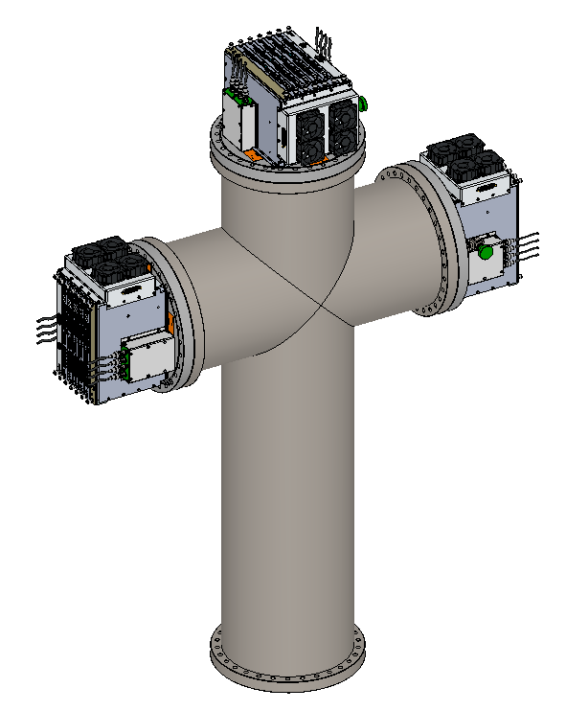
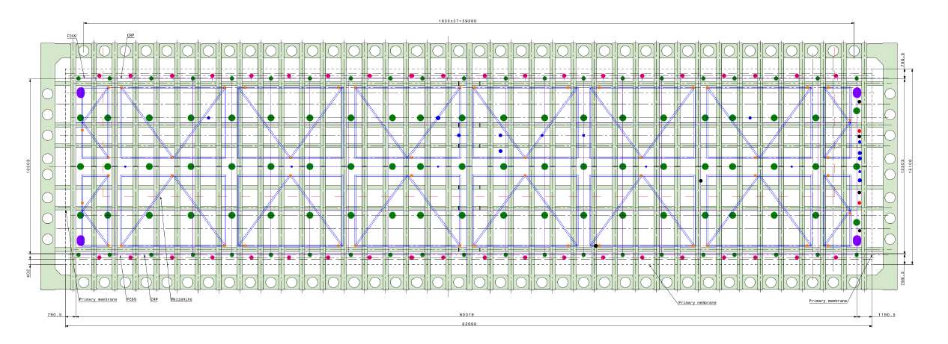
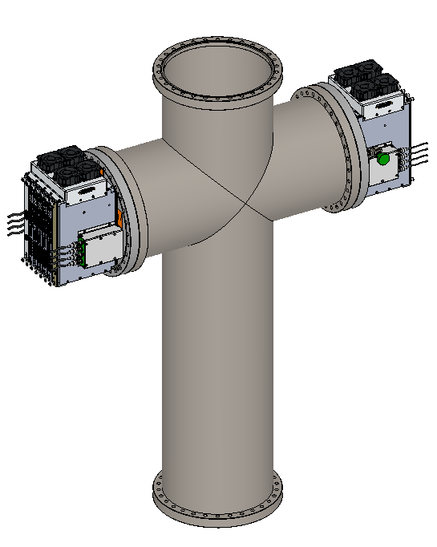
Numbers (ii)
To get to 80+20 WIECs:
Need 40 cryostat penetrations, same design as for FD1-HD (red dots in the figure)
  20 cryostat penetrations with 2/3 flanges used, 40 WIECs total
  20 cryostat penetrations with 3/3 flanges used, 60 WIECs total
  Alternat 1 cryostat penetration with 2 WIECs with 1 cryostat penetration with 3 WIECs
Can the photon detector system use only 20 flanges total ?

Slide 5
Numbers (iii)
Bottom CRP electronics maintain responsibility for distributing bias voltage to bottom CRP and to field cage termination electrodes
  With the 3-views readout and a shield place each CRU requires 3 bias voltages (2 negative (shield + first induction view), 1 positive (collection view). The second induction view is at ground. For the moment we assume each CRU is biased independently
  This is 160 positive bias voltages, 320 negative bias voltages
  Assume TPC electronics also responsible for the 2*48 field cage termination electrodes on the bottom of the TPC (20 on each long wall of the cryostat, 4 on each short wall of the cryostat, top+bottom)
Total: 256 positive (16 ISEG modules with 16-channels each), 320 negative (20 ISEG modules with 16-channels) each
This requires four MPOD crates each with 4 positive and 5 negative ISEG modules
Each bias voltage rack (4 racks total, almost completely full) includes also the interface between DUNE detector safety system and bias voltage power

Slide 6
Numbers (iv)
From the MPOD crates:
  13 RG59 coax cables to each of the 40 cryostat penetrations of TPC electronics (bias voltages for bottom CRPs, bottom FC termination electrodes, 15 cables for the cryostat penetrations in the corner of the detector, to include end wall FC termination electrodes)
  Routing of bias voltages for FC termination electrodes for top part of the detector unclear
  Filter cards for bias voltage of FD1-HD already designed to handle 6+1 or 6+2 (CRU/FC) voltages
Location of MPOD crates in the detector mezzanine racks / routing of cables depends on how cable trays are laid out on the detector
  If like in FD1-HV assume crates located at 4 equidistant point on the detector mezzanine, cables routed along the mezzanine and from there to the cryostat penetrations (assume cable trays on the top of the detector run between the ribs of the cryostat, max cable length ~35 m)

Slide 7
Numbers (v)
Each WIEC requires one channel of a WIENER PL506 (6 channels each)
  Need 17 WIENER crates to provide power to the 100 WIECs (1.8-2.5 kW per crate)
  From each crate 2-3 LV power cables (custom shielded cable with 2 AWG10 power+return leads, 2 AWG20 wires for sensing)
35 racks required on the detector mezzanine
  Each low voltage power crate (17 racks, 3+1U needed in each of them) requires space in nearby rack for power distribution to heaters and fans on the WIEC (controlled by PLC) and interface between DUNE detector safety system and WIECs / low voltage power (17 racks, 12+1U needed in each of them)
    Cannot have LV power and power to heaters/fans in the same rack, as they would exceed the total power
  Each bias voltage rack (4 racks total, almost completely full) includes also the interface between DUNE detector safety system and bias voltage power
  Documentation in https://edms.cern.ch/document/2429058
  Cable have short runs along detector mezzanine, then go to the cryostat penetrations via cable trays that run between the ribs of the cryostat (max lengh ~20m)

Slide 8
Numbers (vi)
Each WIEC has
  Readout to FELIX: 1 FELIX card (12 channels) per WIEC
    10-12 LC fibers from a patch cord that on the other side has an MTP-12 connector
    MTP-MTP connector on a patch panel (for FD1-HD this is located in the nearby PD mini-rack)
    From there a single bundle of 12 fibers goes to the DAQ mezzanine
  Connections to Slow Controls
    12-14 LC fibers from 1-2 patch cords that on the other side has an MTP-12 connector
    MTP-MTP connector on a patch panel (for FD1-HD this is located in the nearby PD mini-rack)
    From there the fiber goes to the detector mezzanine where there is a fanout into an optical network switch
    From the optical network switch there is a link to the main SC computer in the DAQ mezzanine
    Considering RJ45 copper connection for slow controls (to be tested in ProtoDUNE-HD-II)

Slide 9
Numbers (vii)
Each WIEC has
  Connection to the timing system: each PTC has 2 LC fibers going to the nearest clock optical fanout (on the photon detector minirack ? on the detector mezzanine)
  Connection to the DUNE detector safety system: each PTC has 2 LC fibers going to the low voltage PLC panel in the rack next to the PL506
  Power distribution and controls for heaters and fans requires a single 15 twisted pairs (AWG22) shielded cable
As in the case of FD1-HD the space required in the cable trays minimial
Need 100 FELIX cards
Need 100 end-point for optical fiber timing distribution network
Need 520+100 optical (RJ45) slow control connections for WIBs/PTCs
Need 21 slow control connections (RJ45) for WIENER MPOD/PL506 crates
Need 1 network connection for DDSS central PLC CPU

Slide 10
Interface to DDSS
Each WIB / PTC / WIENER PL506 / WIENER MPOD crate is connected to Slow Control system (DCS)
The power to the heaters and fans is under direct control of PLC system that is part of the DUNE Detector Safety System (DDSS)
PLC system provides interlock to low voltage power and bias voltages taking input from WIBs / PTCs / temperature and humidity sensors / other environmental inputs including cryogenic system
DDSS and DCS are interfaced
Full design of DDSS for FD1-HD available in https://edms.cern.ch/document/2401090 including preliminary design of action matrix
Assume will use similar system for FD2-VD
Main feature is possibility of providing LV power / bias voltage interlock at the single CRP level entirely from PLC system, bypassing completely the DCS
PLC panes in 17+4 racks, plus central DDSS panel connected through RJ45 cable loop (running EtherCAT protocol)

Slide 11
Design Maturity (i)
The design discussed in the previous slides is identical to the design of the services on top of the cryostat for FD1-HD
Warm Interface Electronics Crate
  Design unchanged since ProtoDUNE, was already designed with the possibility of having 6 WIBs instead of 5
Warm Interface Board
  First DUNE prototype fabricated and in use in various test stands (40% APA prototype at BNL, ICEBERG at Fermilab)
  Collecting requirements for design changes for second DUNE prototype (simplified power distribution scheme once ASIC selection official, increase monitoring capabilities, I2C interface with PTC via backplane, add RJ45 connection for Slow Control, add precision DAC for front-end calibration, change connectors and cables between WIB and FEMBs)
  New prototype to become available this Winter, to be used in ProtoDUNE-HD-II
  Firmware / software development for WIB in progress, development plan being finalized, first successful test in ICEBERG with readout of 10 FEMBs via FELIX

Slide 12
Design Maturity (ii)
Power and Timing Card (PTC)
  We are planning to have a completely new PTC for ProtoDUNE-HD-I
  May not be ready on day 1, designed to be backward compatible with currently available PTC
  Add FPGA on the PTC, capability of turning on/off and monitoring remotely (Slow Control) every individual WIB (done via dip switches in ProtoDUNE)
  Add communication via I2C between PTC and WIB, allows for transmission of FEMB status from WIBs to PLC and interlocks from PLC to WIBs
  Not a major redesign of the PTC
Interface with DUNE Detector Safety System
  Designed, needs prototyping at ICEBERG, deployment at ProtoDUNE-HD-II
Prototyping plan: it is called ProtoDUNE-HD-II
  For 2022 tests in the NP02 cold box and for ProtoDUNE-VD we will use the same components that are going to be installed in ProtoDUNE-HD-II

Slide 13
Differences between HD and VD
One difference identified so far between FD1-HD and FD2-VD
We have agreed ~1 year ago with DAQ consortium to send the data from each FEMB in the following order:
  All collection wires
  Induction wires from plane 1
  Induction wires from plane 2
This removes one step on the FELIX side, data from collection wires directly available at the input of the trigger decision module (no channel reordering needed)
We will need to modify the channel map in the WIB firmware to do the same thing for FD2-VD
Need to change both firmware on the WIB side, software on the FELIX side
Does it make sense to maintain 2 different WIB firmware versions (one block is different, all the rest is identical) on top of 2 different trigger software versions (different detector geometry) ?
Should we consider reversing the channel mapping decision ?

Slide 14
What else could be different ? (i)
Timing in FD2-HD:
  Top CRP electronics uses White Rabbit for the timing distribution (125 MHz)
  Bottom CRP electronics uses 62.5 MHz clock to sample the signals on the strips of the anode planes
  Different timing end point, current WIB hardware does not have all the components required to operate as White Rabbit end point
  TPC Electronics consortium does not want to have 2 different versions of hardware and firmware
  Decision on what timing system to be used for FD2-VD and where the conversion between White Rabbit and the Bristol timing system takes place (and in which direction) to be taken as soon as possible (may influence design of detector components)

Slide 15
What else could be different ? (ii)
Bias voltage / low voltage supplies
  Does it make sense to have different LV supplies for bottom and top CRP electronics ?
  To have different bias voltage supplies for bottom/top anode planes ?
Design of LV/bias voltage supplies for bottom CRP electronics / anode planes heavily influenced by desire to have hardware interlocks at the CRP level
  CAEN bias voltage supplies are cheaper, but cannot provide hardware interlock at the CRP level
  WIENER MPOD provide adequate noise suppression for bottom CRP electronics, would have to test other supplies to check whether in the end the noise level is the same
Any other design change (readout architecture) requires a significant redesign of WIEC/WIB/PTC with corresponding cost increases / risks
The preference of the TPC electronics consortium is to keep the differences between FD1-HD and FD2-VD as small as possible and not to change the current design

Slide 16
Conclusions
As for the rest of the bottom CRP electronics the plan for the services on top of the cryostat (warm interface electronics crates with WIBs/PTCs), power and bias voltage distribution, interface with the DUNE detector safety system, cable and fiber plant is to keep the design changes to a minimum
Prototyping: use the same components planned for ProtoDUNE-HD-II for all NP02 cold box tests in 2022 and for ProtoDUNE-VD run in 2023
So far identified need to modify one firmware block (channel map) in the WIB firmware
Need to demonstrate that we can fit cables for 64 FEMBs in one crossing tube
Decisions needed on
  Granularity of bias voltages (per CRP ? Per CRU ?)
  Timing distribution (top CRP electronics uses White Rabbit)
  Use common system for bias voltage distribution to top CRP ?
  Use common system for LV power distribution ?
  More in the next presentation

