Slide 1
Preliminary Installation Plan at SURF
Cheng-Ju Lin (Lawrence Berkeley National Lab)
Conceptual Design Review for Bottom CRP Electronics (FD2-VD)
28 May 2021

Slide 2
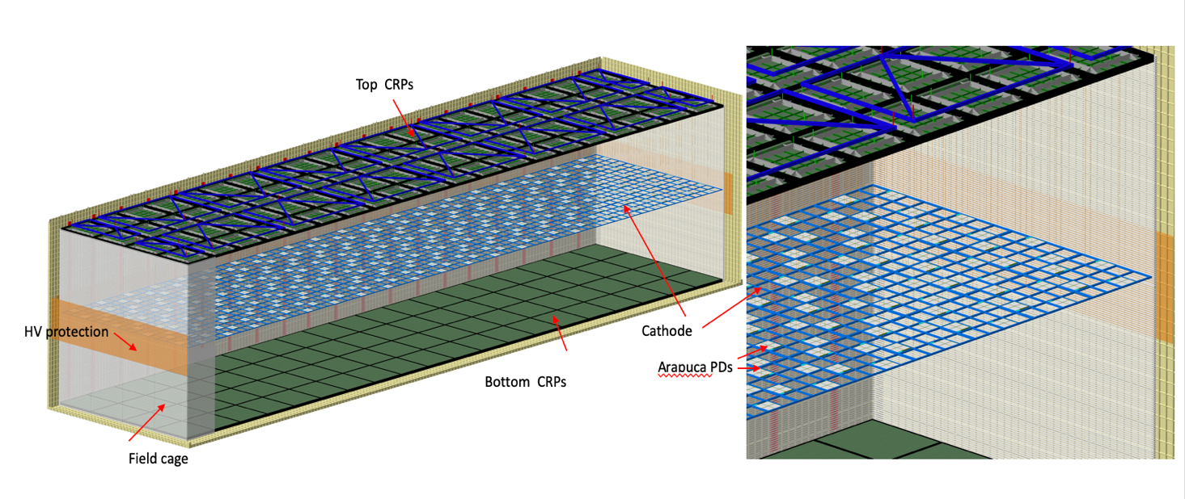
Bottom Cold Electronics
Bottom CRPs
Scope:
Responsible for the electronics to read out 80 CRPs at the bottom of the cryostat
Penetration and warm electronic crates
Power supplies (including bottom CRP bias and FC termination) and DDSS

Slide 3
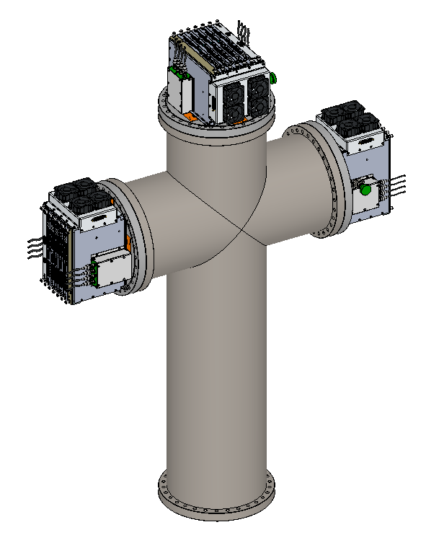
General Installation Sequence
1) Detector Mezzanine: Install power supplies and detector safety system in the racks
2) On top of cryostat: Install penetration
  spool pieces and crosses
3) On top of cryostat: Install warm interface
crates, WIBS, and PTC. Connect warm cables and fibers
4) Inside the cryostat: Install cold cables inside the cryostat. Connect cold cables to the feedthrough flange
5) Inside the cryostat: Connect cold cables to the CRPs
Note: FEMBs will be mounted on the CRPs at the CRP Factories

Slide 4
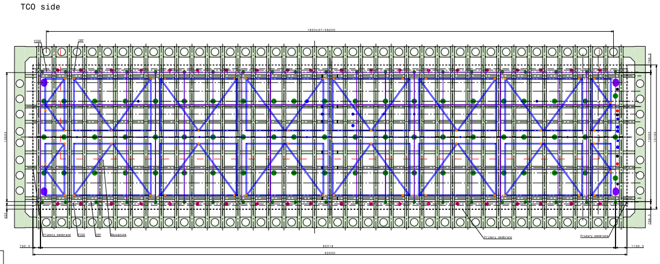
Cryostat Penetrations
“Pink” dots are the penetration ports for the bottom CRP electronics. DN295 (14”) conflat flanges
20 along the south wall and 20 along the north wall

Slide 5
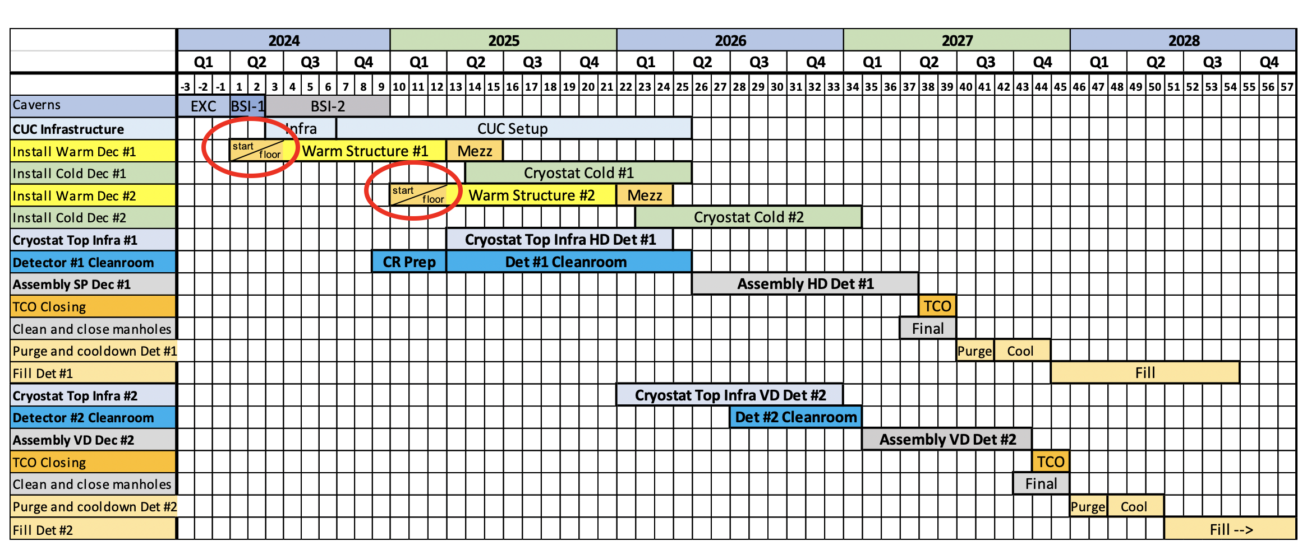
Installation Schedule
Had one round of meeting with the I&I team + lots of emails
Also starting to use some Wed FD integration meeting slots to discuss FD2-VD installation issues
Power supplies and
DDSS installation
Feedthrough and warm
electronics installation

Slide 6
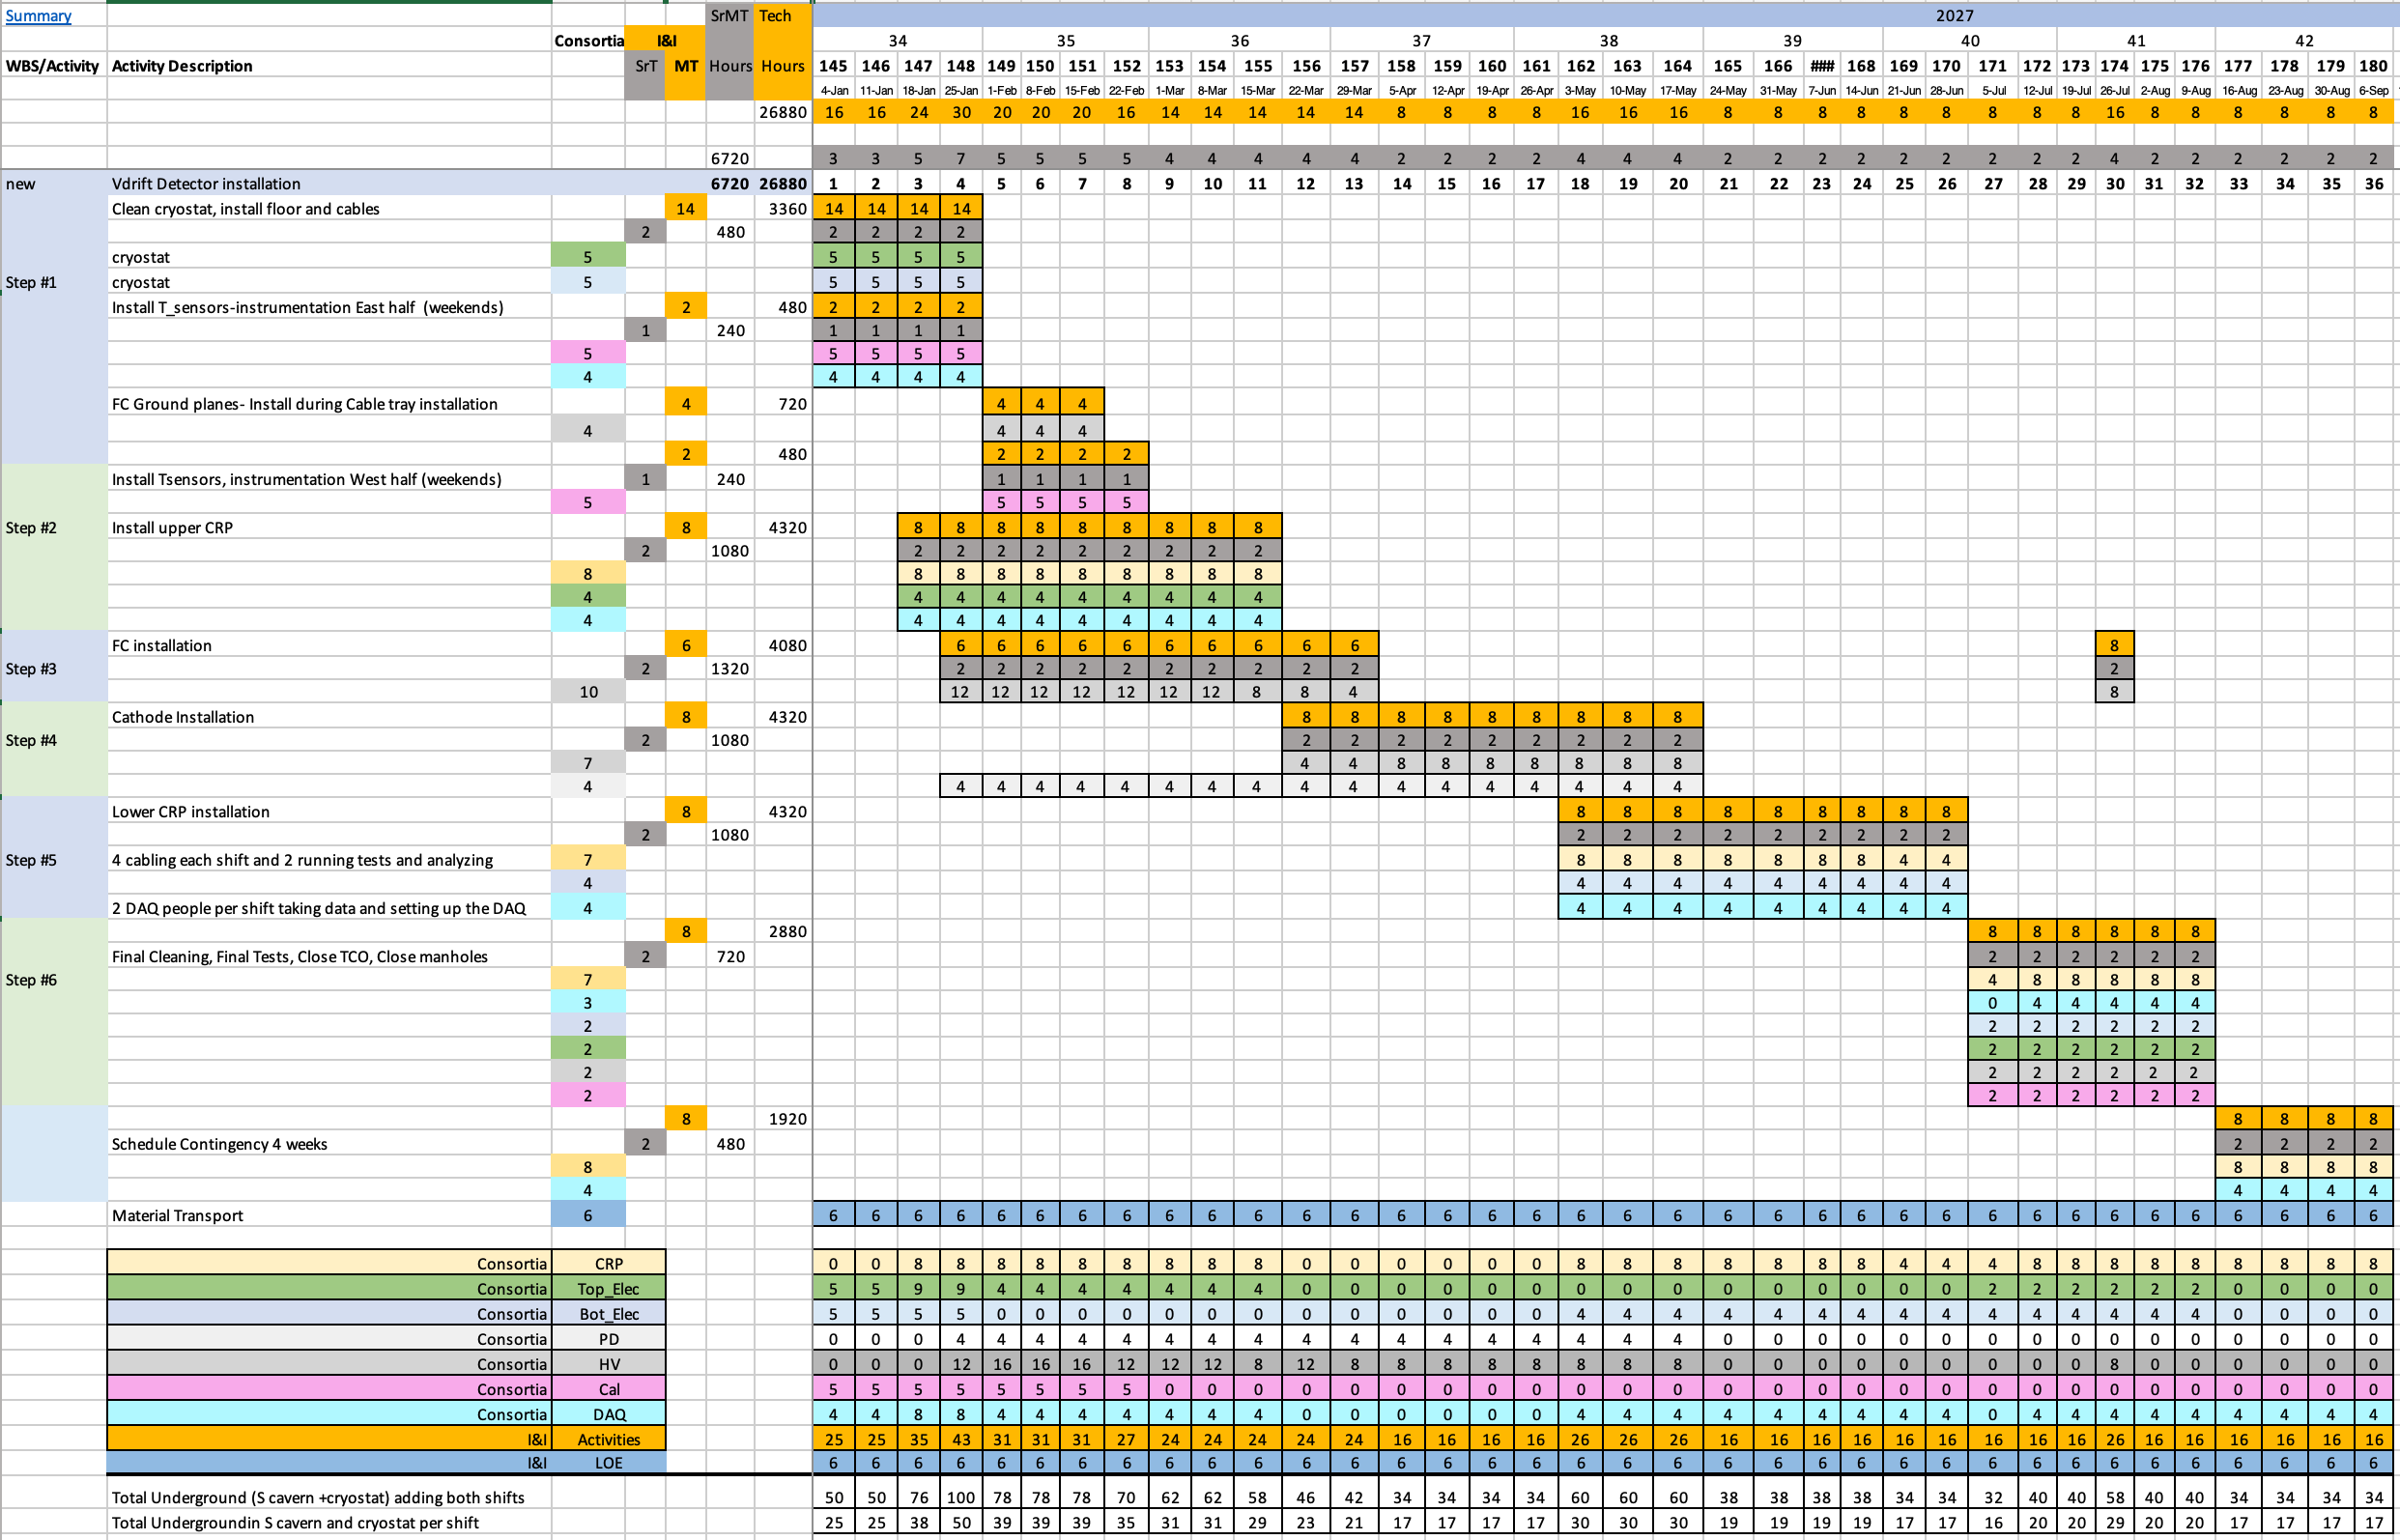
Installation Schedule (Inside Cryostat)
Still refining CE labor resources and schedule
Cold cable installation and
connection to WIEC
Bottom CRP installation

Slide 7
Predecessors:
Predessors for Installation Inside the Cryostat
General
Cryostat roof finished (walking surface done)
Detector mezzanines in place
Cryostat penetrations welded and leak tested.
Detector racks, power to racks, and safety system in place.
Power and fibers for the WIEC in cable trays. (in parallel to T_elec work)
DAQ ready to readout the WIEC.
Cryostat false floor installed in parallel to the cables in the cryostat
WIFI inside cryostat
Bottom Electronics specific
All Bottom Electronics parts are underground or in the SDWF
The connection to the DAQ is fully tested with WIEC
All test equipment and software is available.
All cables are available and underground or in the SDWF

Slide 8
Integrated Floor and Cold Cable Installation
Each sheet of floor is 9.842’(3m) long. Work row by row and complete all work before going to the next row. Two floor installation teams (4ea.) can be working at the same time one on beam right and one on beam left. The cryostat is 15m wide so assume 14m (45’) is covered. The floor is 11+ 4 foot sheets wide so assume 12 sheets. On each side of the initial 2 sheet wide floor path you need ~5 sheets.
Installation process (crew of 4 per side):
  Clean floor under plywood (remove plastic cover and wipe down with alcohol?) - 30 min
  Install floor cable tray 3 sections - 30 min
  Install false floor 5 sheets - assume 1 hours.
  Clean walls and roof – assume 2 hours
  Install wall cable tray – assume 1 hour
    Assume connections at top and bottom only
  Install short cables for top CRP – assume 1 hour
  Install cables and fibers in cable trays wall and floor. – assume 4 hours.
  10 hours total per 9.4’ (3m) area over half the cryostat width. PD will add time if on the wall.
Before covering the bottom cable tray with false floor, CE crew will test all cable connection with FEMBs and readout using WIECs on top of the cryostat (~2 hrs per CRP)
1.25 shift per row and 20 rows gives 25 shifts + additional time for testing and debugging
Separate crew of T_Elect. people can cable and test WIEC in parallel. Will be 1 day behind.

Slide 9
Labor Resource Needs (very preliminary)
~Week#-16 to -13 (power supplies and DDSS installation) :
I&I technicians 3 people working day shift (transporting pallets)
Bottom Electronics 6 people working 2 shift (3 per shift)
    Assumes two teams of 2 people installing modules and 1 person setting up and testing
  I&I cabling technicians laying cables (cryostat to mezzanine)
    Team of 3 people on day shift
Week#-4 to -1 (feedthrough and WIEC installation on roof):
I&I technicians 8+2 persons/week working on 2 shifts (5/shift)
Bottom Electronics 8 persons /week working on 2 shift (4/shift)
  Two mechanical and two scientists → 4 per shift
Week# 1-4 (installation of cold cables inside cryostat and connection to WIEC):
I&I technicians 14+2 persons/week working on 2 shifts (8/shift)
Bottom Electronics 10 persons /week working on 2 shift (5/shift)
Week# 18+ (during Bottom CRP installation):
8 Bottom Electronics people for FEMB cabling and testing (2 CRP in parallel and 2 shifts)
Crane drivers inside the S cavern 6 persons/week working on 2 shifts
Surveyors 2 persons/week working 40h/week

Slide 10
Bottom CRP Installation
Reference installation schedule assumes long cold cables are connected directly to the FEMBs inside the cryostat
Need to coordinate with CRP Consortia on:
  Design of the lifting fixture (CRP needs to be about 2m above floor during cable connection
  False floor is already removed so CRP needs to cantilever off the lifting fixture
  Needs to test FEMB connections after completing cable connections and also again after CRP is placed on the support stands and aligned
As mentioned in earlier talks, exploring the option of a patch panel on the side of the CRP. In this scheme, final cable connections could be made after CRP is positioned on the support stands on the cryostat floor membrane

Slide 11
Interface with Other Subsystems
Calibration installation will start on week #1
Top CRP installation will start on week #3
Ongoing testing and integration with DAQ
Outstanding interface questions:
  PDS feedthrough flange location and how many?
  Is Bottom CE penetration also be used to support Field Cage?
  Connection for Field Cage termination
Other Issues:
Procedure and area for rework (e.g. replacing FEMBs)
CRP acceptance test at SURF? Need to coordinate with CRP Consortium
SDWF storage planning
Define testing plan for the various installation stages
Need to hash out all the installation details!!!

Slide 12
Review Charge Questions
Are the requirements documented? Are they reasonable?
  High level requirements are documented and we believe they are reasonable. We are still defining and refining some lower level requirements
Is the scope understood? Is there a team in place? Which institutions are interested?
- Scope of bottom CRP CE is well defined with exception of potential interface changes with PDS and Field Cage (See Marco’s talk on Interfaces)
- Yes, a team is in place. See the Overview talk for the list of institutions

Slide 13
Review Charge Questions
Is there a reasonable plan for R&D and prototyping?
- Bottom CRP CE benefits greatly from the R&D work done for FD1-HD
- In addition, CRP system integration tests using the Cold Box and NP02 cryostat are planned
- Other R&D are in progress to address some design issues (e.g. patch panel for CRP cables, CE box design, etc.)
- We believe that a bottom CRP test in the nominal facing up configuration and on the support stands to validate the design is important before we start production. Not yet in the testing plan, but we are starting the discussion now with the CRP Consortium and others about it

Slide 14
Review Charge Questions
Is the design concept reasonable and feasible? Have appropriate mechanical and electrical calculations been performed?
- Piggyback off the knowledge from FD1. Keeping the design changes
relative to FD1-HD to a minimum
- Cable rating calculations have been done for FD1. Using the same hardware and similar length cables. Should revisit again for FD2. Expect the same conclusions
- CRP mechanical analysis has been done by the CRP Consortium
- Structural analysis on the penetration is being done for FD1-HD. For FD2-VD, need to understand better the interface with the PDS and HVS Consortia before we proceed with possible design modifications (if needed) mechanical analysis

