Slide 1

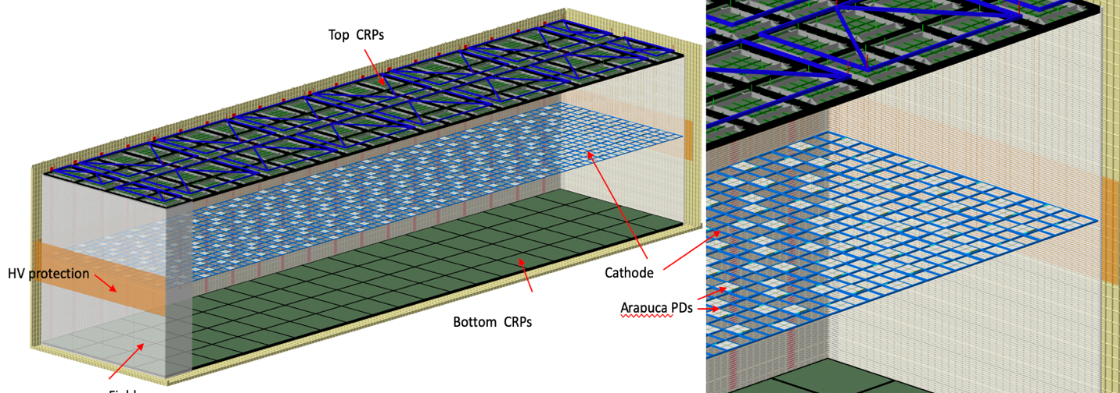
The DUNE Vertical Drift HV System: Overview & Requirements
Arapuca PDs
Field cage
Francesco Pietropaolo (CERN) on behalf of the HVS consortium

Slide 2
Outline of the review

Slide 3
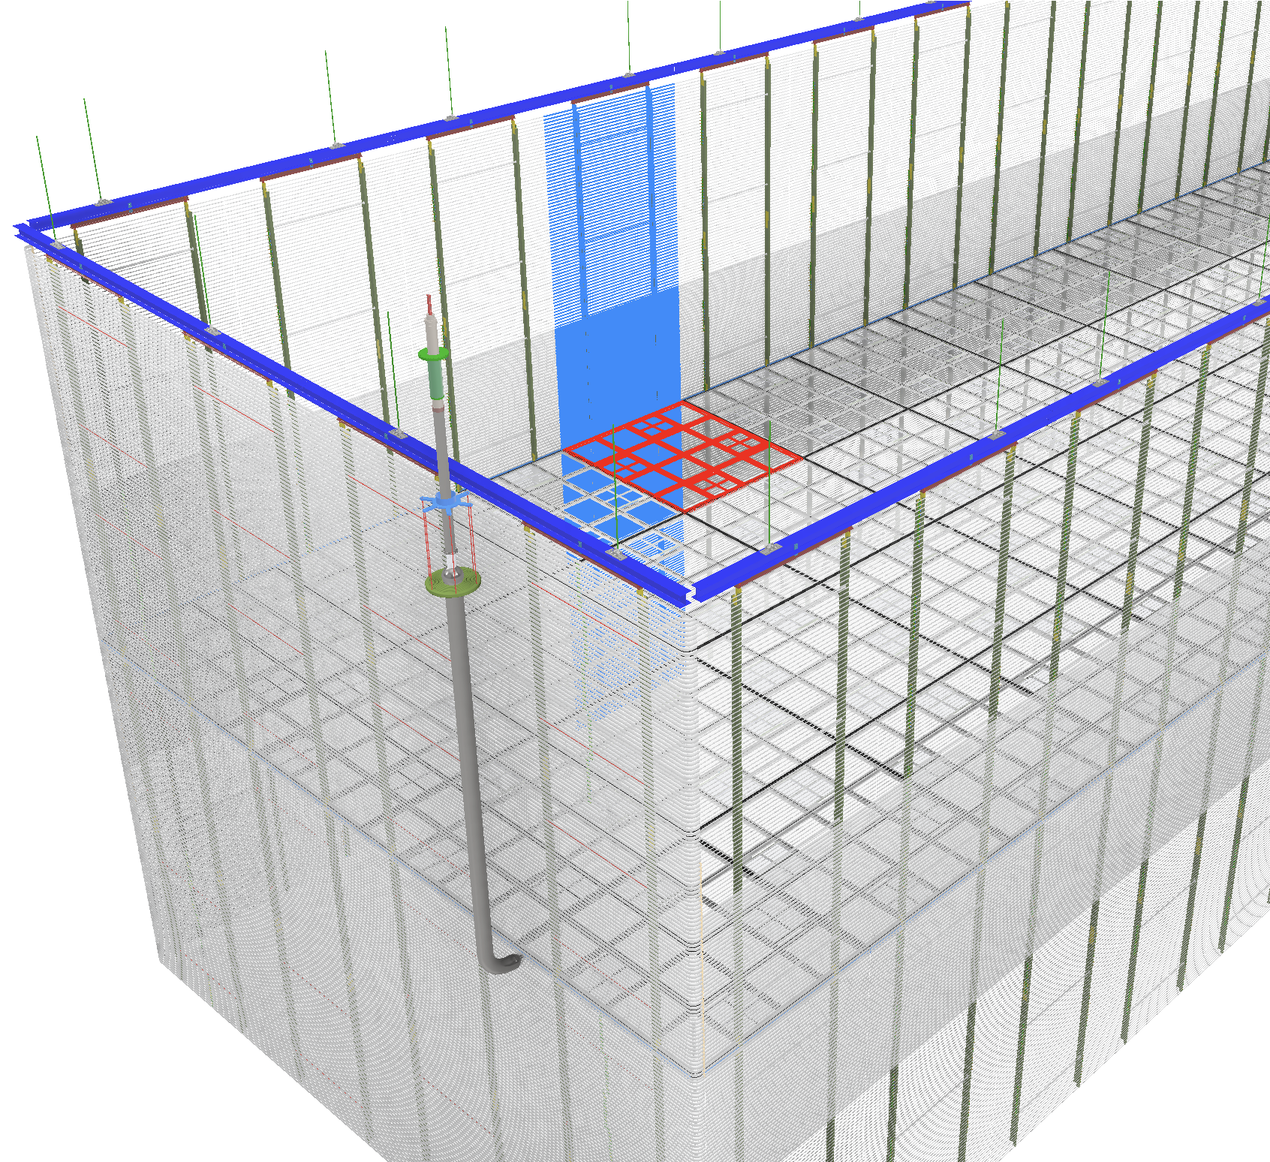
HVS Scope for the FD-VD
Charge Question #2
Vertical Drift HV concept largely derived from previous DP design. HV system designed to maximize active volume:
  Readout units close to LAr surface and cryostat floor: 2 times 6.5 m drift distance
  Cathode at middle height: LAr hydrostatic pressure allows improved HV stability minimizing the distance of Field cage from the cryostat walls (~60 cm)
  Single modular field cage surrounding active volume hanging independently from the roof
Present reference layout (with lessons learned from NP04/NP02 incorporated):
  Cathode planes:
    80 modules (3x3.4m2) with resistive surfaces
    suspension features to the super CRPs
    integration of X-Arapucas Photon Detectors (14% coverage) including networking of PoF/SoF
  Field cages
    192 field cage modules (3x3.3m2) including aluminum profiles and RDB’as in HD and DP
    70% transparency (close to anodes) matching PD’s position on cryostat membrane
  HV delivery
    HVPS, PS monitoring system, HV cable, ripple filters, HVFT, and HV extender

Slide 4
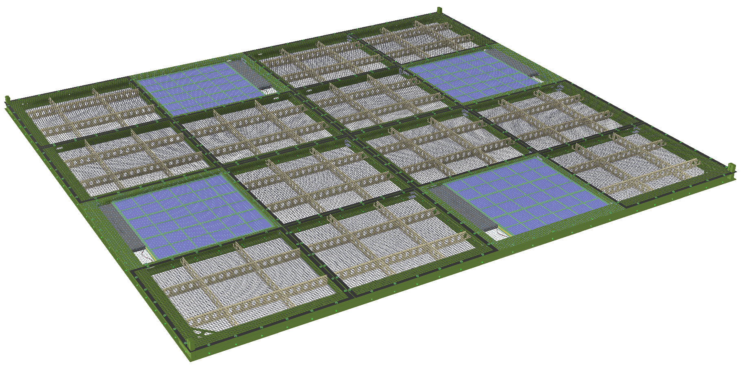
Charge Question #4
Cathode Plane (details in Fabien talk)
Each cathode module is constructed from a 3m x 3.4m x 0.05m FRP I-beam frame with 16 openings. Modules are suspended to the super CRP structure above the top anode plane using insulating ropes (Dyneema).
Double sided X-arapuca PD modules are installed in 4 of the openings (PDS scope), encased by highly transparent (~80%) metal wire mesh panels on both sides.
12 pairs of perforated resistive panels are mounted on the top and bottom faces of the frame, reinforced by light-weight rib structures. These and the wire mesh panels are electrically interconnected to form two highly resistive surfaces with sufficiently slow discharge RC time constant to reduce harmful charge injection to the FEE connected to the anodes. The porosity of the resistive panels is to be determined by CFD.
  The electrical characteristics of this cathode is very similar to that of the FD1 cathode planes.
  Choices of resistive perforation:
Resistive Kapton laminated FR4 sheet (FD1 CPA)
Resistive bulk conducting FR4 sheet
3D printed carbon fiber + PEEK grid.
4
04/28/2021

Slide 5
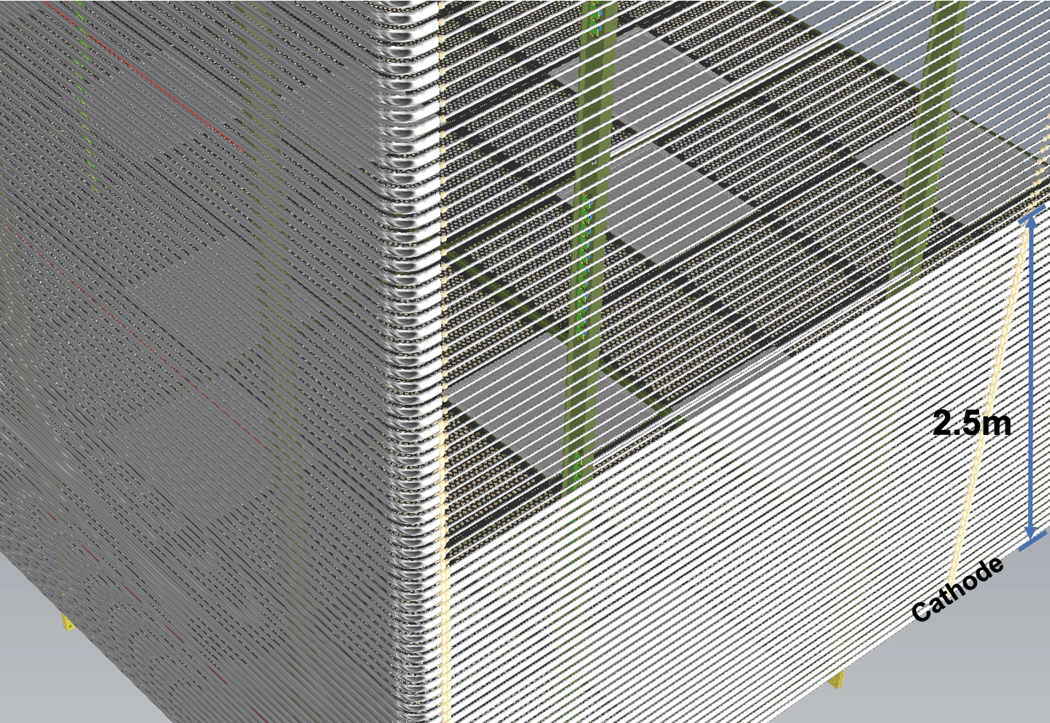
Charge Question #4
Field Cage (details in Jae’s talk)
Design based on experiences gained from both NP04 and NP02 installation/operations.
Arrays of FC modules (~3x3.3m2) surrounding the LAr volume between top and bottom anode planes, 13m double drift depth covered by columns of 4 modules. Two columns supported by a common stainless steel I-beam to form a super FC module, suspended from two roof penetrations
Aluminum profiles mounted on the outer flanges of FRP I-beams, terminated by UHMWPE caps to prevent the exposure of high E field to the bulk liquid argon. Own resistor divider chain eliminates need for lateral electrical interconnect.
Along vertical edges, profiles bent at 90° to provide smooth conductive surfaces and reduce field enhancement.
Minimum distance from ground shield ~ 600 mm (scaled from NP04 experience)
Key assembly/installation features demonstrated in NP02.
70% transparency near the anodes, to match the location of the PD’s on the membrane, ensured with thinner profiles: slightly higher local E field but within the maximum E field requirement.
5
04/28/2021

Slide 6
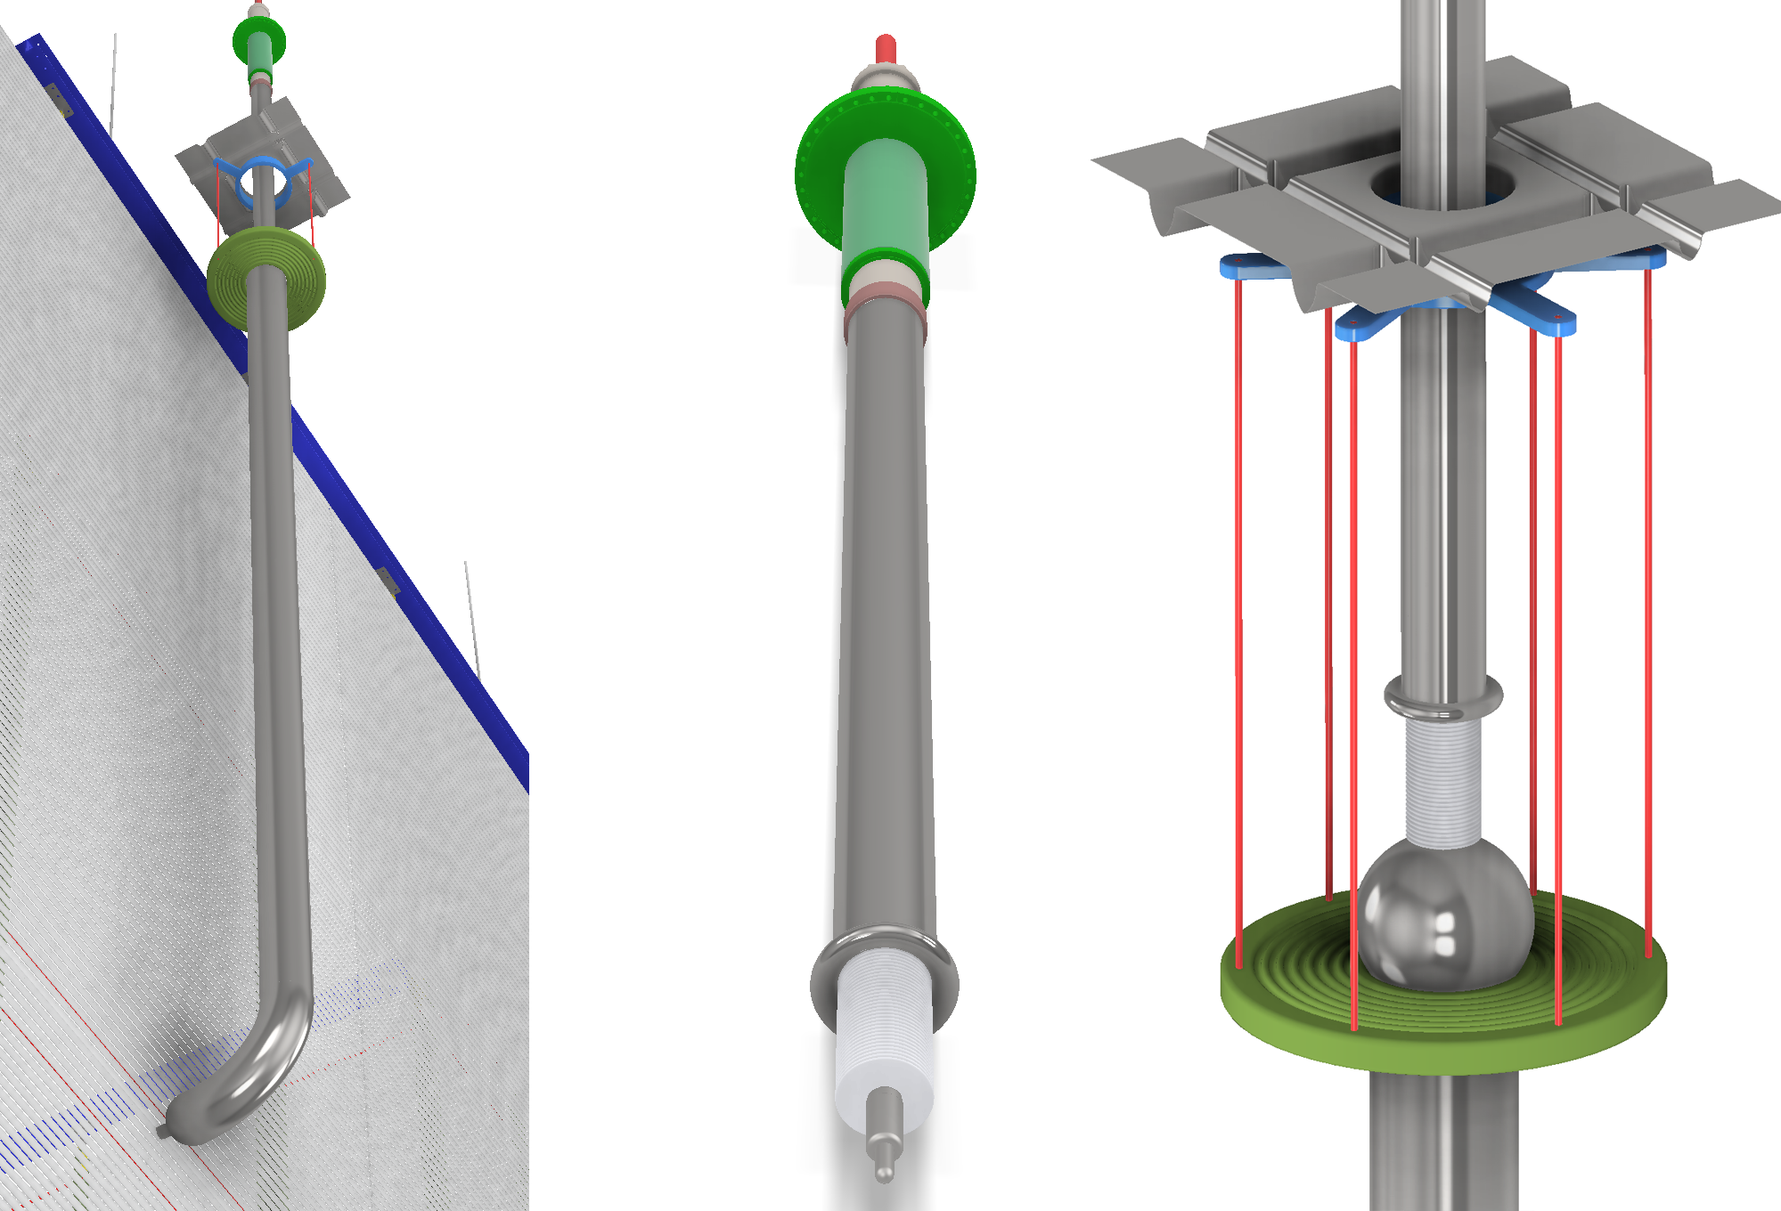
Charge Question #4
High Voltage Delivery System (details in Sarah’s talk)
It comprises: HVPS, HV cable, ripple filters, HV feedthrough, and the HV extender inside the cryostat to deliver the voltage to the cathode and field cage at the mid height of the TPC. Proposed reference design:
    Heinzinger PNChp 300kV power supply to power bias the cathode at ~293kV: successfully deployed in the ProtoDUNEs with good performance.
    Inline ripple filter based on the successful design for NP04 (moderate voltage drop to allow a higher voltage at the cathode).
The HVFTs with improved (UCLA) design wrt the ones in used in ProtoDUNEs. The HVFT in NP04 worked well for more than 2 years. Both HVFTs developed ice buildup at the HV cable connection on the air side: a shortcoming in the FT design. An existing HVFT free from cold connection, built by UCLA for the 35ton TPC being evaluated at CERN for 300kV operations.
A new HV extender (simplified version of the one of NP02); critical elements under tested at Iceberg (FNAL). A full-size extender to be assembled at CERN and tested (with HVFT) in NP02 in the fall.
6
04/28/2021

Slide 7
Charge Question #1
High Level Requirements (EB/TB held)
Most requirements for FD1-HD are also valid for FD1-VD
Higher Cathode voltage and different HV distribution (extender) included
Consortium held requirements and specifications under development.
ID | Description | Spec (Goal) | Comment
SP-FD-1 | Minimum drift field | >250 V/cm, (500V/cm) | Request change the goal to ~ 450V/cm to enable the use of existing 300kV HVPS.
SP-FD-11 | Drift field uniformity due to HVS | < +/-1% in 99.8% of the active volume | Larger drift distance relaxes cathode flatness requirement
SP-FD-12 | Cathode HV power supply ripple contribution to system noise | < 100 e
SP-FD-17 | Cathode resistivity | > 1MΩ/□, <10TΩ/□ (> 1GΩ/□)
SP-FD-24 | Local electric fields | < 30 kV/cm; Exceptions: for specific components with localized E-field higher than 30 kV/cm, perform test in pure LAr at least at 120% of the designed operating voltage | Minor change of wording: voltage -> electric field
SP-FD-29 | Detector uptime | >98%, (>99%)
SP-FD-30 | Individual detector module uptime | >90%, (>95%)
SP-HV-1 | Maximize power supply stability | > 95% uptime
SP-HV-2 | Provide redundancy in all HV connections | Two-fold, (Four-fold) | Request exception on single HVFT
7
04/28/2021

Slide 8
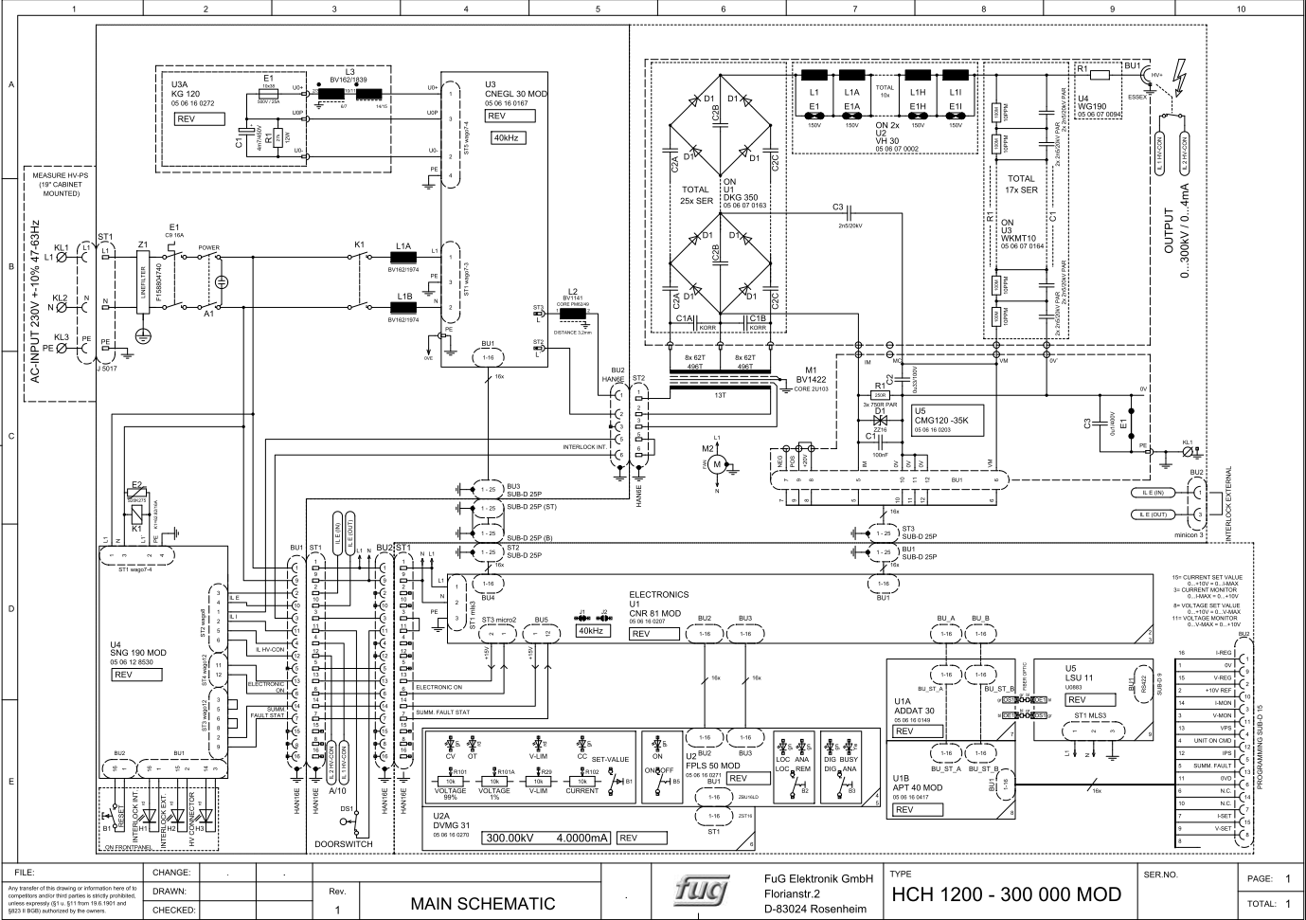
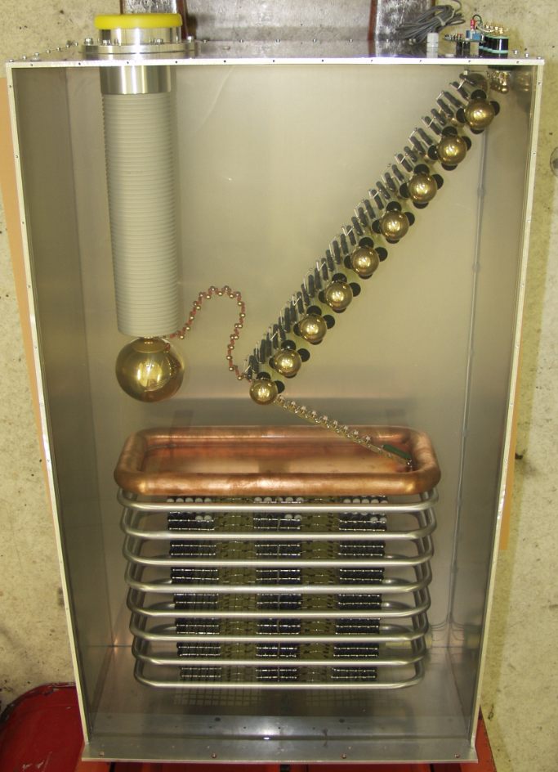
R&D on 350-360 kV HV-PS
Investigations are ongoing to develop a 350-360kV power supply:
  Heinzinger, FuG Elektronik.
FuG was very responsive and willing to collaborate on a joint R&D program:
  detailed discussions on technical aspects on HV scaling and tooling required to achieve it, while maintaining the specs on stability, ripple and longevity.
  Scaling reachable with present technology
  ~one year to develop a working prototype
  BUT: very expensive R&D (650 kEuro including prototype) due to development of infrastructures and tooling and very limited commercial market
  High cost of the final HV-PS (~240 kEuro)
Alternative solutions also surveyed with the help of French colleagues (ILL 380 kV PS built by Heinzinger with dedicated oil bath design)
  Similar cost (> 400-500 kEuro) as for the FuG solution and additional R&D required to adapt to the DUNE underground environment.
Other alternatives under study as well

Slide 9
Motivations for HV-PS delivering more than 300 kV?
In present VD layout, the total resistance of the field cage is 2.81 GOhm (96 RDV in parallel, 270 GOhm each; schematics successfully tested in NP04/02).
A ~50 MOhm resistance for the warm RC ripple filters should be included (as demonstrated by NP04)
With these conditions, to reach the nominal drift field of 500 V/cm, the HV-PS should deliver 330 kV.
With a 300 kV HV-PS, a drift field of 450 V/cm could be reached.
Variation of the most relevant LAr-TPC parameters, going from 500 V/cm to 450 V/cm, (https://lar.bnl.gov/properties/#basic-prop) are sublinear:
  Free electron drift velocity = 1.601 mm/us —> 1.517 (-5.25%)
  Max drift time (6.5m) = 4063 us —> 4285 us (+5.25%)
  El-ion recombination = 0.595 —> 0.5814 (-2.3%)
  Scintillation yield = 0.4395 —> 0.4473 ( + 1.8%)
  Longitudinal diffusion coef. = 6.627 cm2/s—> 6.589 (-0.6%)
  Transverse diffusion coef. = 13.24 cm2/s—> 12.62 (-4.6%)
  Ion drift velocity = 8 mm/s —> ~7.2 (~ -10%)
DUNE physics analysis group involved to evaluate the performance of the VD TPC at a drift field of ~ 450V/cm, compared to 500 V/cm.

Slide 10
Extender as single point failure?
Based on the experience from NP02, the new extender has been designed to overcome single-point-failure risks.
If the validity of this design is confirmed in 2021 tests (CERN/FNAL), the identified failure points are:
    Connection from the Extender to the FC/Cathode. This will be not accessible, but it is be easily mitigated with the already assumed multiple flexible-wired connections.
    Connection from the Extender to the HVFT. This is fully accessible as the HVFT can be extracted and replaced. Note that this operation has been successfully performed several times in several different LArTPC based detectors.
    Failure of the Extender hanging structure. In this case the effects will not be minimal or with high impact for the detector operation, depending on the failure degree (the extender could fall down or change position). Mitigation (implemented) is to use multiple hanging rods.
    Occasional HV instabilities due to hopefully rare discharges to the cryostat walls or the FC. HV current limitation and resistive filtering stages along the warm cable will slow down the discharge thus limiting the effect of the stored energy release.
In all these scenarios, a second extender would not mitigate these issues but rather increase the possibility of failures, being the additional extender at the same HV as the one connected to the HVFT.
For this reason, we do not consider a second extender as a way to mitigate the HV single-point-failure risks.

Slide 11
Key Interfaces (details in Bo’s talk)
Consortia | Interfaces
CRP | Mechanical support of the cathode plane
Bottom CE | Field cage termination cables, and bias supplies
PDS | PD integration inside the cathode modules Cable routing along the cathode Transparency requirement on field cage modules PD PoF and readout module attachment on FC Fiber routing along the field cage
Slow control | Monitoring of HVPS and FC terminations
CALCI | TBD
LBNF I&I | FC top support beams, and roof penetrations HVFT port, HVPS location, HV cable routing Cold camera signal feedthrough ports and anchor points Design of the ground plane Integration and Installation
11
04/28/2021

Slide 12
Charge Question #3
Ongoing and Planned Technology Development
Topics | Status
300kV HVFT with warm cable interface | An existing HVFT is being evaluated
HV extender without solid insulation | Key sections under construction, test within weeks. Full scale test in NP02 in the fall.
300kV ripple filter | Planned this year
Perforated resistive cathode surface | Multiple options are being evaluated
Choice of cathode suspension cables | Under evaluation for CTE, elongation, and creep.
70% transparent field cage | Conceptual design exists, small scale demonstration is planned for this year
RDB component semi-automated testing stands | Planned for later this year
Details on HVS components validation program in Filippo’s and Sarah’s talks
12
04/28/2021

Slide 13
Risks
Evaluation started (discussed at the recent Risk Workshop)
Mostly derived from HD and former DP
To be refined also according to the HV validation with demonstrators
Risk Type | RI-ID | Title | Prob. | Cost Impact | Schedule Impact | Risk Rank | Risk Status | Approval Status
Threat | RT-131-FD2-009 | FD2 insufficient non-costed labor for FC underground activities | 50% | 0--200 k$ | 0 months | 2 (Medium) | Open | 4- approved
Threat |  | FD2 HVFT and Extender fail to hold 300kV in R&D 1 phase | 30% | 100--300 k$ | 3 -- 6 months | 1 (Low) | Proposed | 1-draft
Threat |  | FD2 HVS fails to hold 300kV in module-0 test | 10% | 100--300 k$ | 3 -- 6 months | 1 (Low) | Proposed | 1-draft
Threat |  | FD2 FC profile damage | 30% | 20 k$ | 3 months | 1 (Low) | Proposed | 1-draft
Opportunity |  | FD2 cathode resistivity | 10% | -1000 k$ | months | 1 (Low) | Proposed | 1-draft
Threat |  | FD2 elevated surface electric field on alternative FC configuration | 10% | k$ | months | 1 (Low) | Proposed | 1-draft
Threat | RT-131-FD2-008 | FD2 HVFT and Extender fail to hold 300kV in R&D phase 2 | 20% | 10--1000 k$ | 8 months | 2 (Medium) | Proposed | 4- approved
Threat | RT-131-FD2-011 | FD2 cathode planarity out of spec in prototypes | 20% | 10--200 k$ | 2 -- 12 months | 2 (Medium) | Proposed | 1-draft
13
04/28/2021

Slide 14



HVS consortium Organization
DUNE JT-HVS Consortium
F. Pietropaolo (Leader, CERN)
B. Yu (Technical Lead, BNL)
V. Guarino (HD Engineering Lead, ANL)
D. Mladenov (VD Engineering Lead, CERN)
WG1: Design Optimization
V. Guarino (ANL): HD
B. Yu (BNL): HD & VD
D. Mladenov (CERN): VD
WG4: VD Cathode
F. Cavalier (IJCLAB)
B. Yu (BNL)
WG2: R&D (HD & VD)
F. Pietropaolo (CERN)
S. Lockwitz (FNAL)
WG5: Field Cage
T. Kutter (LSU): HD
M. Wilking (SBU): HD
J. Yu (UTA): HD &VD
J. Nelson (W&M): VD
Connectors to FEMB
WG3: HD Cathode
S. Magill (ANL)
J. Nelson (W&M)
WG6: HV Distribution
F. Pietropaolo (CERN)
S. Lockwitz (FNAL)
IN2P3-Grenoble (under discussion)
14
04/28/2021

Slide 15
Charge Question #2
HVS consortium Institutional commitments
Institutions | Deliverables
Argonne National Lab (ANL) | HD: System design & analysis, CPA production and installation; HD & VD: QA/QC
Brookhaven National Lab (BNL) | HD & VD: System design & analysis, project management, interfaces, cold cameras
CERN | HD & VD: System design, HV R&D, HV distribution system, Components procurements (FC, CPA, HV), ProtoDUNE installation & operation
Fermi National Accelerator Lab (FNAL) | HD & VD: HV R&D, HV distribution system installation and monitoring
Kansas State Univ. (KSU) | HD: HV bus & interconnects, GP monitoring system
IJCLAB (France) | VD: Cathode design, construction, assembly and tests
IN2P3-Grenoble (under discussion) | VD: HV distribution system R&D
Louisiana State Univ. (LSU) | HD: Resistive divider boards, FC termination boards, end-wall FC production and installation
Stony Brook Univ. (SBU) | HD: Top field cage production and installation
Univ. of Texas Arlington (UTA) | HD: Bottom field cage production and installation; VD: field cage production and installation
College of William & Mary (W&M) | HD: CPA production and installation; VD: Resistive divider boards.
15
04/28/2021

Slide 16
HVS funding model for Vertical Drift
The cathode and its suspension system is a deliverable that will be fully funded by France/IN2P3
The scope of the rest of the HV system for the DUNE FD2 is shared between DUNE-US and CERN
DUNE-US is responsible for the design prototyping, production of the FD and the project management and installation at SURF.
CERN contributes with design, prototyping (ProtoDUNE and HV), procurement of all FC profiles, HV power supplies and HV power distribution system.
CERN will contribute with some FTEs during the FD assembly and installation period
16
04/28/2021

Slide 17
Summary
The conceptual design of the HV system components have been developed, with some detailed parameters and material choices under evaluation.
Most of the operating principles and design features are evolved from the FD FD-HD counterparts, and have been validated by the ProtoDUNEs operation, with further improvements.
We recognize a number of new challenges, such as the HV extender, and have planned a series of development activities and small to large scale tests to validate the designs and mitigate the risks.
A 70% transparent field cage design is taking shape. It appears that we have the flexibility of mixing the more transparent FC configuration with the conventional design to accommodate the wall-mount PDs while minimizing HV risks.
The FD-VD HVS is expected to meet the same high level requirements from FD-HD. We are performing cost and benefit analysis to see if we need to set the drift field goal to 450V/cm.
The FD-VD HVS has a distinctively different set of interfaces with other subsystems compared to FD FD-HD. The interface with PDS is very complex and must be closely coordinated.
The first draft of the CDR HVS chapter released to CET on June 10th. The content is presented in this review. HVS prototyping sections also released.
17
04/28/2021

Slide 18
BACKUP
18
04/28/2021

