Slide 1

​FD2 HVS Interfaces and Installation
Bo Yu
Brookhaven National Laboratory
DUNE FD2-VD High Voltage System Conceptual Design Review
14 June 2021

Slide 2
Outline
Major HVS External Interfaces
  CRP (cathode support)
  PDS (PD integration & cable/fiber routing)
  Bottom Electronics (FC termination bias supplies)
  Facility
    Cryostat (FC support, ground plane features, HVPS/FT)
    Cryogenics (interlock on HVPS)
  Slow Control (monitoring and control of HVPS and FC terminations)
  CALCI (TBD)
Installation Sequence
  Cathode installation
  FC installation
  HVFT/Extender installation

Slide 3
Interfaces with CRP
The cathode modules are suspected under the super CRP structure through a number of insulating ropes. The entire load of the cathode (+PDs) is supported by the super CRP structure.
The designs of the super CRP structure and the cathode modules are to be coordinated and iterated to meet the deflection limit.
The positional stability of the cathode during installation must be compatible with the gaps between the CRPs.
Currently, a 10kg/m² weight (dry) limit is imposed on the cathode.
The bottom row of west EWFC modules must be installed after all bottom CRP installation, and must be installed from outside of the FC.
The termination voltages of the FC are set based on the relative heights of the top and bottom CRPs to maintain a uniform drift field.

Slide 4
Interfaces with PDS, 1 of 2
4 photon detector modules are embedded into 4 of the 16 openings on each cathode module.
The attachment points of the PDs into cathode, the cable/fiber routing inside the cathode framework, and the PDs installation procedures are jointly developed by HVS and PDS.
The selected transparency of the wire mesh is determined jointly by HVS and PDS to satisfy both electrostatic field and light collection requirements.
Cable/fiber routing along the cathode to the field cage down to the cable trays on the floor is jointly developed by both HVS and PDS.
However, the current PD power and readout distribution scheme (copper wires distributed and interconnect along the cathode plane) likely defeats the highly resistive nature of the cathode design.

Slide 5
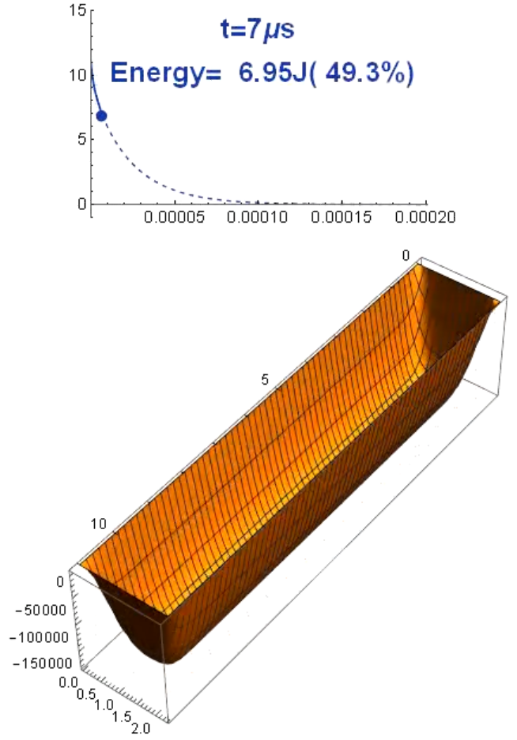
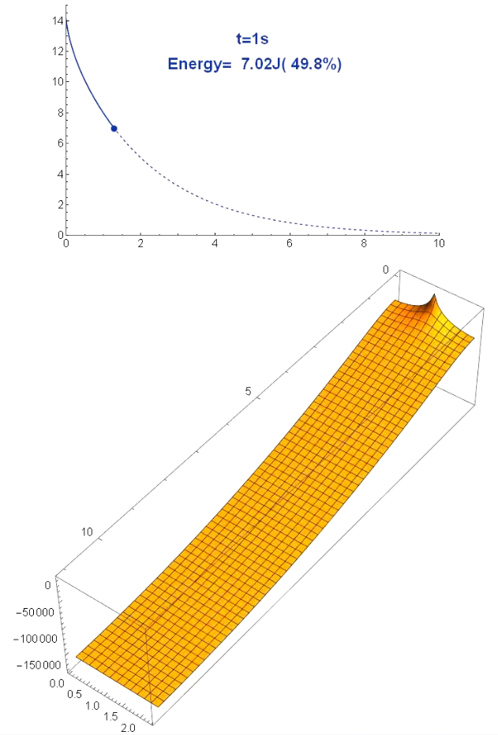
Interfaces with PDS, 2 of 2
A discharge study on the resistive cathode of FD1 was conducted and a report posted at docdb 1320.
The study compared the voltage distribution in time for an all-resistive CPA and one with a conductive frame: figures to the right.
There is a dramatic difference in how quickly the CPA with conductive frame discharge its stored energy compared with that of the all-resistive design.
The current PDS power and signal distribution scheme place a network of copper wires from the edges of the cathode to the PD modules in the middle of the cathode. This makes the electrical configuration similar to or worse than the example with the conductive frame. If the power/data cables cannot withstand high voltage, one can expect damage to the PD modules in case of a HV discharge, as well as a larger charge injection into the FEE.
This issue has been recognized as a risk and entered into the DUNE risk registry by PDS.
PDS and HVS are working on a solution that mitigates this risk.
conductive frame, resistive surface
resistive frame, resistive surface

Slide 6
Interfaces with Bottom Electronics
There are 96 FC termination channels on the TPC. Similar to the configuration in FD1, we plan to have a bias power supply for each termination channel to allow both current monitoring as well as voltage adjustment to improve drift field uniformity post installation,
These power supplies and cables are provided by CE. The bottom termination cables will be routed by CE as part of the bottom readout cable bundle.
Each CE penetration serves 2 bottom CRPs using either 2 or 3 CE flanges. Each CE flange has 8 SHV feedthroughs. Therefore, there are a minimum of 16 SHV connections per CE penetration. Each CRP needs 3 bias voltages. We need to reserve 2 SHV connections for FC termination on most of the CE penetrations, and 6 for the first and last penetrations of the long walls to cover the termination channels on the endwall modules.
Bottom FC termination connections are made from cables already routed in the bottom cable tray once the bottom FC modules are installed.
The new CRP installation scheme of raising the CRP and cathode together before the FC prevents personnel access to the top of the FC to make the termination connections. We are still working on a practical solution.

Slide 7
Interfaces with Cryostat/Cryogenics
Rack space (I&I)
  One HVPS with long cable and ripple filter
  FC termination bias supplies are in CE scope
  No ground plane monitoring in FD2
HVFT penetration, and extender support
  One at the east (non-TCO) end
Field cage support
  48 dedicated roof penetrations for field cage support
Ground plane & cable tray design features
Internal cryogenic pipes on the east end must stay as close as possible to the cryostat wall.
The cathode HVPS must be interlocked to the liquid level (determined by the HVFT) as well as any sudden pressure decrease inside the cryostat.

Slide 8
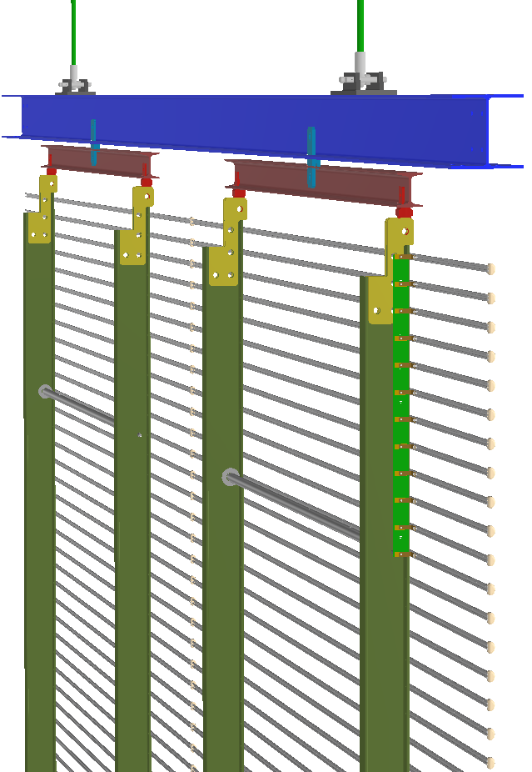
Field Cage Super Module Structure
To FC penetration
Each FC super module consists of:
2 lift rods and their mounting brackets (I&I scope)
  The top of the rods are secured to support flanges on the FC support penetrations.
~ 6m SS I-beam (I&I scope)
  A stiff I-beam decouples the positions of the FC support penetrations w.r.t. the field cage positions.
2 aluminum yokes with links to the I-beam above and the FC modules below (HVS scope)
  The center pivot of the yoke is aligned with the CG of a FC column such that the FC column always hangs vertically regardless of the cryostat roof deflection, and the load is evenly shared by the two FRP beams.
  The CTE of the yokes match that of the aluminum profiles to minimize stress on the FRP beams.
2 columns x 4 high FC modules (HVS scope)
The super module weighs ~ 350kg excluding the SS I-beam.
I&I scope
FC support beam
FC yoke
HVS
scope

Slide 9
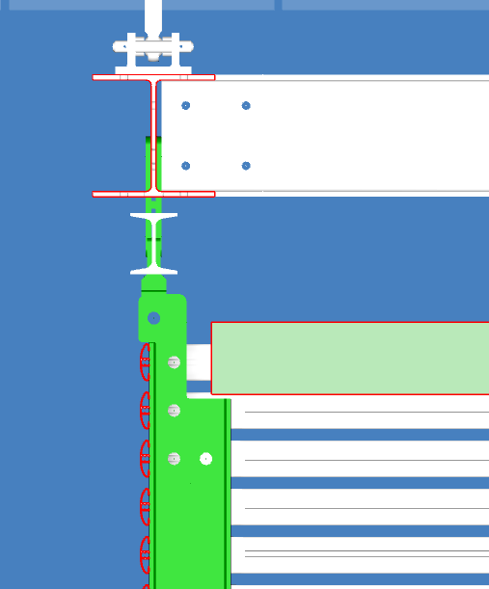
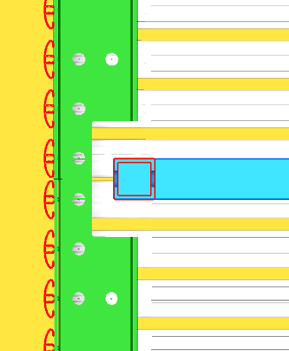
Field Cage Support
FC support beam
Top FC
termination
48 dedicated roof penetrations for field cage support
These FC support feedthroughs must allow the FC modules to laterally slide into final position (~5cm toward the CRP)
  The FC supper modules must be raised slightly away from the CRP/Cathode to avoid collision.
  Once they reached the final height, they can be moved back to the nominal position
The new CRP/cathode installation scheme makes it very difficult to connect the top FC termination cables to the CE penetrations. A possible solution is to add the FC termination cable feedthrough to the FC support penetration using a side port feedthrough.
Some of these feedthrough might need to have parasitic side signal feedthroughs for cold cameras.
Top CRP
Cathode

Slide 10
Interfaces with CALCI
The scope of CALCI in FD2 is not yet defined.
Potential features to implement
  Radioactive point sources on cathode
  Photoelectric targets on cathode
  Ionization laser through field cage:
    Straightforward for top drift volume with the 70% transparent FC
    Challenging for the bottom drift volume

Slide 11
Assembly and Installation of the HV System
The installation of the HVPS, cables and ripple filters can be done as soon as the rack space on the cryostat top is available, and before the installation of the HVFT and extender. (I&I + HVS labor)
The final assembly (two half cathode into a full cathode) and integration of the cathode (with PDs) need to start a few days before the CRP/cathode installation starts. (HVS + PDS labor)
  Floor space inside the cryostat on the TCO ends for two(?) cathode integration stations (~5m x 5m each) is needed ~ 1 week prior to the start of the CRP/cathode installation.
The assembly of the field cage modules needs to start ~ 1 week before the installation of the FC super modules. (HVS labor)
  Floor space inside the cryostat on the TCO ends for two FC assembly stations (~5mx5m each) is required ~ 2 weeks prior to the start of the FC installation
Since the bottom of the field cage is lower than the temporary floor of the cryostat, sections of the floor must be removed prior to the installation of the FC.

Slide 12
Installation of the Cathode Modules
The cathode modules are constructed in the factory with all internal PDs interconnect wiring installed. Each module may be shipped in a folded configuration for the ease of transportation to SDWF.
Each cathode module is moved into the cryostat to the assembly table and restored to the full CRP size by the HVS crew. PDS crew will install the PD modules inside the cathode, and verify the electrical/optical connections.
Either 2 or 6 finished cathode modules are positioned under the CRPs already suspended at 7m height. The cathode modules are connected to their suspension ropes. All intra-cathode cables/fibers are routed and secured to the sides of the cathode. If these cables/fibers are integral part of the fiber bundle already in the cable trays, they are connected to the patch panel/hub on the cathode modules.
The super CRP structure with CRP and cathode modules are raised to the final height. Make interconnects to neighboring cathode modules already in final position.

Slide 13
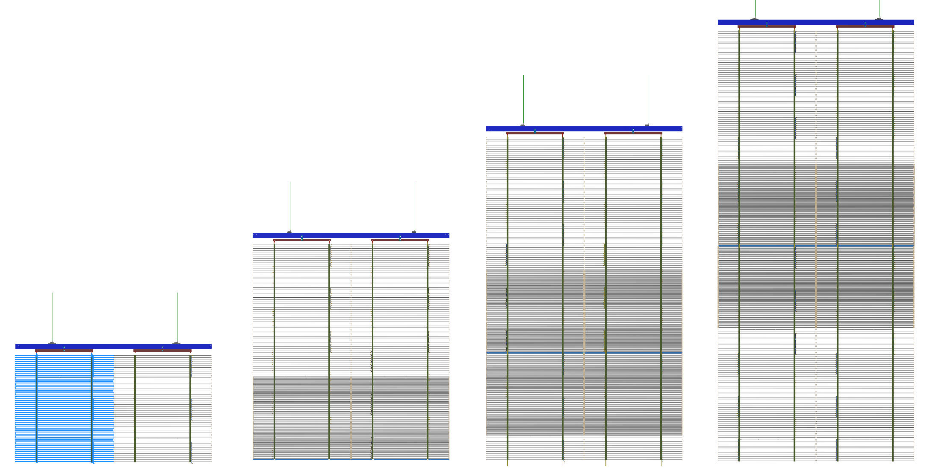
Installation of the Field Cage Modules, 1 of 2
The field cage modules are assembled inside the cryostat on two assembly stations a few days before their installation.
The FC installation takes place after an adjacent super CRP/cathode is in position.
A stainless-steel FC support beam is connected with two winches at the top of the cryostat. The FC yokes are already mounted on the I-beam. Position the winches such that the I-beam is farthest away from the CRP/cathode already at height.
Raise the I-beam to ~ 3.5m height, attach two top FC modules to the yokes under the I-beam. Connect the top FC termination cables.
Raise the top row FC modules by another 3.5m, attach the row two FC modules. Interconnect the RDBs to row 1, interconnect the HV bus between the two modules.
Repeat the similar steps to attach and interconnect the bottom
two rows of the FC modules. The floor needs to be partially
removed to clear the space for the bottom row of
FC modules.

Slide 14
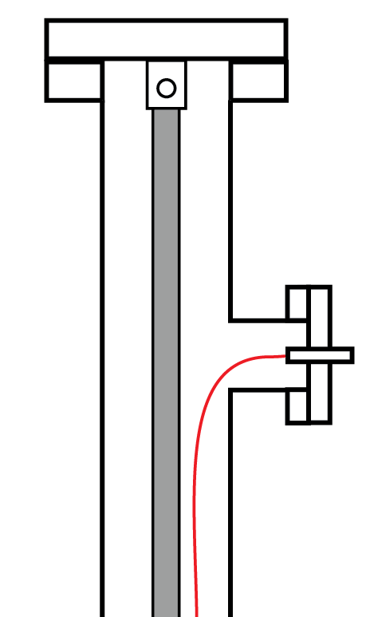
Installation of the Field Cage Modules, 2 of 2
From inside the FC, use a scissor lift to reach the intersection between the cathode and FC. Connect the HV bus on the newly installed FC modules to any existing FC already in position, and connect the HV bus to the cathode at the designated locations.
Connect the bottom FC termination cables already in the bottom cable tray to the bottom of the RDBs.
If the FC support penetrations also house the top FC termination feedthroughs, the termination cables should have been attached to the FC lift rods and pulled out of the FC feedthrough. Thread the cables through the side ports and connect to the SHV feedthrough flange.
Route/secure the PDS fiber bundles along the FRP I-beams of the newly installed FC modules until they reach the bottom cable trays. Confirm optical connection to the PDS (PDS screw)
Move the super FC module closer to the CRP/cathode into final
position. Verify height and level of the FC super module. (I&I crew)
The bottom row of the EWFC modules are not attached to their
upper rows right after the top CRP/cathode installation. They are
to be installed AFTER the entire bottom CRPs are installed.
Installation details are still being developed to address the lack of
access at this final moment of TPC installation.
FC
support
flange
Top FC
termination
feedthrough

Slide 15
Installation of the HV Feedthrough and Extender
The HVFT and extender are installed in the east end of the cryostat. There is >1m of space (need to check the placement of the internal cryogenic pipes), which should allow scissor lift access to the top of the cryostat even after the CRP/cathode and one EWFC super module is installed.
The extender will be raised to the top of the cryostat by a winch through the HVFT roof penetration. Once reaching the correct height, it is secured to the hanger structure under the ceiling around the HVFT port. The bottom elbow is connected electrically to the field cage at the cathode height.
The HVFT is lowered into the HVFT port from the top of the cryostat. People both on top of the cryostat roof and inside under the ceiling must work together to position the feedthrough tip correctly to ensure good electrical connection.
Install the HV cable to the HVFT and verify connection to the field cage/cathode.

Slide 16
Summary
Most of the interfaces with existing systems in the FD2 have been identified through informal discussions with other system.
A formal process similar to those carried out in FD1 to formalize the interfaces and implementations is needed.
The newly proposed CRP/cathode installation scheme is beneficial to the cathode installation, but poses challenges to the FC installation, in particular w.r.t. the top termination connections.
The highly resistive cathode surfaces are designed to reduce charge injection to the FEE in case of a HV discharge. However, the current PD placement and power/readout cable distribution may weaken this safety feature.
We had one round of discussion with I&I on the installation steps. Additional iterations are needed to reach a consistent plan.

