Slide 1

​Field Cage Design
Jaehoon Yu
University of Texas at Arlington
VD HVS CDR Review
14 June 2021

Slide 2
Outline
Field Cage Module Design requirements and concepts
FRP Frame and Its Fundamentals
Al Profile Electrodes
FC Module Configuration
70% Transparent Field Cage
FC Supermodules
HV Divider Board
70% Transparent FC Testing Program
Summary

Slide 3
Field Cage Design Requirements
Minimum drift E field: 250V/cm (goal: 500V/cm or 450V/cm?)
Maintain E field in >99.8% of active volume uniform <+/-1%
Local maximum E field <30kV/cm
Detector up time >98%
Prevent and protect from discharge
Redundancy for reliable connection and operations
Modular design for rapid and uniform parts production, processing and QA/QC
Rapid and consistent module assembly & installation

Slide 4
Field Cage Design Fundamentals
Use Fiber Reinforced Plastic (FRP) I-beams
  Dimension : 5cm wide 10cm tall with 0.64cm thickness
  Two 3.3m long FRP I-beams used as the frame for the extruded Al profile electrodes to mount
  Two 1.7m long metal cross bars of 25mm diameter connects the two FRP beams
Extruded Al profiles of 46mm (15mm in the 70% transparency region) tall tightly mounted on one side of the I-beam frame using slip nuts
Voltage gradient delivered by the HV divider boards
Design reflects the lessons learned from ProtoDUNE SP operations

Slide 5
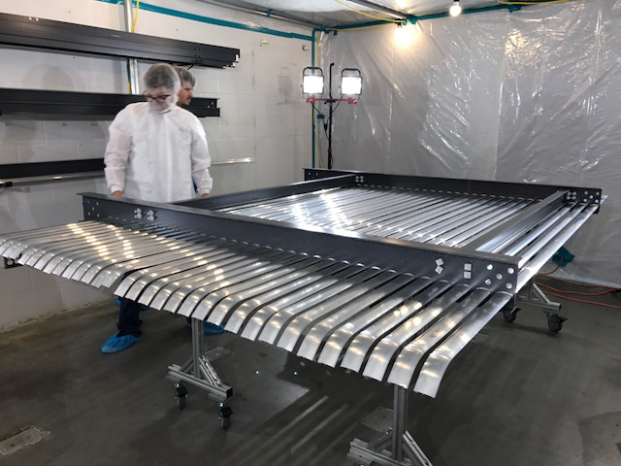
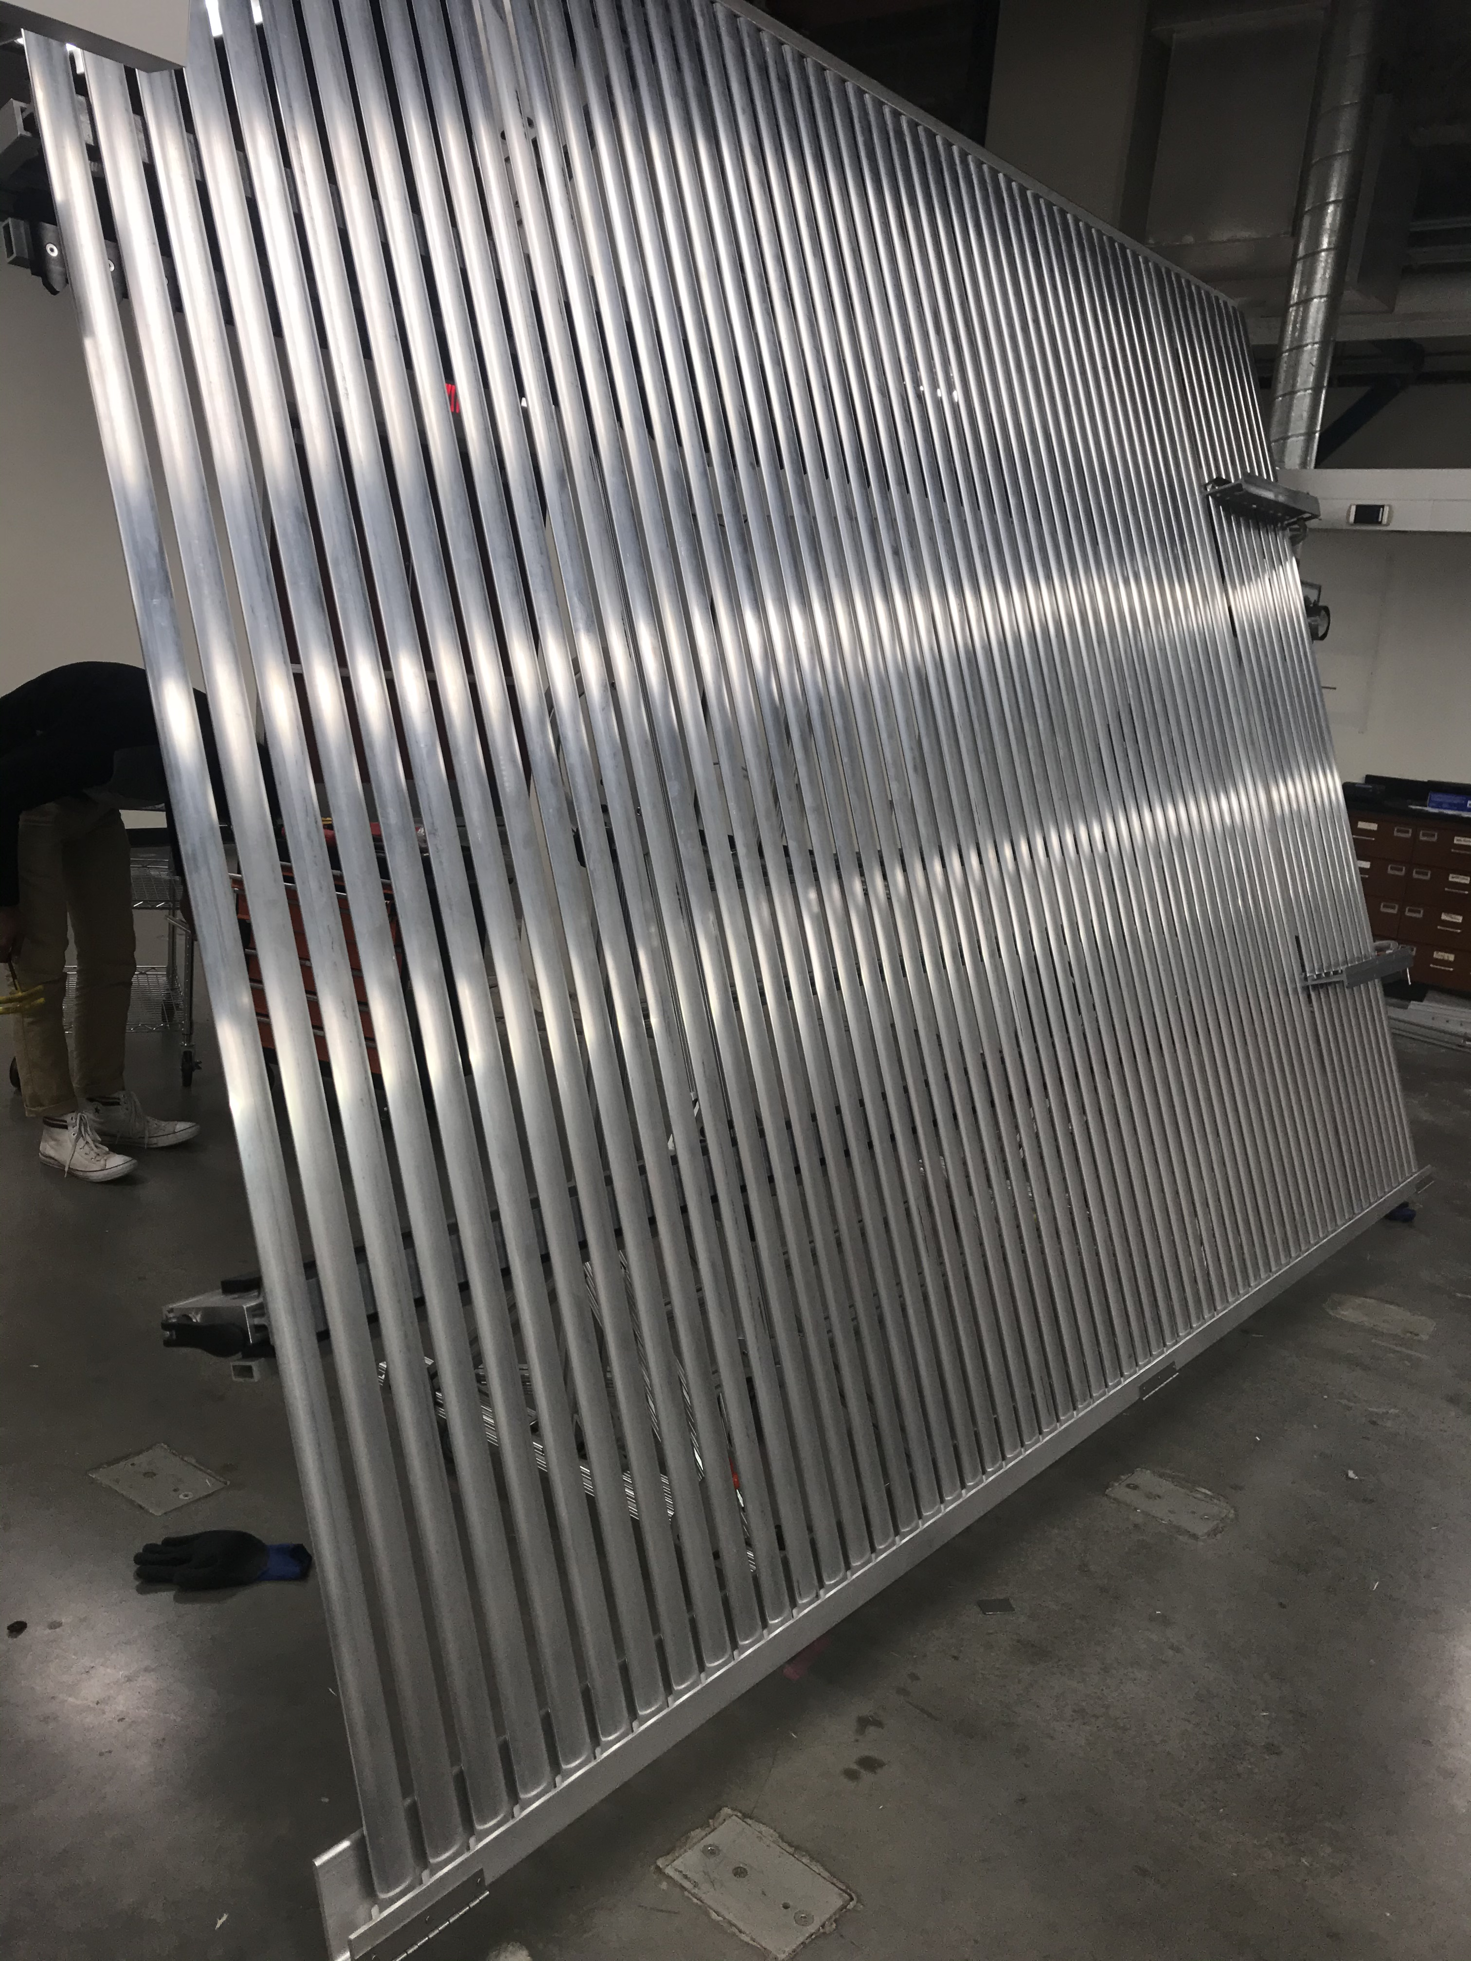
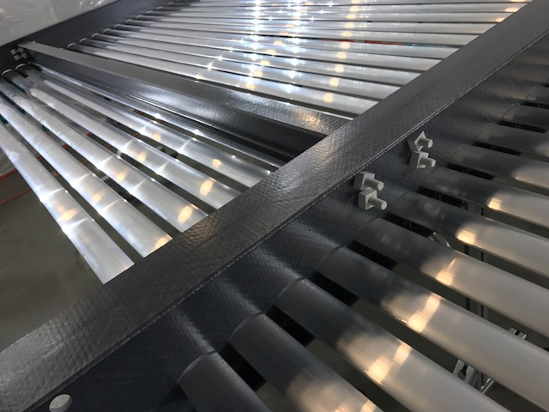
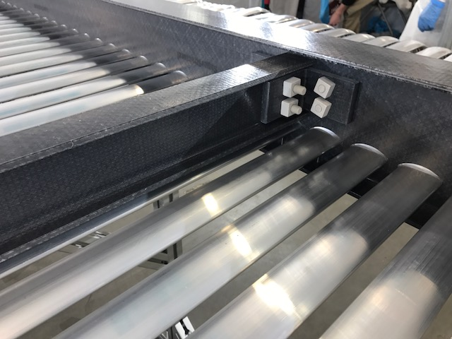
FC FRP Frame Design
Previous FC design exploited slots in FRP beams, which Al profiles are fed through
  Large amount of machined surfaces to debur, sand and coat for fiber suppression ➔ extended processing and QA time
  Al profile surfaces and coating scraped due to the machined surfaces ➔ Extended assembly time
  Large amount insulation toward the membrane ground ➔ charge build up
New HDSP design mounts all Al profiles on one side of flange ➔ no threading in the main beams, much speedier processing and reduced insulator toward the membrane ground

Slide 6
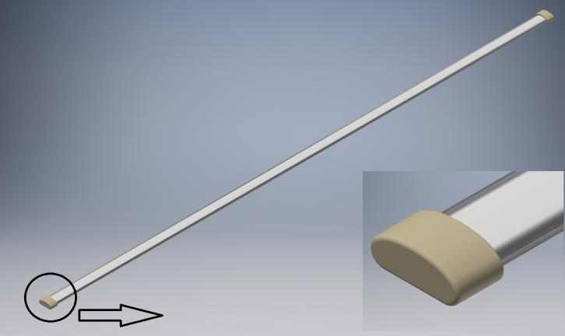
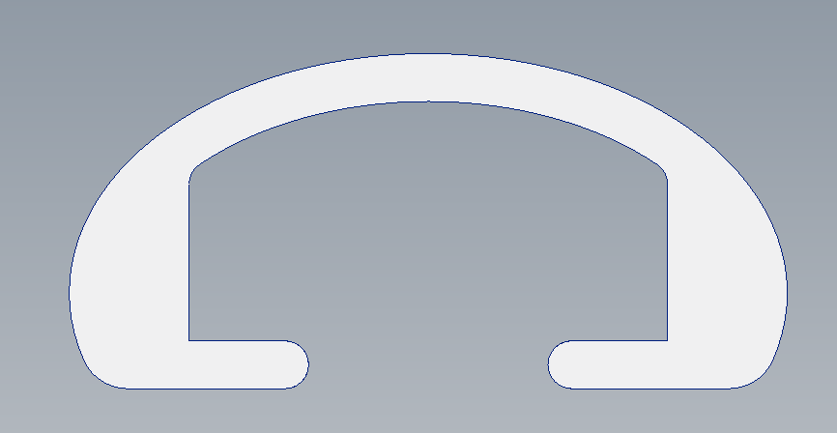
Al Profile Electrodes
Anti-oxidation coated, extruded C-shaped Al profiles the same design as the HDSP with 46mm height and 15mm height for the 70% transparent region
Dimensions
  Long wall profiles: 3m straight; 15mm height for 70% transparent region and 46mm height for other regions
  End wall profiles: 46mm height, 3.38m straight for the middle section and 3.38m with 90º bend one side for the four corners
70% Xparency narrow profiles
3m – 3.38m
46mm
7mm
15mm
Normal profiles

Slide 7
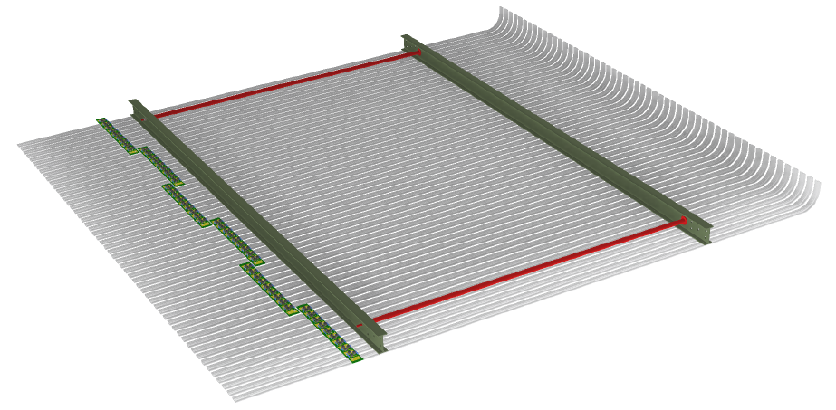
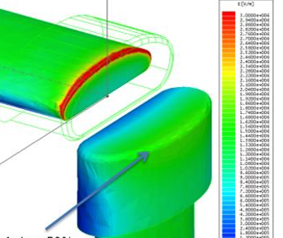
HV Field Cage (FC) Module Unit
Leverages the common basic structural elements and design as in HD
Modular construction with two 5cm wide, 10cm tall, 3.3m long FRP I-beam frames 1.7 m apart with a 2.54cm diameter metal cross bar
One module holds 55 extruded 46mm (15mm) aluminum electrodes in 6cm pitch mounted on the FRP I-beams using metal slip nuts
  Long wall FC : 3.0m (W) x 3.25m (H) straight
  End wall FC: 3.38m (W) x 3.25m (H) straight in mid-section and 90º bend at the corner
  Profiles mounted on the outer flange of the I-beam flange toward the cryostat wall, minimizing charge-up in insulator
  Profiles secured tightly on one I-beam and lose on the other to compensate the different contractions due to vertical temperature gradient
  Each end of the profiles are terminated in UHMWPE caps to prevent exposure of high E to LAr
VD End Wall Corner Module

Slide 8
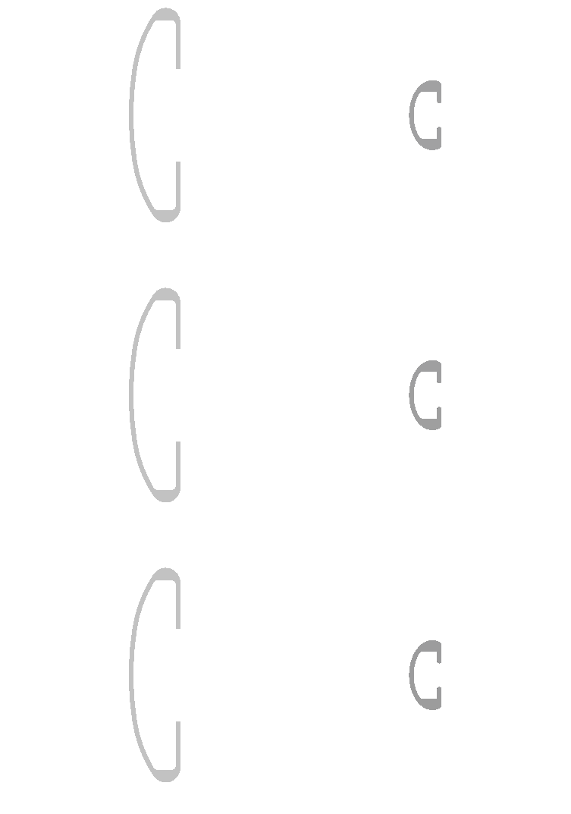
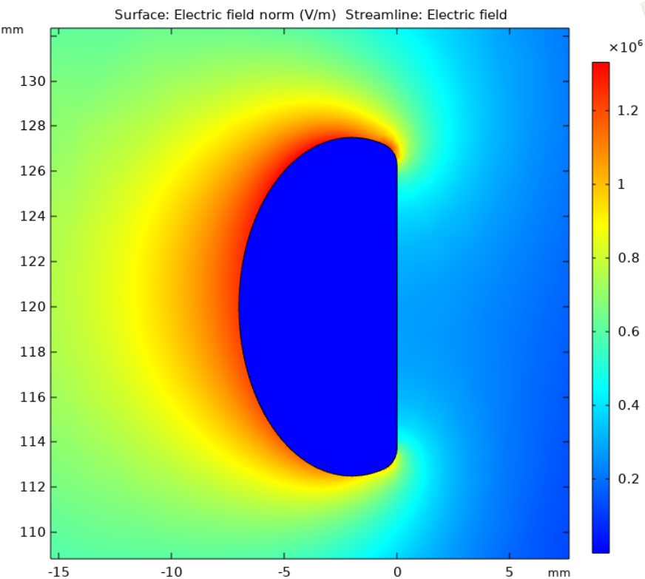
Transparent Field Cage
Provides higher overall optical transparency (70%) to PDS
Replace the normal 46mm width Al profiles with narrow 15mm width profiles in the same 6cm pitch
FEA shows max local field at 13kV/cm with 15mm profile at the cathode height
FD1 profile
narrow profile
46mm
15mm
60mm

Slide 9
FCSupermodule & Hanging Structure
2(W)x4(H) formation of the FC forms a super-module
  Long wall : 6m(W) x 13m (H)
  End wall : 6.76m(W) x 13m (H)
  2 SM/End and 10 SM/Long wall
Each super-module hangs from ceiling on two SS rods to SS I-beams
  Compensating rocking mechanism for each FC column of 13m for potential tilt due to a roof deformation implemented
The vertical installation scheme established and validated at NP02 PDDP
  See Bo Yu’s talk for the further optimized installation procedure and the hanging structure
FC Column
/

Slide 10
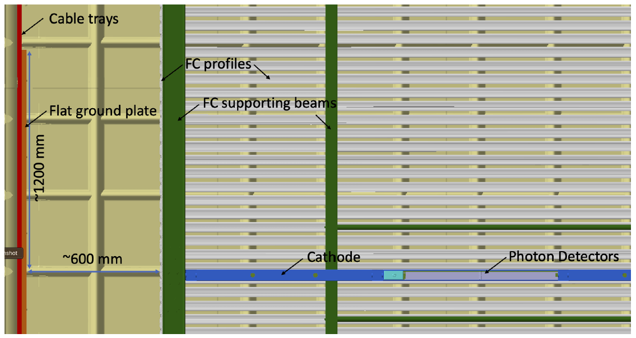
Cross-sectional View at the Cathode Level
E=5.4kV/cm
Recall: PDSP1 @200mm w/ V=180kV at the same parallel plate confg.

Slide 11
Cathode to FC Connection
HV extender brings the bias voltage (325kV or 300kV?) to cathode
FRP beams will have a cutout at the cathode and at the T/B CRP to minimize the 10cm horizontal gap
Lack of well defined electrodes at the cathode level causes the field distortion extends into active volume ➔ an additional field shaping strip to form a 5cmx5cm channel between FC and cathode perimeter smooths E

Slide 12
Transparent FC E Field Uniformity
It has been observed that the 15mm FC profiles biased at a constant voltage drop between profiles at the constant pitch, ~3% of the active volume E field deviate from nominal value over 1% and the field lines diverge as electrons leaving the cathode up to 10cm
This non-uniformity can be corrected by adjusting the bias voltage drop on the first 3 narrow profiles near the cathode surface and keeping the voltage drop the same for the remaining gaps
ΔV_{n,n+1}=3023V
ΔV=3000V
. . . . . . . . .
Field lines: black
Color contours: E amplitude
  Cyan: within +/- 1% of 500V/cm
  Yellow: 1-2% above
  Light blue: 1-2% below
  Orange: >2% above
  Dark blue: >2% below
ΔV₃₄=3023V
ΔV₂₃=3520V
ΔV₁₂=1650V
ΔV₀₁=900V

Slide 13
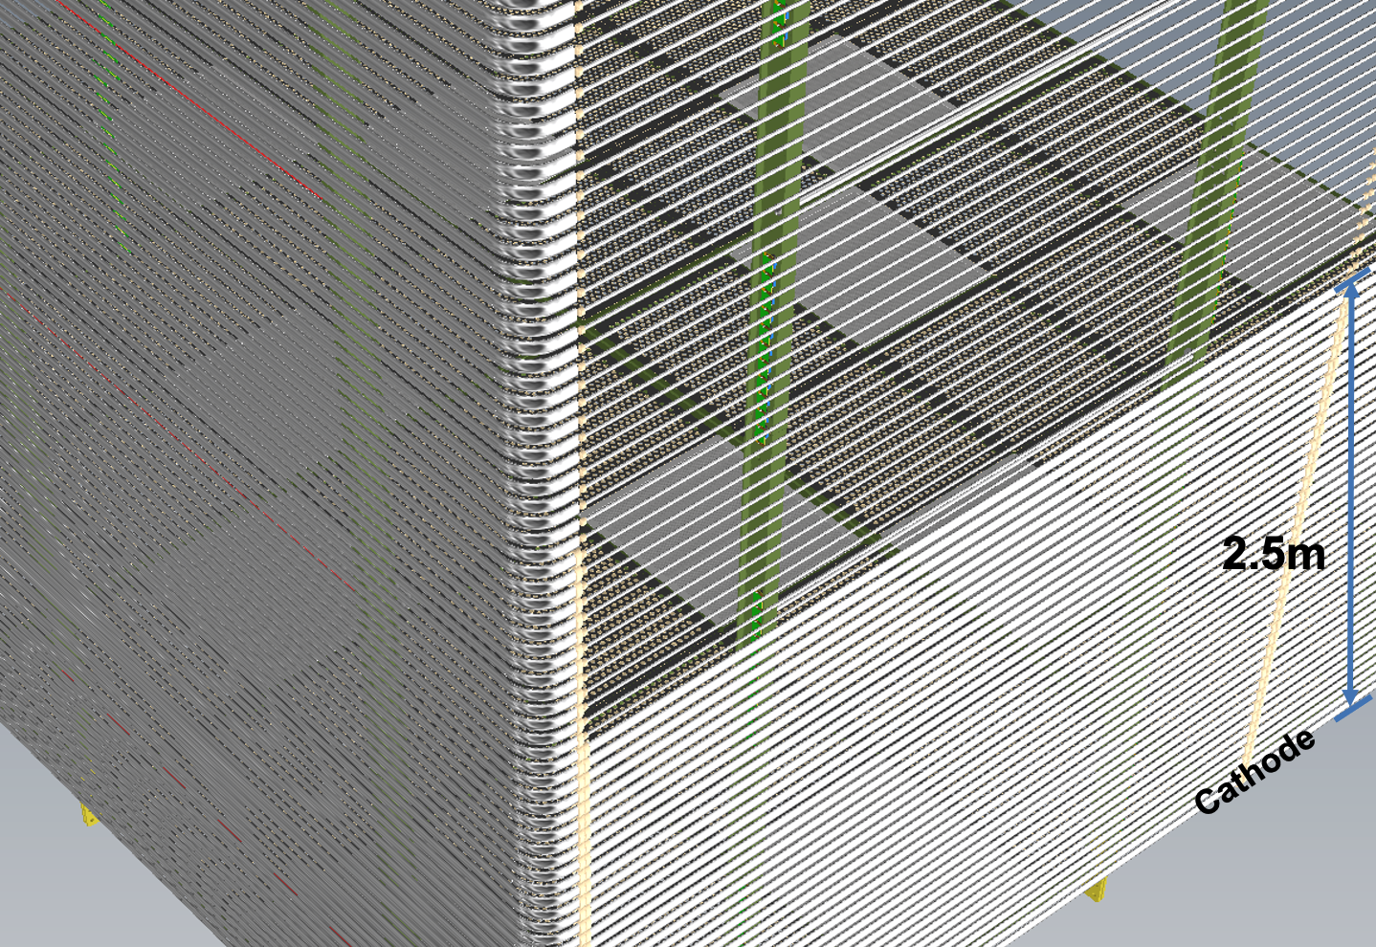
Transparent Field Cage Implementation
To provide higher optical transparency (70%) to PDS
Replace the normal 46mm width Al profiles with narrow 15mm width profiles
To minimize local fields across the FC volume, narrow profiles cover from +/- 2.5m to +/- 6.5m along the long wall only
Careful resistor configuration needed to keep the field uniformity within +/1 1% of the nominal field at the transition region

Slide 14
HV Divider Boards (HVDB)
Provides uniform voltage gradients across FC
Leverages the same design concept developed for ProtoDUNE and in the DUNE HDSP TDR
Each board has 10 junctions bridging 9 pairs of Al profiles
Each gap is bridged by two 5GΩ resistors for redundancy & three varistors of 1.7kV clamping voltage for surge protection
HVBD’s will be mounted on each FC module as it is assembled
  One HVDB chain per each of 48 the 6m tall half FC columns per active volume
  Total current for VD FC is 115.2μA (57.6μA per active volume)
Inter-module connections made at the time of the FC installation
HTPC - HVDB
PDDPHVDB
PDDPHVDB

Slide 15
HVDB On Transparent FC Transition Region
To maximize optical transparency, the HVDBs are mounted using a 90º bracket along the FRP I-Beam frames
The side of the board with resistors and varistors placed such that they are in the I-beam flange to minimize any further optical interference

Slide 16
70% Transparent FC Testing Program
While the design fundamentals are the same, the 15mm height Al profiles for 70% optical transparency hasn’t been tested before for its reliability and functionality
FEA shows the max local E field <13kV/cm at the cathode level but is higher than the normal 46mm height profiles
Requires testing at the nominal E field to ensure no unforeseen flaws
Three phases of testing (see Filippo’s talk for more details)
  Mini FC surrounded by ground plane in high purity LAr in the 2t cryostat ➔ Uniform nominal E field reachable w/ 60-70kV on HVFT
  2m(H) x~2m(W) section of the NP02 field cage equipped with 15mm height profiles during the long term HV extender stability testing
  One entire side of the FC replaced with 15mm height profiles in module 0 testing

Slide 17
Summary
VD FC fully leverages prior experience both from DPDP and PDSP as well as the DUNE HD FD design
70% optically transparent FC design in +/- 2.5m - +/-6.5m from cathode along the long wall implemented as the reference design
  Max local E field seems to be well under 30kV/cm
  An alternative design is to have the entire long wall 70% transparent
Important for us to reach a conclusion on 450V/cm vs 500V/cm field goals
HVS CDR Chapter reflects all new designs

