Slide 1
VCSELs in LHCb
LHCb has 3068 installed, all the same device, driven by GOL
2000 in Silicon Tracker
432 in Outer Tracker
484 in RICH
152 in Muons

Slide 2

VCSEL
Produced by ULM Photonics, Germany (subsidiary of Philips)
Oxide-confined, 850nm, 6mW, 1mA threshold
Packaging (2 steps): TO-46 (Bell electronics)
SMA (IMM Photonics)
Burn-in after TO-46 packaging (48h at 100degC, 15mA)
ULM promise good handling (ESD) procedures (but LHCb can’t!)
ULM promise good hermetic sealing
Wafer tracing underway
Bias currents 1.5 – 3 mA, modulation current = 10mA (fixed)
They are ALWAYS biased above threshold

Slide 3
Timeline
Before spring 2010:
RICH2 early deaths (2007-2008)
RICH1 (3): 2009(2), 2010(1)
All of Muon deaths
Rate is slow (or zero) except Silicon Tracker (biggest user)
Since spring 2010:
All deaths in OT
Most in ST
RICH2 (2)

Slide 4
RICH tests
After consultation from Stefan Simion (ATLAS LAr), we measured optical spectrum of ~ 150 VCSELs in RICH
Look for correlation between spectrum shape and future death:
one subsequently died, but spectrum looked ‘normal’
We would like to measure all VCSELs when data-taking stops this year

Slide 5
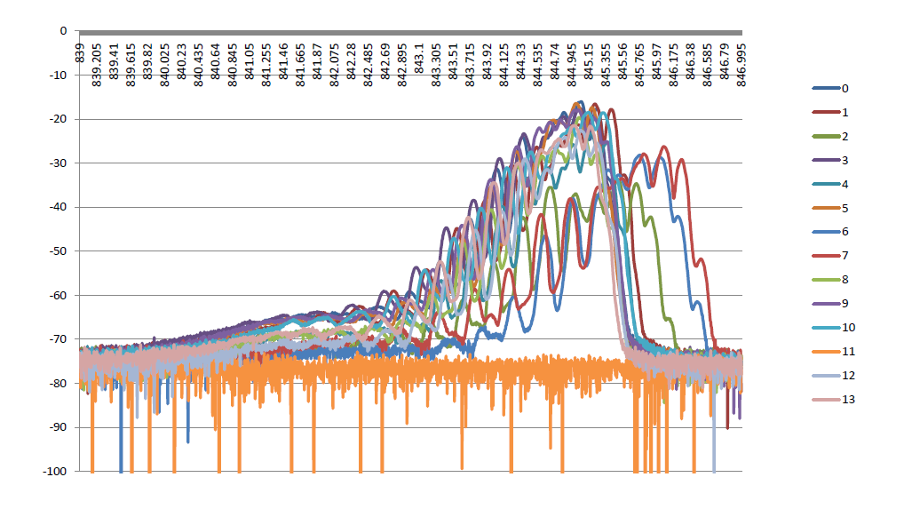
OSA on RICH1, column D3
Higher bias
Dead VCSEL

Slide 6
Failure analysis by ULM
LIV curves: downward shift in diode-turn-on voltage
Only light output from spontaneous emission
No measurements yet with electron microscope (DLDs)
ULM admit failure rate is much higher than normal

Slide 7
What can LHCb do……?
Discussing with ULM on:
Failure analysis
Traceability – wafer – bad batch?
Purchase replacements
Consider alternative devices………
End of year:
OSA measurements, and replace suspicious devices
Our VCSELS are ‘accessible’

