Slide 1
On-going analysis for the on-detector Pixel VCSELs
Status of VCSEL based opto-links
Joshua moss, Jens Dopke
August 19, 2010
Temperature Measurements
Optical spectrum analysis
Predictions

Slide 2
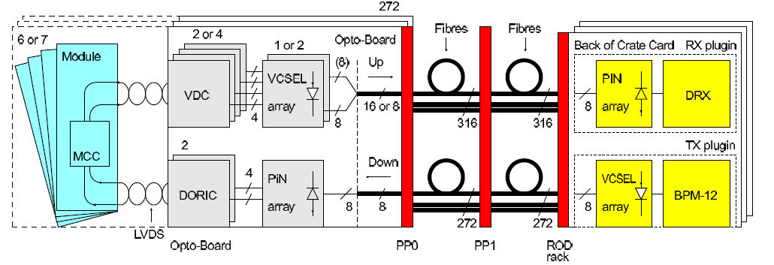
On-detector failures of VSCELs
Current # confirmed VSCEL failures: zero
Difficult to separate a VSCEL failure from a failure in the readout chain
Several links do not return light but this does not mean that the VCSEL is dead

Slide 3
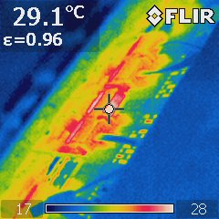
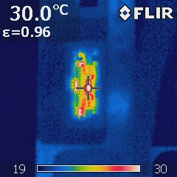
Temperature Measurements
Optoboard – SR1
Tx plugin – USA15
Images were taken with the lasers at 50% duty cycle
Mechanics limited the images that were obtained
Comparable temperatures for VCSEL arrays on both Tx plugins and Optoboards

Slide 4
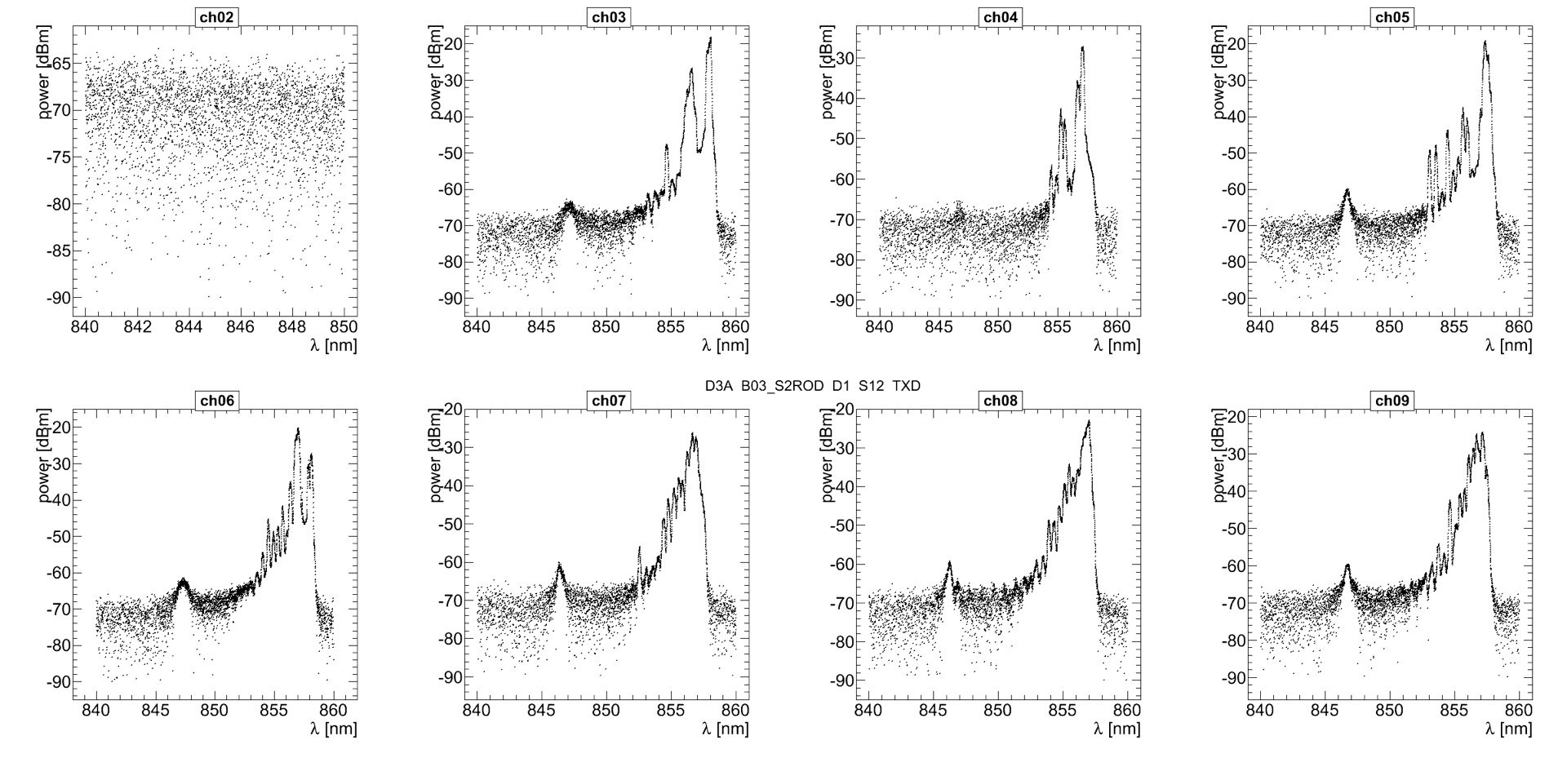
On-detector Optical Spectrum for an Optoboard
Channels 3 to 8 have been in use since pixel installation -2007
Channel 9 is unused → reference spectra

Slide 5
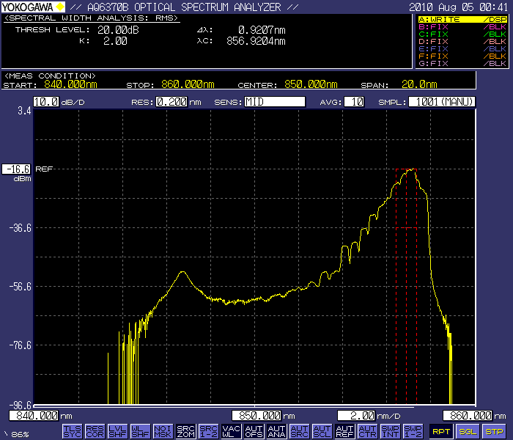
Optical spectra in FLOSS
FLOSS - (Future Lifetime of Optoboard StudieS) is an optoboard aging study which is being performed in SR1.
7 Optoboards (6 D-type, 1 B-type)
Run VCSELs continuously at 8mA forward current at 50% duty cycle
Monitor pin current for the array on the order of every 10 seconds
Measure pin current per channel once per day
Optical spectrum analysis every 2 weeks.
  Spectra shows side peak at 846nm
  Consistent with spectrum obtained from on-detector optoboards

Slide 6
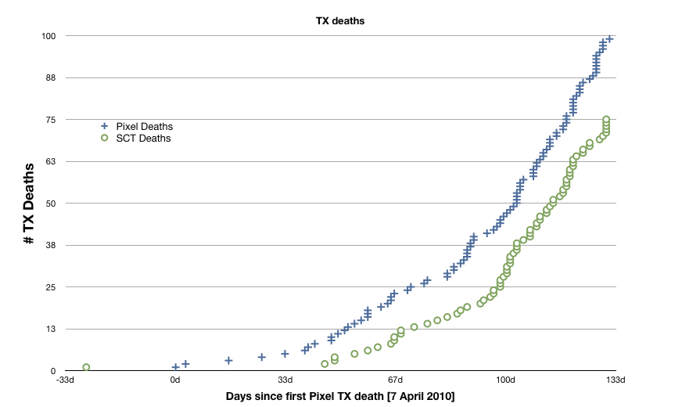
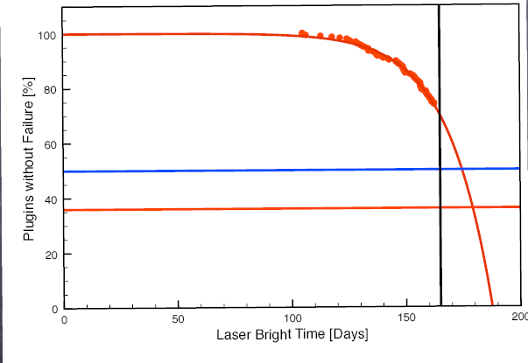
Predictions for Optoboard VCSELs
Assume that the failure mechanism is the same for both on-detector and off-detector VCSEL arrays and that the failure rate is related to the “bright” time for the channel
For the Tx plugins, the single channel lifetime is ~250 days running at half clock (20Mhz)

Slide 7
Bright time calculation for Optoboards
To estimate the bright time, estimates for these quantities were used:
Trigger rate
Luminosity, bunch structure
# operational days for LHC
Efficiency for the LHC
Module occupancy
Readout window and readout speed
Per BC, the data transmitted by the optoboard VCSELs are:
Header+FE#+Trailer: 52 Bits (on average 16 bright bits)
Data: Nhits * 22 Bits (on average 9.22 bright bits)
Bright time also affected by the readout speed of the link and the size of the readout window
Currently running at 40Mbit/s for all links
Plan to move to 80Mbit/s on ~1100 links (~months)

Slide 8
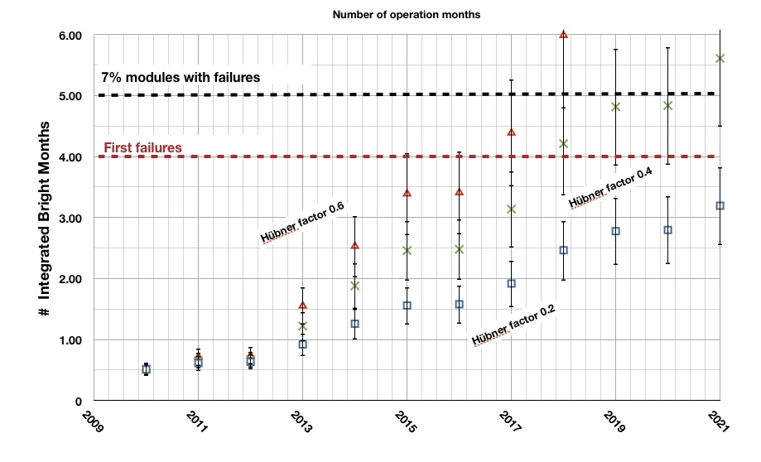
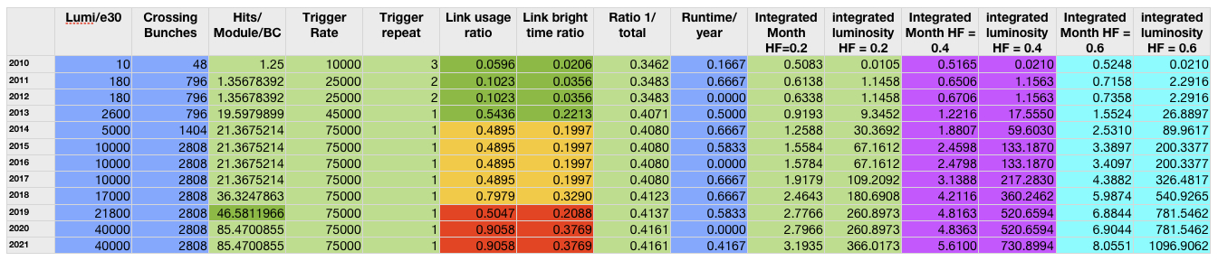
Predictions
Assumptions for Conservative estimates:
Used most occupied module in b-layer
Assumed 40Mbit/s readout until 2013
Readout window of 3BC
16hour/year of Calibration time
Hubner factor for LEP: ~20%

