Slide 1
Failures, beam losses and beam dumps during 3.5 TeV operation
What caused the failure and what captured the failure?
Diagnostic tools to analyze beam dump events and evaluate MPS
What is understood, what remains to be understood?

Slide 2
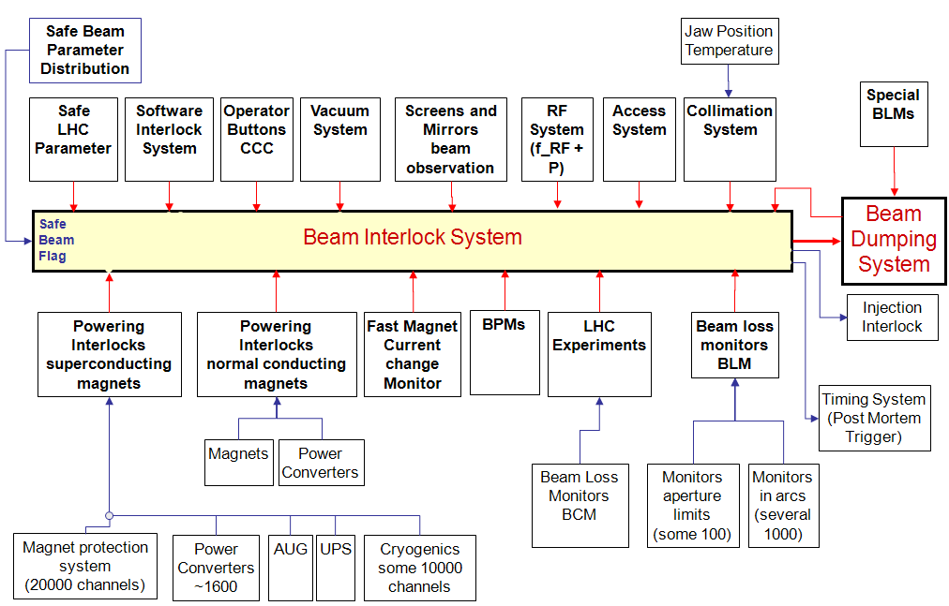
From this morning...

Slide 3
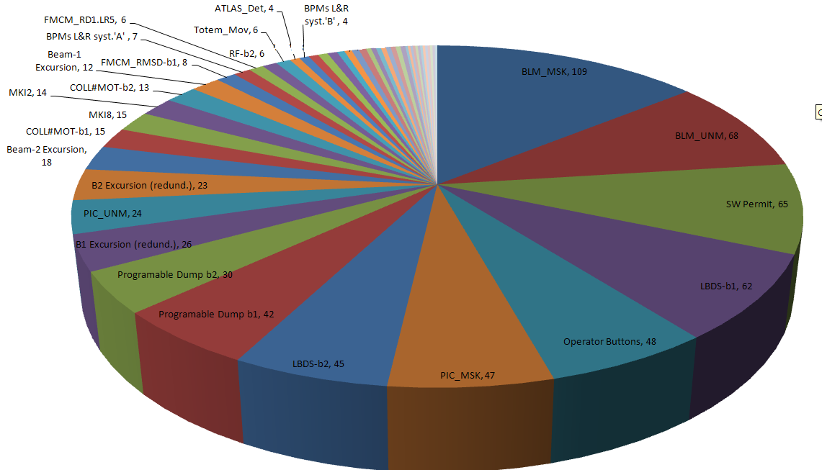
Activation of MPS in 2010
Every beam dump request exercises (parts of) the machine protection system and is being used to evaluate and improve its performance
LHC Machine Protection System has > 250 user input connections, for most frequent failure cases more than one system will/would request a dump of the particle beams
Majority of the events result in avalanches
of interlocks, machine interlock systems
play a central role for the identification
of initiating event and event sequence
So far in 2010 >= 900 activations of
the (armed) Beam Interlock System, mostly
@ injection and/or for MPS tests
Some 212 beam dumps happened AFTER
the start of the energy ramp, on which we shall
concentrate hereafter
User inputs requesting a beam dump in the LHC (since Jan 2010)

Slide 4
A bit of statistics # 1 …
Plot includes dumps at any energy and intensity, mostly @ injection and << intensities
Only slowly decreasing over time, MPS is ~ equally exercised now than during commissioning / much lower intensities

Slide 5
A bit of statistics # 2…
Including end of fill dumps
Again, only slowly decreasing over time, but beam intensity >>…
avg = 1.2 /day

Slide 6
Detailed analysis of Machine Protection performance
Detailed analysis of beam dumps in the LHC are vital for the further understanding of the machine protection system and for unveiling possible loop holes in the protection (beware of combined or rare/unforeseen events)
MPS strategy (especially before increasing intensity): Every beam dump needs to be clean and/or understood before next injection
Key to efficient and easy understanding of beam dumps are
  Complete and accurate data acquisition within every MPS sub-system, following common standards and naming conventions
  Common data acquisition systems and repositories, allowing for easy correlation of data
  Powerful data archiving, extraction and (automated) analysis tools for repetitive tasks
For MPS system, two of the available data acquisition/extraction tools are mostly in use, specialized for continuous data logging (for relatively slow change rates) and transient data recordings in case of beam dump events
[11]
6

Slide 7
Main Data Acquisition Systems for LHC
DATA ACQUISITION SYSTEM | PURPOSE | Acquisition Rate | Data Volume | Importance for MPS
SCADA supervisory systems | Real-time supervisory tools (Java, PVSS) | On change | > 10s of kB / day, local archive, then sent to long term storage | Medium – Used daily for supervision of MPS systems
DIAMON | Diagnostic and monitoring of controls infrastructure | infrequent | Few 10s of changes per day | Medium, used for online monitoring of red power supplies, FE processes, ….
ALARM System | Alarms service (for technical infrastructure,..) | infrequent | > 10.000 Alarms per day | Not used (yet), no efficient alarm filtering yet…
Measurement Database | Continuous Logging of equipment system | Few Hz | > GB /day, kept for 7 days only | Not used for MPS (but identical concept as Logging DB)
Logging Database | Logging system for equipment systems, slower response time | On change, but typically <1Hz | > 100 GB / day, kept for LHC lifetime | High – Used regularly for performance evaluation
Post Mortem | Transient data analysis after powering or beam dump events | >kHz/MHz, < intervals around interesting events | > 1 GB / beam dump event, kept for LHC lifetime | Very High – Used daily for performance evaluation
7

Slide 8
Main Data Acquisition Systems for LHC
DATA ACQUISITION SYSTEM | PURPOSE | Acquisition Rate | Data Volume | Importance for MPS
SCADA supervisory systems | Real-time supervisory tools (Java, PVSS) | On change | > 10s of kB / day, local archive, then sent to long term storage | Medium – Used daily for supervision of MPS systems
DIAMON | Diagnostic and monitoring of controls infrastructure | infrequent | Few 10s of changes per day | Medium, used for online monitoring of red power supplies, FE processes, ….
ALARM System | Alarms service (for technical infrastructure,..) | infrequent | > 10.000 Alarms per day | Not used (yet), no efficient alarm filtering yet…
Measurement Database | Continuous Logging of equipment system | Few Hz | > GB /day, kept for 7 days only | Not used for MPS (but identical concept as Logging DB)
Logging Database | Logging system for equipment systems, slower response time | On change, but typically <1Hz | > 100 GB / day, kept for LHC lifetime | High – Used regularly for performance evaluation
Post Mortem | Transient data analysis after powering or beam dump events | >kHz/MHz, < intervals around interesting events | > 1 GB / beam dump event, kept for LHC lifetime | Very High – Used daily for performance evaluation
8

Slide 9
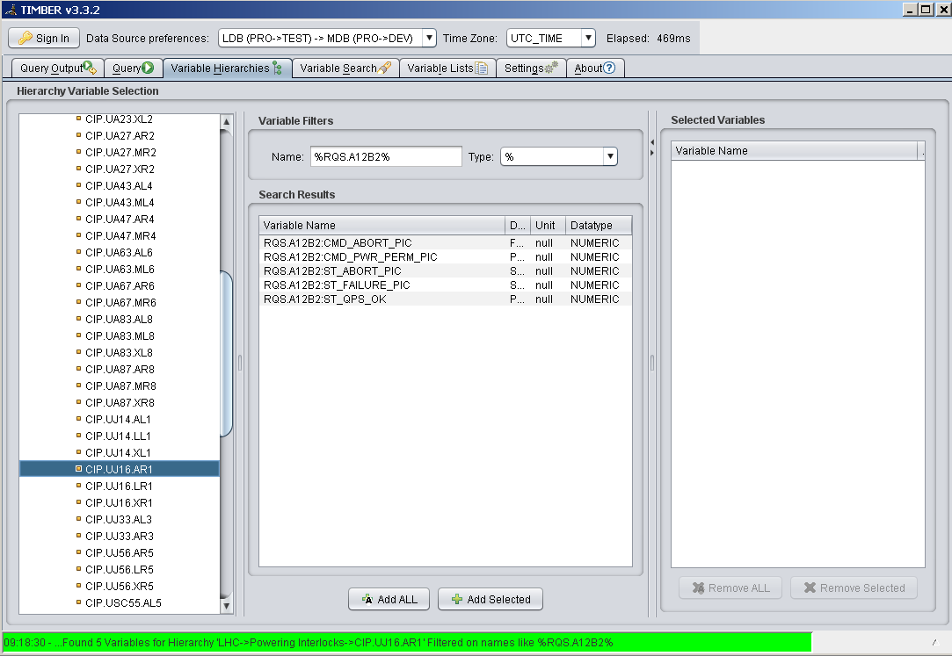
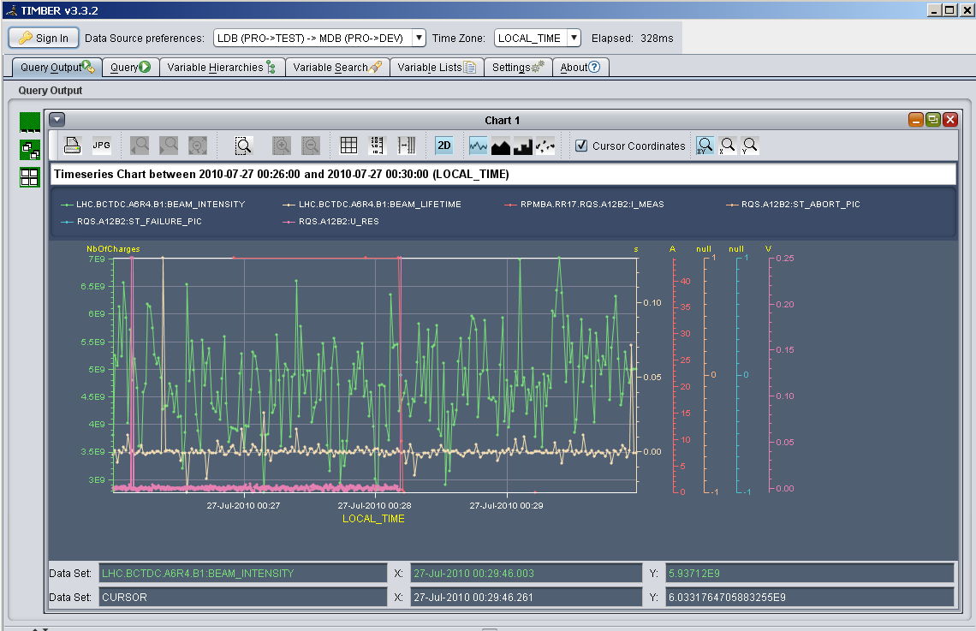
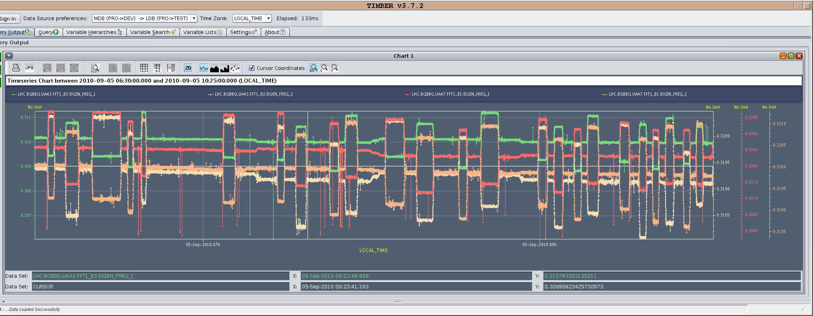
Operation – Logging System
Common repository for all equipment systems, allowing for direct correlation of data
Variable searches based on common variable/system naming
Huge data storage capacity, data maintained throughout complete LHC lifetime
9

Slide 10
Transient data recording after a beam dump (PM)
10

Slide 11
Operation - Post-Mortem
LHC Post Mortem system is an automated post-operational analysis of transient data recordings from LHC equipment systems
Meant to support machine protection by helping the operations crews and experts in understanding the machine performance and beam dump events and answer fundamental questions:
What happened? (ie the initiating event / event sequence leading to dump/incident)
Did the protection systems perform as expected (automated Post operational checks)?
Assist in trend analysis, statistics of machine performance, …
Basis is a reliable and performing data transmission and storage layer
Each beam dump generates ~ 1GB of PM data which is automatically analysed in
typically < 1 min
11

Slide 12
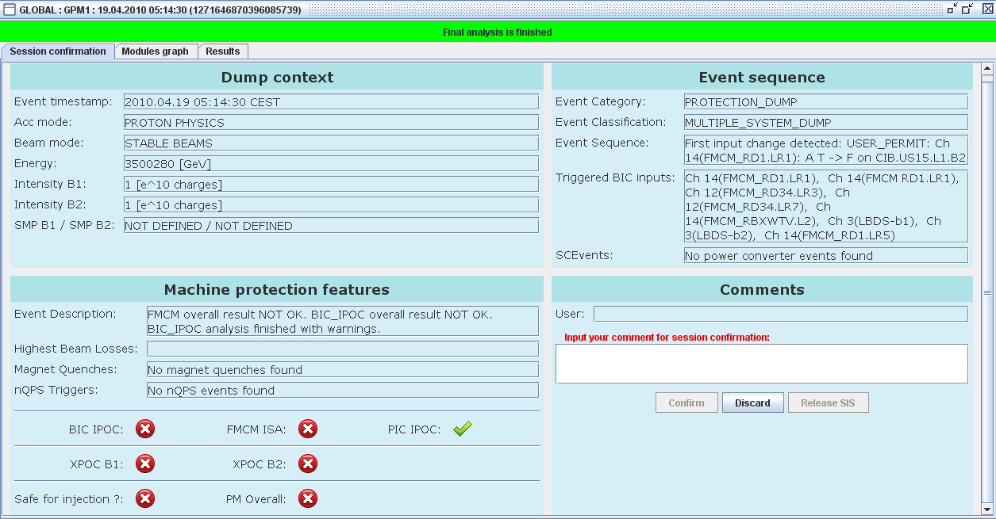
PM Server Architecture
GUI
PMA server
PMA
Scheduler
runs
Modules
FMCM RD1 LR1
3500280 GeV
Modules
triggers
uses
Libraries
(references,
DB Access
Logging)
triggers
reads writes
Database
Event
Builder
PM Data
Manager
browses
notifies
LHC
Logging
PM Data
files
Data
Collection
PM buffers
12
Notes:
12

Slide 13
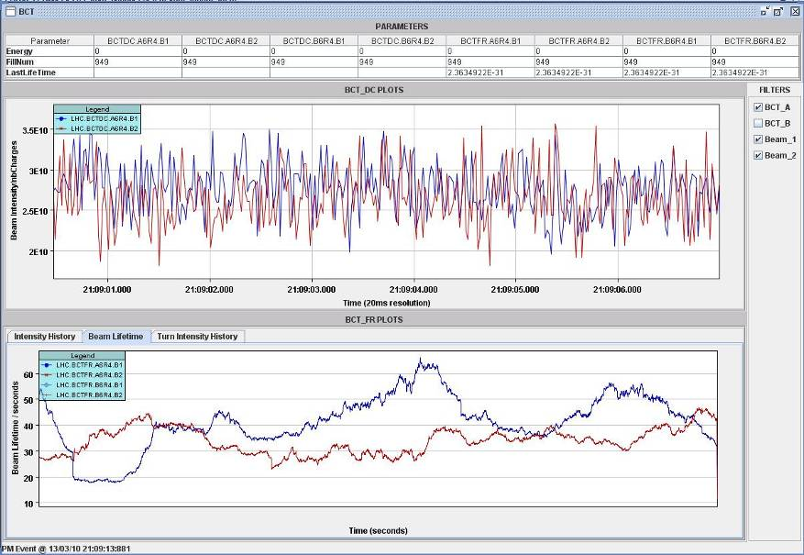
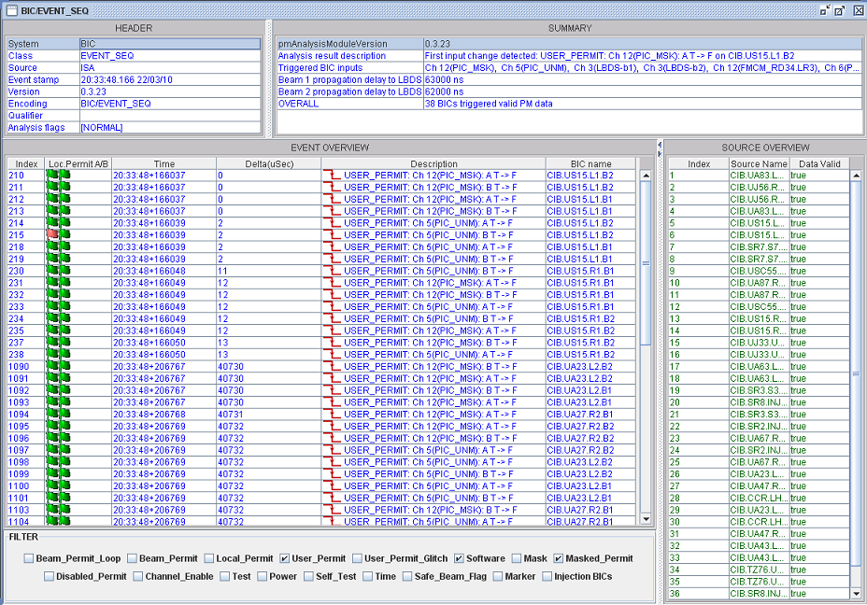
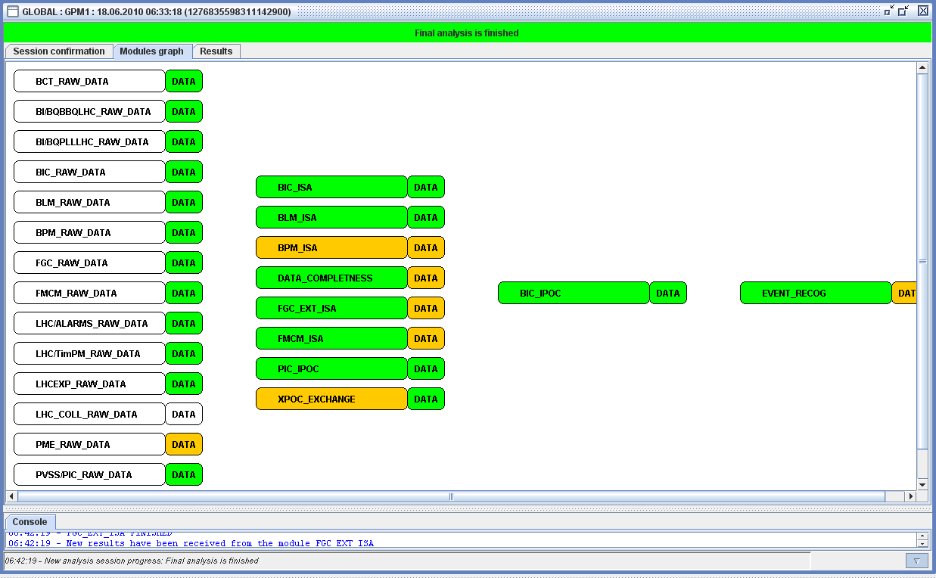
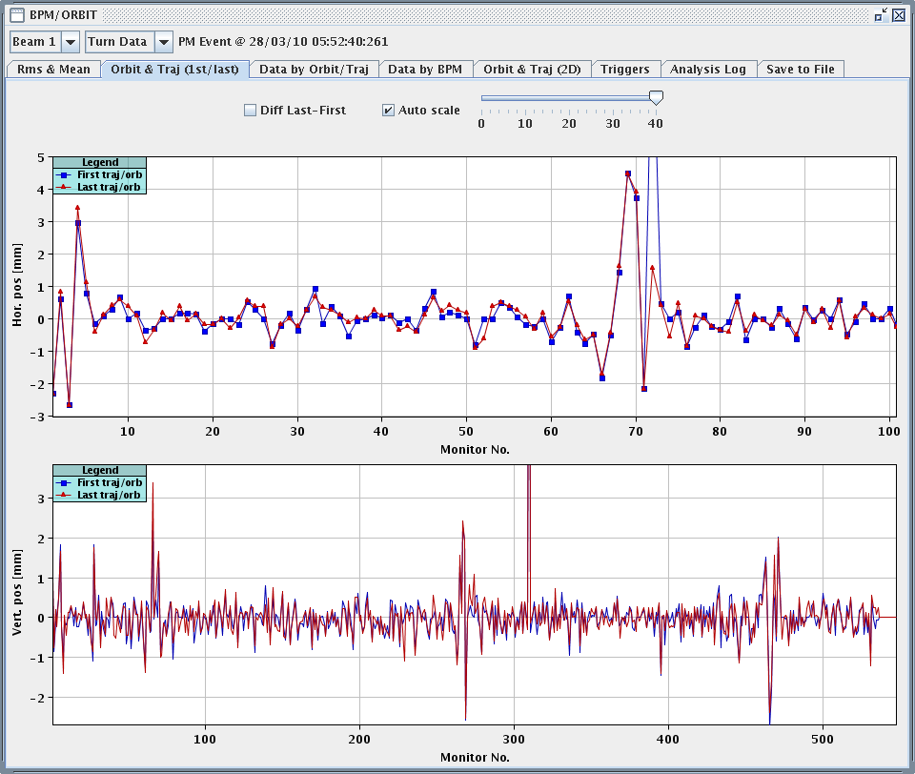
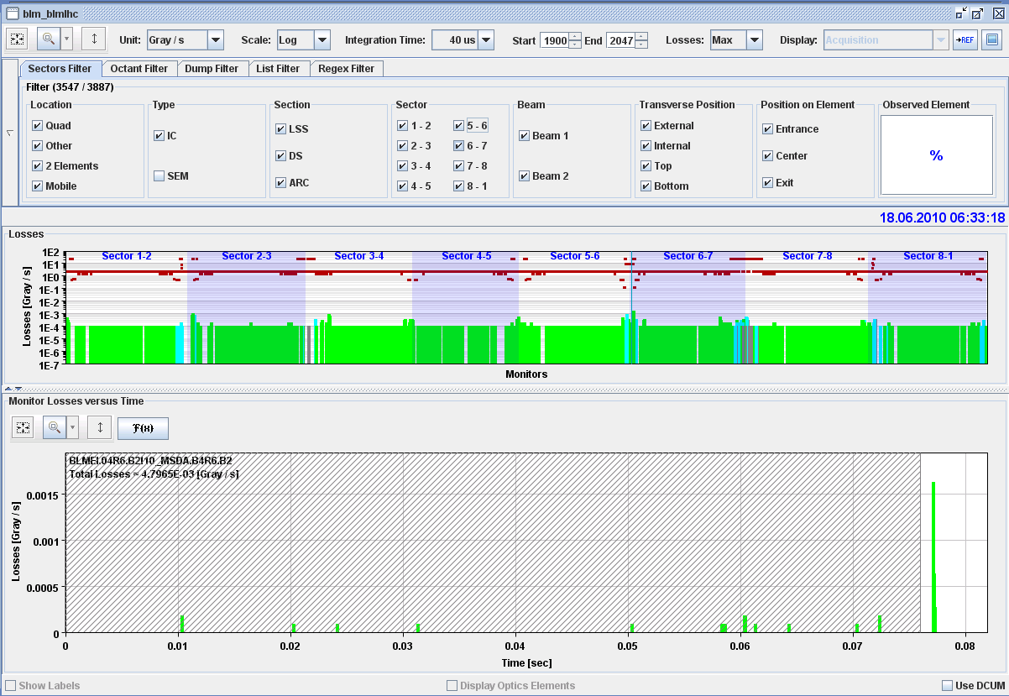
Analysis of global events…
Event Sequence
Beam Intensities, Lifetime
Beam position / orbit
Beam Losses
13

Slide 14
Beam dump events after start of ramp
In the following, some statistics and observations for the ~200 beam dumps which happened AFTER the start of the energy ramp is shown
Statistics are (largely) based on Post Mortem analysis archives and additional manual analysis of MPS experts
~ 40 dumps during ramp
Original Data for following plots courtesy of R.Schmidt

Slide 15
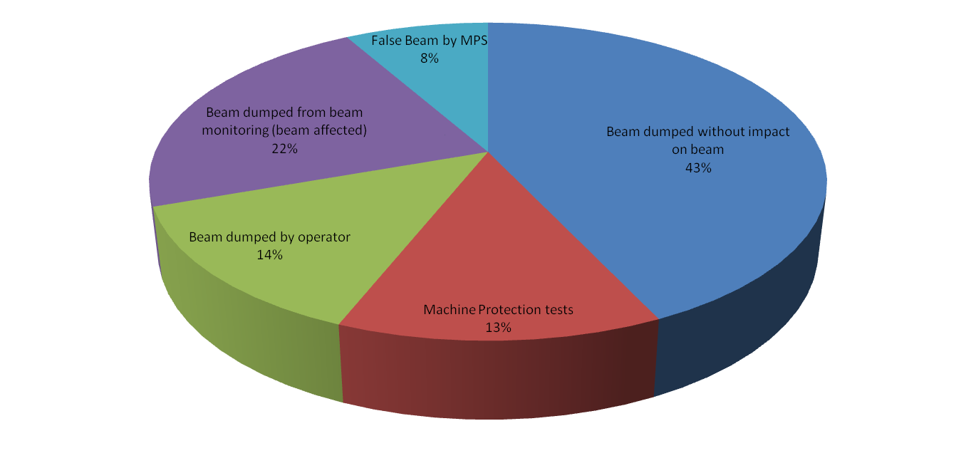
Beam dump events by Category
More than 75% of beam dumps without effects on the beam
Only small fraction of programmed (end of fill) dumps by operations
False beam dumps by MPS will decrease in longer term (initial HW problems in one sub-system)
Additional (hardware and software) measures have been and will be added to further mitigate failure cases with effects on the beam, e.g.
Fast Magnet Current Change Monitors for nc magnets
DIDT interlock for beam current
Additional SIS checks on equipment settings, beam position, etc…
Redundancy /protection of failures by 2 independent channels (for circulating beam) works very nicely (e.g. interlocks from magnet powering fast enough to avoid effects on beam,
beam cleaning / BLM very well set so no quenches yet, etc…

Slide 16
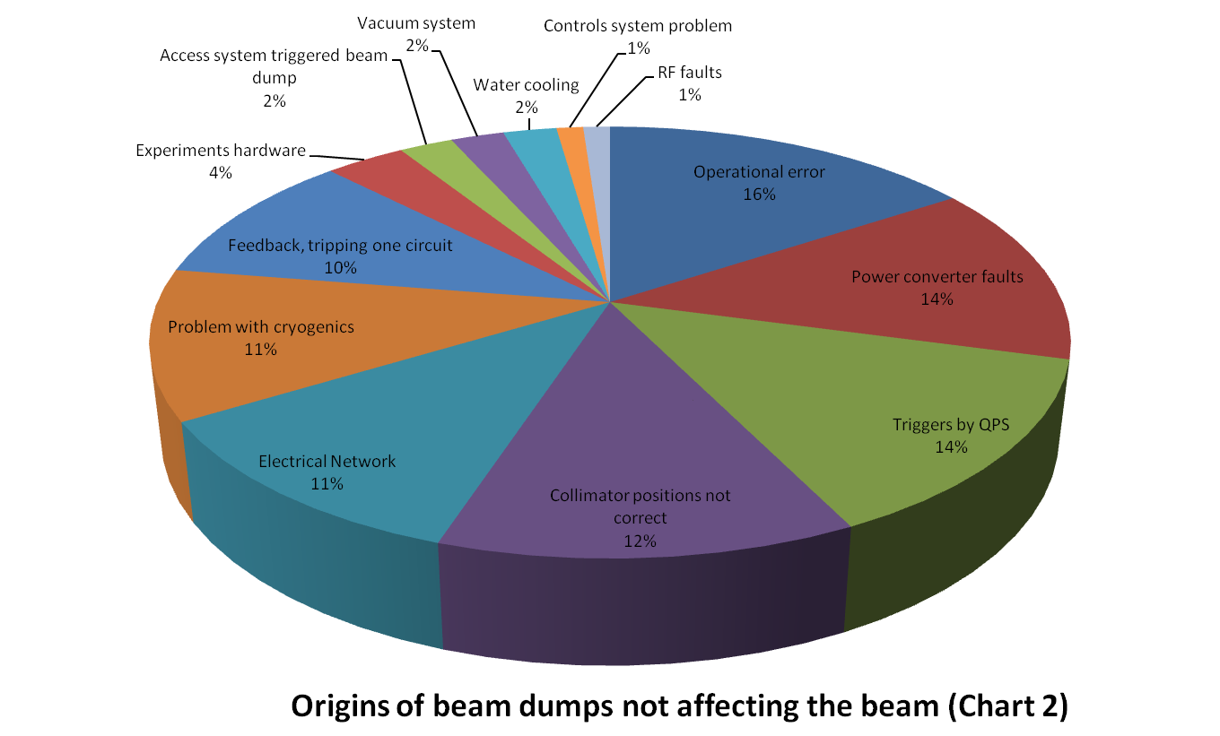
Beam dumps NOT affecting the beam
Wrong settings,
sequencing of tasks,..
Tuning to comply with sc circuit parameters / QPS
Faulty power modules /
water cooling,…
Few losses of cold compressors, often instrumentation or transient signals
Thunderstorms….
Mostly no real quenches, but EMI, too tight thresholds, di_dt/acceleration issues,…
Mostly during initial setup / adjustment

Slide 17
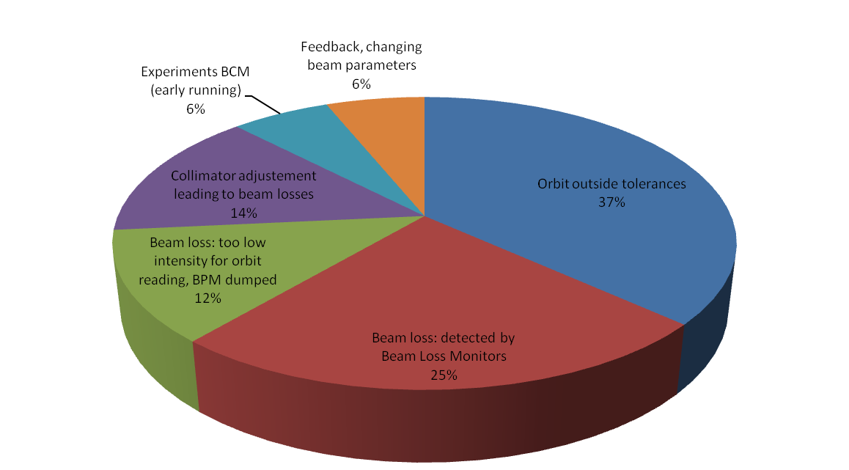
Beam dumps by interlocks affecting the beam
BPMs in IR6 / TCDQ
Orbit feedback / corrector trips
7 fast beam loss events (UFOs? - see later on)
Beam loss on resonance or during scraping
Octupole studies
Wire scanner

Slide 18
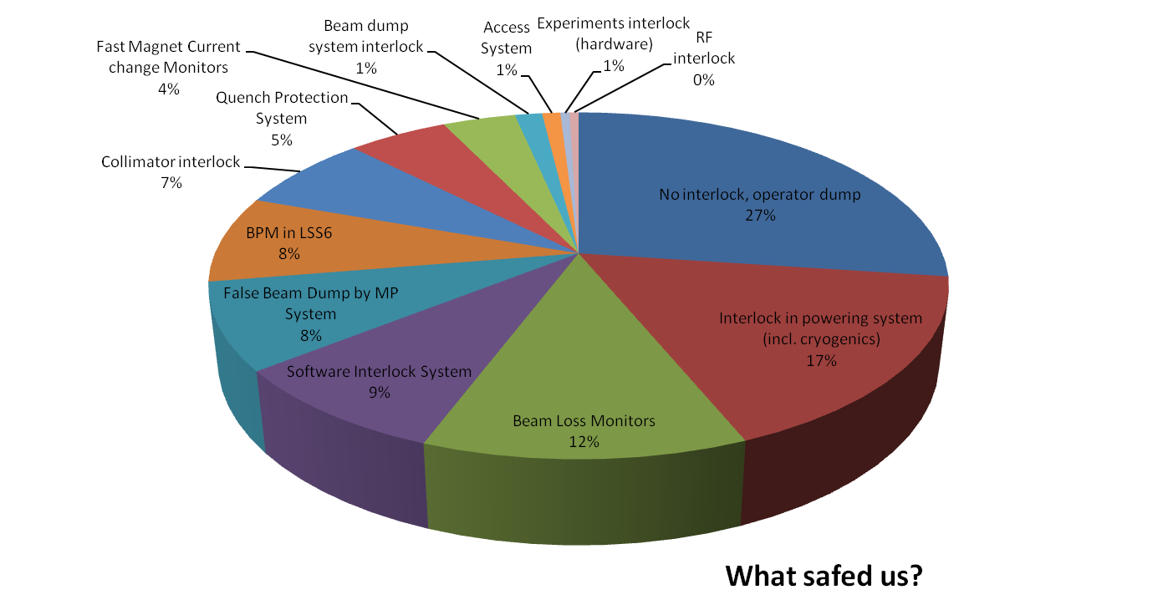
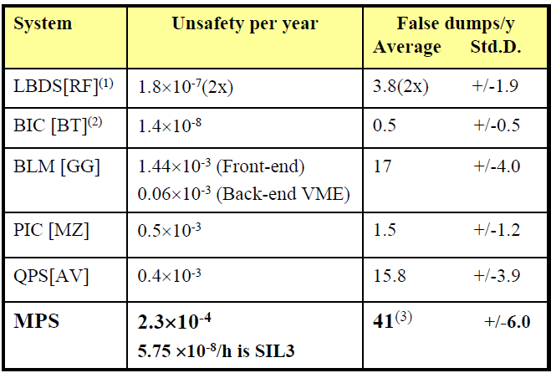
What saved us (who dumped the beam)?
So far ~ 6 months of operation
Dependability studies for MPS systems seem to be confirmed (or be better)

Slide 19
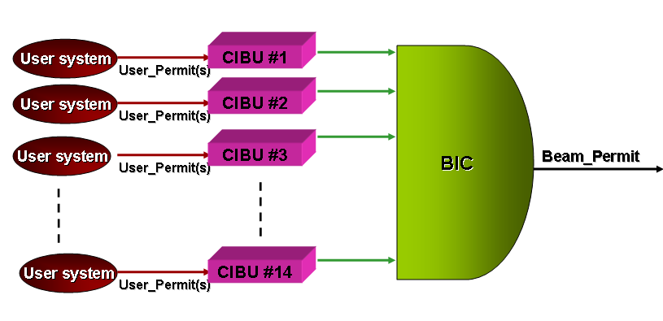
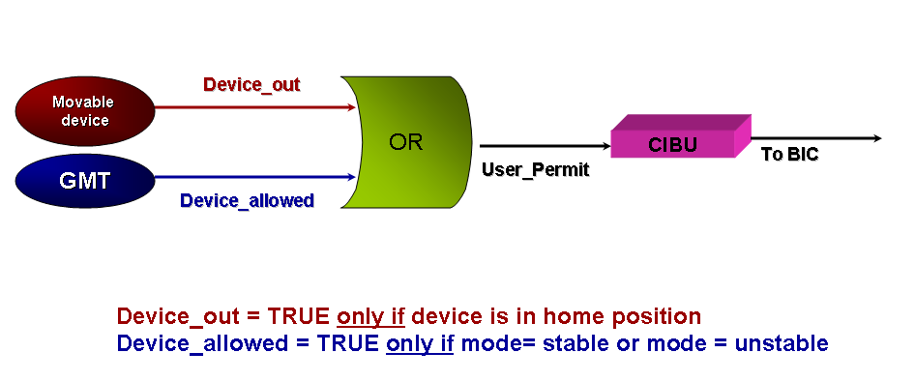
Typical LHC Experiment Protection System
2 to 19 m
a few cm
IP
CVD
1 cm²
0.3-0.5 mm thick
One Beam Condition Monitor (BCM) on each side of IP:
  Stand-alone system using a few polycrystalline CVD diamond pads
  Post-Mortem analysis capability
  FPGA-based dump logic:
    input: measured rates
    output: UserPermit signal
  Unmaskable input to local BIC
  On trigger, dump both beams
BCM protects against circulating beam failures, not against injection and extraction failures, though it will be ON during injection (for fast feedback).
BCM
+others
Magnet
Roman
pots
Courtesy of M.Ferro-Luzzi
19

Slide 20
LHC Exp Protection - summary
All Experiment protection systems are operational
  Teething/learning issue: overprotection by ATLAS BCM low threshold (startup 2009, solved by replacing with ATLAS BLM)
No threshold-exceeding beam losses in experiments observed so far during stable beams
So far, beam conditions are excellent, negligible background rates
Observations (to be watched out / followed up):
  ALICE gaseous detector trips (correlated with beam presence, but no correlation with beam loss could be established)
  LHCb seeing increasing losses when piling up bunch injections
    Much less this year than in 2009, but still visible
  IR BPMs currently not reliable (“soft” protection issue, used to monitor beam drifts => especially relevant for VELO/LHCb, but not crucial)
Courtesy of M.Ferro-Luzzi
20

Slide 21
Fast Beam Losses – UFOs?
So far 7 beam dumps due to fast beam losses (<1% of beam intensity) have been observed, events on both beams and most of the machine
Mechanism for the losses in not understood, but all events show a similar signature, finally dumping beams in 2.5ms running sum of BLM (increasing losses until the beam dump, non exponential increase, suggesting a maximum and possible decay in case of > BLM threshold)
Losses seen at all aperture limits (IR3/IR7, LSS6), confirming real beam loss and at the same time nicely demonstrating BLM redundancy
Date | Location | S (m) | Sector | Beam | Plane | Beta (m) | Max RS01 (G/s) | Risetime (ms) | Fill | No bunches | Intensity | Length (h)
07-07-2010 20:22:19 | MBB.8L7** | 21380 | 67 | 2 | V | 120 | 0.08 | 2.3 | 120x | 9 | 8.4E+11 | 0
30-07-2010 07:26:38 | Q4.R5 | 15160 | 56 | 2 | H | 274 | 0.08 | 1.25 | 1253 | 25 | 1.9E+12 | 13.15
07-08-2010 02:14:38 | Q11.L4 | 11224 | 34 | 1 | H | 179 | 0.09 | 1.2 | 1264 | 25 | 2.1E+12 | 0.53
08-08-2010 01:10:46 | Q15.L5 | 14342 | 45 | 1 | V | 184 | 0.07 | 1.25 | 1266 | 25 | 2.1E+12 | 1.97
14-08-2010 19:13:36 | Q6.R5* | 15222 | 56 | 1 | V | 211 | 0.092 | 0.8 | 1284 | 25 | 2.3E+12 | 3.48
23-08-2010 13:50:28 | Q22.R3 | 9354 | 34 | 2 | H | 180 | 0.082 | 0.75 | 1298 | 48 | 3.7E+12 | 12.97
26-08-2010 17:25:56 | Q25.R5 | 16179 | 56 | 1 | H | 180 | 0.125 | 0.8 | 1303 | 48 | 4.5E+12 | 13.08
*Roman pot event
** 5 pre-cursors / in squeeze
21

Slide 22
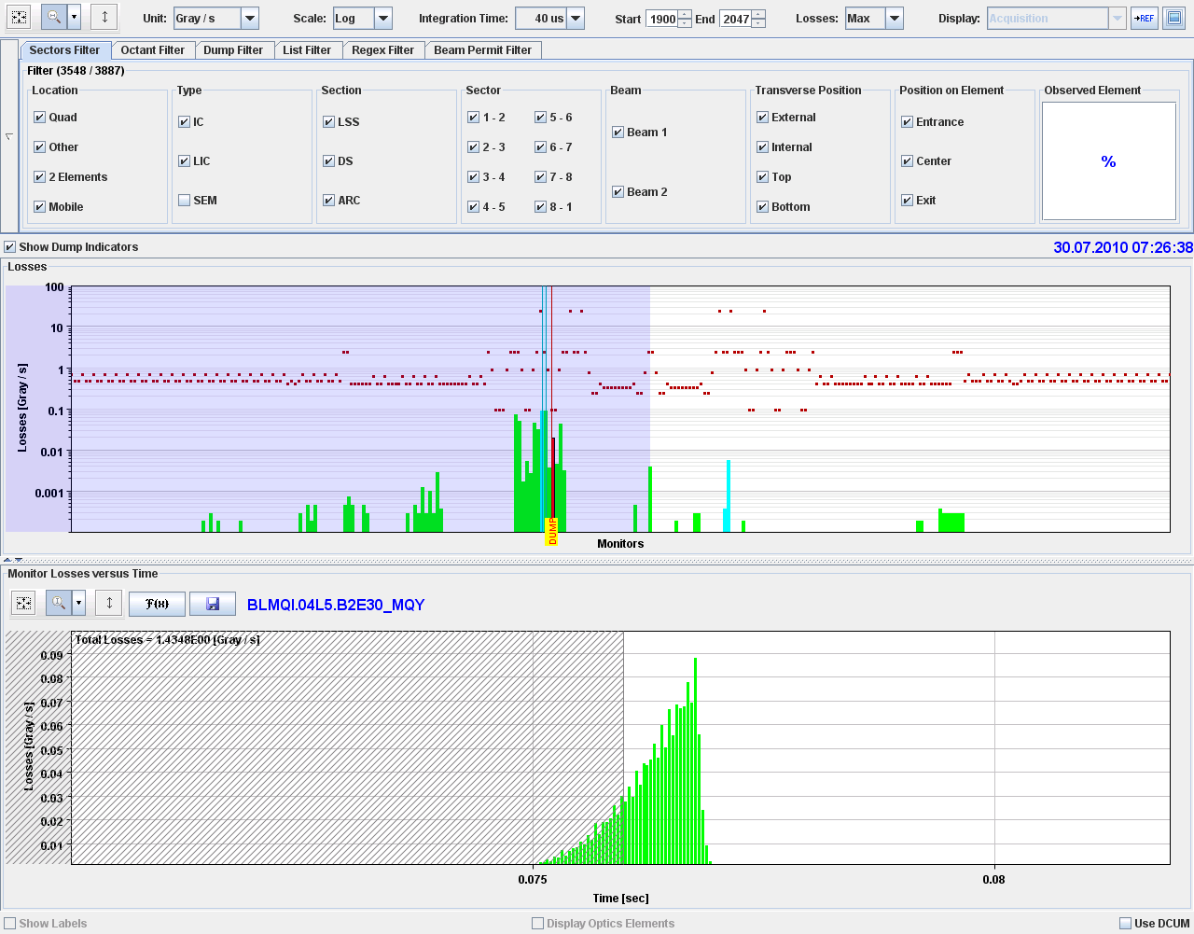
Event 30th July 2010, 07:26:38, Q4.R5

Slide 23
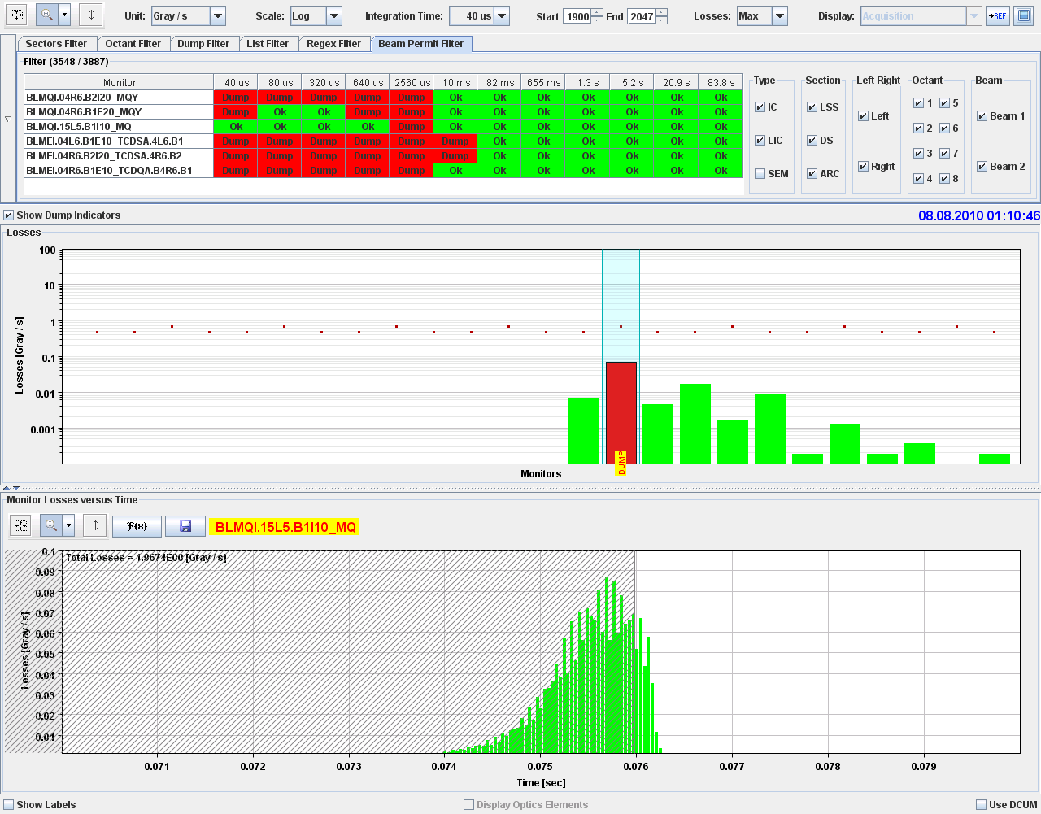
Event 8th August 2010, Q15.L5

Slide 24
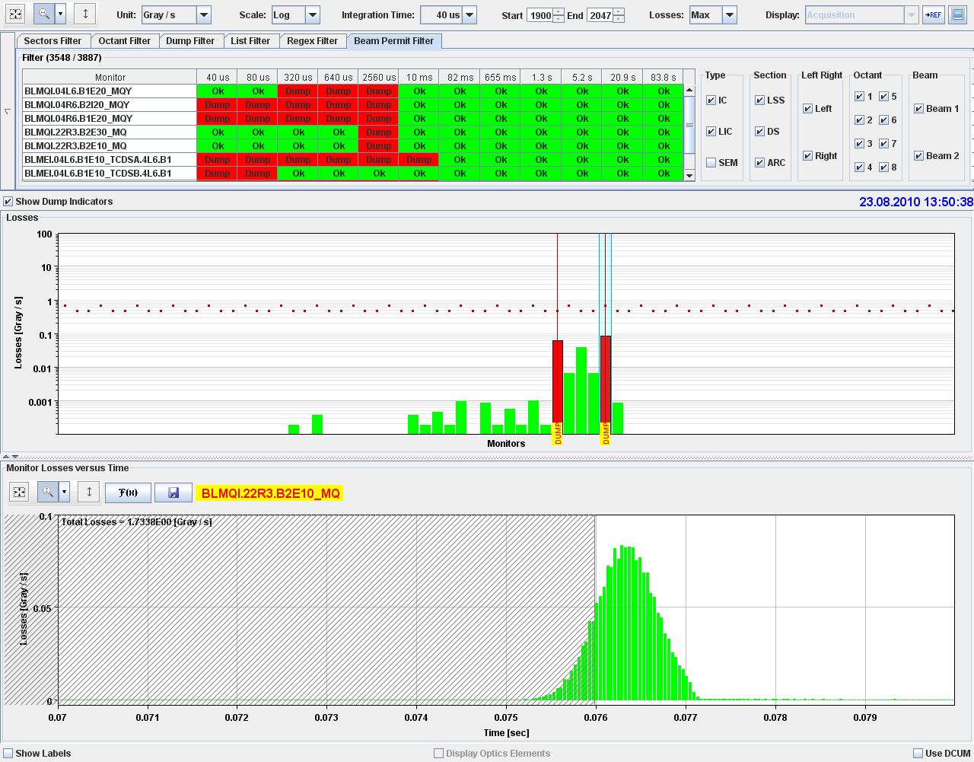
Event 23.08.2010 13:50:38, on MQ22.R3

Slide 25
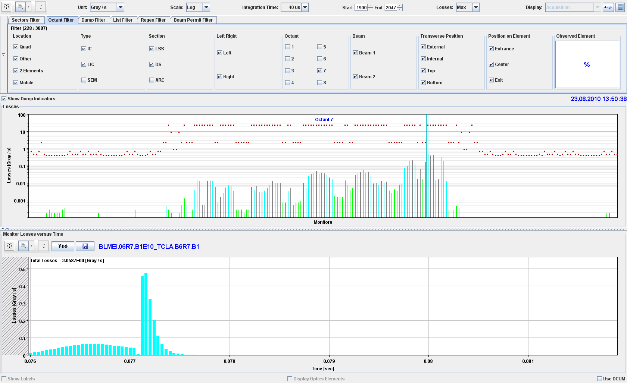
Event 23.08.2010 13:50:38, on MQ22.R3
Same signal seen in cleaning insertion IR7
25

Slide 26
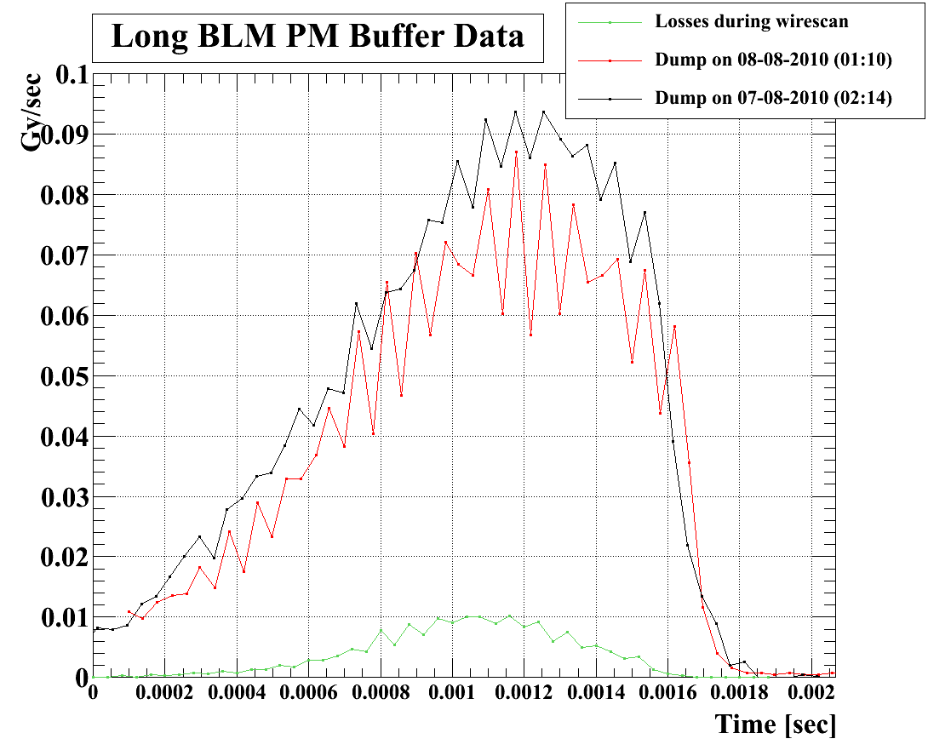
Fast Beam Losses – UFOs?
Current hypothesis of (dust) particles / UFOs falling through the beam
Comparison with loss patterns during a wire scan confirms similarity of shape and timescales
Additional installation of diamond detectors in IR7 done during last technical stop (PM triggered) to get bunch to bunch resolution of losses
Current proposal:
In case of two additional events, increase BLM thresholds on cold MQs by a factor of 2

Slide 27
Quench(ino)s
So far no real quench with circulating beam, but (very) few beam induced magnet quenches at injection
All cases would have recovered without firing of quench heaters
Example of Quench(ino) event from 18/4/2010 @ 22:33:
        Happened at injection energy, when injecting beam 1
        Injected bunch had 8E9 protons (transfer line BCT)
        Defocusing quadrupole magnets in sector 12 were mistakenly at 350A instead of injection current (760A)
        Beam loss over first turn
        PM indicates BPM.Q19R1 at =6mm, same for Q21.R1
        Losses starting in cell 18R1

Slide 28
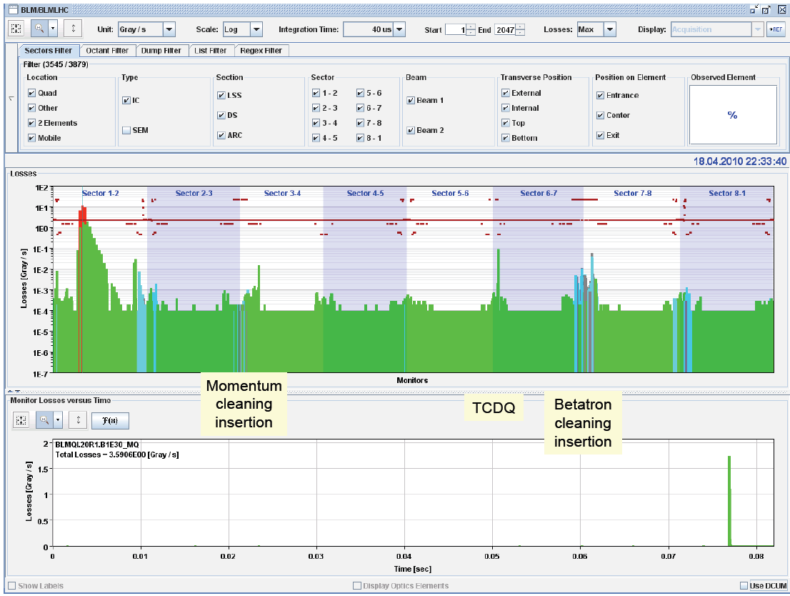
Quench(ino) event from 18/4/2010 @ 22:33
Beam 1
Courtesy of R.Appleby
28

Slide 29
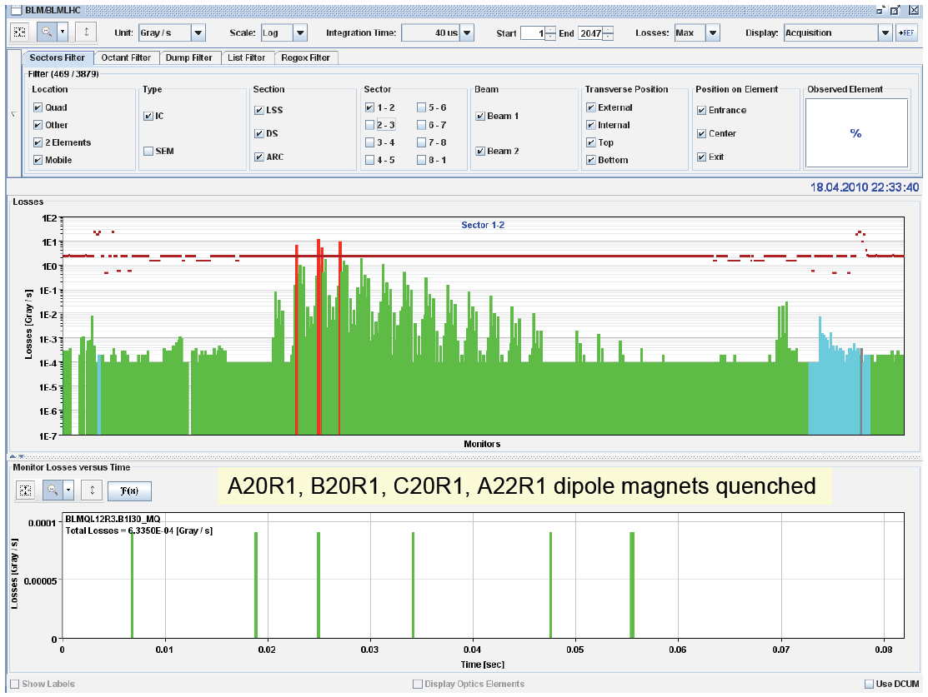
Quench(ino) event from 18/4/2010 @ 22:33
Beam 1
Courtesy of R.Appleby
29

Slide 30
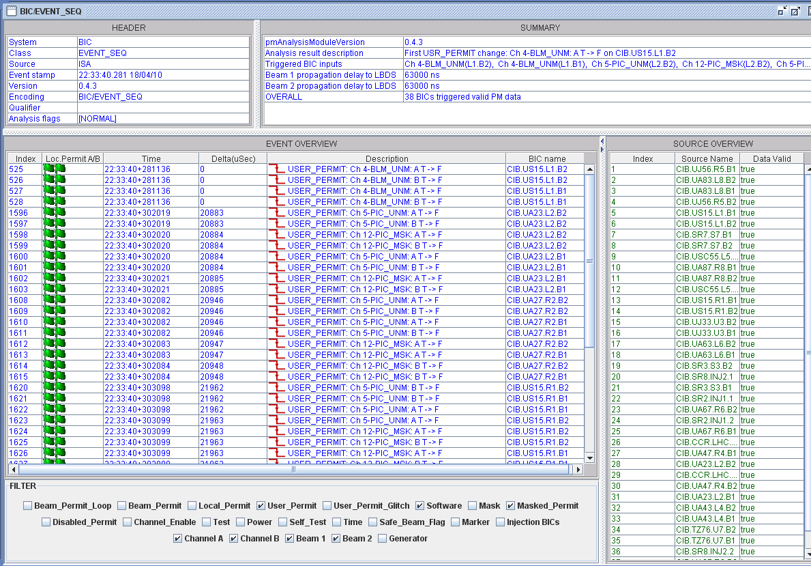
Event sequence for event on 18/4/2010
Beam dump request as expected from BLM in IR1
20 ms later (time to develop and detect the quenchino), 2nd trigger by powering interlocks/QPS
30

Slide 31
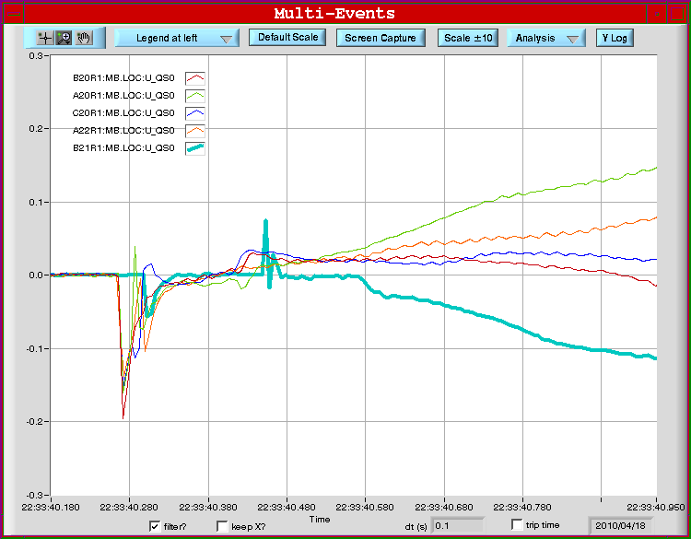
Quench limit vs BLM thresholds
QPS signals on quenching magnets showing threshold crossing of 100mV before recovering (until heater firing becomes effective)
Few quenchinos and current experience shows that BLM thresholds are well set (even too conservative?)
Few ‘quench’ tests will be performed to determine ‘real’ quench limit vs current BLM thresholds
Some of the tests will not quench a magnet, but just measure the voltage below the QPS threshold. Proposed tests:
  Single turn test at injection in cell 14R2 (special QPS diagnostics installed)
  Closed orbit bumps (cell 14R2) at injection and at 3.5TeV (intensities for the 3.5 TeV test tbd after 450GeV test)
  Wire scan at 3.5TeV (probing the time scales of ~1 ms)
  Quench test from collimators (losses in the cleaning insertion)
  Quench test of Q4 in IR6 (important to define the abort gap population limits)
31

Slide 32
Summary
So far the LHC Machine Protection Systems have been working extremely well
Most failures are captured before effects on beam are seen, No quenches with circulating beam (with > 3MJ per beam and 10mJ for quenching a magnet)
Experiments are well protected, no issue with background so far
Most beam dumps are understood (except fast losses)
No evidence of possible loopholes or uncovered risks
MPS systems nicely captured even rare / ‘unexpected’ events, e.g.
    Fast beam losses (seen at all aperture limits, confirming BLM redundancy)
    Controls problems resulting in wrong transmission of beam energy (captured by RF interlock and eventually Collimators) -> implicit protection
    End of fill test by scraping with primary collimator in IR7 the beam 2 tails. Moving it into the beam with 10 micron step every 4 seconds (see collimation talks)
    Thunderstorms (correlated failures of > equipment systems)

Slide 33
Acknowlegements
Thanks a lot for your attention
Many thanks to a number of colleagues for their contributions to the talk (R.Schmidt, M.Ferro-Luzzi, R.Appelby,…)
33

