Slide 1
11T New Task Force – Team 2 – QA QC
Deliverable 1 and 2
May-19, 2021
R. Principe, on behalf of the team

Slide 2
11T New Task Force TEAM2 – QA QC
Team Chair
TE-MSC-LMF: R. Principe
Team Members presents:
TE-MSC-CMI: F. Savary;
TE-MSC-LMF: B. Arias, R. Berthet, N. Bourcey, O. Housiaux, S. Luzieux;
TE-MSC-SMT: F. Lackner, A. Musso;
EN-MME : D. Perini.
Important contribution also from :
EN-MME : S. Sgobba, B. Bulat.

Slide 3
Outline
  Introduction
  Deliverable 1 – WINDING
    Applicable documentation and evolutions
    Components and tooling
    Differences in the 11T and MQXF production strategy
    Non conformities during production
    Adopted mitigations following major NCR
    Future proposed improvements
  Outcome of session 1
  Deliverable 2 – CURING
    Idem
  Oucome of session 2

Slide 4
Schedule TEAM2
Subject | Discussion focusing on | Deliverable | Date
Winding | Fabrication and control procedures, components, tooling, acceptance criteria and NC | Report and proposal for a new released production and control doc | 05.05.2021
Curing | Idem | Idem | 12.05.2021
Reaction | Idem | Idem | 26.05,2021
Impregnation | Idem | Idem | 09.06.2021
11T collaring | Idem | Idem | 16.06.2021
MQXF coil pack and assembly | Idem | Idem | 22.06.2021
Diagnostics, statistics and improvement axes | Statistics, review of NC by families, learned lessons, proposals. | Note | 30.06.2021

Slide 5
DELIVERABLE 1 - WINDING
May 5, 2021
Documentation available at https://indico.cern.ch/event/969681/
O. Housiaux, R. Berthet, B. Arias Alonso, R. Principe

Slide 6
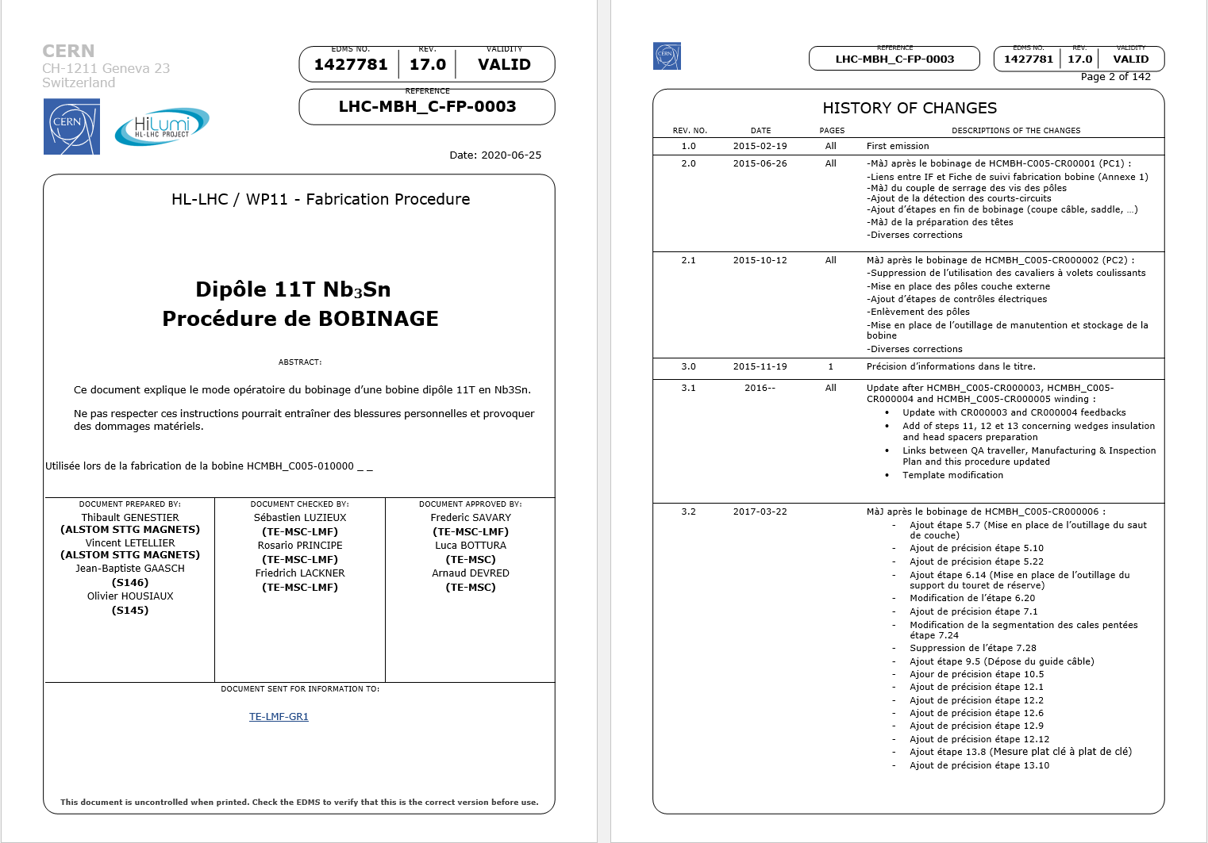
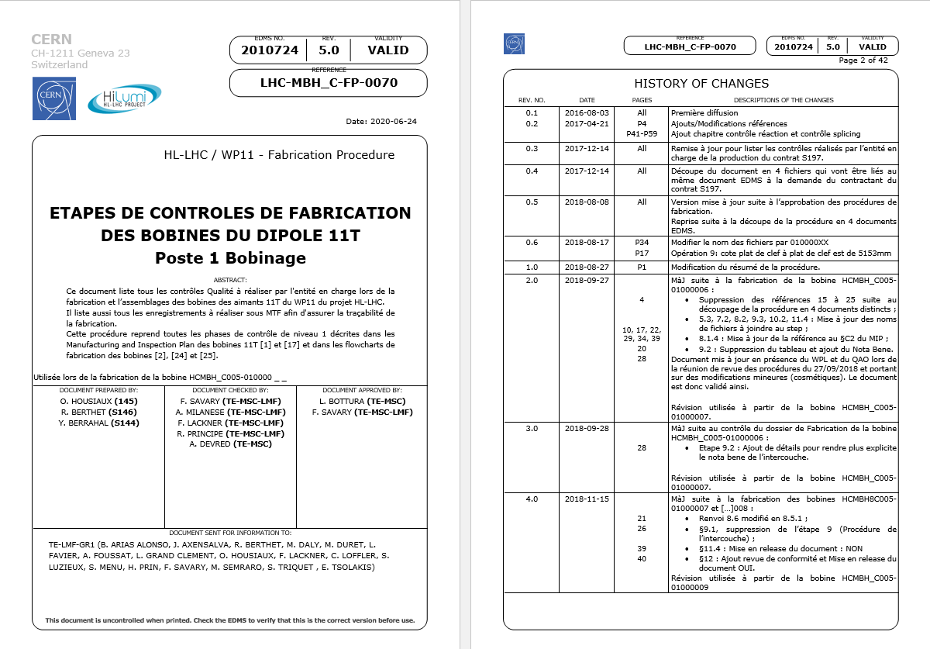
11T applicable documentation
  Procedures 11T
    Manufacturing Procedure LHC-MBH_C-FP-0003 rev 17.0
    Control Procedure LHC-MBH_C-FP-0070 rev 5.0
  Modifications due to
    Review of the applicable doc. with GE before starting production,
    Comments from operators,
    Minor NCRs (degradation of the fiberglass: 1962584, 1974718, 1974457, 2004465, 2004468, 2021764, 2038193, 2151378),
    Knowledge transfer with MQXFB project.
    2 Critical NCRs :
      1995788 : Coil’s deformation during curing due to a forgotten pin (GE04 scrapped),
      2346532 : Coil’s deformation due to pushers’ wrong positioning (GE27 scrapped).

Slide 7
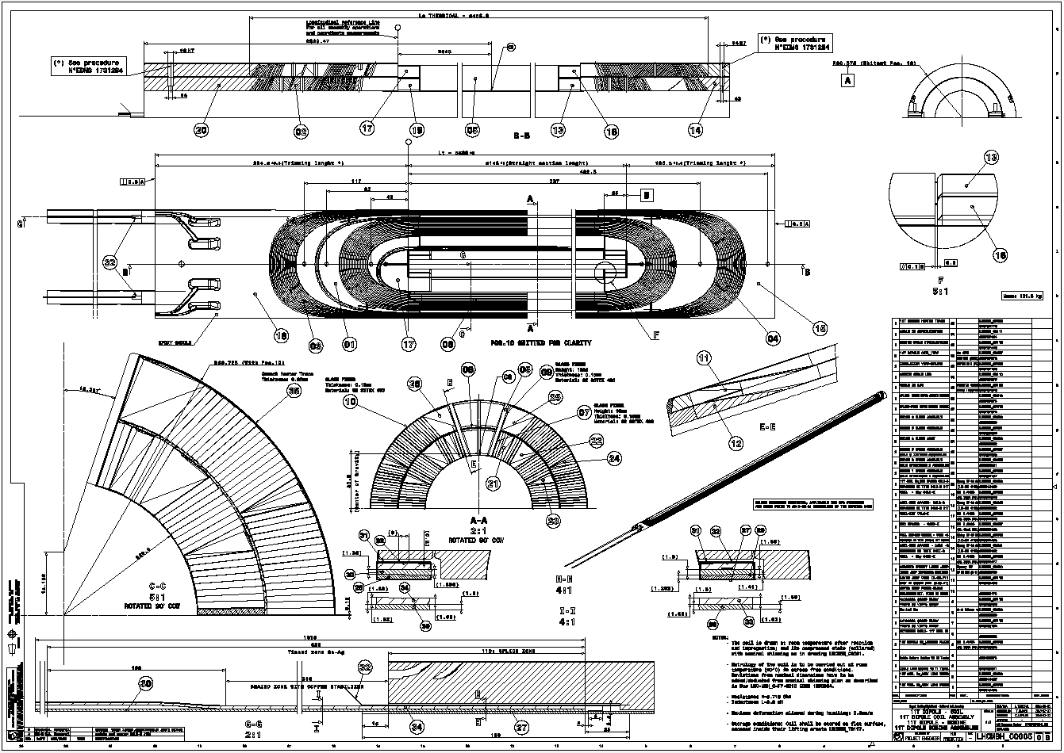
Applicable dwgs and evolution
  Series production starts on 27/02/2018
  Drawings
    Inner layer: LHCMBH_C0011 rev A (approved on 15/02/2018).
    Outer layer: LHCMBH_C0012 rev A (approved on 15/02/2018).
  External quench heater
    Dwg LHCMBH_C005 rev B approved on 20/02/2018
    This drawing was updated after the start up of the series production due to the decision to place the quench heaters outside the coil.

Slide 8
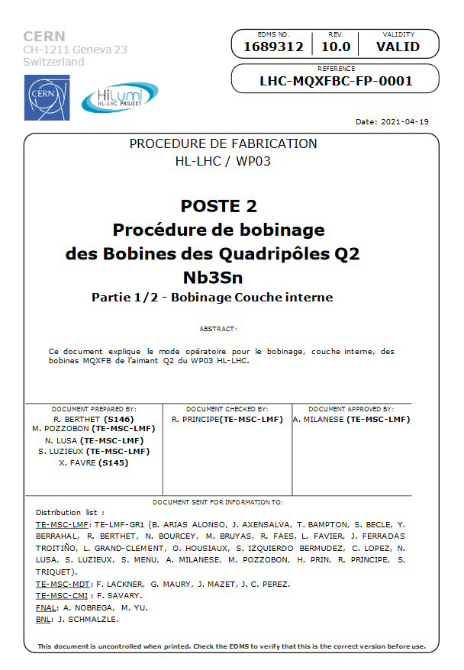
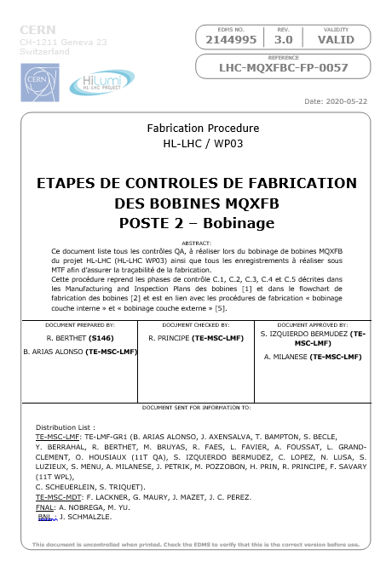
QXF documentation
  Procedures QXF
    Manufacturing Procedure LHC-MQXFBC-FP-0001 v10.0
    Control Procedure LHC-MQXFBC-FP-0057 v3.0
  Modifications due to
    Review of the applicable documentation during the “deverminage” campaign,
    Comments from operators,
    Knowledge transfer with 11T project.
    Two critical NCs
      Critical NCR: 2419556: cable collapsed during winding (CR120 considered as test coil),
      Critical NCR: 1964025: Outer layer cable damaged (CR201 considered as test coil),

Slide 9
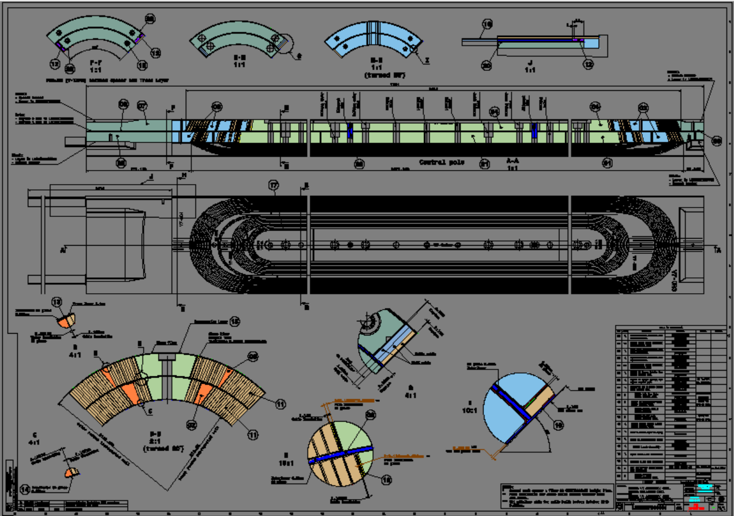
Applicable documentation and evolution
QXFB Series
  Prod start up on 06/03/2019 (Coil CR110)
  Coil Drawings
    LHCMQXFBC0031 rev 0. Approved on 02/03/2018.
    LHCMQXFBC0031 rev A. Approved on 17/05/2019 (beginning of CR110 IL winding). Update of item references.
    LHCMQXFBC0031 rev B. Approved on 04/11/2019. Thickness update (midplane shims, pole insulation) and coil OR.

Slide 10
Components
  Reminder : Each component is formally accepted by the Project Engineer of the component before installation in coil (Step “delivery and acceptance” in MTF see 11T QP: Procurement LHC-LBH-QA-0001 v.2.0).
  Insulated cable:
    Thickness @ 5Mpa, out of tolerance up to 3 µm (tolerance < 105 µm) on 14 coils,
    Minor defects of the insulation: reparation performed during winding.
  Bare cable: no NCs.
  Wedges:
    Metrology performed by the manufacturer shows no geometrical defect.
    Note: no CERN metrology requested by the component’s PE on these pieces.
  Interlayer (manufactured @ CERN):
    2 NCR detected (geometrical measurement out of tolerance, 1907891 and stain, 2045653).
    These 2 interlayers were rejected.

Slide 11

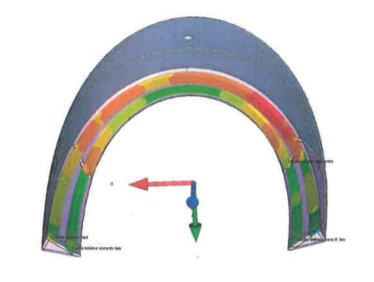
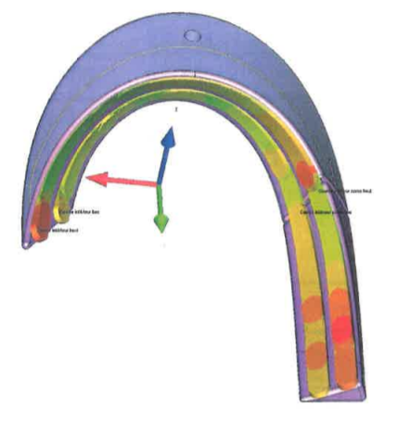
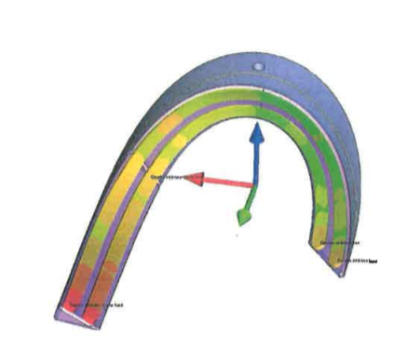







Components
  Spacers:
    NCR 1885777: Magnetic permeability out of tolerances @ 1.9K 1.0057 to 1.0066 (Tol.<1.005).
    The spacers are made of stainless steel (316L, 14435)
    NCR 1898188 and 1898125 : Geometrical defects
    For most of the defects the value is under 5 µm and few are up to 40 µm (shape defect ).
    Note 1: Metrology performed by the manufacturer on samples ≈25%
    Note 2: No CERN metrology requested by the component PE on these pieces.
C4LI-5
C4LI-6

Slide 12
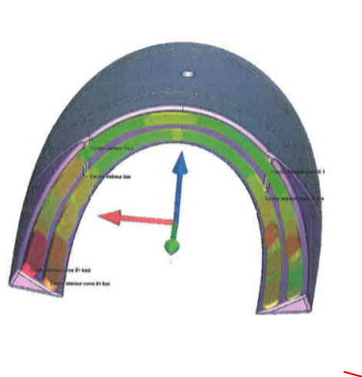
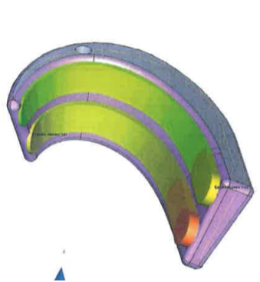








Components
  Spacers:
C4RI-3
C4LI-1

Slide 13
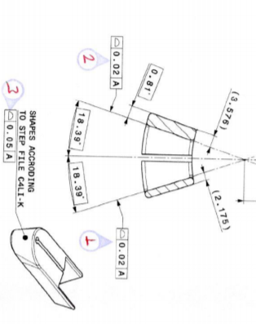
Components
  Winding keys:
    NCR 1885697: Magnetic permeability out of tolerances @ 1.9K 1.014 (Tol.<1.005)
    The spacers are made of stainless steel (316L, 14435)
    Note 1: Metrology performed by the manufacturer on all pieces (100%),
    Note 2: no CERN metrology requested by the component PE on these pieces.
    C4LI (internal layer, connection side):
On 7 parts (out of 38) shape defect up to 0.062
On 3 parts (out of 38) shape defect up to 0.080
On 17 parts (out of 38) shape defect up to 0.083

Slide 14
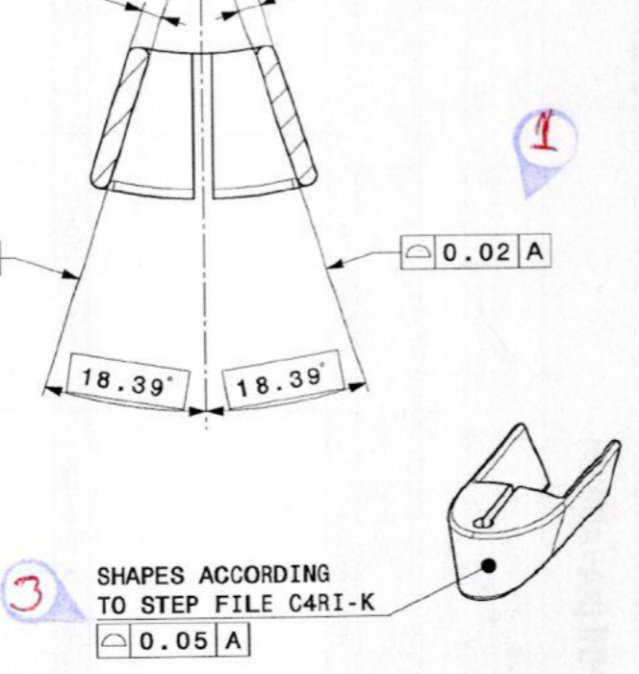
Components
    C4RI (internal layer, non connection side):
On 13 parts (out of 38) shape defect up to 0.028
On 6 parts (out of 38) shape defect up to 0.066
On 4 parts (out of 38) shape defect up to 0.076

Slide 15
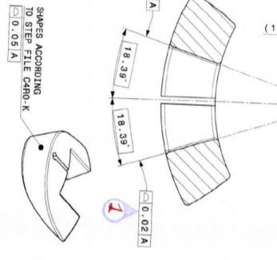
Components
    C4RO (external layer, non connection side):
On 3 parts (out of 38) shape defect up to 0.025
On 4 parts (out of 38) shape defect up to 0.094
On 3 parts (out of 38) shape defect up to 0.061

Slide 16
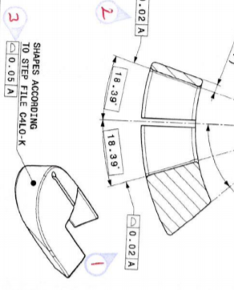
Components
    C4LO (external layer, connection side):
On 1 part (out of 38) shape defect up to 0.025
On 18 parts (out of 38) shape defect up to 0.098 (0.130 for one not used)
On 10 parts (out of 38) shape defect up to 0.075

Slide 17

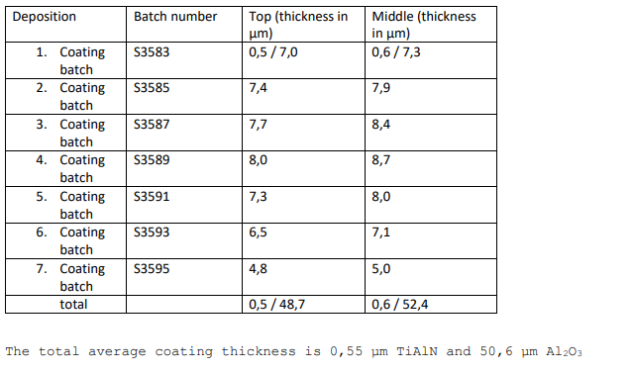
Components
    Coating of the winding keys:
    On all winding keys, coating thickness is ≈ 51µm (reports: EDMS 2058489 and 2021533).

Slide 18
Components – QXFB series production
  Remark: components procured via EN-MME.
  Spacers:
    Metallic parts: 2 deliveries
    Metrology reports Gevalco (sampling). 1st deliv.: 57% non-conform. 2nd deliv.: 0% non-conform.
    Metrology report (1 full set) from CERN available for the 2nd deliv.: 5/14 parts non-conform.
    Coated parts: US vendor. All the parts are measured. Thickness: 152.4 – 254 µm (6.0-10.0 minch)
  Poles: metrology by sampling. Most reports present values out of range. CERN metrology only for the last reception of outer poles: 100% parts non-conform.
  Wedges: 1 single batch used for the series for the time being. 1 NCR (wedge profiles bent and twisted - EDMS 2021818). 386/1150 parts returned to the supplier for rework after QA inspection.
  Interlayer (manufactured @ CERN): 3 NCRs detected (expired ceramic binder used
    EDMS 2274486, polymerization cycle longer than expected
    EDMS 2433071 and layer jump cut-off location
    EDMS 2441803) Minor/concession, all interlayers concerned were installed on coils.
  Bare cable:
    1 minor NCR : non conform cable length (CR115)
  Insulated cable: Thickness @ 5Mpa, out of tolerance on 7 coils (see separate presentation by F. Lackner)

Slide 19
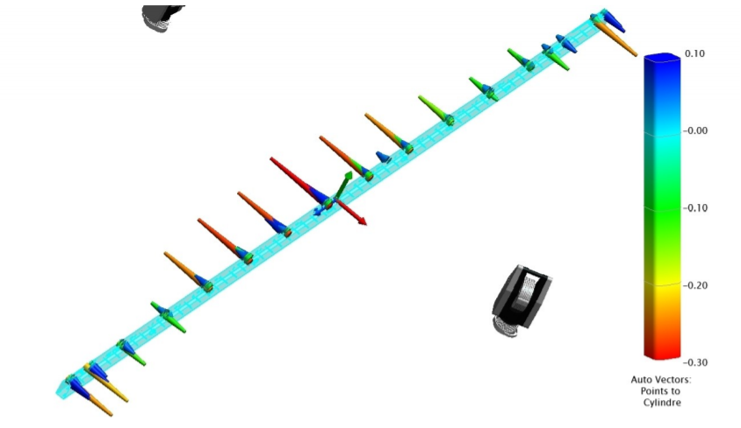
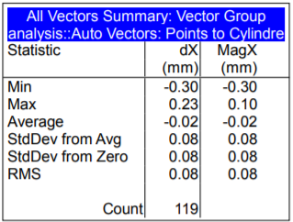
Tooling
  Mandrel inner layer: all drawings approved: LHC-MBH_T-DF-0025
  Mandrel outer layer: all drawings approved: LHC-MBH_T-DF-0026
  Reception: out of tolerance (LHC-MBH_T-RPT-0022)

Slide 20
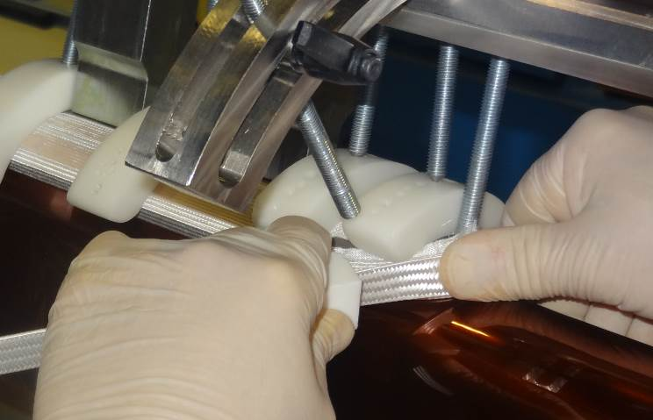
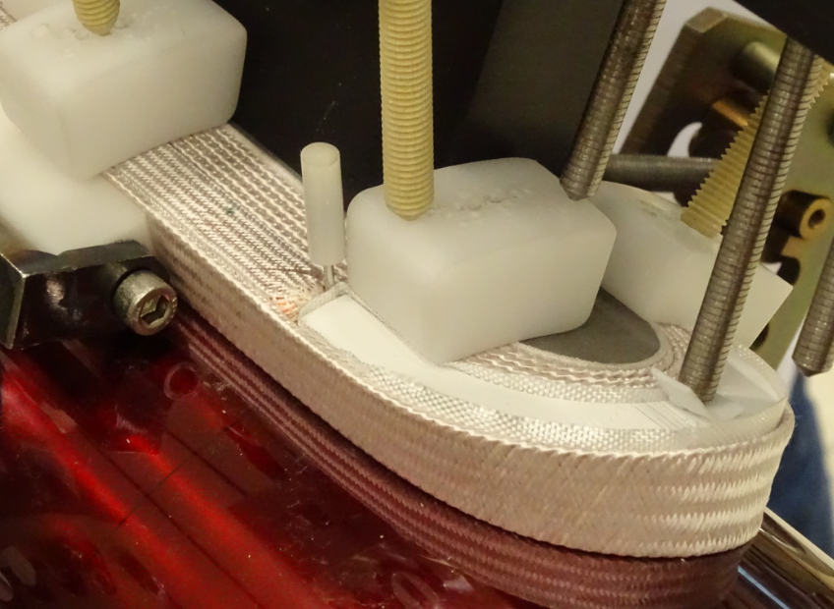
Differences in the 11T and MQXF production
  Note: In the turns, for 11T and MQXFB, the cable must be in contact with the mandrel during the entire turn.
  Tooling poles for 11T, final poles for MQXFB
  The winding tension is different on both due to the cable and coil geometry:
      11T: 23 kg for Inner layer and 17 kg pour outer layer,
      MQXFB: 19 kg for straight parts and 7 kg for turns on both layers (the tension in the turns is decreased following an analysis performed with US).
  Wedges: Sanded for MQXFB since beginning of series production.

Slide 21
Non conformities during production
  Non conformities (16 non critical, 2 critical)
  2 critical NCR on coils GE04 and 27 (scrapped).
  14 : Minor damages of the insulation.
  2 : important Pop out. Insulation damaged, repair needed.
Extracted from GE’s documentation

Slide 22
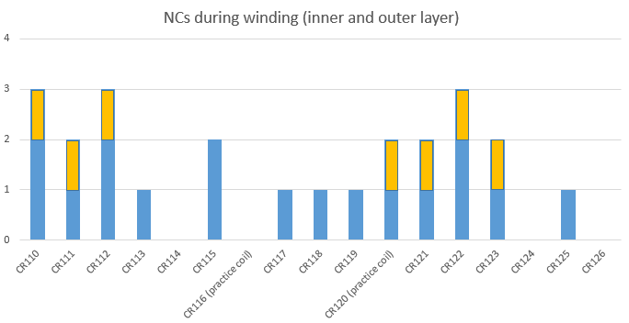
Non conformities during QXFB series Production
  24 non conformities (15 non critical, 9 critical)
  7 critical NCRs on cable insulation thickness (CR110, CR111, CR112, CR120, CR121, CR122, CR123)
  2 critical NCRs on coils CR120 and CR123:
    CR120: cable collapsed during winding
    CR123: cable insulation thickness + important pop out repaired (NCR 2455792)
  15 non critical NCRs related to cable insulation defects and minor issues during coil production.

Slide 23
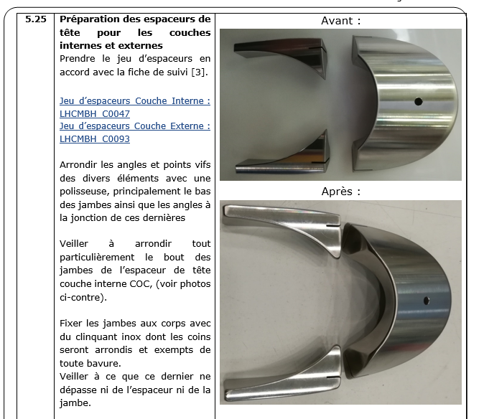
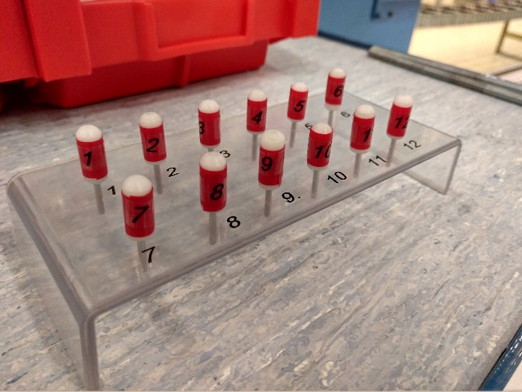
Adopted mitigations following major NCR (11T)
  Since GE03 (rev.8.0): the spacers are filed to avoid sharp edges (damage of cable ‘s insulation on GE02 during spacer installation, NCR 1962584):
  Since GE05 (rev.9.0): a pins storage box is used (major NCR on GE04 due to a forgotten pin, NCR 1995788):

Slide 24
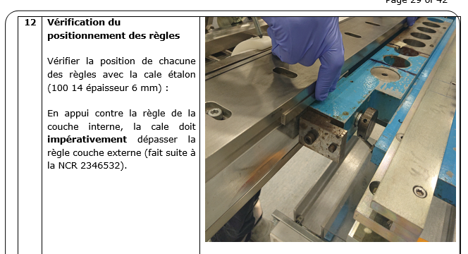
Adopted mitigations following major NCR (11T)
  Since GE28 (rev.17.0): an join inspection GE+ LMF-QA is carried out on the outer layer pushers (major NCR on GE27 due to a poor placement of the outer pushers, NCR 2346532):

Slide 25
Adopted mitigations following major NCR (MQXFB)
  Adopted mitigations before series production:
    Tooling: following NCR 2112154 (CR204) and NCR 2087338 (CR205), floating shim welded.
    Coil:
        following NCR 2025180 (CR201), NCR 2113779 (CR202), NCR 2142901 (CR203) and CR204, electrical insulation weakness: additional 5 turns of fiber glass around the pole parts
        Following NCR 2019982 (CR109), NCR 2113779 (CR202), NCR 2085135 (CR203), spacers coating damaged: new coating supplier.
  Adopted mitigations related to 11T magnet disassembly, before series production
    Coil component: copper wedges and pole parts sandblasted.
  Adopted mitigations during series production:
    Winding machine: following NCR 2341294 (CR115) and NCR 2419556 (CR120), consolidation of the cable tension sub-system and improvement of the cable unrolling sub-system.

Slide 26
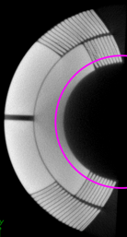
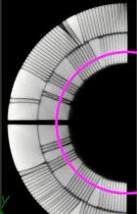
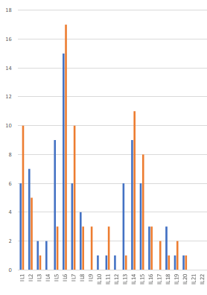
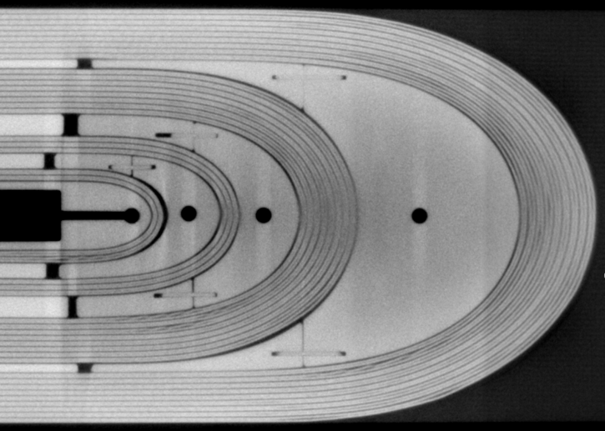
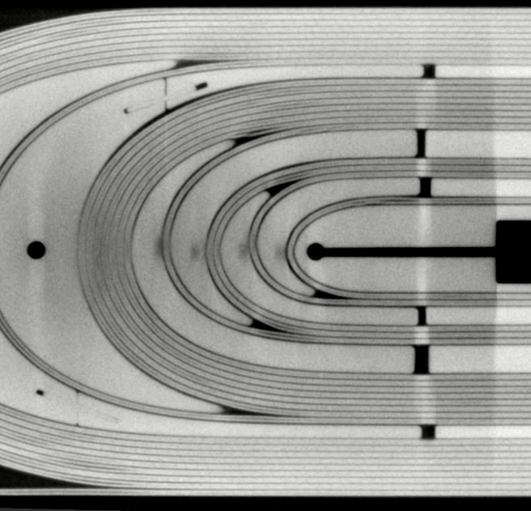
Outcomes after cold tests inspections
  Cable on inner layer (Tomography, courtesy of Dr S. Sgobba and B. Bulat)
GE11, Connection side
GE15, Non Connection side

Slide 27
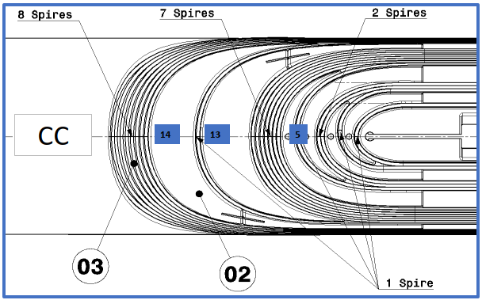
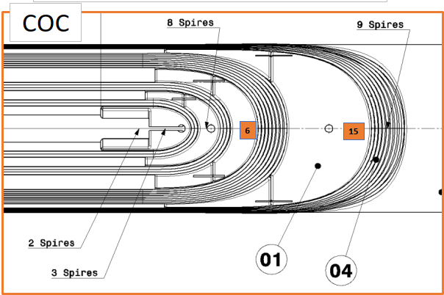
Outcomes after cold tests inspections
  Pop out during winding, on inner layer

Slide 28
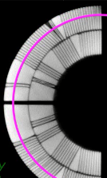
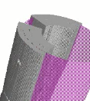
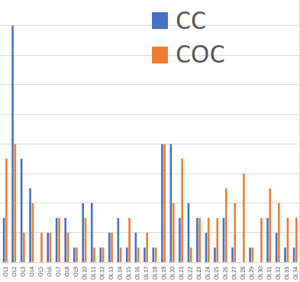
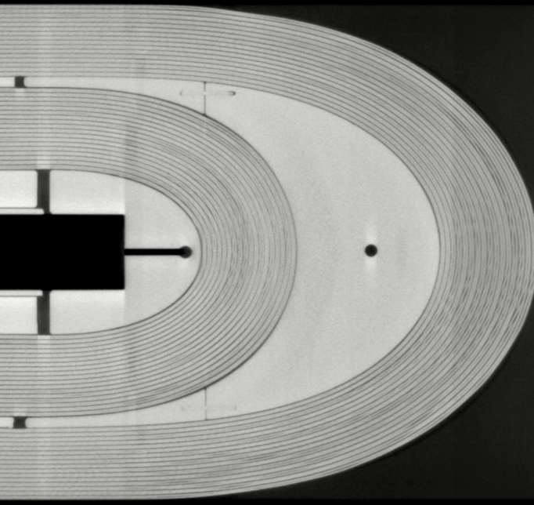
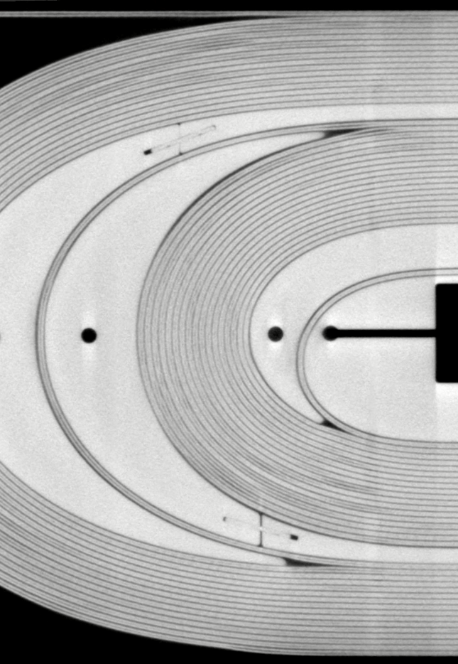
Outcomes after cold tests inspections
  Cable on outer layer (Tomography, courtesy of Dr S. Sgobba and B. Bulat):
GE11, Connection side
GE15, Non connection side
16
14
12
10
8
6
4
2

Slide 29
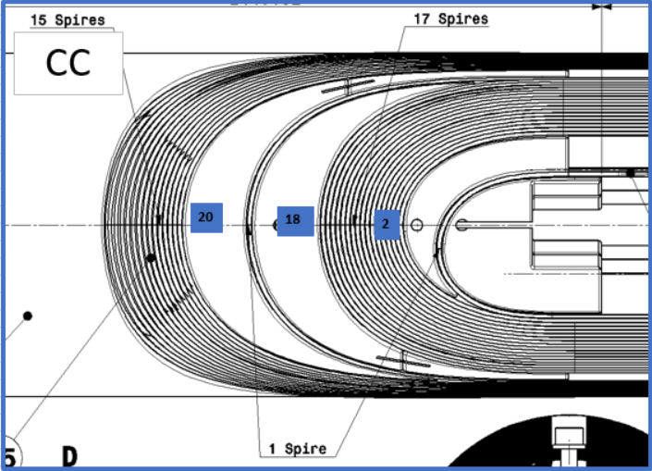
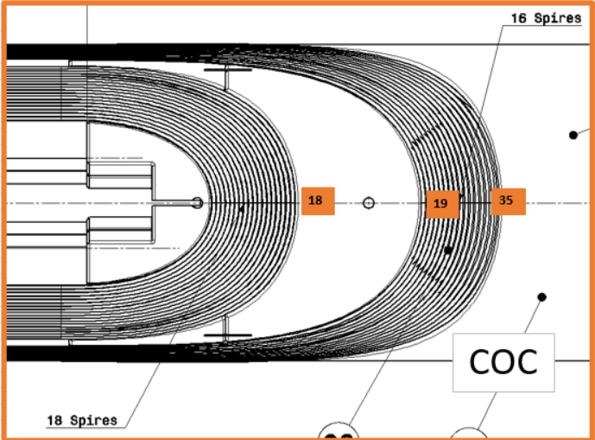
Outcomes after cold tests inspections
  Pop out during winding, on outer layer
16
14
12
10
8
6
4
2

Slide 30
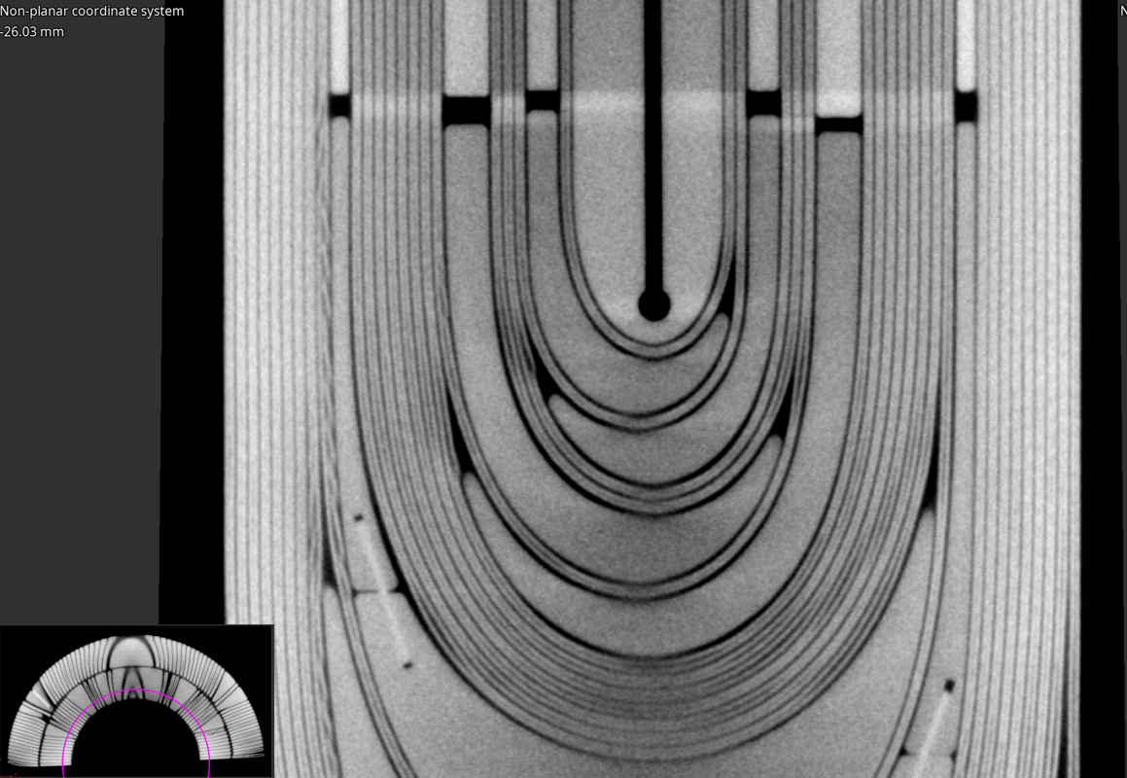
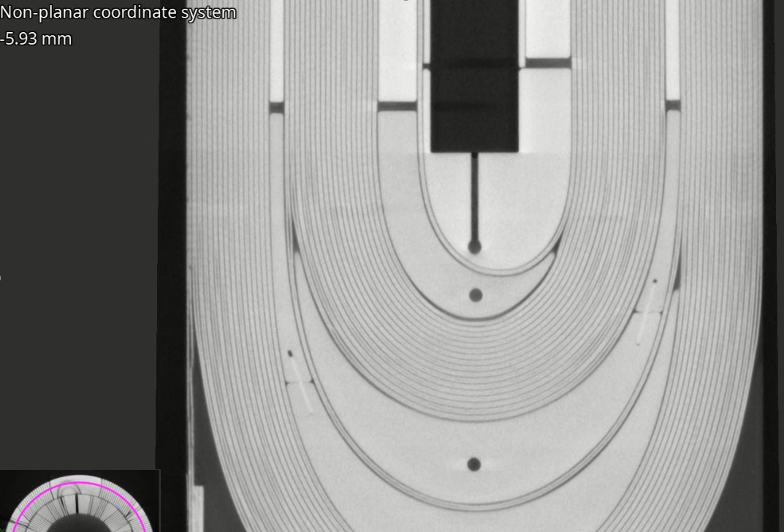
Outcomes after cold tests inspections
  Cable position on short coil 122 (Tomography, courtesy of Dr S. Sgobba and B. Bulat).

Slide 31
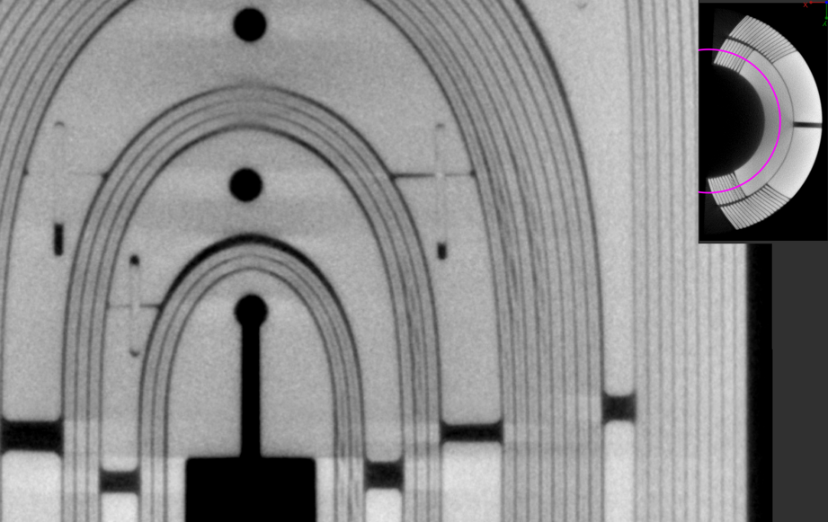
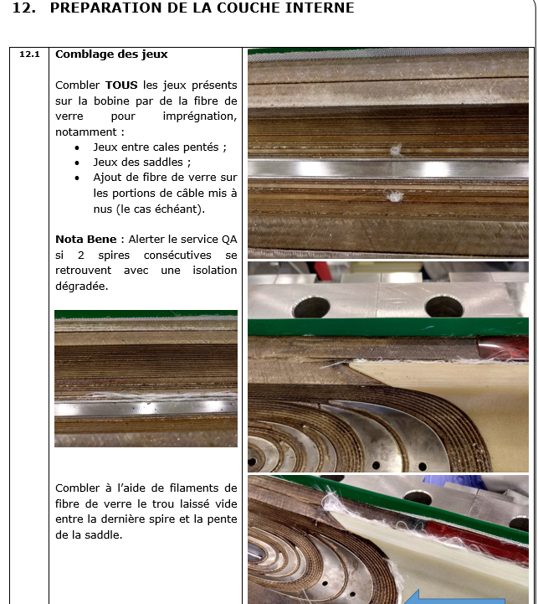
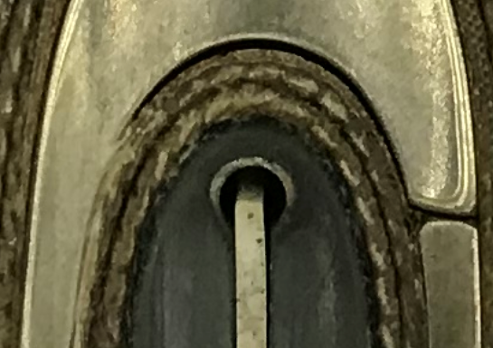
Outcomes after cold tests inspections
  On inner layer, empty spaces on non connection side (GE15).
  The gaps are filled with fiberglass before impregnation.
Does the fiberglass fill entirely the void (in depth)?

Slide 32
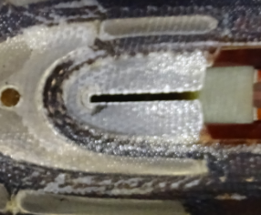
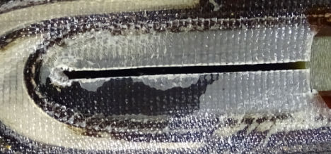
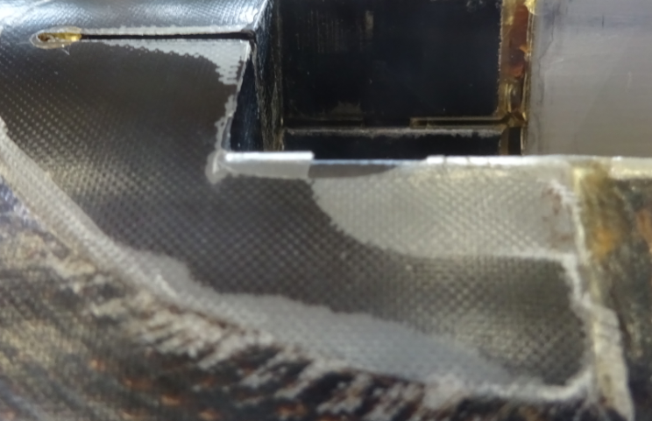
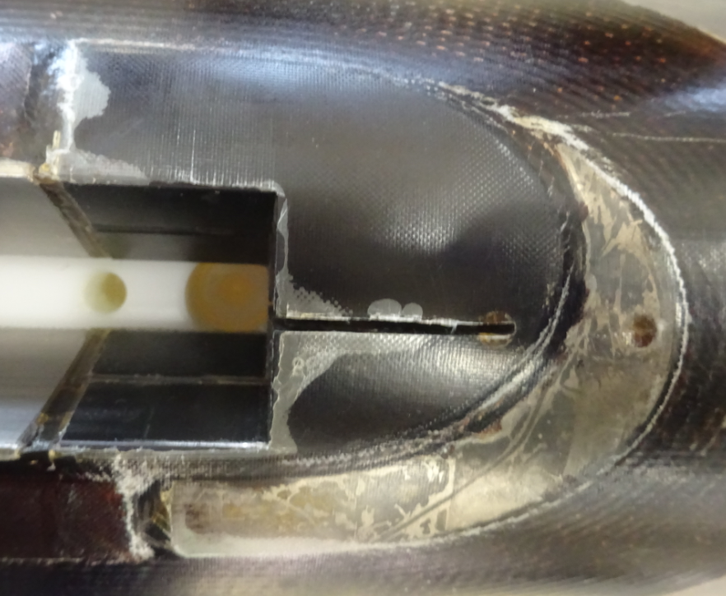
Outcomes after cold tests inspections
  Outcome from inspections after dismantling on GE02, GE03, GE08,GE09, GE10, GE12, GE14, GE15 and GE16.
  Recurent defects detected:
  Delamination on winding keys (both outer and inner layers):

Slide 33
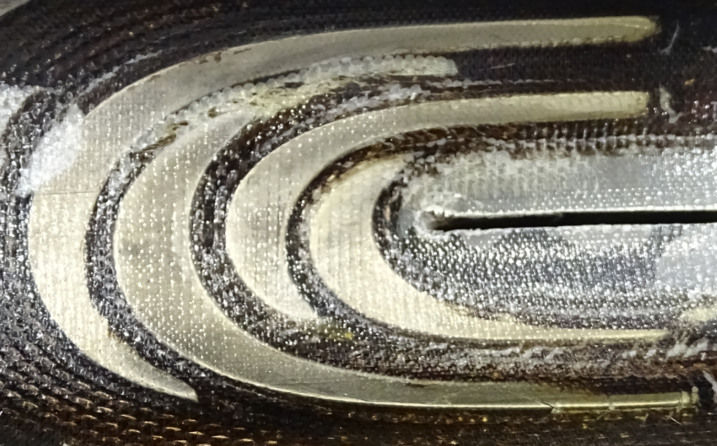
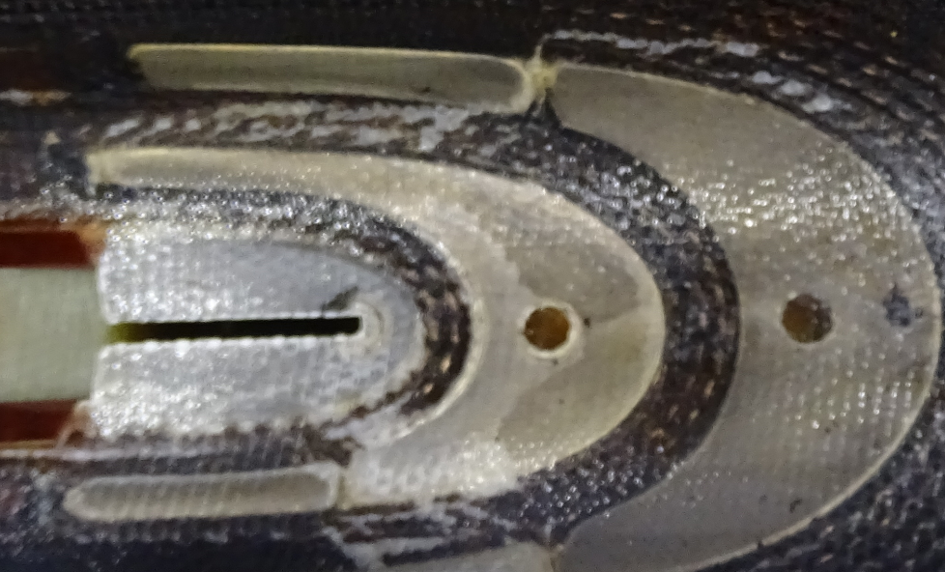
Non conformities and defects
  Cracks on the first turns on both sides (GE15):

Slide 34
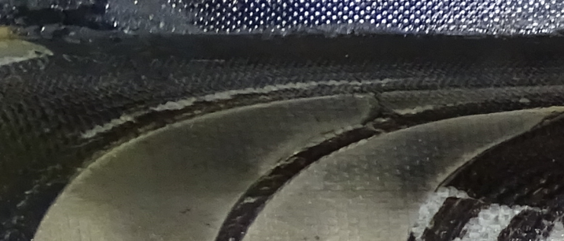


Outcomes after cold tests inspections
  Cracks on the between turns 14th and 15th on both sides:
Courtesy of Dr S. Sgobba and B. Bulat

Slide 35
Future proposed improvements
  Winding keys to be sanded for a better adhesion of the resin (action already taken on MQXFB).
  Spacers and winding keys geometry?
  Process? Choice to keep the cable in contact with the mandrel during the turns?
  The empty spaces on inner layer could be filled before outer layer winding (no more access later on the outer side of the inner layer).

Slide 36
11T and QXF SC cable insulation, production and sampling
May 5, 2021
Documentation available at https://indico.cern.ch/event/969681/
F. Lackner, R. Principe

Slide 37



Recent NC on insulation thickness
Main observations:
  Visual inspection: Irregular braiding (yarn count)
  Compressive test: 10-stack sample thickness out of tolerance
!
Courtesy of - Elena Fernández Mora TE-MSC-SMT

Slide 38

Company visit at (22nd of April)
Agenda:
Observed NC’s on CERN site related to the braiding uniformity
Feedback from CERN QC control of braiding thickness
Established production process/procedures at CGP for the different production lines
The procedure for the 6 m sample preparation at CGP
QC hardware and established QA at CGP
Documentation and reporting
Feedback and experience from CGP on the contract B1505 with CERN
Visit of production line
Conclusion and identification of mitigation/action items
Visit report EDMS
NC report EDMS

Slide 39


Visit at manufacturing lines for CERN
Dedicated braiding area for CERN contract
Stringent QA/QC including documentation of NC and mitigation
Online monitoring (geometrical QC), optical cameras (20000 points per cable length)
3 production lines in operation, varying in the amount of spindles used
2 vertical braiding lines (24 and 32 spindles max.)
1 new horizontal braiding line (32 spindles max.)

Slide 40


Horizontal braiding
Several advantages were listed for the horizontal braiding:
Increase of spindle volume, no interchange throughout long cable braiding
Easier trajectory of cable, less deformation in transverse direction
Reduced maintenance due to fact that small fibers are not filling up on the otherwise vertical filament guides, low risk in fiber pollution due to lubrication
Easier manipulation of 800 m cable reels, the portal support of the unrolling and collection rolling units allow improved logistics

Slide 41
Observations: Sample preparation
Change towards sample preparation at CGP
  6 m samples are required to verify insulation thickness based on 10-stacks in bldg. 927.
  Previously cutting performed at LMF in non dedicated zone, therefore strong wish to improve cutting operation.
  Change of procedure correlates with NC observations, therefore careful investigation of the sample preparation.
  Due to significant amount of NC with new horizontal machine CERN requested production on vertical braiding line.

Slide 42

Procedure: The 6 m sample preparation at CGP
Braiding operation is launched for MQXFB based on usual parameters for both production lines (Old vertical and new horizontal braiding line)
Braiding full cable length (Lcable) minus the 6 m sample length (Lsample).
Stop after the condition Lcable – Lsample has been achieved.
Subsequent the braiding is cut and secured with tape. Tape is overlapping 50% of the fiber and 50% on the cable, avoiding opening or movement of the fiber scheme.
The braiding is prepared on the 6 m sample
The machine is restarted for the last 6 m. Reduced torque and tension!
The sample is cut after finalizing the 6 m braiding.
Packing and shipping of sample is prepared.
Risk: Sample not representative of full cable length?

Slide 43


Facts
Very low amount of NC observations related to “old” purely mechanical controlled braiding line
Significant amount of NC on horizontal line
Feedback CGP: Mechanical braiding line is stabilizing very quick after a restart – 6 m sample shows better results
Newer electronic controlled production line requires longer distance to stabilize
Hypothesis:
Current sample preparation does not allow to represent quality of full braided cable length
Error less pronounced on vertical (“old”) machine due to faster stabilization

Slide 44
Mitigation
Why CGP is not unrolling the sample from finalized length?
According to CGP the cutting of braided fibre shall always be avoided. Taping shall always be carried out with a sufficient overlap to the base material.
With 2x 26 m long samples of the MQXFB Rutherford cable, CGP is asked to provide braiding on both, the horizontal and vertical machines. This shall allow to confirm the feedback and hypothesis regarding the sample preparation.
Vertical machine: 20 m braiding incl. a 6 m braided sample according to the same procedure as currently established for the full length production.
Horizontal machine: 20 m braiding incl. a 6 m braided sample according to the same procedure as currently established for the full length production.
If the hypothesis in confirmed further mitigation items will be discussed related to the sample preparation.

Slide 45
Conclusion
Investigation of observed NC ongoing, potential root cause is given by the sample preparation at CGP.
CGP sample is prepared with last 6 m of full cable length (about 750 m).
Prior sample braiding the machine is stopped to re-tape the fiber insulation, avoiding to cut the sensitive fibers.
Horizontal and Vertical machine differ in their stabilization time required to achieve homogeneous fiber matrix.
Mitigation on the way, 2 samples will be produced at each machine (shall allow to confirm observations).
Further action items will be defined subsequent to proposed analysis.

Slide 46
Outcome
DELIVERABLE 1 - WINDING
May 5, 2021
Documentation available at https://indico.cern.ch/event/969681/
R. Principe and all

Slide 47
Outcome MEETING#1 May-5, 2021 1/3
QA system
    Appears to be sufficient to cover the production step.
    Appears flexible enough to cover future evolutions (updates of control procedure / Follow-up / MIP).
Component
    NCRs do not seem to have an impact on the functionality of the coils.
    the geometry of the winding keys and spacers can be analysed for improvement.

Slide 48
Outcome MEETING#1 May-5, 2021 2/3
Correlation cable pop outs / coils tomographies
    Intersting possible correlation between the observation of cable pop-outs registered during winding and coils tomographies.
    To be checked if this can be an indicator of defects after the future tomography of coil candidate GE27 (not reacted coil).
    A tomography on GE27 (not reacted coil) is proposed to determine if the defects observed on reacted coils are present since the winding or if they are generated later.

Slide 49
Outcome MEETING#1 May-5, 2021 3/3
Procedure evolution
  Check before inner layer curing if gaps between spacers and cable of the inner layer are deeply filled with fiberglass (no more access to the inner layer after this production activity).
  The sandblasting of the winding keys can be carried out if the production resumes.
QC improvement: cable insulation thickness measurement
  Following the visit to the supplier, the sampling insulated cable samples used for the cable insulation thickness measurement appear not representative for MQXFB. A new control method at CERN is under discussion.

Slide 50
DELIVERABLE 2 - CURING
May 12, 2021
Documentation available at https://indico.cern.ch/event/1038110/
R. Berthet, B. Arias Alonso, O. Housiaux, R. Principe

Slide 51

Applicable documentation and evolution – 11T
  Procedures 11T
    Manufacturing Procedure LHC-MBH_C-FP-0004 rev 9.0
    Control Procedure LHC-MBH_C-FP-0070 rev 5.0
  Modifications due to
    Review of the applicable documentation with GE before starting production,
    Comments from operators,
    Following the NCR 2004465: quantity of ceramic binder decreased.

Slide 52

Applicable documentation and evolution QXFB
  Procedures 11T
    Manufacturing Procedure
    LHC-MQXFBC-FP-0011 v4.0
    Control Procedure
    LHC-MQXFBC-FP-0057 v3.0
  Modifications due to
    Review of the applicable documentation during the “deverminage” campaign,
    Comments from operators.

Slide 53

Components
  Ceramic binder
    Specification Ceramic binder CTD 1202 (example for batch 7353-074: LHC-MBH_C-RPT-0007).

Slide 54


Tooling – 11T
    Curing tool inner layer: all drawings approved: LHC-MBH_T-DF-0027
    Curing tool outer layer: all drawings approved: LHC-MBH_T-DF-0028
    Approved on December 2017, before series production
    Reception of the carcan and shells: conform (LHC-MBH_T-RPT-0018)

Slide 55


Tooling – QXFB
4
    Curing tool for inner and outer layers: all drawings approved: EDMS 1479822
    Approved on December 2015, before series production
    Carcan and half shells measured by the supplier (EDMS 208470), no metrology performed at CERN).

Slide 56



Differences in the 11T and QXFB production
  Pressure in the press:
  Quantity of ceramic binder
  Areas without ceramic binder
 | 11T | MQXFB
Pressure in the straight part’s jacks | 80bar | 40bar
Pressure in the heads’ jacks | 50bar | 40bar
 | 11T | MQXFB
Qty of ceramic binder in each head IL | 13.8g | 13g
Qty of ceramic binder in straight part IL | 28g/m | 60g/m
Qty of ceramic binder in each head OL | 21.3g | 13g
Qty of ceramic binder in straight part OL | 46g/m | 60g/m
Inner Layer 11T | Outer Layer 11T | MQXFB
2 first turns | No area free of binder | 4 first turns around poles 2 turns around each spacer

Slide 57
NCR related to the curing production step – 11T
  3 non critical NC
  NCR 2381672: Heating cycle not registered on CR117 (MQXFB). Heating device upgraded for better reliability.
  NCR 2385866: Due to a switch not activated, the pressure in the jacks reached 103.4bars (instead of 80 bars).
  NCR 2004465: On GE01, the insulation of the two first turns is missing on 12cm.

Slide 58
Adopted mitigations on tooling following NCR – 11T
  NCR due to tooling (improvement of the tooling):
    NCR 2381672: Heating cycle not registered on CR117 (MQXFB). Heating device upgraded for better reliability.
      All the data are now registered in the CERN supported interface (Timber).
    NCR 2385866: Due to a switch not activated, the pressure in the jacks reached 103.4bars (instead of 80 bars).
      The coil GE29 and the tooling were inspected and showed no damage,
      Lock on the switch to make sure it is ON..

Slide 59

Adopted mitigations on procedure following NCR – 11T
  Corrective actions following NCR 2004465: On GE01, the insulation of the two first turns is missing on 12cm.
  It is decided to avoid ceramic binder application on the 2 first turns around the pole on the inner layer. And to decrease the quantity of ceramic binder on the inner layer
Masse totale pour la couche interne [g]
Produit A | 139.5
Produit B + C | 146.5 + 19.6 = 166.1
Total Couche Interne | 305.5
Masse totale pour la couche interne [g]
Produit A | 90.26
Produit B + C | 94.79 + 12.68 = 107.5
Total Couche Interne | 197.7

Slide 60
NCR related to the curing production step – QXFB
  10 non critical NC
  Ceramic binder (1 NC):
    NCR 2274486 (CR110, CR111, CR112, CR113, CR003): Use of expired ceramic binder for interlayer manufacturing and inner/outer layer curing.
  Machine + Tooling (5 NC):
    NCR 2326848 (CR112): Impregnation data not registered in Timber.
    NCR 2344270 (CR116): Failure in heating cabinet during IL curing cycle.
    NCR 2381672 (CR117): Regulation cycle not registered during inner layer curing.
    NCR 2397489 (CR118): Regulation cycle not fully registered during outer layer curing.
    NCR 2385008 (CR117): Mould closing issue.
  Manpower (3 NC):
    NCR 2384251 (CR117) and NCR 2397499 (CR118): mandrel temperature out of range.
    NCR 2466935 (CR124): Cable insulation damaged after IL curing.
  Component (1 NC):
    NCR 2381667 (CR116): Coating of 2 spacers chipped after outer layer curing.

Slide 61


Adopted mitigations on QXFB following NCR
  Machine: Corrective actions following NCR 2326848, 2344270, 2381672, 2397489:
      Machine upgrade (heating cabinet, press software, data acquisition)
      Data storage in Timber database.
  Curing tooling: Corrective actions following NCR 2385008:
      Missing chamfrain machined
      Update of drawing.
  Spacer coating chipped after outer layer curing: Corrective actions following NCR 2381667 (coil CR116) and similar defects observed on coils CR121 and CR125: spacer coating chipped after outer layer curing:
      QA inspection of the internal cavity of the coil after outer layer curing during the transfer to the reaction baseplate added to the control procedure (reaction).
      Deformation slits on IC2 and OC3 spacers: currently under evaluation.

Slide 62

Conclusion
Small number of NCs on the curing production step (1.5% of total NCR),
The shorter production step,
Mainly automatic,
Most of delicate operations are included in the winding production step.

Slide 63
Outcome
DELIVERABLE 2 - CURING
May 12, 2021
Documentation available at https://indico.cern.ch/event/1038110/
R. Principe and all

Slide 64
Outcome MEETING#2 May-12, 2021
QA system
    Appears to be sufficient to cover the production step.
    Appears flexible enough to cover future evolutions (updates of control procedure / Follow-up / MIP).
Thermal cycles
    The NCRs (all minor, level 1 or 2) detected during the 11T production do not seem to have an impact on the functionality of the coils.
    The internal layer undergoes twice the curing thermal cycle. The second time when the OL is cured. Is this producing any visible effect on the coil conditions? To be checked.
    GE 27
    GE27 NC critical due to the cable damage (collapsed). Presented and discussed during MEETING#1, may-5, session dedicated to the WINDING process (deliverable 1).
    The coil will be cut and prepared for tomography as discussed.
    The coil after curing is not stable. It will be fixed with non metallic supports (ongoing).

Slide 65
Thank you

