Slide 1
Physics Strategies in China
Zhengguo Zhao
University of Science and Technology of China
Chinese Physics Society

Slide 2
Major Contents to be Presented
  Big science: physics with big facilities → nuclear, particle and astroparticle physics
  Accelerator based experiments
  Underground experiments
  Cosmic-ray physics at high altitude
  Space experiments
Priorities in condensed matter, optics, statistical & quantum physics and technology…
  Quantum and topological orders in condensed matter systems.
  precision measurements and manipulations based on atomic and molecular physics and quantum optics.
  Fundamentals and applications of extreme light fields
  Propagation, regulation and application of sound in complex media.
  Quantum physics for the development of information and computation technologies.
  Statistical physics for complex, finite-size systems and life science.
  Advanced light source and application.

Slide 3
Present accelerator-based experiments &
Proposals for future facilities

Slide 4
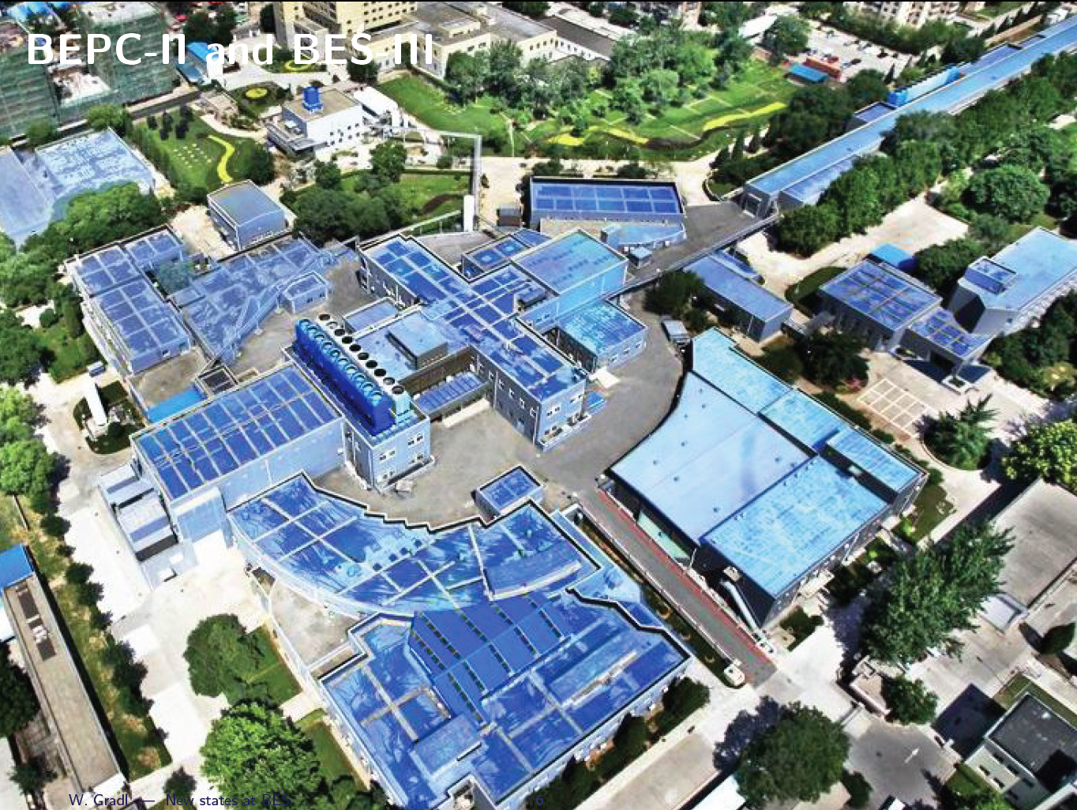
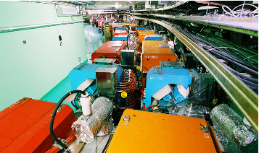
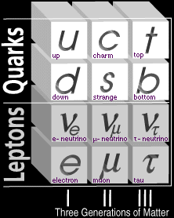
Beijing Electron Positron Collider (BEPC)
BEPC construction: 1984-1988, operation: 1989-2004, L_{peak}=1.0x10³¹ /cm²s
BESI: 1989 – 1997, BESII: 1998 - 2004
BEPC upgraded to BEPCII: 2004-2009, BEPCII operation: 2009 to now
L_{peak}= 1.0 x10³³/cm²s, BESIII: 2009 to now
LINAC
BESIII
detector
Storage ring
Science questions:
Are there any exotic hadrons→new form of matter
What are the structure of hadrons→ Strong interaction (QCD)
Are there any new physics that could be observed from this high precision frontier?
4

Slide 5
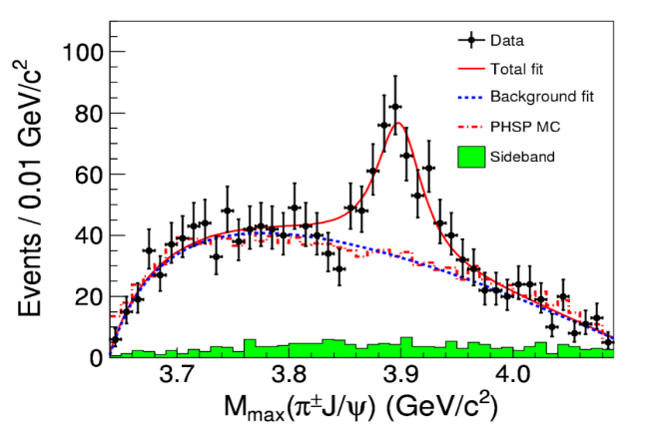
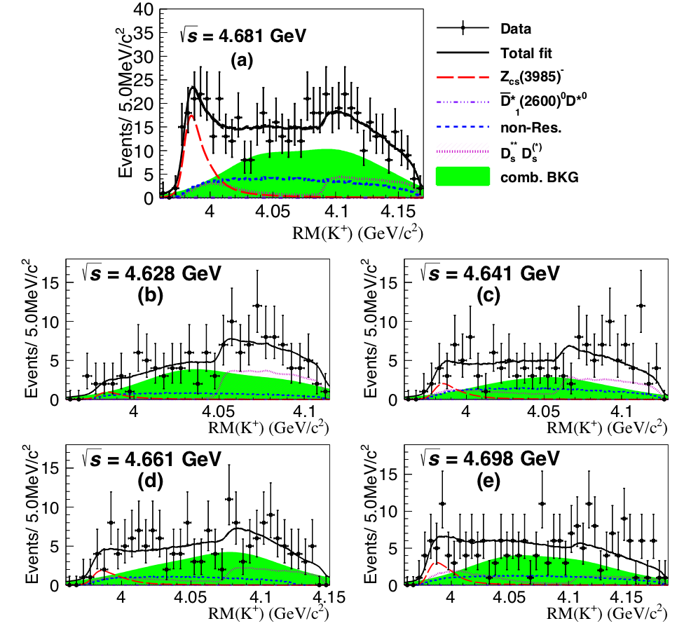
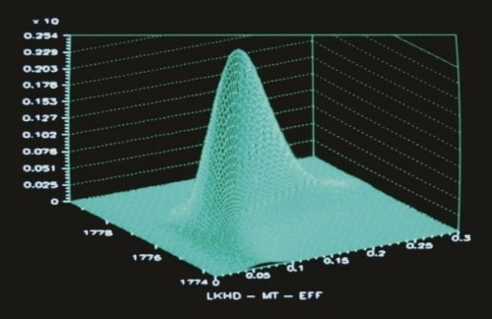
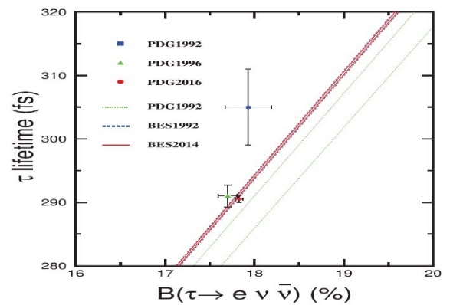
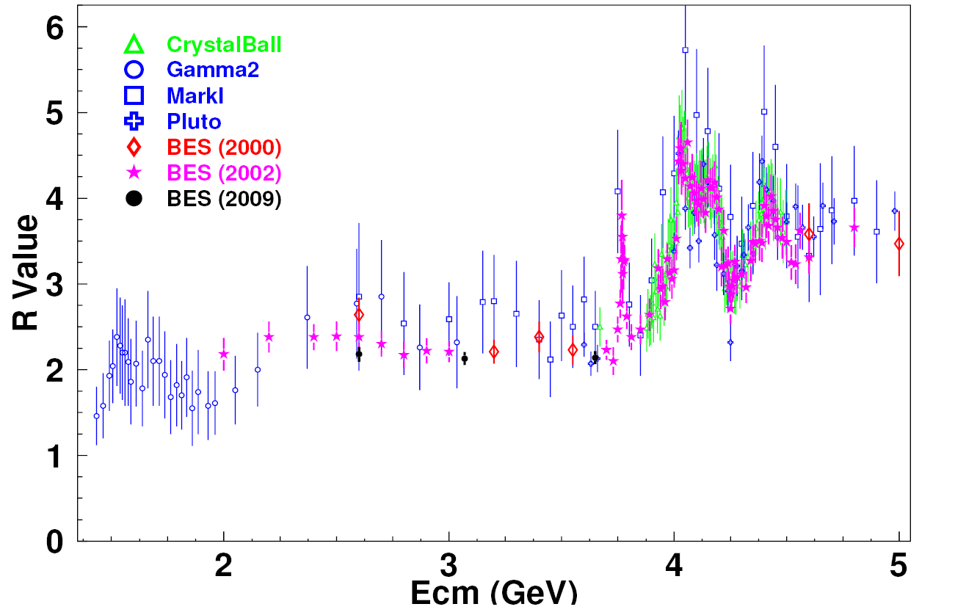
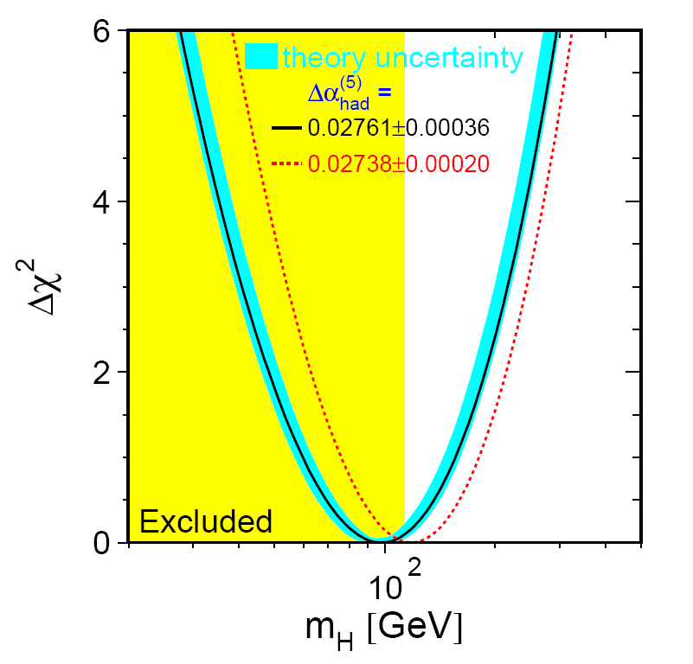
BESI measurement of τ lepton mass
Measurement in 1992 achieved most precise Mτ measurements when published, validated the universality of leptonic μ-τ coupling,
BESIII observed Z_{c}(3900) and Z_{cs}(3985）
BESIII
Z_{c}(3900)
Z_{cs}(3985）
BESII measured R values in 2-5GeV energy range
R values: one of the most fundamental quantities in particle physics. measurements reduced the uncertainties of R from ~20% to ~6%. Crucial to the estimation of Higgs mass from SM fit.

Slide 6
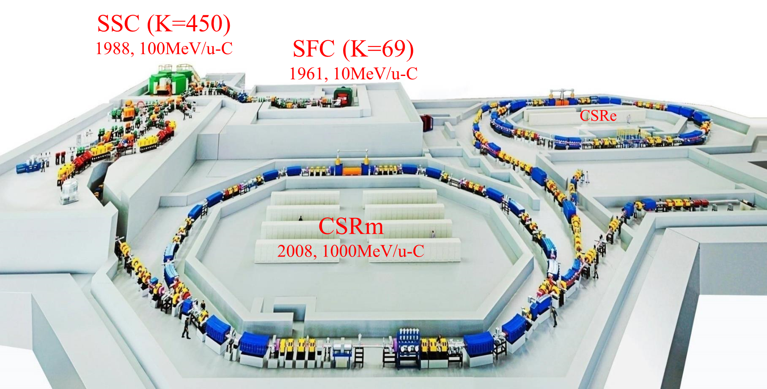
Heavy Ion Research Facility in Lanzhou (HIRFL)

Slide 8
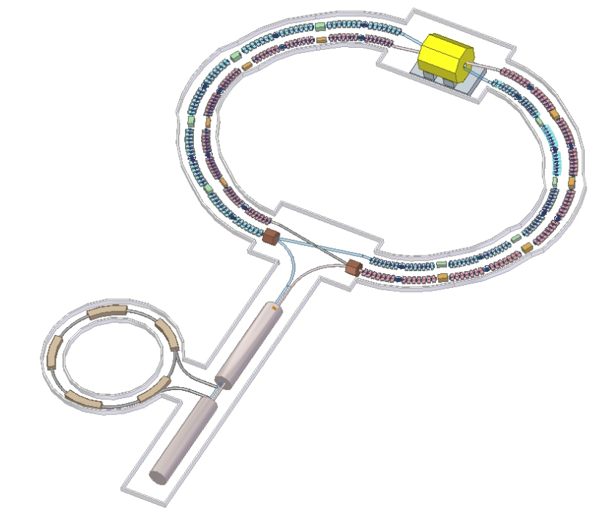
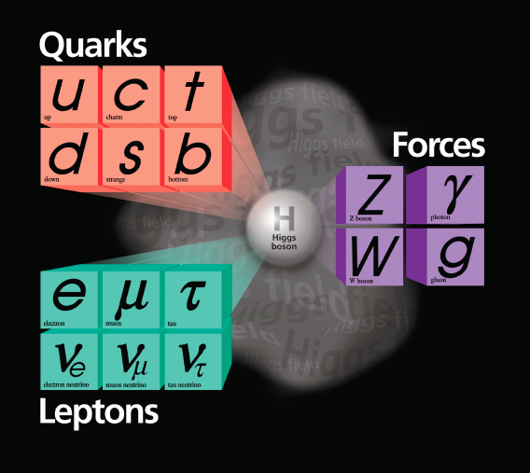
Proposals of future facility in China
1 km
100 km
STCF
CEPC (with ZF)
E_{cm}: 91/240 GeV
L: 25/3 ×10³⁴ cm⁻²s⁻¹
Cost: 11.6 B CHF B (int.)
35 B RMB (CN)
Could be the biggest center
of HEP in the world
E_{cm}: 2-7 GeV
L: 0.5/1 ×10³⁴ cm⁻²s⁻¹
Cost: 4.5 B RMB
One of the 5 centers for HEP
Notes:
Add SBF, CEPC, HIEPA, DAMPE

Slide 9
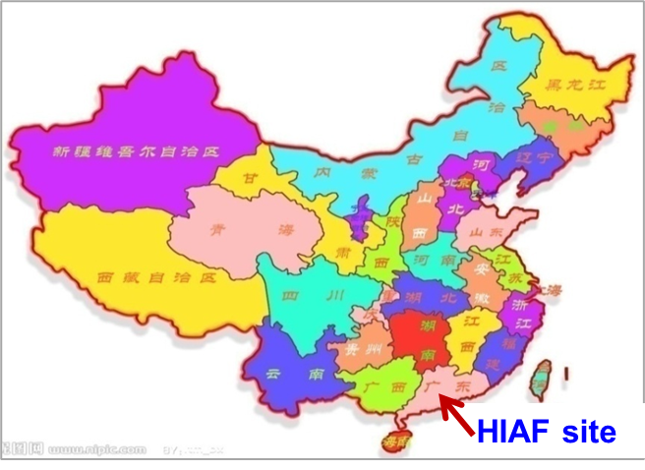
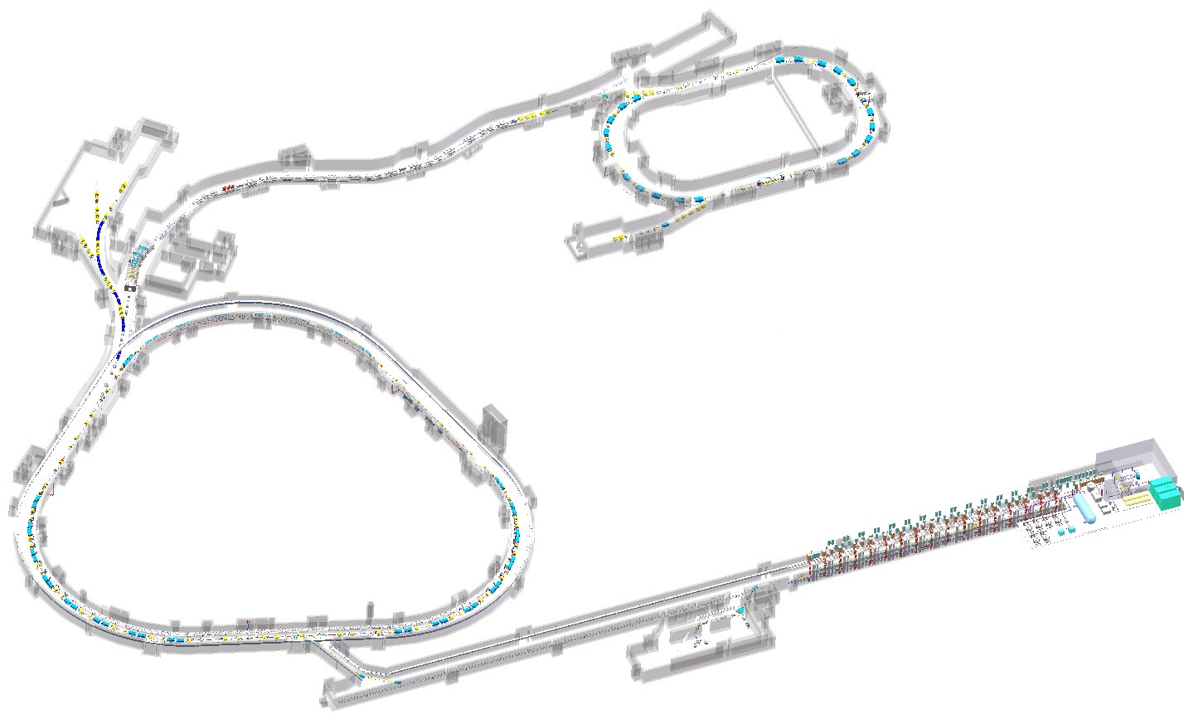
High-Intensity Heavy Ion Accelerator Facility (HIAF）
Under construction
External target station
SRing: High precision
spectrometer ring
High energy irradiation
Science motivations:
High intensity radioactive beams to investigate the structure of exotic nuclei, nuclear reactions of astrophysics and to measure the mass of nuclei with high precision.
High charge state ions for a series of atomic physics programs.
Quasi-continuous beam with wide energy range for applied science.
High energy and intensity ultra-short bunched ion beams for high energy and density matter research.
Spontaneous electron–positron pair production
4
HFRS: Radioactive beam line
Circumference: 277.3m
Rigidity: 15.8 Tm
Electron/Stochastic cooling
Two TOF detectors
Four operation modes
8
5
L: 190m, Bρ: 25 Tm
3
6
RIBs physics station
e-ion recombination
spectroscopy
7
High Energy Density Physics
BRing
BRing: Fast cycle ring
Circumference: 569.1 m
Rigidity: 34 Tm
Large acceptance (200/100)
Two planes painting injection
Fast ramping rate（3-5Hz）
SECR:
Superconducting ECR source
Low energy nuclear
structure terminal
iLinac: Superconducting linac
Length:100 m
Energy: 17(U³⁵⁺)- 48(H₂⁺) MeV/u
1
2
Low energy irradiation

Slide 10
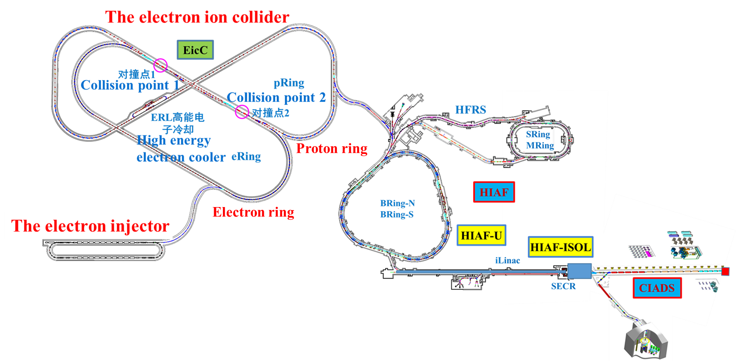
The future upgrade of HIAF
A polarized electron ion collider (EicC) is proposed based on the HIAF accelerator, which is aimed to study the structure of nucleon in the sea quark region.

Slide 11
None Accelerator Based Experiments

Slide 12
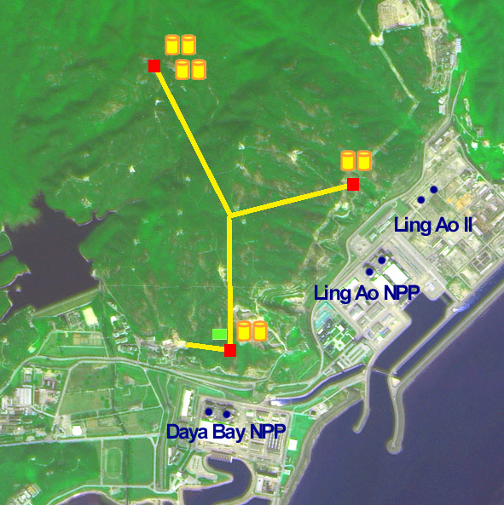
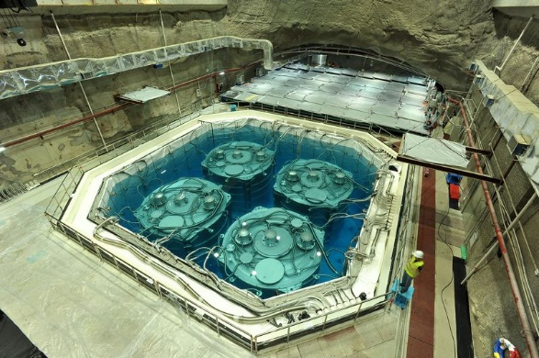
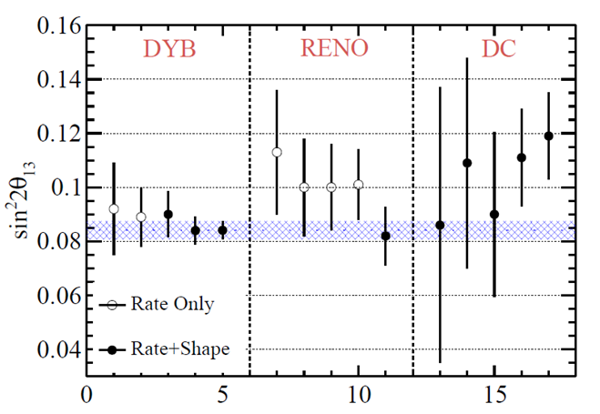
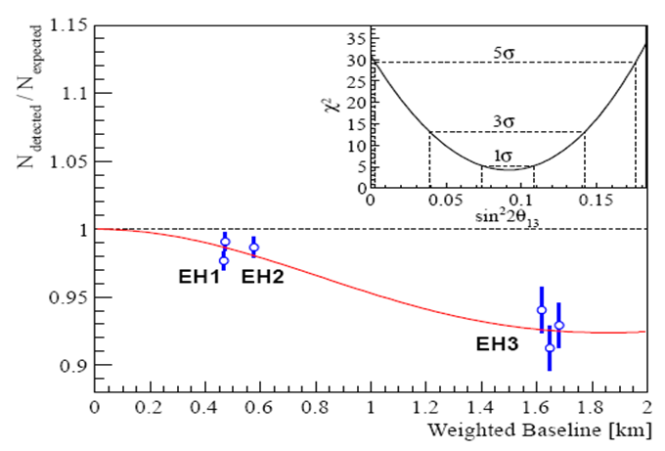
Daya Bay Reactor Neutrino Experiment (Shutdown)
Sin²2θ₁₃ = 0.092 ± 0.016(stat) ± 0.005(syst)
Daya Bay: PRL 108, 171803 (2012)
Year 2020
sin²2θ₁₃ precision improved from ~ 20% to ~ 3.4%

Slide 13

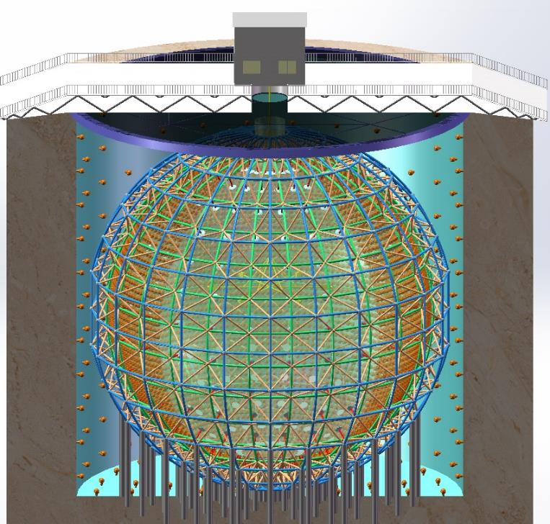
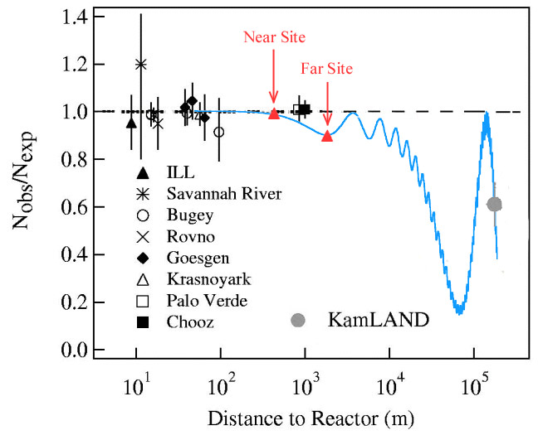
Jiangmen Underground Neutrino Observatory (JUNO)
A multiple-purpose neutrino experiment. Ground-breaking in 2015. Cost ~300 M USD
To be completed in 2022.
Daya Bay
JUNO
20 kton liquid scintillator detector
3% energy resolution
700 m underground
Rich physics possibilities
Mass hierarchy and precision measurement of oscillation parameters
Neutrinos from Supernovae, Atmosphere earth, Sun
Proton decay

Slide 14
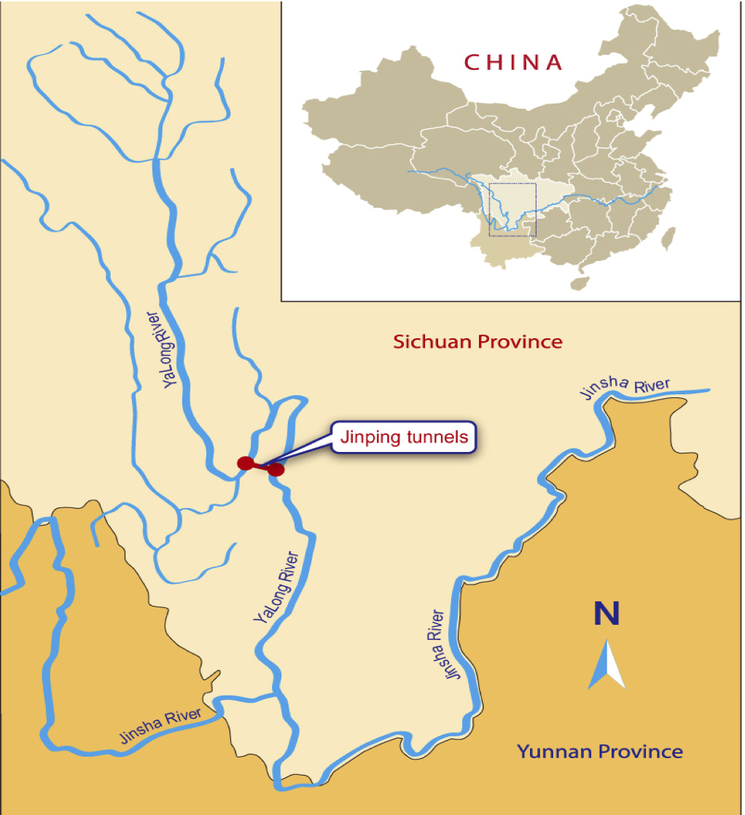
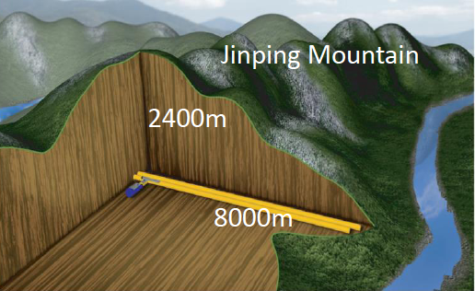
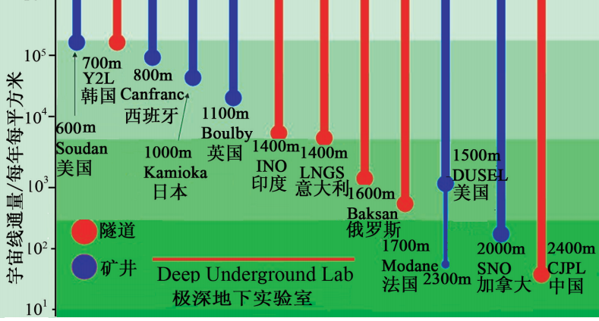
Deep Underground Laboratory in China
Deepest
Horizontal access

Slide 15
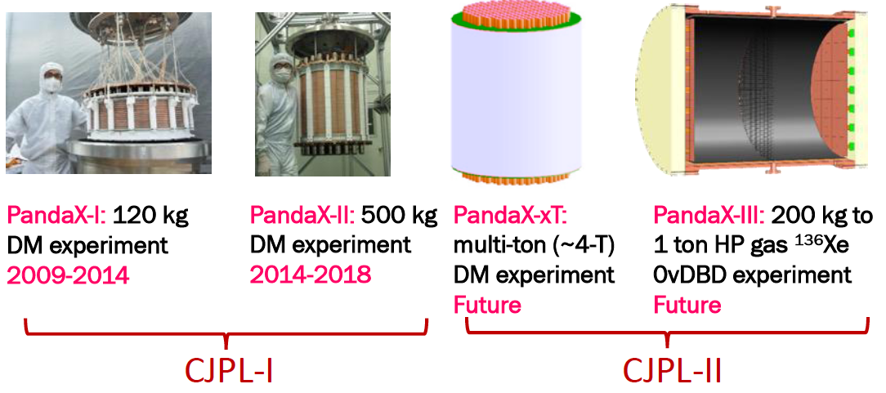
Particle and Astrophysical Xeon Experiment
PANDAX-xT for DM searches, PANDAX-III for 0ν2β searches

Slide 16
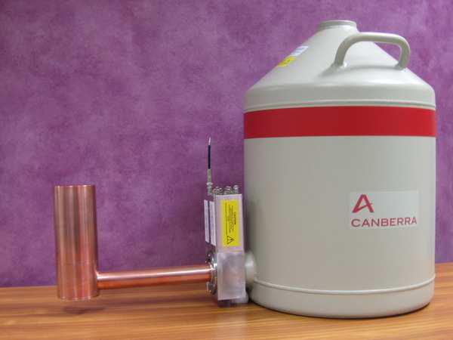
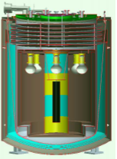
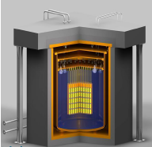
CDEX Development Stages
CEDX-1
1 kg Ge
CEDX-10
10-100 kg Ge
CEDX-1T
1 T Ge

Slide 17
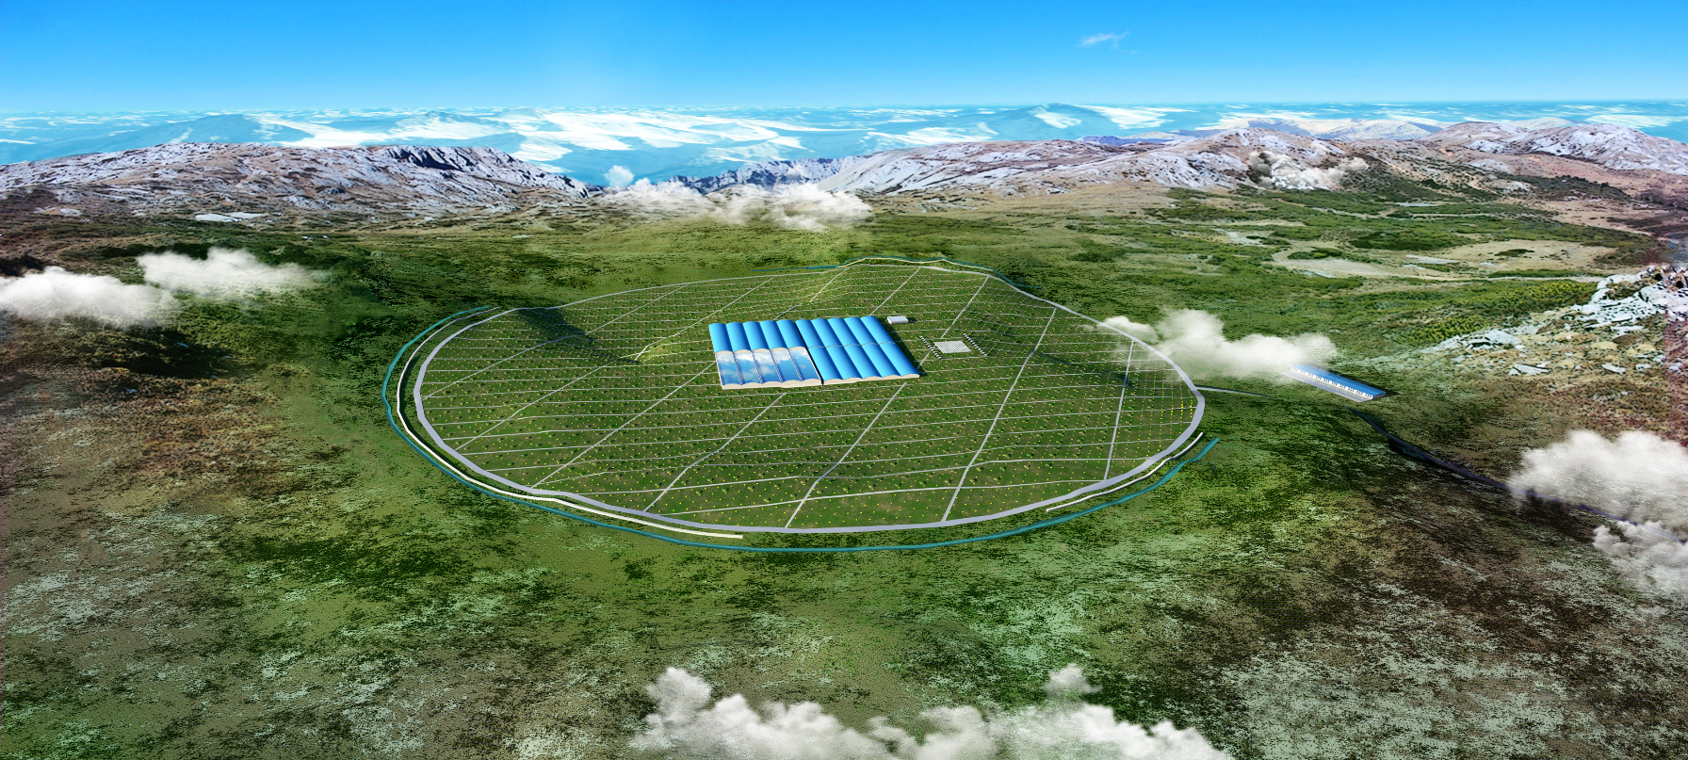
Large High Altitude Air Shower Observatory (LHAASO)
A large air shower array for cosmic-rays and γ-astronomy
Complementary to CTA：
  All the time, all the sky
  Time-variant and extended sources
  Fast indication for CTA
Data taking started since 2019, completed installation this year
Sichuan, 4300 m a.s.l.
Main Array:
5195 scintillator detectors every 15 m
& 1146 μ–detectors every 30 m
Water Cherenkov Detector
80,000 m²

Slide 18
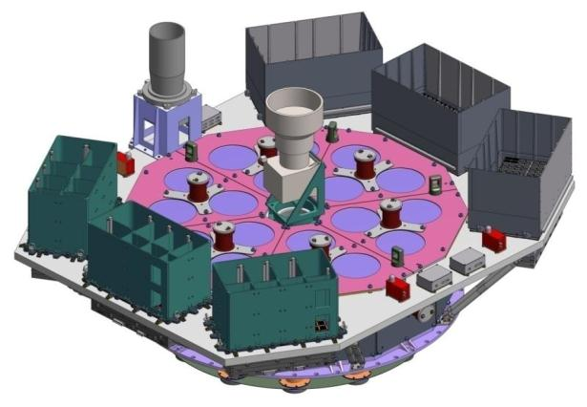
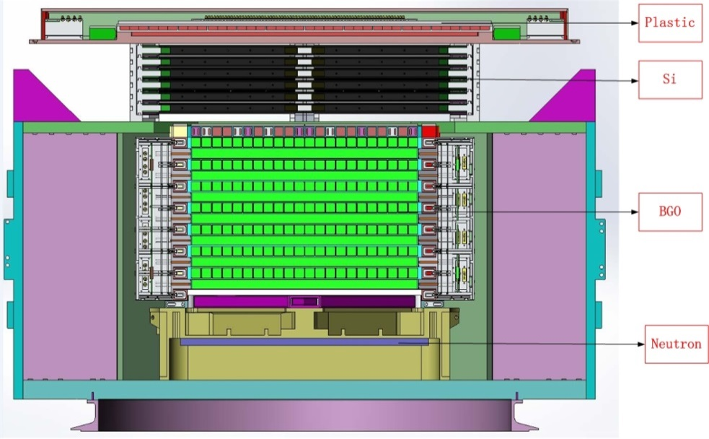
Space Experiments
Hard X-ray modulated telescope (HXMT)
DArk Matter Particle Explorer (DAMPE)
Full sky survey with good angular resolution and sensitivity
Lunched in June, 2017
Cosmic-ray & gamma detector up to 10 TeV with good resolution
Lunched in Dec., 2015
ME
LE
HE

Slide 19
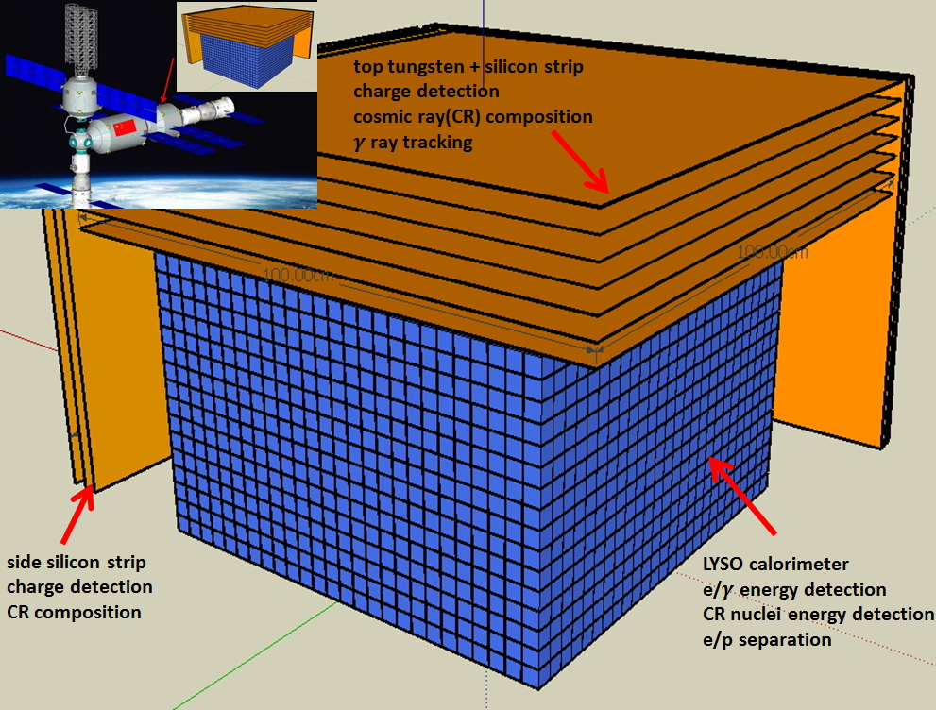
HERD to be at the China’s Space Station
Science
  Dark matter search: γ from 100 – 10,000 GeV
  γ-ray astronomy: GRBs, microquasars, Blazars and other transients down to 100 MeV
  Spectral and composition measurements of CRs between 300 GeV to PeV
    Complementary to LHAASO: directly measured composition & spectrum in space
Status
  Groups from China，Italy，Switzerland，Sweden,…
  To be launch in ~2025
 | X0(λ) | ∆E/E for e | e/p sep | e GF m²sr@ 200GeV | p GF m²sr@100TeV
HERD (2020) | 55(3) | 1% | 10⁻⁶ | 3.1 | 2.3
Fermi (2008) | 10 | 12% | 10⁻³ | 0.9 | --
AMS02 (2011) | 17 | 2% | 10⁻⁶ | 0.12 | --
DAMPE (2015) | 31 | 1% | 10⁻⁴ | 0.3 | --
CREAM (2015) | 20(1.5) | -- | -- | -- | 0.2
Acceptance & H-energy > 10X all others

Slide 20
Spallation neutron source and light sources

Slide 21

Facilities for Nuclear and Particle Physics + Particle Sources in China
Beijing
BEPCII
HEPS
Lanzhou
HIRFL
Hefei
HLS2, HALS
Shanghai
SLS
Tibet
Cosmic observatory
Fujing
HIAF
Sichuan
CJPL
LHASSO
Guangdong
DayaBay Reactor ν JUNO CNSS

Slide 22
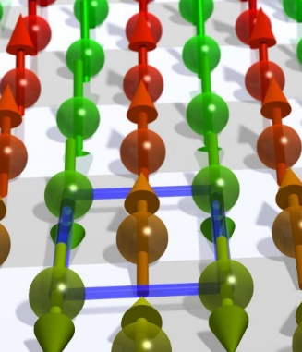

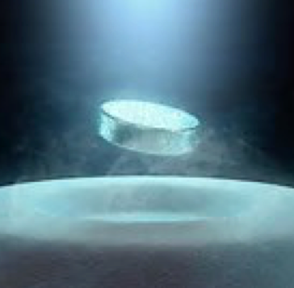
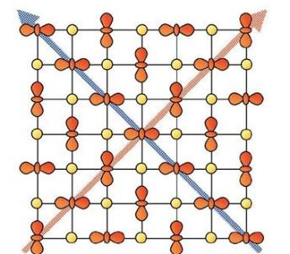
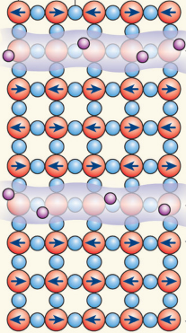
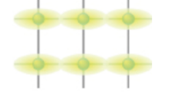

Quantum and topological orders in condensed matter
Spin
order
charge
order
superconducting order
orbit
order
nematic
order
topological
order
The study of quantum and topological orders in condensed matter systems:
leads to the discovery of new materials and phenomena
help understanding the origin of high-temperature superconductivity etc.
helpful to material science, energy and information science including quantum computation.
Current achievement
Future goals
Material synthesis and mechanism study of iron-base superconductors
Prediction and realization of near-room-temperature hydrogen-rich superconductors at high pressures.
Prediction and discoveries of topological insulators, Weyl semimetals, quantum anomalous Hall effect.
Discover new quantum and topological orders, manipulate these orders.
Solve the mechanism of high-temperature superconductivity.
Develop experimental techniques for precise
growth, measurement and control

Slide 23
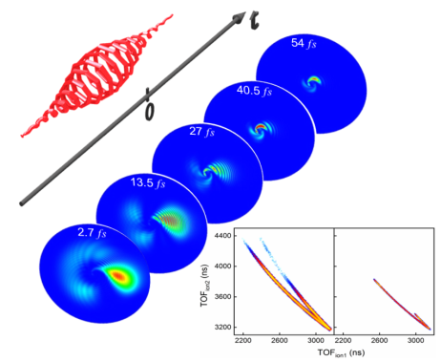
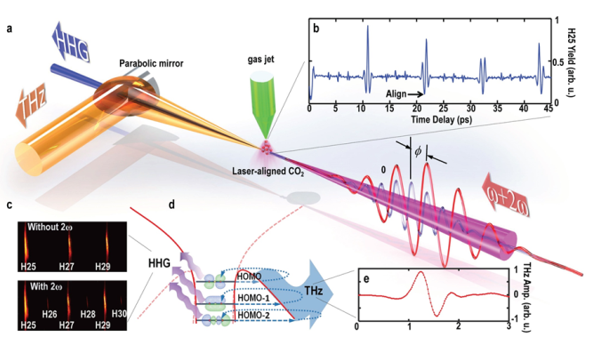
Precision measurement and manipulation based on atomic,
molecular physics and quantum optics
Explore the physics of complex interaction through precise measurement and control of the electronic states of atoms and molecules at a new level of space (sub-angstrom) and time (atto-second), to promote and improve scientific understanding and control ability of matter.
Main research fields and key scientific problems
Multibody correlation quantum effects of warm dense matter and highly charged ions
Ultrafast dynamics of non-equilibrium electronic states of atoms and molecules and their clusters
New states of cold atomic and molecular gases and their precise measurement and control
Spectral precision measurement technology, theory and application
Quantum cavity photo-mechanics, strong-coupling cavity quantum electrodynamics
High-energy photon quantum optics and high-frequency entanglement sources

Slide 24
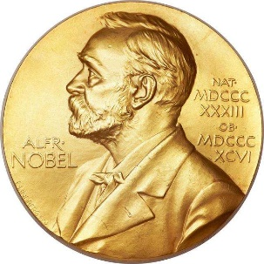


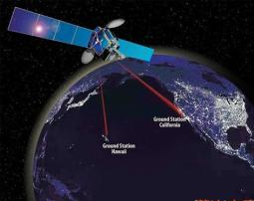
Extremely strong light field
Extremely strong light is a field of science that studies light field and its interaction with matter under extreme conditions such as very short time, very small space, very narrow spectrum, very high intensity and very low temperature.
Main research fields and key scientific problems
New extreme optical field preparation and multi-dimensional precision control in space, time and frequency domains
New extreme optical materials and devices: focus on the development of deep subwavelength scale optical field local and on-chip photonic devices
Physics of the interaction of light with atoms, molecules, clusters, plasmas, and condensed matter under extreme conditions
Application of extreme light field in precision measurement: focus on optical clock, precision measurement and ultra-high resolution spectroscopy techniques

Slide 25
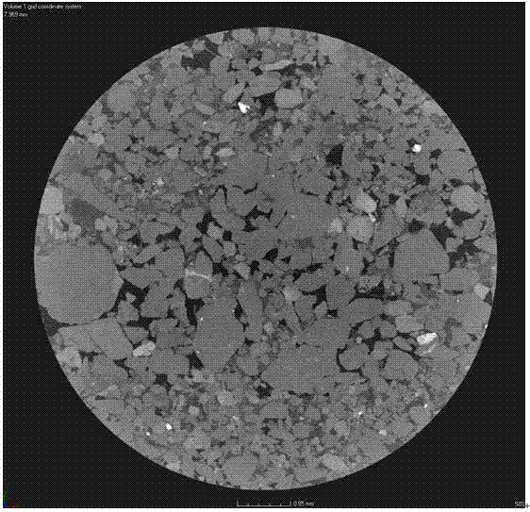
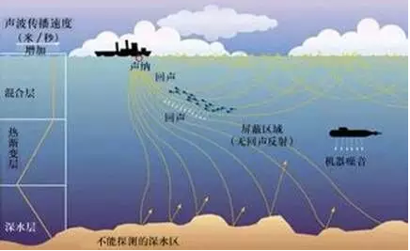

Propagation, regulation and application of sound field in complex media
Main research fields and key scientific problems
Study on transmission mechanism and law of extremely low frequency acoustic signal in seawater medium
Three-dimensional effect caused by sea floor, water undulation effect, sea-air interaction and mechanism of Marine environmental noise
Propagation law of acoustic waves in complex formation structure, and multi-scale large-scale simulation
The acoustic artificial structure can control the low frequency acoustic waves, and the small scale material can control the large scale acoustic waves
Study on the biological mechanism of ultrasound neuroregulation and its regulatory mechanism in the intervention and treatment of brain diseases
Medical ultrasound
Digital core
Underwater acoustic detection
Acoustic artificial structure

Slide 26
Development of quantum communication and computation
Main research fields and key scientific problems
Research on security and reliability of quantum communication technology;
Theory and experiment of scalable solid-state quantum computing;
The application of quantum entanglement in condensed matter and its relation with quantum gravity theory;
Quantum sensitive detection of single spin and single-molecule level structure analysis and imaging;
Quantum inertial systems and quantum measurements beyond classical limits;
Fundamental problems of quantum mechanics based on information theory

Slide 27
Statistical physics for complex, finite systems and life science
Main research fields and key scientific problems
Theory and experimental methods for soft condensates and living systems
Finite System Thermodynamics and Micro/Nano Scale Heat Transfer, Thermal Cycle Power - Efficiency Optimization Problems
Statistical physics of water science
Maximum entropy principle and fluctuation theorem, spin glass, neural network and the statistical physics of the block system

Slide 28
Extra slides

Slide 29
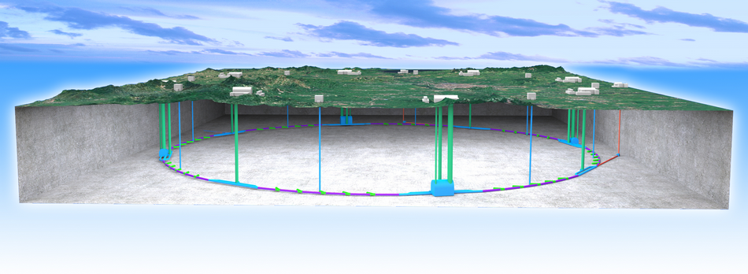
Proposal for future facility
Circular Electron Positron Collider (CEPC) as a Higgs factory
The idea of a Circular e+e- Collider(CEPC) followed by a Super proton-proton collider(SPPC) was proposed in Sept. 2012, and quickly gained the momentum in IHEP and in the world
  Looking for Hints@e⁺e⁻ Collider ➔ If yes, direct searches@pp collider
  The tunnel can be re-used for pp, AA, ep colliders up to ~ 100 TeV ➔ compatibility study needed now

Slide 30

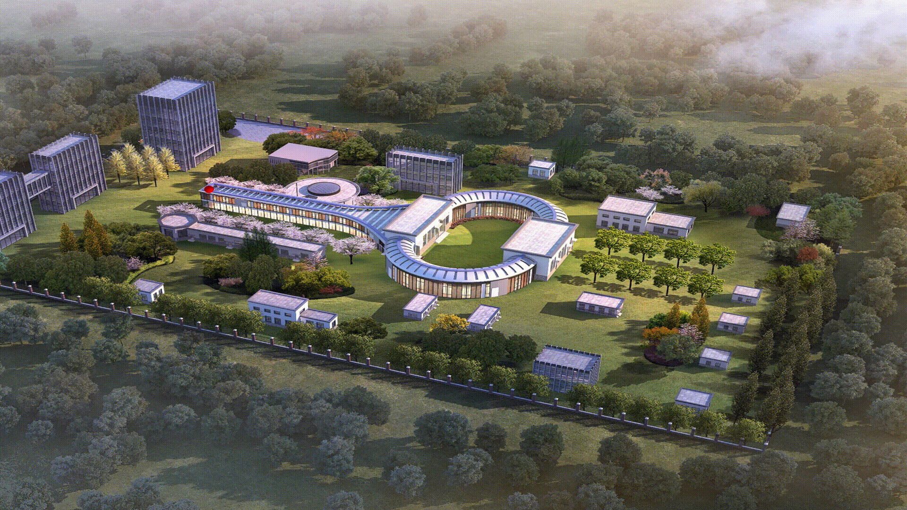
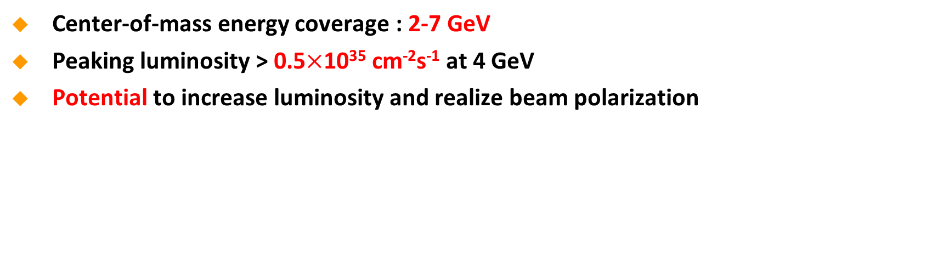
Proposal for future facility
Super Tau-Charm Factory (STCF)
Center-of-mass energy coverage : 2-7 GeV
Peaking luminosity > 0.5$×$10³⁵ cm⁻²s⁻¹ at 4 GeV
Potential to increase luminosity and realize beam polarization

