Slide 1
Electron Clouds in the SPS: progress in the analysis of cures/mitigations measures and potential schedule of implementation
J.M. Jimenez
This talk is a summary of my views meant for a recommendation.
For detailed results and pictures, please report to presentation given by
M. Taborelli (TE/VSC on behalf of SPS-U SG) during the LIU Day
http://indico.cern.ch/conferenceDisplay.py?confId=112934

Slide 2
Main Topics
Introduction
Review of the studies made so far
Proposed milestones
Closing Remarks
  Acknowledgments:
SPSU SG: G. Arduini, J. Bauche, C. Bhat, F. Caspers, S. Calatroni, P. Chiggiato, K. Cornelis, S. Federmann, E. Mahner, E. Metral, G. Rumolo, B. Salvant,
M. Taborelli, C. Yin Vallgren, F. Zimmermann, H. Bartosik, Y. Pappaphilipou + speakers
BE/RF: W. Hofle
LIU/TF: R. Garoby, B. Goddard, V. Mertens
EN/MME: for their continuous support
TE/VSC: for the support in Labs and SPS tunnel
(my apologizes for the missing names/groups)

Slide 3
Introduction
Operating the SPS with:
  High bunch intensity, up to 2.5 10¹¹ p/bunch
  and
  Small emittances (LHC requirements)
  cannot be guaranteed since electron cloud limitations have been identified:
    Pressure rise: beam gas scattering, dose rates to tunnel and components
    Beam instabilities: transverse emittance blow-up and single bunch vertical instability
This statement is confirmed by many studies and MDs carried out in the frame of the SPS-U Working Group chaired by E. Shapochnikova
  Identification and understanding of the potential limitations
  Significant progresses made on the effects on beams
  Beam scrubbing and other mitigation solutions mainly amorphous carbon a-C studied in the SPS

Slide 4
Review of the studies made so far
Beam Scrubbing
Beam scrubbing is successfully used since 1999 to reduce the electron cloud activity, BUT:
  Suppression was never achieved except in field free regions
    Residual electron cloud activity in the bending sections after 1 week of scrubbing
  Corresponds to a mitigation solution and NOT to a suppressing method
  Has an intrinsic limitation
    Reaching smaller SEY (δ) need larger electron bombardment doses (log behaviour)
    The closer to the threshold for a given bunch population and the lower the electron bombardment dose
Electron cloud is a threshold mechanism with a build-up varying with train length
  Use higher bunch population and smaller bunch spacing during scrubbing
  Run at lower bunch population and larger bunch spacing
  Allows to profit from threshold effect, NO build-up

Slide 5
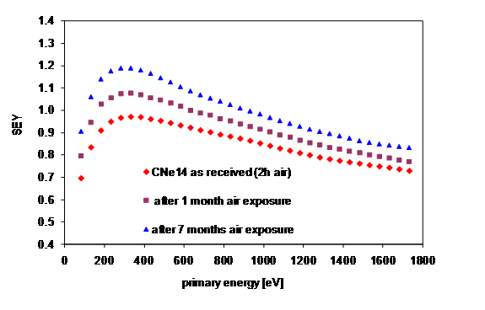
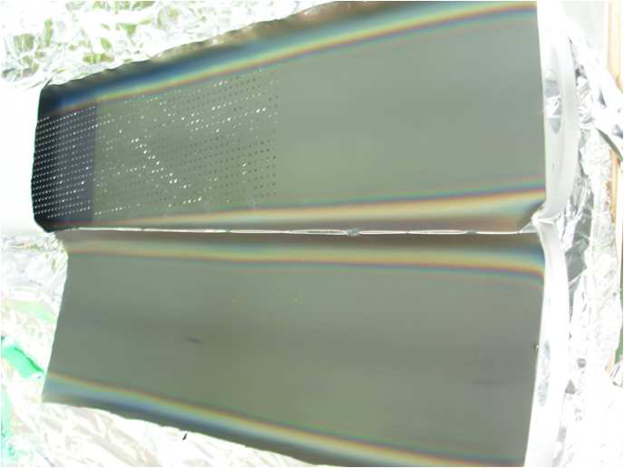
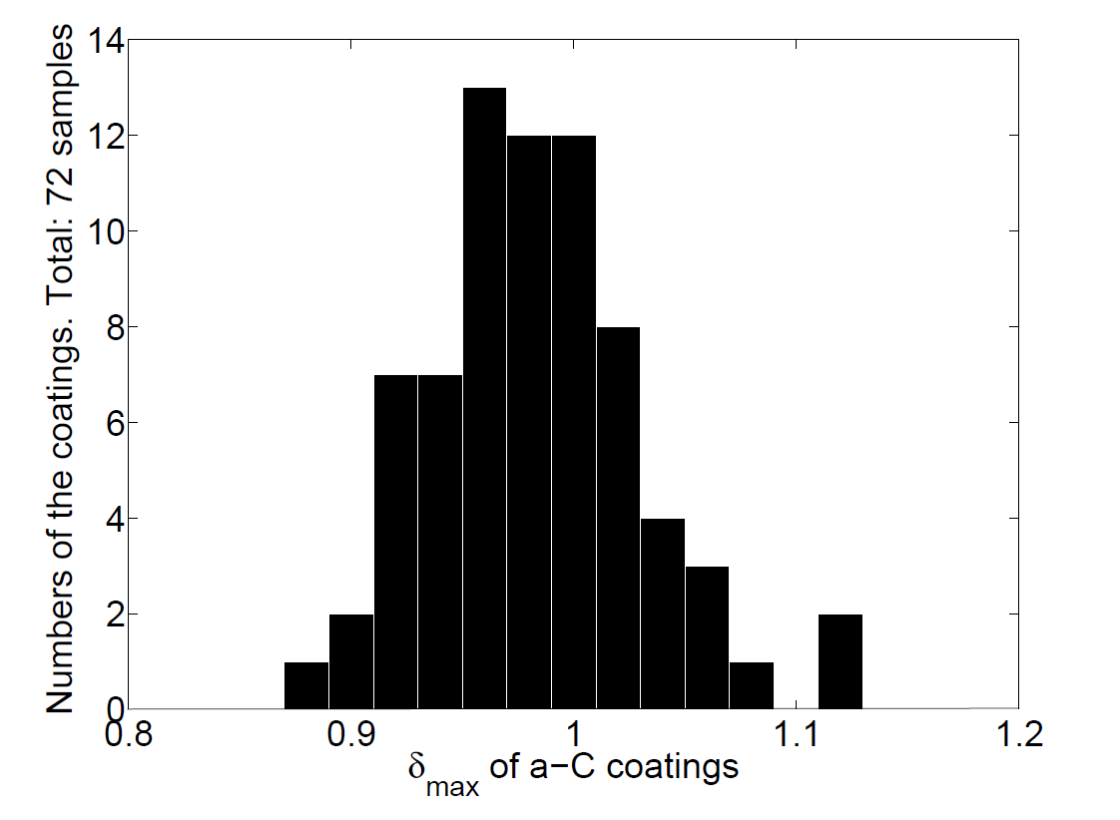
Review of the studies made so far
Coatings (1/3)
Feasibility and Status-of-the-art
  Magnetron sputtering is a mastered technology at CERN
  Amorphous carbon (a-C) selected since:
    Provides low SEY (<1.2) and is only slightly affected by venting to atmosphere
    Does not require any activation (bake-out)
  Two options are possible:
    Coating made without removing the beampipe from the magnets
      Using the dipole field to enhance the glow discharge was not entirely successful: no homogeneity of the coating
      Using an internal magnetron sputtering looks more promising, successfully tested for 50 cm, tooling being prepared to coat a 2 m dipole chamber
    Coating made prior to installation of the beampipe in the magnets
      Magnetron sputtering in the test bench used for the LHC beampipes
      (LSS – NEG)
      Best solution to get an homogeneous coating BUT need to open the magnets to install the new beampipes
M. Taborelli and al.

Slide 6
Review of the studies made so far
Coatings (2/3)
Hard limits and Open questions
  Diagnostics available in the accelerator
    Indirect measurements of coating efficiency, not always very conclusive
  Coating optimization
    Cleaning the beampipe prior to coating is a concern: easier to do on a new beampipe
      Studies made in Bld867 on 15 magnets showed no activation of the liquids used
    Lower deposition rate to keep magnet’s temperature to stay bellow 150°C during the coating
    Outgassing rate is 10 times higher (static vacuum)
      Considering to coat only part of the top/bottom surface
    Lifetime and peel off is of concern, positive feedback so far
      1-2 year without ageing observed with samples installed on an ecloud monitor
      No evidence of peel off, good adherence
        No dust coming out from the samples, event though exposed to electron bombardment and radiation dose
      Limited effect of venting, more studies needed
    Acceptable electron cloud load from remaining non-coated length?
      Short straight sections, radiation and alignment issues, etc.

Slide 7
Review of the studies made so far
Coatings (3/3)
Required infrastructures and tooling
  Option to do these activities in a building at the surface has major disadvantages
    No building available, building a new one is not compatible in term of schedule and costs
    Too many transports will increase the duration
  Go for ECX5 cavern solution (done for magnet consolidation campaign)
Schedule implications
  Coating of the existing magnet beampipes is the preferred solution
    Transport dominates (up to 4 stands in parallel)
  Inserting a new coated chamber will be difficult to do in the ECX5 cavern
    Faster for coating BUT much more demanding for Magnet crew
      Duration of magnet opening and closure dominate by far all activities if we go for new beampipes
Phasing feasibility
  Yes BUT only if shutdown duration are at least 4 months: 3 shutdowns required
    Preparation and dismantling of ECX5 is taking time
J. Bauche and al.

Slide 8
Review of the studies made so far
Clearing electrodes (1/2)
Feasibility and Status-of-the-art
  Vertical configuration to take into account the trapping of the electrons spiraling along the dipole field lines
    Not pushed forward since resulting in a aperture restriction (~1 mm in total)
  Validated at low magnetic field in the PS
  Studies are much less advanced than coatings
Hard limits and open questions
  Required clearing voltage to be assessed
    Can we found a value that works for all energies and beam characteristics?
    Cost and maintenance of the cabling and required power supplies
    Long term reliability: active system with feedthroughs
  Results in a vertical aperture restriction and impedance issue
  Difficult to equip the quadrupoles and short straight sections
  Engineering issues
    Equipping new chambers will result in a significant increase in cost since mechanical tolerances for manufacturing (twist and straightness) shall be significantly decreased as compared to existing beampipes
F. Caspers and al.

Slide 9
Review of the studies made so far
Clearing electrodes (2/2)
Required infrastructures and tooling
  Similar to the one to be prepared for coatings
    In the tunnel, in ECX5 cavern
    In the surface, in an existing building or by building a new one
  Retrofitting in existing dipole chambers will require development of complex tooling
Schedule implications and Phasing feasibility
  As for the coatings, phasing can be foreseen
    Must equip at least 2/3 of the SPS ring to be able to see an effect
  Transport time dominates if retrofitting the clearing electrodes in existing beampipes
  Duration of magnet opening and closure dominate by far all activities if we go for new beampipes

Slide 10
Review of the studies made so far
High bandwidth feedback systems (1/3)
Feasibility of the high bandwidth feedback system
  Study being carried out in the framework of LARP, this system requires:
  New pick-up for high bandwidth feedback system
    Long strip lines (at least 1.5 m)
    Complex design (accuracy and 50 Ohm impedance)
    Technically challenging but feasible
    Can be done at CERN, collaboration RF/MME?
  New kicker for high bandwidth feedback system
    Complex design
    Technically challenging but feasible
    EM Simulations can be done by L Berkeley Lab in the framework of LARP
  High speed digitization and digital treatment
    Prototype system being developed in the framework of LARP, will be able to treat a small number of bunches only
W. Hofle and al.

Slide 11
Review of the studies made so far
High bandwidth feedback systems (2/3)
Potential “showstoppers”
  Emittance growth could be dominated by incoherent effects which cannot be damped
  Excessive power required to correct effects on all bunches due to the fast growth rates
Challenging but not thought to be “showstoppers”
  Adjustment of the loop delay will be very delicate for the high frequency high bandwidth system (GHz)
  Mix-up with longitudinal motion possible if bunches not stable longitudinally
  Suppression of common mode signal crucial to avoid amplifier saturation and to allow good usage of dynamic range available
  Could be required to split the system into several bands in order to be able to cover the entire frequency range

Slide 12
Review of the studies made so far
High bandwidth feedback systems (3/3)
Required infrastructures
  Electronics and amplifiers shall be partially installed in the tunnel close to the wide-band pick-up and kickers
    Radiation and shielding issues, could require civil engineering: platform, concrete shielding
  New pick-up and kicker need modifications in the tunnel
    Layout modification, electronics, hardware and significant cabling
    Preferred location BA3 (dispersion suppressor), alternatively BA5
Schedule implications and Phasing feasibility
  Demonstrator for wide-band feedback
    Installation could take place during the 2011-12 winter stop (cabling)
    Validation of FB with demonstrator in 2013 → decision for go-ahead
  Final system with new pick-up and kicker
    Pick-ups and kicker could be ready for late 2013
    Final version of electronics could be available 2 years after complete validation with demonstrator: 2014-15
    Layout modification and cabling could be advanced to 2012

Slide 13
Proposed milestones
Feasibility studies on clearing electrodes
Industrialisation of a-C coatings
Enhancement of electron cloud for scrubbing purposes
Deadline: end Sept’11
Development of additional electron cloud diagnostics
SPS MD measurements to validate efficiency of proposed solutions
Deadline: end Sept’11
Preparation of a prototype section: 1 or 2 half-cells for 2011-12 Technical Stop
  With all diagnostics
Deadline: end Dec’11
Proceed to a complete evaluation
Deadline: Sept’12
Define the strategy for 2013
Deadline: Oct’12 (Chamonix is too late)
Installation of the pilot sector
During shutdown 2013
Validation using a pilot sector (half an arc ?) as from 2014 until 2017-18 shutdown:
Deadline for final decision: end 2016
Full installation:
Shutdown 2017-18

Slide 14
Closing Remarks
Existing accelerator
limited by electron
cloud
Suppression
Mitigation
Cures
Clearing
electrodes
Coatings
a-C
Scrubbing
Run
Feedback
systems
Status in ’10
R&D completed
Prototyping
Validation
Industrialisation
N
N
N
N
Y
Y
Y/N
Started
Y
-
Y/N
-
Y/N
N
N
Y/N
Status in ’11
R&D completed
Prototyping
Validation
Industrialisation
Y
?
Y/N
N
Y
Y
Y
Y
Y
-
Y
-
Y
Y/N
N
Y/N

Slide 15
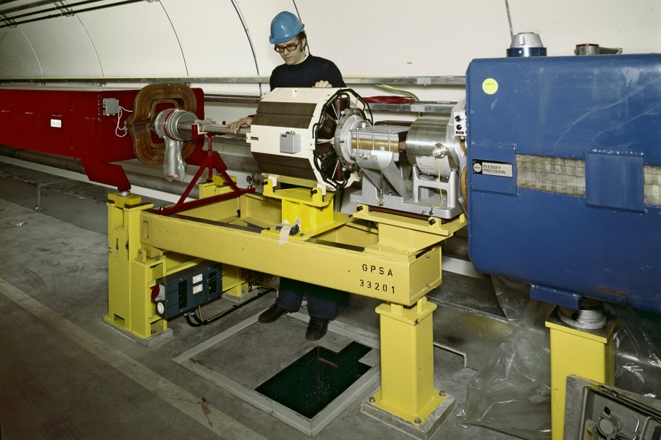
Closing Remarks
Questions still to be answered
Suppression: Clearing electrodes
  Aperture, impedance, technical solution, full-scale feasibility, lifetime, quads, LSS, cabling, powering, etc.
Mitigations
  a-C coatings
    Lifetime, stability with venting, outgassing rates, in-situ coating, LSS.
  Scrubbing runs
    Feasibility and margin, MD time.
Cures
  High bandwidth feedback systems
    High speed digitization and digital treatment
Simulations
  E-cloud budget, stability expected, emittance growth, impedance from electrodes, effectiveness of bandwidth feedback, etc.
  If we rely on beam scrubbing in the LHC why not in the SPS?

Slide 16
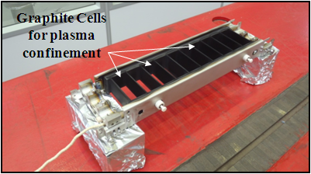
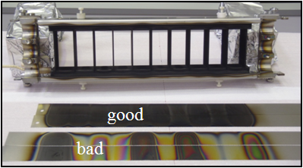
Closing Remarks
Priorities versus Resources
Satisfactory situation with mitigation solutions
  Scrubbing run is scheduled, MMDs have been requested
    We’ll also learn from LHC scrubbing run
  Coating are progressing well, new approach recently tested showed very promising results from the “industrialization” point of view
  Strengthen efforts on diagnostics to improve the validation of the proposed solution with beams in the SPS
Feedback systems can be on track with reasonable efforts
  Collaboration framework (LARP) exist
  Engineering and manufacturing to be internalized
Clearing electrodes running “out-of-phase” as compared to other ongoing studies
  Resources to be allocated to achieve a status which could allow a decision making are still reasonable in theory, in practice, where to find them?
  Going for industrialization is another story…
Hollow cathode squared cell prototype

