Slide 1
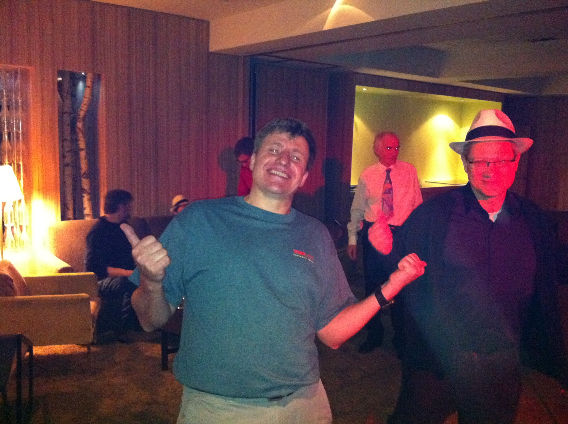


HL-LHC: parameter space, constraints & possible options
Many thanks to
R. Assmann, C. Bhat, O. Brüning,
R. Calaga, R. De Maria,
S. Fartoukh, J.-P. Koutchouk,
S. Myers, L. Rossi, W. Scandale,
E. Shaposhnikova, R. Tomas,
J. Tuckmantel ,…
Chamonix 2011
LHC Performance Workshop
Frank Zimmermann
Photo: courtesy R. Assmann

Slide 2
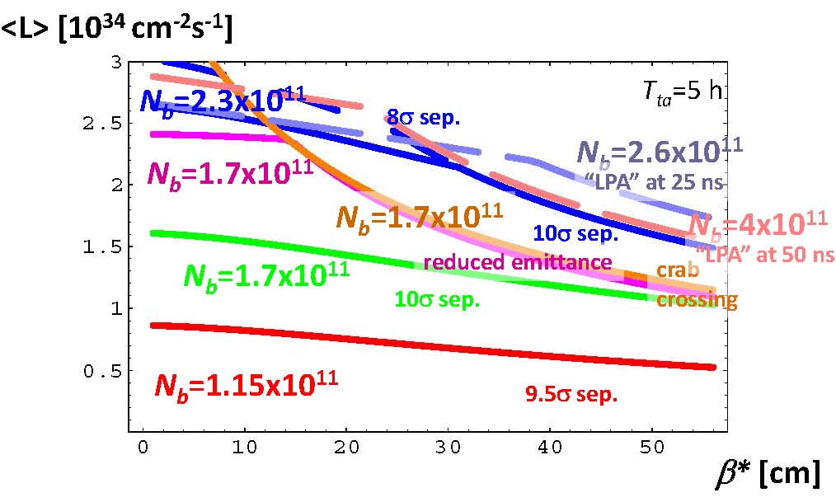
reminder -“key plot” from Chamonix ‘10

Slide 3
changes since Chamonix 2010
  (head-on) beam-beam limit at least 2x higher
  possibility to operate with lower emittance & higher brightness
  we know HL-LHC will use leveling
  leveled luminosity is defined: 5x10³⁴ cm⁻²s⁻¹
  “ATS optics” solution for β* < 30 cm

Slide 4
luminosity leveling
run at constant luminosity during the store
motivations
→ reduced peak event pile up
→ reduced peak IR power deposition
→ maximized integrated luminosity

Slide 5
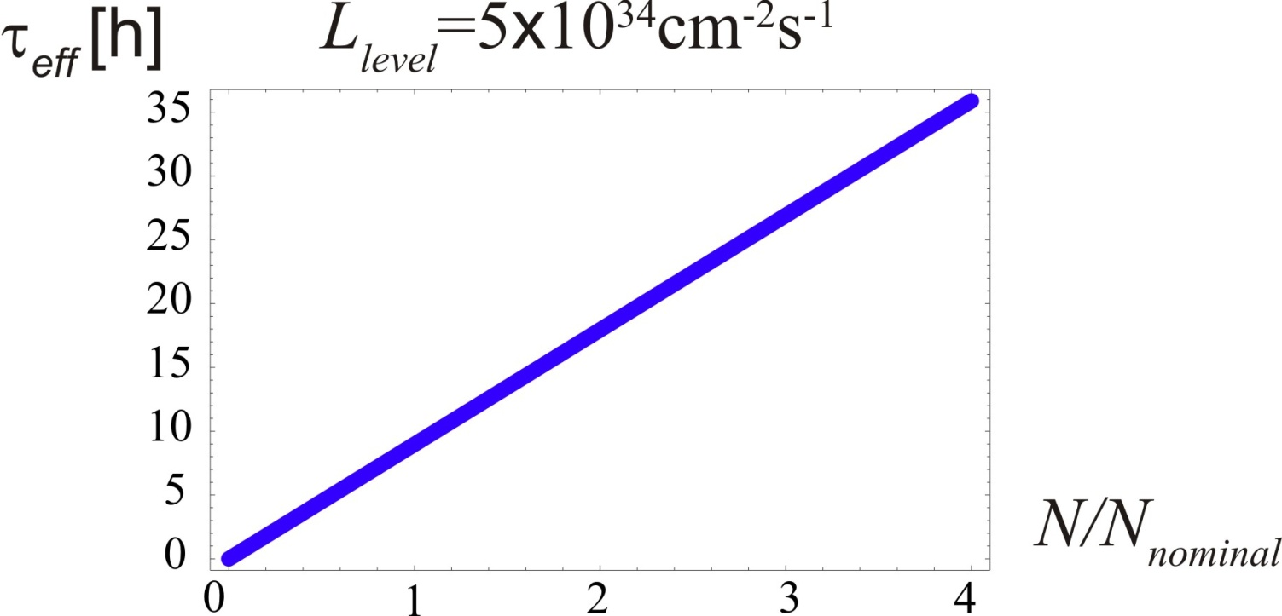
effective beam lifetime
for given luminosity
τ_{eff} scales with total beam current
(σ=100 mbarn)

Slide 6
luminosity formulae with leveling
F: geometric reduction
from crossing angle
and/or offset
f_{lev}: time-dependent
leveling factor, f_{lev} ≤ 1
define virtual “potential peak luminosity”

Slide 7
leveling schemes
vary beam offset Δx (successful in 2010)
vary Piwinski angle φ_{piw} ,that is σ_{z}, θ_{c}, or V_{crab}
for two IPs with alternating crossing
vary IP beta function β* e.g. at constant φ_{piw}
formulae above assume round beams

Slide 8
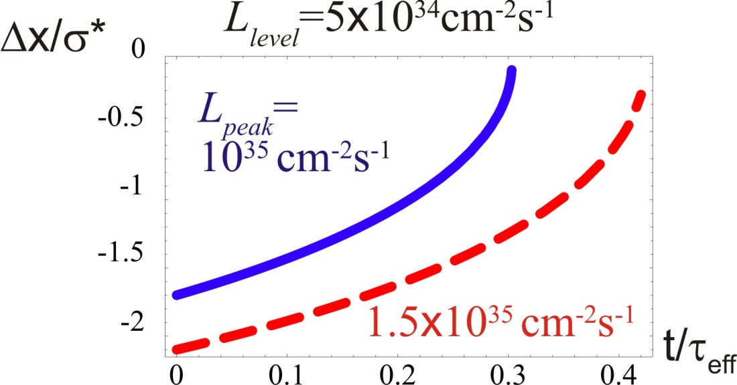
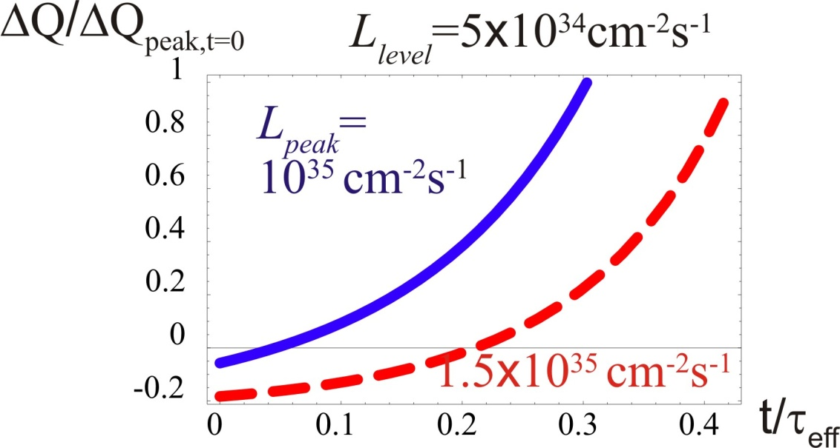
leveling with Δx
example: L_{peak}=1.0 (1.5) x10³⁵ cm⁻²s⁻¹
initially φ_{piw}=1.7 (2.1) mrad to get L_{lev}=5x10³⁴ cm⁻²s⁻¹
alternating offset Δx, Δy
maximum leveling time = 0.3 (0.42) τ_{eff}
tune shift changes sign during the store

Slide 9
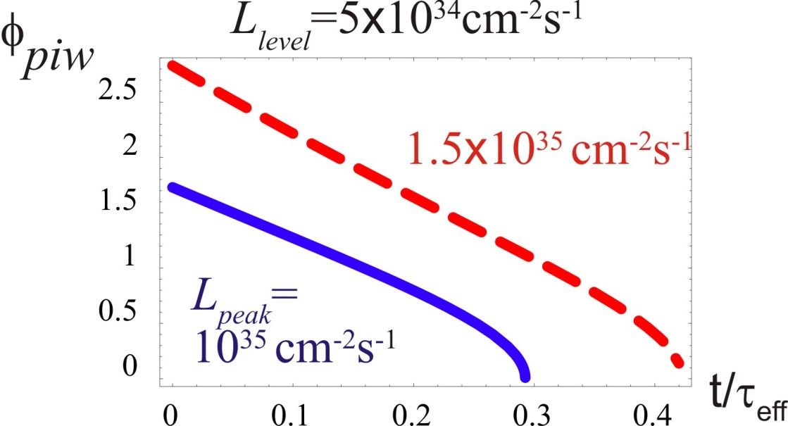
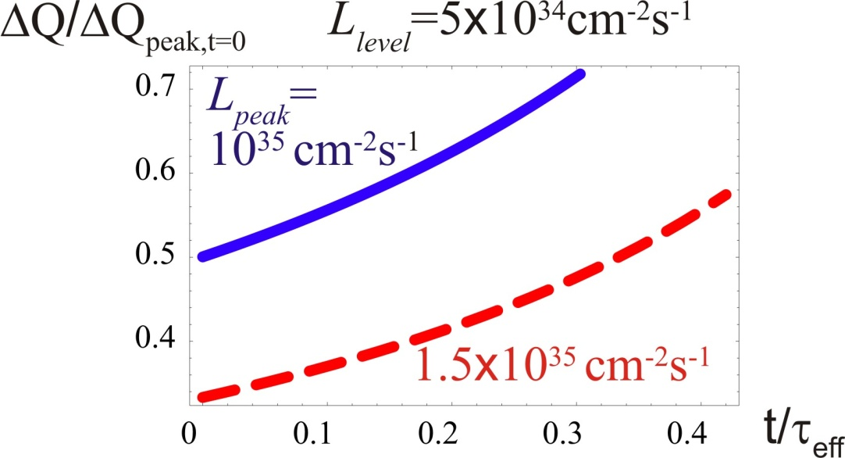
leveling with θ_{c} or V_{crab}
example: L_{peak}=1.0 (1.5) x10³⁵ cm⁻²s⁻¹
initially φ_{piw}=1.7 (2.8) σ to get L_{lev}=5x10³⁴ cm⁻²s⁻¹
maximum leveling time = 0.3 (0.42) τ_{eff}
tune shift increases during the store

Slide 10
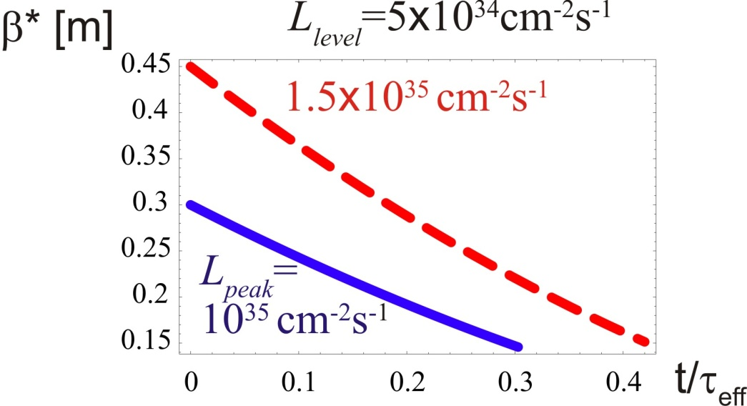
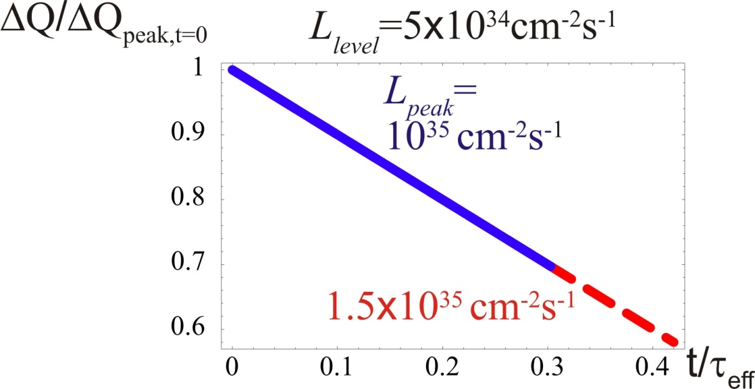
leveling with β∗
example: L_{peak}=1.0 (1.5) x10³⁵ cm⁻²s⁻¹ at β*=0.15 m
initially β∗=0.3 (0.45) m to get L_{lev}=5x10³⁴ cm⁻²s⁻¹
maximum leveling time = 0.3 (0.42) τ_{eff}
tune shift decreases during store
independent of
leveling scheme

Slide 11
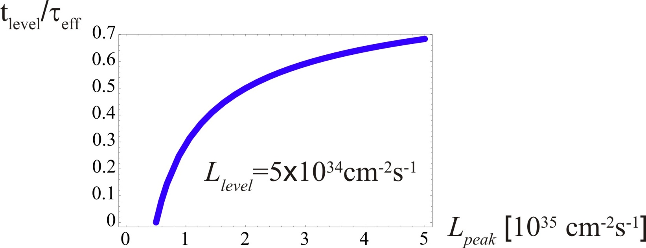
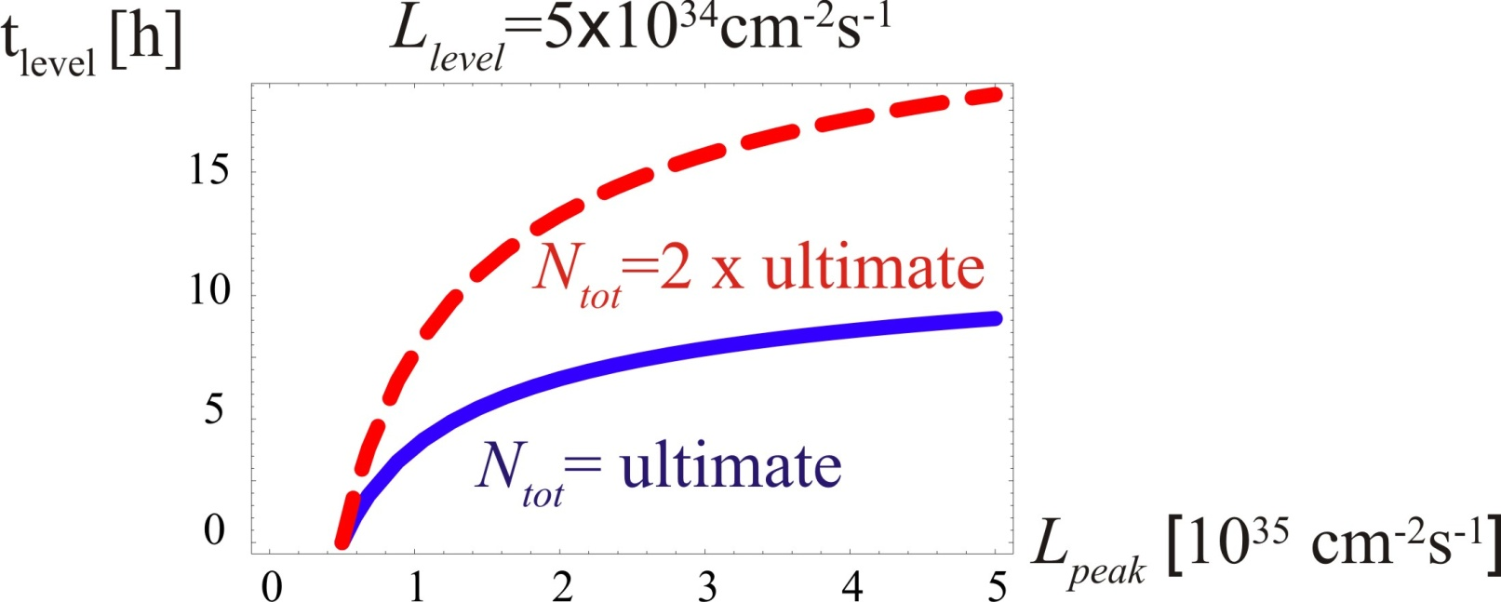
maximum leveling time
universal plot
absolute leveling
time scales linearly
with total beam intensity

Slide 12
estimating integrated luminosity
assumptions
two high-luminosity collision points
beam & L lifetime from p consumption
200 physics days of proton run per year
(w/o restart, w/o TS’s, w/o MD periods)
5 h turnaround time
75% machine availability
  [Nov. 2010: 80%, W. Venturini, Evian]

Slide 13
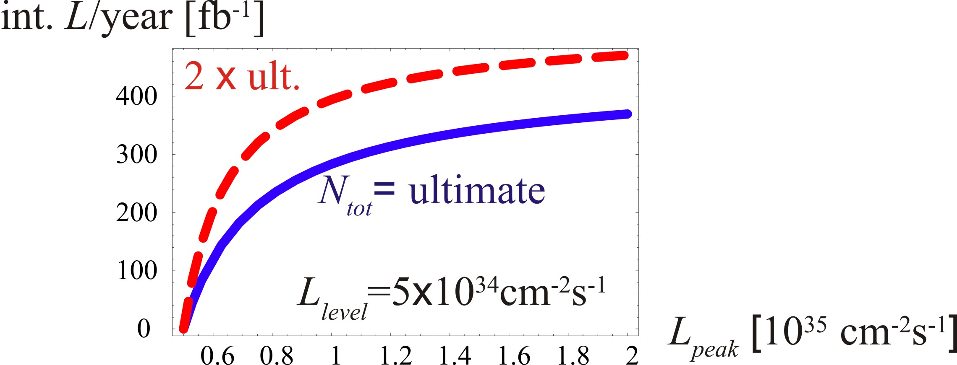
integrated luminosity w leveling
e.g. to get 300 fb⁻¹ per year:
at ultimate intensity we need L_{peak}=1.10x10³⁵ cm⁻²s⁻¹
At 2x ultimate intensity L_{peak}=0.71x10³⁵cm⁻²s⁻¹

Slide 14
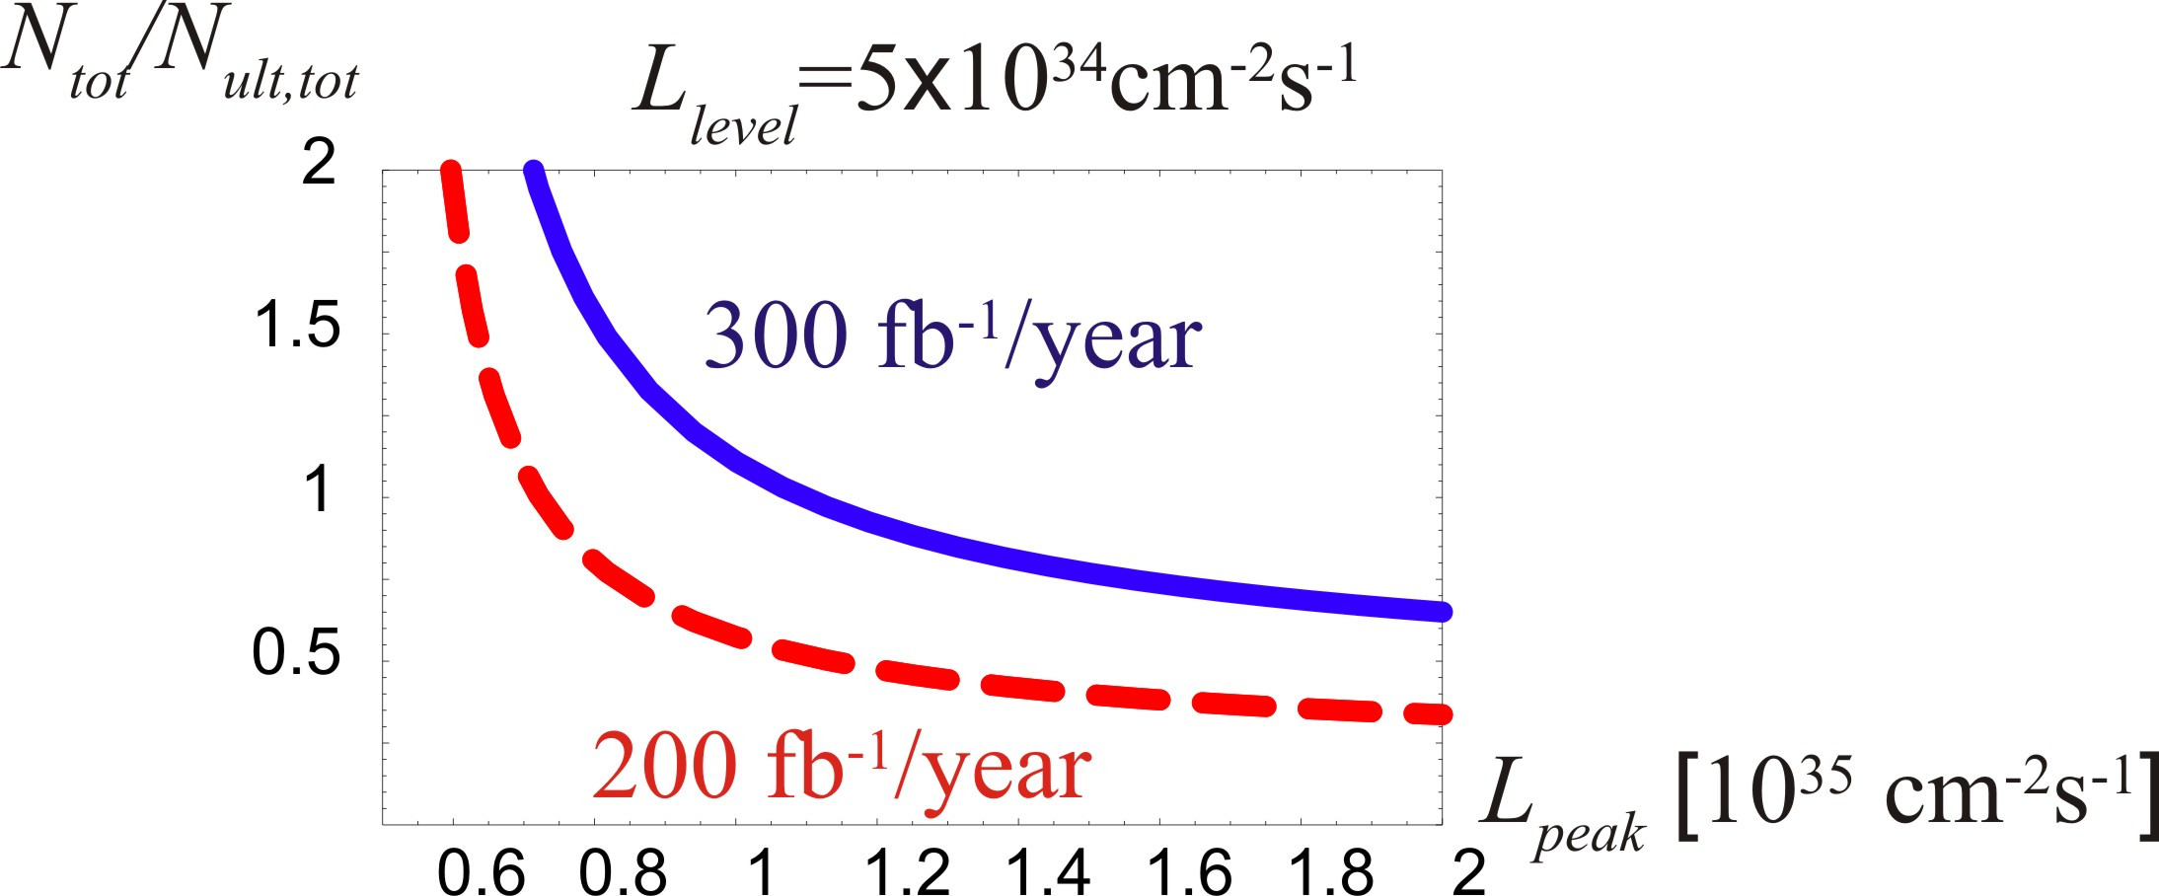
intensity vs “peak” luminosity
peak luminosity
scales with
(intensity)²

Slide 15
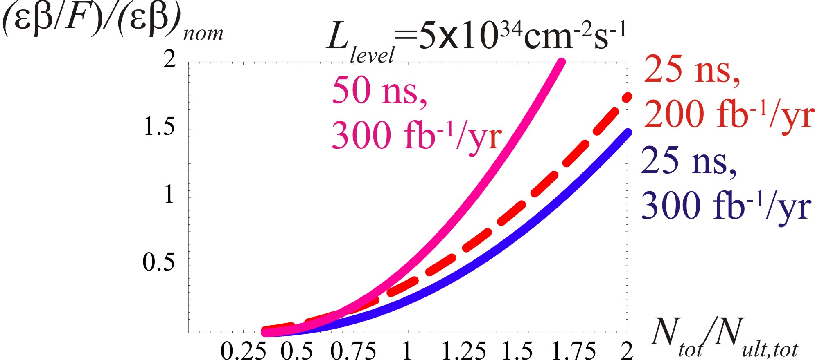
how much do we need to squeeze?
e.g. to get 300 fb⁻¹ per year:
at N_{b}=2x10¹¹ & 25 ns we need to reduce (βε)/F by x0.38
at N_{b}=3.4x10¹¹ & 50 ns we need to reduce (βε)/F by x0.48

Slide 16
approaches to boost LHC luminosity
low β* & crab cavities (80 MV)
low β* & higher harmonic RF (7.5 MV @800 MHz) + LR compensation
large Piwinski angle (& “flat” bunch shape) + LR-BB compensation
always pushing intensity to “limit”
θ_{c}
θ_{c}
θ_{c}

Slide 17
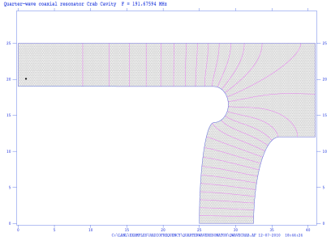
Crab Cavities
benefits
improving geometric overlap (main motivation)
boosting beam-beam limit (potential additional benefit) [next slides]
luminosity leveling (main motivation)
avoiding off-center collisions from beam loading (additional benefit)
concerns:
emittance growth from RF noise, impedance, field nonlinearity
machine protection, trip rate, technical challenges, time line
status & plan:
SPS/LHC prototype beam tests from ~2015, before final decision
4-5 promising compact cavity designs
Parallel bar elliptical TEM cavity (JLAB)
Half wave spoke resonator (SLAC)
Four rod compact crab cavity (Cockcroft)
Rotated pill-box cavity (KEK)
Quarter-wave resonator (BNL)

Slide 18
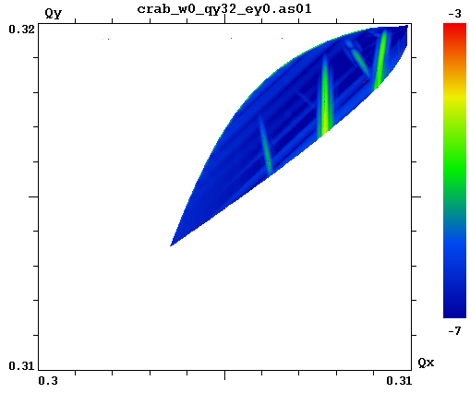
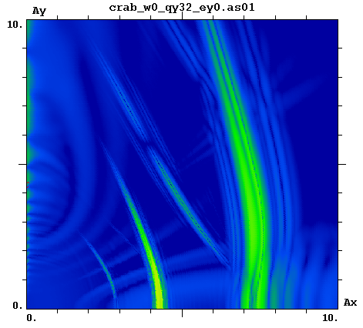
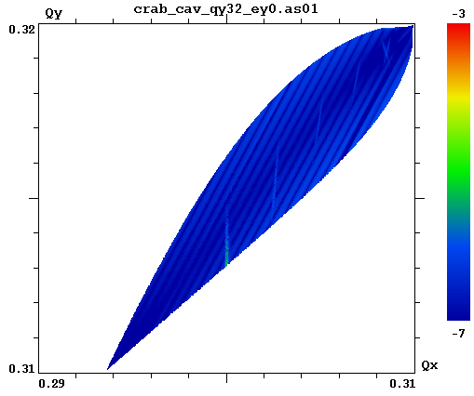
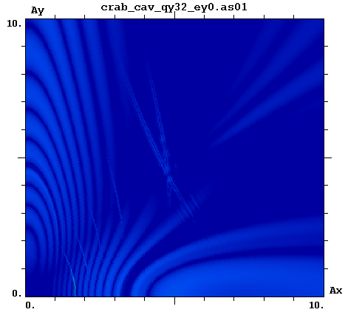
beam-beam simulation w crab cavities
M. Zobov, D. Shatilov
collisions with
crossing angle
frequency
map analysis
of Lifetrac simulation
resonances
resonance suppression by LHC crab cavities
parameters:
ε_{x,y} =0.5 nm
E = 7 TeV
β_{x} = 30 cm,
β_{y} = 7.5 cm,
σ_{z} = 11.8 cm,
θ_{c}= 315 μrad
(φ =1.5),
N_{b} = 4.0x10¹¹,
Q_{s} =0.002,
ΔQ_{x,y} ~ -0.0065,
single IP
crab crossing
resonance
free!

Slide 19
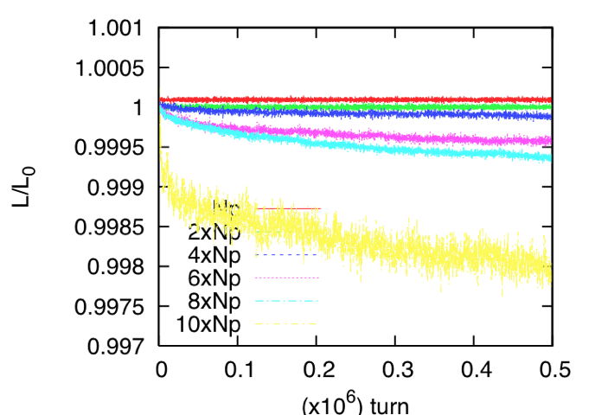
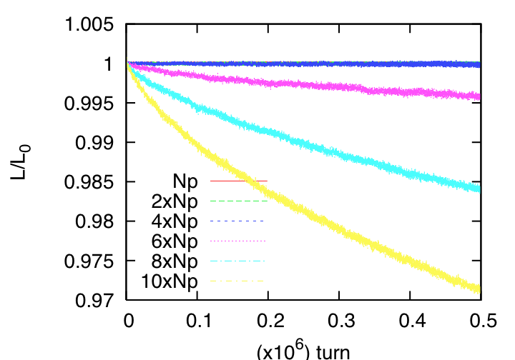
another beam-beam simulation w CC’s
collisions with 280 μrad
crossing angle
crab crossing
K. Ohmi
2 IPs
crab cavities increase LHC beam lifetime 10x !
2 IPs
simulated luminosity lifetime with crab crossing is 10 times better than without crab crossing

Slide 20
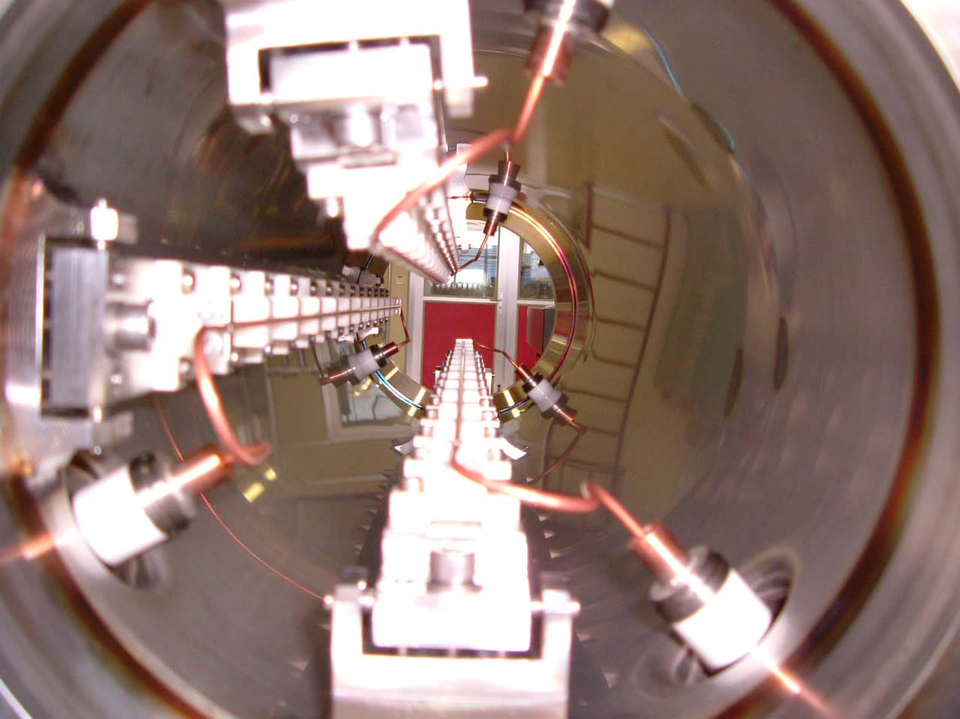
Long-Range Compensation
2x2 water-cooled
units
presently
installed
in the SPS
(two with remote
control)
1x2 spare units
ready
1st RHIC
BBLR stored
at CERN
2nd RHIC
BBLR
being shipped
in total 5
sets available
J.-P. Koutchouk, G. Burtin, et al

Slide 21
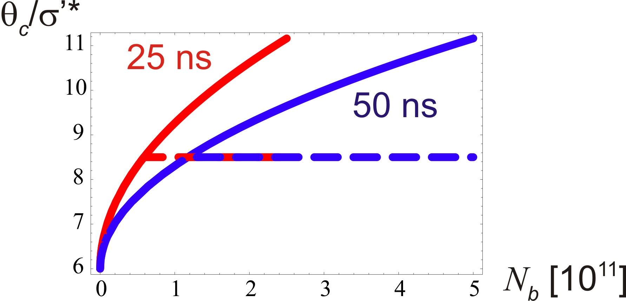
normalized crossing angle versus bunch intensity
with LR compensation
long range compensation will reduce the crossing angle

Slide 22
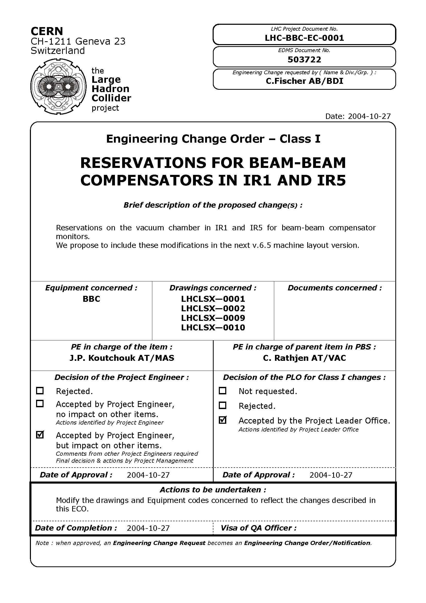
for future wire
LR beam-beam
compensators,
3-m long sections
have been reserved
in LHC at 104.93 m
(center position)
on either side of
IP1 & IP5

Slide 23
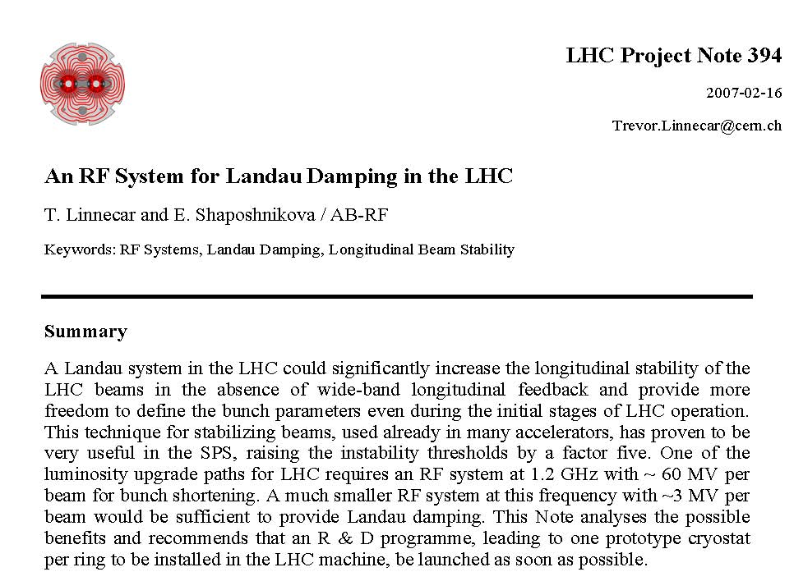
Higher-Harmonic RF Cavity
800-MHz system;
stability gain > factor 3;
e.g. lower longitudinal emittance (no blow up in LHC), short bunches,
higher intensity
“octupoles for the longitudinal plane”

Slide 24
intensity & emittance from injectors
talk by O. Bruning
 | spacing [ns] | bunch intensity [10¹¹] | transv. rms norm. emittance [μm]
nominal | 25 | 1.15 | 3.75
available “now” | 25 | 1.20 | 3.75
available “now” | 50 | 1.70 | 3.75
available “now” | 50 | 1.70 | 2.50
w LINAC4 | 25 | 1.40 | 3.75
w LINAC4 | 50 | 2.50 | 3.75
w LINAC4+LIU | 25 | 2.00 | 2.50
w LINAC4+LIU | 50 | 3.30 | 3.75
HL-LHC class
could we get 20% more?

Slide 25
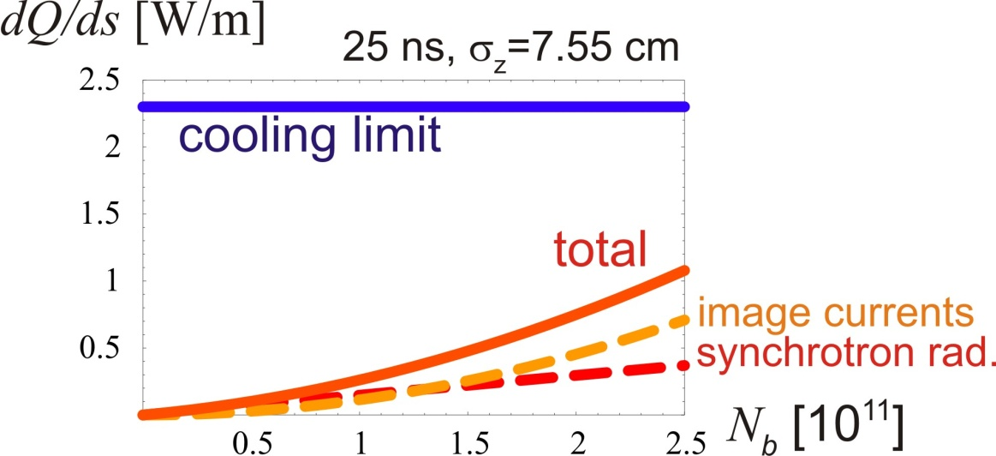
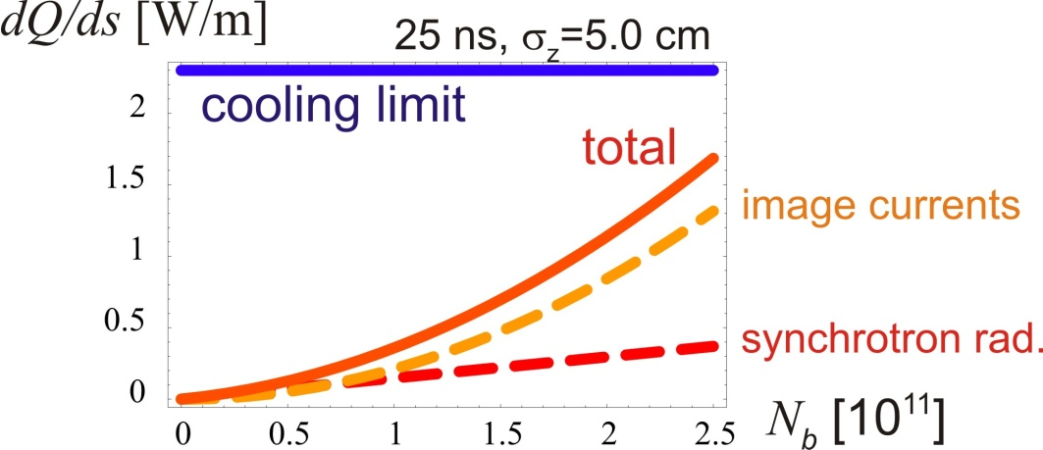
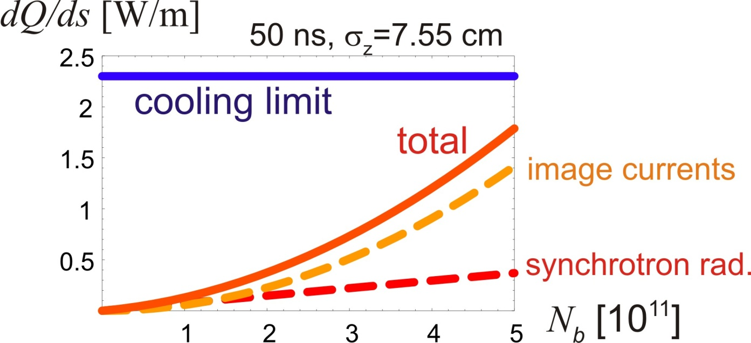
intensity limit: heat load due to image currents & synchrotron radiation
2.5x10¹¹at 25 ns
and 5x10¹¹ at 50 ns
still look OK
also note:
nuclear beam-gas scattering with τ~100 h (32 ntorr RT hydrogen) contributes an equivalent 0.15 W/m at nominal current [e.g. HHH-2004]

Slide 26
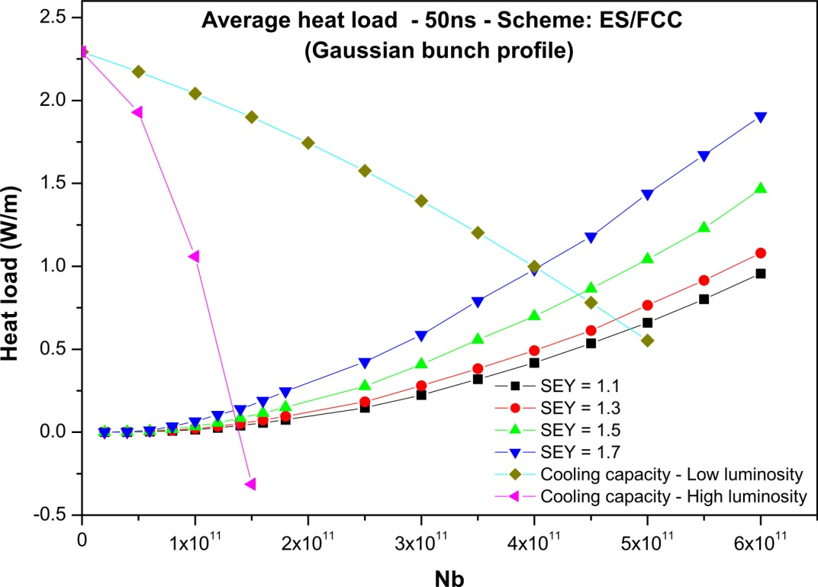
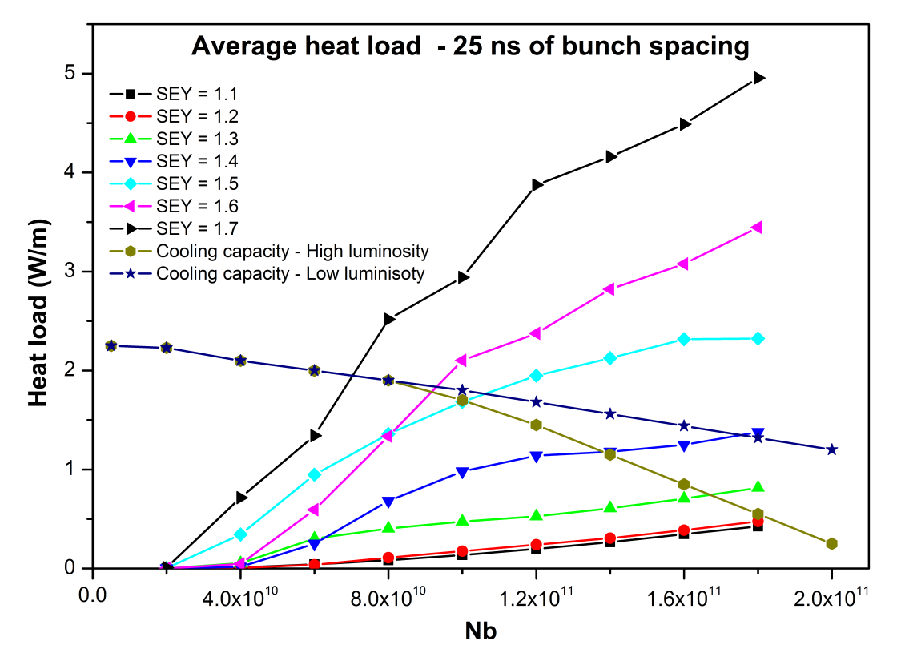
electron-cloud heat load
25-ns bunch spacing
50-ns bunch spacing
H. Maury
electron cloud contribution acceptable if δ_{max}≤1.2

Slide 27
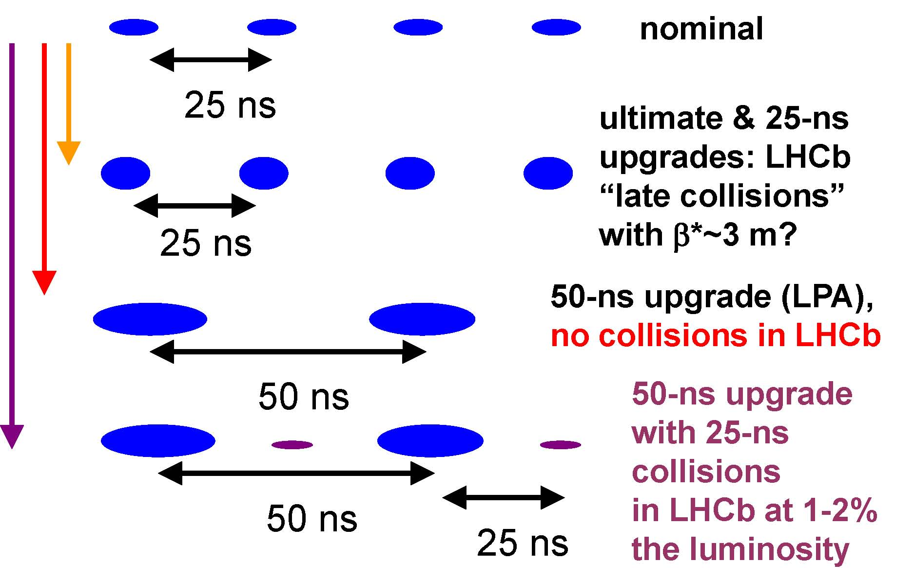
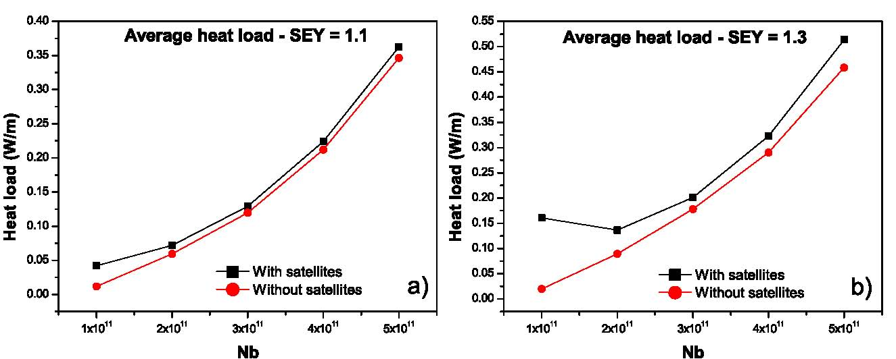
e-cloud heat load also OK for 50 ns spacing plus “LHCb satellites”
H. Maury

Slide 28
example HL-LHC parameters, β*=15 cm
parameter | symbol | nom. | nom.* | HL crab | HL sb + lrc | HL 50+lrc
protons per bunch | N_{b} [10¹¹] | 1.15 | 1.7 | 1.78 | 2.16 | 3.77
bunch spacing | Δt [ns] | 25 | 50 | 25 | 25 | 50
beam current | I [A] | 0.58 | 0.43 | 0.91 | 1.09 | 0.95
longitudinal profile |  | Gauss | Gauss | Gauss | Gauss | Gauss
rms bunch length | σ_{z} [cm] | 7.55 | 7.55 | 7.55 | 5.0 | 7.55
beta* at IP1&5 | β∗ [m] | 0.55 | 0.55 | 0.15 | 0.15 | 0.15
full crossing angle | θ_{c} [μrad] | 285 | 285 | (508-622) | 508 | 508
Piwinski parameter | φ=θ_{c}σ_{z}/(2*σ_{x}*) | 0.65 | 0.65 | 0.0 | 1.42 | 2.14
tune shift | ΔQ_{tot} | 0.009 | 0.0136 | 0.011 | 0.008 | 0.010
potential pk luminosity | L [10³⁴ cm⁻²s⁻¹] | 1 | 1.1 | 10.6 | 9.0 | 10.1
events per #ing |  | 19 | 40 | 95 | 95 | 189
effective lifetime | τ_{eff} [h] | 44.9 | 30 | 13.9 | 16.8 | 14.7
run or level time | t_{run,level} [h] | 15.2 | 12.2 | 4.35 | 4.29 | 4.34
e-c heat SEY=1.2 | P [W/m] | 0.2 | 0.1 | 0.4 | 0.6 | 0.3
SR+IC heat 4.6-20 K | P_{SR+IC} [W/m] | 0.32 | 0.30 | 0.62 | 1.30 | 1.08
IBS ε rise time (z, x) | τ_{IBS,z/x} [h] | 59, 102 | 40, 69 | 38, 66 | 8, 33 | 18, 31
annual luminosity | L_{int}[fb⁻¹] | 57 | 58 | 300 | 300 | 300

Slide 29
example HL-LHC parameters, β*=30 cm
parameter | symbol | nom. | nom.* | HL crab | HL sb + lrc | HL 50+lrc
protons per bunch | N_{b} [10¹¹] | 1.15 | 1.7 | 2.28 | 2.47 | 4.06
bunch spacing | Δt [ns] | 25 | 50 | 25 | 25 | 50
beam current | I [A] | 0.58 | 0.43 | 1.15 | 1.25 | 1.03
longitudinal profile |  | Gauss | Gauss | Gauss | Gauss | Gauss
rms bunch length | σ_{z} [cm] | 7.55 | 7.55 | 7.55 | 5.0 | 7.55
beta* at IP1&5 | β∗ [m] | 0.55 | 0.55 | 0.30 | 0.30 | 0.30
full crossing angle | θ_{c} [μrad] | 285 | 285 | (359-462) | 359 | 359
Piwinski parameter | φ=θ_{c}σ_{z}/(2*σ_{x}*) | 0.65 | 0.65 | 0.0 | 0.71 | 1.07
tune shift | ΔQ_{tot} | 0.009 | 0.0136 | 0.0145 | 0.0128 | 0.0176
potential pk luminosity | L [10³⁴ cm⁻²s⁻¹] | 1 | 1.1 | 8.69 | 8.32 | 9.41
events per #ing |  | 19 | 40 | 95 | 95 | 189
effective lifetime | τ_{eff} [h] | 44.9 | 30 | 17.8 | 19.3 | 15.8
run or level time | t_{run,level} [h] | 15.2 | 12.2 | 4.29 | 4.33 | 4.29
e-c heat SEY=1.2 | P [W/m] | 0.2 | 0.1 | 0.6 | 0.7 | 0.3
SR+IC heat 4.6-20 K | P_{SR+IC} [W/m] | 0.32 | 0.30 | 0.93 | 1.65 | 1.23
IBS ε rise time (z, x) | τ_{IBS,z/x} [h] | 59, 102 | 40, 69 | 30, 52 | 7, 29 | 17, 29
annual luminosity | L_{int}[fb⁻¹] | 57 | 58 | 300 | 300 | 300

Slide 30
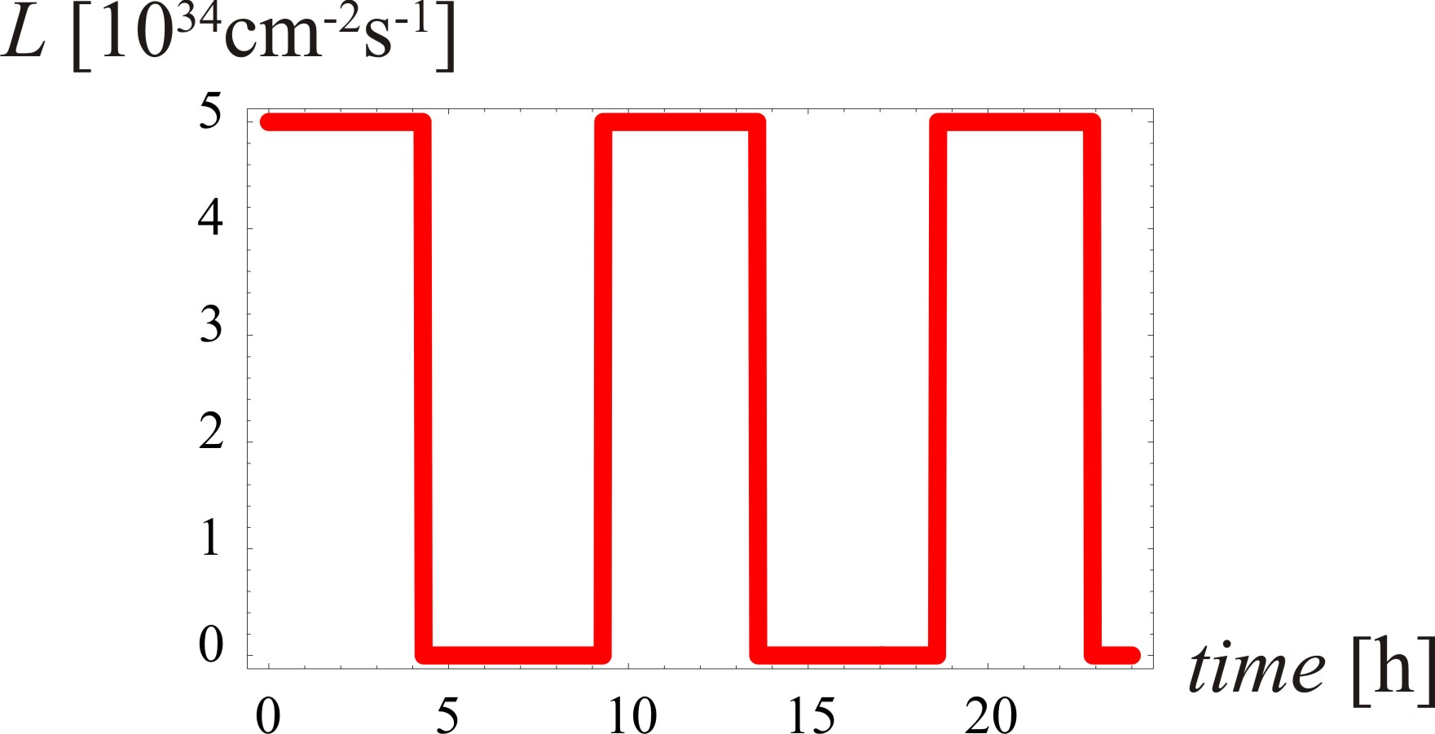
typical day at the HL-LHC…
similar for all scenarios

Slide 31
preliminary conclusions - 1
HL-LHC parameter space well defined
to achieve 300 fb⁻¹ per year:
about 1 A beam current (+/- 10%)
potential peak luminosity 10³⁵ cm⁻²s⁻¹
run time 4.3 h ~ assumed turnaround time of 5 h
β* between 15 and ~30 cm
high(er) beam intensity helps in every regard
both 50-ns and 25-ns scenarios
200 fb⁻¹ per year would relax intensity demand

Slide 32
preliminary conclusions - 2
beam-beam limit (at 0.02) no longer a constraint
three alternative scenarios for 300 fb⁻¹ / year:
crab cavities
higher harmonic RF (shorter bunches) + LR compensation
50 ns bunch spacing, large Piwinski angle,
  + LR compensation
decreasing β* from 30 to 15 cm is equivalent to 10-20% beam current increase (scenario -dependent)
effect of smaller ε similar to (better) than smaller β*

Slide 33
proposed roadmap & branching points
LHC MDs for HL-LHC – starting in 2011
- ATS optics ingredients
(beta wave, phase changes)
- LR beam-beam limits
- effect of crossing angle on HO b-b limit
- electron cloud limits
- “flat beam” optics [S. Fartoukh, LHCMAC19, e.g. r~2, Δn₁~1
- effect of crossing plane (H-V, V-V, H-H)
install LR-BB compensators in LHC (2013)
develop & prototype compact crab cavity (2011-16) for beam test in (SPS+) LHC (2017)
develop&install LHC 800-MHz system (2016?)
several MDs may be done
regardless of HL-LHC and
also benefit nominal
LHC performance

Slide 34
thank you for your attention!

Slide 35
useful leveling formulae
 | w/o leveling | L=const | ΔQ_{bb}=const
luminosity evolution
beam current evolution
optimum run time
average luminosity
ΔQ_{bb}=const→ exponential L decay, w decay time τ_{eff} (≠ τ_{eff}/2)

