Slide 1
Establish flow - Exercise
I. Bejar Alonso, B. Almeida Ferreira
2021-06-08

Slide 2
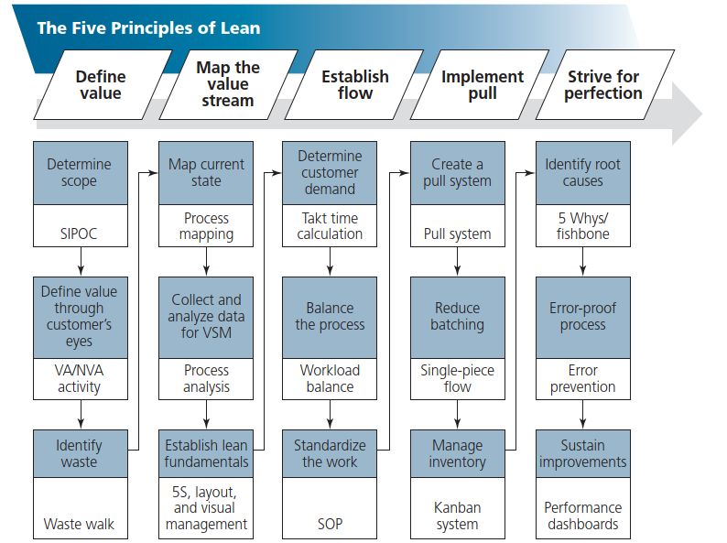
Let’s continue

Slide 3
What we have in our hands now
Selected the process or subprocess to be process-mapped
Defined the process
  Inputs to the process, including suppliers
  Outputs from the process
  Users/customers to whom outputs are directed
  Requirements of users/customers
  Constraints (such as standards, regulations, and policies)
Map out the principal flow (the main flow without exceptions)
Add the decision points and alternative paths
Add the check/inspection points and alternative paths
FILL IN THE COMPUTER TOGETHER THE QUESTIONS

Slide 4
[[Customer] [demand]] identification
Classify your customers. Identify what makes them different. Is the type of service that they require? Is when they arrive? Is the information that they provide? Is just the type of contract?
Do you have a clear statement of what should be accomplished in each step?
Do you identify non stated demands that should be done by another service?

Slide 5
[[Customer] [demand]] identification
How much time takes each one of the actions to provide a service. Do you have statistics? Do you analyze them?
How do you monitor the flux of customers? Can be anticipated, controlled, modulated, adapted?

Slide 6
Balance the process
Is the personnel adapted to the flow (number of people)? Shall change in function of the day?
Is the space adapted to the flow? Can be improved? Shall change in function of the day?
Is the tooling that blocks the flow?

Slide 7
Standardize the process
Is every task defined? It is on written? (Standard Operational Procedures – SOP)
Has the team validated them?
Are validated/crosschecked with other teams that interact with them?

Slide 8
Standardize the process
Are reviewed systematically and timely?
Are available in a language that is understood by all members of the team?
Do you have templates or forms?

Slide 9
Next steps
Analyse the process flow to identify
  Non-value-added steps
  Redundancies
  Bottlenecks
  Inefficiencies
  Deficiencies
Prioritize problems:
  Quantify the results of each problem
  Identify the impact each problem has on the overall process
  Subject the problems to Pareto analysis and identify the most important problem
Redo the map to remove a primary problem
THINK BUT DO NOT DO IT YET

Slide 11
Use the tools
Remember Making a bad process quicker just produces waste more quickly
Sort | involves quickly assessing whether a particular information item is needed and disposing of it as soon as that is clear
Set in order | is a key element and requires assessing the needed information items and determining what type of action (if any) is required
Shine | minimizing your mess—for example, unsubscribing from mailing lists. It also can refer to minimizing the mess for others by limiting the distribution of emails and meeting invitations.
Standardize | The organization benefits from a standard approach to information management, but creative workers need the flexibility to adopt the standard approach using tools that work for them.
Sustain | requires a maintenance and audit process to ensure that the organizational process continues to function and does not start to accumulate waste material.

Slide 12
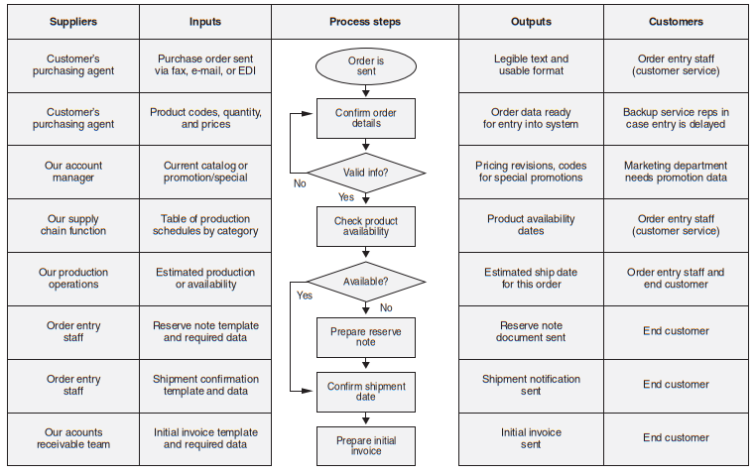
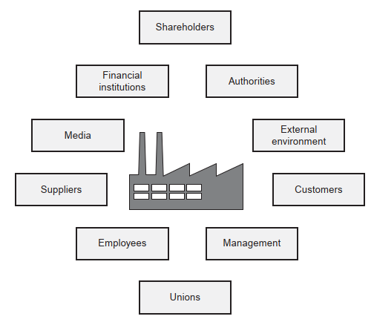
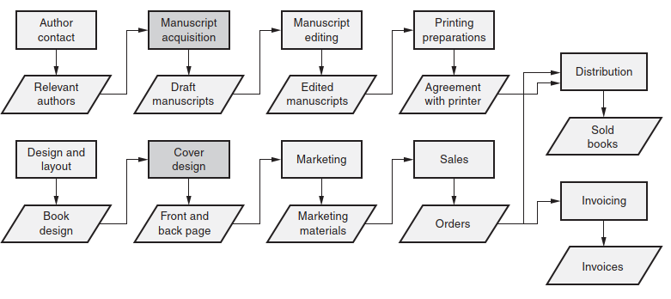
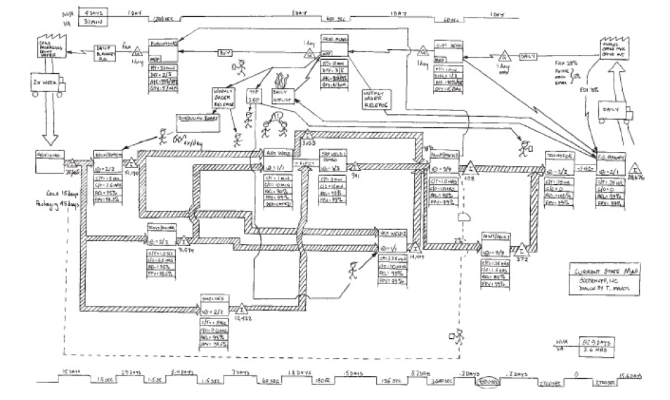
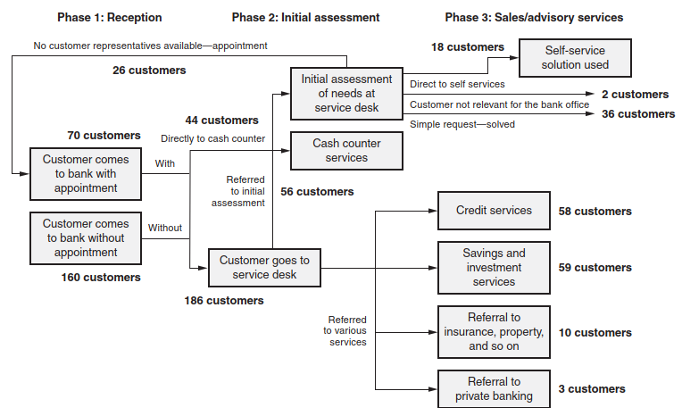
How it looks like
Stakeholder maps
High level process
How they connect + in and out
Bottlenecks
Probably not yet the global view of all together

Slide 13
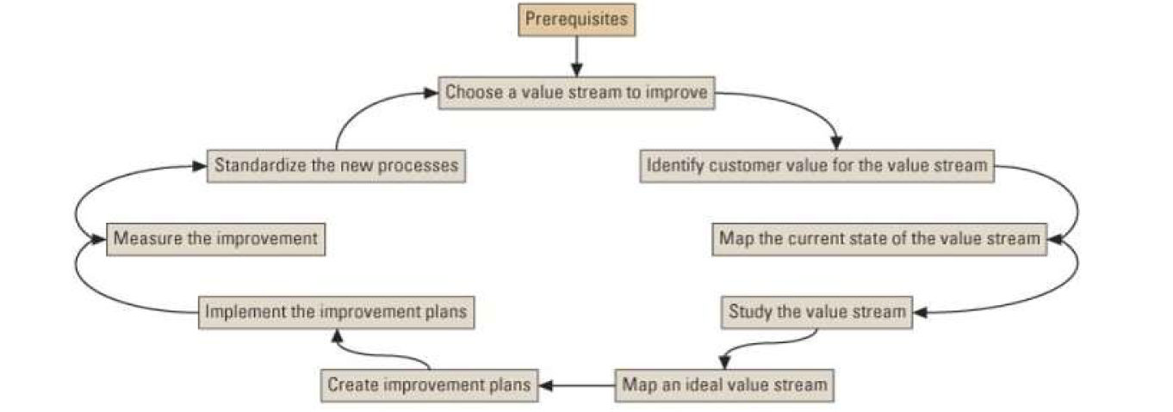
Are you ready?
Next week we will have to identify the flow. Which are the steps? Which is the added value in each one of them? Bottlenecks? Can be solved?

