Slide 1
Strive for perfection - Exercise
I. Bejar Alonso, B. Almeida Ferreira
2021-06-08

Slide 2
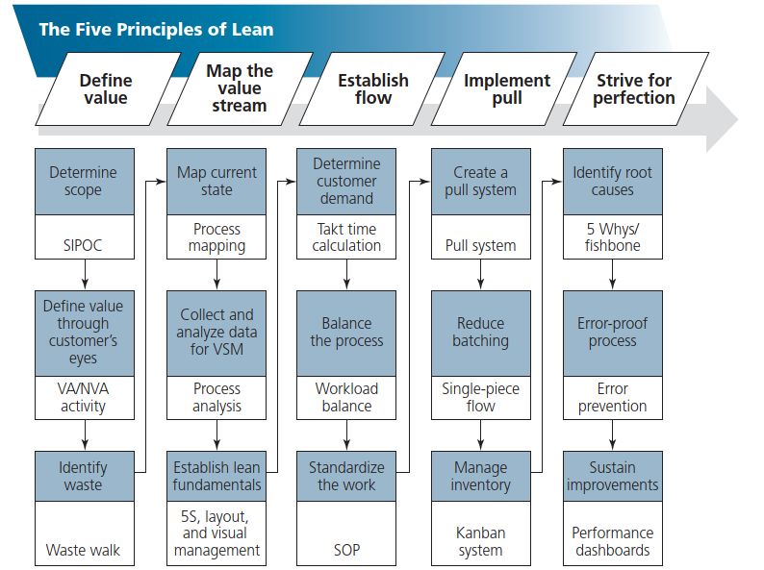
Let’s continue

Slide 3
Next steps
Analyse the process flow to identify
  Non-value-added steps
  Redundancies
  Bottlenecks
  Inefficiencies
  Deficiencies
Prioritize problems:
  Quantify the results of each problem
  Identify the impact each problem has on the overall process
  Subject the problems to Pareto analysis and identify the most important problem
Redo the map to remove a primary problem
Do a desktop “walk-through” with persons who are involved with the process
Modify the process map as needed (and modifications will be needed!)

Slide 4
Use the tools
Go step by step and ask if any is applicable.
Sort | involves quickly assessing whether a particular information item is needed and disposing of it as soon as that is clear
Set in order | is a key element and requires assessing the needed information items and determining what type of action (if any) is required
Shine | minimizing your mess—for example, unsubscribing from mailing lists. It also can refer to minimizing the mess for others by limiting the distribution of emails and meeting invitations.
Standardize | The organization benefits from a standard approach to information management, but creative workers need the flexibility to adopt the standard approach using tools that work for them.
Sustain | requires a maintenance and audit process to ensure that the organizational process continues to function and does not start to accumulate waste material.

Slide 5
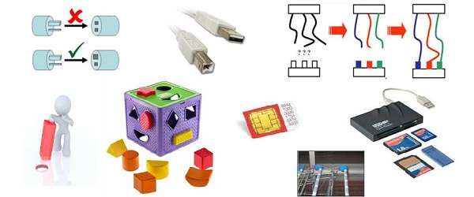
Error proof processes
Go step by step and ask if any is applicable.

Slide 6
If you have a problematic process ….
Let's start with What, Where, When and Who
What “it” is—what are we trying to explain?
Where was “it” observed?
When did “it” occur?
Who was present
Then Why and How and add the woman called What else
Is the cause of the problem truly known or merely suspect?
Is “it” a real or assumed problem?
How did “it” become a problem?
Has “it” been a problem before, how long ago, and what was done at the time?
Is “it” a technical or nontechnical problem?
How widely spread is the problem?
What is unsatisfactory about the present situation?
What are the observed symptoms? How often do these symptoms occur?
What could have occurred, but didn’t?
Who or what is impacted/affected by the present situation?
How serious is the problem according to those affected?
What previous actions have already been taken to solve this occurrence of “it”?

Slide 8
Step 2 - Collect all objective data you have
I keep six honest serving men
(They taught me all I know);
Their names are What and Why and When
And How and Where and Who.
If in the doubt still you are
call my friend “What else”

Slide 9
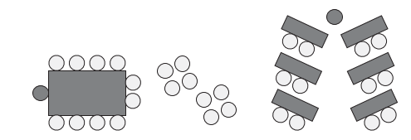
Step 3 – Prepare the Brainstorm session
There must be a moderator/facilitator
There must be a room
  Big
  With coffee (and cookies)
  With a lot of post-its, flipcharts, tape, markers, …
  With a place where to display the information
  Chairs distributed to avoid monologs and to encourage coworking
There must be a timekeeper
When possible, the “NC objects must be accessible”
Participants shall confirm their attendance

Slide 10
Step 4 – Brainstorming rules
We are brainstorming because it’s important to
go beyond the obvious
ensure that all details are discussed
Rules
No criticism is allowed—all ideas are good ideas.
Each person has equal opportunity to express ideas.
Quantity is more important than quality.
Encourage piggybacking of ideas.
AGAIN: Do not limit thinking by stating what has always been done. Be creative. When brainstorming, don’t be afraid to write down the most outrageous or silly idea. This prevents the team from shutting down and keeps the channels open to all possibilities.
If you think that the group will not speak or is not speaking
use Brain Writing (your friend the post-it)

Slide 11
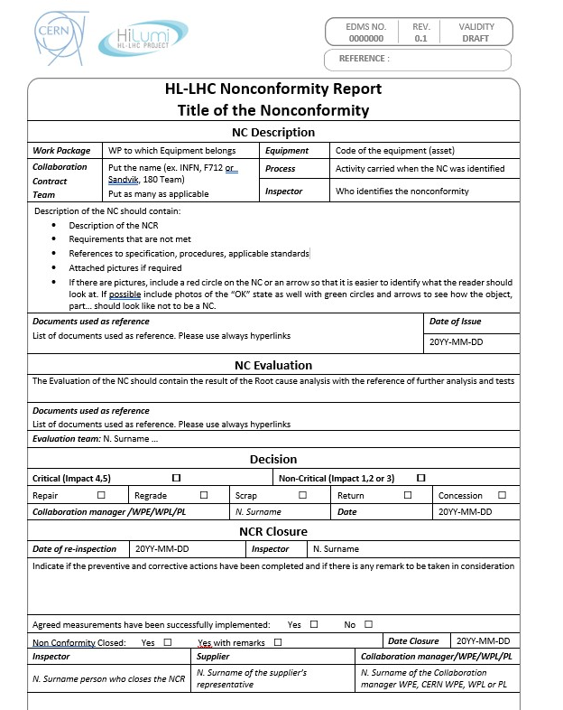
Step 6 – Wrap the objectively data in the form

Slide 12
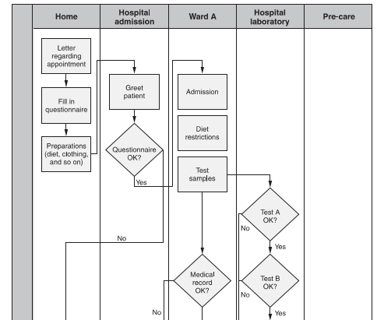
Step 7 – Is the process clear?
Use the process flowchart (if exists) to put your data before starting the root cause analysis
If not create together a cross functional flowchart of the part of the process affected by the NC

Slide 13
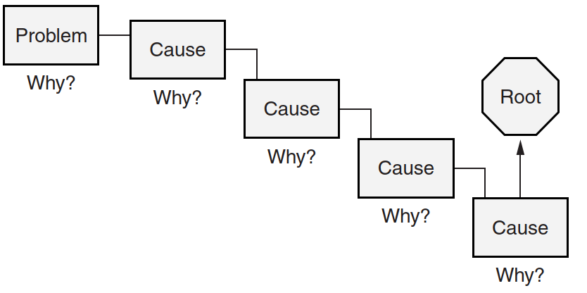
Step 8 A – 5 Whys
Use the 5 Whys. Team people by categories or all together. Start with “Why do we have this problem?”
Remember no guilty!

Slide 14
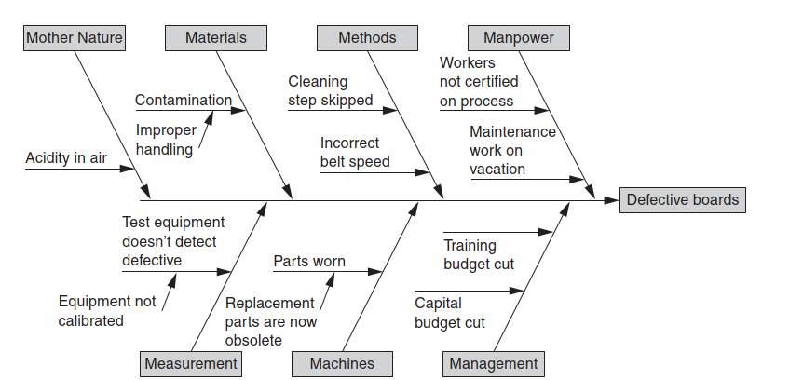
Step 8 B – Map/classify the causes
Use the Fishbone. You can team people by categories or all together

Slide 15
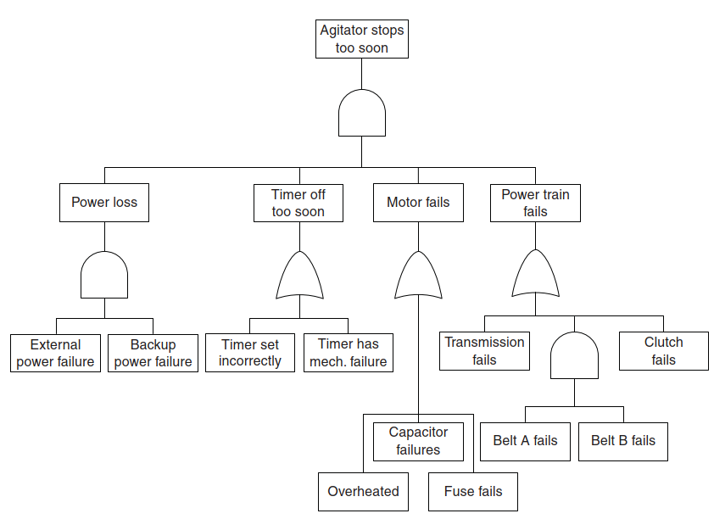
Step 8 C – Fault trees
Use Fault trees. When you try to understand the root cause from a more technical point of view … but not only

Slide 16
Step 9 – Wrap the root cause in the form

