Slide 1
Theory overview:
Changing (Exciting?) Times
Lisa Randall
Aspen Winter Conference, 2011

Slide 2
Promise
Large Hadron Collider
  Explore weak energy scale
  Nothing replaces studying as high energy as possible!
Dark Matter Experiments
  On Ground and in Space
  Direct and Indirect
CMB , Dark Energy, Black Holes
Gravity Waves

Slide 3
Where Are We Now?
LHC working as well as can be hoped
  Repeatedly achieving new milestones
  Experiments working in an unprecedented manner at turn-on
Dark matter searches constantly improving
  Searches from different directions
  Synthesizing information from new regimes

Slide 4
Progress in Last Year
Dark Matter Searches and Models
Light Dark Matter
New Ideas for Dark Matter Candidates
  Motivated by anomalies
  Motivated by theoretical insights

Slide 5
Progress in the last year
Experiment: stuff ruled out—some light Higgs models
  Light susy, light black holes
New recognition of early LHC BSM capacity
  Wide resonances **
  Long-lived hadrons
Jet physics
  General cleaning up of events
    Precision with jet physics
  Higgs-> bbbar
  ISR tagging **
    Kinematic handle

Slide 6
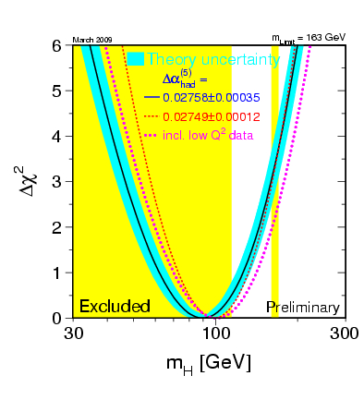
Higgs Should be Within Reach
Particle Physics Goals for the Coming Decade
Challenge to establish its properties
Measure as much as possible
Can we tell it’s a Higgs?
Can we decide if it’s part of a more complicated Higgs sector?

Slide 7
More progress
Dark Matter
  New classes of models **
  New “coincidences”
    ρB~ρDM
  Lots of new models
    Some new signatures
    Some new challenges

Slide 8
Past Year’s Progress
I: Wide Resonances
With Brian Shuve, Randall Kelly
Resonances will be first and simplest place to look
Particularly Drell-Yan processes with decays to muons
  Background well understood
  Low background at high invariant mass
Useful for models
  Z’
  RS
  Understanding detector and experiment reach

Slide 9
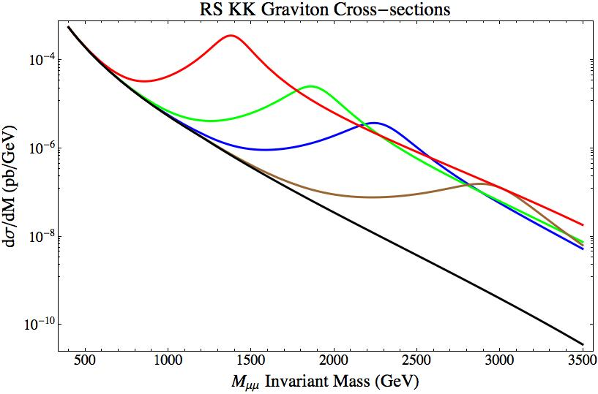

RS X-sections (varying mass)
M_{G} = 1.4 TeV
M_{G} = 1.9 TeV
M_{G} = 2.3 TeV
M_{G} = 3.0 TeV
SM
k/M_{Pl} = 0.35

Slide 10
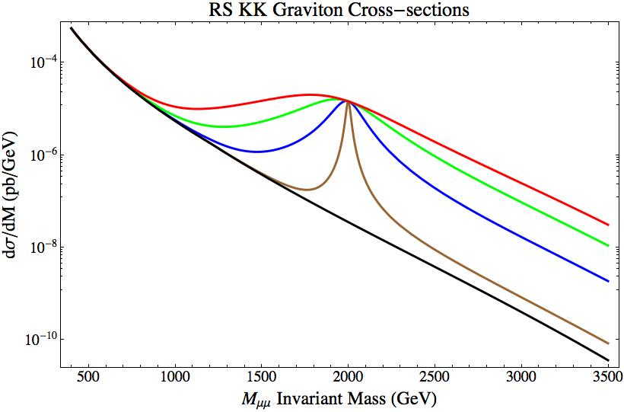
RS X-sections (varying k/M_{Pl})
k/M_{Pl} = 0.55
k/M_{Pl} = 0.4
k/M_{Pl} = 0.25
k/M_{Pl} = 0.1
SM
M_{G} = 2 TeV

Slide 11



On vs Off Resonance
On peak:
Off peak-need to integrate against parton distribution
Estimate using narrow width.
Favors wide states, large k/M, Resonance mass through luminosity

Slide 12
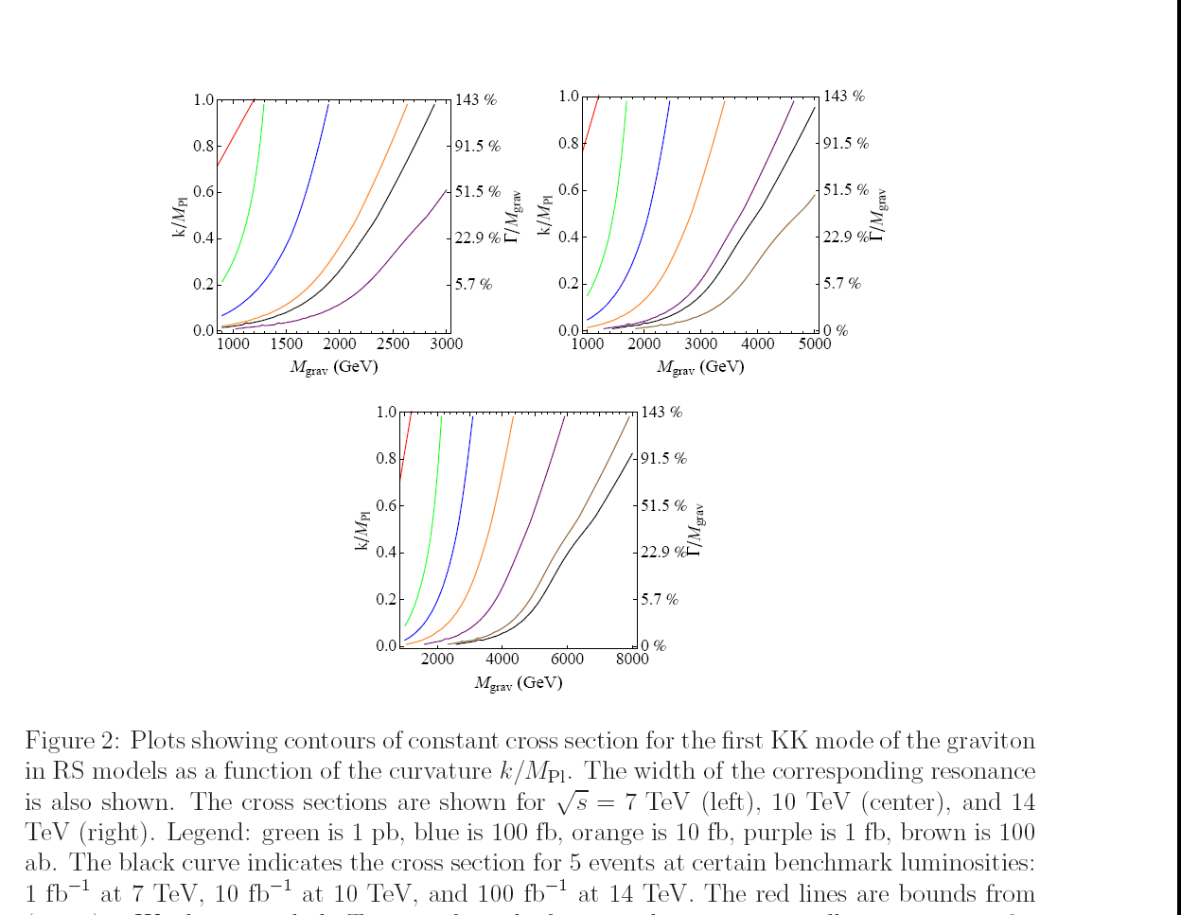
Wide Resonances

Slide 13
Understand reach of various LHC parameters
When does LHC beat Tevatron, even in early run
  High mass
  Resonances from glue-glue initial state
  Wide resonances
Focus on wide resonances
  Especially important since large coupling needed for sufficient event rate at low luminosity
When can we see resonances?
When can we distinguish them from contact interactions?
Can we learn about nature of interaction that produced resonance?

Slide 14
Focus
Shape of distribution
For much of parameter space can distinguish broad resonance from featureless falling distribution (SM or SM +contact)
Simple: look for “upturn” or absolute rise in rate
More sophisticated statistical analysis
  Use both excess events in some bins and absence in others
Binned maximum likelihood analysis

Slide 15
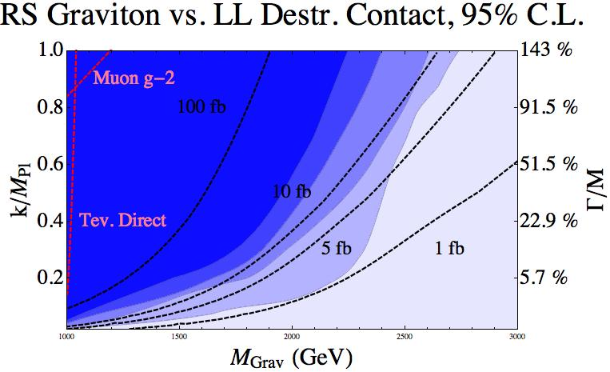

Results
100 %
99 %
90 %
70 %
50 %
0 %

Slide 16
Can we learn more?
Seems reasonable event rate
And distinguishable
We’ve considered total cross section and distribution with energy so far
With enough statistics, angular information can also prove valuable

Slide 17
In particular, can distinguish parity-violating interactions
SM interactions violate parity whereas new physics does not necessarily

Slide 18
In particular, can distinguish parity-violating interactions
SM interactions violate parity whereas new physics does not necessarily

Slide 19
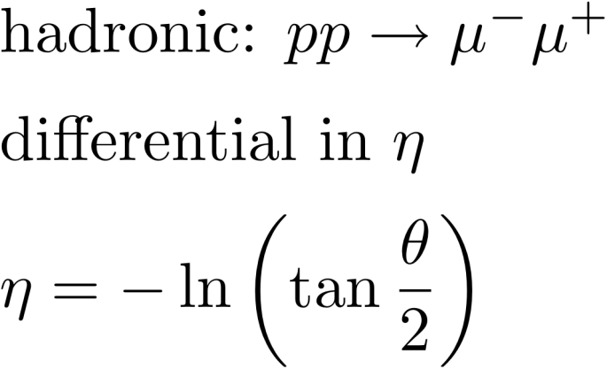
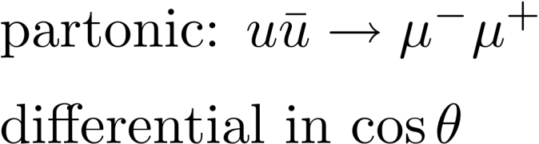
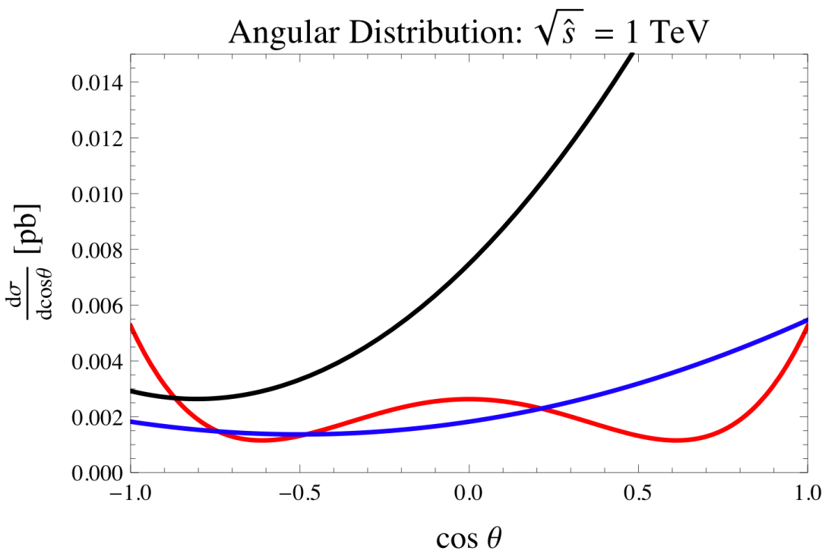
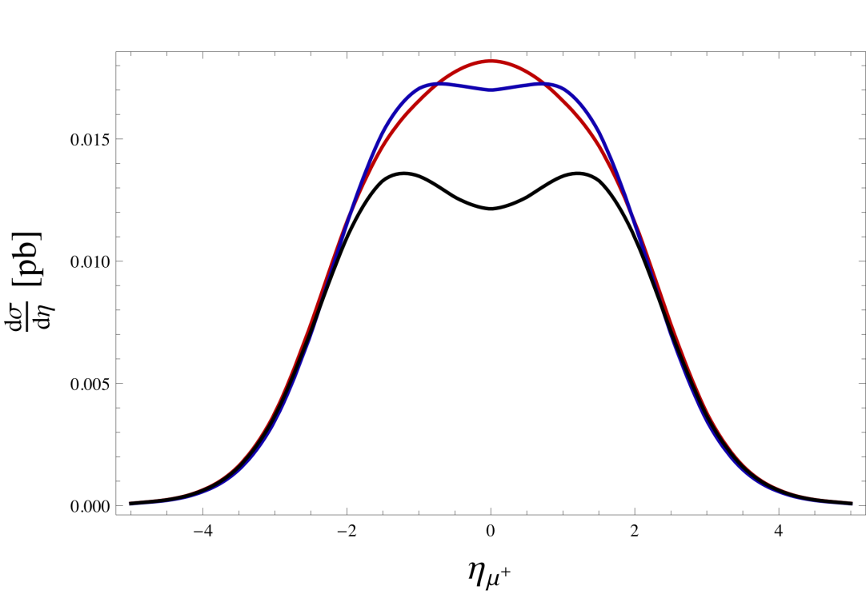



Pseudorapidity distribution

Slide 20
Interpretation
Muon preferentially forward (wrt quark) due to parity violating SM interactions
Quark has on average more momentum (larger x) therefore boosted more forward
Large η, small θ, large cos θ
Sum curves and get the McD curve
Wider with less hard invariant mass cut

Slide 21
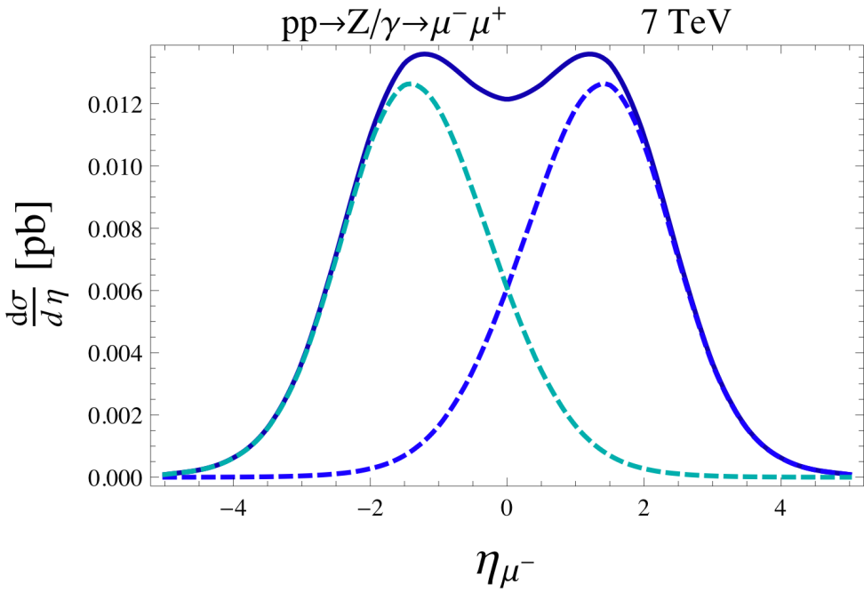
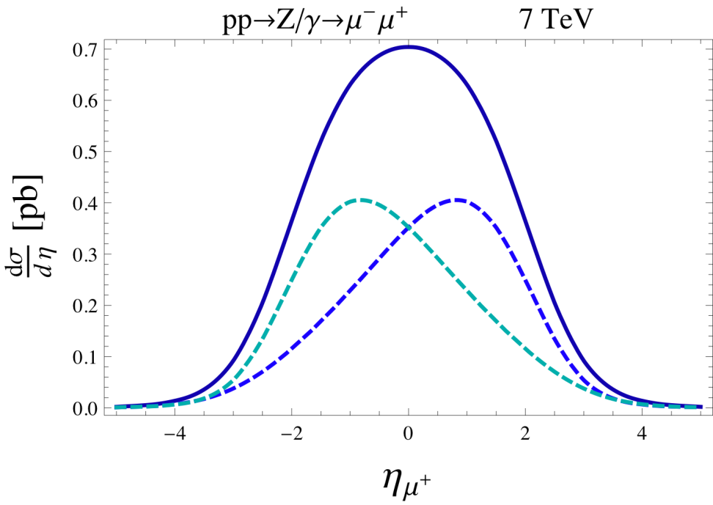
RS model

Slide 22


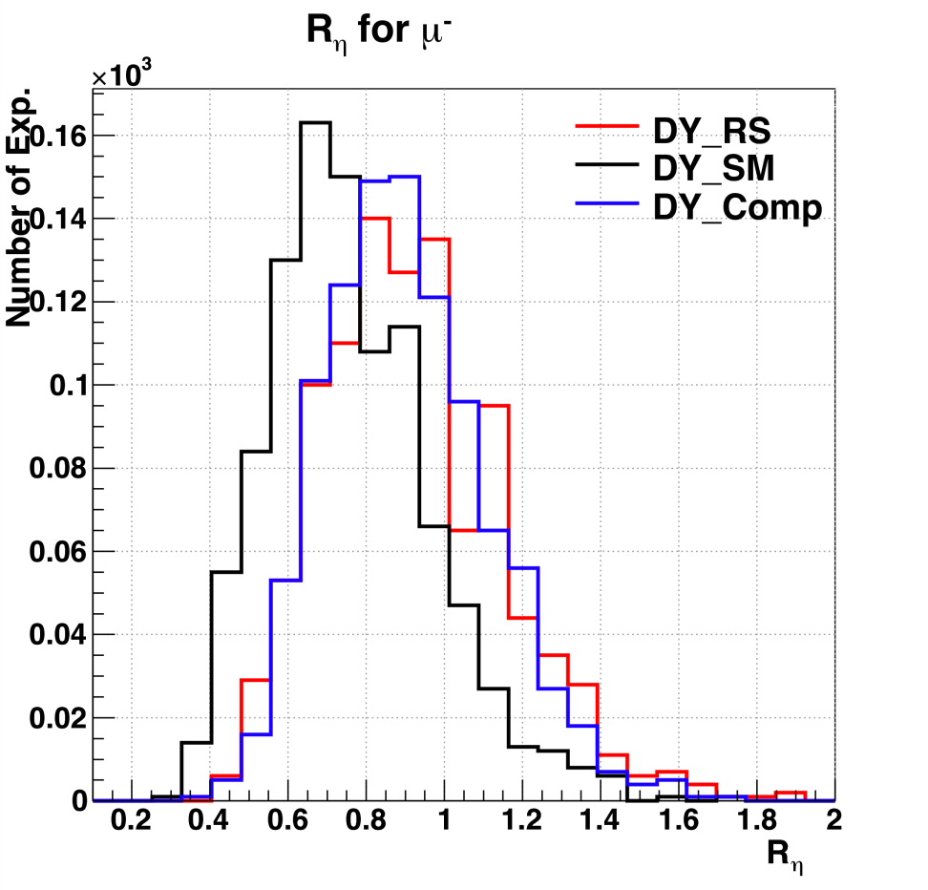
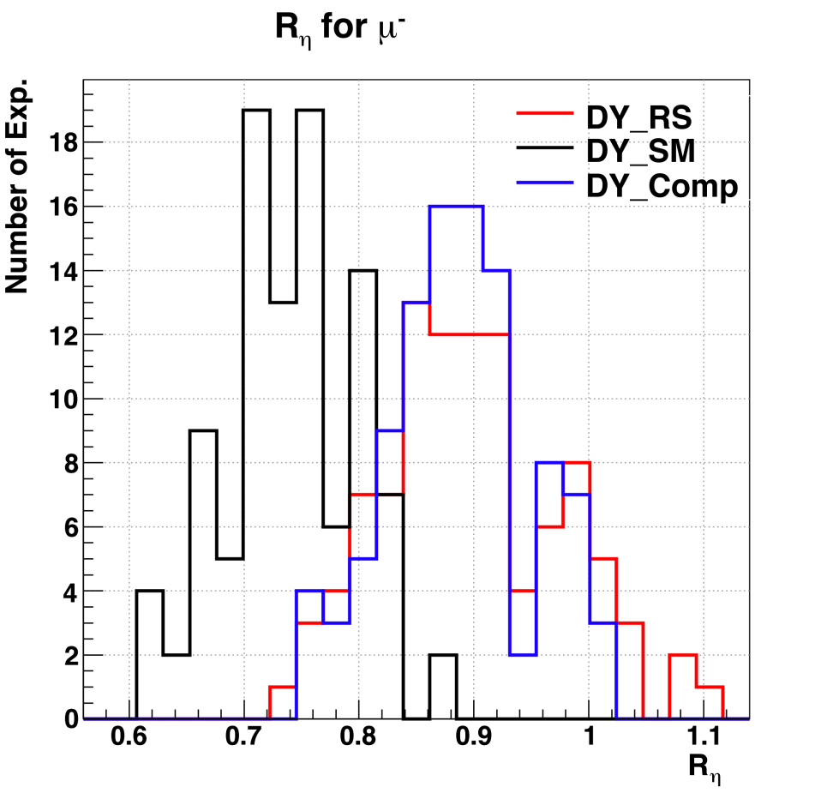
Separation of Distributions in Ellipticity

Slide 23
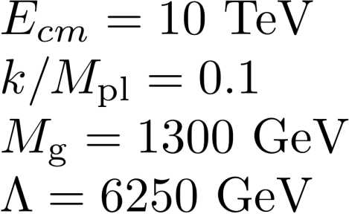
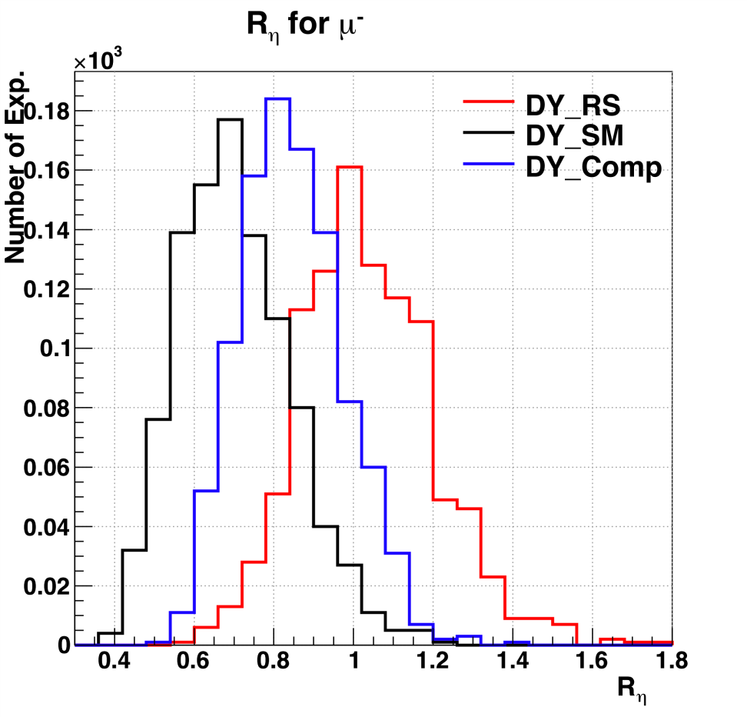
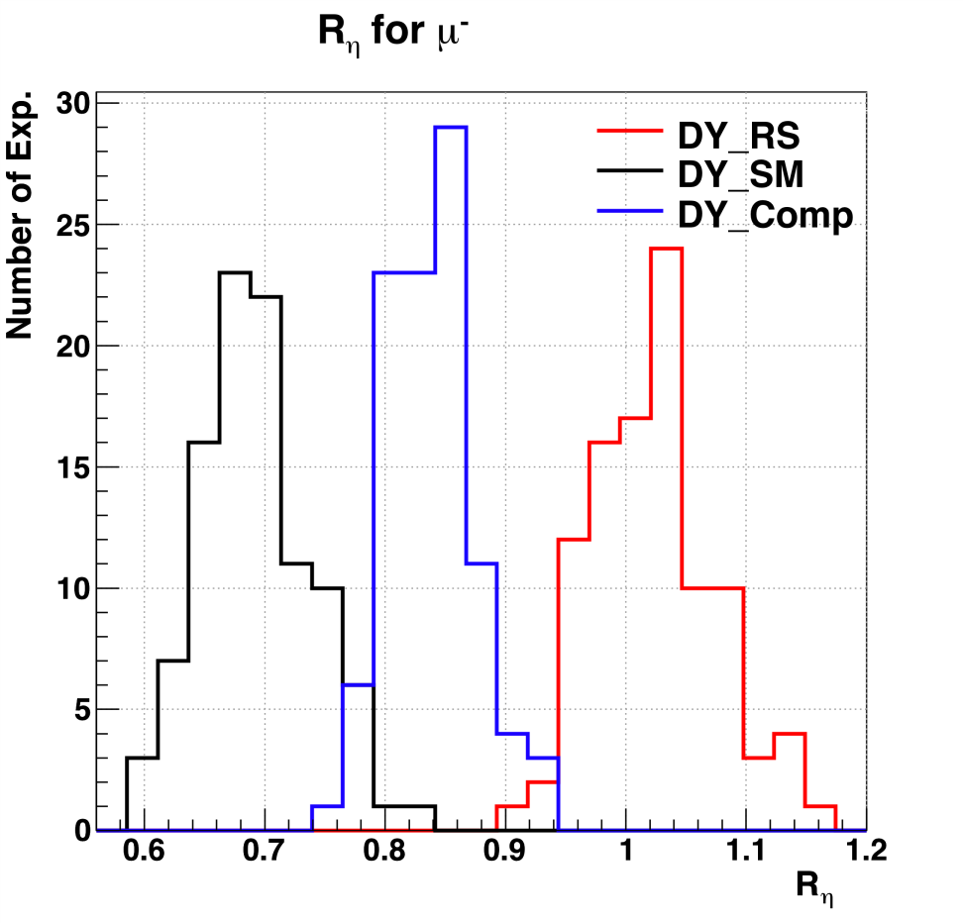
Better at Higher Energy

Slide 24
Wide Resonances
Large cross section
Distinctive shape wrt energy
Distinctive wrt pseudorapidity
Very promising

Slide 25
II: Progress
Initial State Radiation (ISR) Tagging
w/Krohn, Wang
ISR produced due to standard QCD process at proton-proton collider
Radiation tells us nothing about new physics (or weak interactions)
Just QCD messiness
Or???

Slide 26
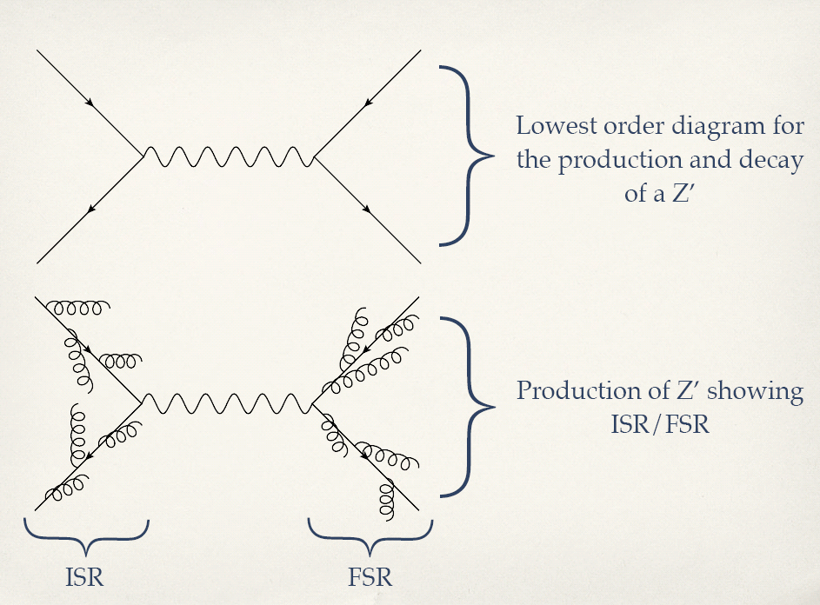
Example

Slide 27
Initial State Radiation
Seems a nuisance
More complicated
  More radiation
  Initial and final state
  Additional jets
  Can contaminate existing jets
  Or
  Be their own jet

Slide 28
ISR
Either way
  seems like a nuisance
But we show
If you can identify it in BSM processes, valuable kinematical information

Slide 29
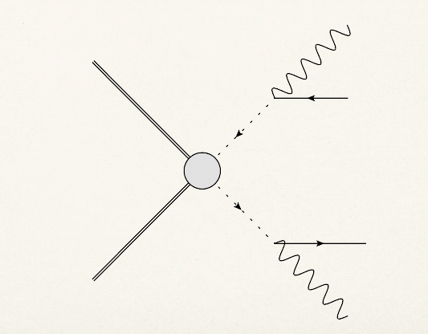
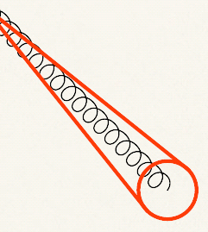
Example: Disquark production

Slide 30
Can use Identify and Use ISR
We show
  Distinctive
  Carries valuable kinematical information

Slide 31
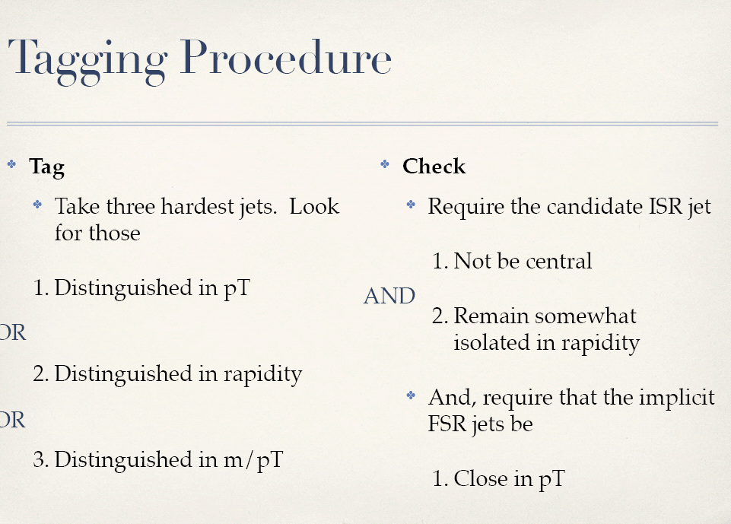






First step: Identify ISR

Slide 32
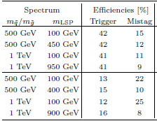
Works very well
And not yet optimized

Slide 33
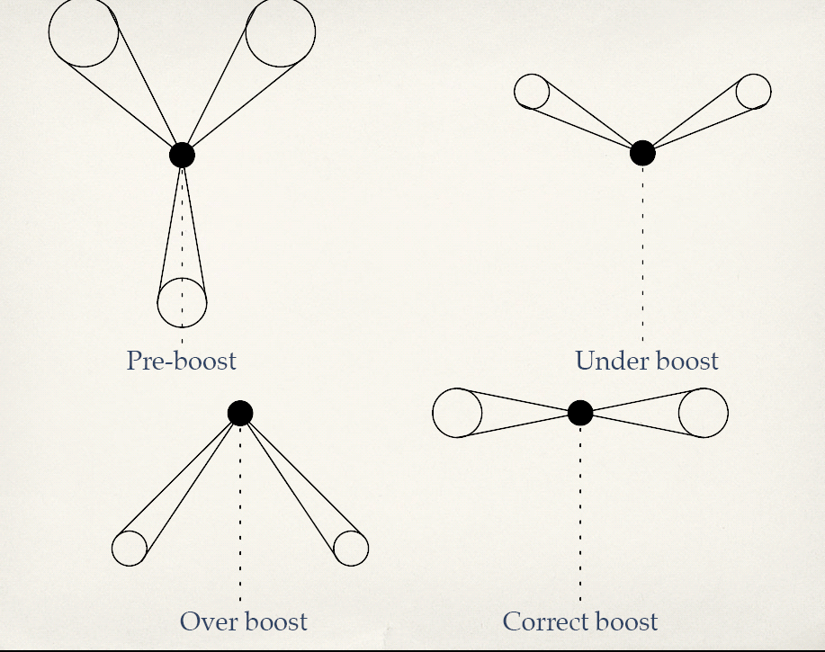
Next step: use kinematics to find mass of squark that gives correct boost to balance transverse momentum (assumes near on-shell, really s)

Slide 34
Determining mass by boost
Boost along longitudinal direction to get visible momentum in new frame
Boost along transverse direction parallel to ISR jet to compensate for ISR
  Requires assumption of system’s mass
  Assume squarks nearly onshell at production
Measure projection of visible momentum along ISR direction
  Correct boost there should be no net projection

Slide 35
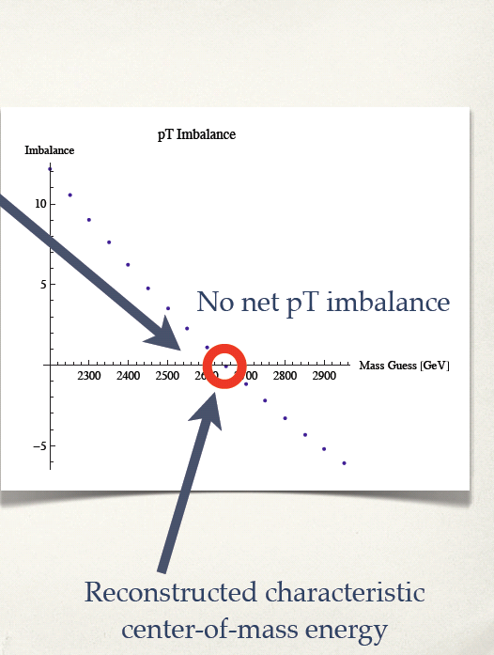
We determine mass at 20% level!
Independent lyof LSP mass, decay chain

Slide 36
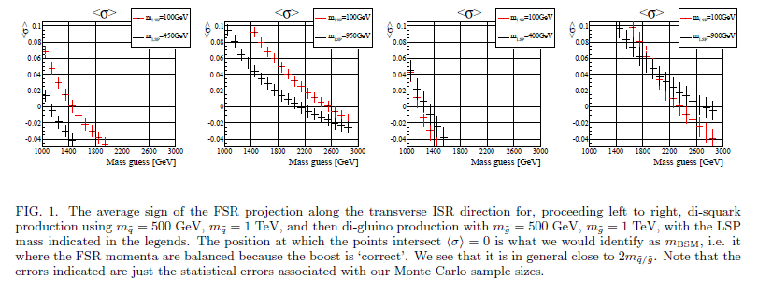

Slide 37
Progress III: New Dark Matter Models
w/Matt Buckley

Slide 38
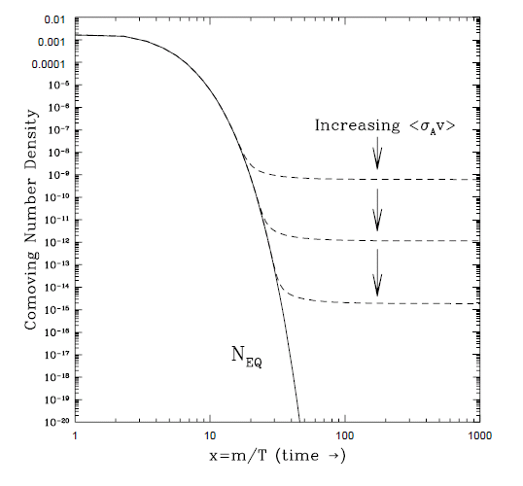


WIMP “Miracle”

Slide 39
Is WIMP the right Miracle?
ρ_{X}~5ρ_{B}
Why should dark matter and ordinary matter energy densities be at all comparable?
Could just be independently generated—baryogesis somehow and weak miracle
Could be related: Asymmetric Dark Matter
  n_{B}~5n_{X}
Could be more generally related; naturalness not quite so inflexible
  Weak scale dark matter still natural
    Thermal suppression
    Bleeding excess number density through in eqm lepton violation below sphaeleron scale

Slide 40
All Sorts of Miracles Possible
Asymmetric Dark Matter
  Make B, Transfer B to X, n_{B}~n_{X}, light DM
  Zurek,Luty,Kaplan
Hylogenesis
  Make B, X together n_{B}~n_{X}, light DM
  Morrissey, Tulin, Hall, March-Russell
Darkogenesis, Dark Genesis
  Make X, Transfer X to B n_{B}~n_{X}, light DM
  Shelton, Zurek
Xogenesis
  Make X, Transfer X to B, n_{B}<n_{X}, weak scale DM
  Buckley, LR
Xogenesis’
  Make X, B, n_{B}<n_{X}, weak scale DM
  Cui, Kahawala,LR, Shuve
Light Dark Matter
Weak Scale Dark Matter

Slide 41
Idea
Asymmetry in dark matter
Transfer asymmetry to normal matter
Here we assume dark matter asymmetry produced in early universe
Question is when we have operators violating B or L and X simulatneously will be get correct matter density
Question is whether number densities work out for a given mass
Perhaps most natural mass is weak scale mass

Slide 42




Light Dark Matter:
“Relativistic Solution”
Chemical equilibrium between B or L and X
Net asymmetry
Ratio chemical potential~ratio number density~ratio energy density

Slide 43

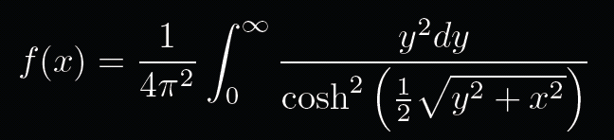
Weak Scale (or Heavy) Dark Matter
“Nonrelativistic Solution”
More generally
Number density suppressed for m>>T

Slide 44
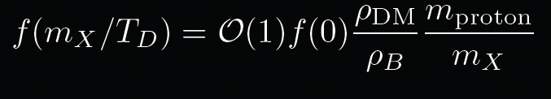
Nonrelativistic Solution
Need to solve
Number density of X less than B
Chemical, but no longer thermal equilibrium
Allows for different masses

Slide 45
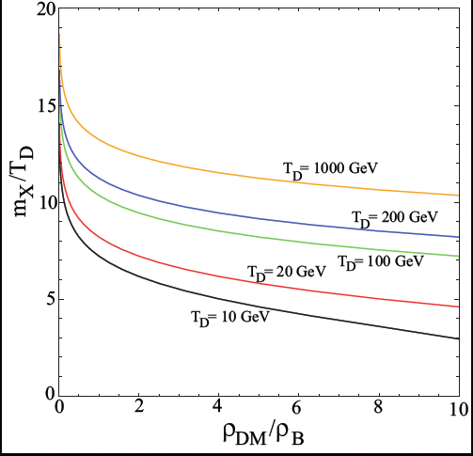
Naturalness allows hierarchy of order 10
Right ratio of densities found for wide range of m/T
Usually need m/T~10, which is quite reasonable
Expect comparable densities over the whole range

Slide 46
Xogenesis New Class of Models
New “miracle”-New models
  Transfer asymmetry from dark matter to matter
  Create both at same time
    Can be weak scale
    Can be light
Different bounds
Different tests
Lighter more accessible
Challenges for future-
  Models
  Searches

Slide 47
For the Future
Open mind
Open data sets
Multiple data sets
  Complementarity
Optimize and exploit what we have
Think about experiments, theory in parallel
  Individually and as a community

Slide 48
What to Do?
Anticipate
  As much as we can…
Model building is good!
  Simple best
  But not if not realized in nature
Truly tragic if LHC misses something that is there
  Even unrelated to hierarchy
    Vector representations
    Light particles
Jet physics
  Many advances
  Asking different questions
  Helping with both SM, BSM physics

Slide 49

What to Do?
Celebrate experiments working
Make sure we do everything we can with existing experiments
Think about what experiments true implications will be
Think about what is most necessary for future
  Soon?

