Slide 1
Hereward Damping Peak Detector for the PS accelerator.
Pierre Hawil

Slide 2
Table of contents
Introduction
  Block schematic
Measurements
  Schematics and PCB for the tests
  Plots of linearity
Final Design sent to the Design Office
Firmware
  Concept
  VHDL Code examples
  Simulation
Conclusion

Slide 3
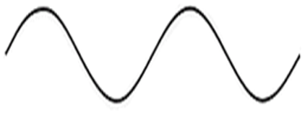

Block schematic
LHC Low Level Chassis
New PCB to develop
Main Voltage Program
P1
VME
P2
Backplane
Serial stream
(CVORB)
FPGA
ADC
New PCB to develop
SPI
10 MHz matrix
CVORB
External
Circuit
Of
Attenuation
RF Peak Detector
AVC
Pick up
CVORB
Bunch with quadrupole oscillation
Opto-isolated block
Pick
Up
RF Cavity
Beam f
CVORB

Slide 4
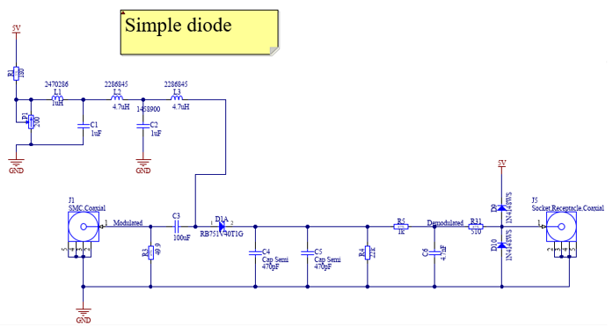
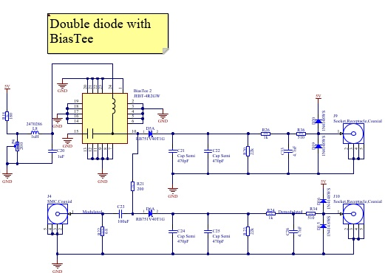
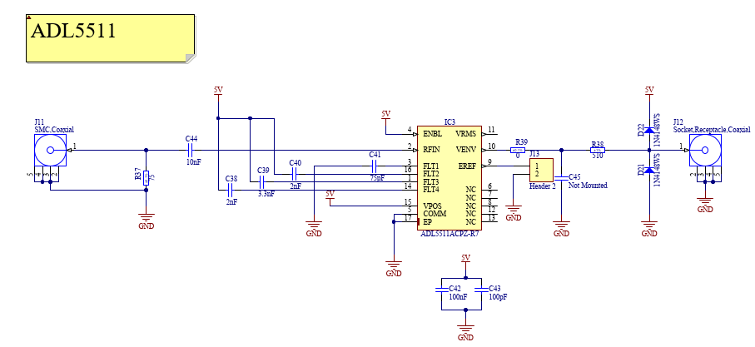
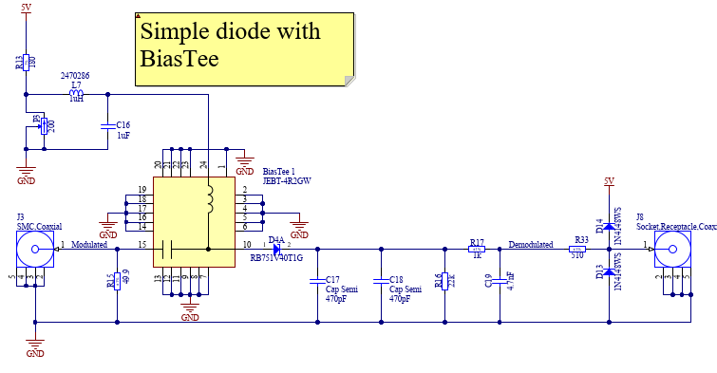
Demodulation options

Slide 5
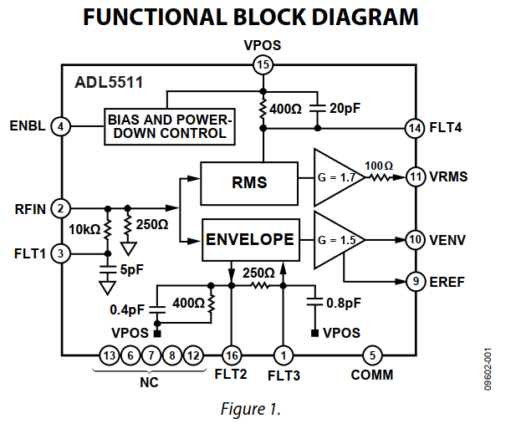
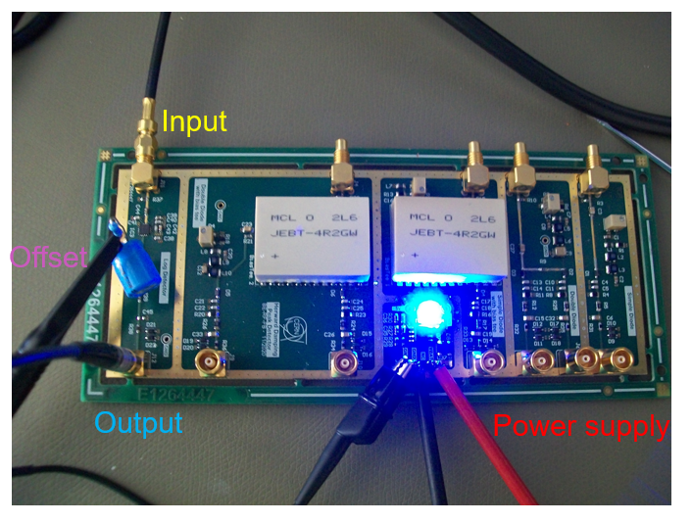
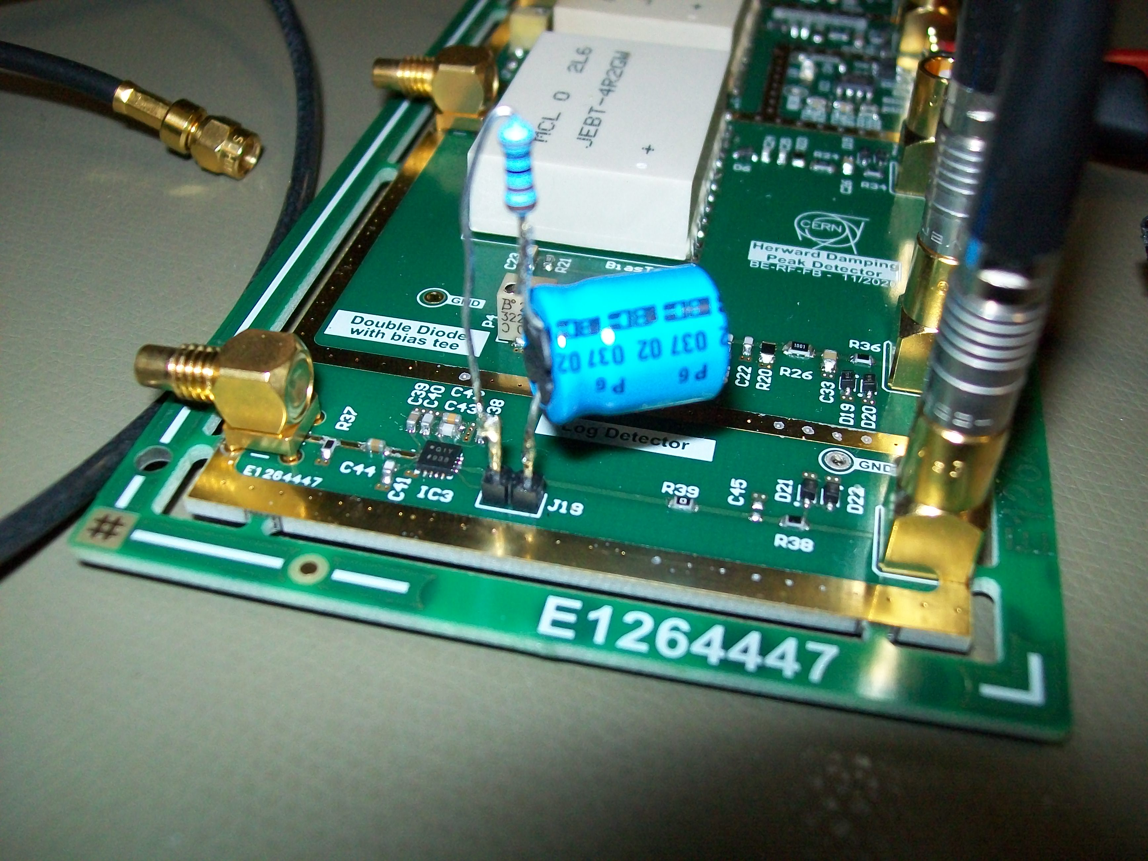
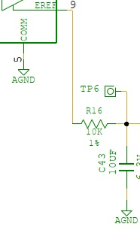
Measurements: PCB realized and mounted
Cabling on the channel of ADL5511
Output
Offset
Addition of a filter on EREF (the offset)

Slide 6
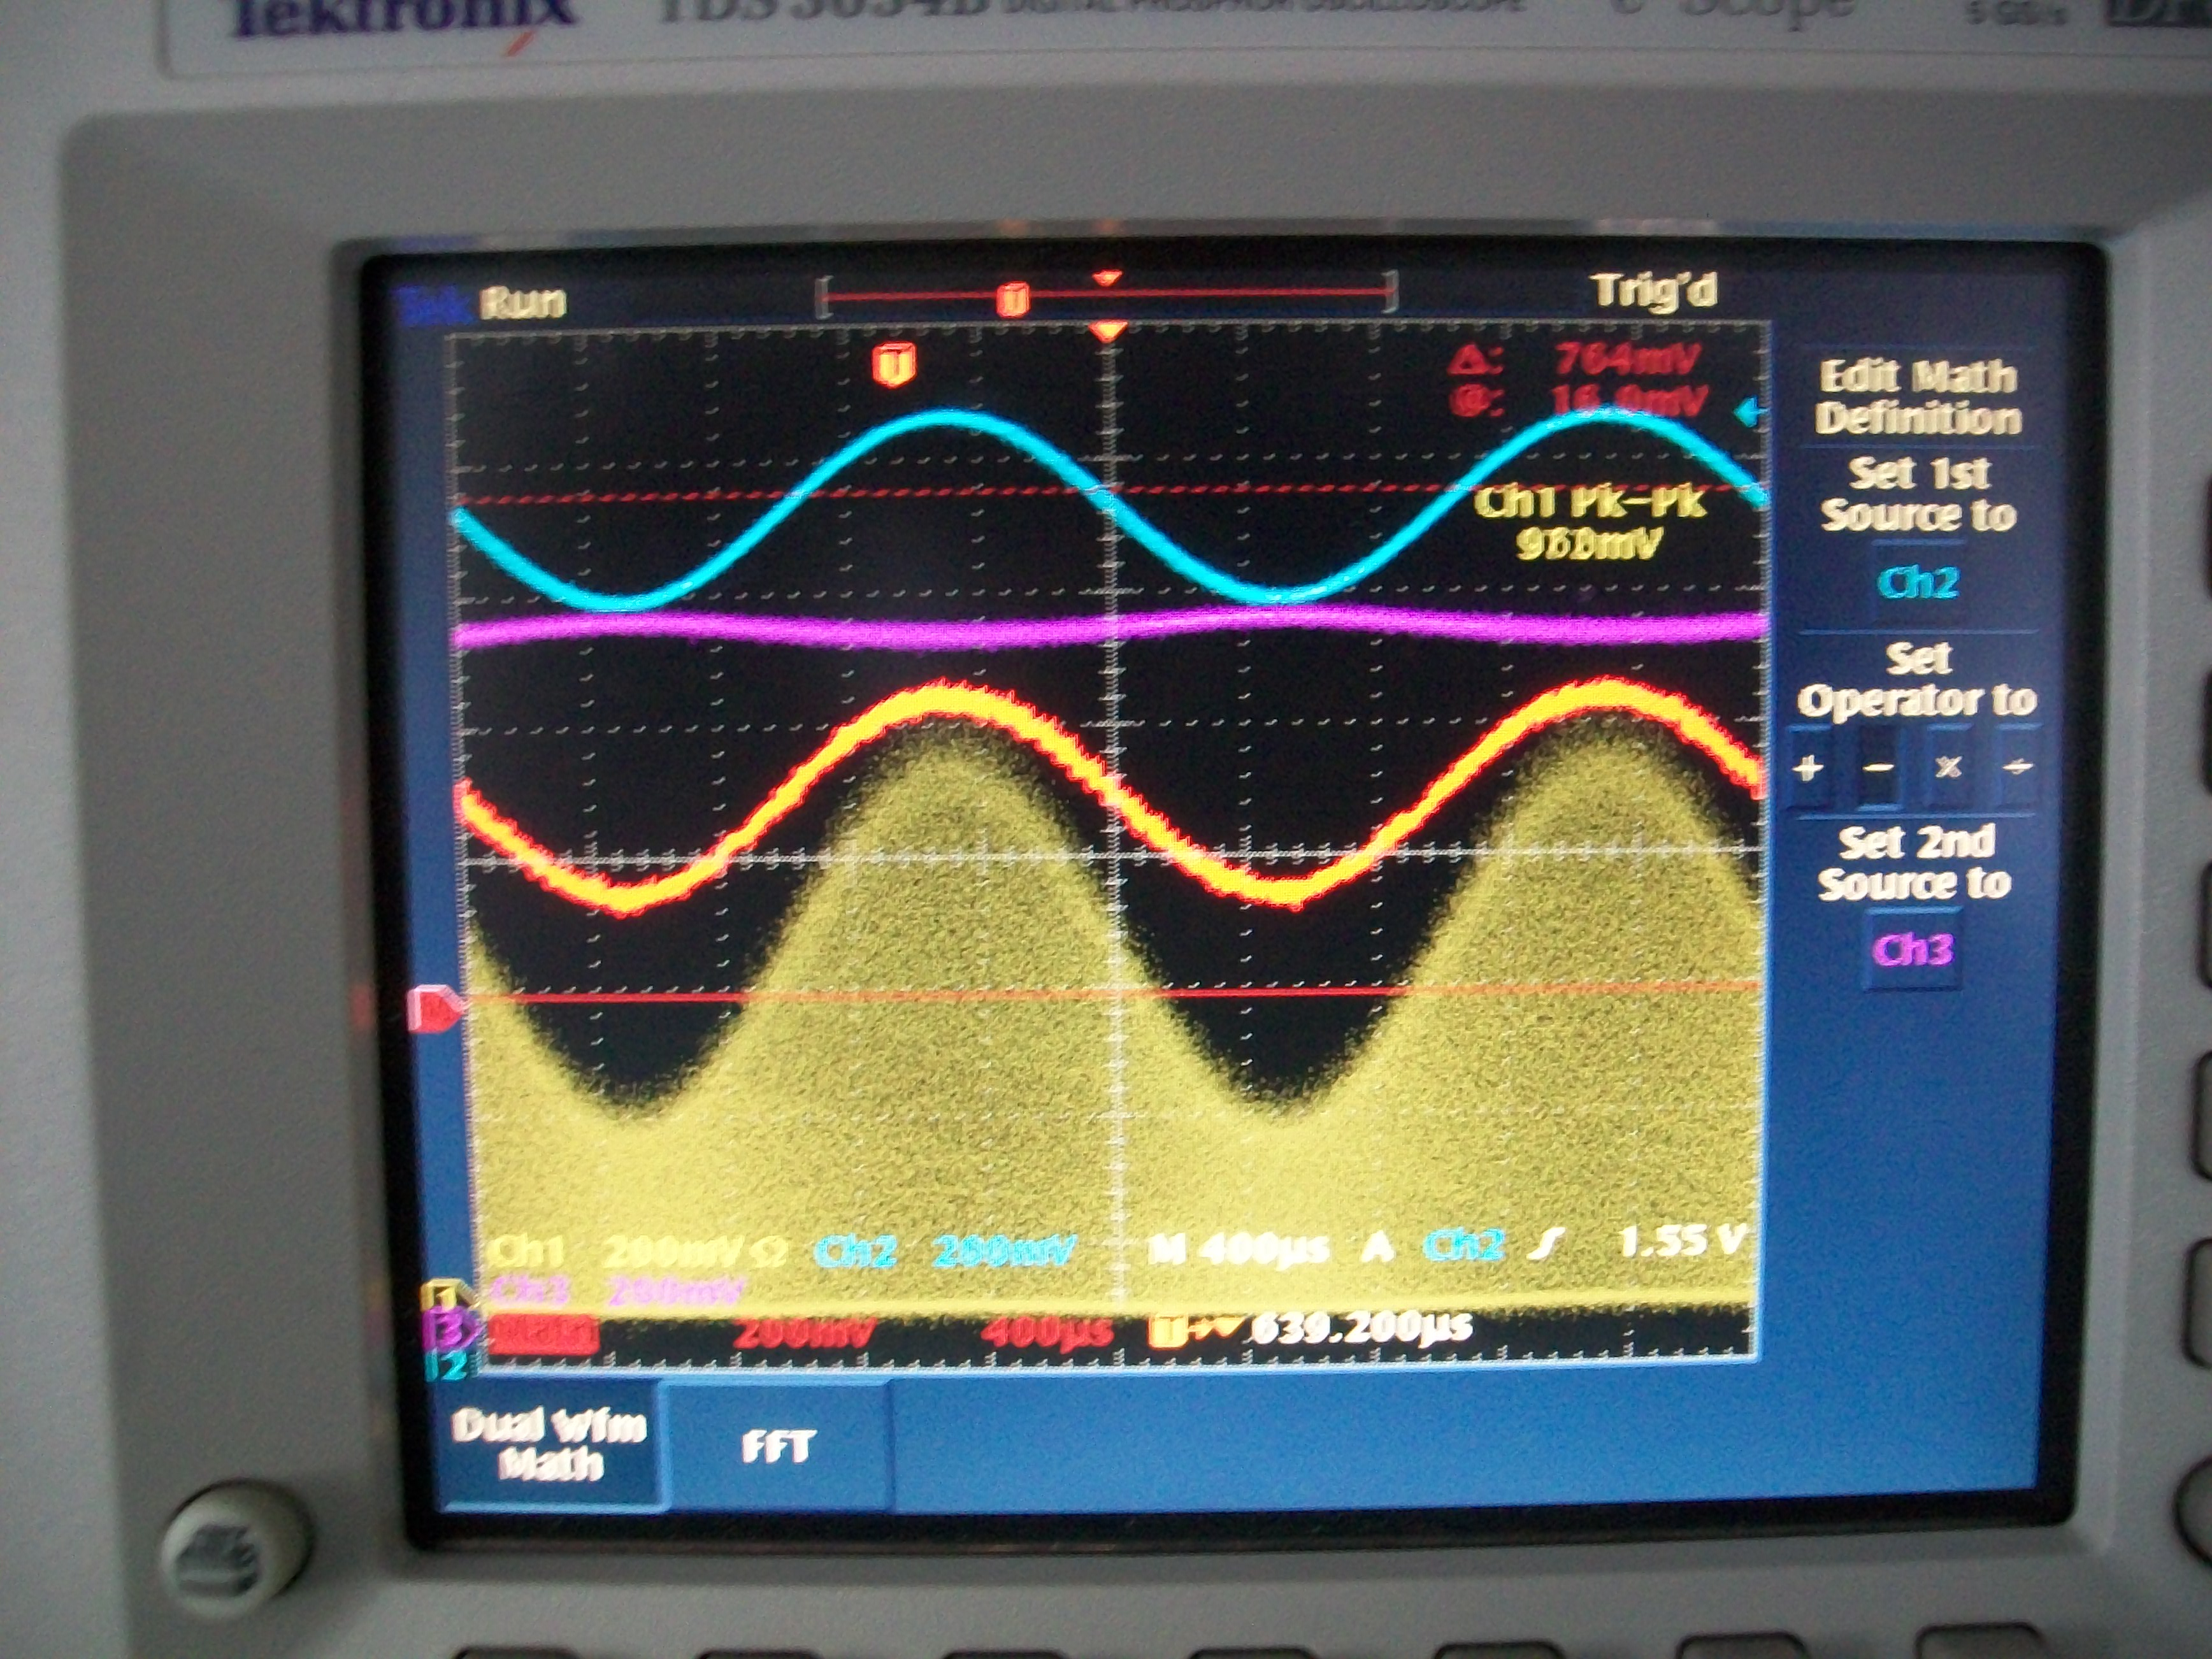
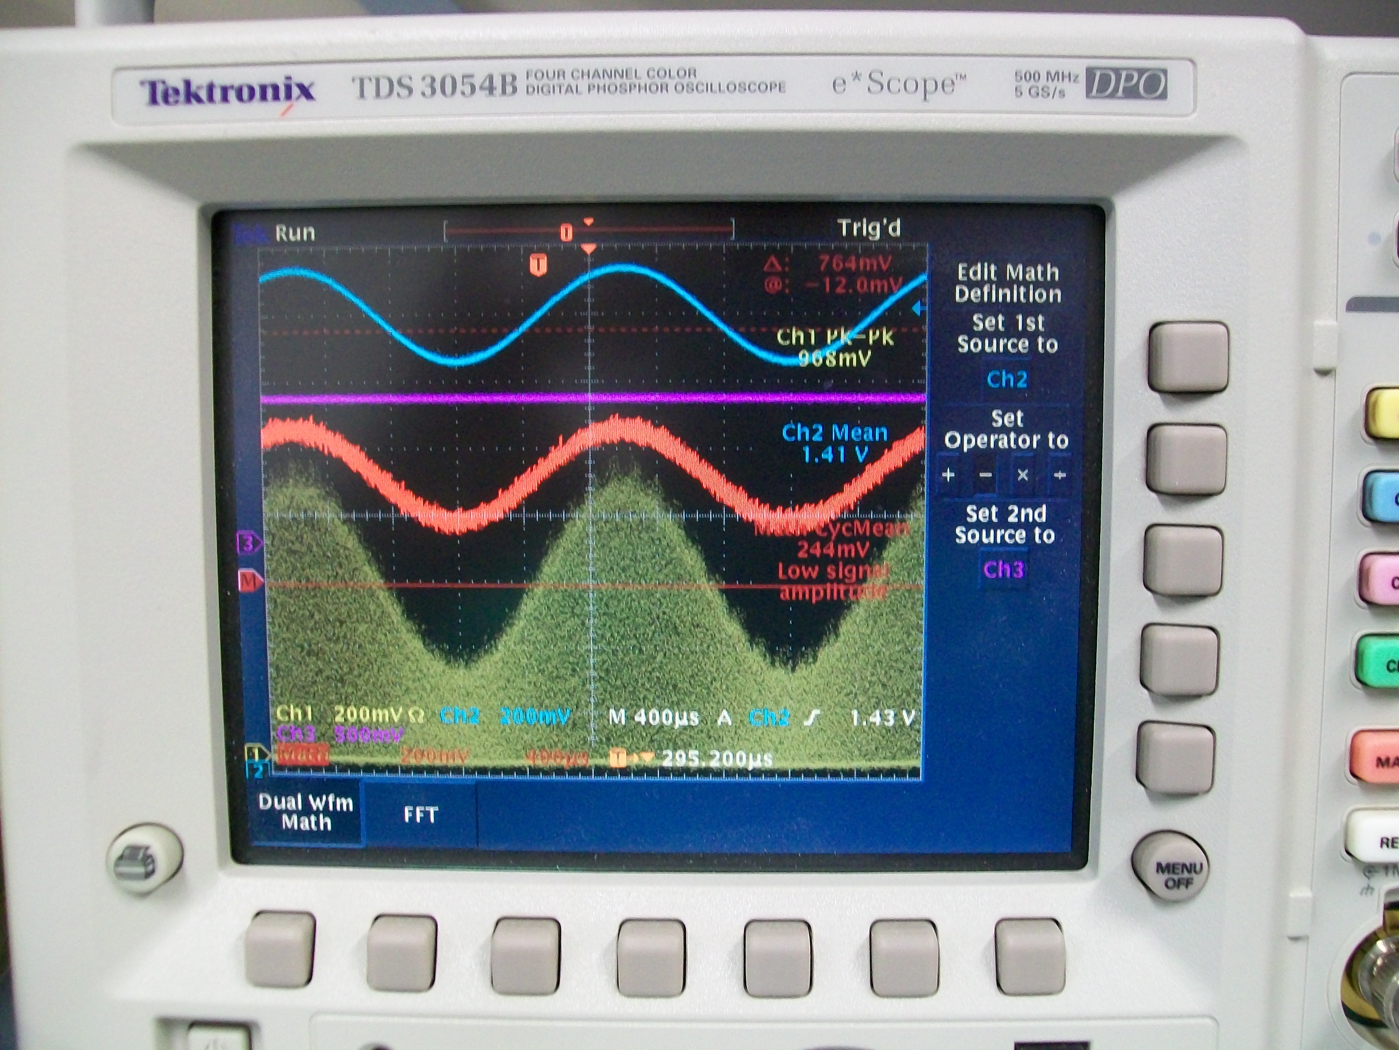
ADL5511 Measurements: Addition of low pass filter
Without filter on EREF/offset (purple signal)
With filter on EREF/offset (purple signal)

Slide 7
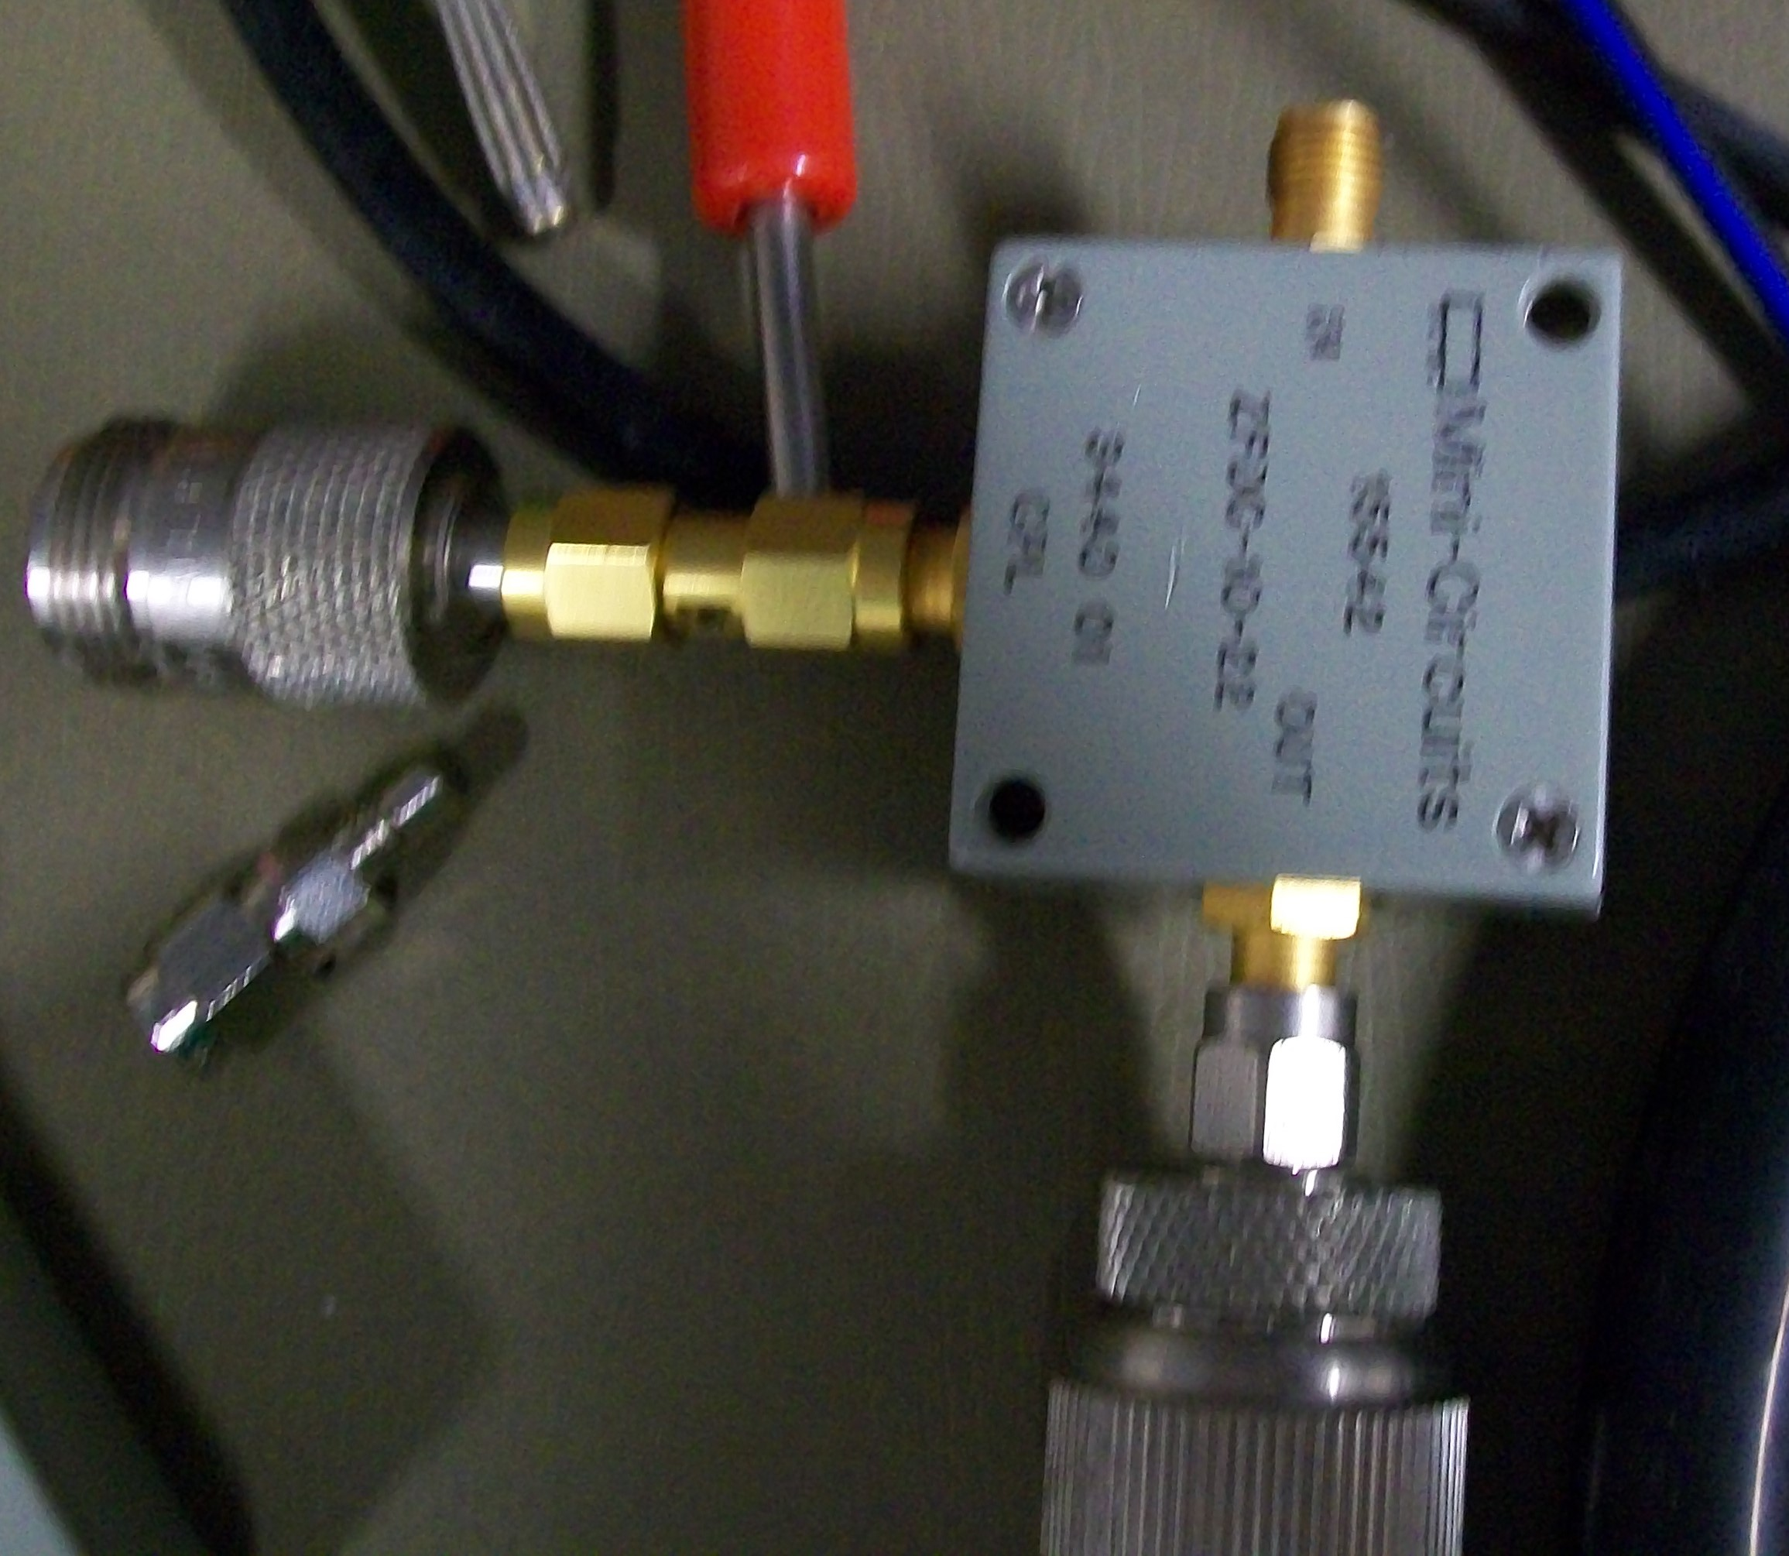
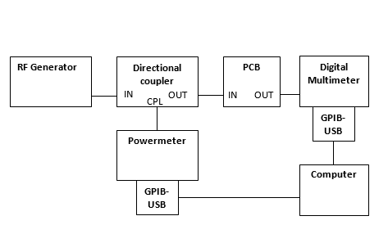
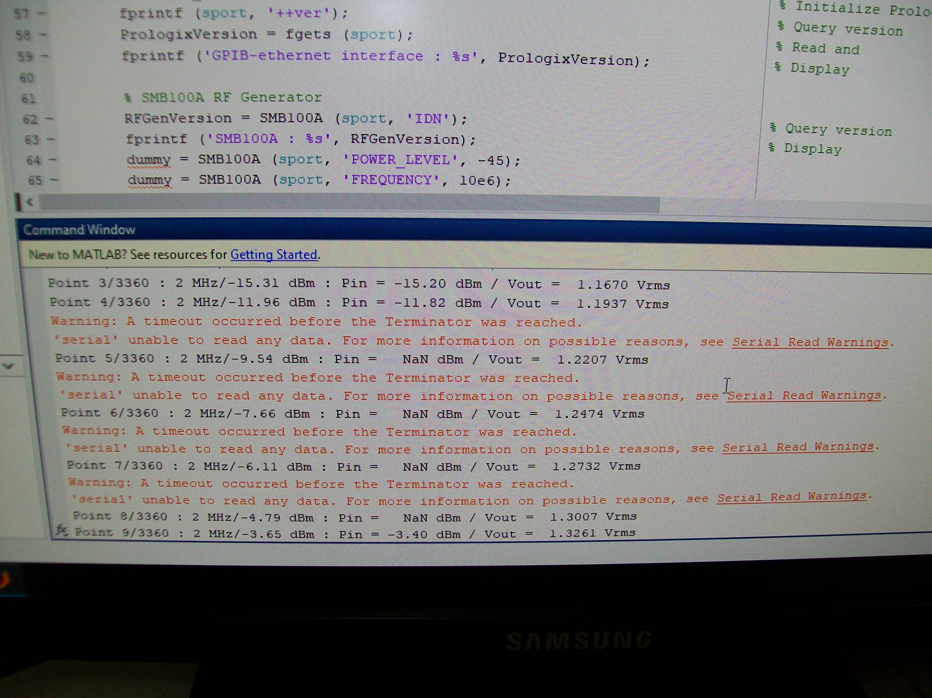
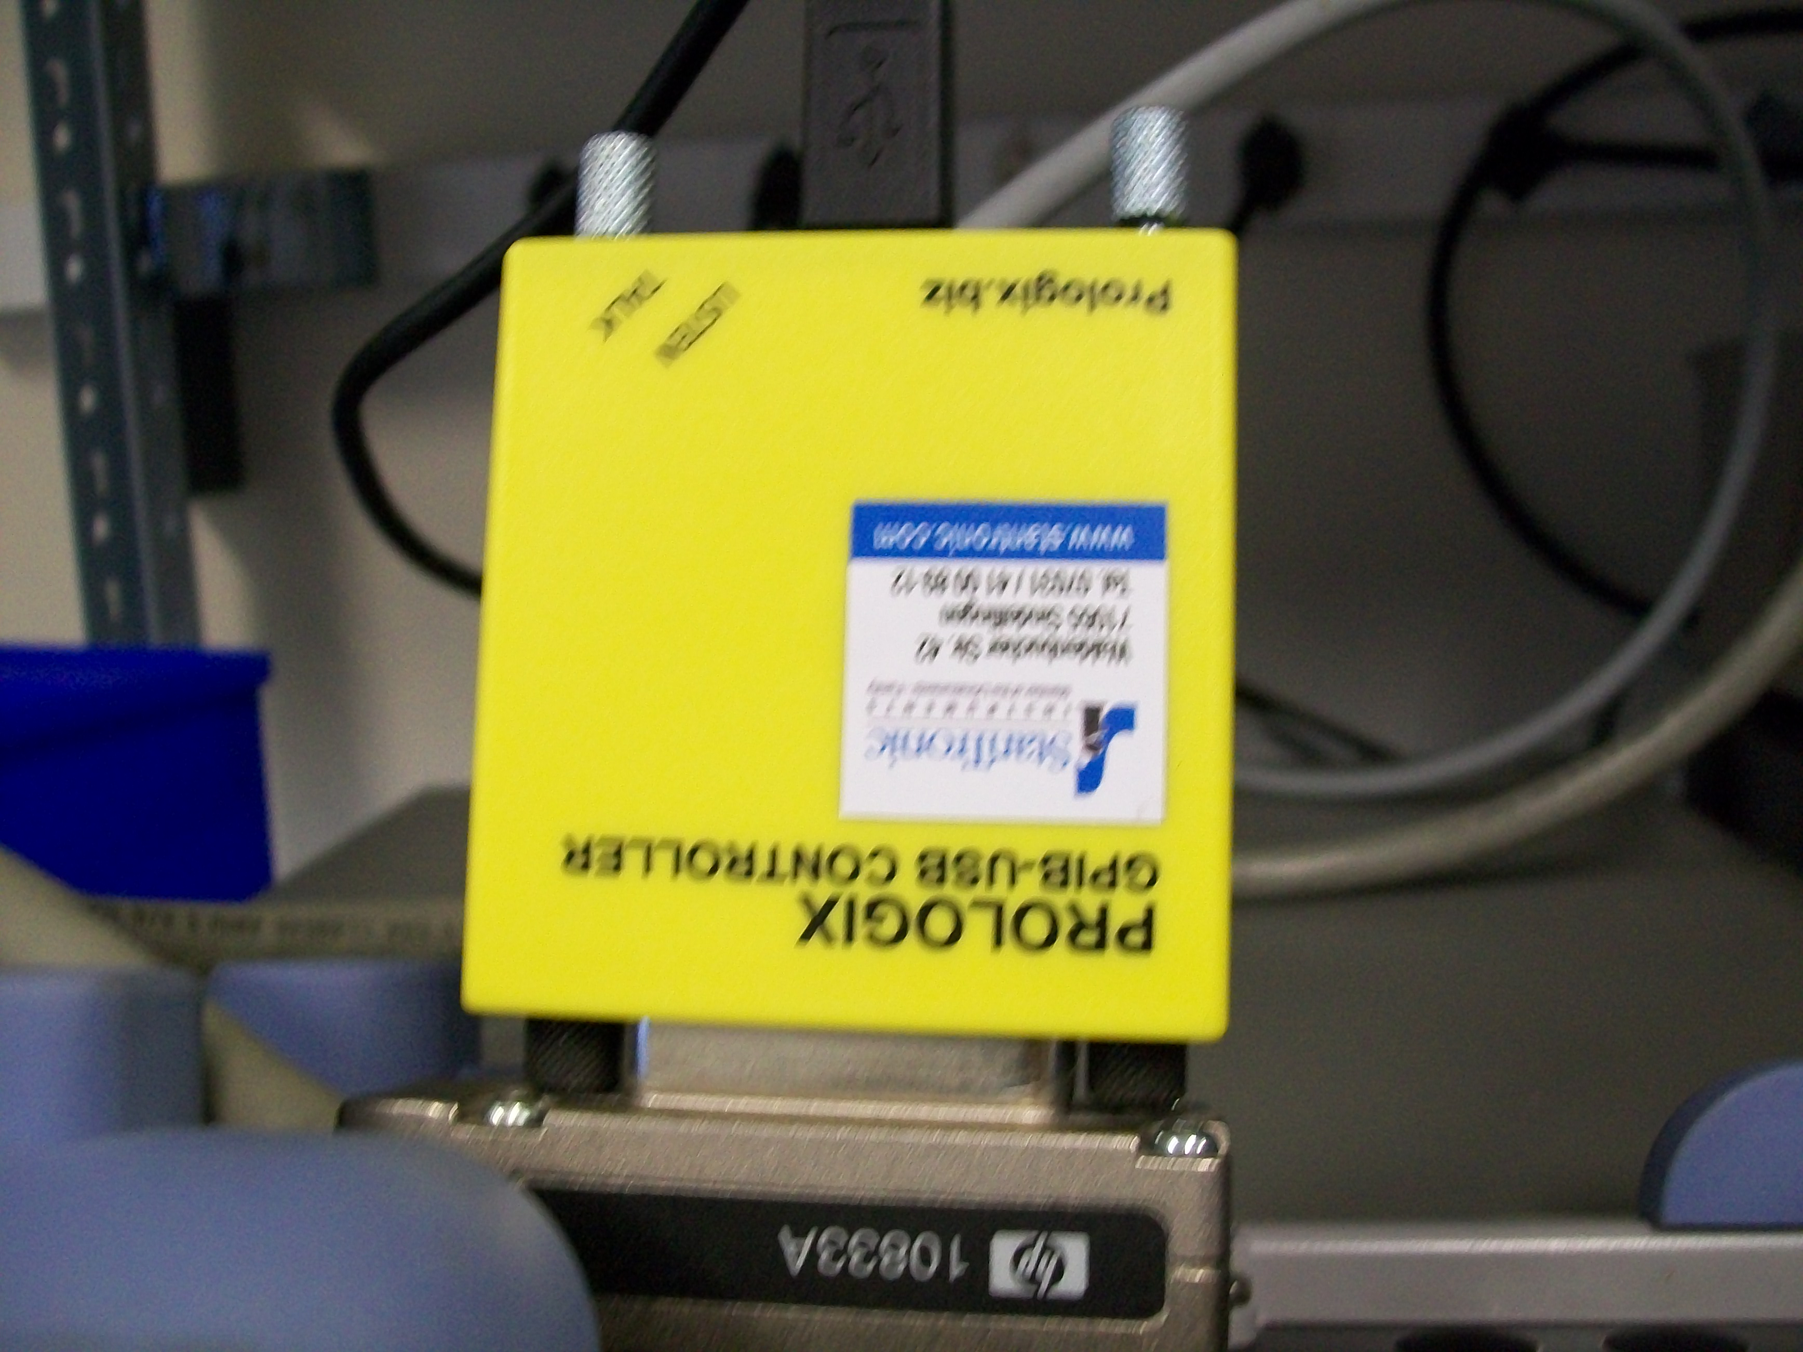
Measurements: Automatic measuring system

Slide 8
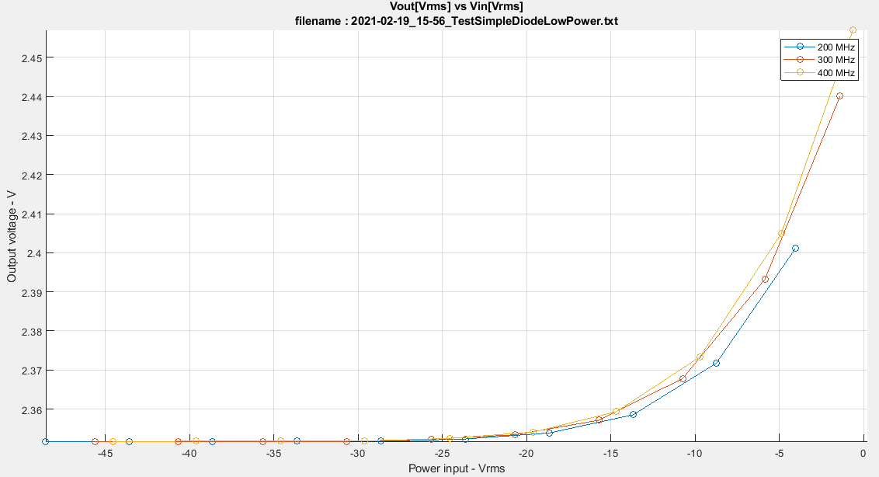
Plot for the simple diode: Low Power

Slide 9
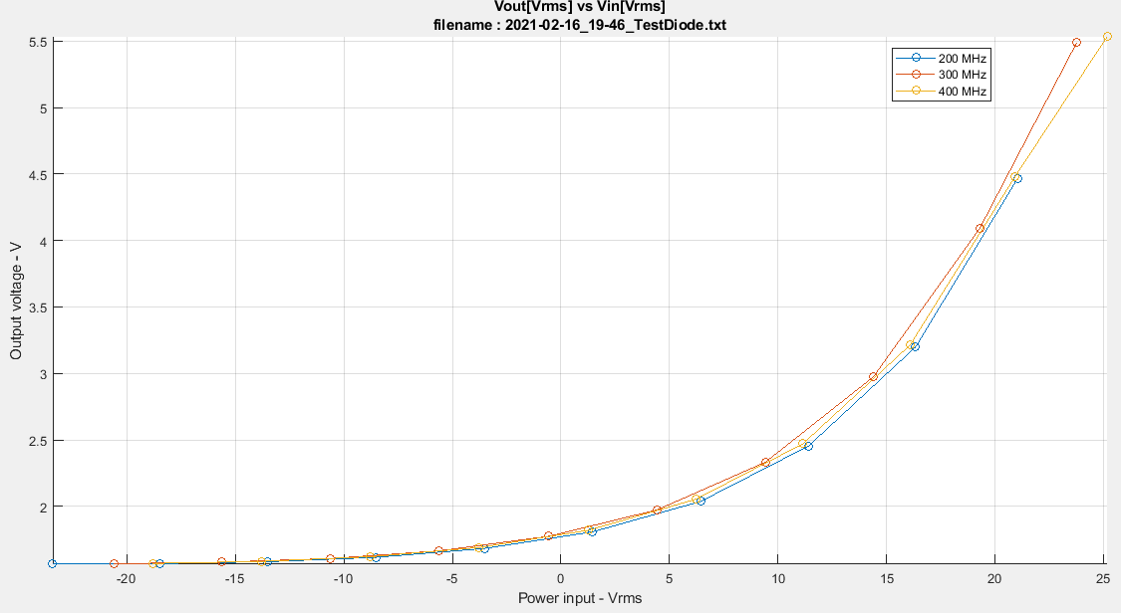
Plot for the simple diode: High Power

Slide 10
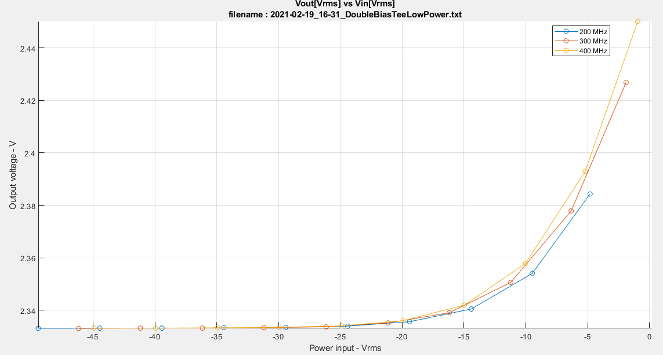
Plot for the BiasTee: Low Power

Slide 11
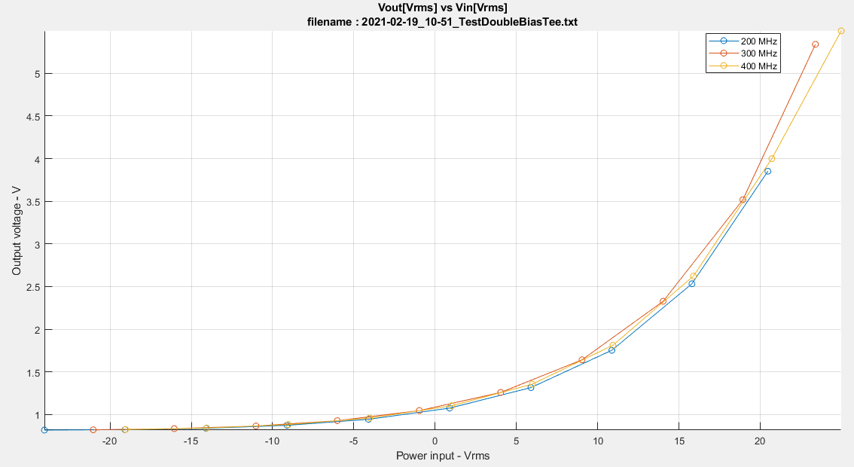
Plot for the BiasTee: High Power

Slide 12
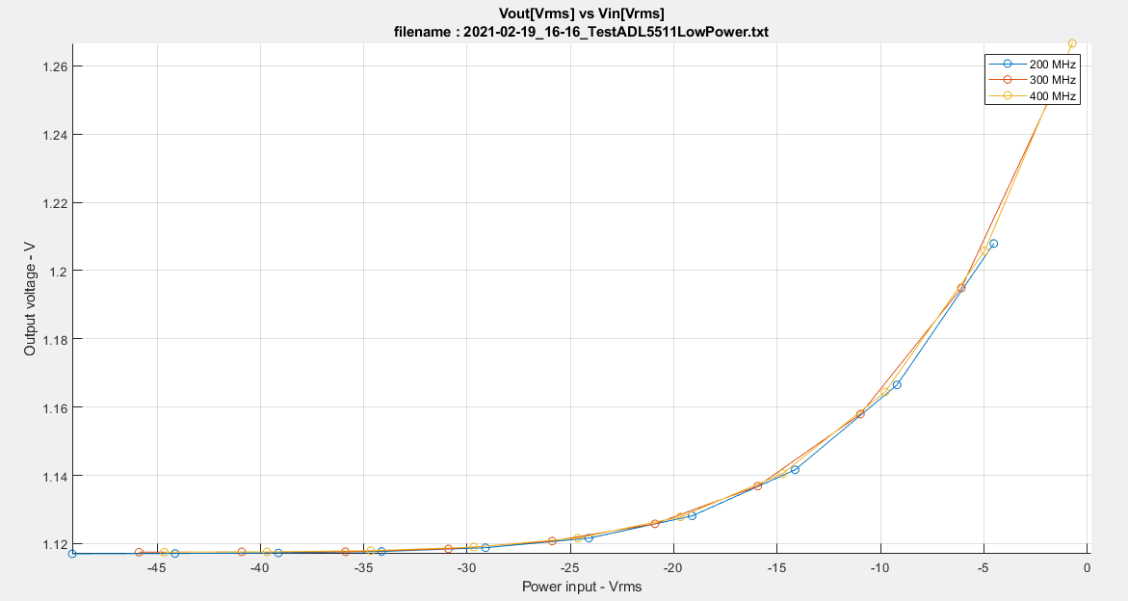
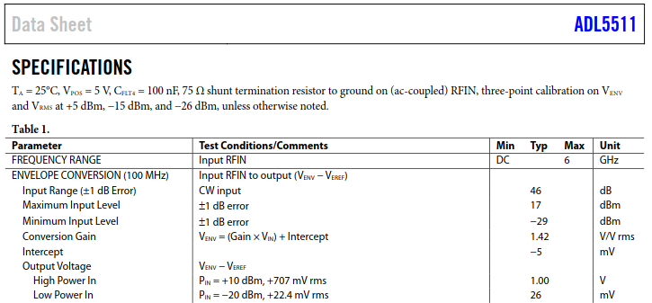
ADL5511-Low Power
29
1.129
Venv - Veref = 1.129 - 1.1 = 29mV => 26mV

Slide 13
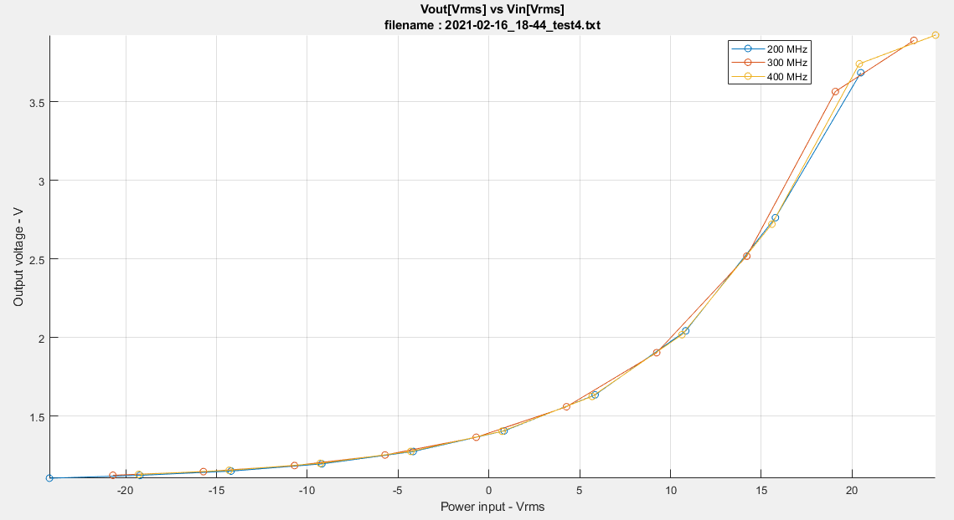
ADL5511-High Power
17
Venv - Veref = 2 - 1.1 = 900mV => 1.00V

Slide 14
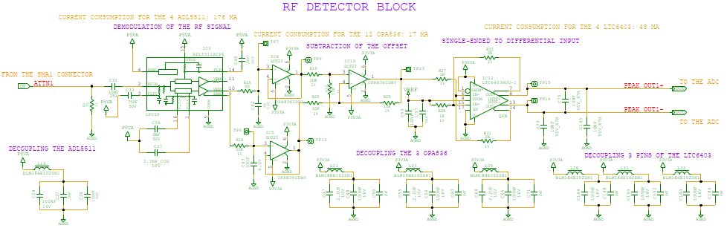
RF Peak Detector Block
Isolates the offset subtraction stage from the demodulation filters.

Slide 15
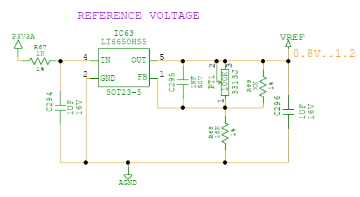
RF Peak Detector Block: Vref
Trimmable potentiometer to adjust Vref as required.
Values based on Ltspice simulation
NOTE: Vref, sets the output common mode voltage of the differential ADC input driver.

Slide 16
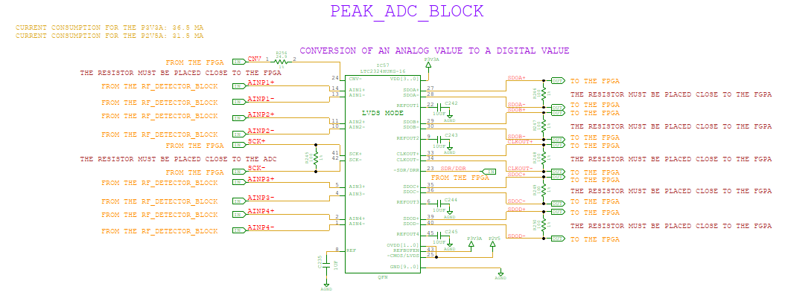
ADC: LTC2324
  16-bits
  4 simultaneous sampling channels
  2 MSPS
  SPI interface

Slide 17
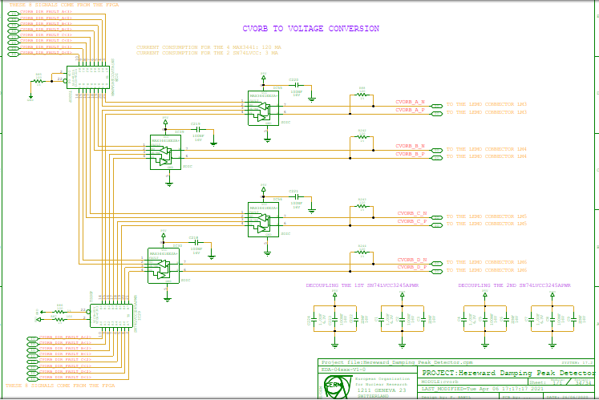
CVORB
Schematic part taken from EDA-02668 or EDA-02175

Slide 18
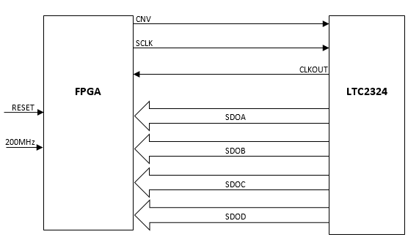
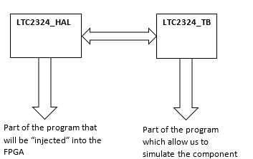
Firmware: Concept
HAL = Hardware abstraction layer
TB = Test Bench

Slide 19
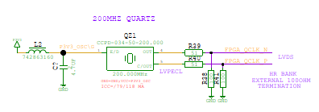
Firmware: Concept
In the test bench (TB) file:
  Non-synthesisable VHDL is authorised; can use most common control structures without problems (if…else, while…loop, for…loop, wait unit, etc)
  Can use wait statements (delays) using physical values of time (ns, ps etc.)
In the hardware extraction layer (HAL) file:
  All VHDL must be synthesizable (delay statements etc, not allowed)
  200MHz quartz oscillator is the main system clock.
    All other clocks and delays are derived from this clock.

Slide 20
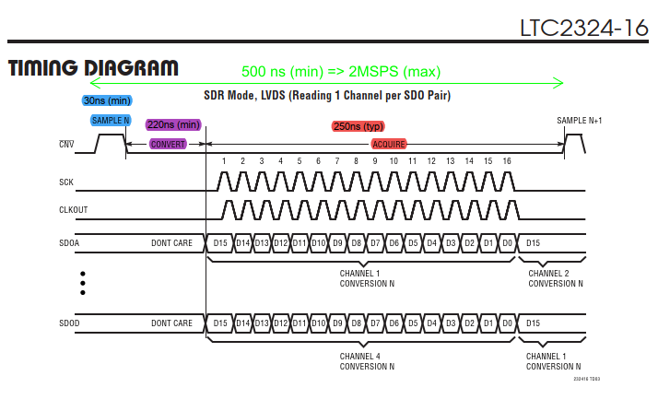
LTC2324: SPI FRAME
Signals from the FPGA
Signals from the ADC
Frequency of SCK = 100MHz

Slide 21
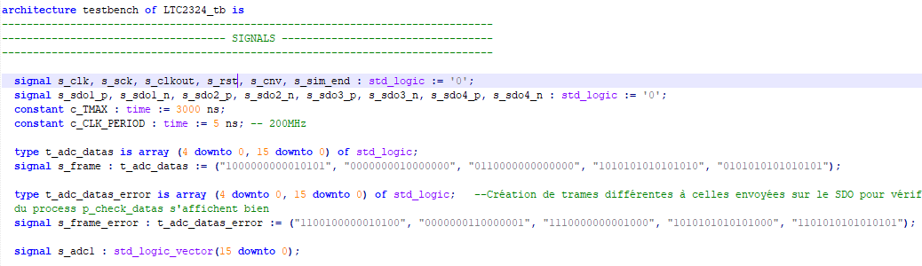
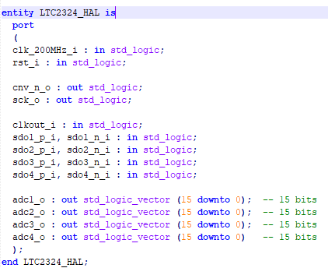
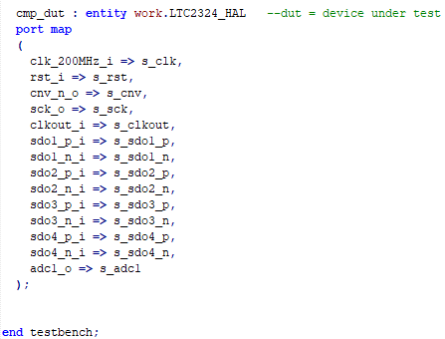
Firmware: HAL vs TB
Declaration of inputs and output seen from the FPGA’ side
Declaration of what is present in the HAL, BUT AS SIGNALS
The TB: Creates the stimuli to test the HAL: 200MHz clock, serial data, etc.
The program about the TB
The HAL:
Generates the ADC sample clock and serial clock from the 200 MHz system clock.
Decodes the serial stream from the ADC into parallel data.
Port map to make the link between the HAL and the TB

Slide 22
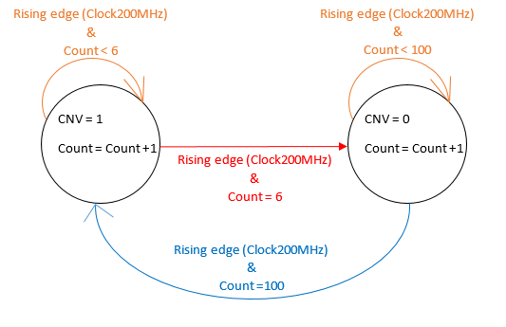
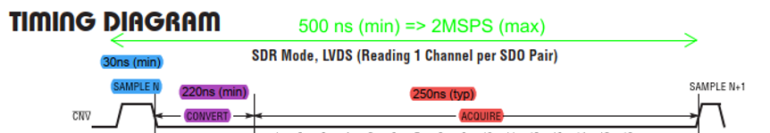
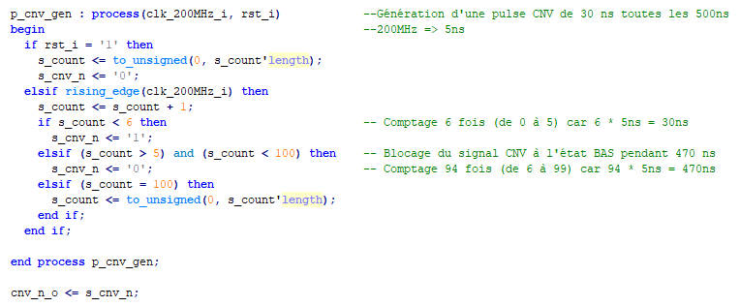
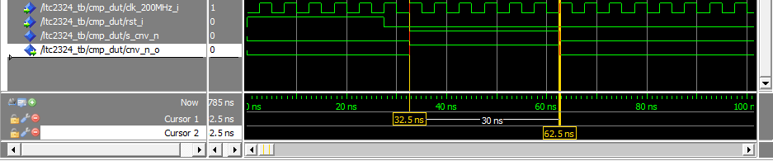
Firmware: Creation of the CNV
Clock 200MHz => 5 ns
CNV_HIGH: 30ns / 5ns = 6
CNV_LOW: 470ns / 5ns = 94
CNV_PERIOD: 500ns / 5ns = 100
Count = 0
Creation of sample clock/convert pulse using simple counter and
if statements.

Slide 23
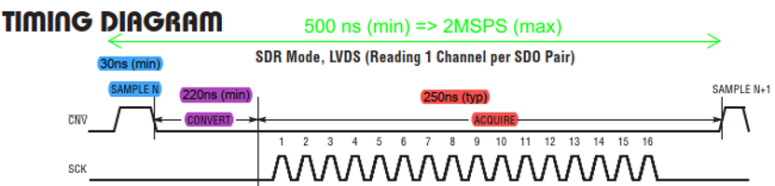
Firmware: Detection of the end of the pulse CNV
Need to detect the end of the pulse to start the convert time
Need to build a falling edge detector that samples using the system clock
For example, it’s FORBIDDEN to write:
  If falling_edge(s_cnv_n)

Slide 24
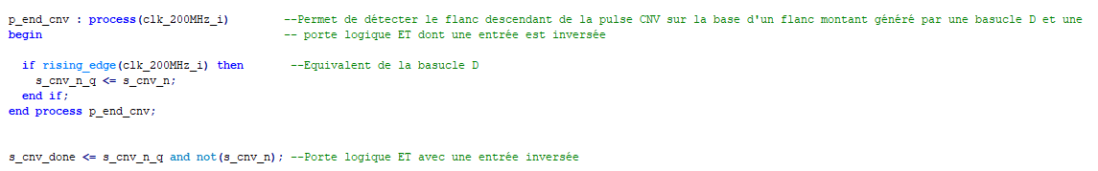
Firmware: Detection of the end of the CNV pulse
s_cnv_done
Falling edge detector using flip-flop and an AND gate.
s_cnv_n
D
Q
s_cnv_n_q
clk_200MHz_i

Slide 25
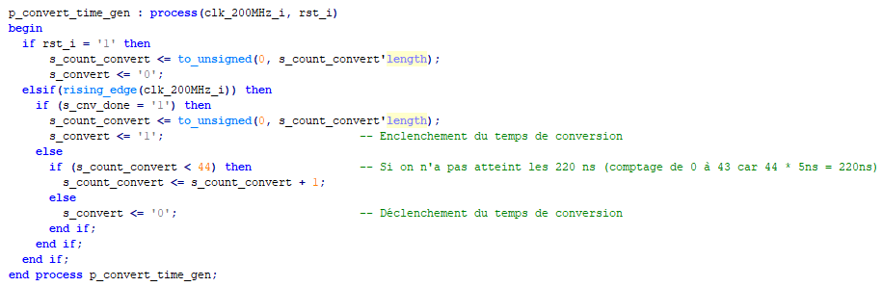
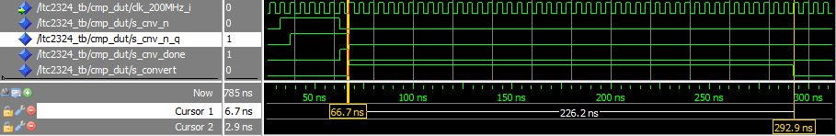
Firmware: Start the convert time
Another counter and if statements to start the convert time.

Slide 26
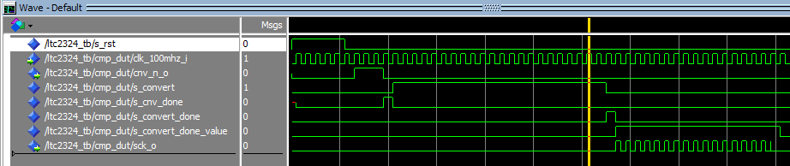
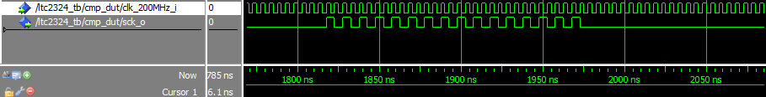
Firmware: Creation of the serial clock for the ADC
First iteration using 100 MHz as system clock caused a glitch because of the combinatorial logic.
Solution: Divide the quartz clock (200 MHz) by two, to produce a 100MHz SCLK.
Glitch

Slide 27
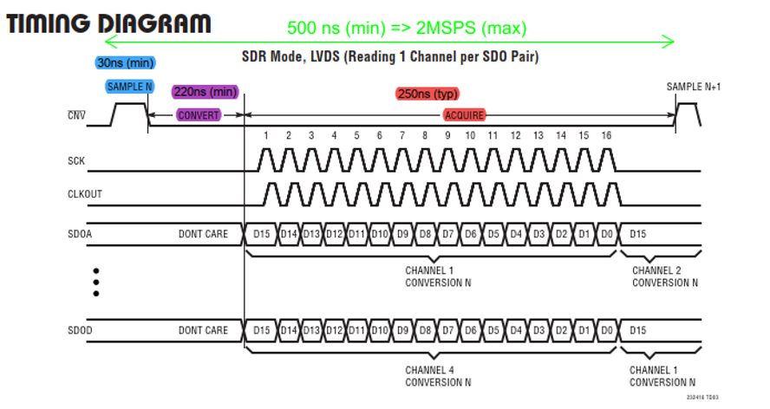
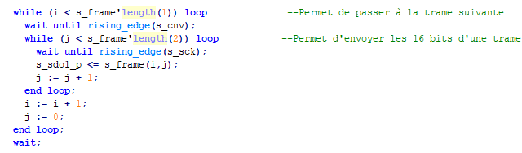
Firmware: Frames to send to SDO
TestBench

Slide 28
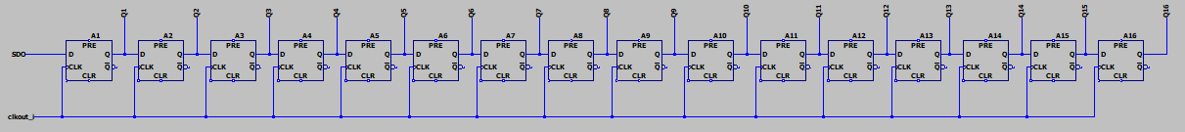
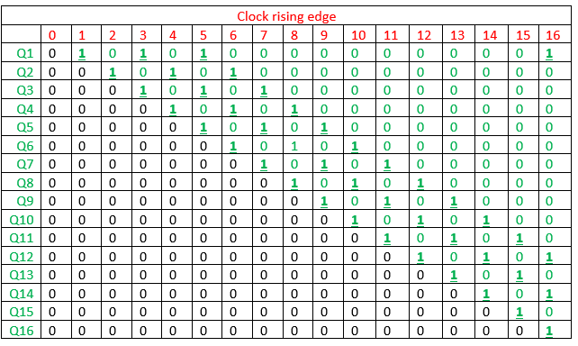
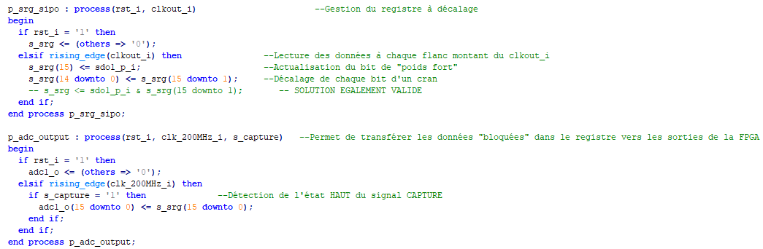
Deserialization the SDO data
Output of the FPGA

Slide 29
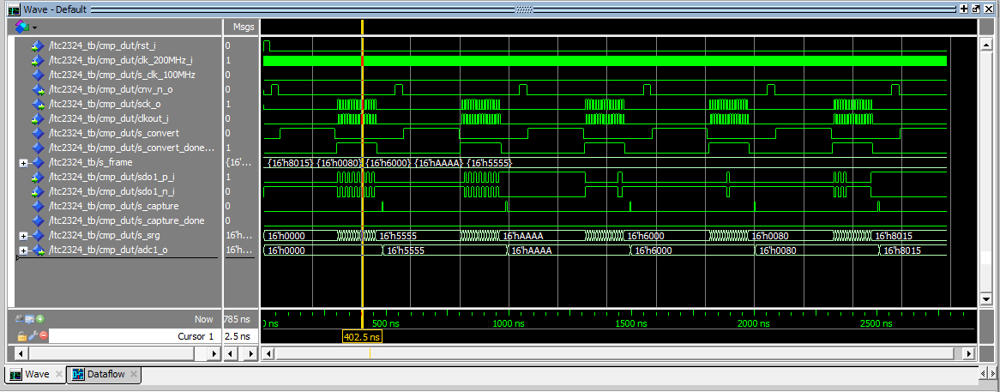
VHDL-Simulation so far…

Slide 30
Conclusion
Completed work
  Validating the efficiency of the ADL5511 in the lab.
  Finished the schematic of the project and sent to the design office.
  Good progress made on the firmware for the ADC (LTC2324). With fully synthesizable HAL and testbench.
What will be done in the near future
  Layout and assembly of PCB by the Design Office (normally by the beginning of June)
  Continue working on the VHDL code: signal processing, CVORB encoder/decoder and Hereward damping parts.

